Slide 1

NGS Programs and Geodetic Tools
Marti Ikehara
California Geodetic Advisor
Marti.ikehara@noaa.gov
Sacramento, CA
ftp://ftp.ngs.noaa.gov/pub/marti
CSUF Geomatics Conference, Fresno, CA; January 2011

Slide 2
Order of Topics
Researching geodetic control
OPUS (i)
HTDP (deci-year! option)
Updating CORS ref frame/coordinates
VDATUM
Revamping the NSRS (geometric&orthometric)
Datasheets, understanding the metadata
March 19, NSPS-sponsored Survey USA

Slide 3
Researching Geodetic Control
NGS Sources
  NGS Datasheets
  MAP-based:
  NGS CA Advisor webpages, hosted by Caltrans
  DSWorld, application with Google Earth
  OPUS-DB
CSRC Height Mod project

Slide 4
Visualization of NGS Geodetic Control
Geodetic advisor website, located at Caltrans Office of Land Surveys webpages
http://www.dot.ca.gov/hq/row/landsurveys/geodetic
  Google Earth kmls
  Google Maps online
  Shapefiles
DSWorld, NGS partner software

Slide 5
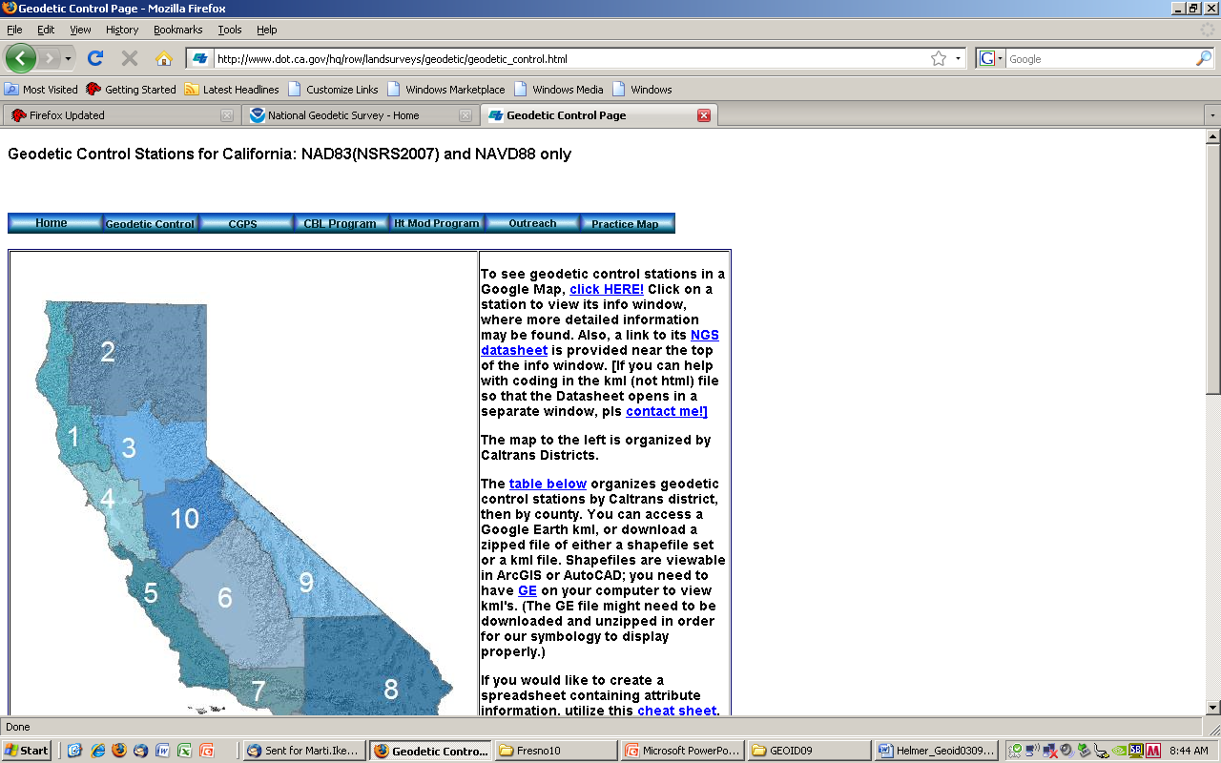
http://www.dot.ca.gov/hq/row/landsurveys/geodetic/geodetic_control.html
Notes:
Shown on the state are the 12 Caltrans districts; the counties are arranged by which CT District they are in.

Slide 6
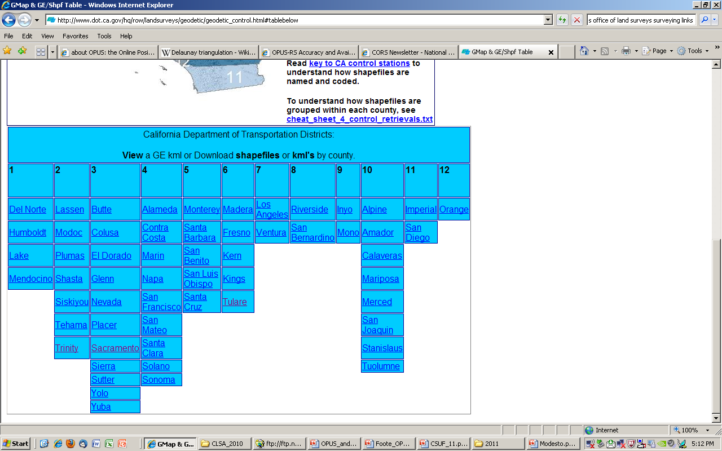

Slide 7
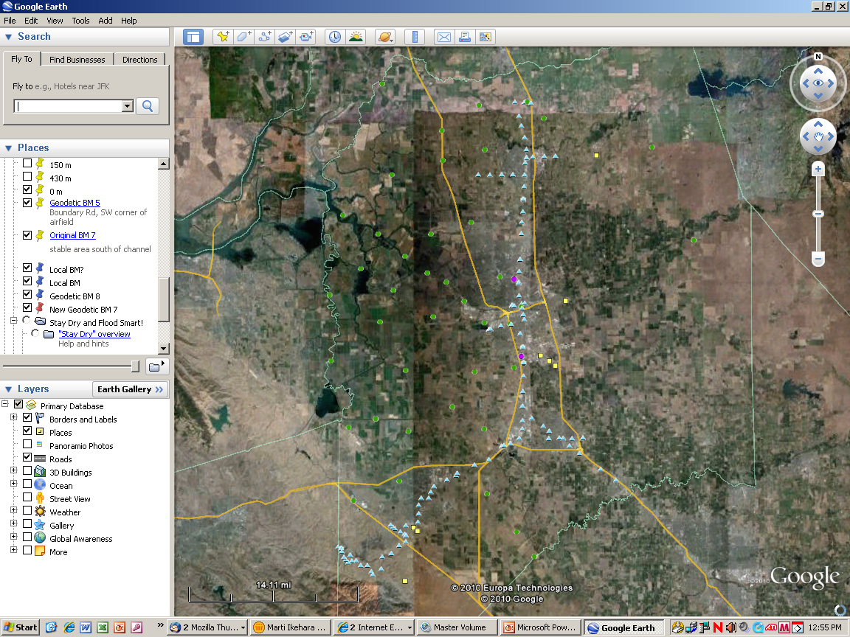

Slide 8
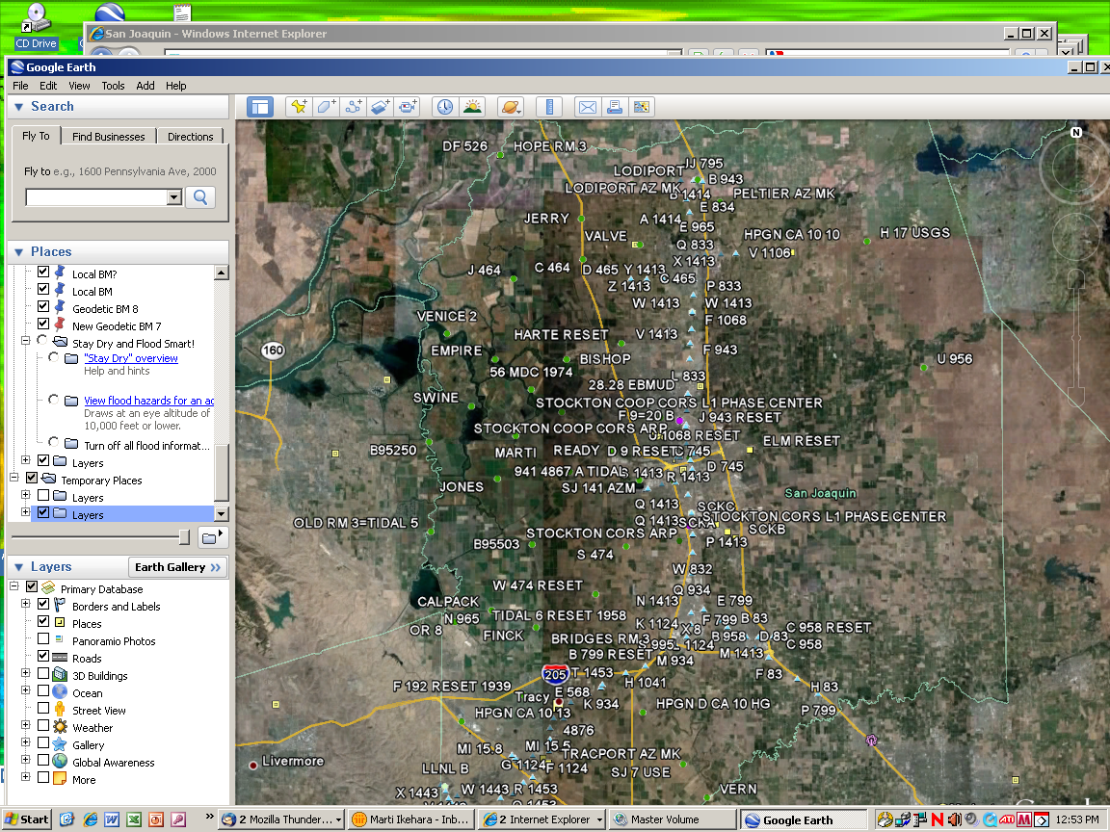
Notes:
If it’s too crowded, you can expand the layers and show only those that you want.
Blue triangles are leveled NAVD88, green hexagons are Ht Mod, yellow squares are HARN (not HM), beigey-green pentagons are leveled HARNs, purple circles are CGPS.

Slide 10
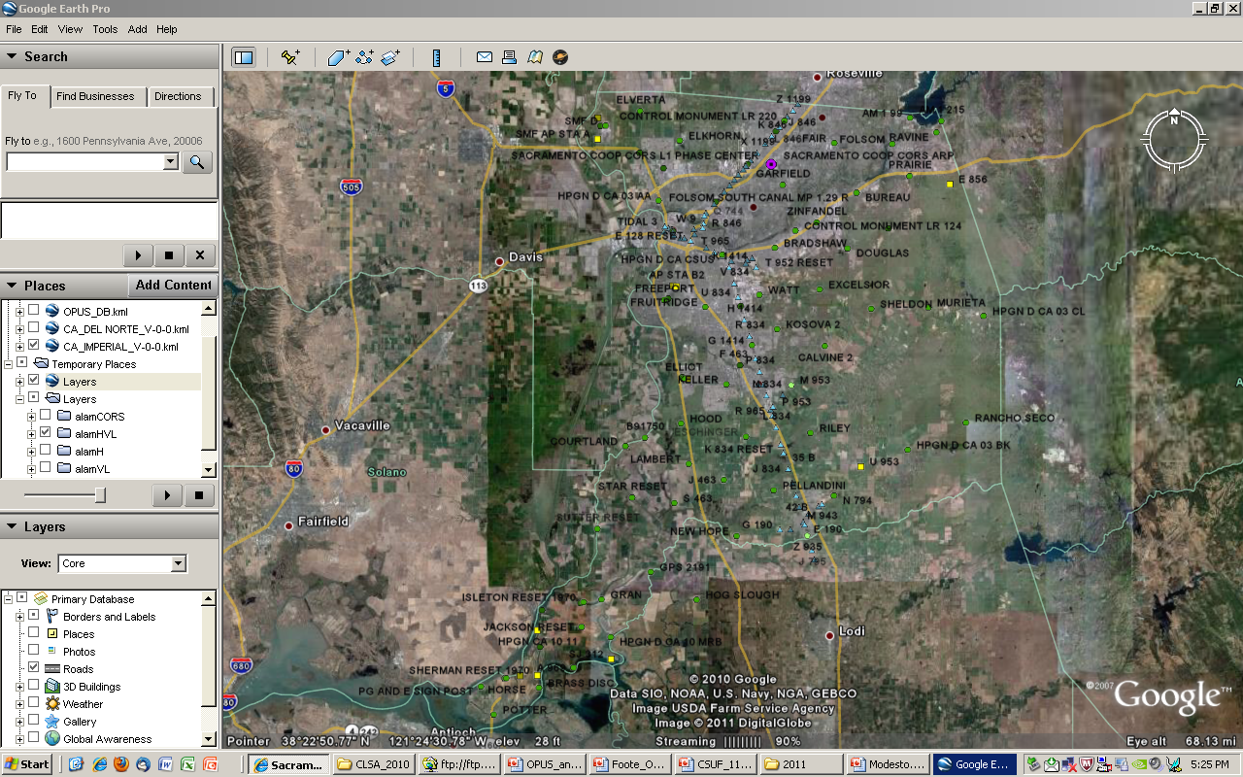

Slide 11
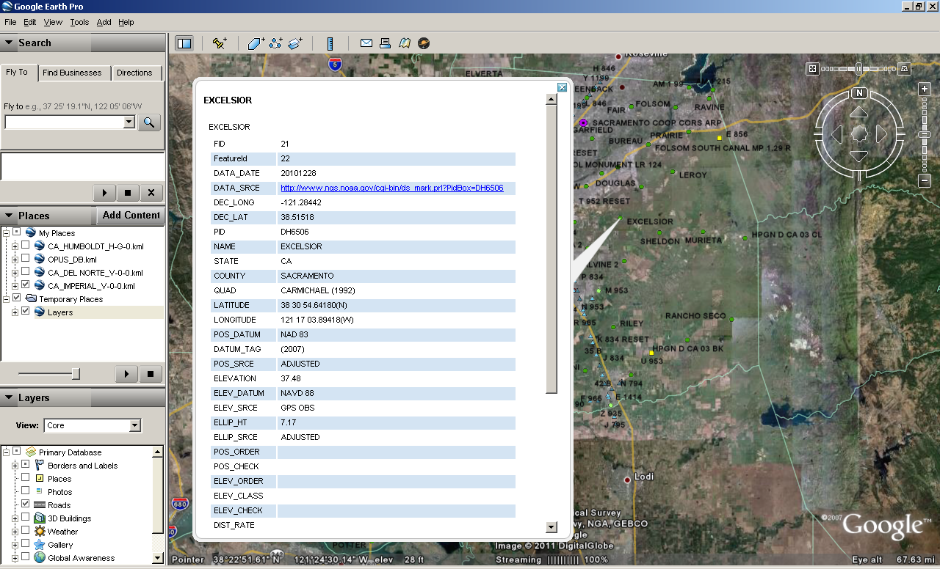

Slide 12
http://www.dot.ca.gov/hq/row/landsurveys/geodetic/geodetic_control.html

Slide 13
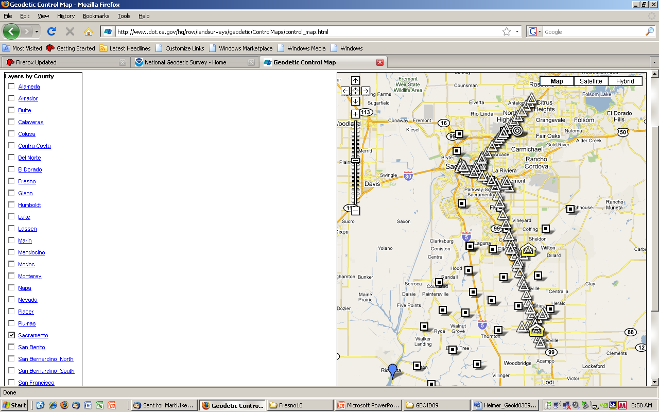
Notes:
To better spread out and make easier accesss to vertical control, NGS started an initiative in the mid-1990’s called Height Modernization, whereby GPS data was observed in networks often at the scale of a county. This shows Sac County before the Sac Valley HM project was loaded in mid- 2010. Because conversion fr GE to GM is not working (can someone help?), these are not the most current.

Slide 14
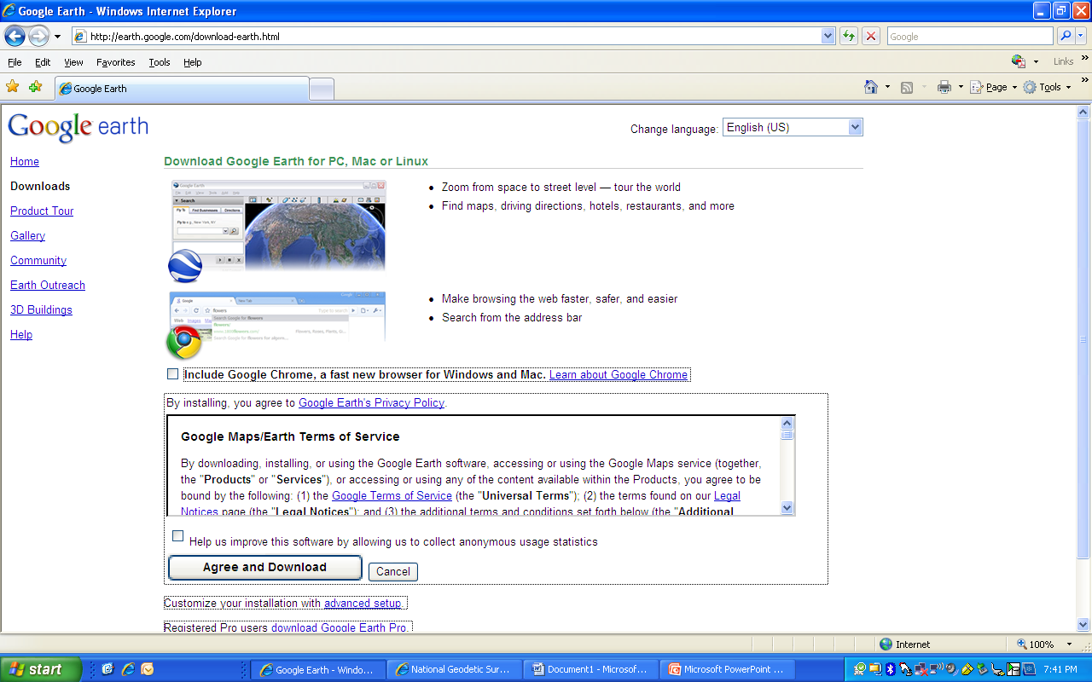
Using NGS DSWORLD software and
Google Earth to get any vintage geodetic data from NGSIDB
Start by downloading “Google earth” at:
http://earth.google.com/download-earth.html
Click here

Slide 15
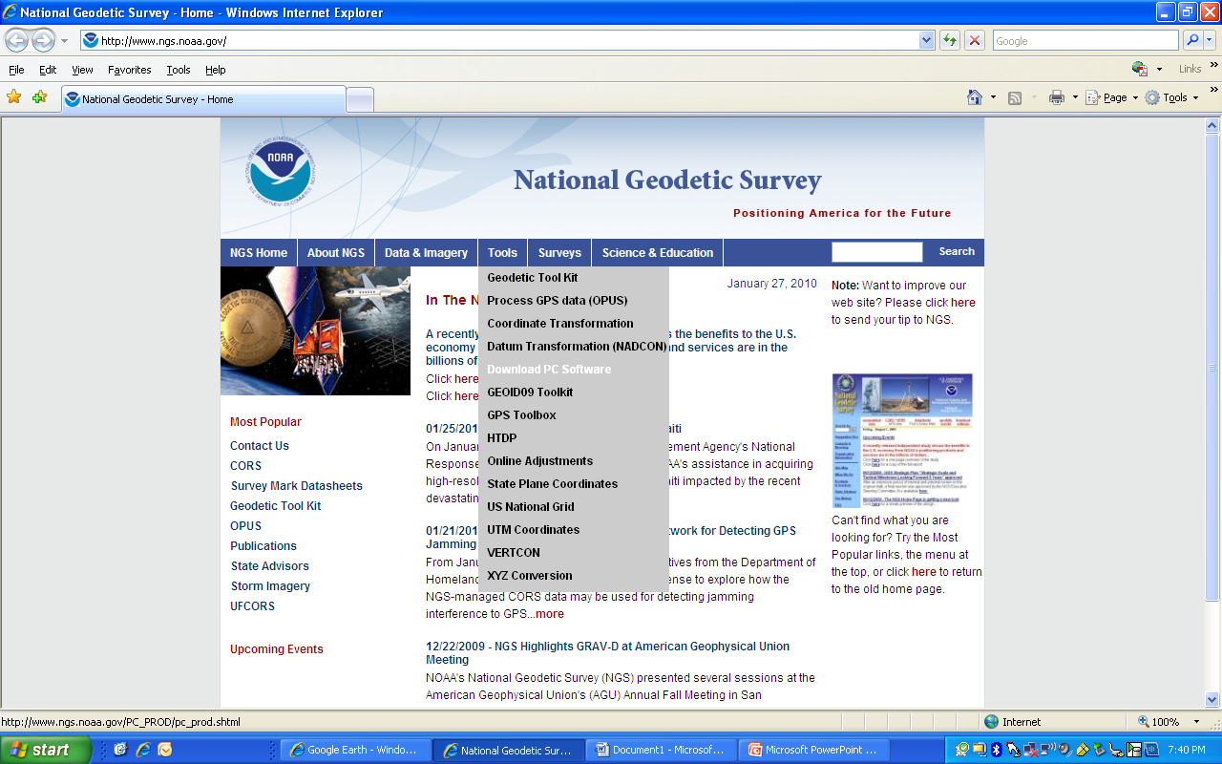
Open the NGS main page at www.ngs.noaa.gov
Mouse-over the
“TOOLS” button
Click on
“DOWNLOAD PC SOFTWARE”

Slide 16
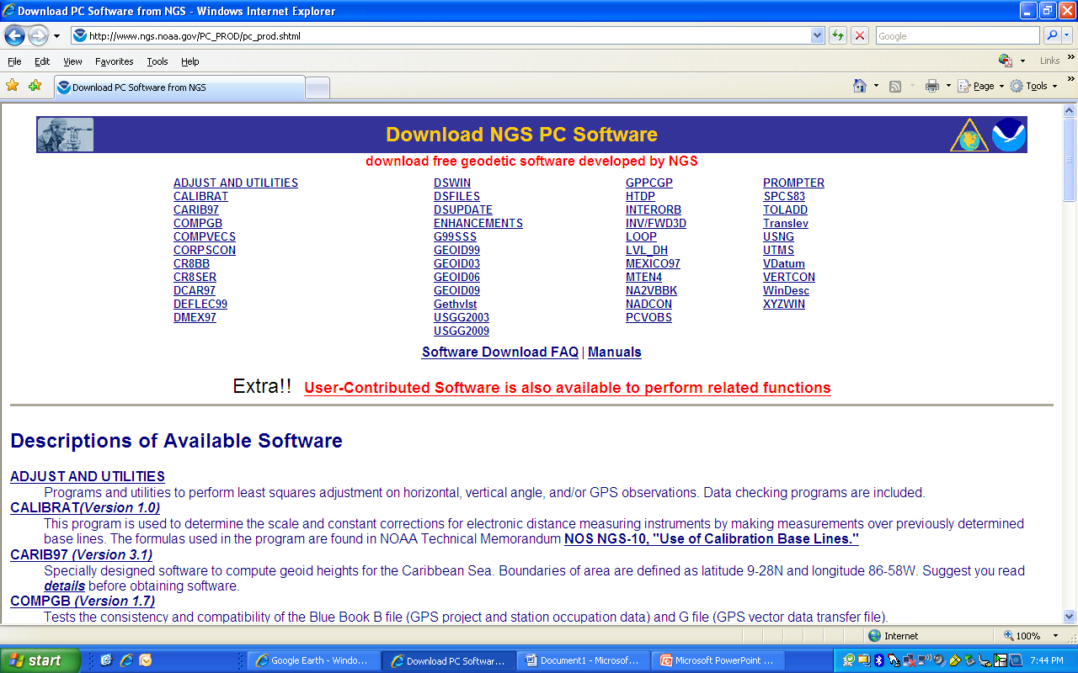
Click on the link: “User Contributed Software is also available…..”
Click here

Slide 17
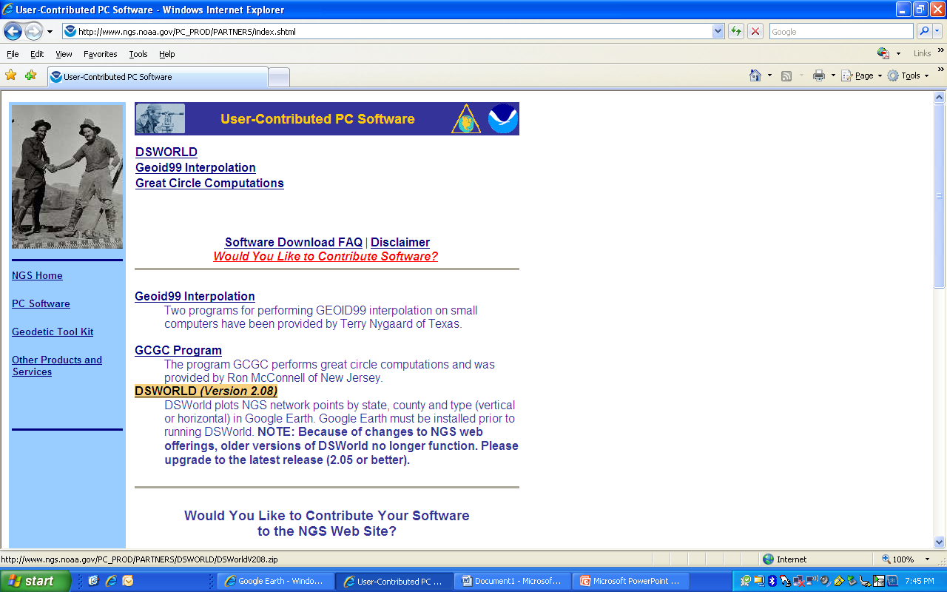
Next, click on the DSWORLD (Version *.**) link. A “file download” window will appear. Choose to save the file where you can easily find it. It will be a zip file, so you will need to unzip it and then double click on the setup.exe file. That will install the program for you.
For additional information or assistance, please contact your NGS State Geodetic Advisor

Slide 18
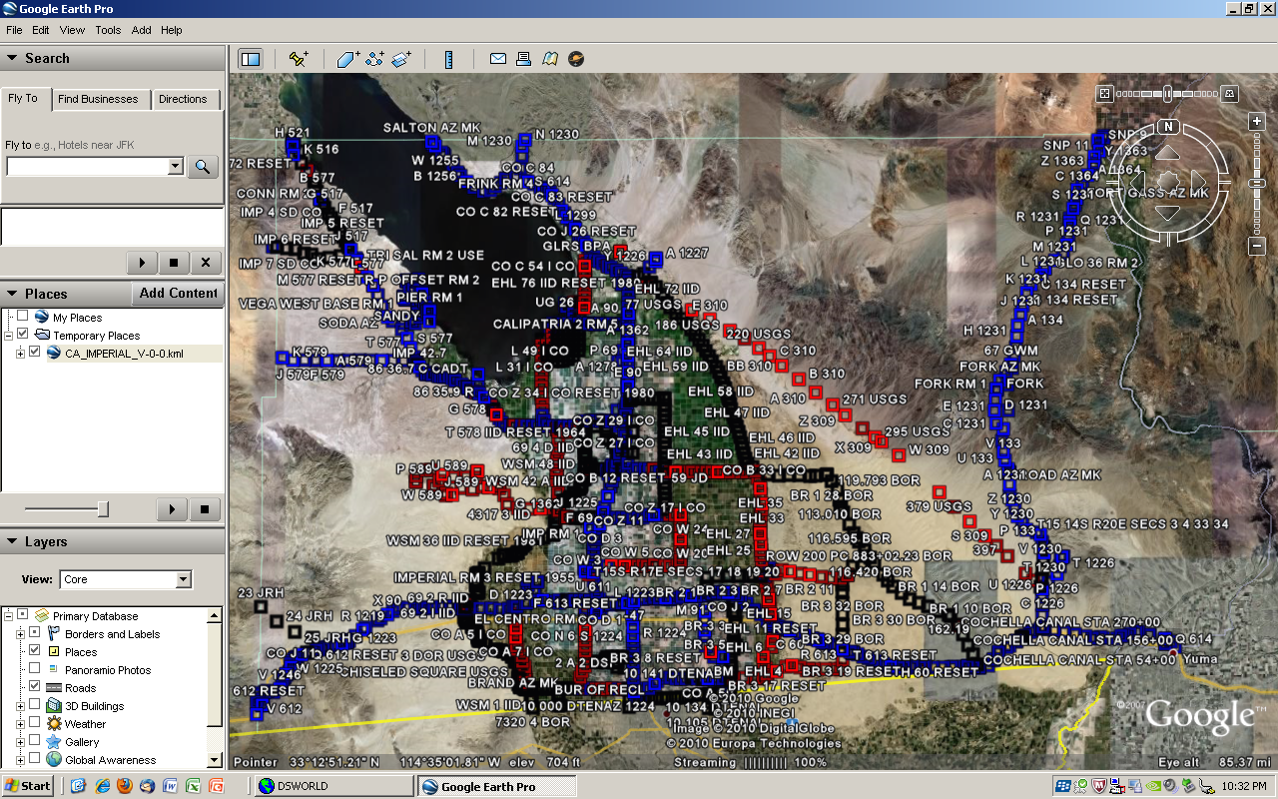
Notes:
Does not distinguish between VERTCON and other NAVD88. Blue-first order, Red-second order, Black-other, eg, third or readjusted or posted

Slide 19
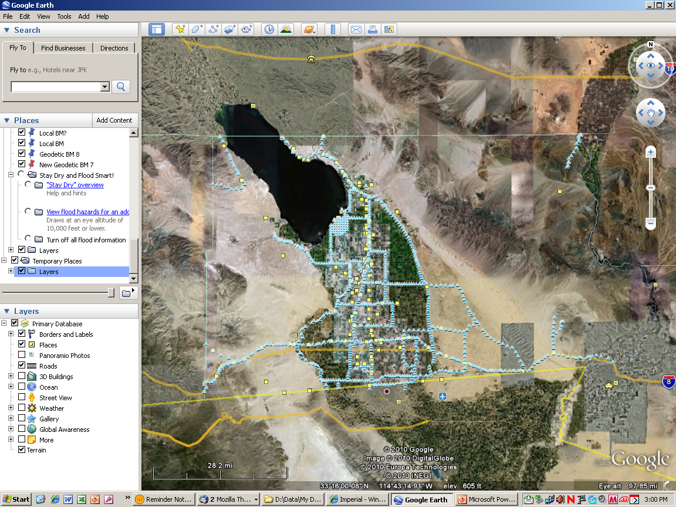

Slide 20
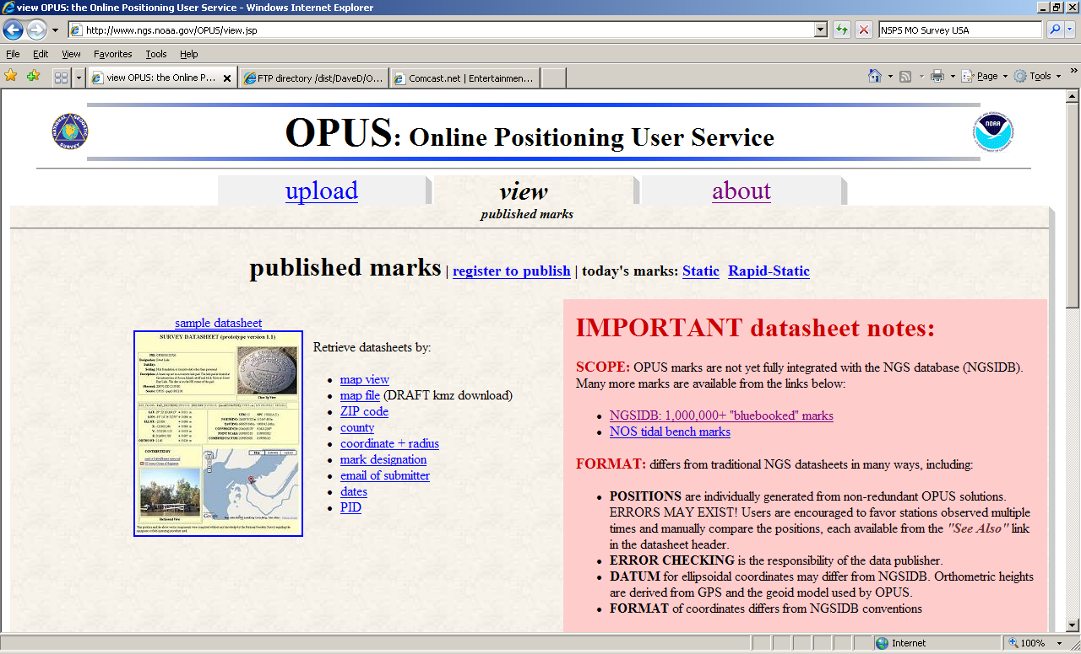

Slide 21
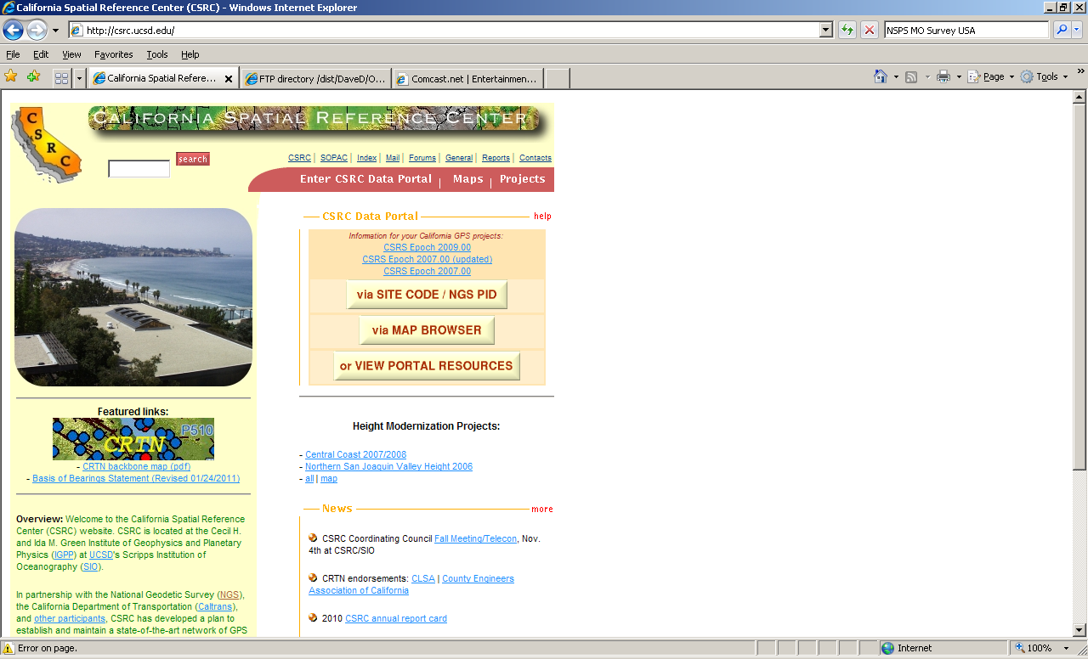
http://csrc.ucsd.edu [NO www]
Central Coast Ht Mod project

Slide 22
OPUS/OPI
OPUS-S [static]
2 hrs-<2 UTC midnites
[DB (publish): 4.25+ hours]
3 CORS, no distance limit
OPUS-RS [rapid static]
15-120 minutes
Up to 9 CORS w/in 250km
Within 50km of circle “enclosing” each 3 CORS
Need to know/provide antenna model, and correct HI
Orthometric height is calculated from eHt and GEOID09
NAD83 (CORS96) is 2002.0 epoch; ITRF00 is survey date
Coordinates, eht and RMS values provided

Slide 23
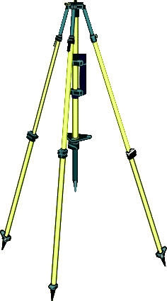
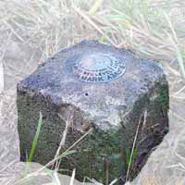

IERS geophysical models
IGS satellite orbits
ITRF reference frames
NGS antenna calibrations
NGS CORS base stations
NGS geodetic toolkit
NGS site information files
UNAVCO teqc conversion
calibrated antenna type
geodetic
data
your
GPS data
online positioning user service
OPUS
www.ngs.noaa.gov/OPUS/
JGE 2008v3
mark info (optional)
(optional)
publish in
NGS
database
your
position

Slide 24
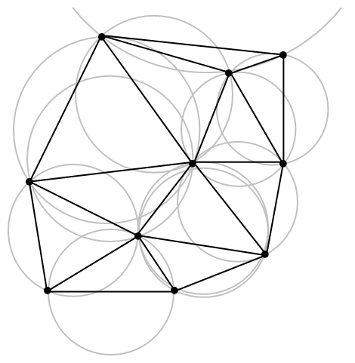
Delauney triangles, circumcircles

Slide 25
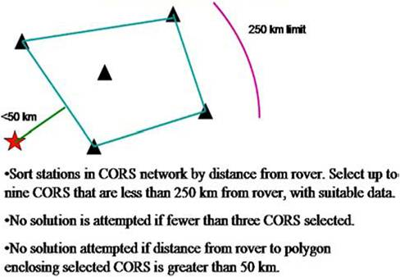
Simplified distance diagram for OPUS-RS processing

Slide 26
More about OPUS-RS
With 1600+ CORS operating, most locations in the US have dozens of CO RS w/i 250km

Slide 27
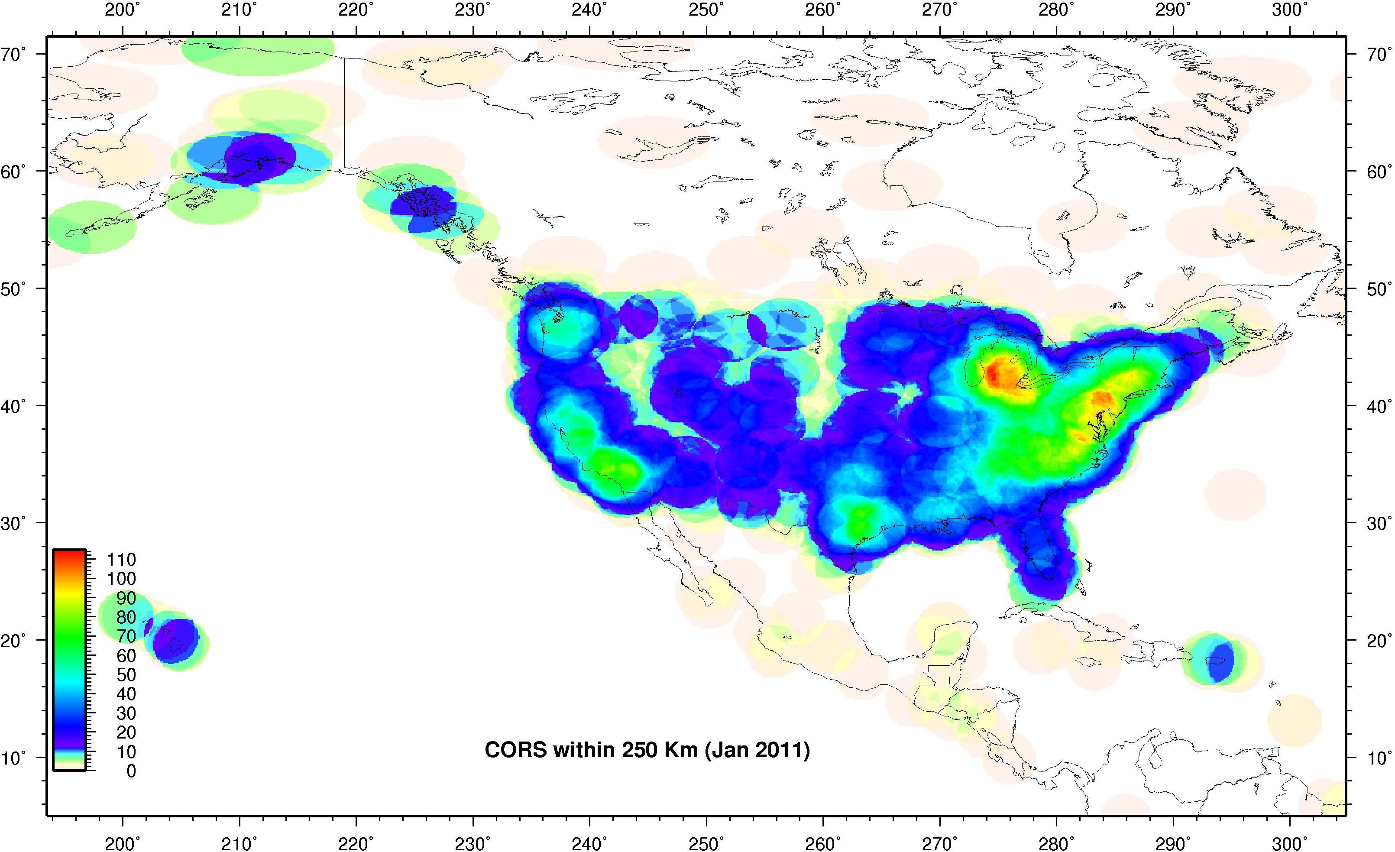

Slide 28
More about OPUS-RS
With 1600+ CORS operating, most locations in the US have dozens of CO RS w/i 250km
CORS Newsletter has links to nifty tools

Slide 29
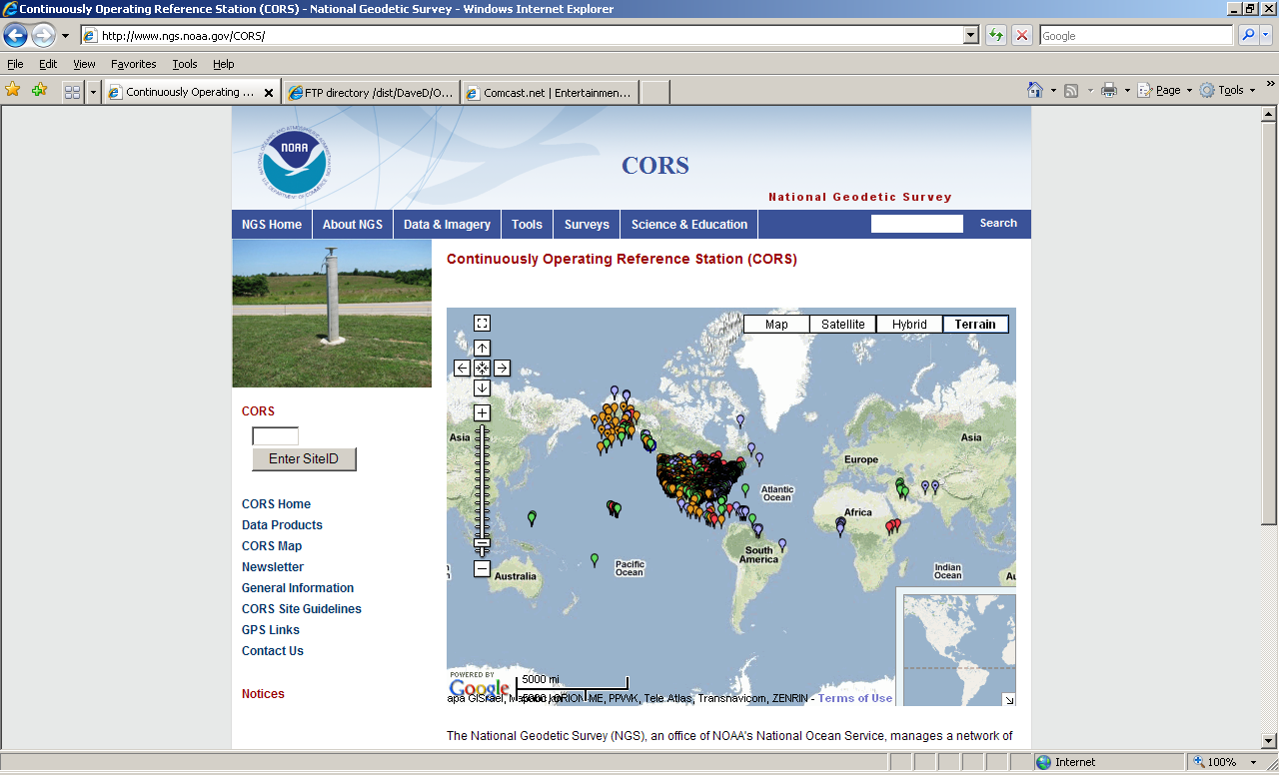

Slide 30
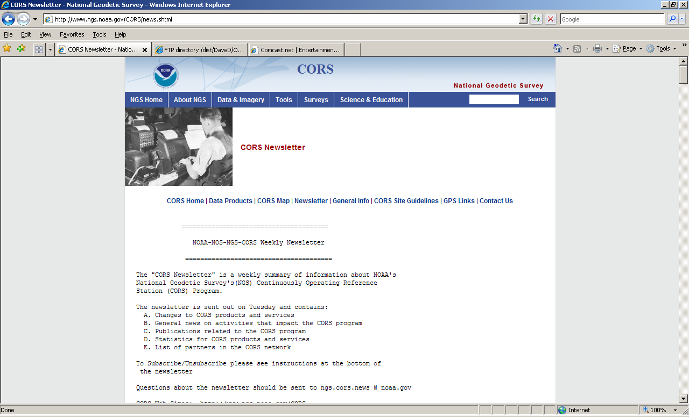

Slide 31
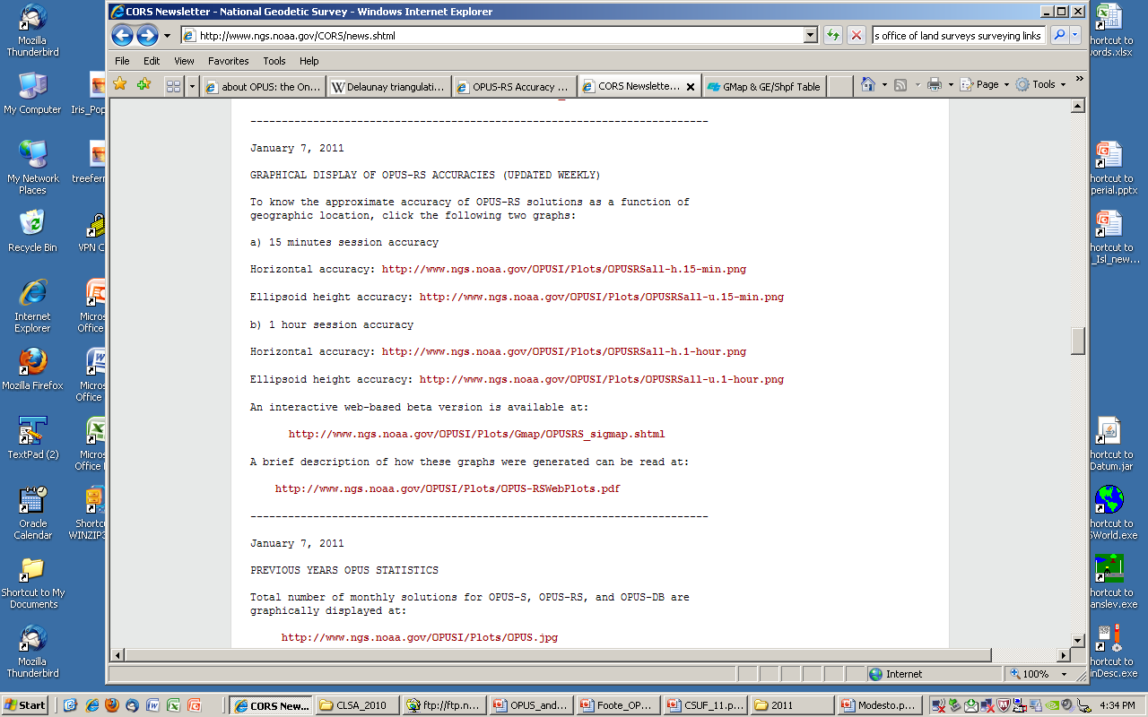
Graphical Display of OPUS-RS Accuracies (Updated Weekly)

Slide 32
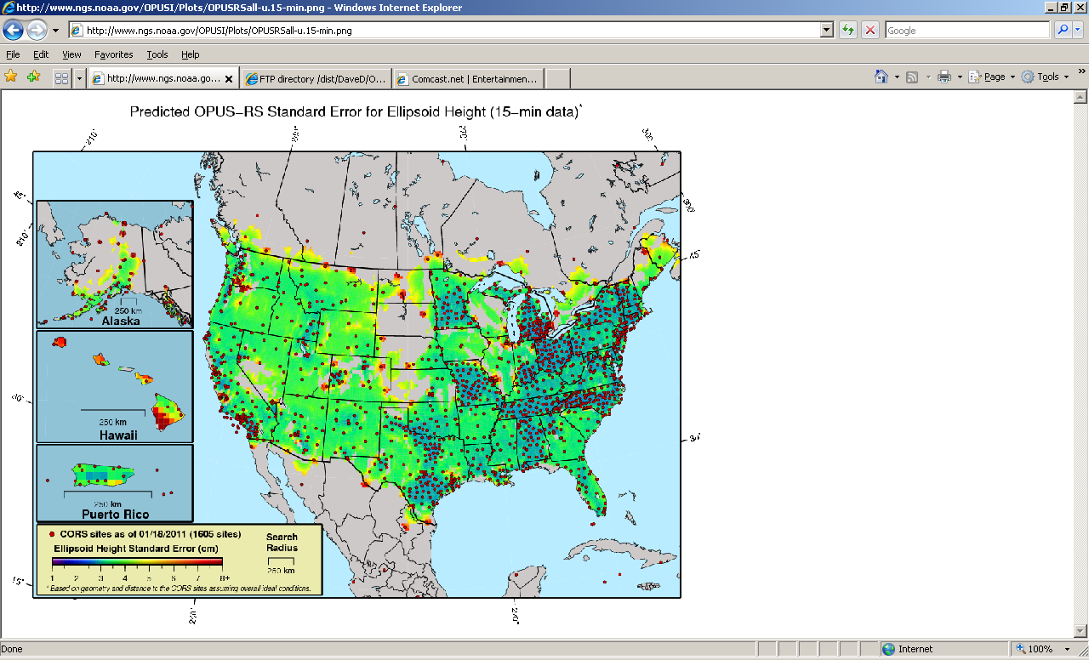

Slide 33
Interactive link for more detailed map at your location (beta version)

Slide 34
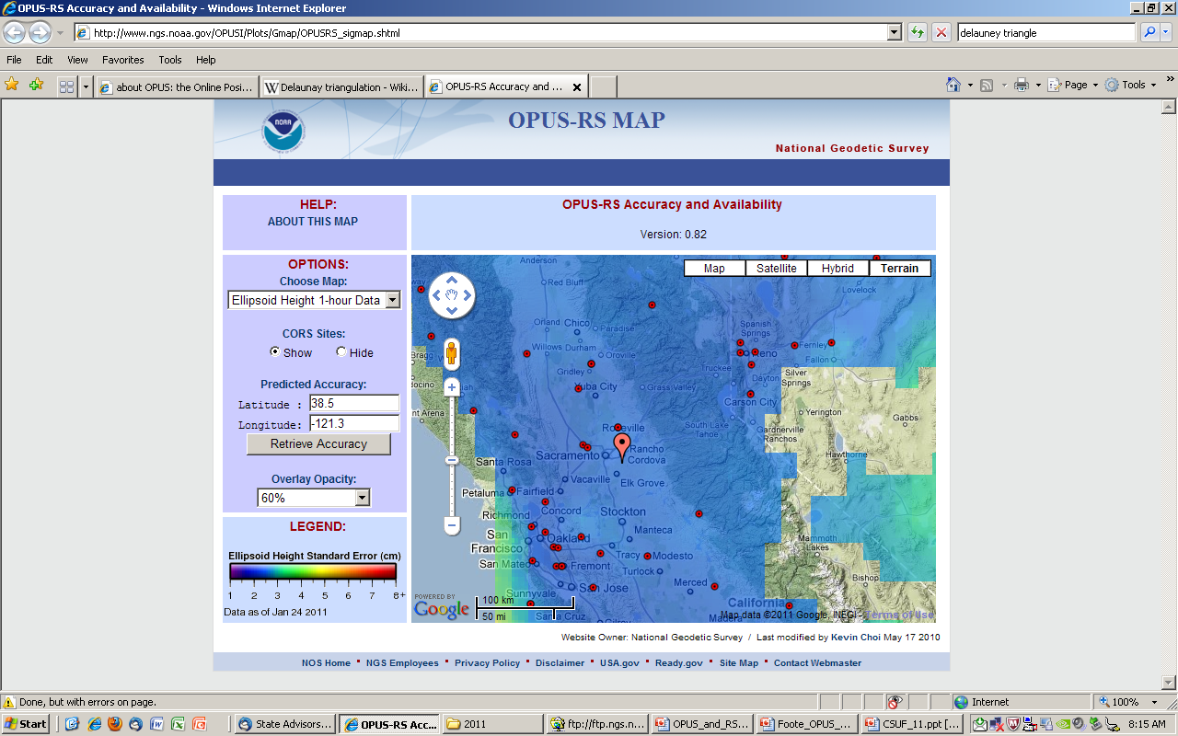

Slide 35
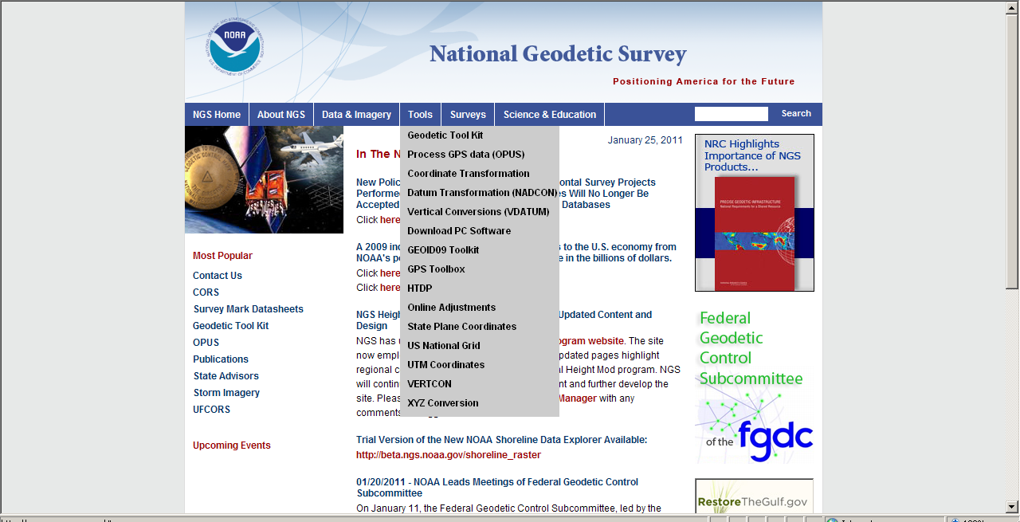
HTDP [3.1 BETA]
Horizontal Time Dependent Positioning

Slide 36
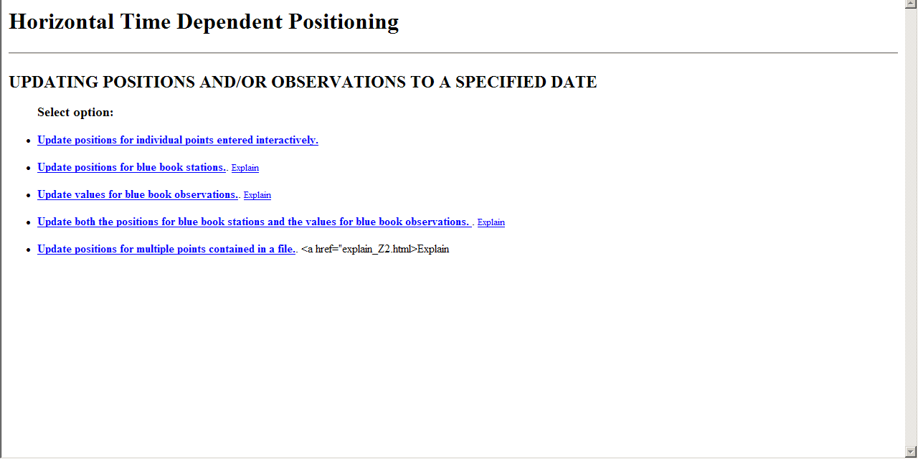

Slide 37
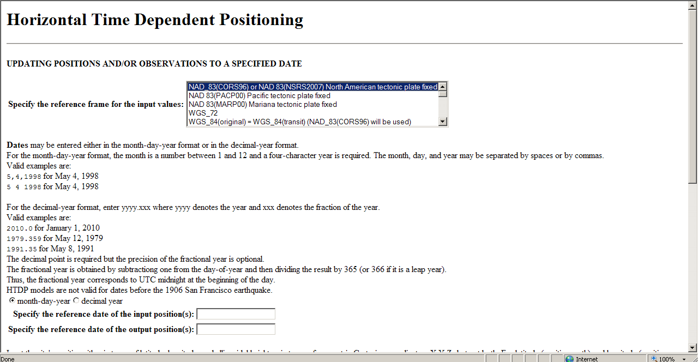

Slide 38
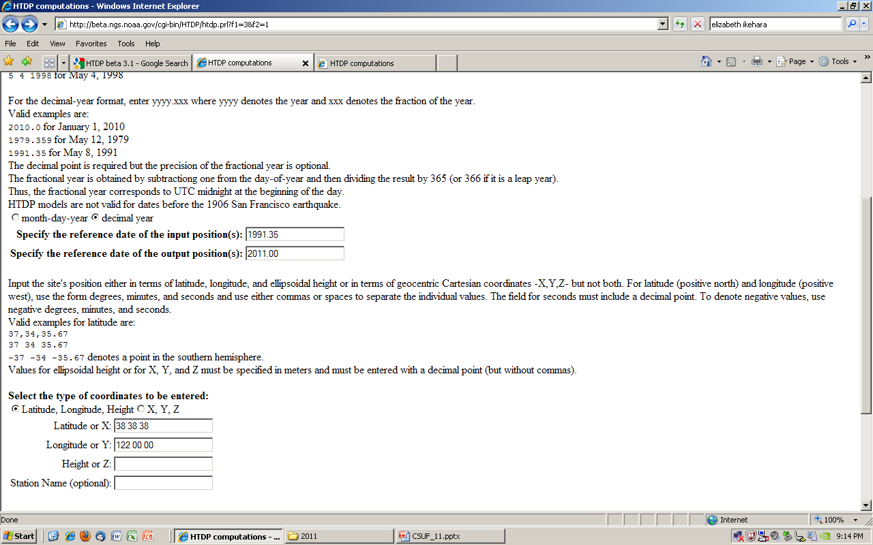
Just north of Winters, west of Davis

Slide 39
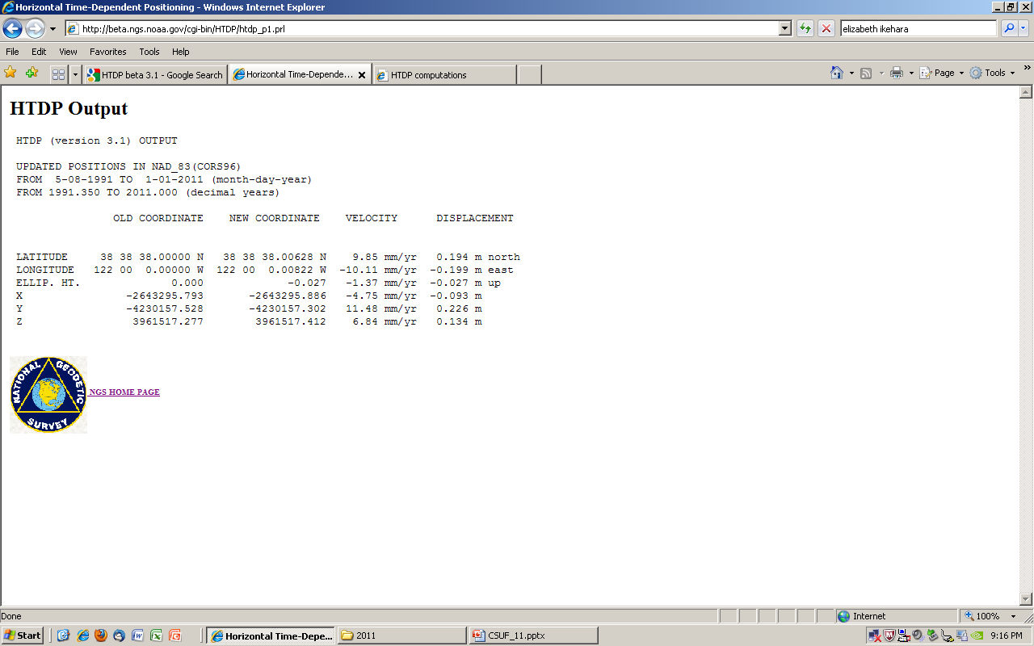
0.2 meter for both N and E

Slide 40
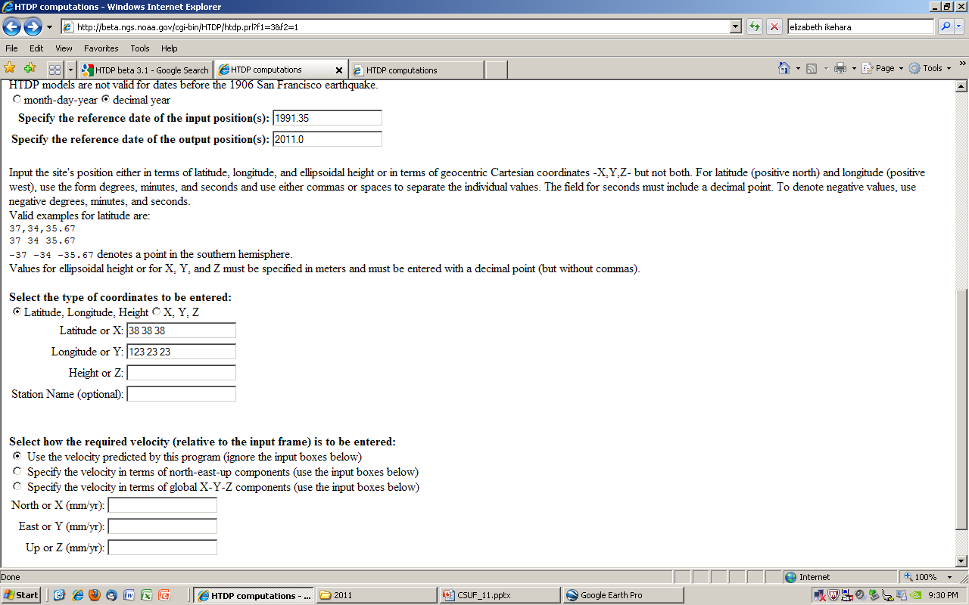
In Mendocino County, on the coast near Stewart’s Point; San Andreas Fault Zone is offshore

Slide 41
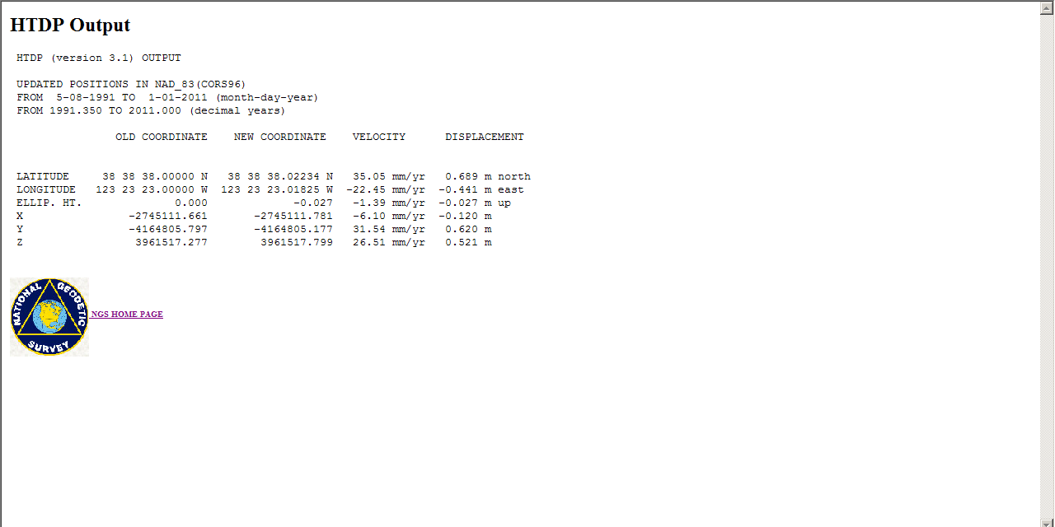
Almost 0.7m N and -0.5m E
You MUST incorporate/apply horizontal velocities to ‘published’ coordinates to do geodetic surveying

Slide 42
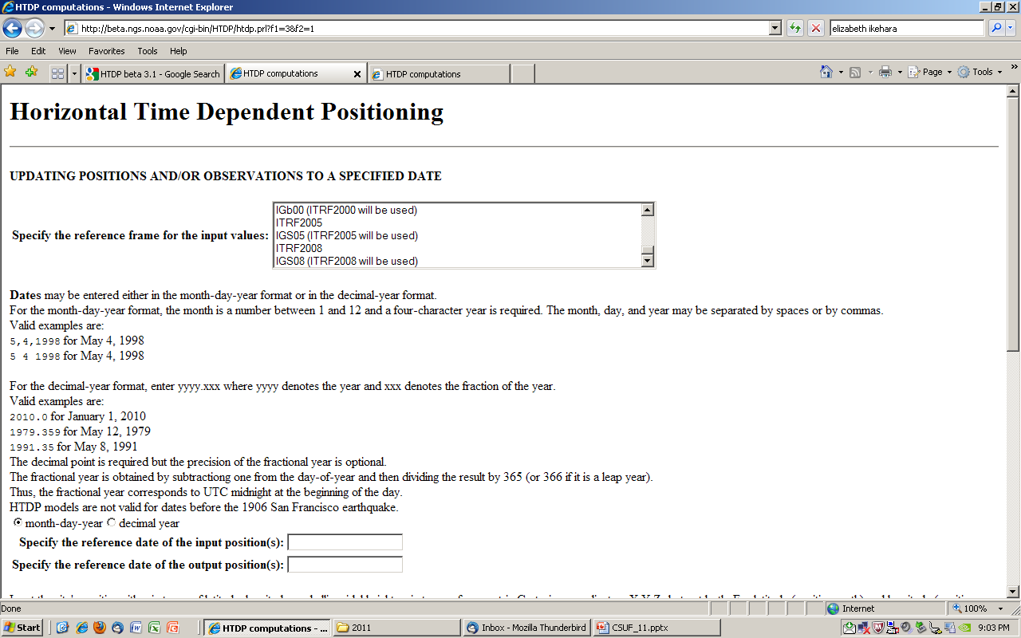
New reference frame, ITRF08

Slide 43
Updating ref frame/ epoch for CORS
Current: ITRF2000, 2002.00
“Soon”: ITRF2008, 2008.00
and NAD83 (“CORS96A”), 2010.00 for CORS (only)
No change to passive monumentation, eg, NAD83 (NSRS2007), 2007.00
About 1000 CORS (out of >1600) nationwide
  Those with >2 years of data
  Changes on the order of mm, but a few outliers are showing several decimeters
Change to using absolute antenna calibrations

Slide 44
VDATUM
How do you relate the geodetic datum (elevation) to a tidal datum water level?
Leveling from tidal bench marks OR
Use VDATUM software, a NOAA product that incorporates tide gage and NGS BM data
INTEGRATING AMERICA’S ELEVATION DATA

Slide 45
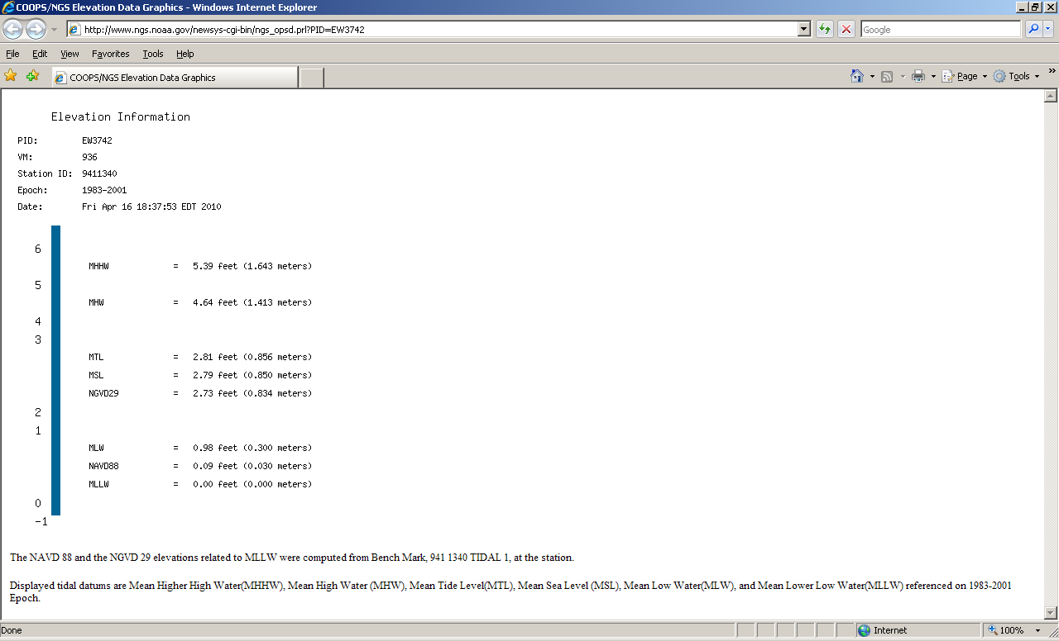

Slide 46
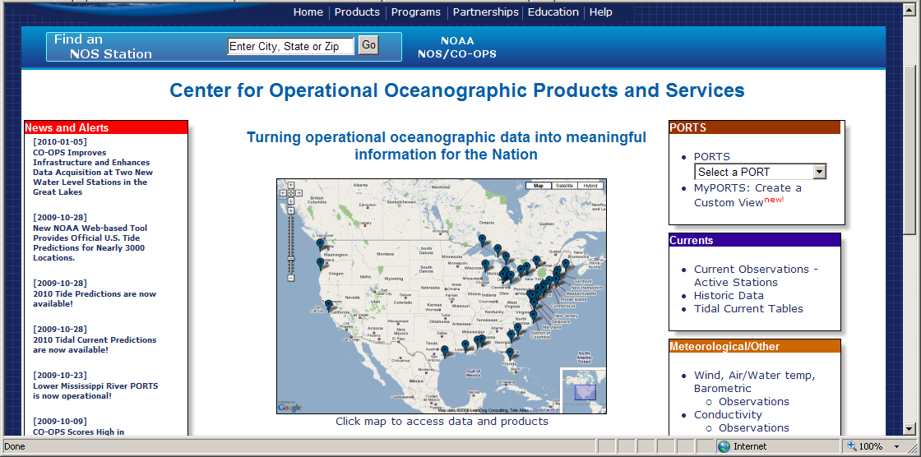
www.tidesandcurrents.noaa.gov

Slide 47
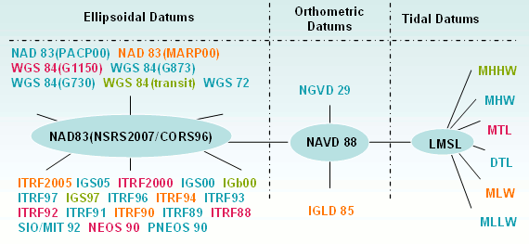
Datums available in VDATUM
Notes:
The most common datums are highlighted

Slide 48
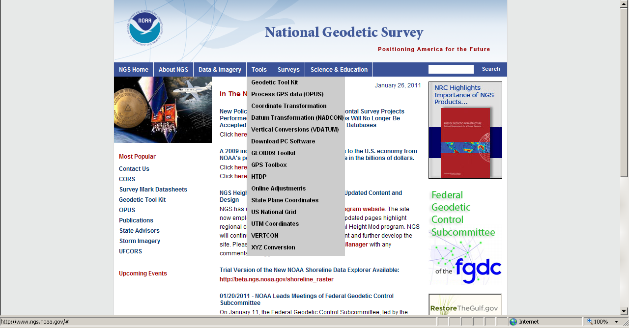

Slide 49
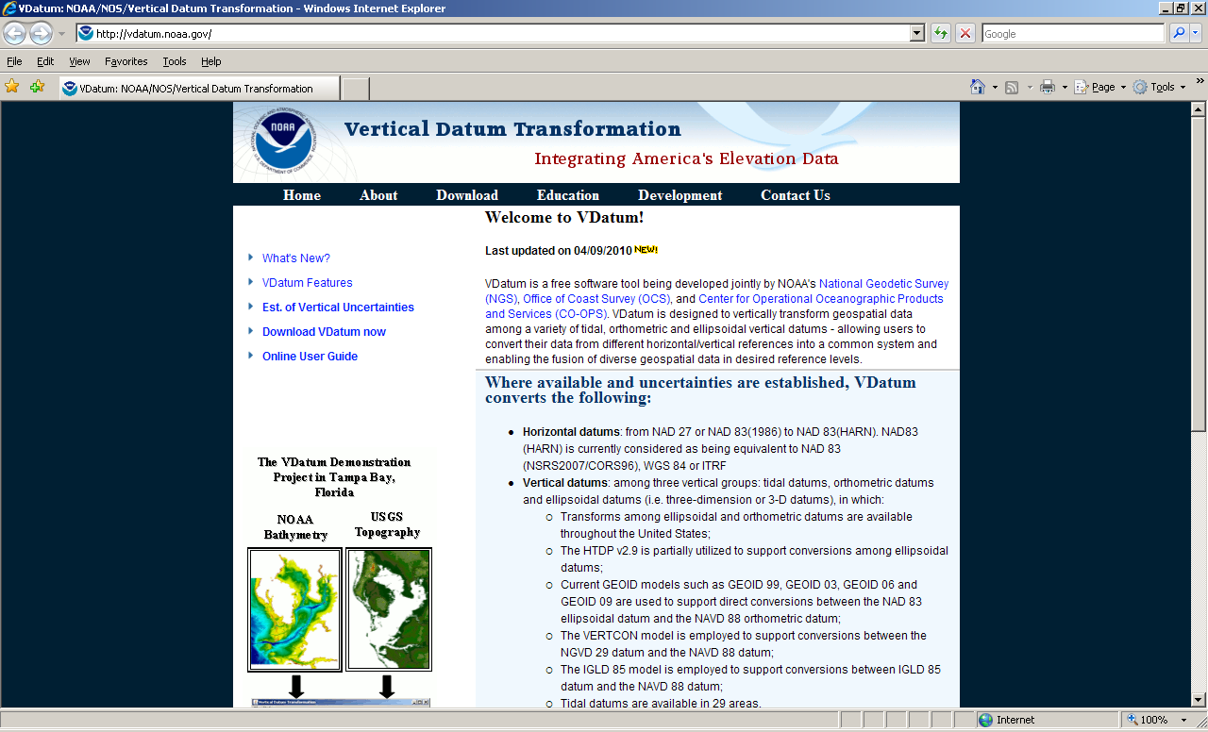

Slide 50
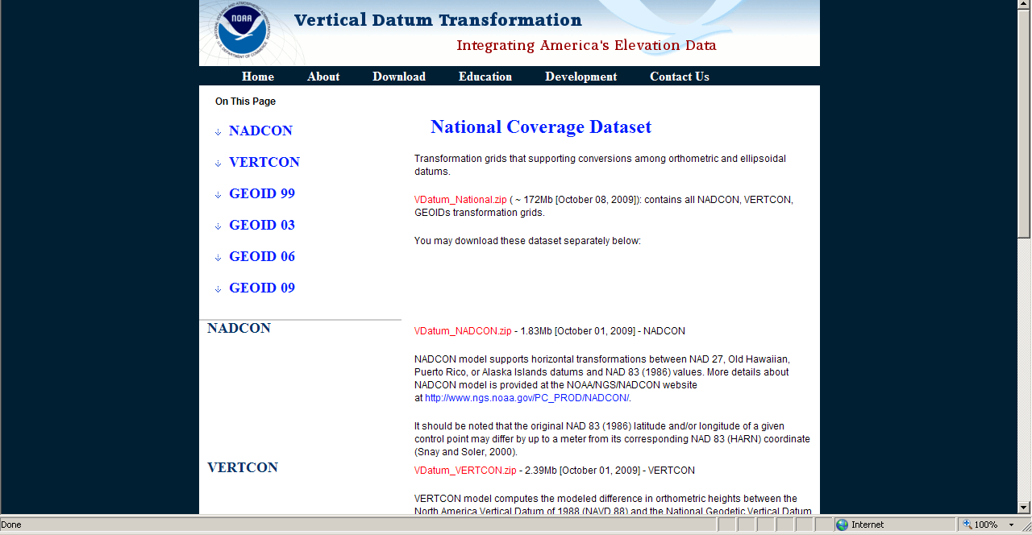

Slide 51
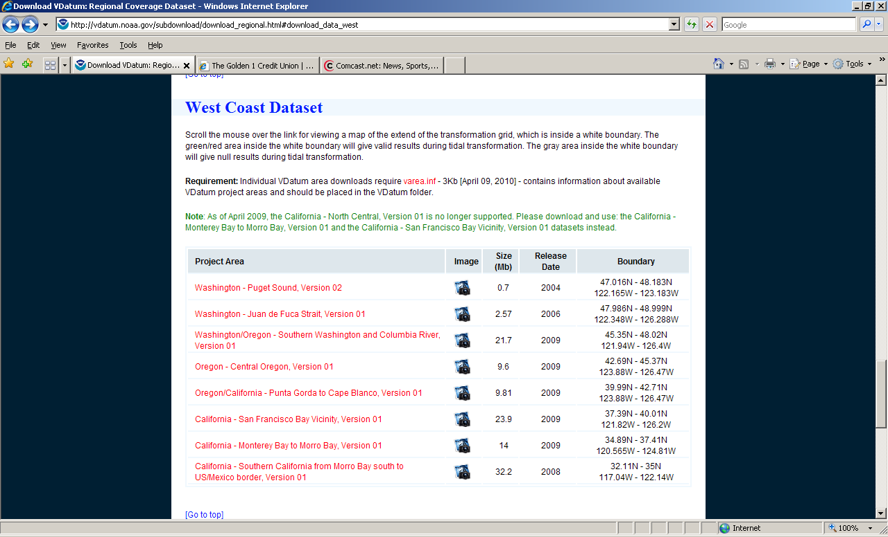

Slide 52
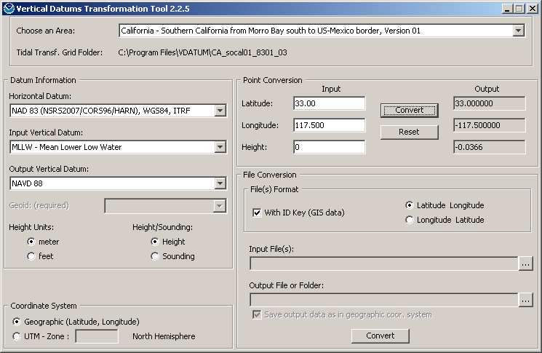

Slide 53
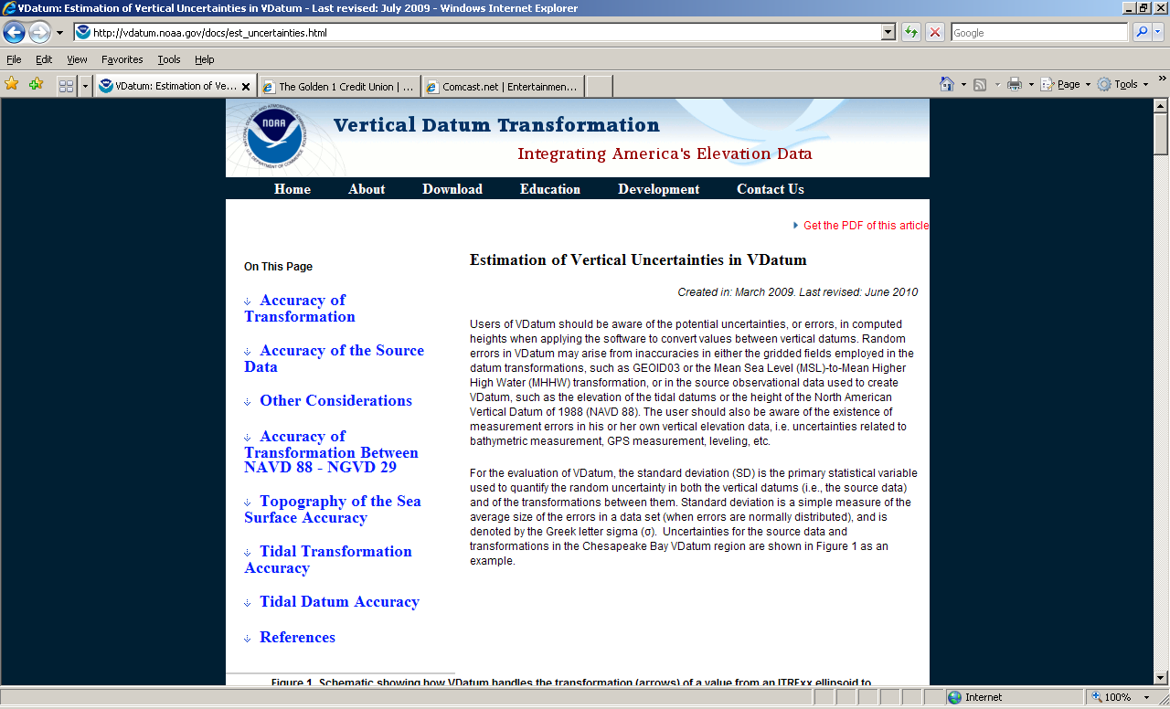

Slide 54
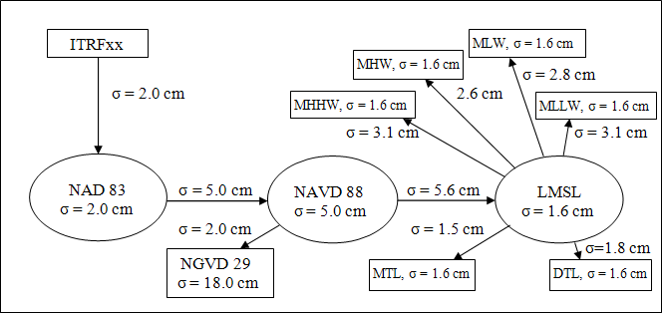
Sources of transformation errors

Slide 55
NGS will develop New Datums:
Geometric and geopotential
The NSRS will be redefined
Horizontal and vertical datums are separate
Future NSRS will be unified, still 2 datums but really only one reference frame (ellipsoid)
Key component will be knowledge of gravity potential expressed as a geoid model
GRAV-D program is generating airborne gravity contour maps, esp at mountains and coastline

Slide 56
Rationale for new Datums
Terminology
  Horizontal becomes GEOMETRIC
  Vertical becomes GEOPOTENTIAL
When? 2020, or when GRAV-D program is complete
Why? But why?!
  Primarily need a better vertical datum for “vertical” data(geoid, ortho ht) not obtained by traditional leveling
  Modern Geodetic Data collection relies upon satellites (GNSS, gravity) orbiting around the mass center of the Earth
  NAD83 datum is not geocentric
  Ability to fit GPS-derived ellipsoid heights+ use of a geoid model, to a vertical datum defined by leveling is increasingly difficult as time goes by

Slide 57
Simplified Concept of NAD 83 vs. ITRF00 (or WGS84)
h₈₃
h₀₀
Earth’s
Surface
ITRF 00
Origin
2.2 meters
NAD 83
Identically shaped ellipsoids (GRS80)
a = 6,378,137.000 meters (semi-major axis)
1/f = 298.25722210088 (flattening)
Origin
Notes:
57
ITRF (International Terrestrial Reference Frame)
Ellipsoid heights NAD83 vs. ITRF00/WGS84 - Defined origins were best estimate—at the time-- of the center of mass; NAD83 is not geocentric but ITRF and WGS84 are.

Slide 58
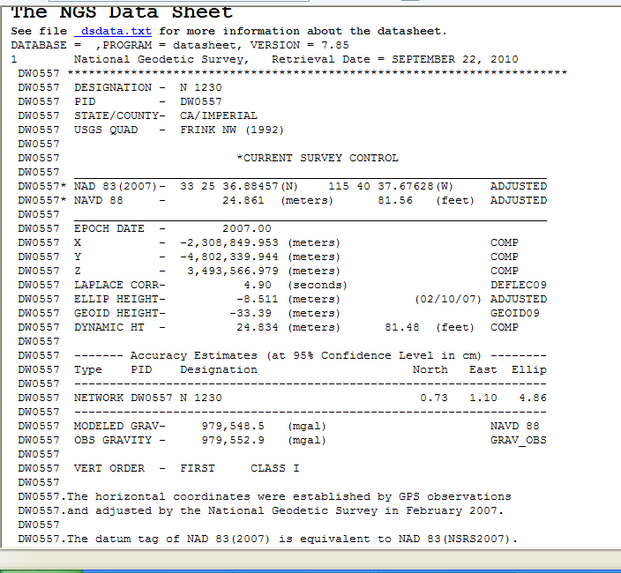

Slide 59
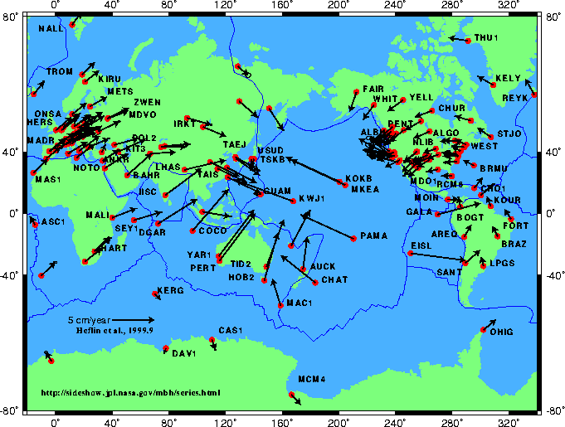
Worldwide Tectonic Horizontal Motions
Notes:
59
Velocities horizontally, so a big question to be discussed and answered is whether to define velocities as >0 for most of the US (not here), as NAD83 is defined now because velocities are so minimal that they can be ignored.

Slide 60
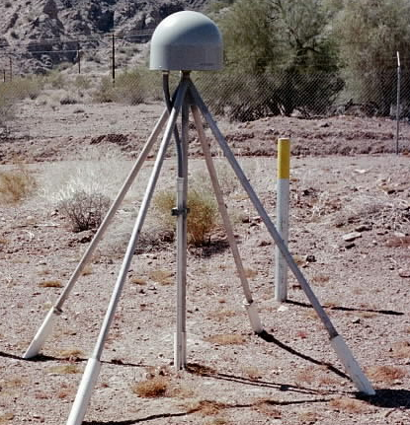
Evolution of Geodetic Datums: from NAD27/NGVD29 to NAD83/NAVD88 to ?/ ?
H + V
2 + 1
27, 29
H + V
2 + 1
83(86), 88
GPS
H + V_{E} + V_{O}
2 + 1 + 1
83(92), 88
+VELOCITIES (time)
H + H_{t} + V_{E} + V_{O}
2 + 2 + 1+ 1
83(07)+HTDP, 88
H + H_{t} +V_{E}+ V_{Et}
2 + 2 + 1+ 1
GEOMETRIC
(V_{E}+G)[+V_{Et}] + G_{t}
1 + 1
GEOPOTENTIAL
H + H_{t} +V_{E}+ V_{Et}
2 + 2 + 1+ 1
ITRF00 (2002.00)
+ GRAVITY
(geoid model)
Notes:
Conceptual: Generally, Orange represents ‘horizontal’ or NAD83 at present; yellow represents orthometric vertical.
1)moved fr non-geocentric to 2)geocentric as well as we knew at the time from early satellite technology (DOPPLER). And leveling efforts resulted in a national vertical datum with only one constraint, rather than 26 (tide gauges). 3)Static GPS exploded on the scene which 4) led to 5)the HARN networks and state-specific adjustment. With GPS surveying, we got V(E), vertical ellipsoid and V(O), vertical orthometric. 6)With the results of repeat static surveys and the advent of CGPS (Continuous CGPS), such as NGS’ National CORS, 7)the velocity of the earth’s crust relative to a reference frame, could be determined over time. 8)Using the crustal motion model HTDP for horizontal velocities on the West Coast, eg, the Pacific-North American Plates interface, NGS produced 9) a National Re-adjustment in the NAD83 (NSRS2007) datum. (No change to ortho.) However, 10)underlying the NAD83 adjustment are data and analysis referenced to ITRF00, epoch 2002.00, which does take into account both horizontal AND vertical ellipsoid velocities. (velocity=time related terms shown as italicized.) This is what we have now. 11) With better global gravity models and airborne gravity data collected by NGS, we will 12) move forward with 13) new datums BOTH referenced to an ECEF, earth-centered, earth-fixed datum which we are calling 14) Geometric, for the horizontal and ellipsoid height values, and Geopotential for the orthometric height values which will be based on a a geoid model and changes in gravity over time (G(t).

Slide 61
Datasheets
Orthometric height
Geoid model
Adjustments—hor, el ht, ortho ht
History/Recovery Note

Slide 62
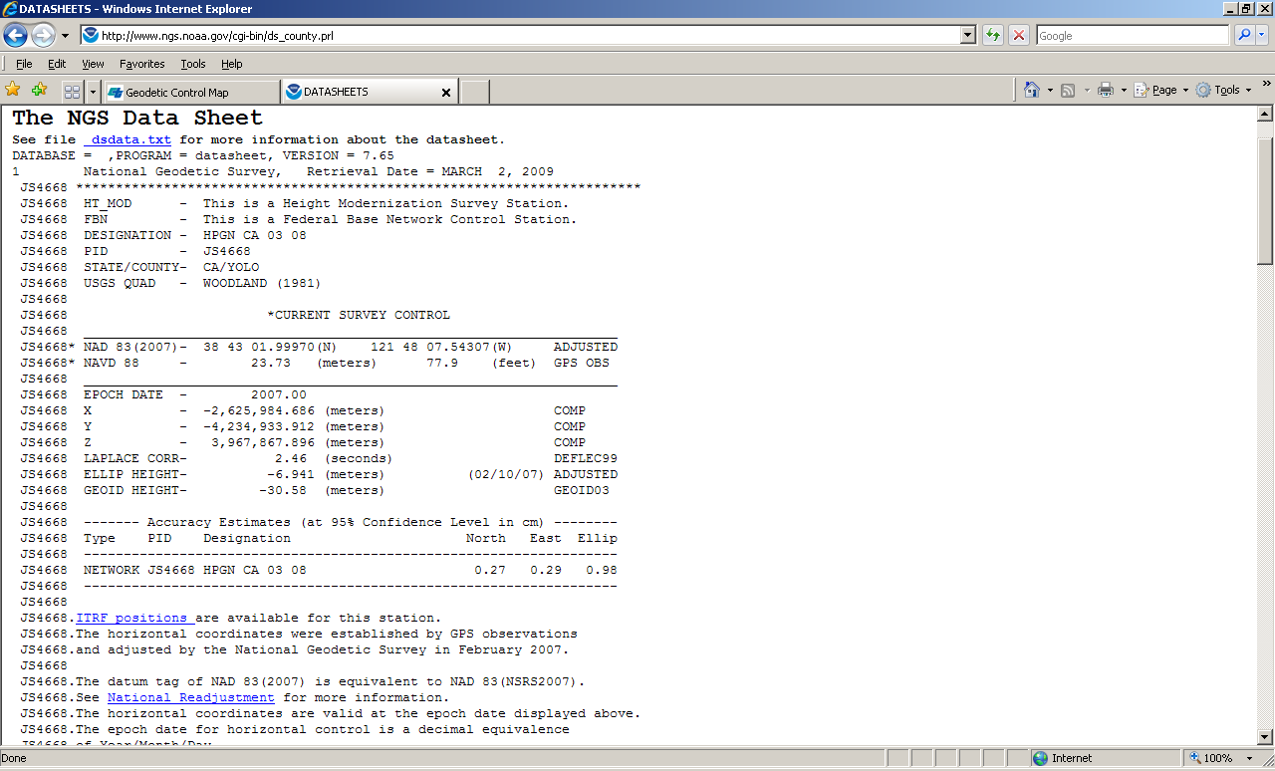

Slide 63
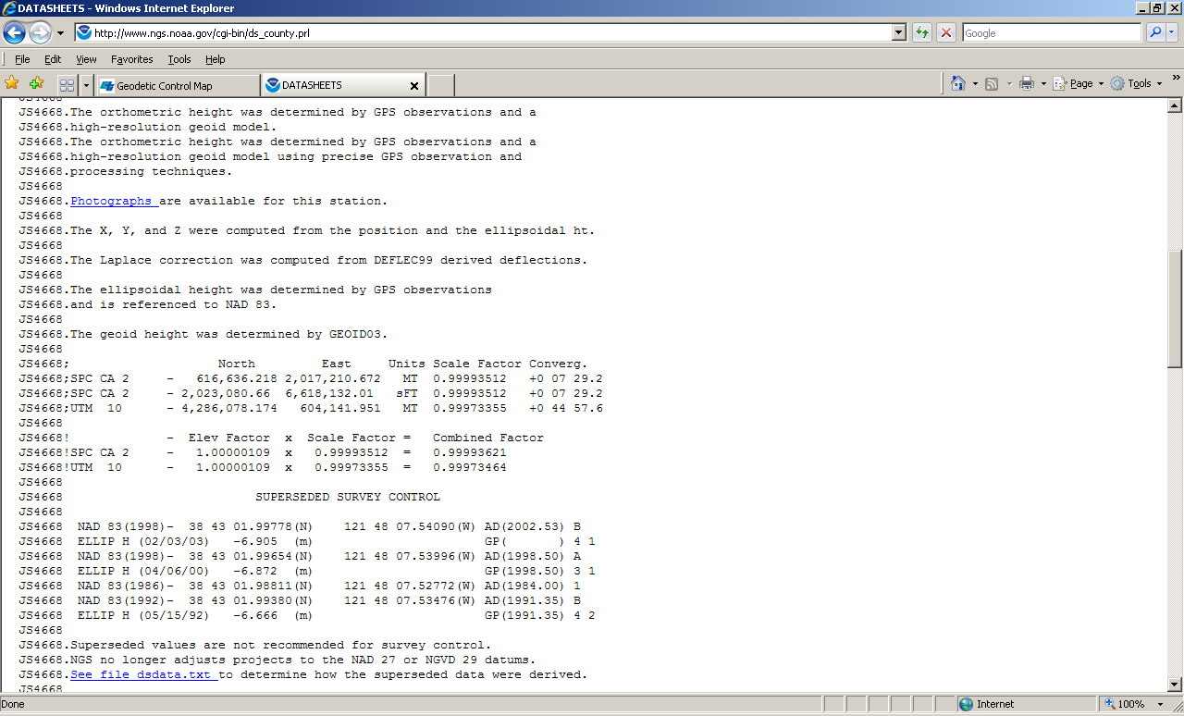

Slide 64
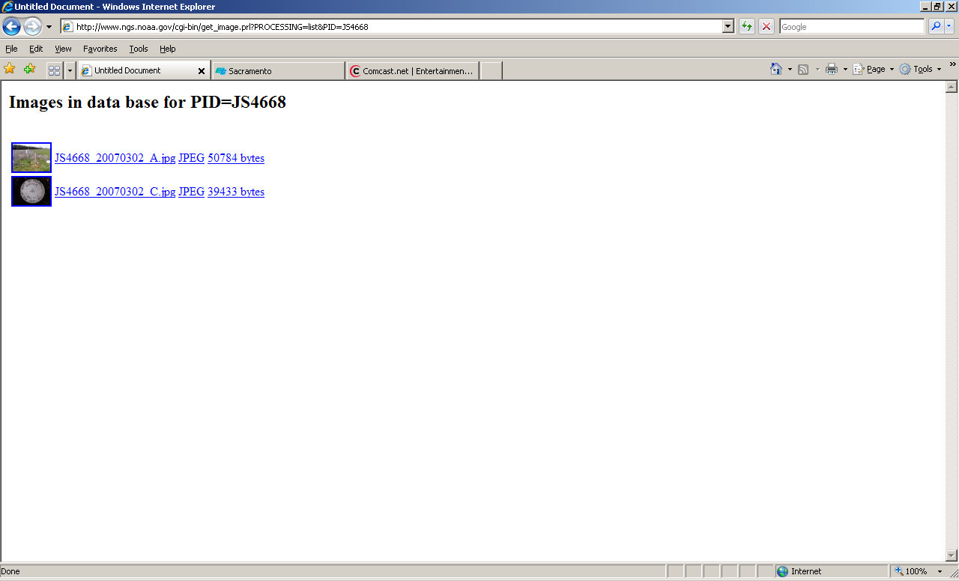

Slide 65
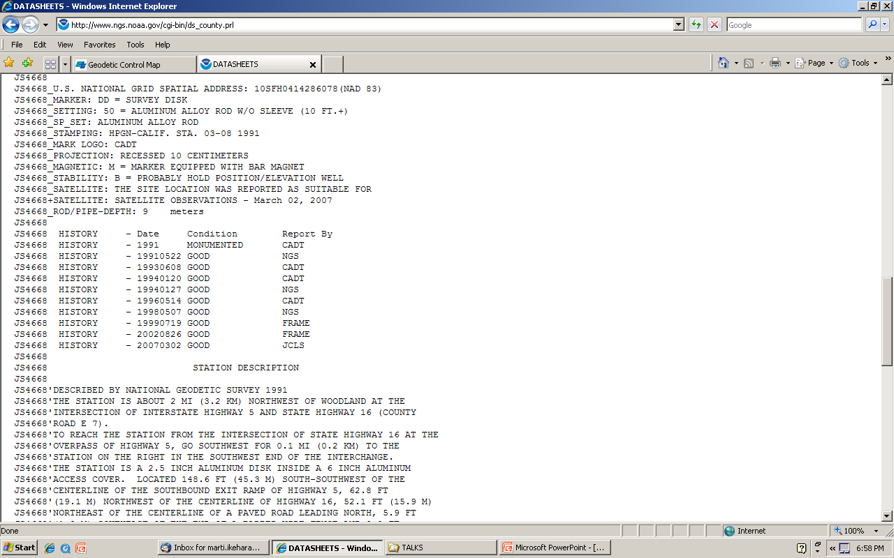

Slide 66


Slide 67


Slide 68


Slide 69


Slide 70

NSPSMO.org
Surveying USA

Slide 71
“ OPUS : Acceptance of OPUS Results for Publishing
OPUS solutions meeting certain criteria and accompanied by metadata describing the site may be eligible for publication on Data Sheets from the NGS Integrated Data Base (IDB). Users submitting to the IDB must be registered with NGS to receive a user ID and password and agree to the terms of this publication. Please review the procedures for IDB submission.
The numerical criteria for an OPUS solution
to be accepted for publication are:
NGS calibrated GPS antenna
minimum 4 hour data span
minimum 70% observations used
minimum 70% fixed ambiguities
maximum 0.04m horizontal peak-to-peak
maximum 0.08m vertical peak-to-peak

Slide 72
NSPS Survey USA
NGS can use 4 hours DF at an ‘88 BM
Data submitted to OPUS-DB can contribute to next iteration of NGS geoid model
Dual-frequency GPS for 4.25 hours
Where? Not at same nor rejected locations, unless ‘h’ is shown as reason (Col V)
  Review map and xls file that are on my ftp site
Looking for GPS ellipsoid height data at a BM that has a leveled NAVD88 height AND is not likely to have subsided since 1988

Slide 73
GEOID09 published in Sept 09
In California, GEOID03 considered 567 bench marks with GPS data (ellipsoid heights), and kept 549
In GEOID09, there were 833 considered; 738 were included, a 36% increase from Geoid03

Slide 74
GEOID09 compared to GEOID03
09: teal, good; yellow: State advisor-rejected;
red: analysis-rejected (subsidence)
03 (underlying dots): dk blue, kept; orange: rejected
Notes:
New points for 09 include data from Height Modernization projects: Leveling/GPS from BMs to CGPS in southern CA;
GPS data on BMs in San Joaquin Valley and northern CA. Yellow dots represent those HPGN marks that were leveled to from NGVD29 but which were improperly coded as NAVD88 in the database. Their use in G03 probably contributed to the errors in the model in the central valley that were seen.

Slide 75

ftp://ftp.ngs.noaa.gov/ dist/marti/geoid09

Slide 76

Notes:
Red are rejected; in this case, these were NOT NAVD88 level ties.

Slide 77

ftp://ftp.ngs.noaa.gov/pub/marti
FINAL QUESTIONS?
Marti.ikehara@noaa.gov

