Slide 1

NGS Produces New Coordinates: Is it still NAD83?
Past, Present, Future
Marti Ikehara
California Geodetic Advisor
Marti.ikehara@noaa.gov
Sacramento, CA
www.ngs.noaa.gov

Slide 2
Order of Topics
Terms: datum, realization,
ellipsoid, epoch, projection
The many flavors of NAD83
Future datums WILL be different
Changes to datasheets, shapefiles
Geodetic advisor program changes

Slide 3
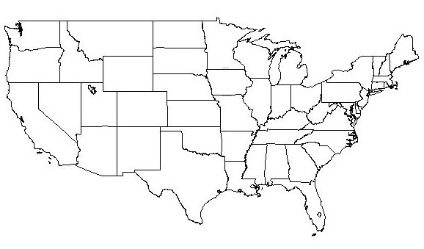
Changing the Datum
The Grid shifts Uniformly (mathematically) in any one region
Everything gets a
New coordinate!
1927-1983: up to 100’s of meters
1983-2022: 1-2 meters
1927
1983

Slide 4
Adjusting Coordinates within the Datum is a new Realization
1 cm
Modifying each point for its ”issues”: change is not uniform/constant everywhere
Actual Motion/Velocity
Error correction/Old data
New Information/Obs
On the order of centimeters
Done regularly: Next 2012
1983

Slide 5

A rose by any other name is still a rose
W.S.
Same NAD83 DATUM, different Realizations:
(86) –original, pre-GPS data
(92) for California; for other states (9#)
(CORS96)
(98) in CA
(NSRS2007) or (2007)
(2011)
Future: ~2022 and
maybe in-between

Slide 6
What’s the same, what’s different?
Same reference ellipsoid: GRS80 for each datum NAD83, WGS84, and ITRF## or IGS##
Difference in datums is location of origin (center)
NAD83(#) is the datum tag, represents an adjustment, either national or by state
Difference is the dataset of which geodetic control points used as constraints
Difference could be epoch date of coordinates
NAD83(2007) 2007.00 or NAD83(2007) 2008.00

Slide 7
Projections
Tool to ‘translate’ geodetic locations—those that take into account the earth’s curvature-- to ‘show’ them on a flat, 2-dimensional plane
Independent of datum
On NGS main page, select Geodetic TOOLKIT
State Plane Coordinates

Slide 8
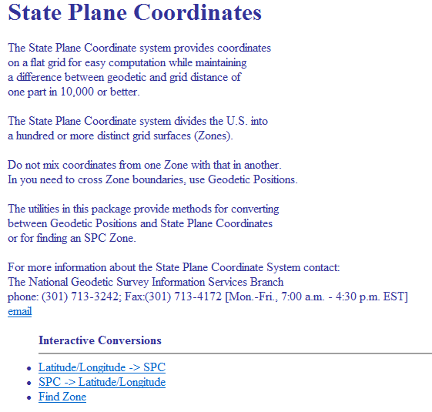
http://www.ngs.noaa.gov/TOOLS/spc.shtml

Slide 9

NAD83 Present
Past…
and
Future

Slide 10
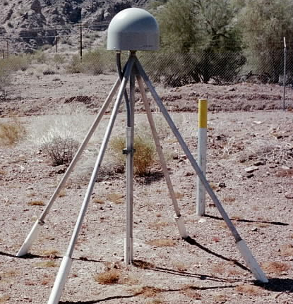
Evolution of Geodetic Datums: from NAD27/NGVD29 to NAD83/NAVD88 to ?/ ?
H + V
2 + 1
27, 29
H + V
2 + 1
83(86),88
GPS
H + V_{E} + V_{O}
2 + 1 + 1
83(92), 88
+VELOCITIES (time)
H + H_{t} + V_{E} + V_{O}
2 + 2 + 1+ 1
83(11)+HTDP, 88
H + H_{t} +V_{E}+ V_{Et}
2 + 2 + 1+ 1
GEOMETRIC
V_{E} + G_{t}
1 + 1
GEOPOTENTIAL
H + H_{t} +V_{E}+ V_{Et}
2 + 2 + 1+ 1
ITRF08 (2010.00)
+ GRAVITY
(geoid model)
Notes:
Conceptual: Generally, Orange represents ‘horizontal’ or NAD83 at present; yellow represents orthometric vertical.
1)moved fr non-geocentric to 2)geocentric as well as we knew at the time from early satellite technology (DOPPLER). And leveling efforts resulted in a national vertical datum with only one constraint, rather than 26 (tide gauges). 3)Static GPS exploded on the scene which 4) led to 5)the HARN networks and state-specific adjustment. With GPS surveying, we got V(E), vertical ellipsoid and V(O), vertical orthometric. 6)With the results of repeat static surveys and the advent of CGPS (Continuous CGPS), such as NGS’ National CORS, 7)the velocity of the earth’s crust relative to a reference frame, could be determined over time. 8)Using the crustal motion model HTDP for horizontal velocities on the West Coast, eg, the Pacific-North American Plates interface, NGS produced 9) a National Re-adjustment in the NAD83 (NSRS2007) datum. (No change to ortho.) However, 10)underlying the NAD83 adjustment are data and analysis referenced to ITRF00, epoch 2002.00, which does take into account both horizontal AND vertical ellipsoid velocities. (velocity=time related terms shown as italicized.) This is what we have now. 11) With better global gravity models and airborne gravity data collected by NGS, we will 12) move forward with 13) new datums BOTH referenced to an ECEF, earth-centered, earth-fixed datum which we are calling 14) Geometric, for the horizontal and ellipsoid height values, and Geopotential for the orthometric height values which will be based on a a geoid model and changes in gravity over time (G(t).

Slide 11
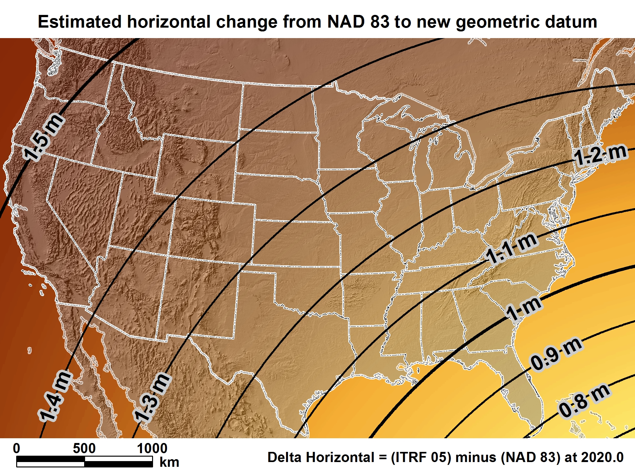
New geometric datum minus NAD 83 (horizontal)

Slide 12
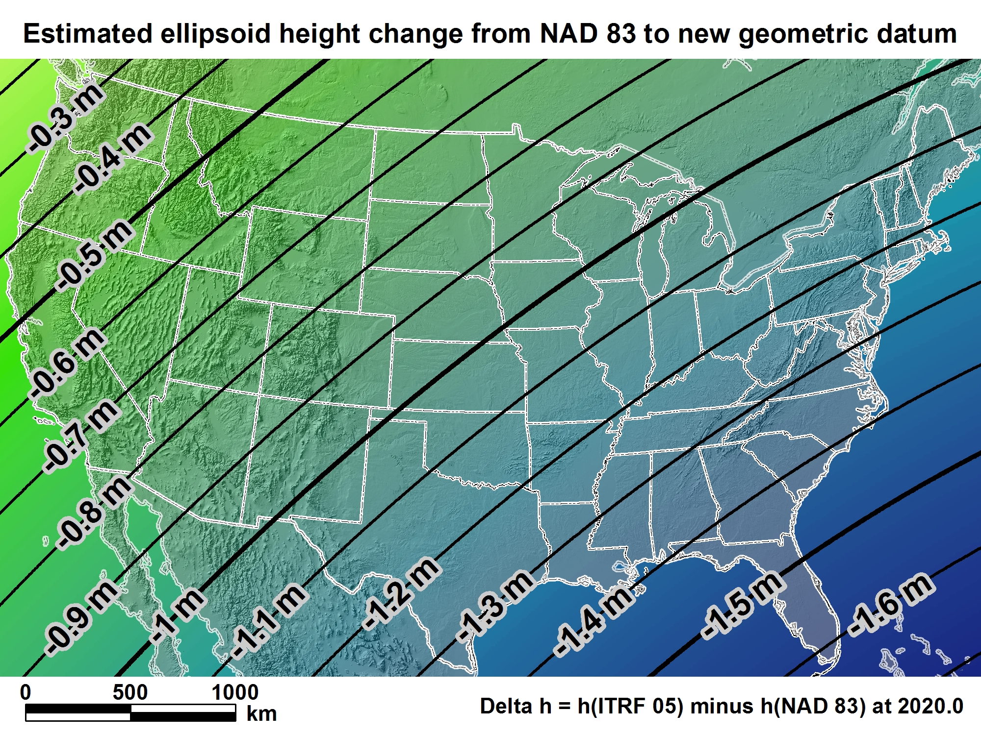
New geometric datum minus NAD 83
(ellipsoid height)

Slide 13
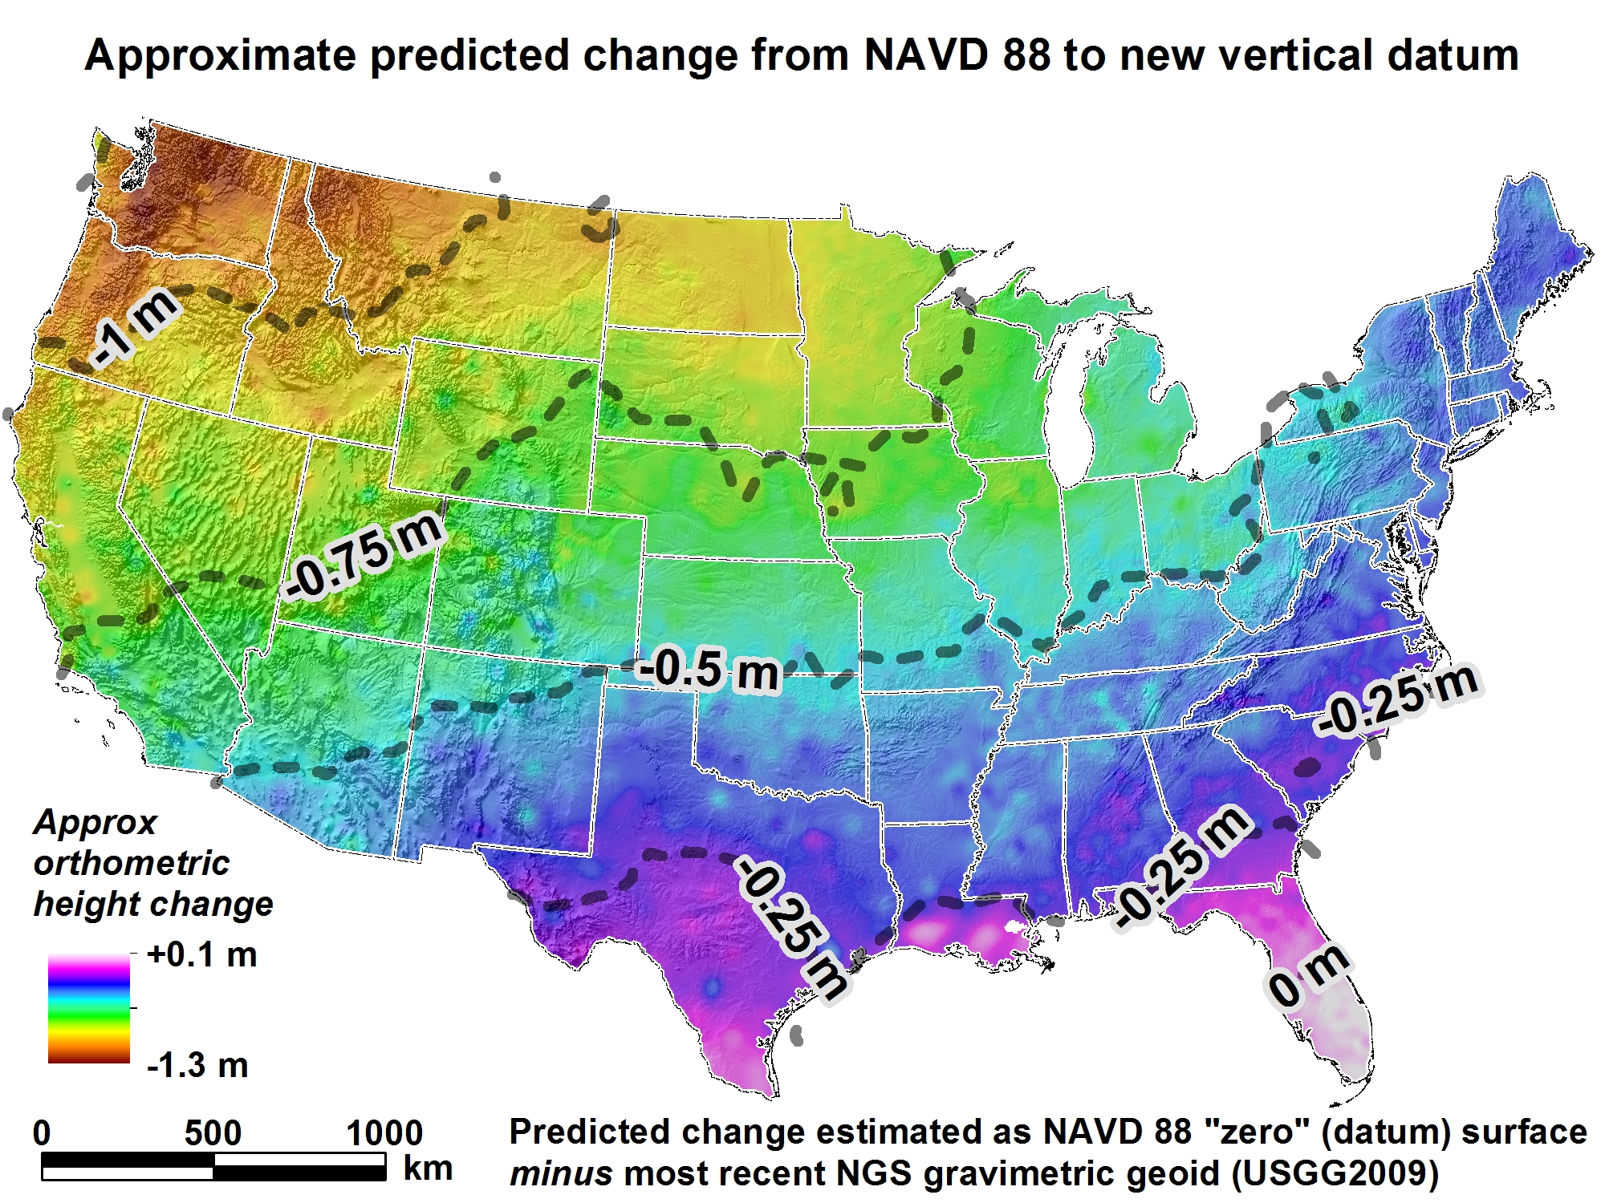

Slide 14
How to Plan for the Future
Utilize newest realization, i.e. NAD 83(2011) epoch 2010.00
  NAD 83(HARN) <-> NAD 83(NSRS2007) &
  NAD 83(NSRS2007) <-> NAD 83(2011) tools under development
Move from NGVD 29 to NAVD 88
  Understand the accuracy of VERTCON in your area
Move away from passive marks to CGPS
  Especially move off of classical (non GPS) passive geodetic control
Require/provide complete metadata for all mapping contracts
  What realization? Just “NAD83” is not enough. What EPOCH?
  How did they (you) get the positions/heights? DOCUMENT!!

Slide 15
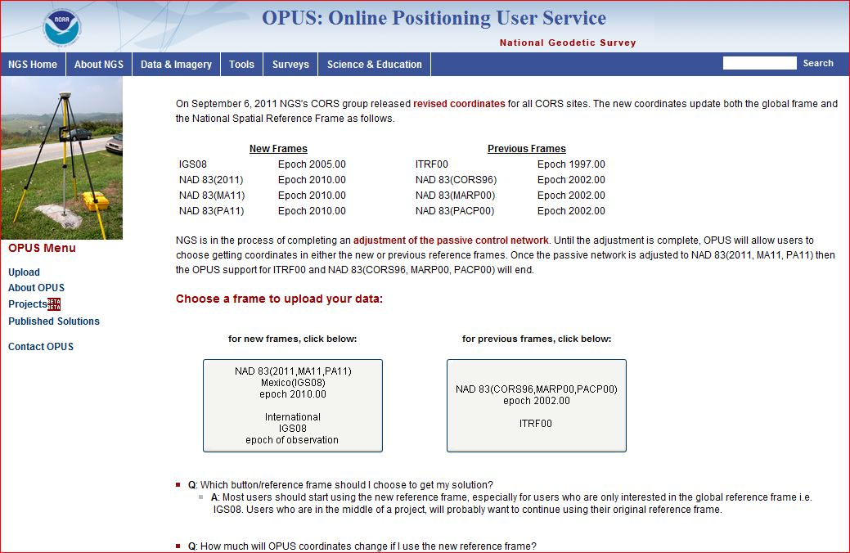
OPUS Reference Frame Choices
Notes:
Both available until the passive adjustment is published.

Slide 16
NEED for a new national adjustment, NA2011 project, for passive geodetic stations
Optimally align passive control with CORS
>1000 projects submitted since 2007 NatlReadj
  Number of stations increased by 1/3 in just 5 years!
  Plus Observations for Hawaii & other Pacific islands
Database pull as of 3/28/12; includes some critical leveling (& GPS obs) in Gulf States
More consistent results in tectonically active areas:
  Longer time series for CORS, as well as
  More current data for passive, and better tectonic modeling for applying HTDP to obs back 20+ years

Slide 17
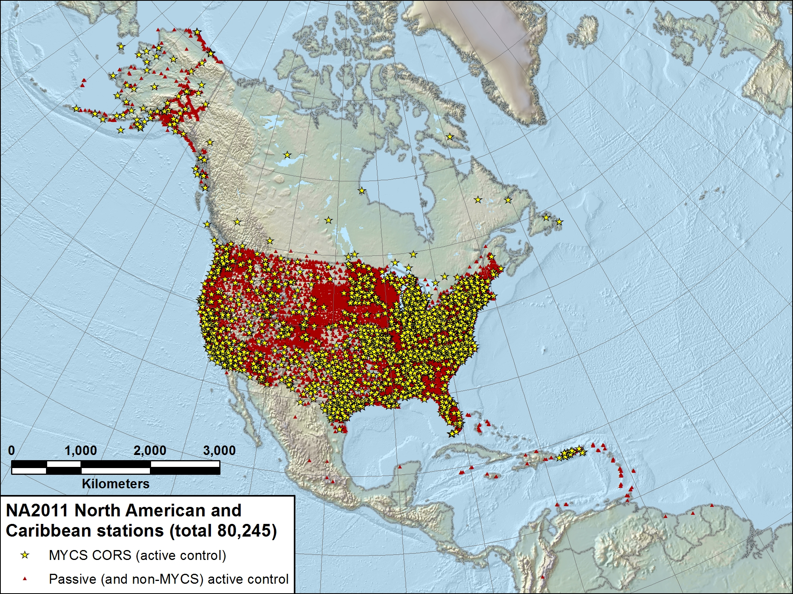

Slide 18
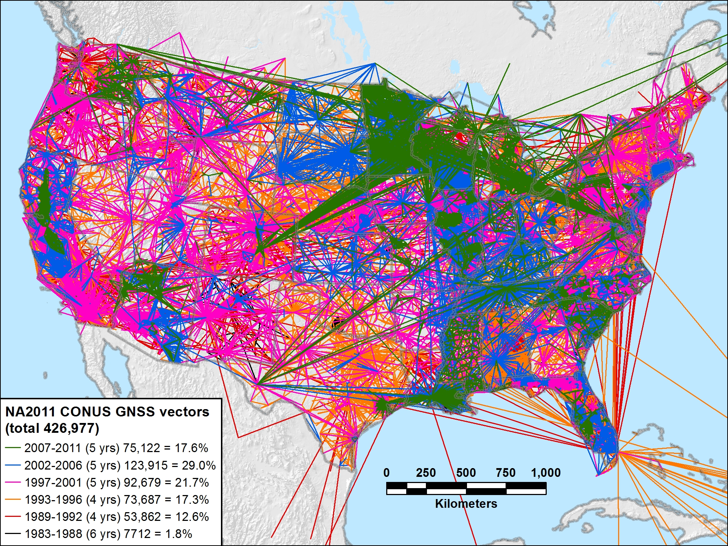
NA2011 CONUS 1983-2011 (29 yrs): 426,977 vectors

Slide 19
DATASHEET Change highlights
Better grouping of geometric elements, eg, ellipsoid height and epoch date
CLARITY about geoid model usage, including for superceded ortho height data
Note: last year, NGS started publishing superceded GPS-derived ortho heights
Inclusion (hyperlink) to Local Ties & Accuracies
Shapefile content changing—adding field to identify/distinguish Ht Mod (GPS OBS) vertical

Slide 20
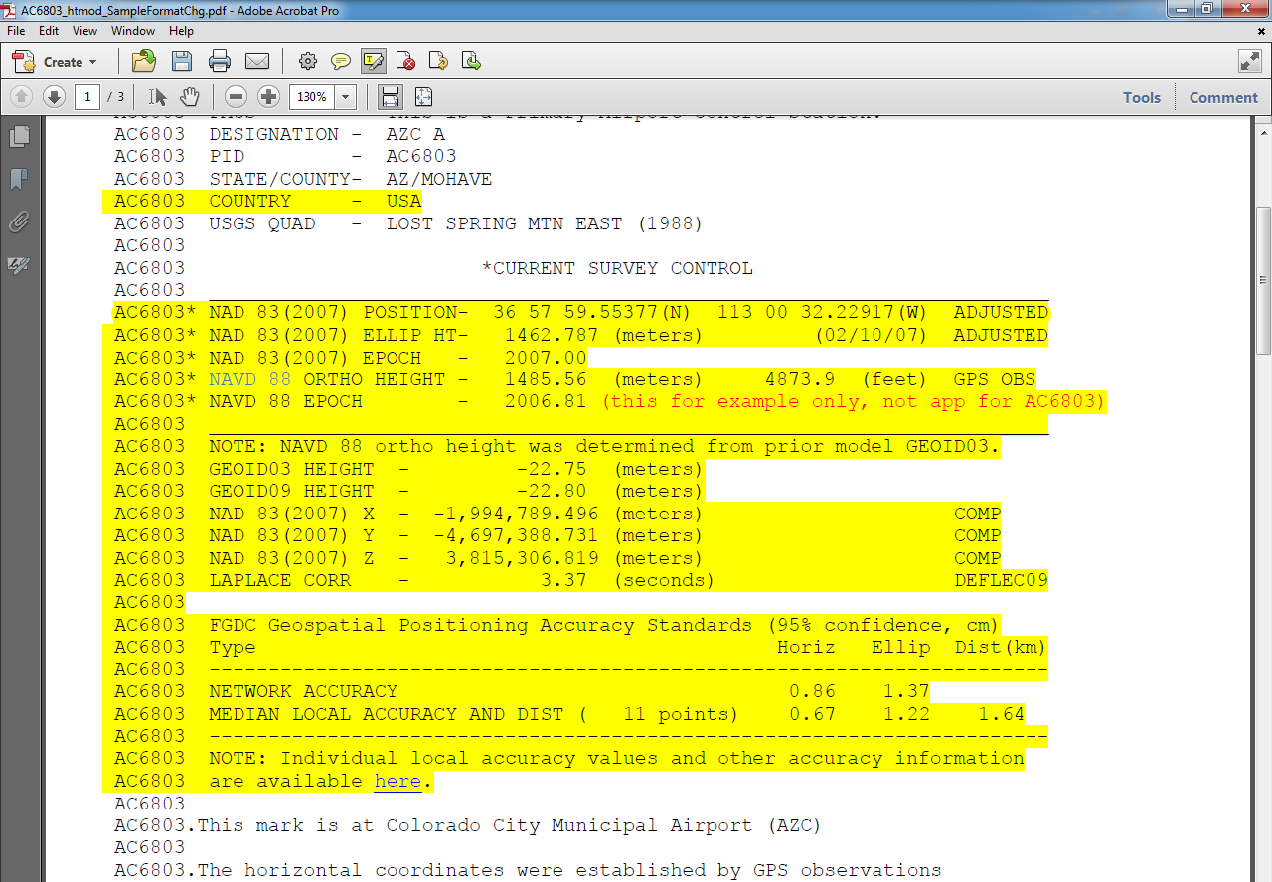
Datasheet Format/Content Changes
Move ell ht and epoch info into top box
Note when GPS Ortho Ht computed with previous geoid model, and provide that model ht
Better way to quantify accuracies

Slide 21
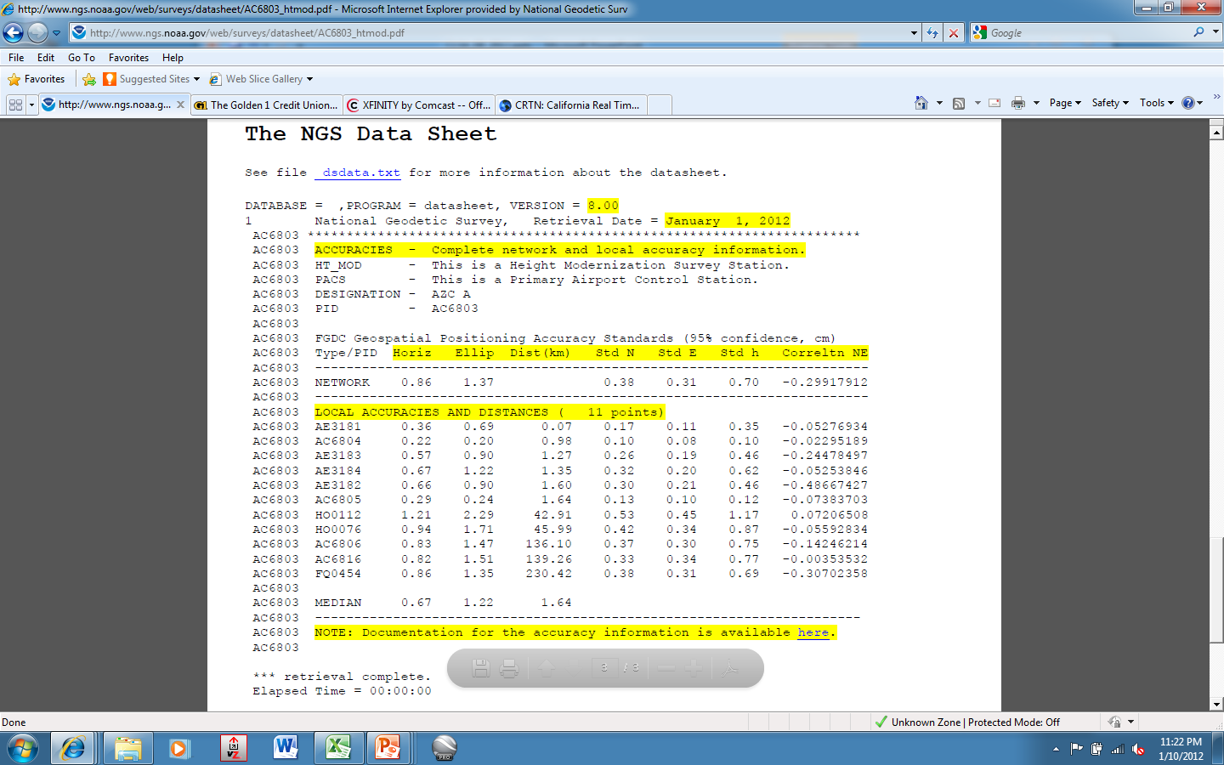
Local Accuracies

Slide 22
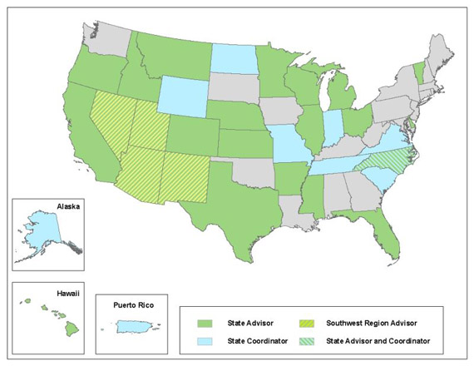
NGS Geodetic Advisors in the West
SW Region
(AZ,NM,NV,UT)
William Stone
Oregon
Mark L. Armstrong
Colorado
Pam Fromhertz
Idaho/Montana
Curt Smith
Wyoming
Mike Londe (BLM)
State Advisor Branch Chief: Ross.Mackay@noaa.gov

Slide 23

The Changing Face of the Geodetic Advisor Program
1. What are we not?
GEODENTIST
2. What/who are we?
3. How is it changing?

Slide 24
The Changing Face of the Geodetic Advisor Program
1. What are we not?
2. What are we?
We provide the link between
Geodesy and other customers, typically surveyors but also anyone wanting to connect to the NSRS
Who are we?
20 advisors; 3 are PLS, 2 of those also PE, 2 are PhD
1/3 transitioned from NGS field assignments; others came fr other gov, 2 came fr the cooperator

Slide 25

The Changing Face of the Geodetic Advisor Program
Provide equal service to non-coop states
REGIONALIZATION
15 advisors total for 50 states, PR, Pacific islands
Regions being discussed in NGS Advisory Group
Ross.Mackay@noaa.gov is Chair (SAB Chief)
Proposal includes “State Coordinator” as POC
Transition in next 4 years, with attrition due to retirements

Slide 26

Marti.ikehara@noaa.gov

