Slide 1
The National Spatial Reference System (NSRS) and VDatum
Juliana Blackwell
NOAA National Geodetic Survey Director
Hydrographic Services Review Panel
Portsmouth, NH
September 2017

Slide 2
outline
The National Spatial Reference System (NSRS)
NSRS Modernization
VDatum
NOAA-S Rainier crew uses GPS to measure the position of an aid to navigation near Ketchikan, AK
(Damian Manda, 2009)
2

Slide 3
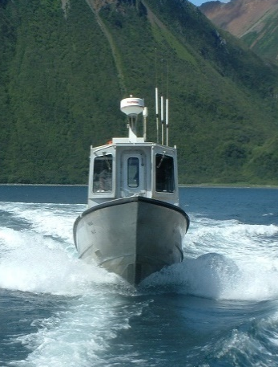
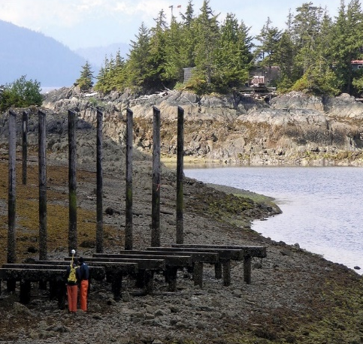
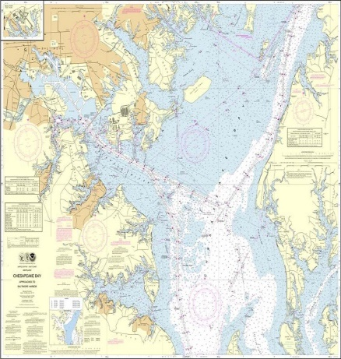
The National Spatial Reference System (NSRS)
A consistent geospatial framework to meet the economic, social, and environmental positioning needs of our Nation.
Foundational elements include:
Latitude • Longitude • Elevation • Gravity • Shoreline Position
+ changes over time
+
+
=
Reliable charts and maps require data from disparate sources and dates to be aligned
3

Slide 4
The NSRS of Today (simplified)
Primary elements:
Horizontal North American Datum of 1983 - NAD 83(2011) coordinates
Vertical North American Vertical Datum of 1988 - NAVD88 orthometric heights
These elements are geodetic datums that define the shape and size of the earth to enable precise positioning
System based on connections to published passive control
4

Slide 5
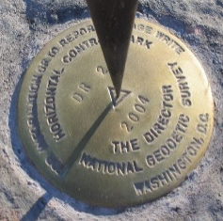
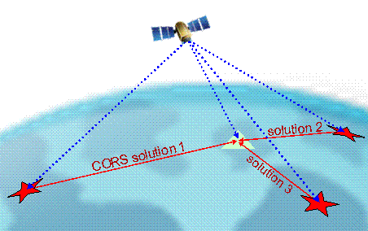
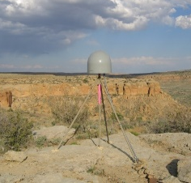
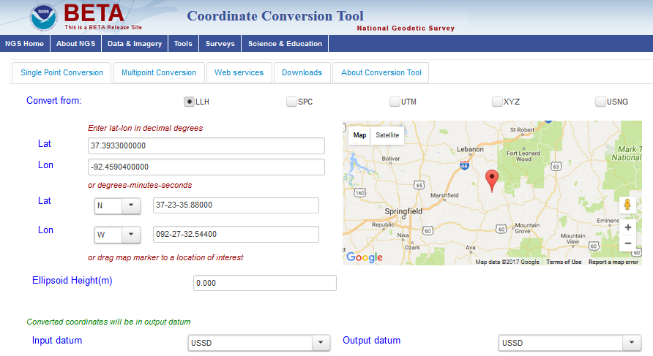
NGS Provides Tools to Access the NSRS
Integrated Database (IDB) of Published Control
Continuously Operating Reference Stations (CORS)
Online Positioning User Service (OPUS) Tool Suite
Coordinate Conversion and Transformation Tools
5

Slide 6
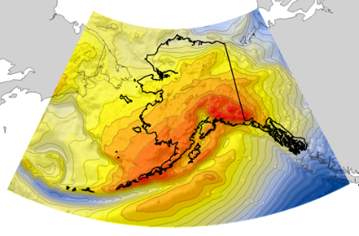
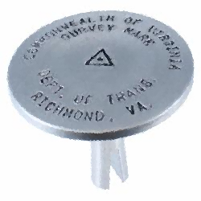
Supporting GPS Access to NSRS Heights
A geoid is a surface of constant gravity potential
A geoid model can be used to obtain orthometric heights from GPS-derived ellipsoid heights
The current geoid model for obtaining NAVD 88 heights is GEOID12B
USGG2012
GEOID12B
Topography
Ellipsoid
Geoid
Orthometric height ≈ Ellipsoid height (from GPS) - Geoid height
NAVD 88 height ≈ NAD 83 height - GEOID12B height
NGS is refining the gravimetric geoid model with GRAV-D Project
6

Slide 7
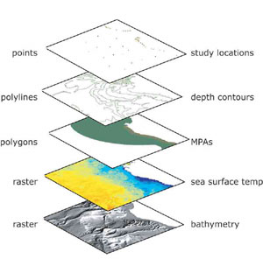
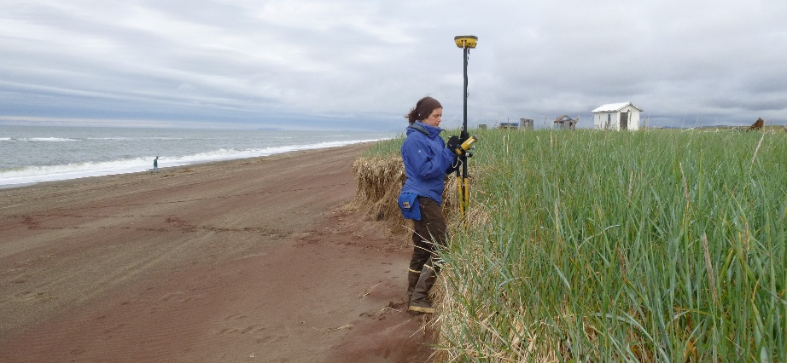
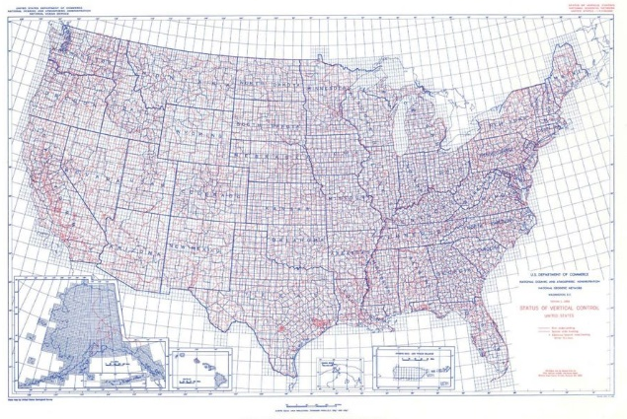
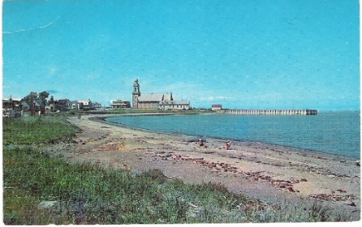
NSRS Considerations – The 4 C’s
Requirements
Expectations
CONSISTENCY
CONVENIENCE
Semi-CONSTANT Coordinates
COHERENCE with Sea Level
stamped with elevation
7

Slide 8
The NSRS of Tomorrow (2022)
Primary elements:
The geometric North American Terrestrial Reference Frame of 2022 (NATRF2022) plus the Caribbean, Pacific, and Mariana plates
The North American-Pacific Geopotential Datum of 2022 (NAPGD2022)
New reference system is:
Time-dependent and geocentric
Defined by relationships to a global/international ideal frame
Primarily accessed via GPS technology and a newly refined semi-dynamic geoid model
8

Slide 9
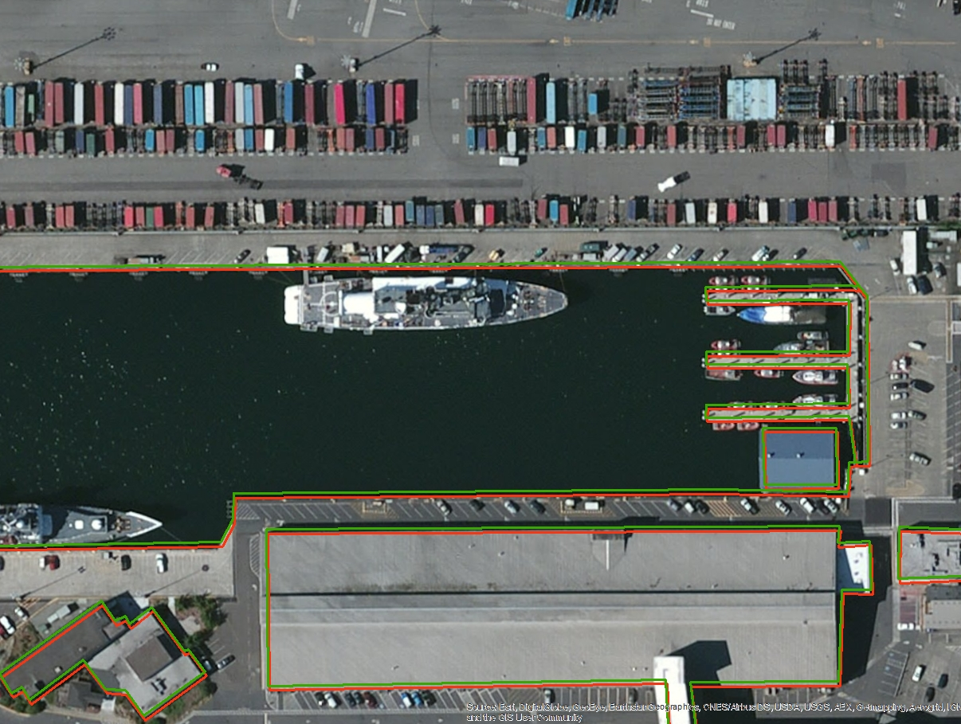
NSRS Modernization: Horizontal Change
Seattle, WA
Easting Difference: 0.45 meters
Northing Difference: 1.33 meters
9

Slide 10
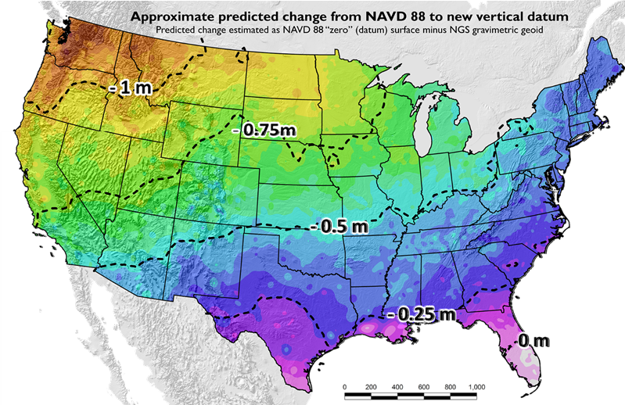
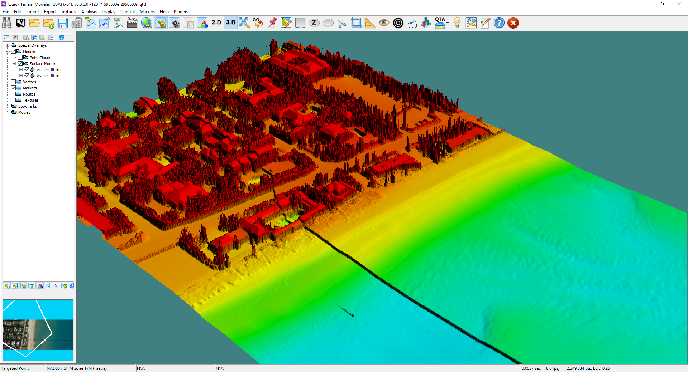
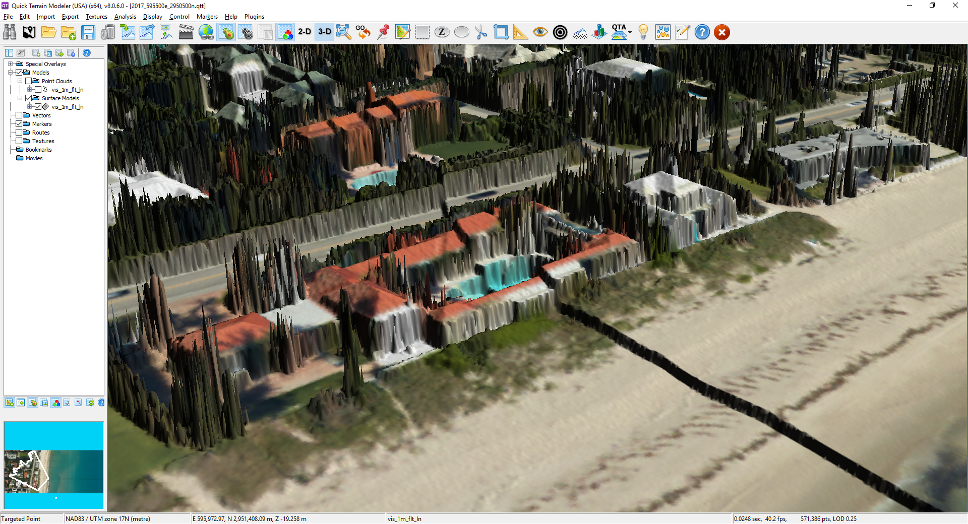
NSRS Modernization: Vertical Change
GEOID12B (NAVD88)
Updates available online from the New Datums website and Modernization News
xGEOID17
Vertical offset of more than 1 meter
https://geodesy.noaa.gov/datums/newdatums/index.shtml
10

Slide 11
Allure of the Seas passes under the Store Belt Bridge, Denmark (October, 2010)
☑
Importance of Vertical Datums to Hydrographic Surveys
☒
☑
Container barge in Bergum, Netherlands (C. Fries, 2011)
Tianjin passes under the Talmadge Bridge, Georgia (Steve Bisson, 2015)
11

Slide 12
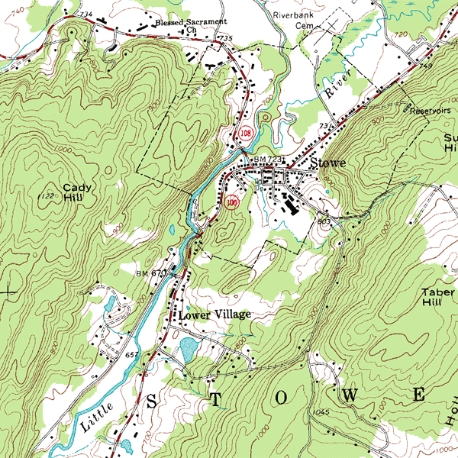
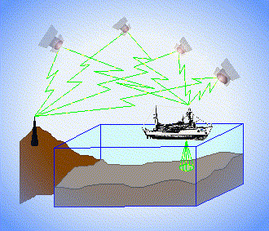
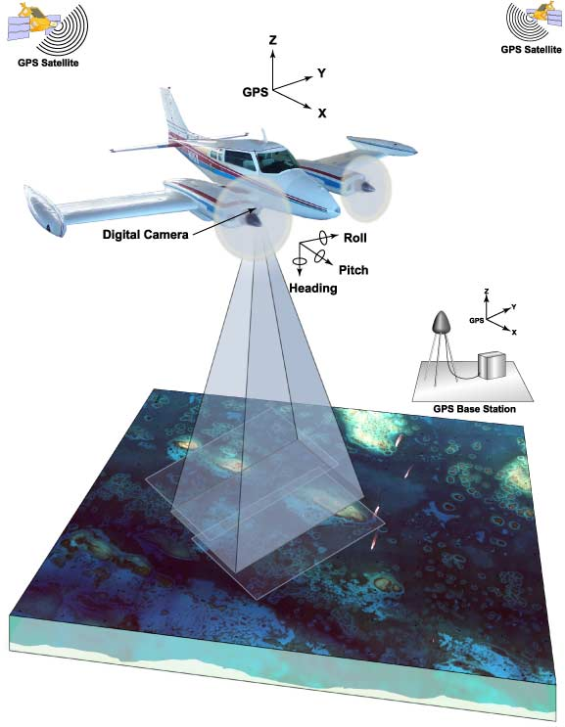
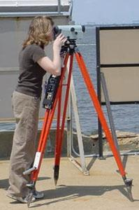
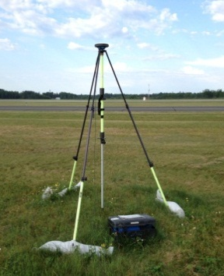
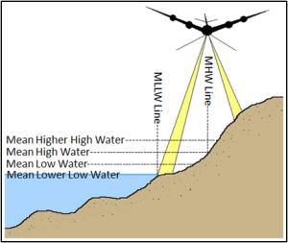
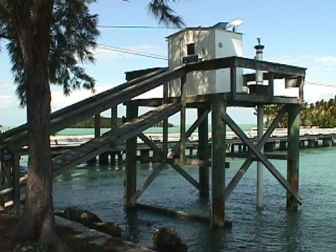
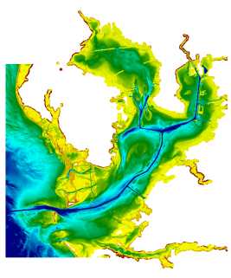
3 Categories of Vertical Datums
Orthometric
Ellipsoidal
USGS
Topography
Raw Hydrographic Surveys vertically referenced with RTK-GPS
FEMA Flood Insurance Rate Maps
Engineering and Development Site Surveys
Tidal
Native GPS measurements
Raw Lidar
NOAA Bathymetry (MLLW)
Shoreline Mapping (MHW) and Regulatory Boundaries at the Coast
Daily and Extreme Water Levels
12

Slide 13
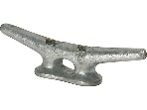
Topographic and Bathymetric
Reference Datums Differ
Topography
Ellipsoid
Geoid
?
MLLW
?
Bathymetry
13

Slide 14
VDatum Links Vertical Datums
Topography
Ellipsoid
MSL
Geoid
Topography of Sea Surface (TSS)
MLLW
Bathymetry
14

Slide 15
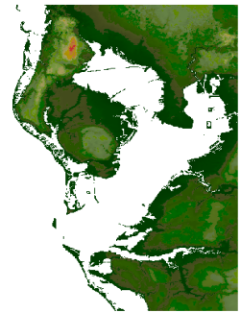
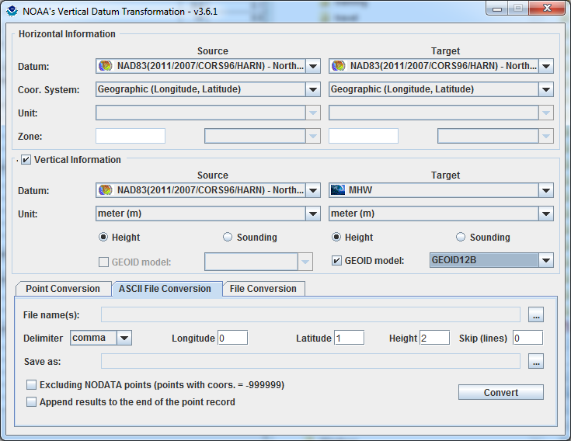
Development and Use of VDatum
Mapping the Land-Sea Interface: VDatum converts elevation data (heights and soundings) among different vertical datums
Topography
Bathymetry
VDatum is a transformation tool developed jointly by:
National Geodetic Survey (NGS)
Office of Coast Survey (OCS)
Center for Operational Oceanographic
Products & Services (CO-OPS)
15

Slide 16
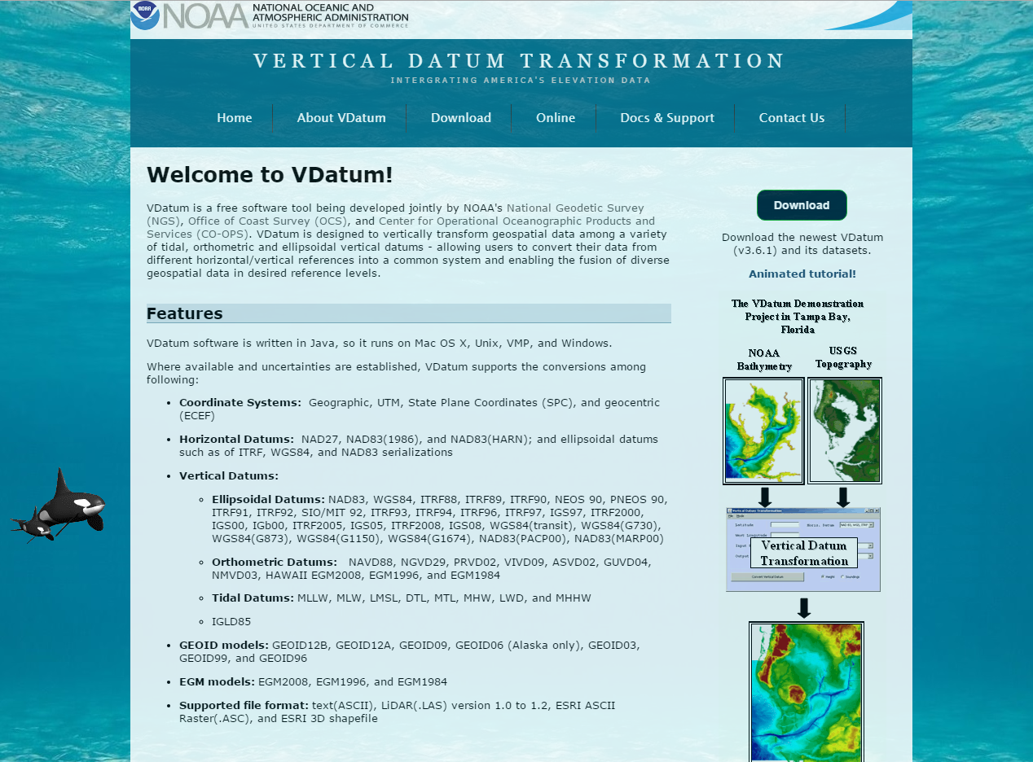
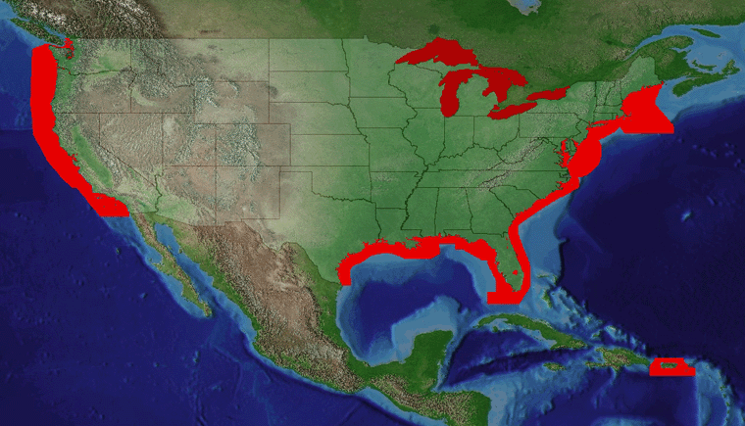
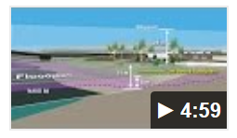
VDatum Website: vdatum.noaa.gov (Version 3.6 Released, May 13, 2016)
Map of coverage
Available user interfaces:
Online
GUI Download
Command Line
https://vdatum.noaa.gov/docs/vdatum.mp4
16

Slide 17
Surveying on the Ellipsoid: A VDatum Charting Application
Advantages:
Decouples tide measurement from survey
Reduces vertical uncertainty from heave, dynamic draft
Ellipsoid
Height of Ship (measured)
Datum offset known
(VDatum)
Requires:
Advanced TSS that extends offshore
Validation against existing hydro survey techniques (TCARI)
Sensor offset known
MLLW
Chart Depth
(computed)
Depth from Ship (measured)
17

Slide 18
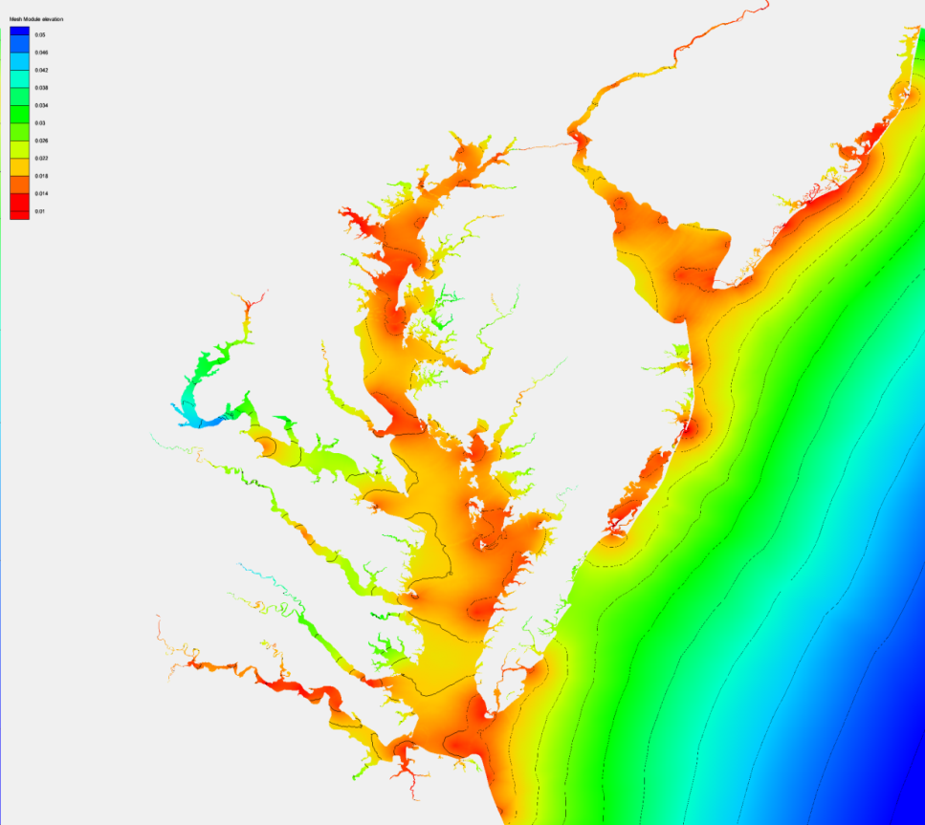
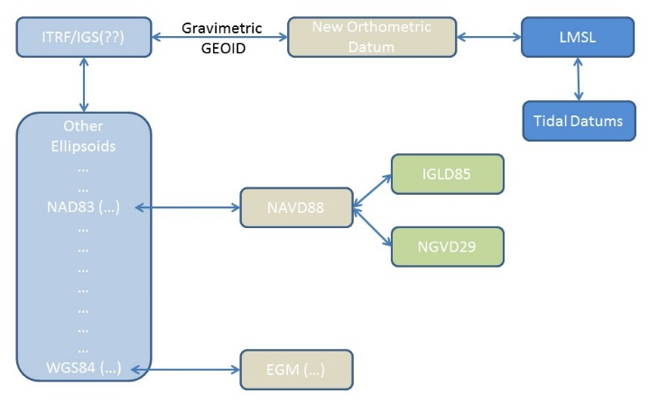
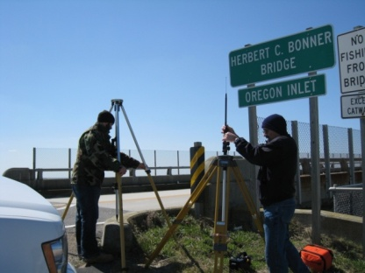
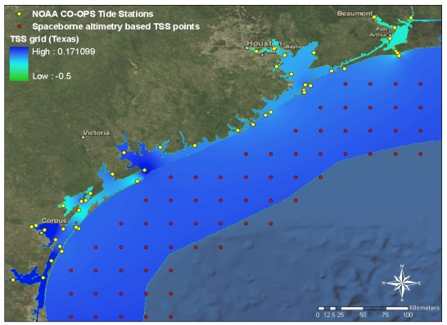
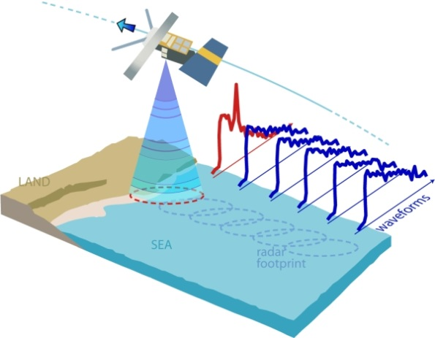
Future Enhancements to VDatum
Incorporation of Spatially-Varying Uncertainty Model
New Transformation Roadmap
based on new Gravimetric GEOID2022
GPS on benchmarks Campaign to determine new relationships
Development of Next Generation TSS: (wish list)
GPS tide buoys to be utilized for data input and validation
Satellite Altimetry/Derived Products to better understand offshore TSS
Re-tracked coastal altimetry data to capture nearshore sea surface height signal
18

Slide 19
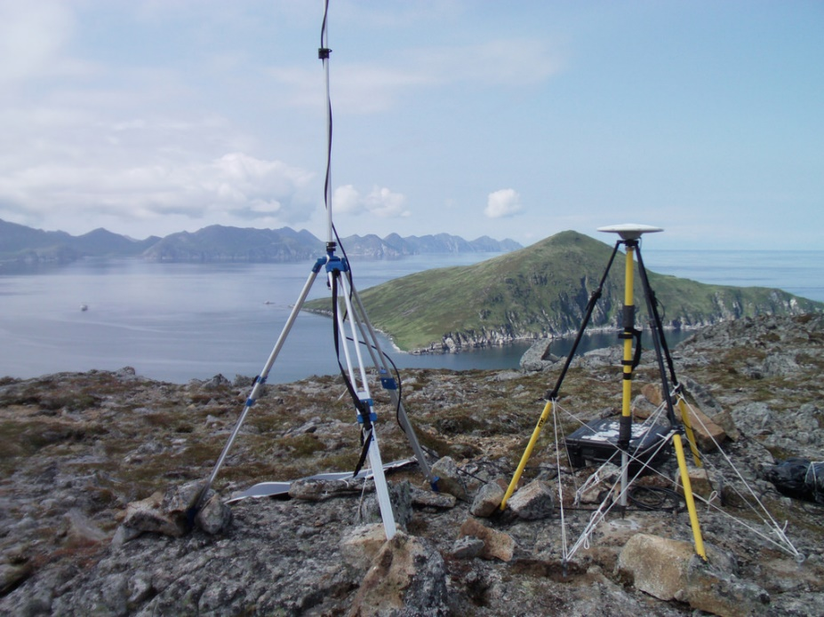
Little Koniuji Island, Alaska.
GPS Base Station in support of NOAA-S Fairweather hydrographic operations (Weston Renound, 2007).
Thank you. Up next: Part 2 – Water Level Datums
19

