Slide 1

National Geodetic Survey:
Past, Present, and Future
Jacob M. Heck, Ph.D.
jacob.heck@noaa.gov
NOAA’s National Geodetic Survey
geodesy.noaa.gov

Slide 2
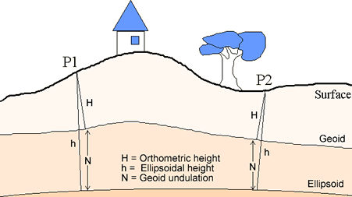
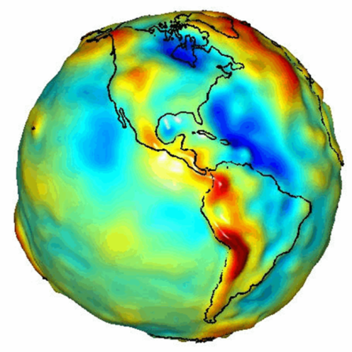
What is Geodesy?
Geodesy (geodetic control) is a foundational science that defines position & height
Why is Geodesy important?
The Earth is an irregular surface and is difficult to model. Accurate positions are required for a wide variety of applications
(e.g. monitoring climate change impacts/sea level change)
Notes:
Geodesy is the science of accurately measuring and understanding the Earth's geometric shape, orientation in space, and gravity field.
While we may tend to think of the Earth as a uniform, smooth globe, in reality its shape and surface are quite complex. This complexity provides challenges when trying to determine the latitude, longitude, or elevation of a point on the Earth’s surface. Figuring all this out is part of the science of geodesy.

Slide 3
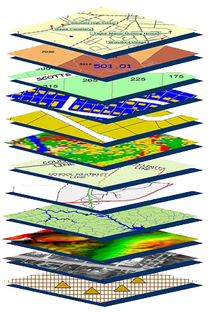
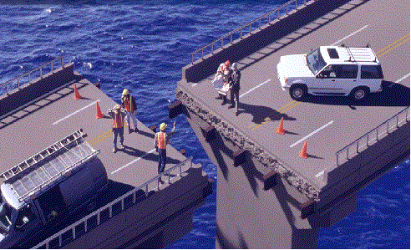
Accurate positioning begins
with accurate coordinates
geodetic control (the NSRS) is the foundation for all geospatial products.
without Geodetic Control as a “base map” layer, GIS applications will not work properly
Source: Zurich-American Insurance Group
Notes:
Digital services must ensure that geo-referenced data collected and published are consistent with NOAA’s National Spatial Reference System (NSRS), which provides the foundation for all positioning and navigation activities in the United States and is defined and maintained by NGS.

Slide 4
The Relationship of Heights

Slide 5
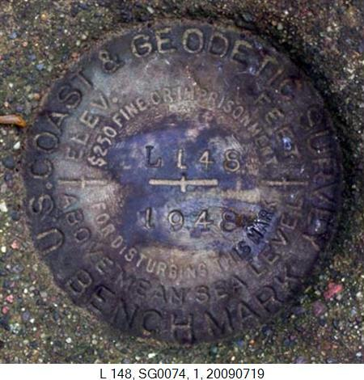
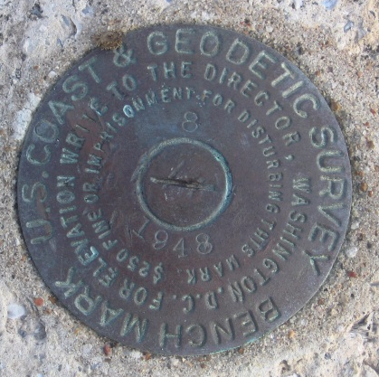
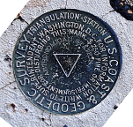

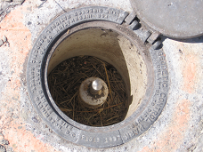
Notes:
SG0074 in South Range

Slide 6
The past

Slide 7
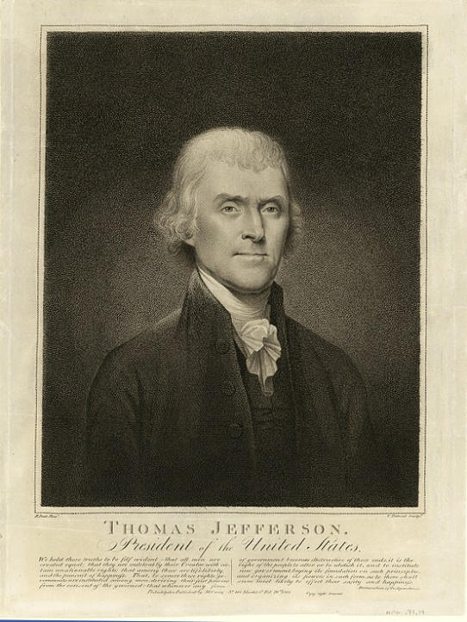
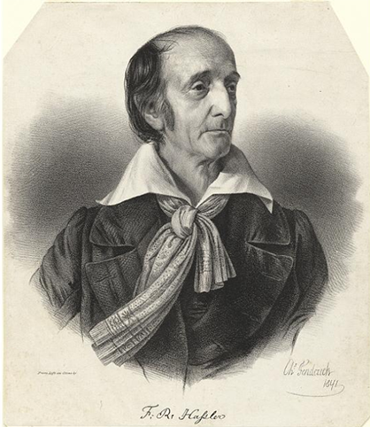
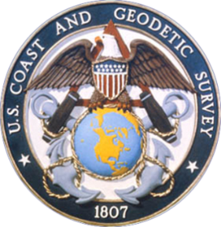

NOAA and NGS
Our Nation’s first civilian science agency
1807
Thomas Jefferson
Survey of the Coast
1811
Ferdinand Hassler
Superintendent
1836
U.S. Coast
Survey
1878
U.S. Coast and
Geodetic Survey
1970
NOAA established
Notes:
NGS has been around a long time. For more than 200 years, NGS and its predecessor agencies have collaborated with public and private organizations to establish reference stations at precisely determined locations.
We began on a mission established by Thomas Jefferson in 1807 to conduct a “Survey of the Coast” (as the United States Coast Survey).
(Pictured are Thomas Jefferson and Ferdinand Hassler, the first Superintendent of the Coast Survey). We were renamed the U.S. Coast and Geodetic Survey in 1878. NOAA was established in 1970.
Traditionally, precise positioning locations have been identified by setting a survey mark—usually a brass, bronze, or aluminum disk. Locations might also be identified by a deeply driven rod, or a prominent object, such as a water tower or church spire.

Slide 8
SUPERINTENDENT HASSLER
- HASSLER TRAVELED TO EUROPE TO ACQUIRE INSTRUMENTS
- HASSLER’S RETURN DELAYED BY WAR OF 1812
- WORK BEGAN IN 1816-17 IN NEW YORK

Slide 9
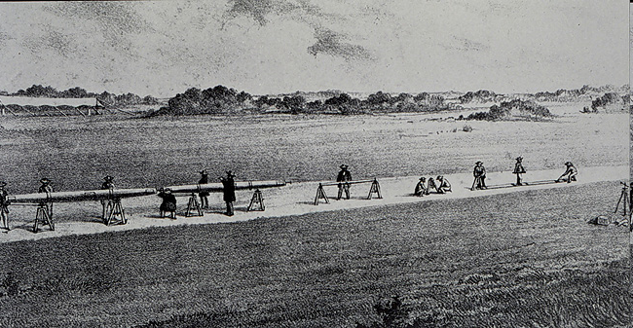
BAR FOR MEASURING BASELINE

Slide 10
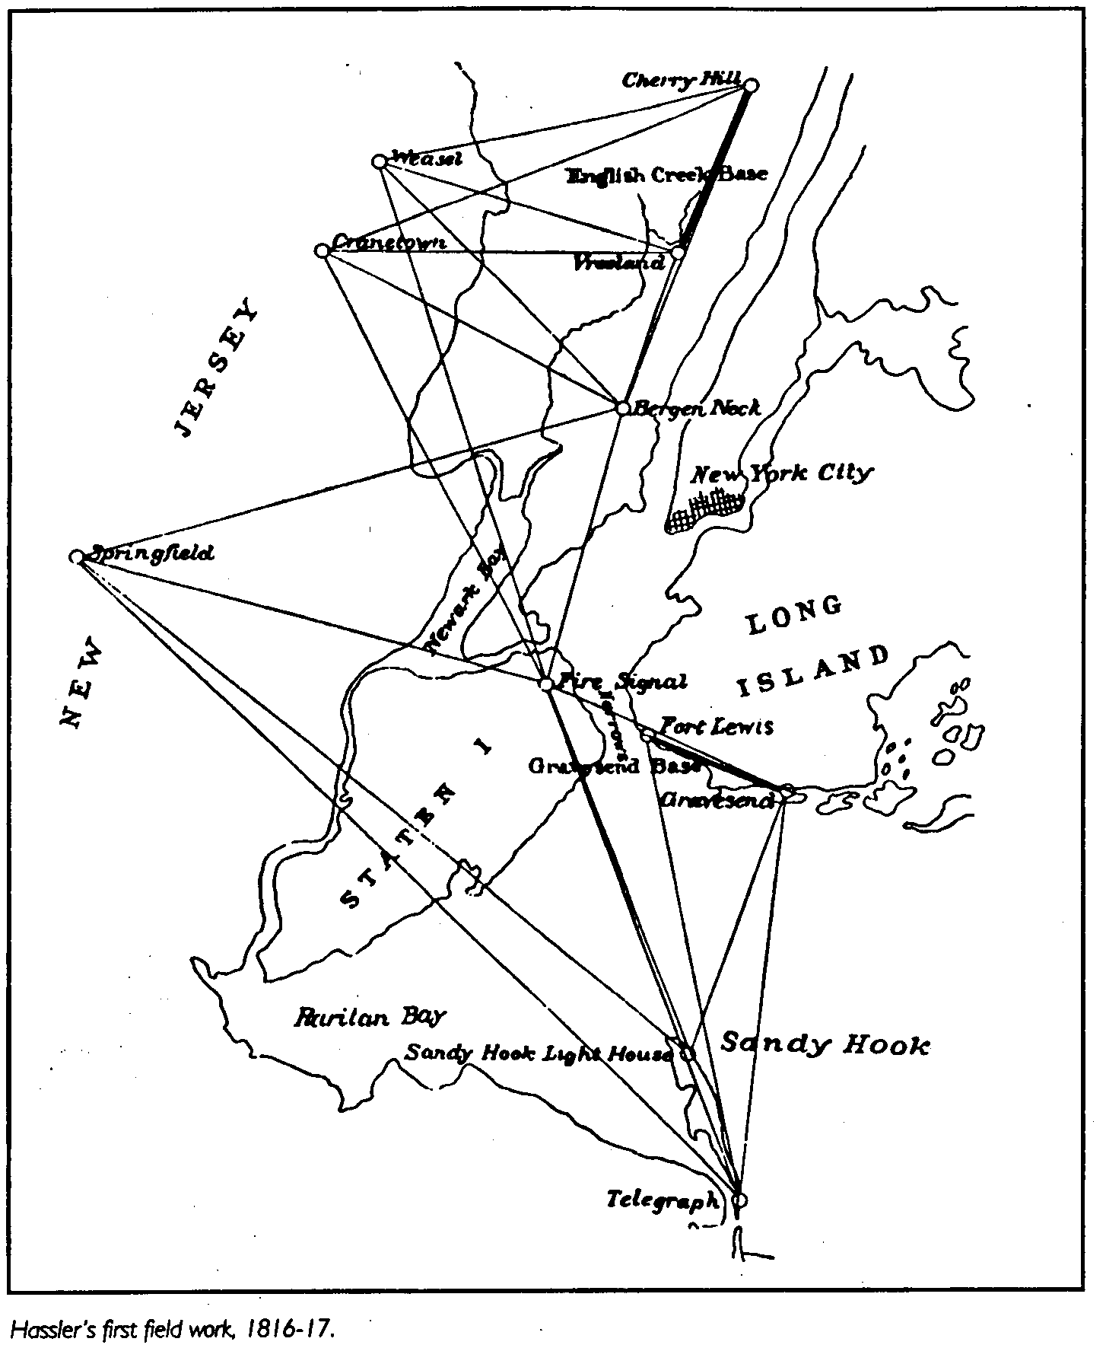
FIRST FIELD WORK OF THE “SURVEY OF THE COAST”
Notes:
Only pt remaining is Sandy Hook Lt – and its top portion was rebuilt in the 1850’s
Name later change to “Coast Survey” and later to USC&GS

Slide 11
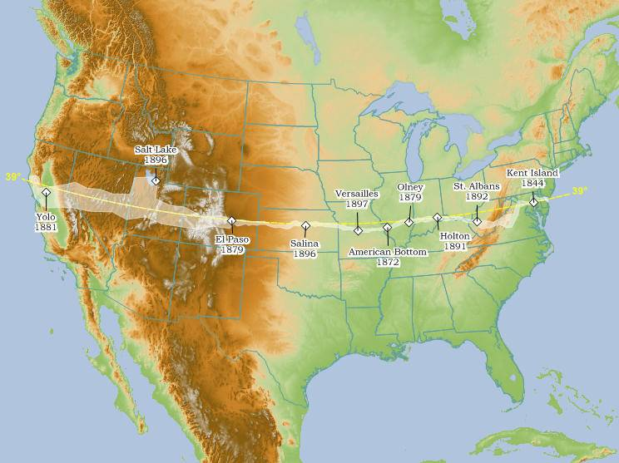
TRANSCONTINENTAL ARC OF TRIANGULATION
http://www.holoscenes.com/cgi-bin/moin.cgi/TranscontinentalTriangulation
Map courtesy of Jim Irwin
Notes:
Tied east and west coast survey networks together
Provided survey control all across the country
Names on map are the measured Baselines used for scale
Provided an arc to help determine precise size and shape of earth
Total cost $500K
Longest Arc of a parallel ever undertaken by any single gov’t
Completion called “One of the historic events in the progress of geodesy” (from SP#4)

Slide 12
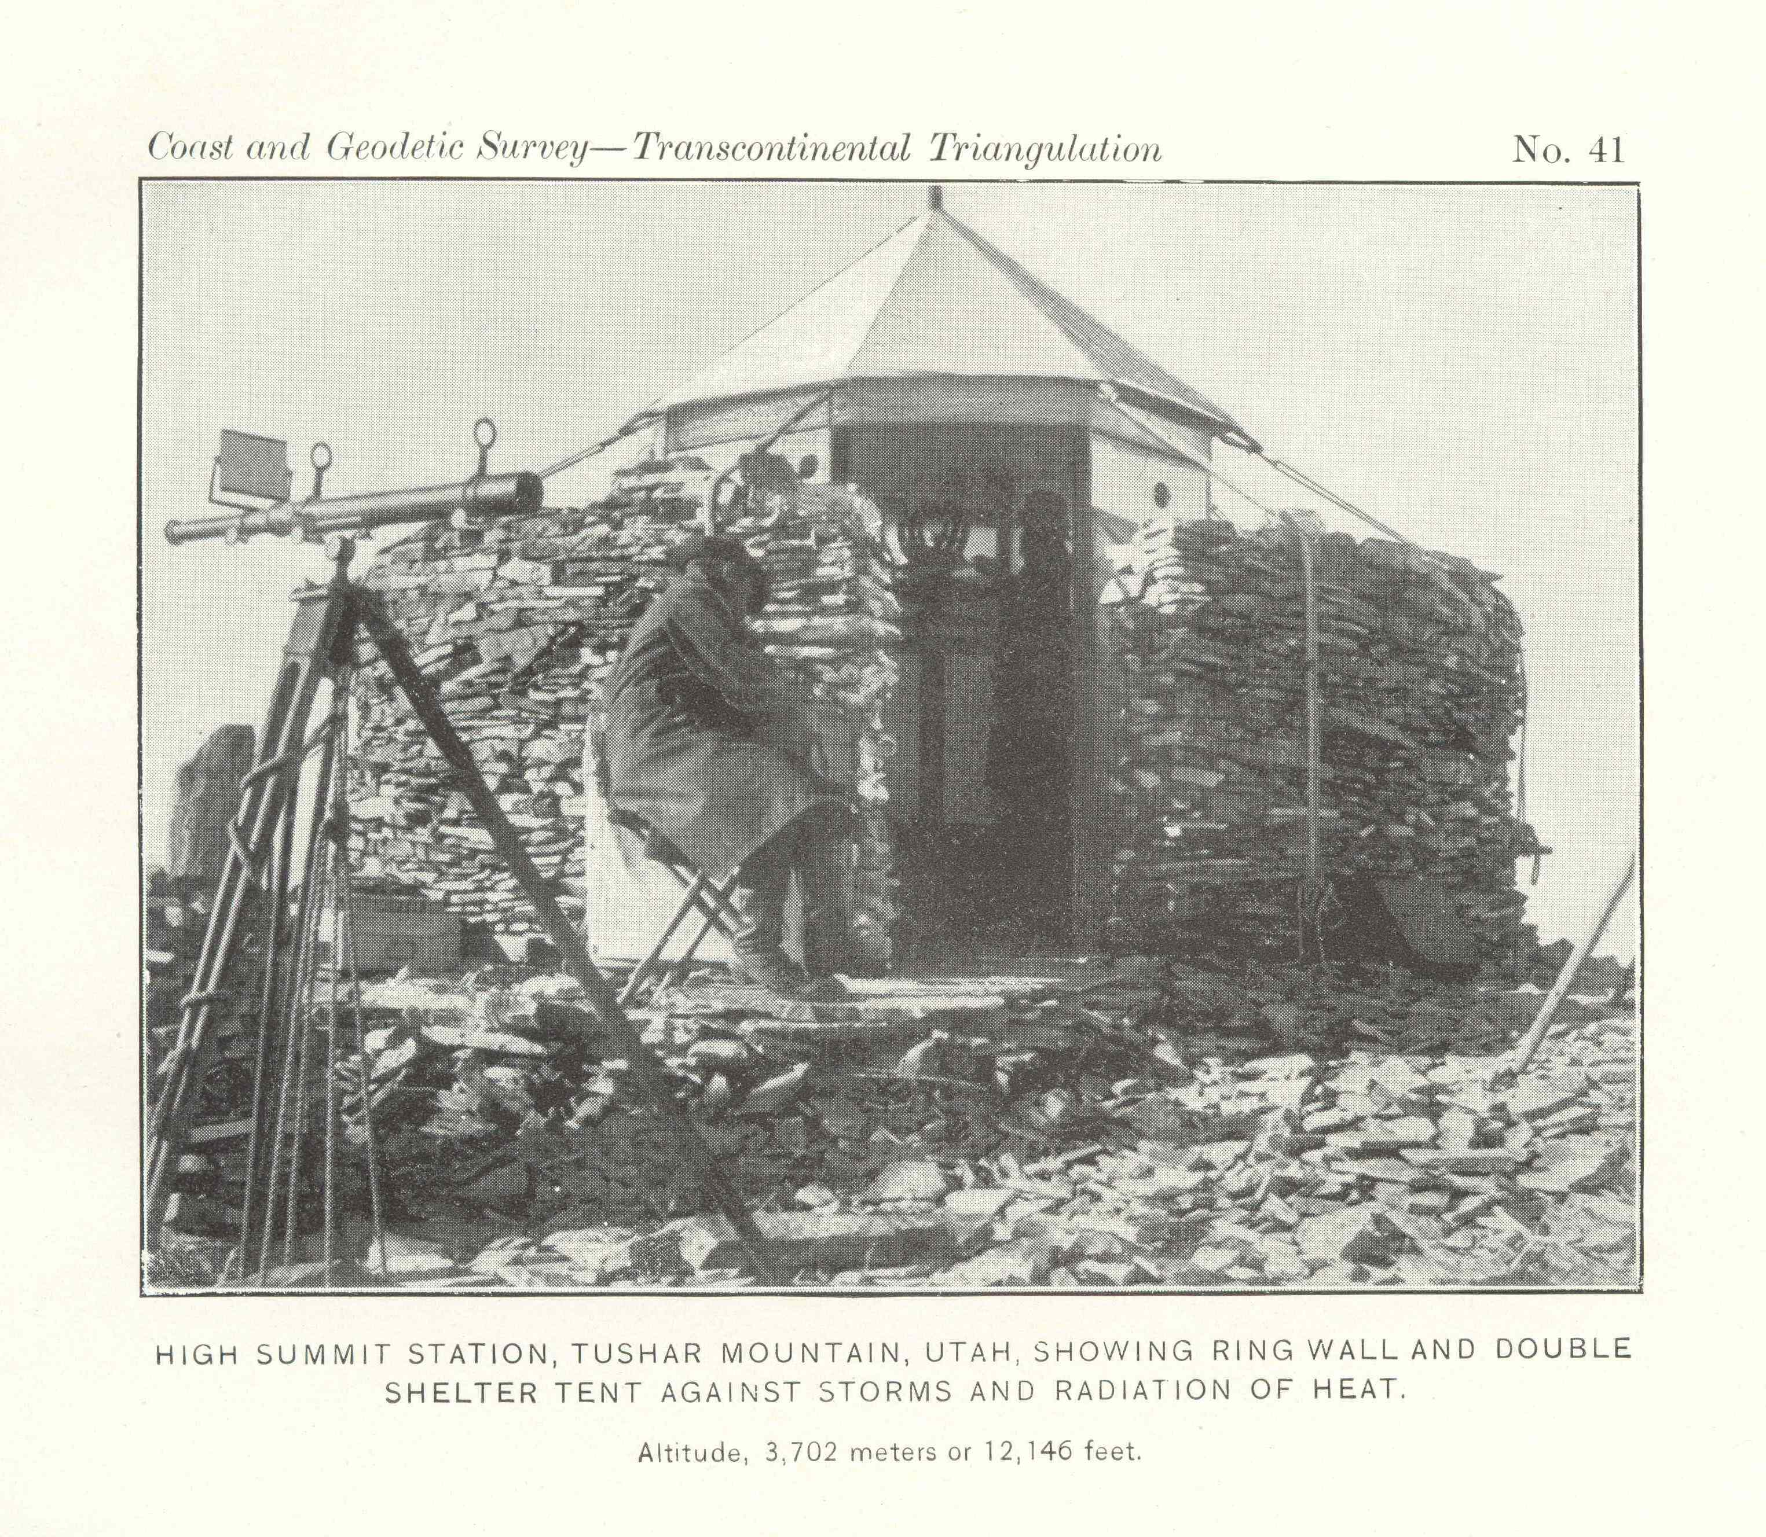

Slide 13
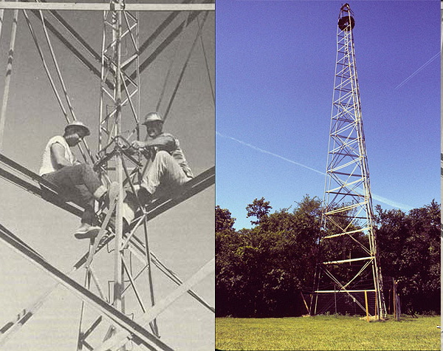
STEEL BILBY TOWER
Notes:
123 FT TOWER

Slide 14
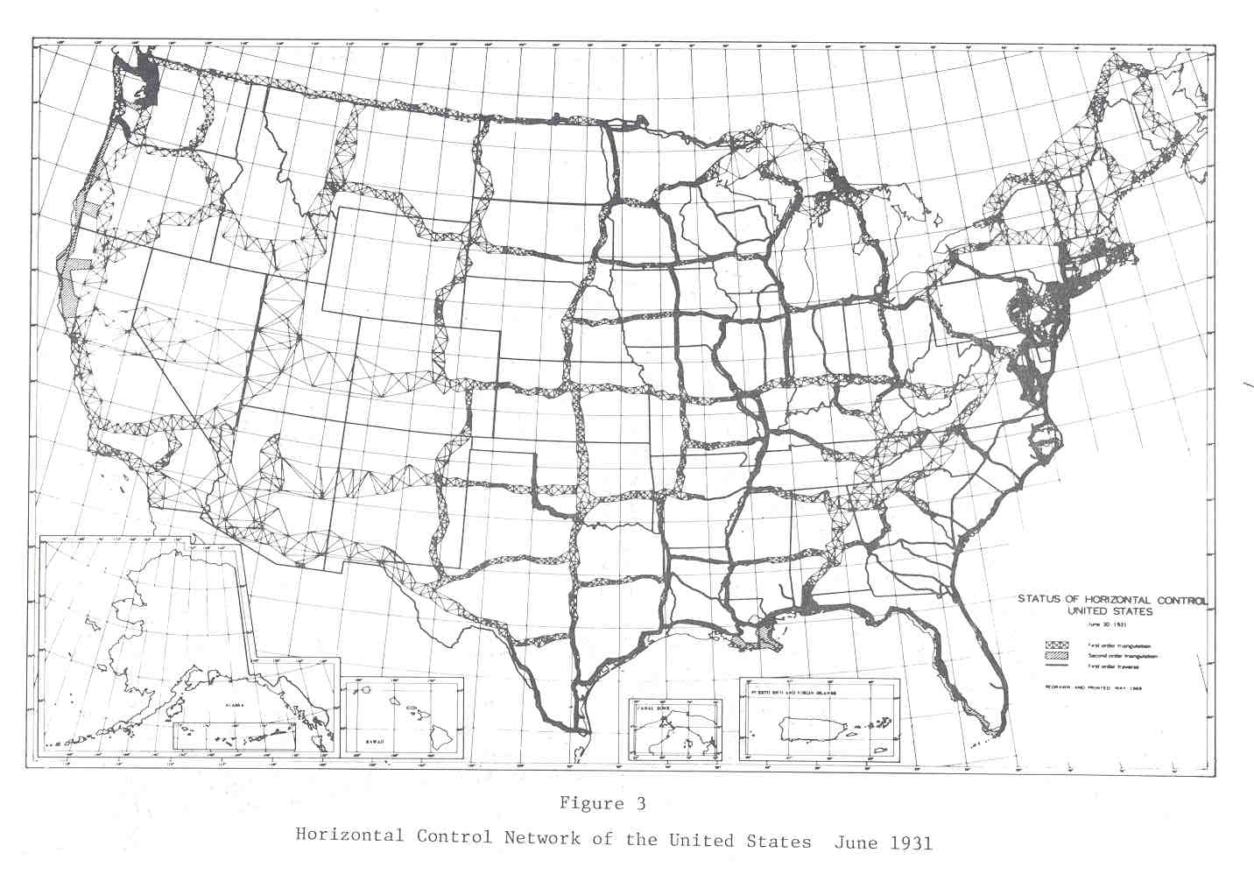
Notes:
Grid structure provide survey control across country
First disks used in ~1900 in TX, OK, KS
DUNCAN – nail in concrete with letters “USC&GS 1901”

Slide 15
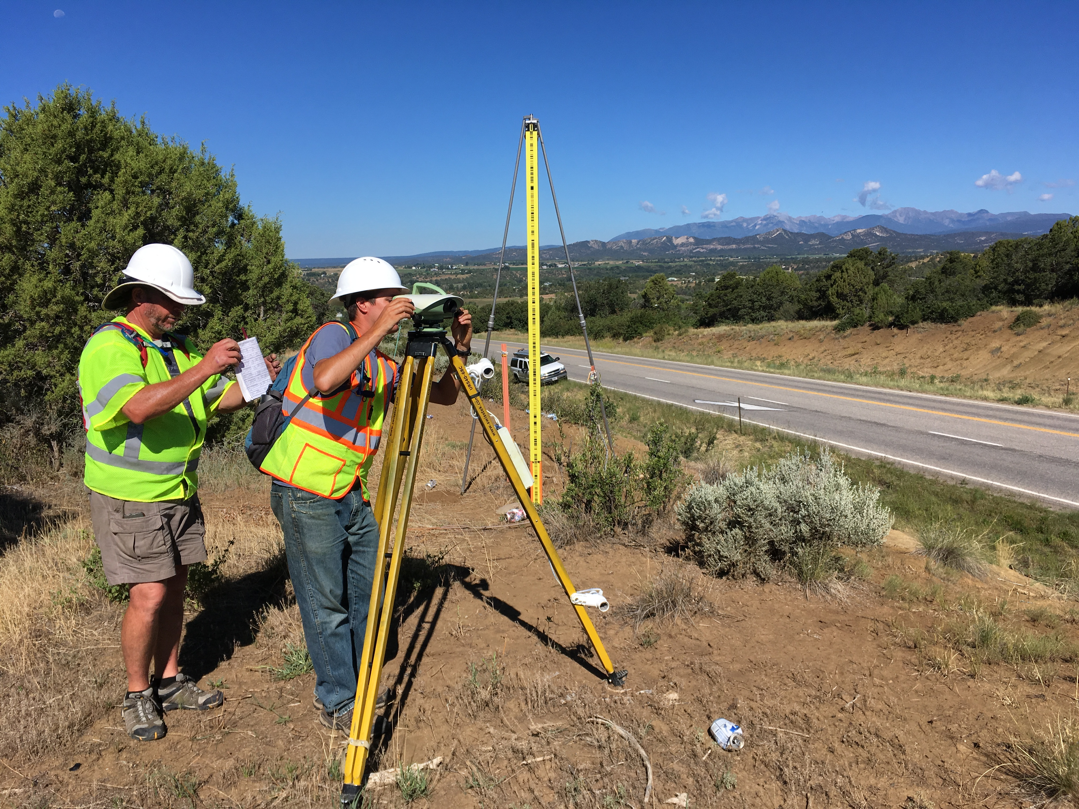
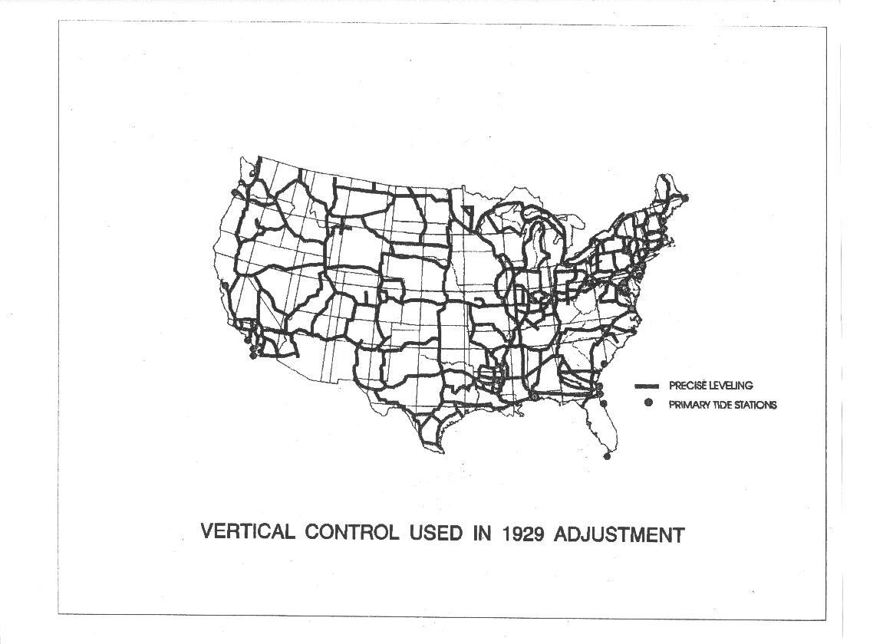
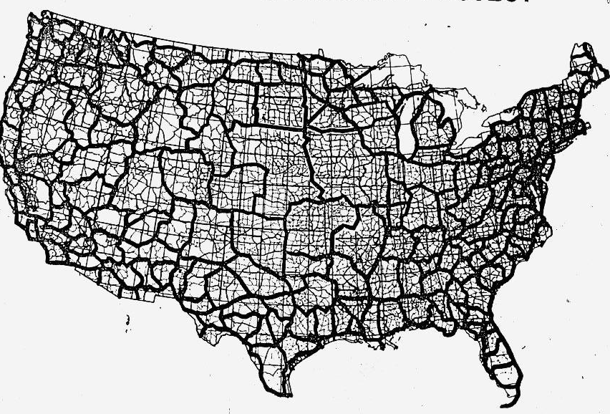
NSRS Vertical Evolution
NGVD 29
NAVD 88
Notes:
NGVD29 on left
NAVD88 on the right
Over the last 100+ years NGS has continued to densify the network that defined for the heights of the US. Leveling is a very arduous and time consuming surveying method but provides height difference much more precise and accurate than can be achieved with most other methods.

Slide 16
The present

Slide 17
U.S. Department of Commerce
National Oceanic & Atmospheric Administration
National Geodetic Survey
Mission: To define, maintain & provide access to the
National Spatial Reference System (NSRS)
to meet our Nation’s economic, social & environmental needs
& their time variations
(& National Shoreline, etc.)
Latitude
Longitude
Height
Gravity
Orientation
Scale
North American
Datum of 1983
(NAD 83)
North American
Vertical Datum of 1988
(NAVD 88)
Notes:
- NSRS benefit to the nation = $2.5B/year
est. 300K precision GPS users worldwide (2008); ¼ in US
- Very exciting to us at NGS to see how it has evolved over the years – now cm-accuracy capability / tracking with time

Slide 18

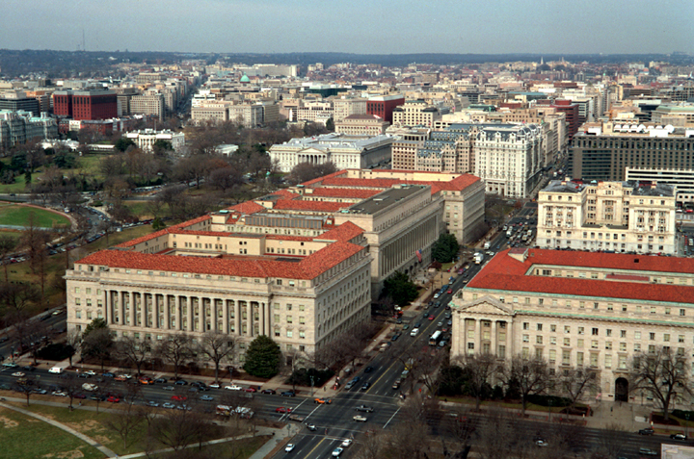
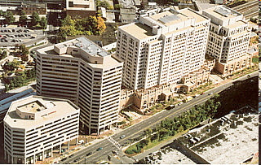




About the National Geodetic Survey
Executive Branch
White House
Department of Commerce (DOC)
National Oceanic and Atmospheric Administration (NOAA)
National Ocean
Service (NOS)
National Geodetic Survey (NGS)

Slide 19
Divisions and Branches
Geodetic Services Division (GSD)
  Regional Advisor Branch
  Communications and Outreach Branch
  Instrumentation and Methodologies Branch
Spatial Reference System Division (SRSD)
  Geodetic Standards and Applications Branch
  Continuously Operating Reference Station Branch
Remote Sensing Division (RSD)
  Applications Branch
  Systems and Quality Assurance Branch
  Requirements Branch
Observation and Analysis Division (OAD)
  Project Analysis Branch
  Field Operations Branch
  Records Management Branch
Systems Development Division (SDD)
  Geodetic Applications Branch
  Network and Systems Administration Branch
Geosciences Research Division (GRD)

Slide 20
Where NGS offices are
Silver Spring, MD
Woodford, VA
Norfolk, VA
Boulder, CO
Across the US (Regional Advisors)

Slide 21
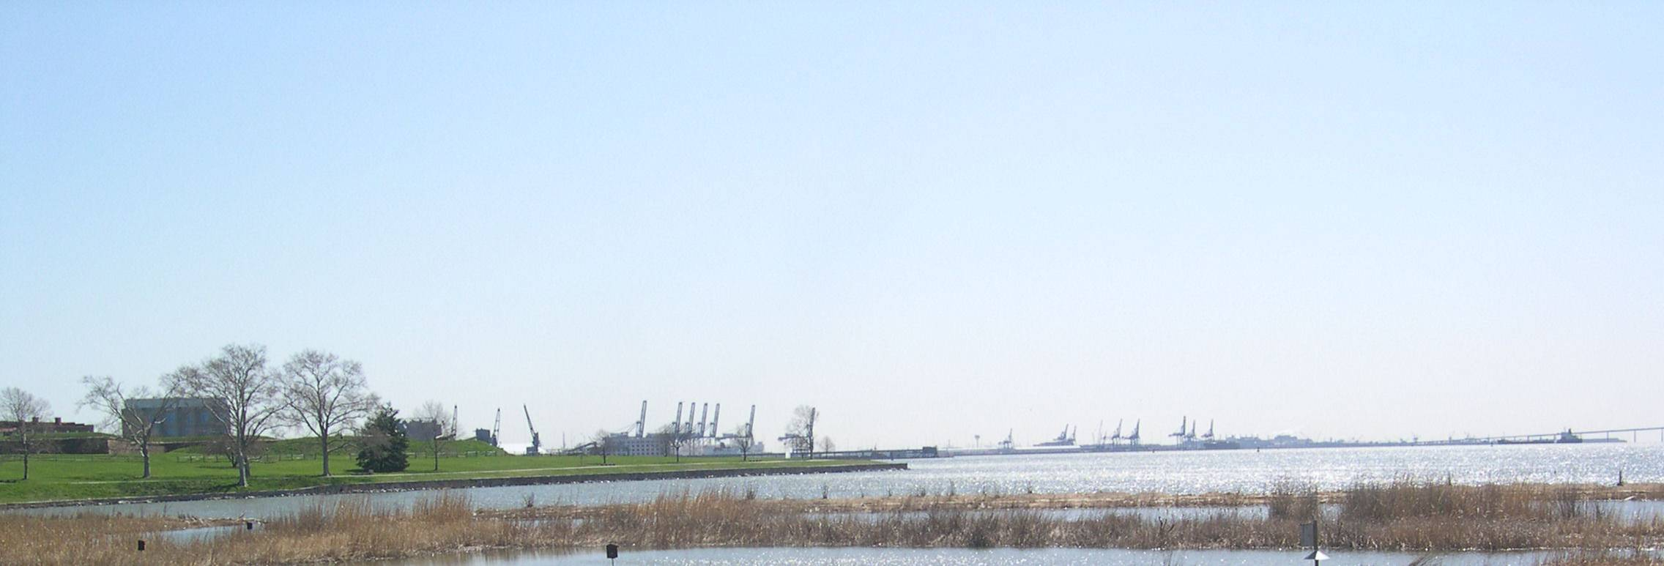
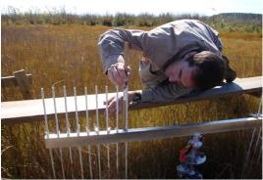
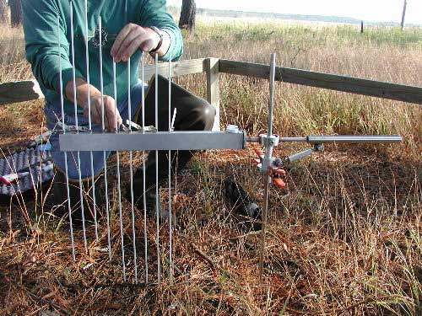
NGS Ecosystem and Climate Operations(ECO) Activities
http://www.ngs.noaa.gov/web/science_edu/ecosystems_climate/
The NGS ECO program is working to apply precise positioning models, tools and techniques for marsh restoration and to support community resilience in response to climate change.
ECO also develops guidelines for collecting elevation data and monitoring in restoration projects.
Courtesy USGS, Patuxent Wildlife Research Center
Notes:
(Pictured: A Surface Elevation Table (SET) - A SET is a portable mechanical leveling device for measuring the relative elevation of wetland sediments)
Accurate heights related to water levels are critical for differentiating sea-level change from land elevation change. The NGS Ecosystem and Climate Operations (ECO) Program adapts geodetic survey technologies, instrumentation, and procedures in support of coastal community resilience, ecosystem services, and ecological integrity; especially in responding to climate change. ECO conducts collaborative research and development across several NOAA line offices, especially within the traditional Navigation Services: the National Geodetic Survey, the Center for Operational Oceanographic Products and Services and the Office of Coast Survey. ECO has also helped lead NOAA's efforts to establish Sentinel Sites for monitoring the impact of changing sea levels and coastal inundation.

Slide 22
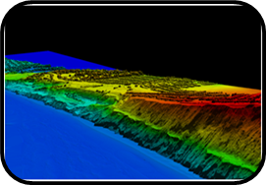

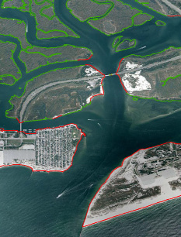
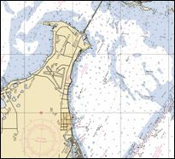
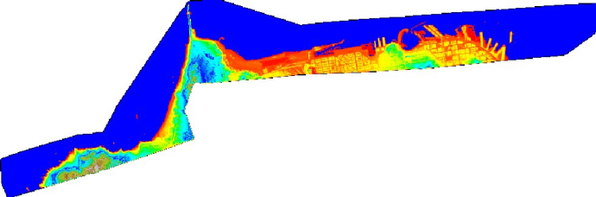
Coastal Mapping Program (CMP)
http://www.ngs.noaa.gov/RSD/cmp.shtml
NGS delineates produces the Nation’s national shoreline which defines our nation’s territorial limits.
Up-to-date shoreline is an integral component of NOAA Nautical Charts and supports a wide range of coastal applications.
NGS uses multiple remote sensing technologies (imagery, lidar, radar, etc) from various sources (aircraft, satellites) to survey the shoreline and we continually assess new technologies and workflows.
Notes:
(Picture: Image of Jones Inlet, Long Island, NY using Applanix Digital Sensor System. The green line represents marsh (apparent) shoreline, and red line represents mean-high water shoreline.
Picture: Example of a nautical chart section
Picture: NOAA King Air aircraft which is used to support the NOAA CMP
Picture: A pseudo-color ramp on a Digital Elevation Model from LIDAR data collected in San Francisco. he Golden Gate bridge is the peak protruding at the top left of the image, while the Fisherman's Wharf and downtown commercial district along the bay are at the right in the image. )
NGS produces the national shoreline which provides critical baseline data for updating nautical charts; defining our nation’s territorial limits, including the Exclusive Economic Zone; and managing our coastal resources.
NGS delineates the shoreline through various photogrammetric sources, including tide-coordinated stereo aerial photographs, commercial satellite imagery, Light Detection and Ranging (LiDAR), and related remote
sensing technologies. An accurate, consistent, and up-to-date national shoreline can provide and improve:
- Official nautical charts for maritime navigation,
- Data to model sea level change, storm surge, coastal flooding, and pollution trajectories,
- Contemporary ocean management plans,
- Wave and wind energy site selection,
- Land and marine geographic information system base layers, and
- Environmental analysis and monitoring.

Slide 23
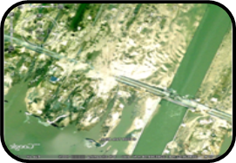
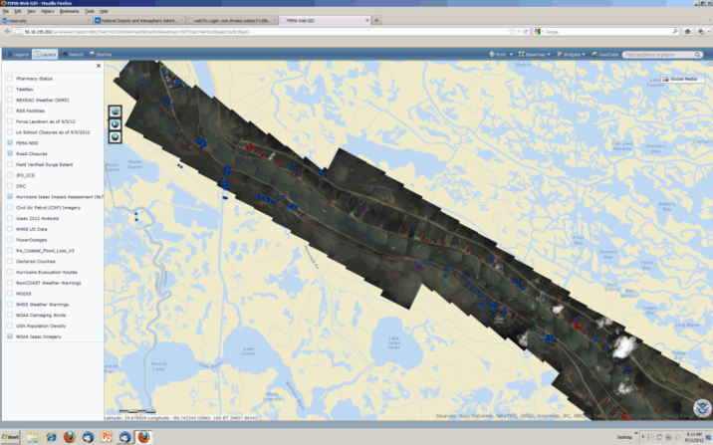
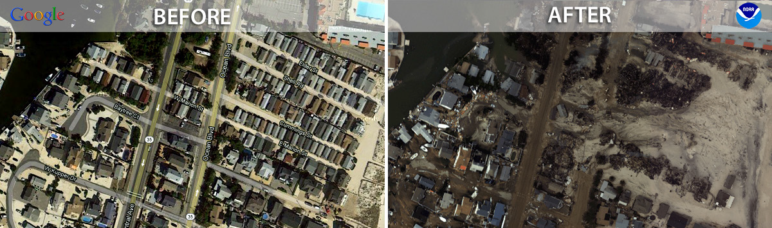
Emergency Response Imagery
http://storms.ngs.noaa.gov/eri_page/index.html
To support NOAA national security and emergency response requirements, NGS collects high resolution, geo-referenced imagery of the effects of disasters such as hurricanes, tornados and earthquakes.
Notes:
(Picture: Geo-referenced aerial imagery taken by NOS shows the New Jersey coastline before and after Superstorm Sandy in 2012.
Picture: Example of how FEMA uses the response imagery. Hurricane Isaac impact assessment through the FEMA Portal. The red dots represent wind damage, blue dots inundation, and purple dots wind and inundation.)
NGS collects high resolution, geo-referenced airborne imagery using NOAA aircraft that support NGS’ Coastal Mapping Program. NGS posts images on the web, often within hours, to make these images available to the general public. The imagery is used to determine impacts to NOAA as well as federal, state, local, and public interests.
This imagery can be indirectly applied to restoring natural resources after a disaster.
NGS has been called on to collect imagery following many different types of disasters including the 2011 Joplin and Tuscaloosa tornados, the 2010 Haiti earthquake, and all major hurricanes since 2003. From the imagery, those in charge of response and restoration can determine the effect of storms on the land; for example they can determine where flooding has wiped out parts of barrier islands and affected their formation.
President has been briefed using NOAA Hurricane Damage Assessment Imagery - FEMA used of some of the photos that were taken by NOAA during our response to Hurricane IKE in a Presidential briefing 16 September, 2008.
FEMA has greatly decreased the response time for the FEMA Individual Assistance Program by using the NOAA imagery to determine extent of damage, release initial funds, and assign inspections.

Slide 24
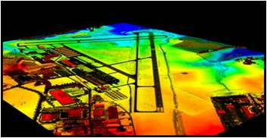

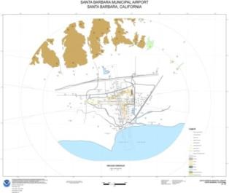
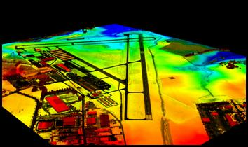
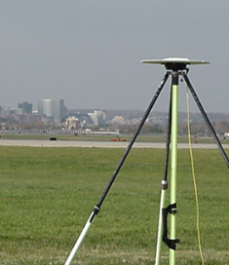
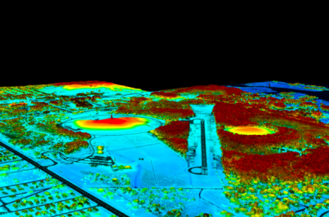
Aeronautical Survey Program
http://www.ngs.noaa.gov/AERO/aero.html
NGS has a long standing relationship with the FAA to conduct airport surveys used to develop runway approach procedures and obstructions charts. Activities include:
QA/QC third party aeronautical survey data (primary function).
Develop survey standards, guidelines, tools, and models to assist surveyors conducting aeronautical surveys.
Provide positional, height, and orientation data to the FAA in support of the National Airspace System (NAS) and safe navigation.
Notes:
(Pictures:Top left:
Image of survey grade GPS receiver at an airport
Probably set up on Airport Control Station (not sure what airport)
Top right: Image of the Airport Obstruction Chart (AOC) for Santa Barbara Municipal Airport (SBA). 2006 survey
Referred to as a digital eAOC (geo-spatial data provided in 3D shape-file format)
Back when we were producing this product (for the FAA) the chart data was also provided in a GeoPDF file
Middle: Lidar intensity image of Frederick Municipal Airport (FDK), Frederick, MD
Bottom: Lidar intensity image of First Flight Airport (FFA), Kill Devil Hills, NC
Wright Brothers National Memorial Monument on left of image
Both products of FAA Lidar Demonstration Projects (research into use of airborne lidar technology in airport obstruction surveys.)
Data likely collected using Optech Airborne Laser Terrain Mapper (ALTM) mounted on the NOAA Cessna Citation.
)
The National Geodetic Survey (NGS), in accordance with a series of interagency agreements with the Federal Aviation Administration (FAA), provides airport geodetic control, runway, navigational aid, obstruction, and other aeronautical data that is critical to the operation of the National Airspace System. Most of this data is source information obtained using field survey and photogrammetric methods. This data is used to develop runway approach procedures and obstruction charts.
NGS conducts this work on a “reimbursable” basis with the FAA, meaning that we do not have base funds for this activity, but are paid through FAA base funds in accordance with a series of interagency agreements.

Slide 25
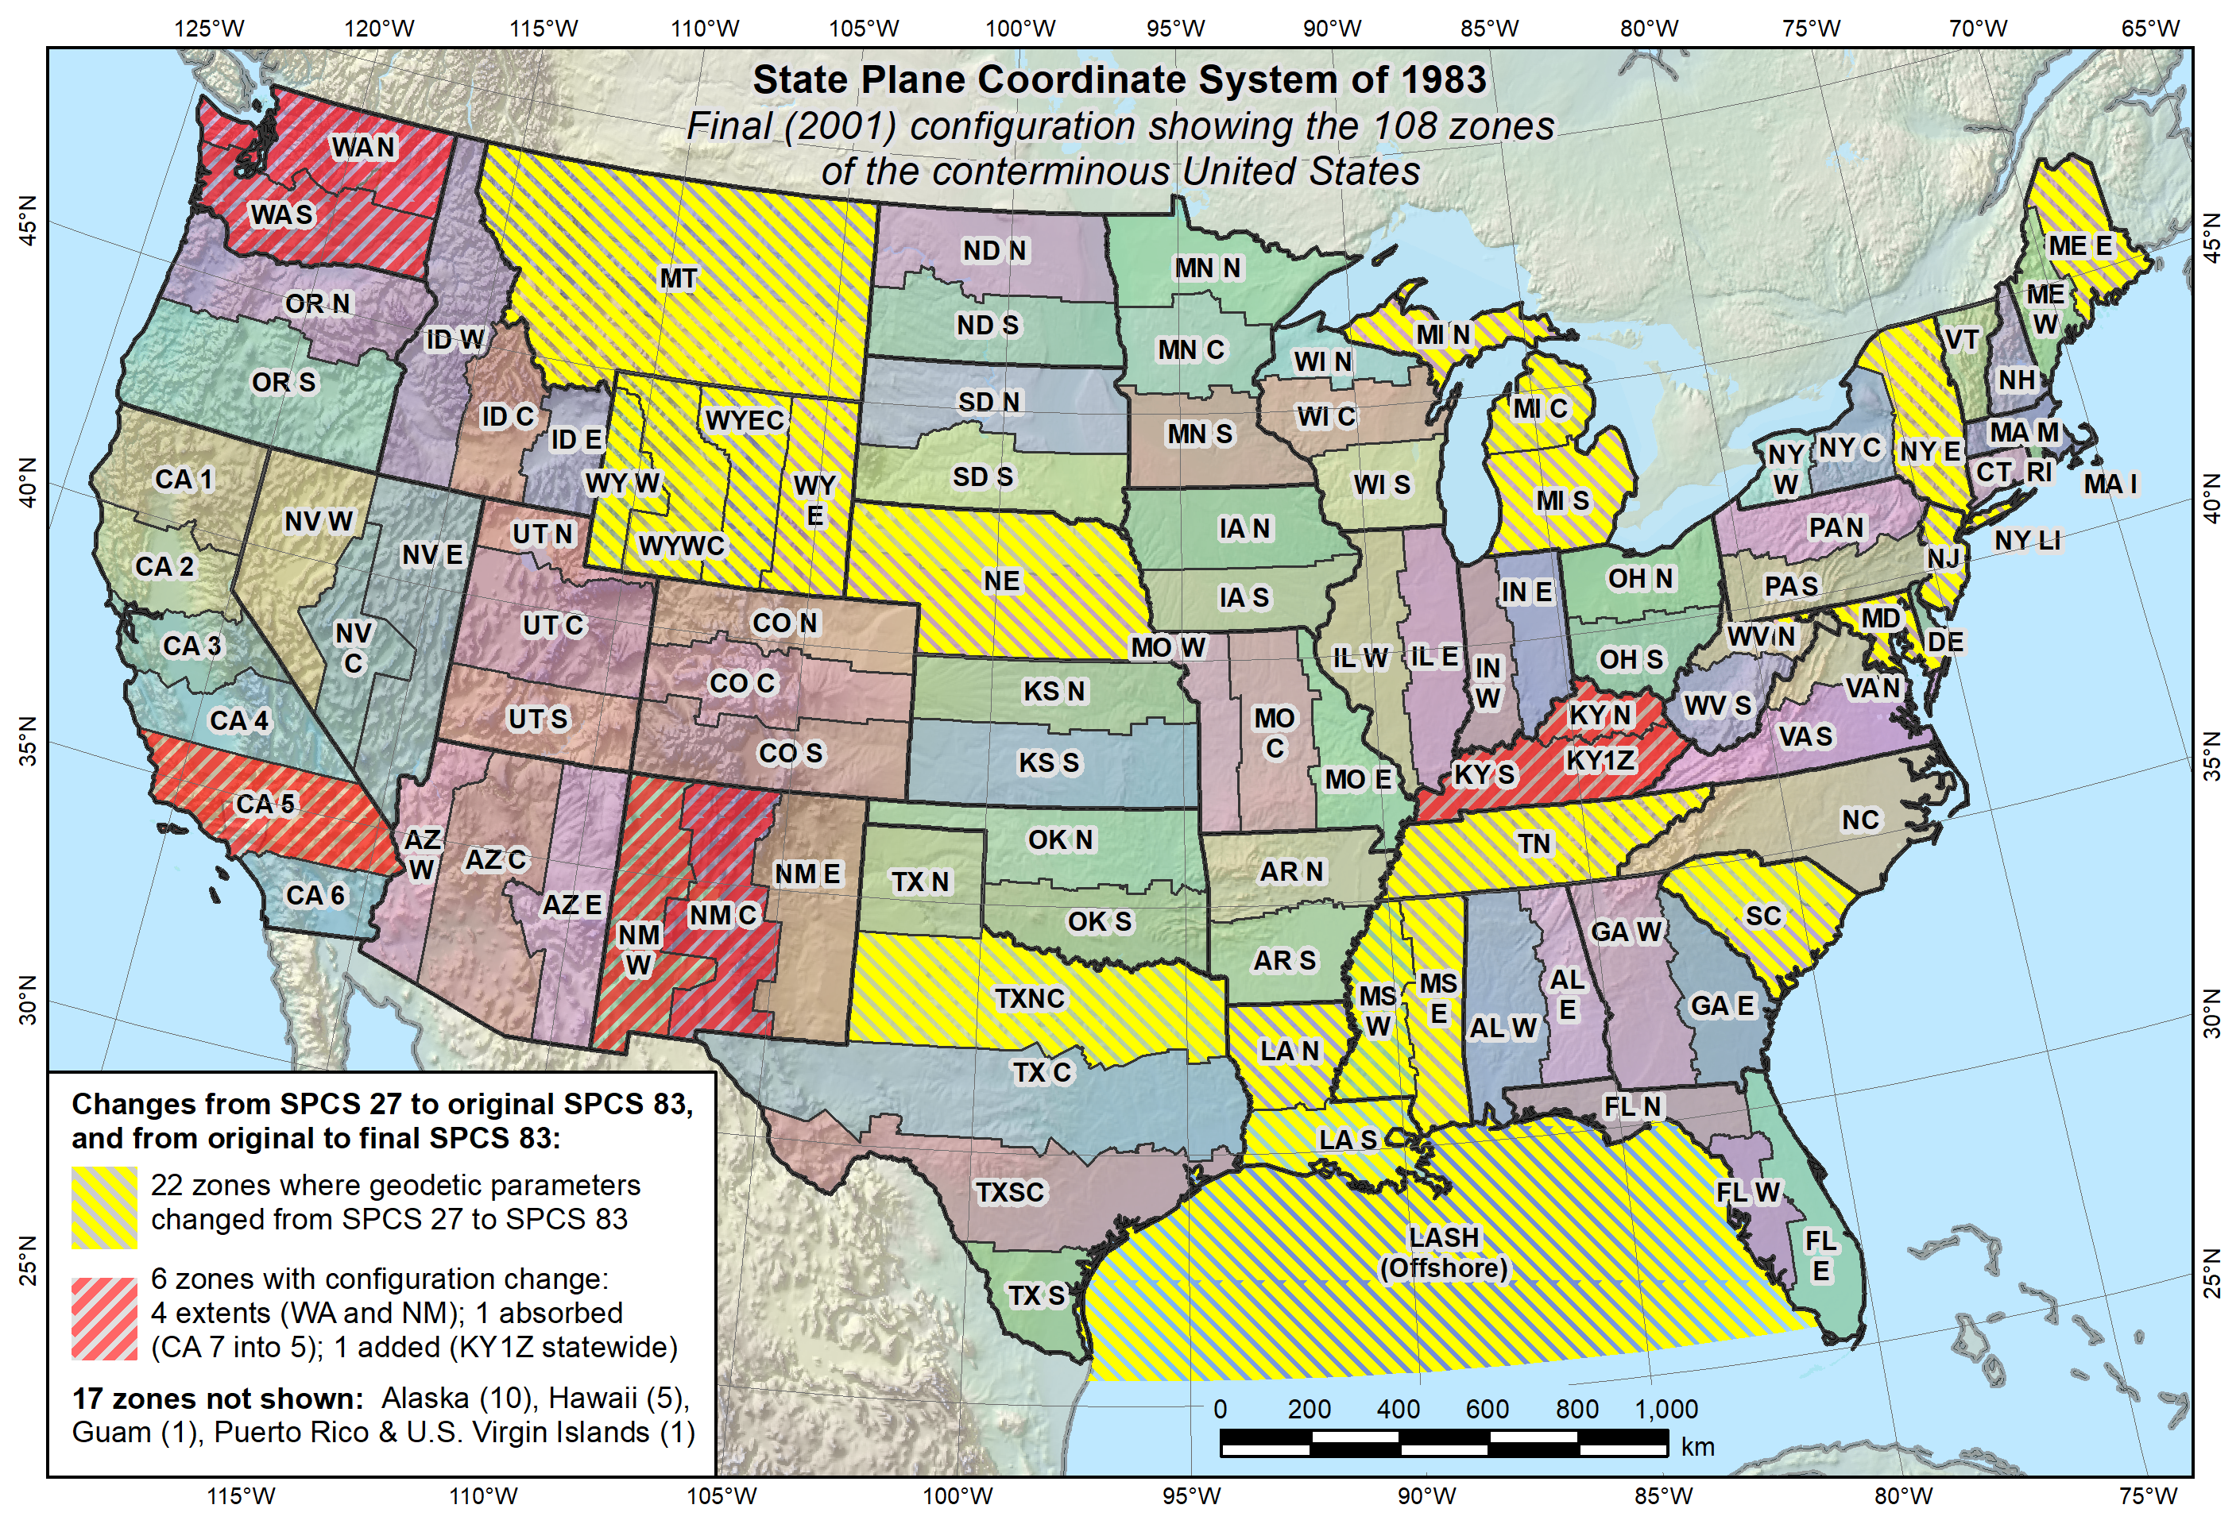
State Plane Coordinates
https://www.ngs.noaa.gov/SPCS/index.shtml

Slide 26
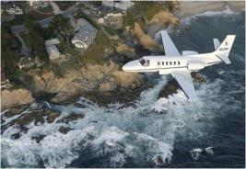
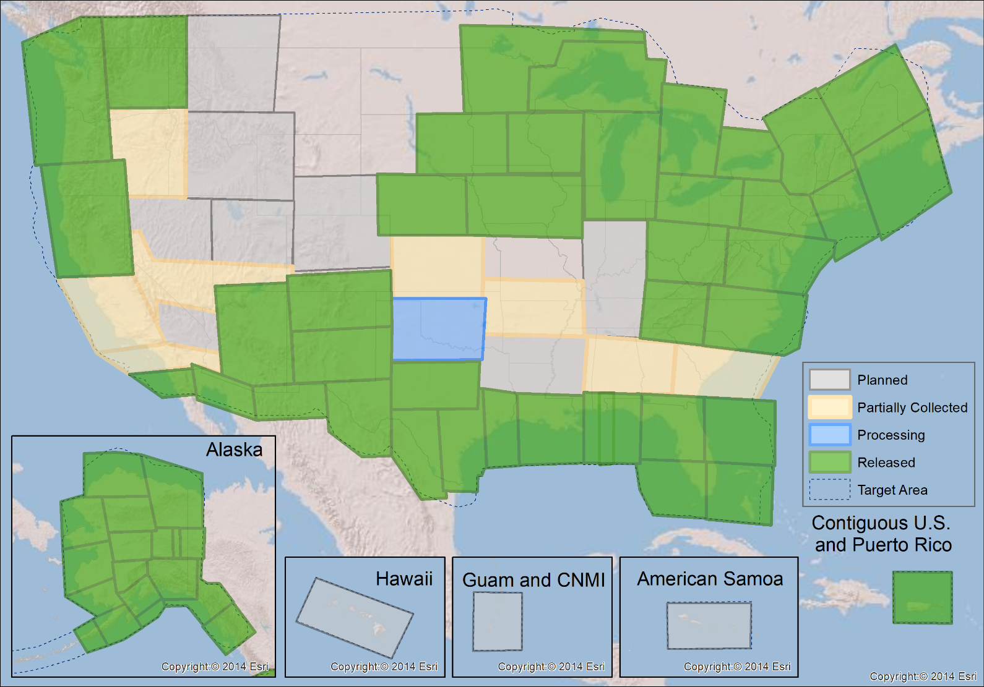
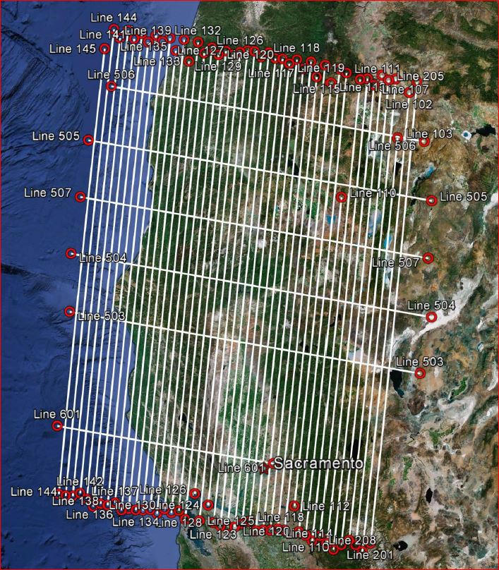
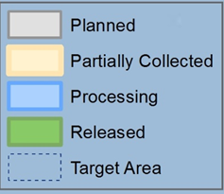
Gravity for the Redefinition of the American Vertical Datum (GRAV-D)
10 km data lines
70 km cross lines
20,000 ft altitude
230 kt flight speed
2019-Q1:
75% complete

Slide 27
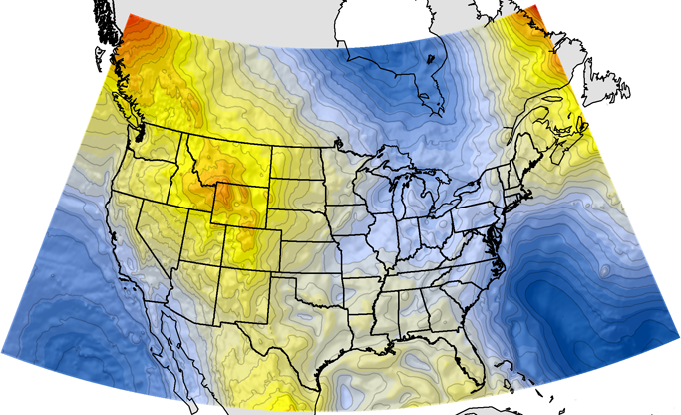
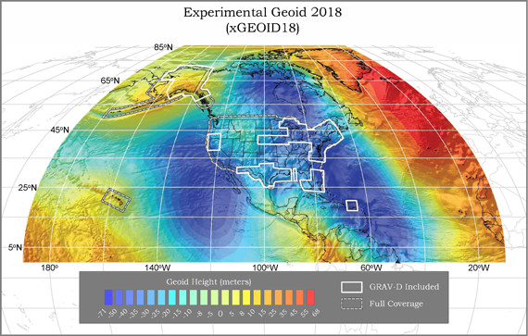
Geoid Models
GEOID12B
Hybrid (NAVD 88)
xGEOID18
Gravimetric (aka Scientific)
Past/Present
Present/Future
Notes:
Gravimetric Geoid models are developed using the best gravity data and topography data of the time. The geoid is an approximate reference surface that often termed “Sea Level”. This is what is used by GNSS observations to convert an ellipsoid height (provided using GNSS) into an elevation also known as an Orthometric Height.
Hybrid geoid models are generated by developing a gravimetric geoid and then fitting it to a known vertical datum. In the case of NGS we take a beautifully formed gravimetric model and hammer it to fit NAVD88 so that you can get a precise NAVD88 elevation from GNSS.

Slide 28
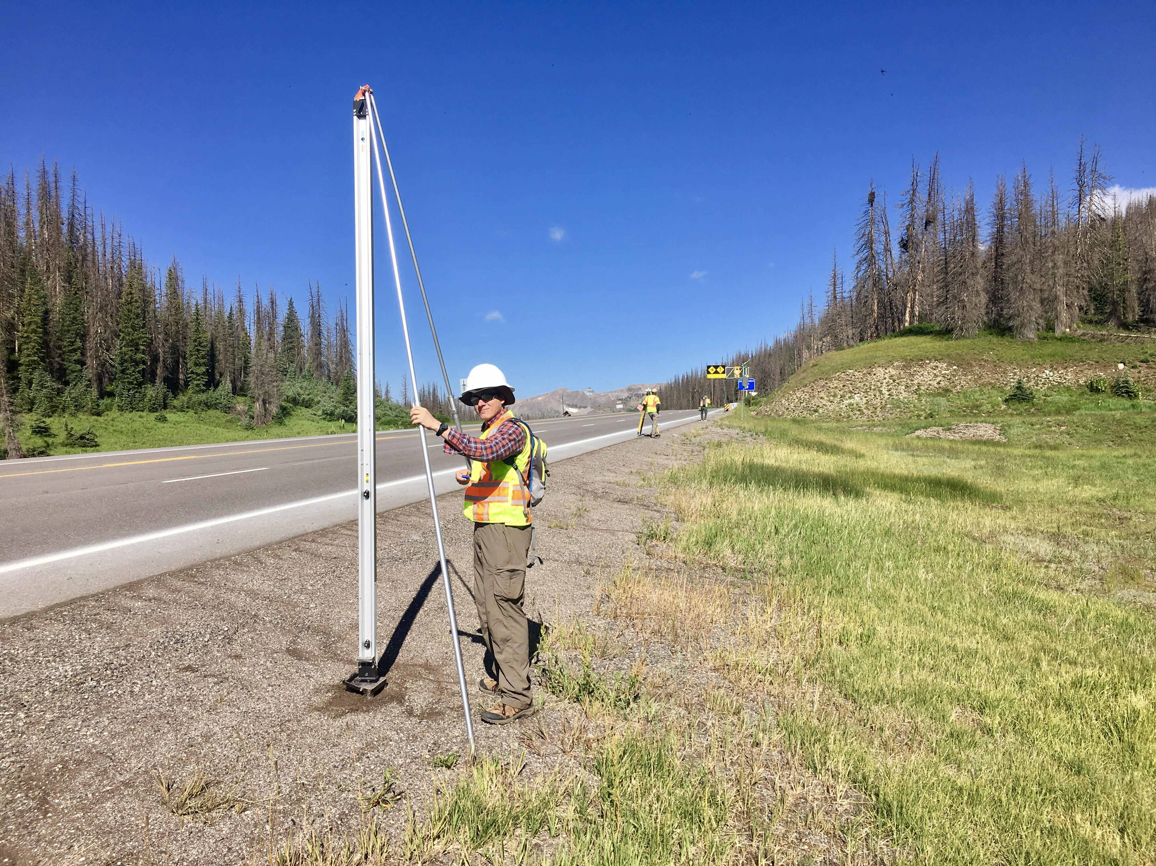
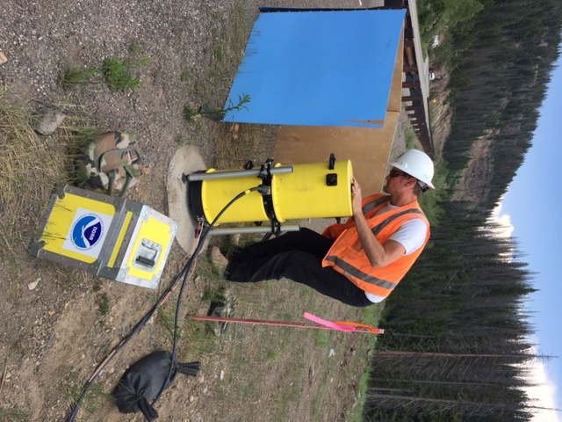
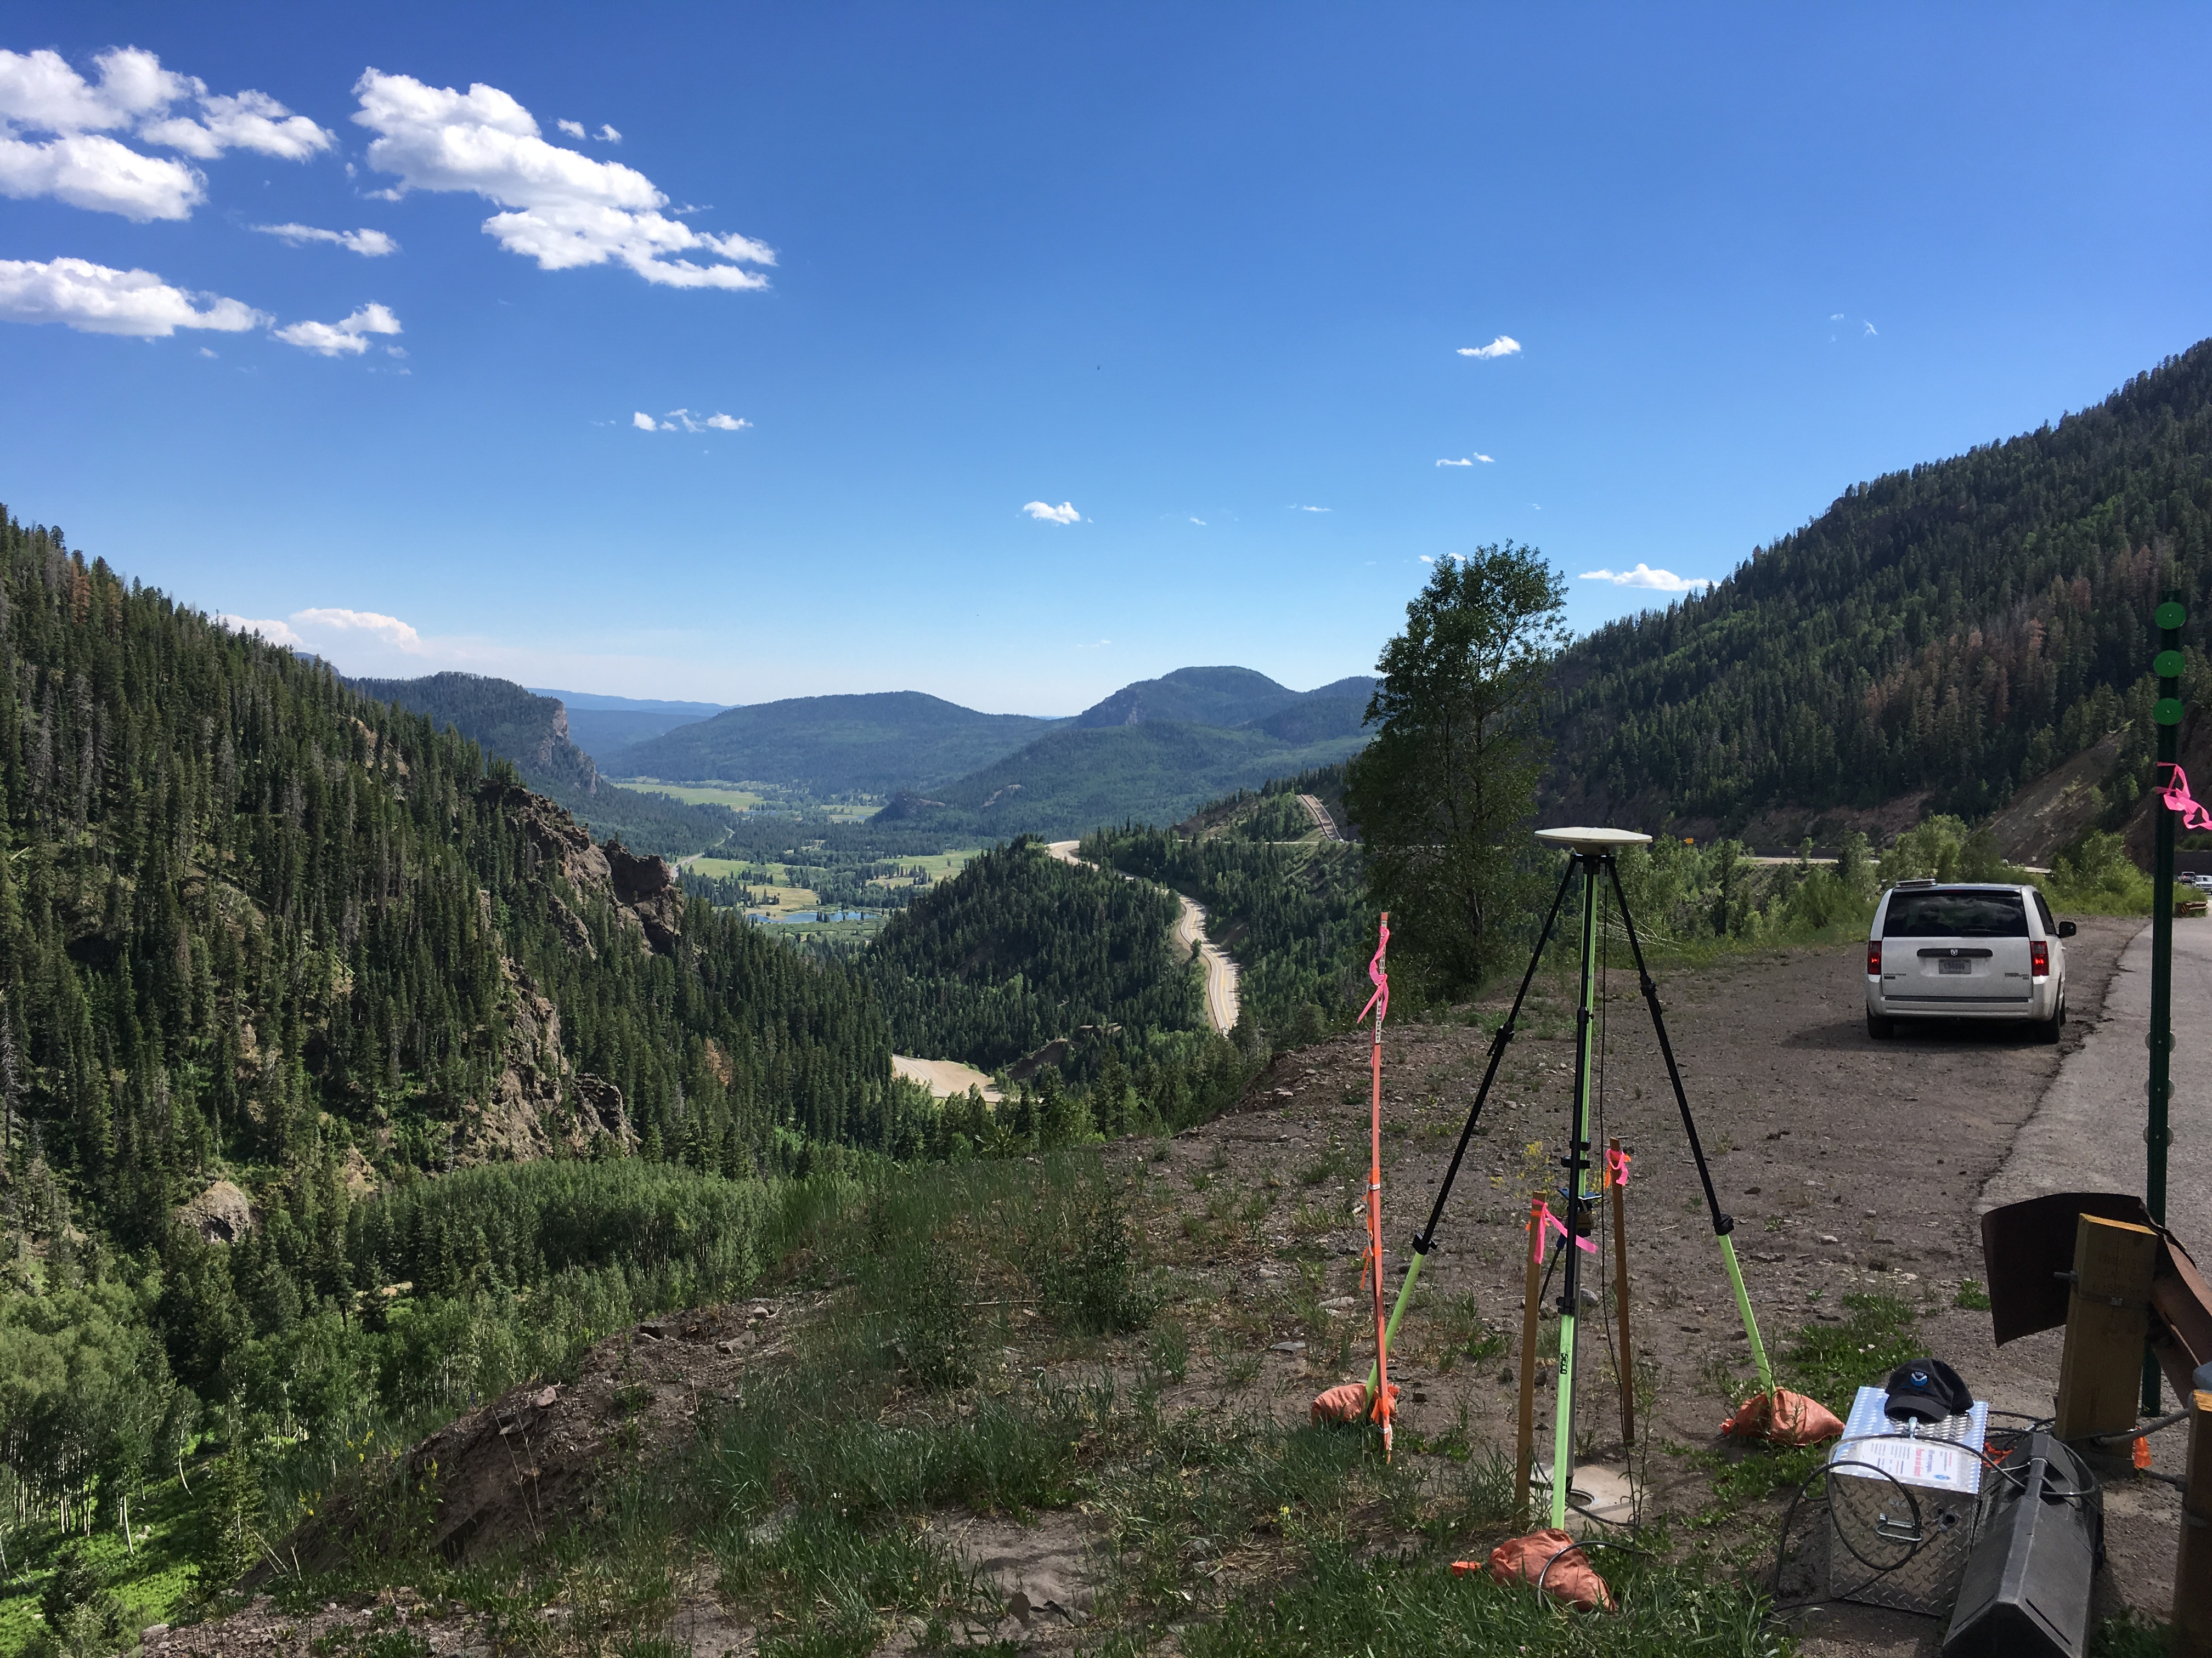
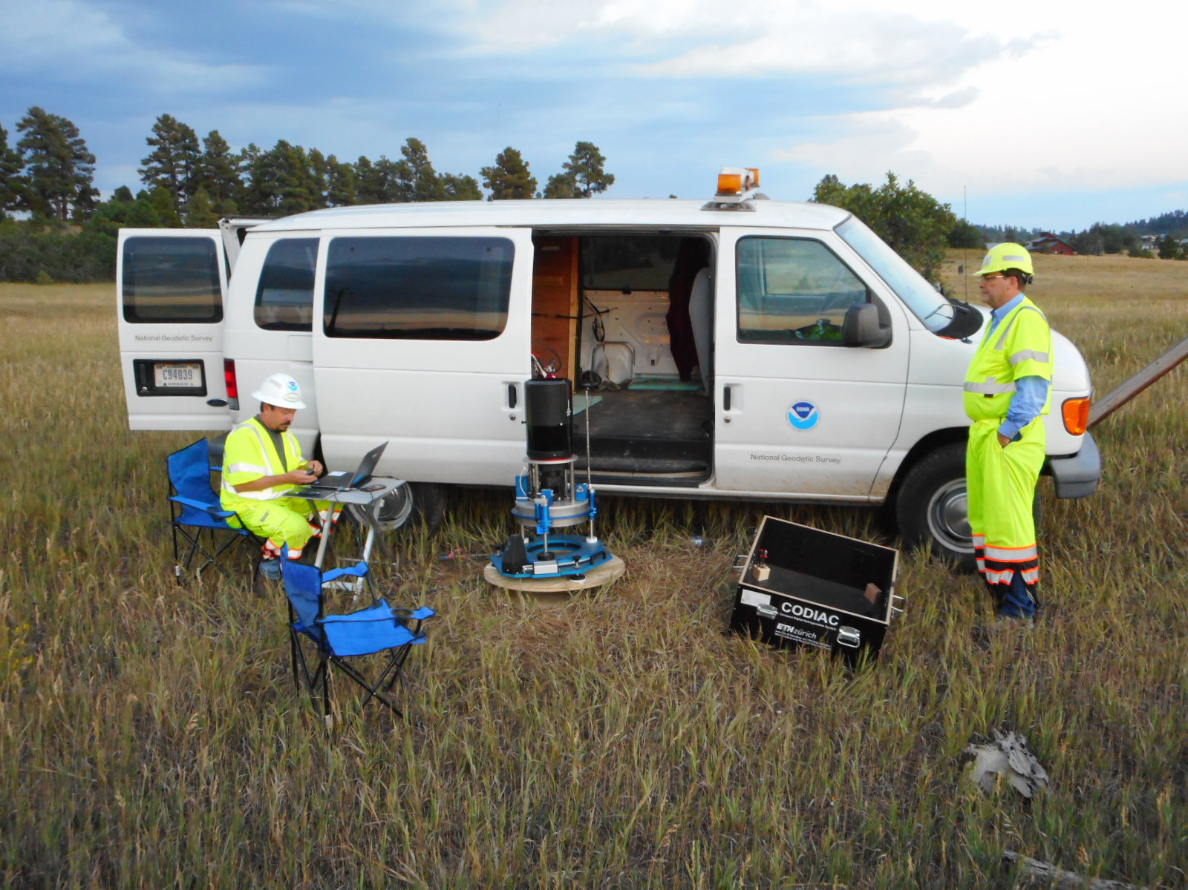
Geoid Slope Validation Survey

Slide 29
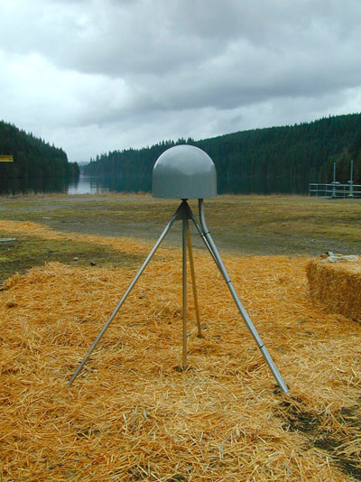
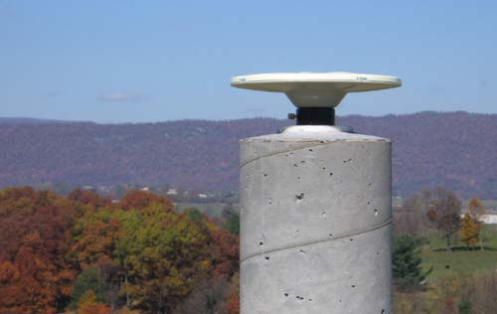
Continuously Operating Reference Station (CORS) Network
Over 1200 permanent GNSS receivers
The defining points of the NSRS
Used for:
  Geodesy : Differential Positioning / Reference Frame definition
  Geophysics: Tectonic motions
  Surface Weather: Monitor and predict moisture content
  Space Weather: Monitor and predict total electron content in ionosphere

Slide 30




Continuously Operating Reference Station (CORS) Network
2000 sites
225 organizations

Slide 31



NGS Multi-year CORS Solution-2 Processing
Transitioning to ITRF2014/IGS14 (@2010.00)
1996 -2016 data
3050 stations
25 TerraBytes of data

Slide 32




GPS Satellite Orbits
http://www.ngs.noaa.gov/orbits/
NGS is one of several Analysis Centers (AC) of the International Global Navigation Satellite Systems Service (IGS).
The accuracy of a user-determined GPS position is directly related to the accuracy of the GPS orbit information used.
Data from Continuously Operating Reference Stations (CORS) and IGS stations are used to determine GPS satellite orbits, station positions, and Earth orientation.
Notes:
(Picture: GPS satellite orbit planes projected on Earth (arcs), Locations of the Reference Frame stations (dots), Locations of six satellites at UTC midnight (stars)
The accuracy of a user-determined GPS position is directly related to the accuracy of the GPS orbit information used. Since the early 1990s, NGS has contributed to enabling such GPS/GNSS access to the national spatial reference system by computing high-accuracy GPS orbits. NGS is one of several Analysis Centers (AC) of the International Global Navigation Satellite Systems Service (IGS), and in this role, NGS uses data collected at U.S. Continuously Operating Reference Stations (CORS) and IGS stations to determine GPS satellite orbits, station positions, and Earth orientation.

Slide 33



Online Positioning User Service (OPUS)
upload L1/L2 GPS data >>> solution via email in minutes
  OPUS-RS (Rapid Static) ----15 min to 2 hr (per CORS)
  OPUS-S (Static) ---- 2 to 48 hr (anywhere)
  OPUS-DB (Database) --- sharing of results
  OPUS-Projects --- network of multi-stations/occupations

Slide 34


A (very) brief history of NAD 83
Original realization completed in 1986
  Consisted (almost) entirely of classical (optical) observations
“High Accuracy Reference Networks” (HARN) and Federal Base Network (FBN)realizations
  Done in 1990s and early 2000s, essentially state-by-state
  Based on GNSS but classical stations included in adjustments
National Re-Adjustment of 2007
  NAD 83(CORS96) and (NSRS2007)
  Simultaneous nationwide adjustment (GNSS only)
New realization: NAD 83(2011) epoch 2010.00

Slide 35
NAD 83 vs. ITRF
h_{NAD83}
h_{ITRF}
Earth’s
Surface
ITRF
Origin
2.2 meters
Ellipsoid for both NAD83 and ITRF:
Geodetic Reference System 1980 (GRS80)
NAD 83
Origin
Notes:
ITRF (International Terrestrial Reference Frame) just has an origin; take NAD83 shaped ellipsoid centered at the ITRF origin to derive ITRF97 ellipsoid heights.
Ellipsoid heights NAD83 vs. ITRF97 - Defined origins are best estimate of the center of mass; NAD83 is not geocentric. Move origin; move ellipsoid surface as illustrated.
Ellipsoid height differences reflect the non-geocentricity of NAD83.

Slide 36


Current Vertical Datum in the USA
NAVD 88: North American Vertical Datum of 1988
Definition: The surface of equal gravity potential to which orthometric heights shall refer in North America*, and which is 6.271 meters (along the plumb line) below the geodetic mark at “Father Point/Rimouski” (NGSIDB PID TY5255).
Realization: Over 500,000 geodetic marks across North America with published Helmert orthometric heights, most of which were originally computed from a minimally constrained adjustment of leveling and gravity data, holding the geopotential value at “Father Point/Rimouski” fixed.
Father Point Lighthouse, Quebec
*Not adopted in Canada
Notes:
By fixing the geopotential value at the origin point, it was possible to ensure that the origins of IGLD 85 and NAVD 88 aligned.
*It should be pointed out that while the datum was defined in such a way as to be usable on the North American continent, it was never actually adopted in Canada. It can be used there, but it’s not their official civilian datum.
Note that the designation of the vertical control point at Father Point is “1250 G=NAVD 88 DATUM POINT” for PID# TY5255 and is not available from the publicly accessible NGSIDB.

Slide 37
Problems with NAD 83 and NAVD 88
NAD 83 is not as geocentric as it could be (approx. 2 m)
  Positioning Professionals don’t see this - Yet
NAD 83 is not well defined with positional velocities
NAVD 88 is realized by passive control (bench marks) most of which have not been re-leveled in at least 40 years.
NAVD 88 does not account for local vertical velocities (subsidence and uplift)
  Post glacial isostatic readjustment (uplift)
  Subsurface fluid withdrawal (subsidence)
  Sediment loading (subsidence)
  Sea level rise

Slide 38

The future
Soylent Green
Metro-Goldwyn-Mayer, 1973

Slide 39
Why replace NAVD 88 and NAD 83?
ACCESS!
  easier to find the sky than a 60-year-old bench mark
  GNSS equipment is cheap and fast
ACCURACY!
  easier to trust the sky than a 60-year old bench mark
  immune to passive mark instability
GLOBAL STANDARDS!
  systematic errors of many meters across the US
  aligns with GPS, international efforts
Notes:
Things are looking up! GNSS technologies simplify and improve access to and accuracy of our spatial reference system.
While we can continue to leverage this technology to maintain the old datums, it makes sense to adopt GRAV-D results in an unpolluted form, and align it to modern global standards.

Slide 40
Future Geometric Reference Frame
CORS-based, via GNSS
coordinates & velocities in ITRF and official US datum
Identical to the latest IGS reference frame (as available in 2022) at an epoch to be determined
replace NAD 83 with new geometric reference frame – by 2022
passive control tied to new datum; not a component of new datum
address user needs of datum coordinate constancy vs. accuracy
lat / long / ellipsoid height of defining points accurate to 1 mm, anytime
CORS coordinates computed / published daily; track changes
support development of real-time networks

Slide 41

Future Geometric Reference Frame
Tectonic Plate based:
North America
Caribbean
Pacific
Mariana
[NATRF]
[CATRF]
[PATRF]
[MATRF]
Notes:
NSRS Modernization Naming Conventions https://geodesy.noaa.gov/datums/newdatums/naming-convention.shtml

Slide 42

Plate Tectonics

Slide 43

Euler Pole
Each reference frame will get:
Euler Pole Latitude/Longitude
Rotation rate (radians/year)
Used to compute time-dependent TRF2022 coordinates from time-dependent global (IGS) coordinates
EULER Pole
Euler's fixed point theorem states: any motion of a rigid body on the surface of a sphere
may be represented as a rotation about an appropriately chosen rotation pole (“Euler Pole”)

Slide 44
The relation of five global reference
frames through time.
NATRF2022
MATRF2022
Rotations are not to scale
CATRF2022
Rotation of North American Plate
PATRF2022
Rotation of Pacific Plate
ITRF2014 frame
ITRF2014 frame through time
ITRF2014 frame
Rotation of Caribbean Plate
PATRF2022
CATRF2022
Rotation of Mariana Plate
NATRF2022
Time “t ” when
all four TRFs and
ITRF2014 are identical.
(2020.0)
0
MATRF2022
t=t - Δt
(“the past”)
t=t + Δt
(“the future”)
0
0

Slide 45

The “drift”: Annual change to ITRF2014 coordinates

Slide 46

The “drift”: Annual change to NATRF2014 coordinates

Slide 47

PIN1 (S. California)

Slide 48

PIN1 (S. California)
Latitude in NATRF2022 and PATRF2022 change over time

Slide 49

PIN1 (S. California)
Longitude in NATRF2022 and PATRF2022 change over time

Slide 50

PIN1 (S. California)
No matter WHAT frame, the ellipsoid height is rising over time

Slide 51

Velocities (ITRF2014)

Slide 52

Velocities (NATRF2022)

Slide 53

Velocities (PATRF2022)

Slide 54

Why should we care about epochs?
Sch...ugar?
I think I got the epoch wrong!
The operator must be on ITRF2020.
We gave ETRF89 as-built coordinates!
Notes:
From R. Stanaway, et al. 2014. Defining a Local Reference Frame using a Plate Motion Model and Deformation Model, IAG Commission 1 Symposium
Reference Frames for Applications in Geosciences - REFAG2014 Kirchberg, Luxembourg, 13-17 October 2014

Slide 55
Future Geopotential Reference Frame
replace NAVD88 with new geopotential reference frame – by 2022
gravimetric geoid-based, in combination with GNSS
monitor time-varying nature of gravity field
develop transformation tools to relate to NAVD88
build most accurate ever continental gravimetric geoid model (GRAV-D)
determine gravity with accuracy of 10 microGals, anytime
support both orthometric and dynamic heights
Height Modernization is fully supported

Slide 56
Replacing NAVD 88
  The Old:
  NAVD 88
  PRVD 02
  VIVD09
  ASVD02
  NMVD03
  GUVD04
  IGLD 85
  IGSN71
  GEOID12B
  DEFLEC12B
Orthometric
Heights
  The New:
  The North American-Pacific Geopotential Datum of 2022 (NAPGD2022)
  - Will include GEOID2022
Normal
Orthometric
Heights
Dynamic
Heights
Gravity
Geoid
Undulations
Deflections of
the Vertical

Slide 57


North American-Pacific Geopotential Datum of 2022 (NAPGD2022)
Gravity
Potential
Energy
>>> global geopotential field model (GM2022)
orthometric height (elevation; via GNSS)
geoid undulation (GEOID2022; 0 elev.)
deflection of the vertical (DEFLEC2022)
gravity anomalies (GRAV2022)

Slide 58

Expected changes to orthometric heights

Slide 59

Expected changes to orthometric heights

Slide 60


What to Expect?
~1 to 1.5 meters North America
~2.5 to 4 meters in Pacific
0 to 1.3 meters CONUS
Notes:
New Datums What to expect https://geodesy.noaa.gov/datums/newdatums/WhatToExpect.shtml
NGS is not shifting the land, merely shifting the reference surfaces to which we reference the geospatial data to.

Slide 61
The Future Beyond 2022
Precise clocks
Multi-GNSS
Geoid Monitoring Service
RTN alignment
New ways of accessing the NSRS (Leveling and GNSS)

Slide 62
Get involved

Slide 63


geodesy.noaa.gov

Slide 64


GPS on Bench Marks
2018 Prioritized List
~2500 of 5900 completed
3600 observations
GEOID18
2022 Transformations
Notes:
GPS on Bench Marks Web Map (2018)
https://geodesy.noaa.gov/GPSonBM/webmap/

Slide 65


New Mark Recovery Webpage
Submitting recovery information will let NGS and others know if the mark is still usable and pictures will make it easier to find.
www.ngs.noaa.gov/surveys/mark-recovery

Slide 66



NSRS Modernization: the “Blueprints”
Blueprint for 2022, Part 3: Working in the Modernized NSRS
#1 Geometric:
Sep. 2017
#2 Geopotential:
Nov. 2017
#3 Working in the
Modernized NSRS:
Coming Soon

Slide 67




NGS Workshop, Conference and Training Opportunities
http://www.ngs.noaa.gov/web/science_edu/training/
Training Classes
Workshops/Conferences
Online Learning Resources
http://oceanservice.noaa.gov/multimedia/

Slide 68

Online training resources
https://www.ngs.noaa.gov/INFO/training-education.shtml

Slide 69

NGS Webinar Series
https://www.ngs.noaa.gov/web/science_edu/webinar_series/2019-webinars.shtml

Slide 70

NGS Video Library

Slide 71

NGS Presentations Library
http://www.ngs.noaa.gov/web/science_edu/presentations_library/

Slide 72


Sign up for NGS Training Notifications
http://www.ngs.noaa.gov/web/science_edu/training/

Slide 73



Slide 74

NGS Regional Geodetic Advisors
Great Lakes
(IL, IN, MI, WI)
John T. Ellingson, NOAA
N6080 Kenyon Rd
Black River Falls, WI 54615
Mobile: (202) 306-6904
john.ellingson@noaa.gov

Slide 75


How to apply for a federal job
https://www.usajobs.gov

Slide 76


Slide 77

NGS 2019 Geospatial Summit
May 6-7, 2019 --- Silver Spring, MD (remote attendance option too)

Slide 78
Questions?
For more information, visit https://geodesy.noaa.gov

Slide 79
Thank You!
Dr. Jacob Heck
U.S. National Geodetic Survey, NOAA
jacob.heck@noaa.gov

