Slide 1
GNSS Absolute Antenna Calibration at the National Geodetic Survey
Andria Bilich & Gerald Mader
Geosciences Research Division
National Geodetic Survey

Slide 2
The Antcal Team
Steven Breidenbach
Hong Chen
Kendall Fancher
Charles Geoghegan
David Gietka
Heeyul Han
Dennis Lokken
Frank Marion
Jaya Neti
Giovanni Sella
Bruce Tran
Jarir Saleh
Mark Schenewerk

Slide 3
Talk Outline
What is antenna calibration?
Relative versus absolute
Motivation for NGS absolute facility
NGS methods and observation models
Example results
Tools for the customer

Slide 4
Where do I receive the signal? Where is the “phase center”?
Antenna element
Nonphysical and inconstant point floating in space?!
Antenna reference point (ARP)
Notes:
Antenna calibration attempts to answer very important question – where do I receive the signal?

Slide 5
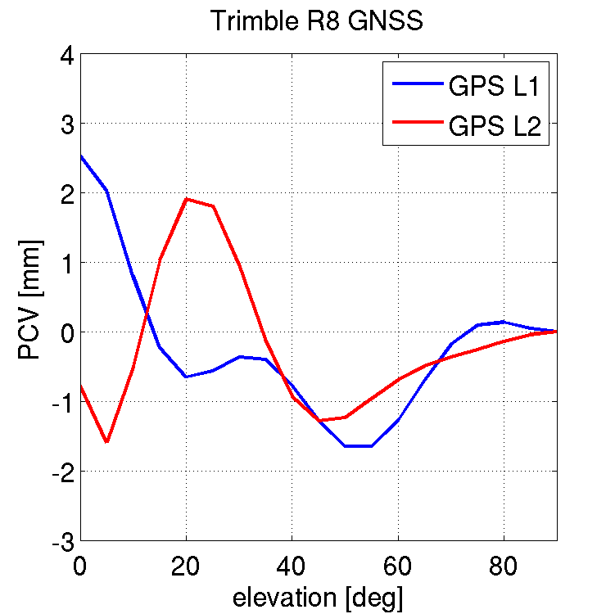
Calibration = Map of “Inconstant Point”
20° elev
L1: -0.5 mm
L2: 2.0 mm
PCO [ENU]
mm of phase advance/delay
Mean point being positioned … phase center offset: PCO
Spatial variations about the mean … phase center variations: PCV
0° elev
L1: 2.5 mm
L2: -1 mm
PCV
(elev)
Notes:
Antenna calibrations allow us to model and remove the phase advance/delay and reduce all signals coming from all directions back to the ARP.

Slide 6
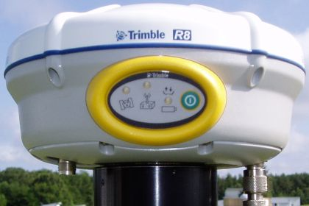
PCV Azimuthal Dependence
Notes:
For some antennas, those spatial variations can have a strong dependence on azimuth as well as elevation

Slide 7
Why Do I Need Calibrations?
Antenna introduces several mm-cm of phase advance/delay -> range errors
Input to most GNSS data processing software
Omitting calibrations can cause problems:
Long baselines
Combining multiple antenna models
Height errors

Slide 8
Relative vs. Absolute
 | Relative | Absolute
Calibration values | Relative to a reference antenna (AOA D/M_T) | Independent of reference antenna
Method | Stationary antennas | Test antenna moves
Advantages | Straightforward math | Sample full hemisphere and low elevation angles
Limitations | Cannot sample full pattern | Requires robot and rigorous accounting of angles & rotations
Do not combine relative and absolute calibrations!
Notes:
In a relative calibration, all antenna offsets (PCO) and phase center variations (PCV) are computed with respect to a reference antenna which is normally assigned zero PCV values. For NGS relative calibrations, the reference antenna is the Dorne Margolin choke ring antenna, type T (AOAD/M_T). A relative calibration is therefore biased by the phase advance/delay experienced by the reference antenna
In an absolute calibration, all antenna offsets and phase center variations are independent of the reference antenna. To conduct an absolute calibration, the antenna being tested is moved via a robot so that a particular satellite is received at different angles by the test and reference antennas. This angular separation enables cancelation of the reference antenna effects, leaving behind only the antenna offsets and phase center variations of the test antenna.

Slide 9
Why Go to Absolute?
Better/fuller description of phase behavior
0-10° elevation coverage
Azimuthal variations
Multipath removed/negated
The way of the future
International GNSS Service (IGS) standard
Used in OPUS
Used in CORS multiyear [IGS08 epoch 2005.0 and NAD 83(2011) epoch 2010.0]

Slide 10
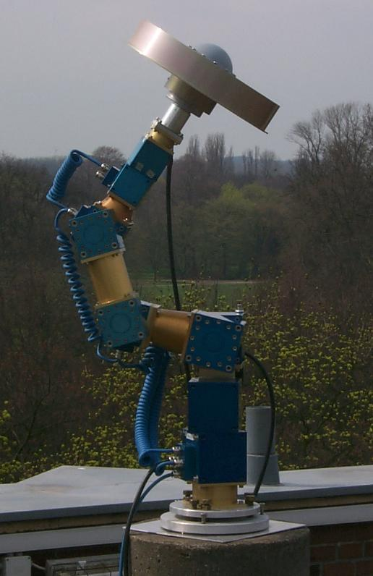
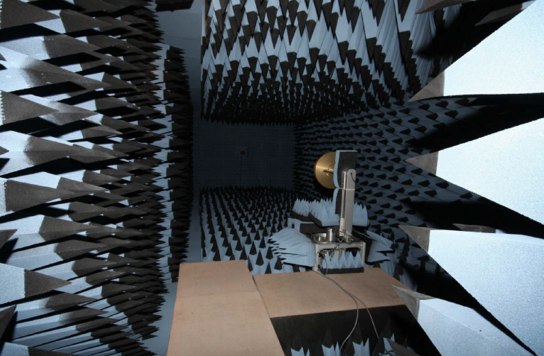
Who Does Absolute Calibrations?
 | Geo++ | TU Darmstadt
Method | Field with GNSS signals | Anechoic chamber with pure sine waves
Robot | 3-axis, PCO held fixed | 2-axis, PCO moves
Institution | For-profit | University
Up and coming: Australia, China

Slide 11
NGS Absolute Calibration Motivations and Goals
Serve high precision needs of U.S. surveying and geodesy communities
Multi-frequency, multi-GNSS calibrations
2-D (elevation, azimuth) phase center patterns
Free calibration service w/ quick turn-around
Calibration values publicly distributed via Internet
Compatibility with IGS ANTEX values
Notes:
Although there are other absolute antenna calibration facilities in operation, the National Geodetic Survey felt that a domestic, free calibration service is consistent with our mission. Our overall goal is to serve high precision needs of US surveying/geodesy communities. To do this, we have developed a facility that… (read other bullets)

Slide 12
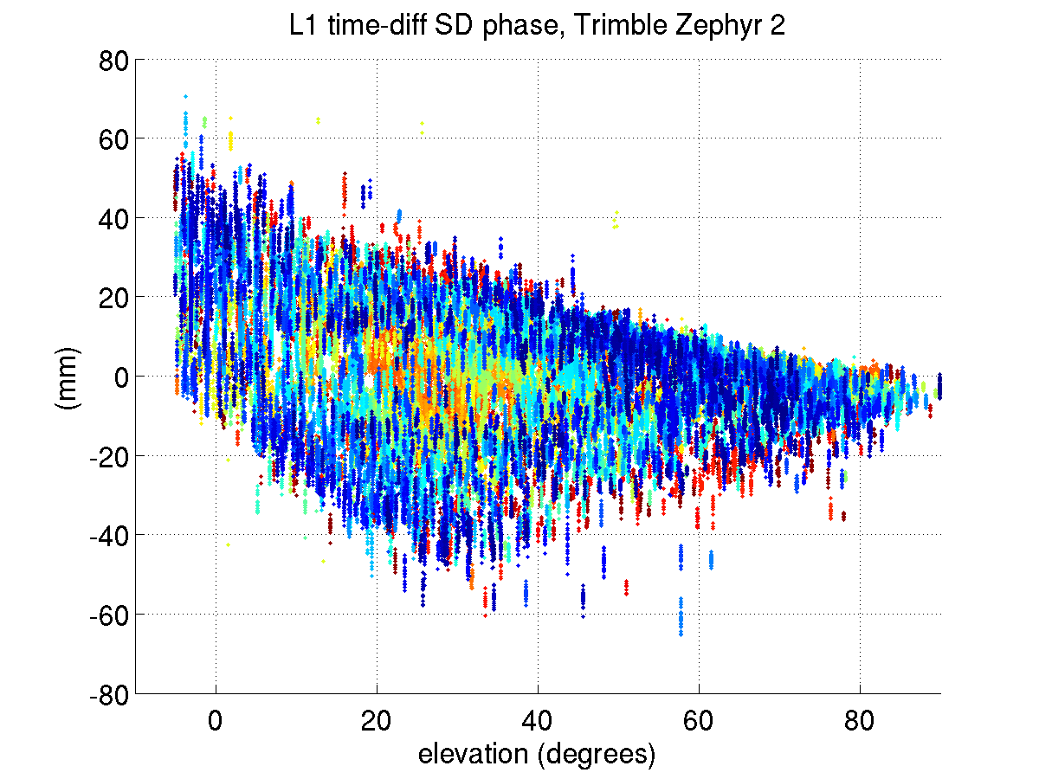
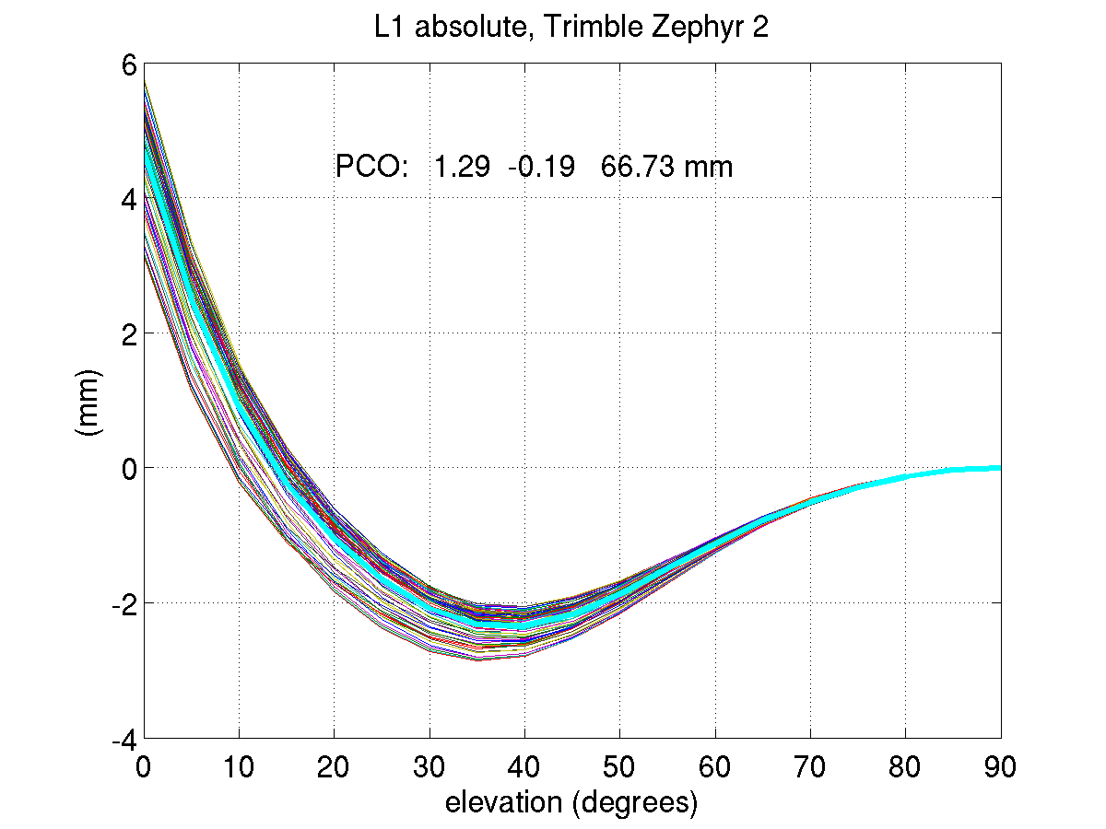
Compatibility with IGS
IGS ANTEX as “truth”
IGS Antenna Working Group acceptable deviations
< 1 mm for high elevations (>= 10°)
< 2 mm for low elevations (0-10°)

Slide 13
NGS Calibration Facility and Methods
Hi, I’m Pete.

Slide 14
Modelled Factors
PCV (az,el)
PTU:
A priori position
Frame rotation(s) between robot and local frame
Rotation arm length
Phase windup (antenna motion)
GPS/PC clock offsets
PCO [ENU]
V
N
E

Slide 15
Calibration Setup
Carrier phase single differences
Short baseline (5 m)
Simplified multipath environment
Common clock (heading receiver)
Remaining factors = phase centers (ref, test), differential multipath, hardware bias
Notes:
Experimental setup removes many common phase delay factors via single difference

Slide 16
Time Difference of Single Differences
Closely spaced time pairs + robot motion =
PCO/PCV at reference antenna removed
slowly varying biases (differential MP, hardware bias) minimized
Fixed reference antenna
Test antenna
Notes:
When time pairs are closely spaced (< 10 seconds), satellite motion is negligible.
Between time 1 and time 2, I move antenna under test by a large pan or tilt angle
Results in large change in reception angles for test antenna, but no net change at reference antenna
** Removes phase center effects of reference antenna, and minimizes the slowly varying biases

Slide 17
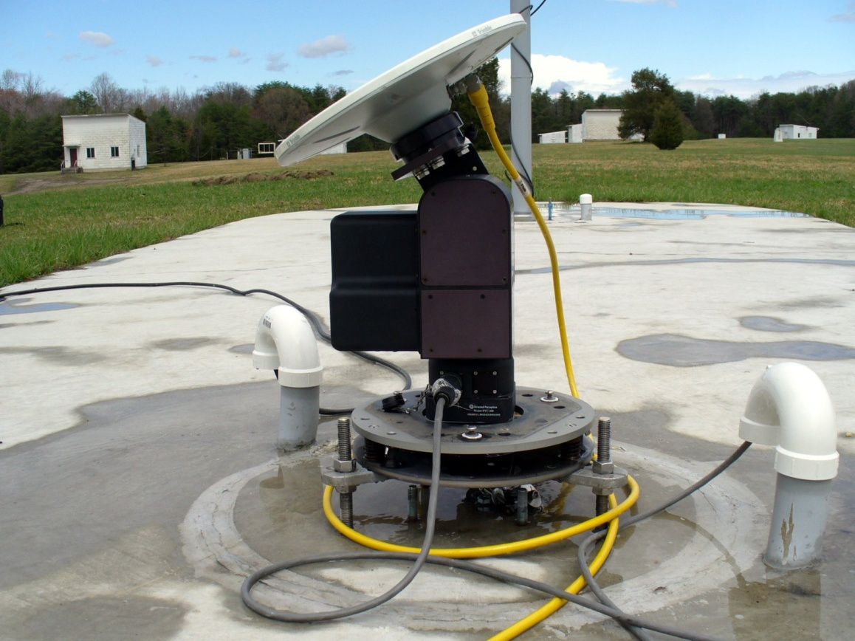
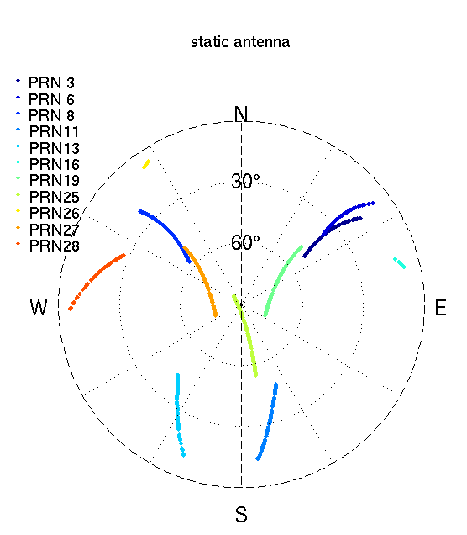
Why Robot?
Introduce angle changes for TDSD
Better spatial coverage

Slide 18
NGS Robot Limitations
2-axis = cannot sample full angular range
Motor box limits tilt
Tilt introduces change in antenna height above ground … multipath?

Slide 19
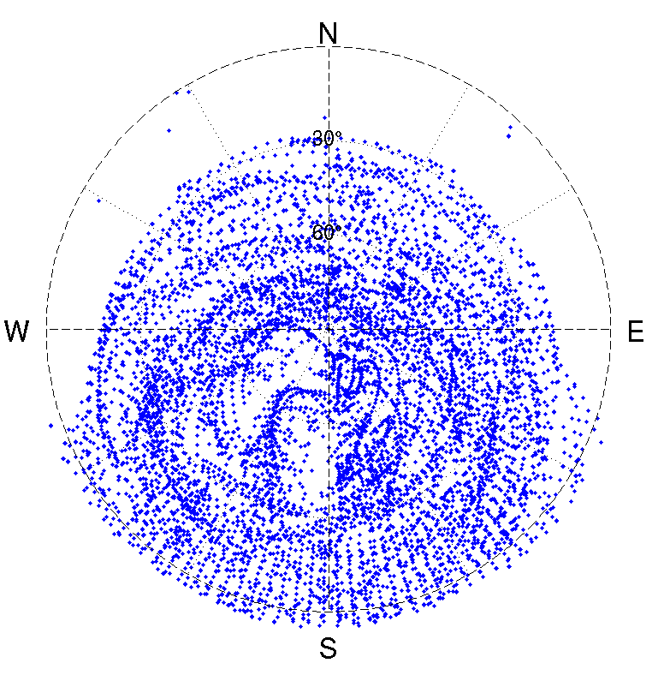
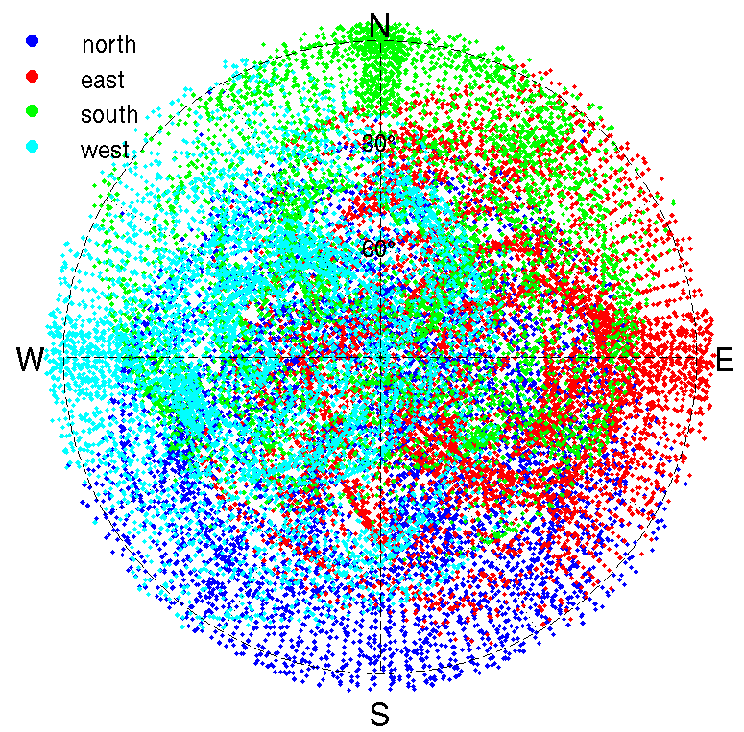
4-stage Process
“holes” in coverage
Each antenna run for 4 cardinal directions
Combined for full coverage

Slide 20
Estimation strategy
Pre-Edit Phase
Geometric range
Single Difference Phase
Cycle slip editing
Time Difference of Single Difference Phase Pairs
Phase windup
PTU tilt arm
Satellite XYZ/velocity calcs (for windup)
Form / Solve Normal Equations
PCO (east, north, up components)
PCV (elevation and azimuth angle)
Calculation of angles
Angles in local frame
Angles in antenna frame
North
East
South
West

Slide 21
So Many Variables!
Elevation cutoffs
Local frame
Antenna frame
Order/degree of harmonics
Data spacing/distribution
Robot motion scenario (delta pan)

Slide 22
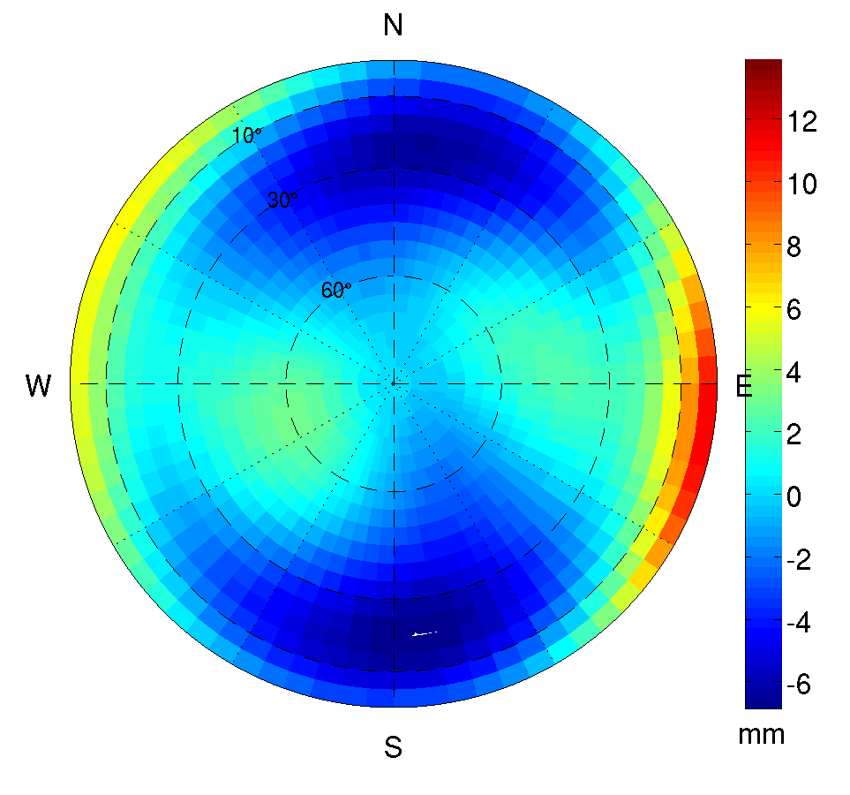
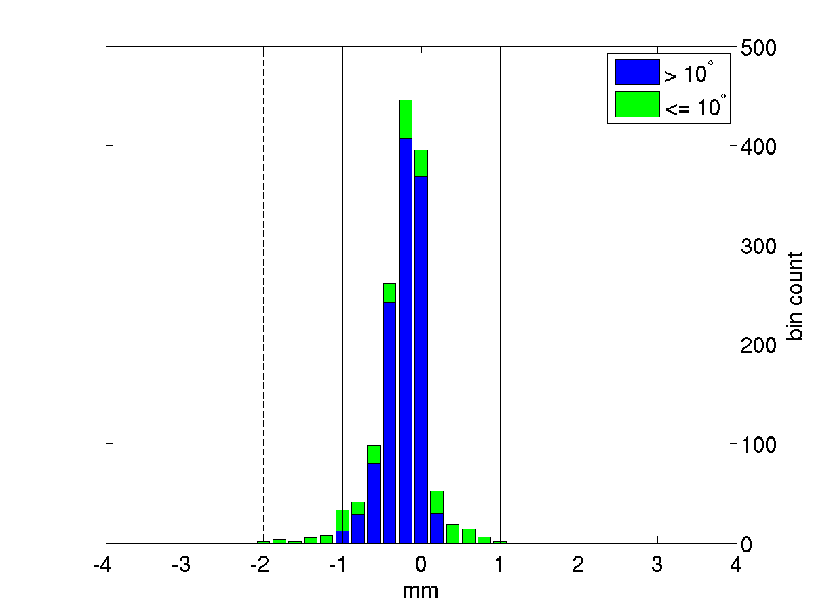
NGS Calibration Results

Slide 23
NGS Catalog to Date
IGS comparison
AOA D/M_T
Topcon CR-G3
Javad RingAnt D/M
Trimble Zephyr Geodetic (GPS)
Trimble Zephyr 2 (GNSS)
Ashtech Whopper
Previously uncalibrated antennas
ITT chokerings (NGA)
Topcon CR-G5 FullWave

Slide 24
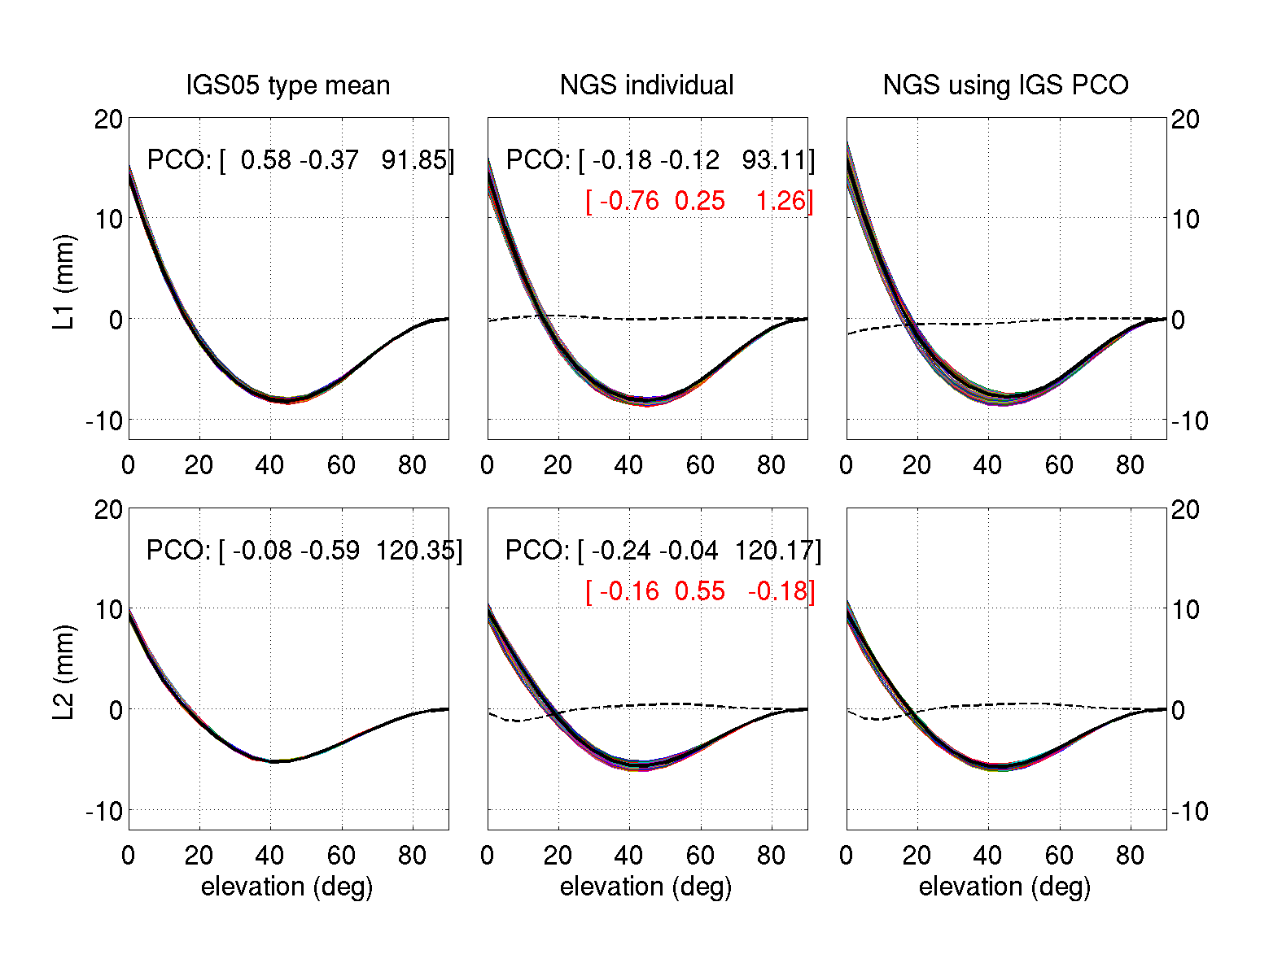
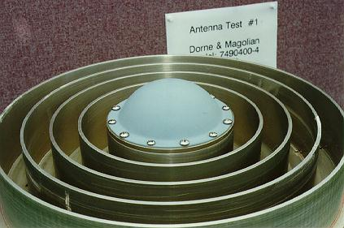
Allen Osborne chokering rev T AOAD/M_T
s/n 149
Notes:
Thin colored lines = azimuthal slices from full PCV
Heavy black line = NOAZIM pattern
Dashed black line = difference in NOAZIM for NGS individual vs IGS type mean

Slide 25
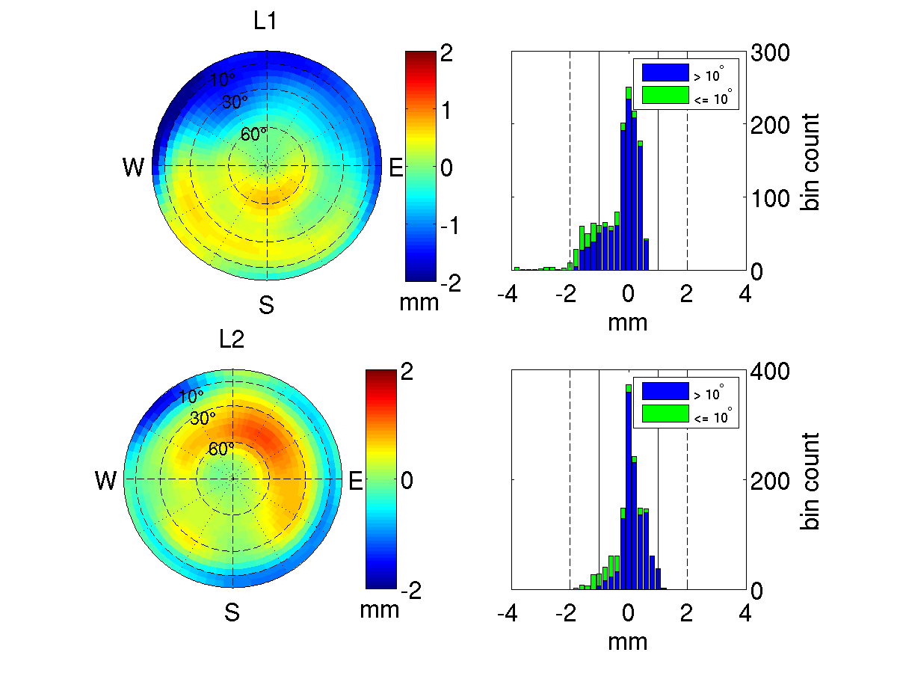
Allen Osborne chokering rev T deviation
 | < 1 mm (elev > 10°) | < 2 mm (elev <= 10°)
L1 | 91% | 90%
L2 | 97% | 100%

Slide 26
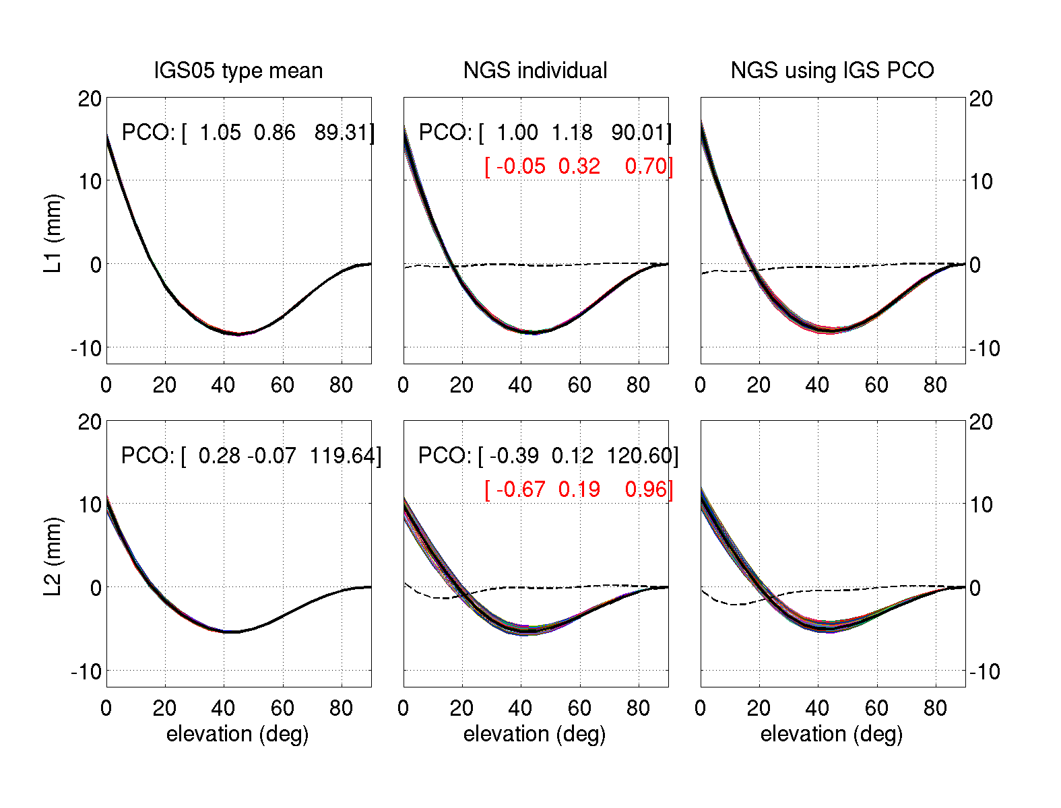
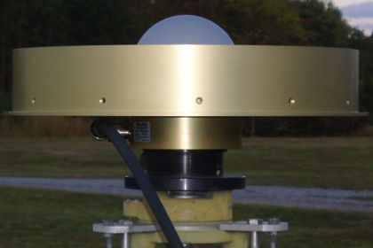
Javad RingAnt-DM JAVRINGANT_DM
s/n 00553
Notes:
Thin colored lines = azimuthal slices from full PCV
Heavy black line = NOAZIM pattern
Dashed black line = difference in NOAZIM for NGS individual vs IGS type mean

Slide 27
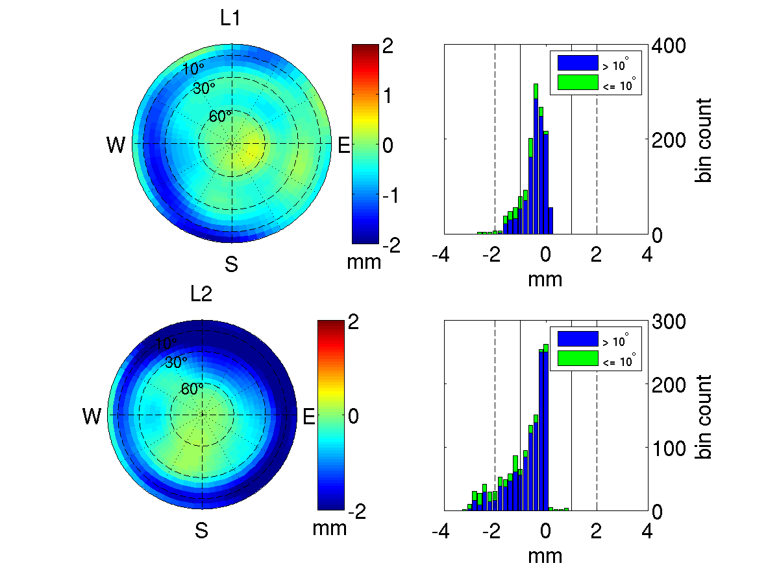
Javad RingAnt-DM deviation: shifted to IGS PCO values
 | < 1 mm (elev > 10°) | < 2 mm (elev <= 10°)
L1 | 93% | 96%
L2 | 77% | 69%

Slide 28
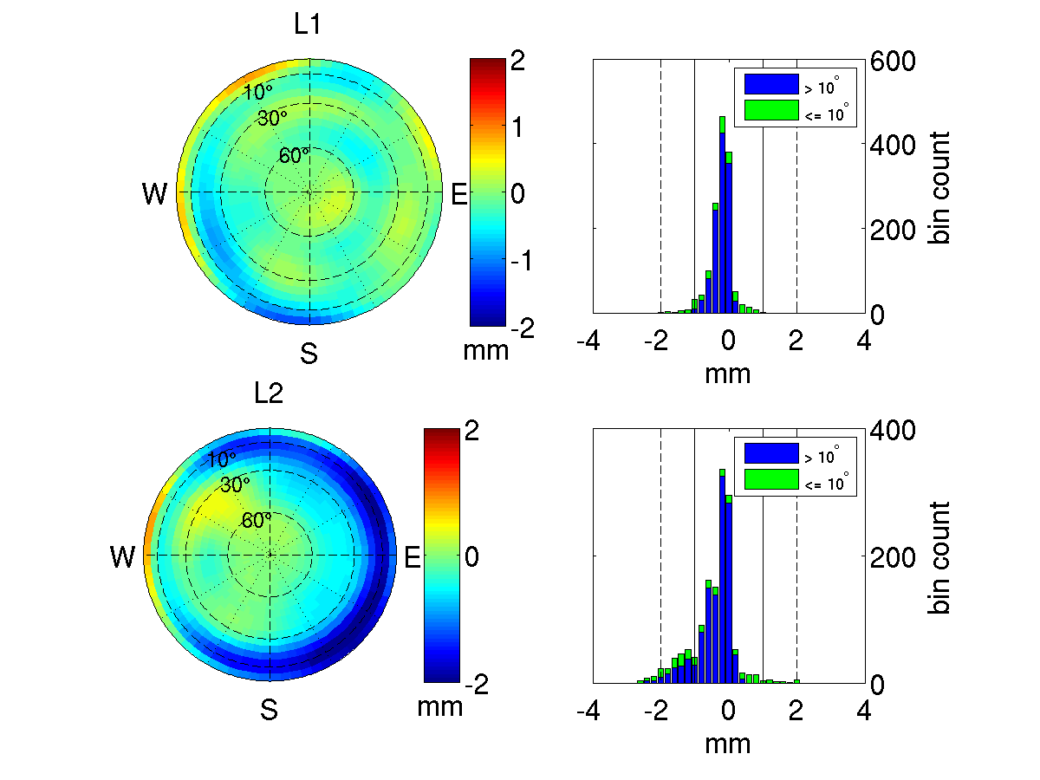
Javad RingAnt-DM deviation: keeping NGS PCO values
 | < 1 mm (elev > 10°) | < 2 mm (elev <= 10°)
L1 | 100% | 100%
L2 | 90% | 92%

Slide 29
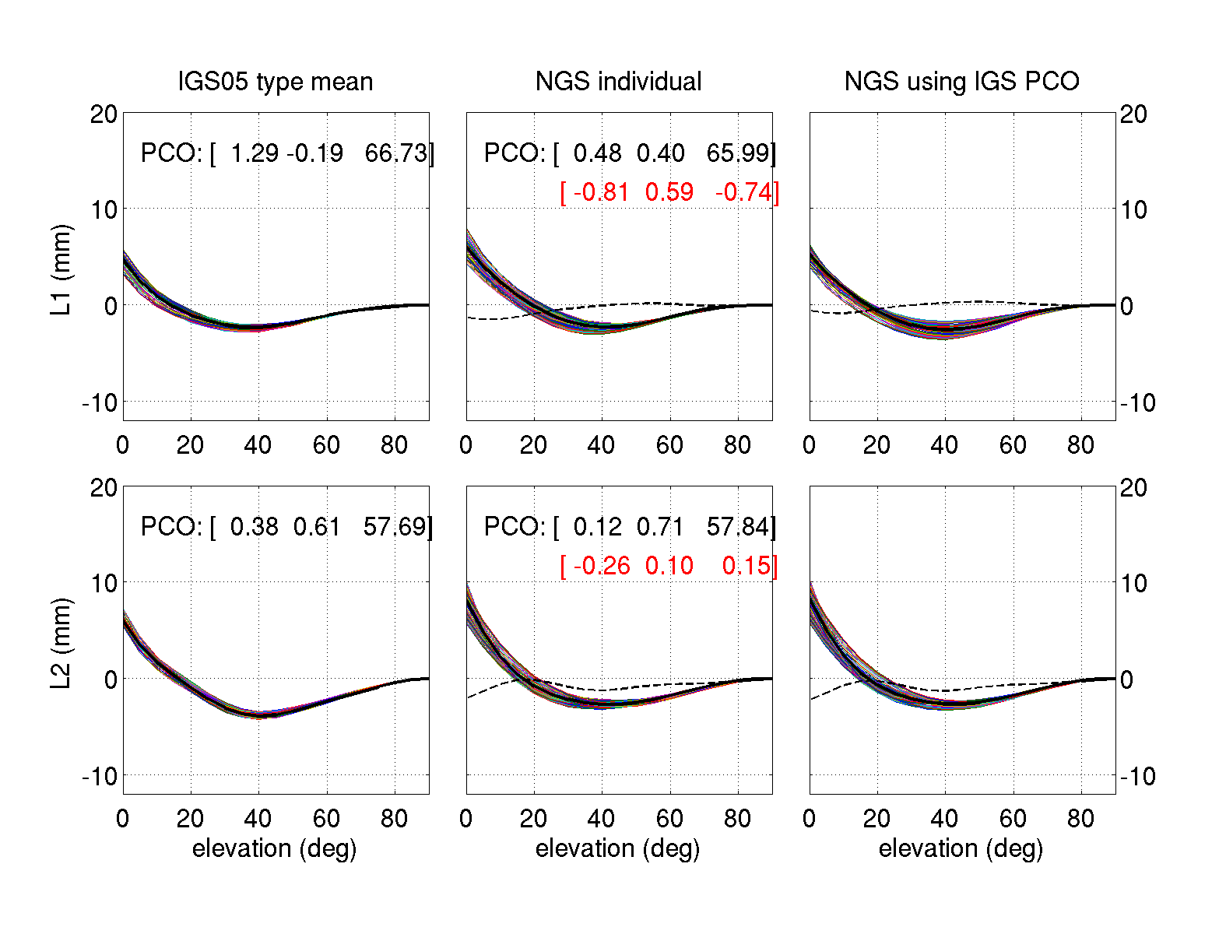
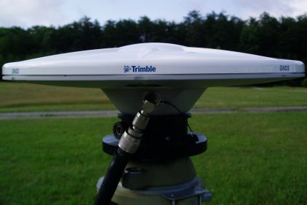
Trimble Zephyr 2 TRM55971.00
s/n 30255823
Notes:
Thin colored lines = azimuthal slices from full PCV
Heavy black line = NOAZIM pattern
Dashed black line = difference in NOAZIM for NGS individual vs IGS type mean

Slide 30
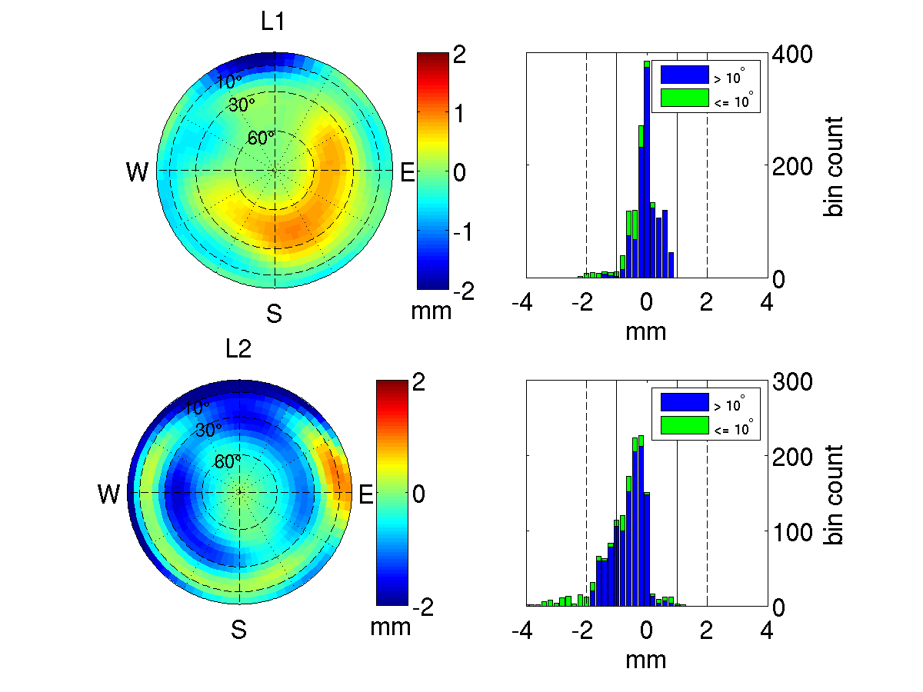
Trimble Zephyr 2 deviation, S/N 30255823
 | < 1 mm (elev > 10°) | < 2 mm (elev <= 10°)
L1 | 99% | 99%
L2 | 81% | 67%

Slide 31
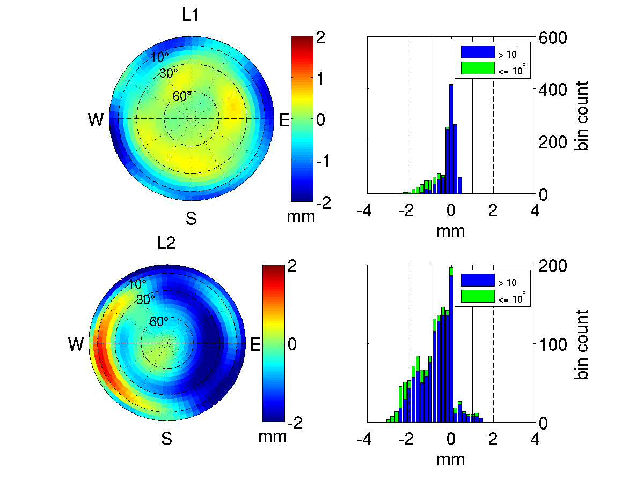
Trimble Zephyr 2 deviation, S/N 30212854
Different serial number, different deviations
 | < 1 mm (elev > 10°) | < 2 mm (elev <= 10°)
L1 | 98% | 97%
L2 | 71% | 67%

Slide 32
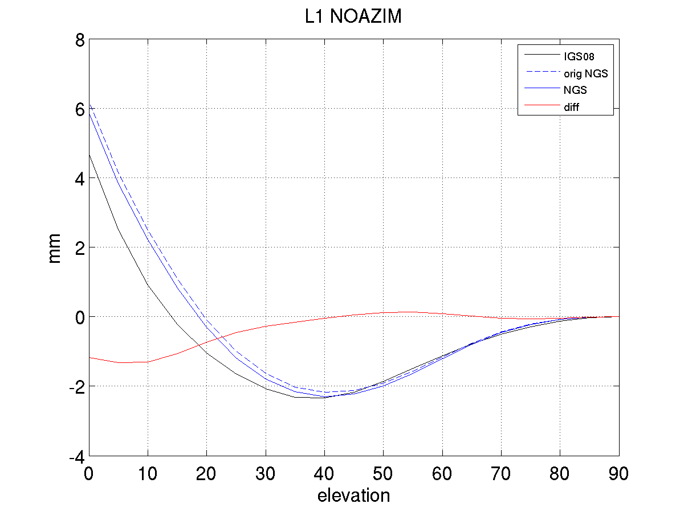
Trimble Zephyr 2 L1 Type Mean
test 1: 0.90 0.40 66.69
test 2: 0.58 0.16 67.57
test 3: 0.48 0.40 65.99
test 4: 0.73 -0.42 65.96
test 5: 0.94 -0.19 66.26
test 6: 0.61 -0.01 65.88
std : 0.18 0.33 0.65
NGS MEAN: 0.71 0.06 66.39
IGS MEAN: 1.29 -0.19 66.73
Diff : 0.58 -0.25 0.34

Slide 33
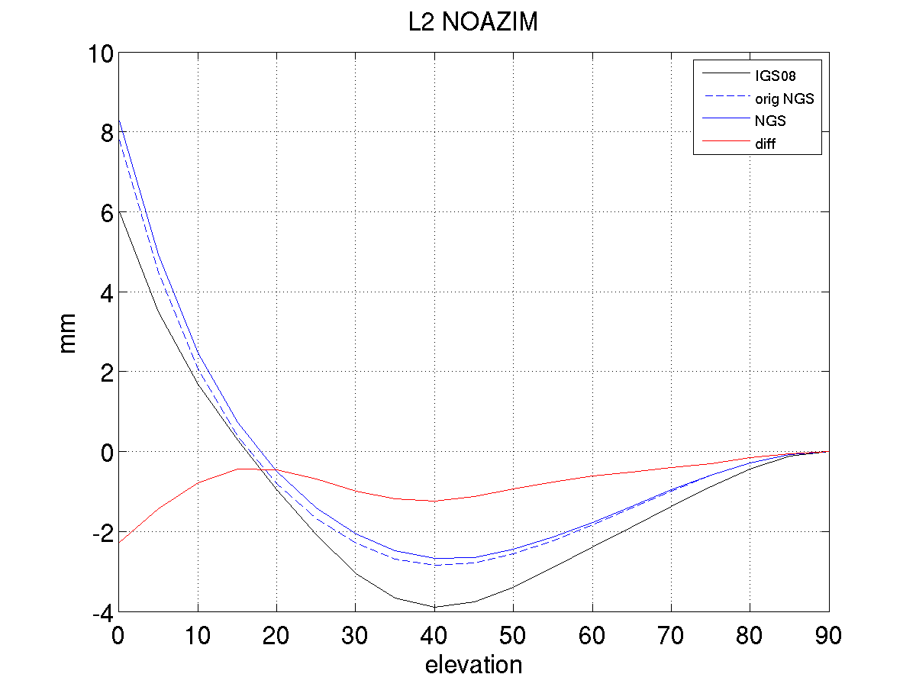
Trimble Zephyr 2 L2 Type Mean
test 1: 0.61 1.50 58.32
test 2: 0.20 1.24 58.65
test 3: 0.12 0.71 57.84
test 4: -0.41 -0.16 57.93
test 5: -0.16 0.18 58.63
test 6: -0.25 0.80 57.63
std : 0.37 0.62 0.43
NGS MEAN: 0.02 0.71 58.17
IGS MEAN: 0.38 0.61 57.69
Diff 0.36 -0.10 -0.48

Slide 34
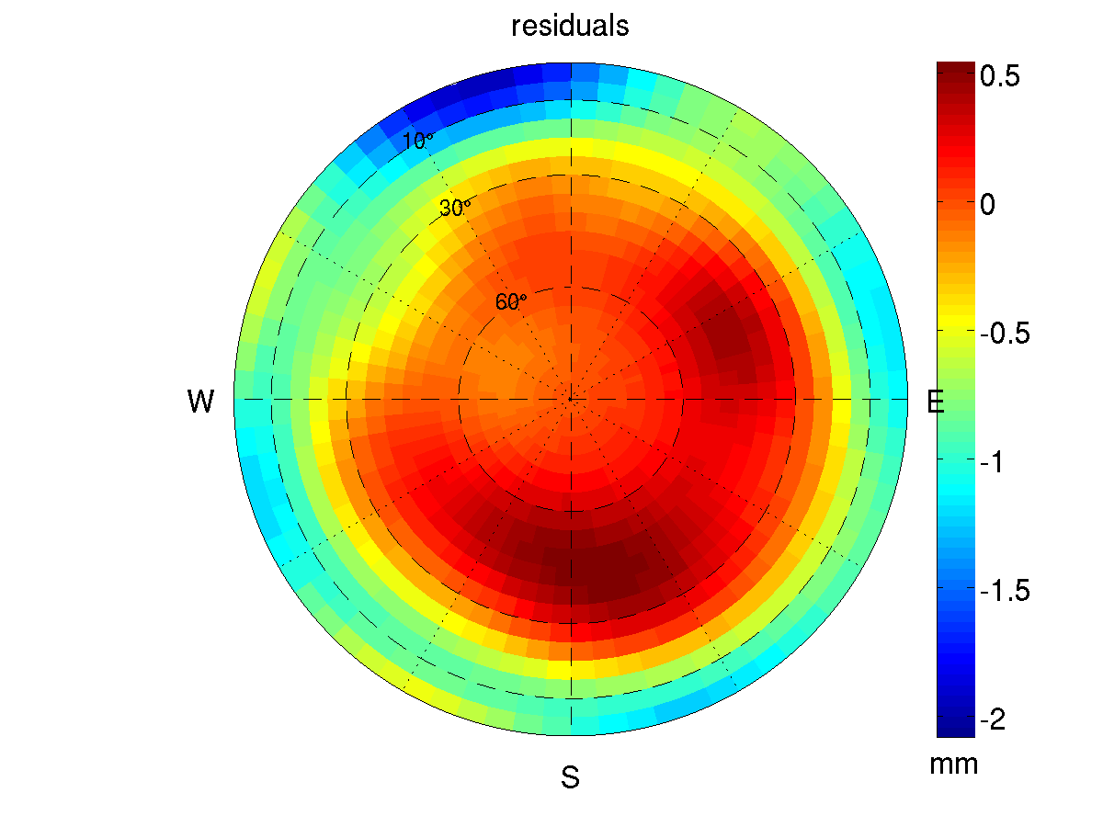
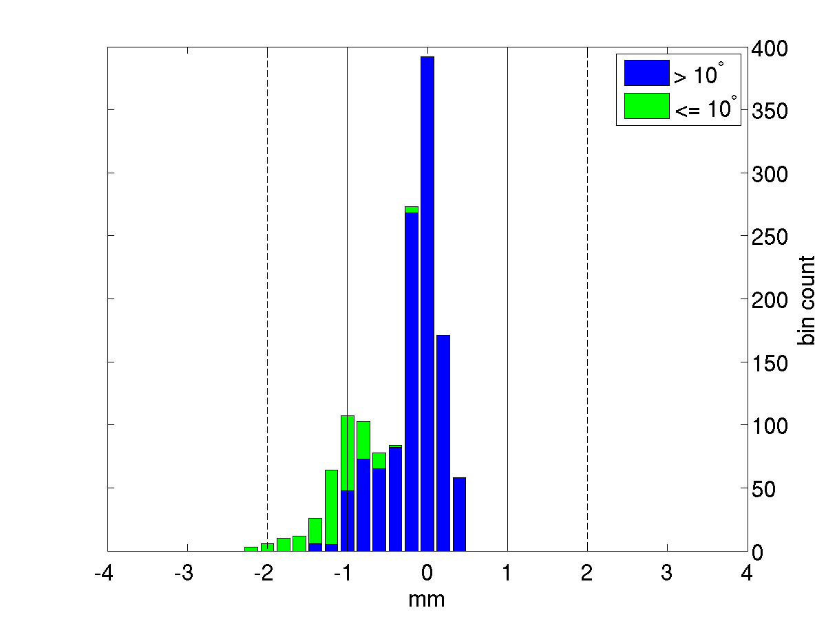
Trimble Zephyr 2 L1 Type Mean: NGS vs IGS

Slide 35
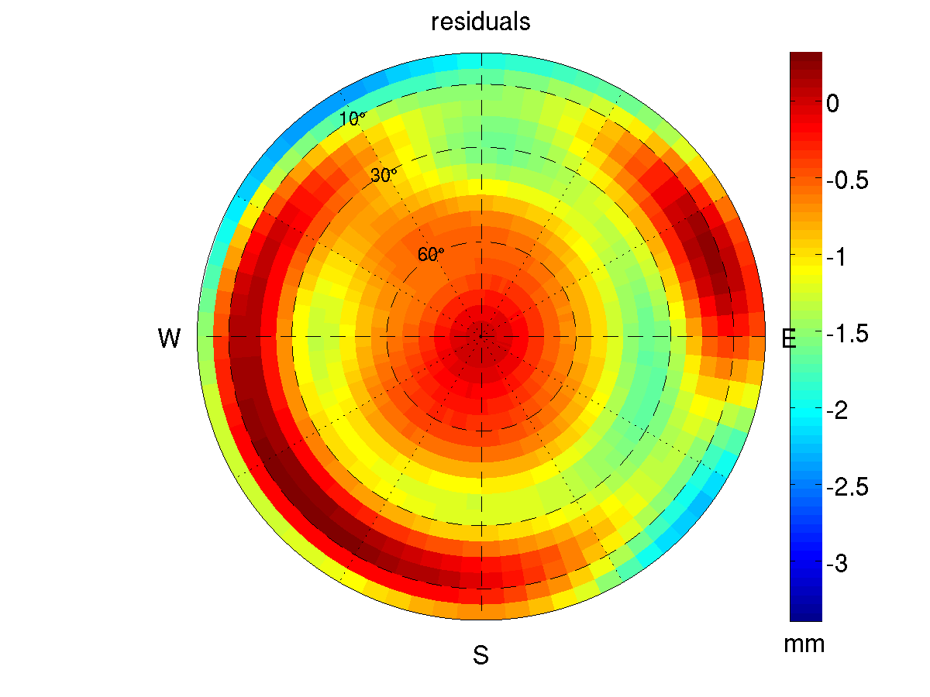
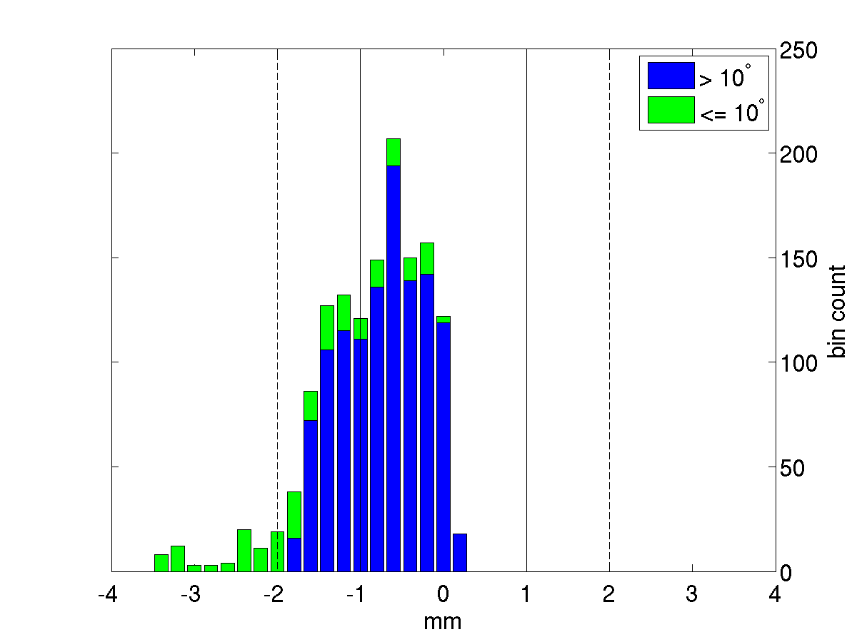
Trimble Zephyr 2 L2 Type Mean: NGS vs IGS

Slide 36
Outstanding Questions
Source of histogram bias and skew towards negative residuals
Misfit at < 20°
Type mean
Common PCO or individual PCOs?
Statistics?
Number of antennas required?

Slide 37
Development Next Steps
IGS AWG approval
Permanent piers
GLONASS
More automated data retrieval/processing

Slide 38
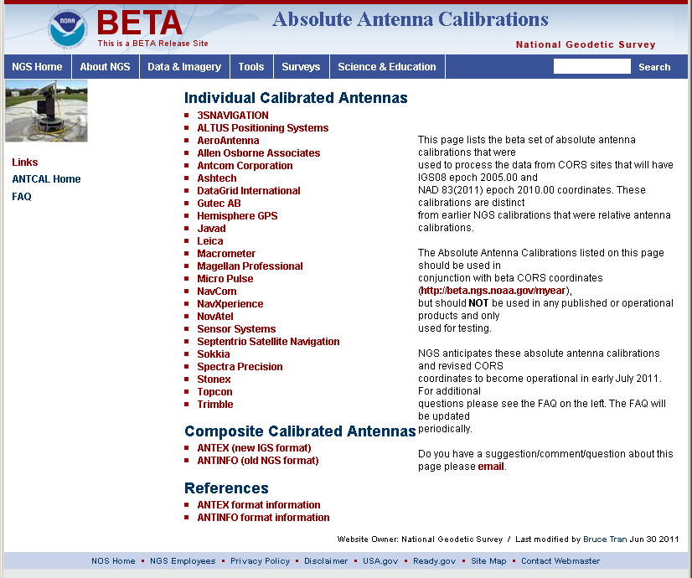
NGS Calibration Services
Database, website, processes and policies

Slide 39
New Website
Revamped along with database
Photo & drawing mouseovers for easy ID
ANTINFO and ANTEX formats

Slide 40
Formal Policy Document
Approved by ESC
Purpose/Goal
Clear expectations
Make our jobs easier
Doc contents
Calibration process and stages
Eligibility for calibration
Rights and responsibilities (both NGS and antenna provider)
Revisions expected
with manufacturer input
after calibration tracking system comes online

Slide 41
Antenna Intake
Request calibration via web form
Tracking system
Customer notification emails

Slide 42
Conclusions and Outlook
Good agreement with IGS type means... but needs improvement
Pending approval from IGS Antenna Working Group
Soon to be “open for business”
For more information
http://www.ngs.noaa.gov/ANTCAL
Email andria.bilich@noaa.gov or NGS.AbsAntCal@noaa.gov

