Slide 1
GEOID18: Hybrid Geoid
Kevin Ahlgren, Ph.D.
Geodesist and Geoid Modeler
GEOID18 Technical Lead
 | NGS Geospatial Summit | 7 May 2019

Slide 2
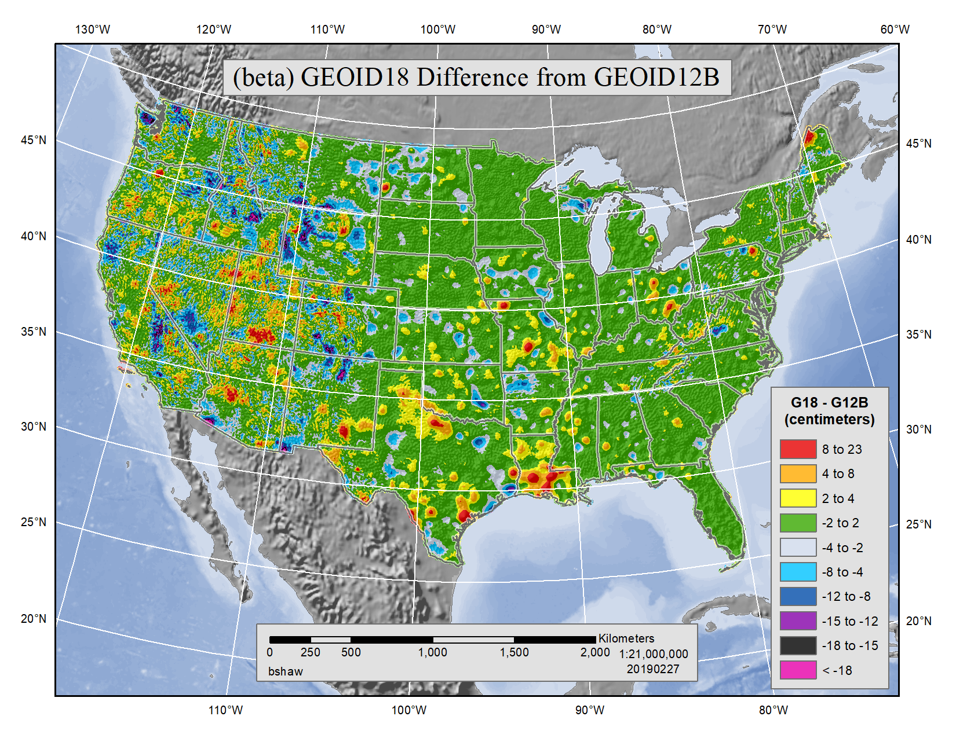
GEOID18 - Hybrid
GPS on Bench marks used to constrain gravimetric geoid
Future Model:
BETA GEOID18
Valid in CONUS and Puerto Rico/ U.S. Virgin Islands
32,149 GPS on Bench marks

Slide 3
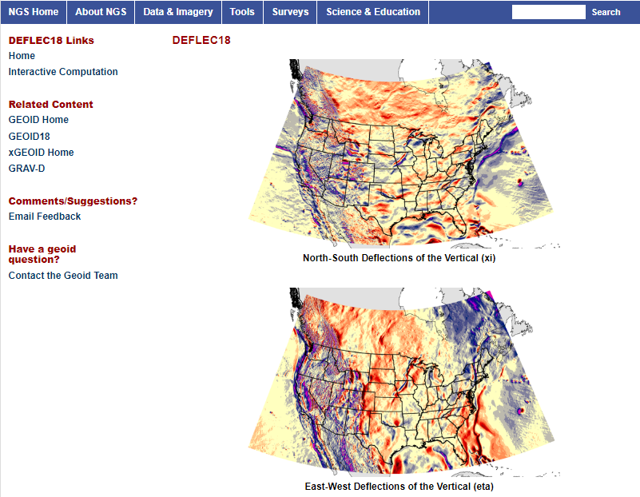
DEFLEC18
DEFLEC18 is a companion product derived from the 2018 hybrid geoid model (GEOID18), and represents the deflections of the vertical (DOV's) at the surface of the Earth. These DOV's are also in the NAD 83 (2011) reference frame. These quantities are typically a few arc seconds, but can reach an arc minute of departure.

Slide 4
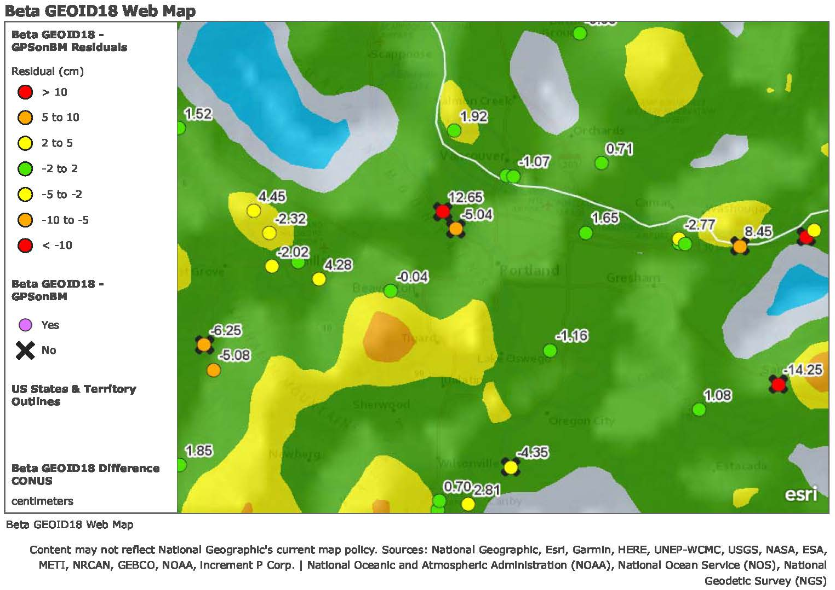
GEOID18 – ArcGIS Online Tool
Publically available at: https://arcg.is/vSn8K

Slide 5
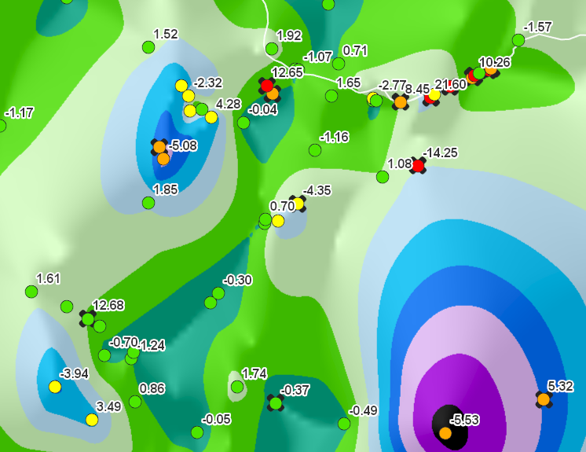
GEOID18 – Validation of BETA
Look at your local area/region
Submit OPUS Share observations on NAVD 88 marks NOT USED in the model
Something more elegant….

Slide 6
Official GEOID18 Release:
Summer 2019
kevin.ahlgren@noaa.gov
GEOID18 Feedback: ngs.feedback@noaa.gov

