Slide 1
State Plane 2022 Where Things Stand and the Road Ahead
Michael L. Dennis, PhD, RLS, PE
SPCS2022 Project Manager
December 9, 2021

Slide 2
SURVEYORS
projected
coordinate systems
REAL GEODESISTS
…don’t use projected
coordinate systems

Slide 3
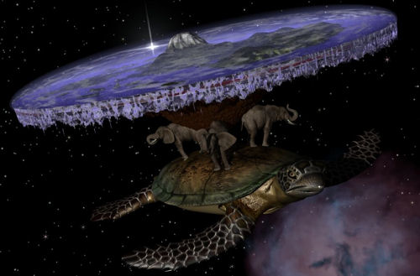
The stuff of geodesist nightmares…

Slide 4
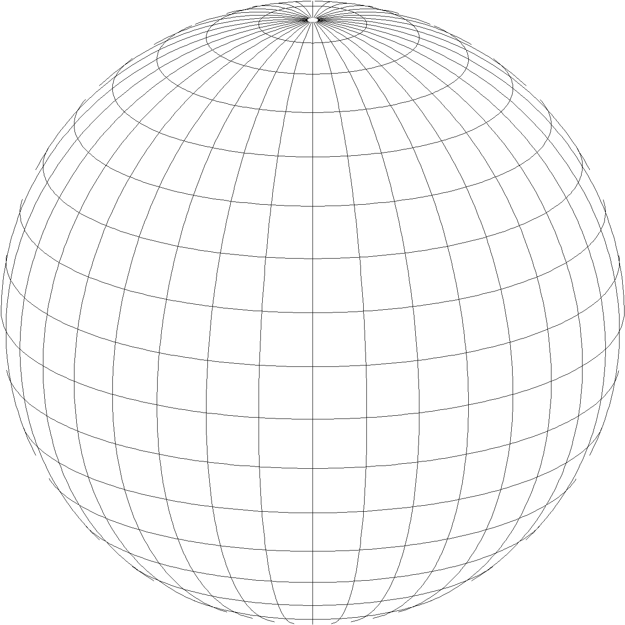
A “flat Earth” for the future
State Plane Coordinate System of 2022 (SPCS2022)
Referenced to 2022 Terrestrial Reference Frames
Same reference ellipsoid as SPCS 83 (GRS 80)
Same 3 projection types as SPCS 83 and 27:
Lambert Conformal Conic (LCC)
Transverse Mercator (TM)
Oblique Mercator (OM)

Slide 5
Previous NGS State Plane webinars
State Plane Coordinate System (May 5, 2021, at Geospatial Summit)
State Plane 2022: The Shape of Things to Come (June 11, 2020)
Be a Part of the Change: A Guide to Customizing State Plane for 2022 (October 10, 2019)
The State Plane Coordinate System of 2022: Making It Your Way (May 6, 2019, at Geospatial Summit)
State Plane Coordinate System Update (March 7, 2019)
Building a State Plane Coordinate System for the Future (April 12, 2018)
The State Plane Coordinate System: History, Policy, Future Directions (March 8, 2018)

Slide 6
Poll Question
Which of the previous seven State Plane webinars have you attended?
418 of 604 attendees responded

Slide 7
Poll Question
Are you associated with any of the following SPCS2022 stakeholder groups in your state? (select all that apply)
427 of 604 attendees responded

Slide 8
Getting acquainted with SPCS2022
Distortion design philosophy
Linear distortion minimized at topographic surface (not at ellipsoid surface)
Purpose: to reduce difference between projected “grid” and actual “ground” distances
Other things:
Zone “layers”
Low distortion projections (LDPs)
Status and performance of zone designs
The timing of it all…

Slide 9
SPCS2022 “layers” and designs
Max of up to 3 zone “layers” allowed
One must be statewide zone
Most states will have total of 2 layers
NGS designs:
Statewide zone for every state
Multiple zones not designed by stakeholders
Many states made requests and proposals
Requests for zones designed by NGS
Proposals for zones designed by stakeholders

Slide 10
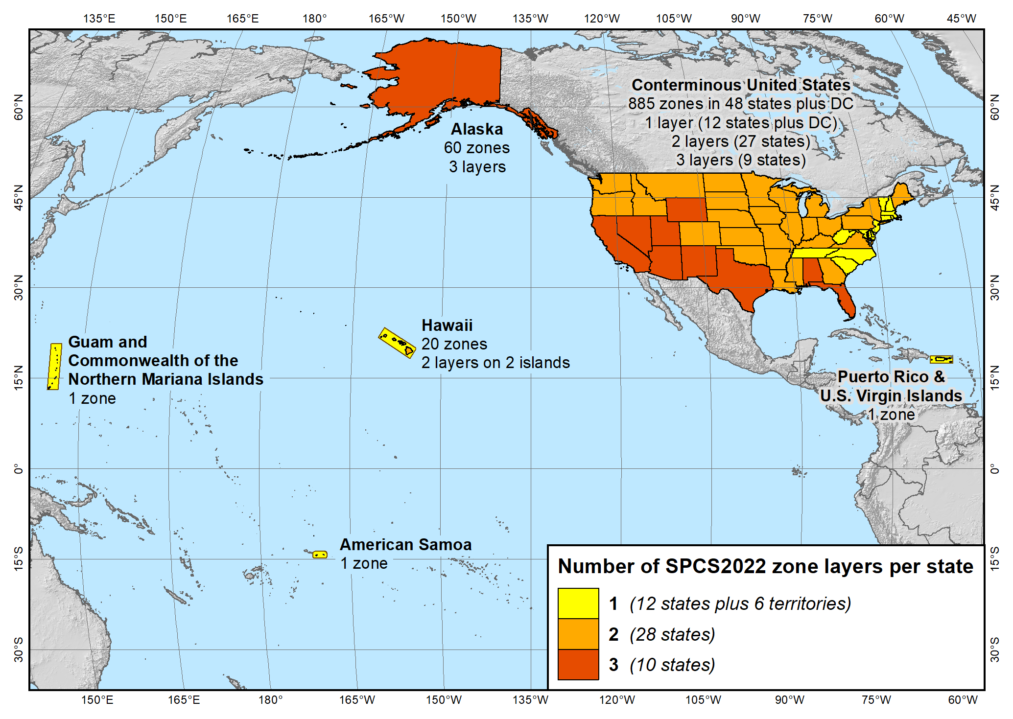
State Plane Coordinate System of 2022 (968 zones in 56 states and territories)

Slide 11
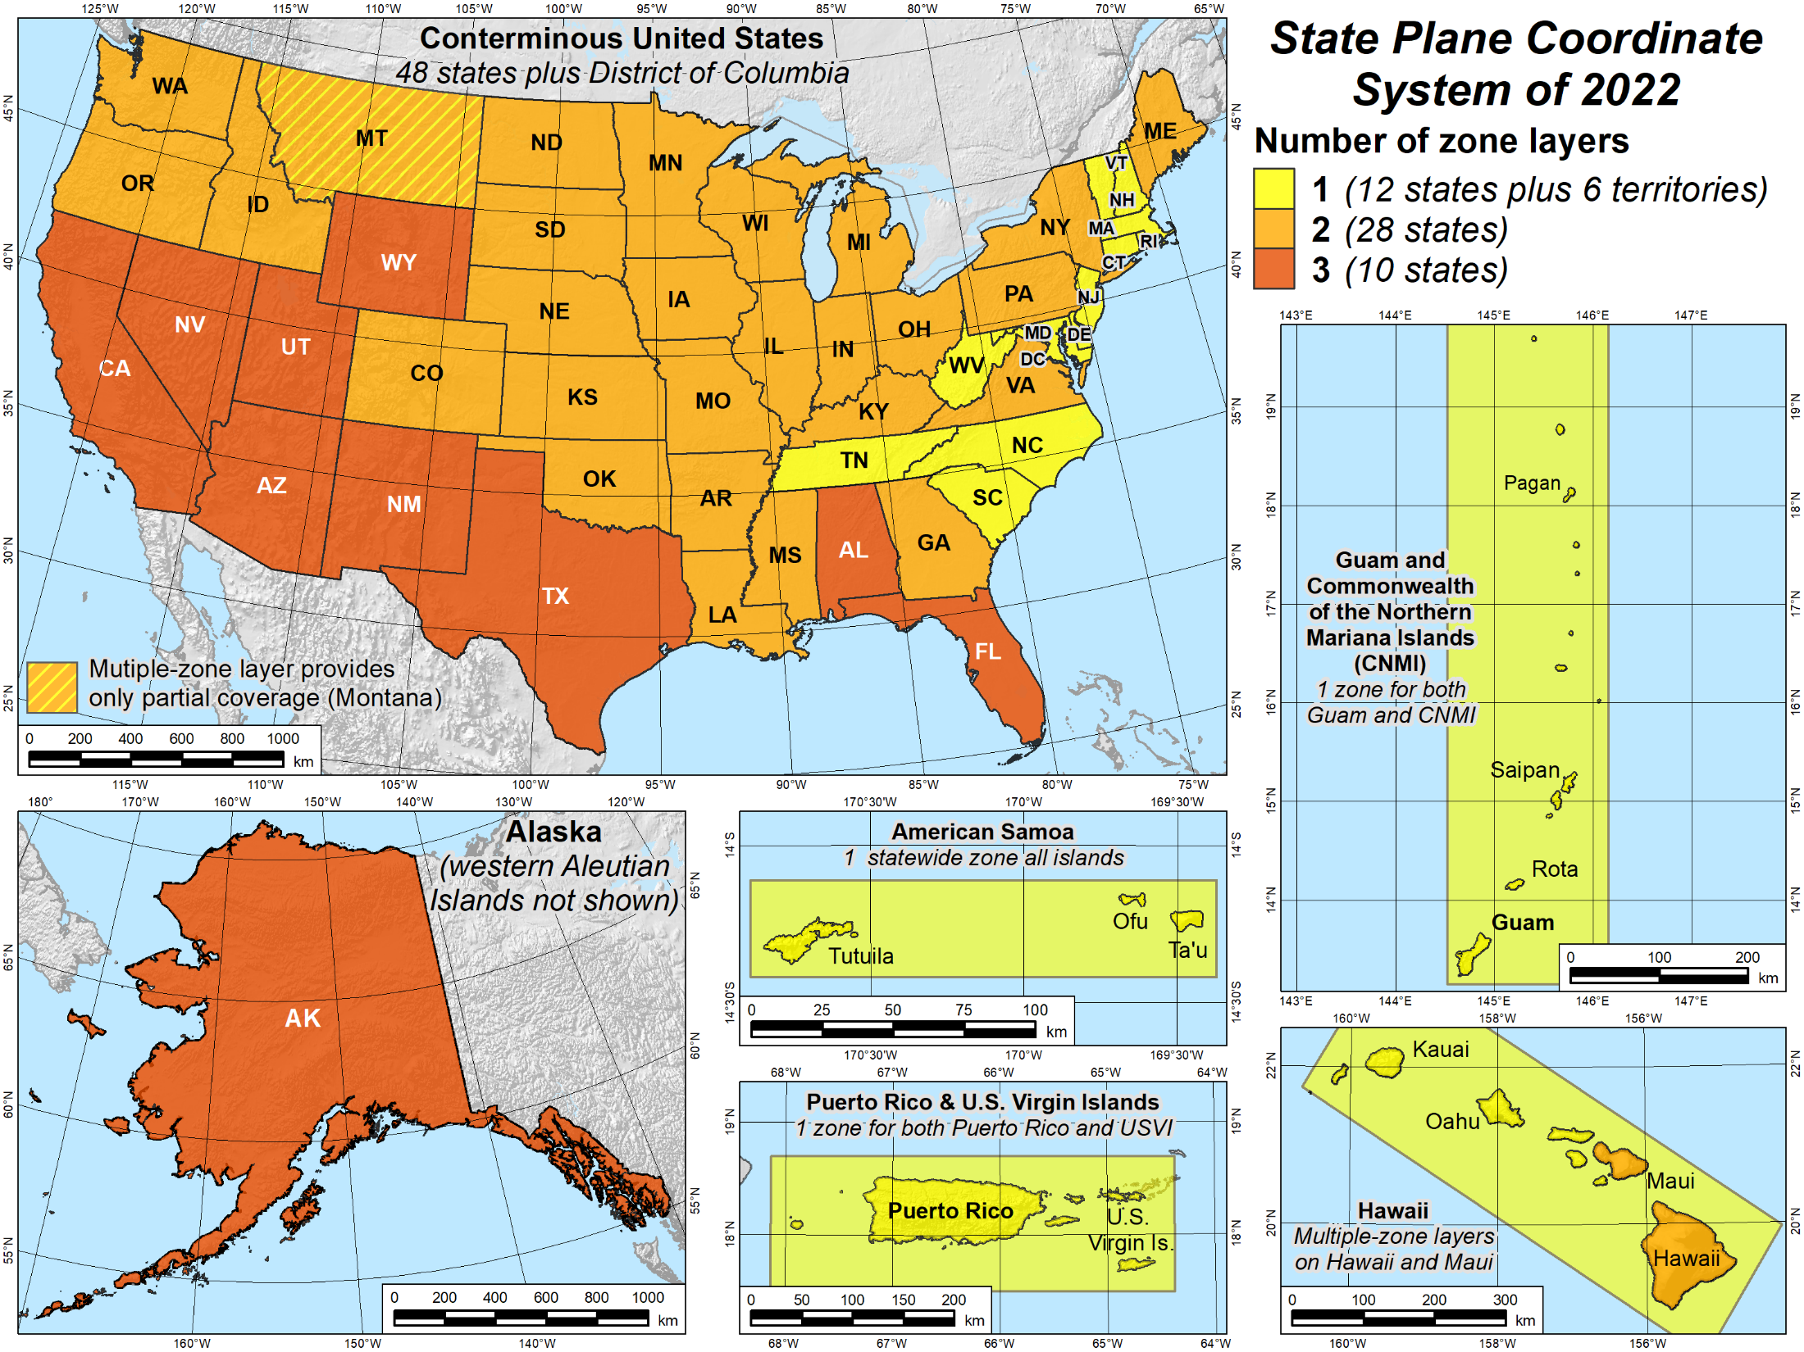

Slide 12
Status of zone layout and designs
Designs by NGS
159 zones (including 54 statewide)
Range from 1 to 22 zones per state (max in Alaska)
Plus 3 “special use zones” (in more than one state)
Designs by state stakeholders
806 zones in 28 states
Range from 1 to 88 zones per layer (max in Ohio)
Total = 968 zones for 56 states and territories
Number may decrease, but will not increase

Slide 13
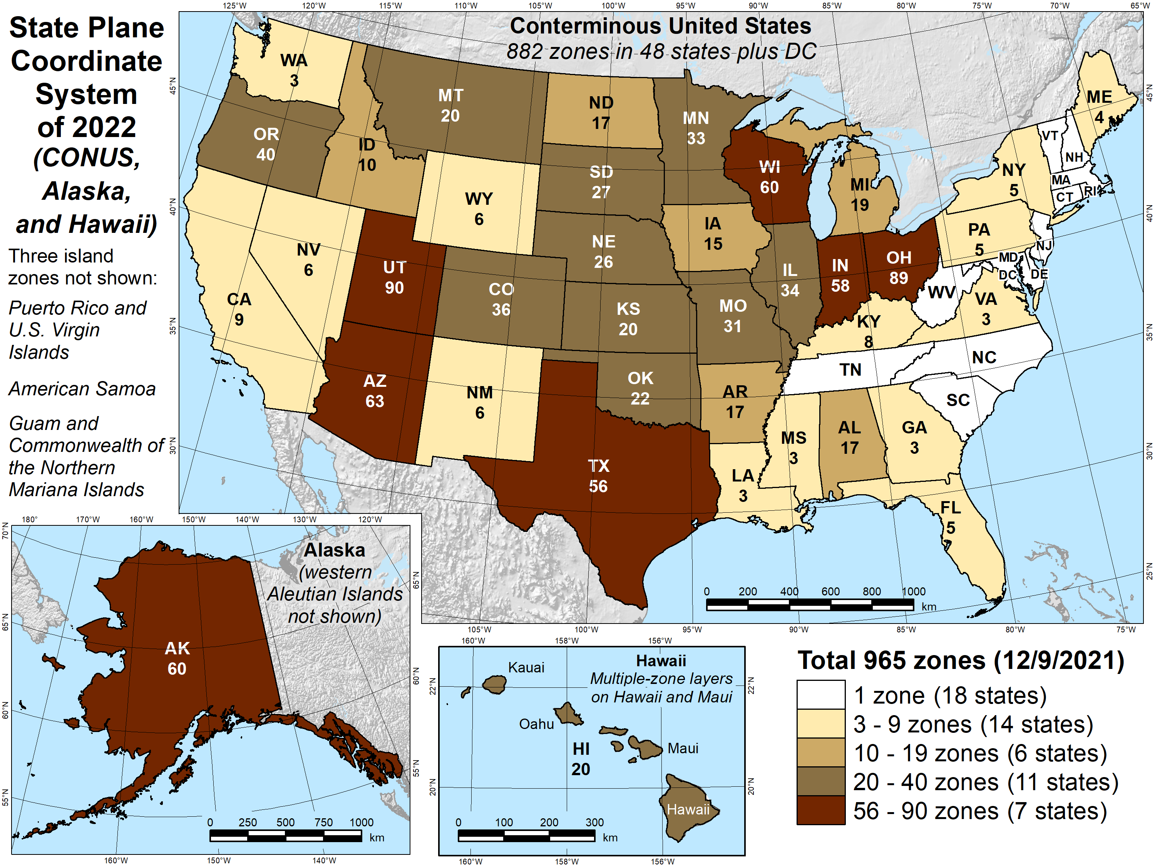

Slide 14
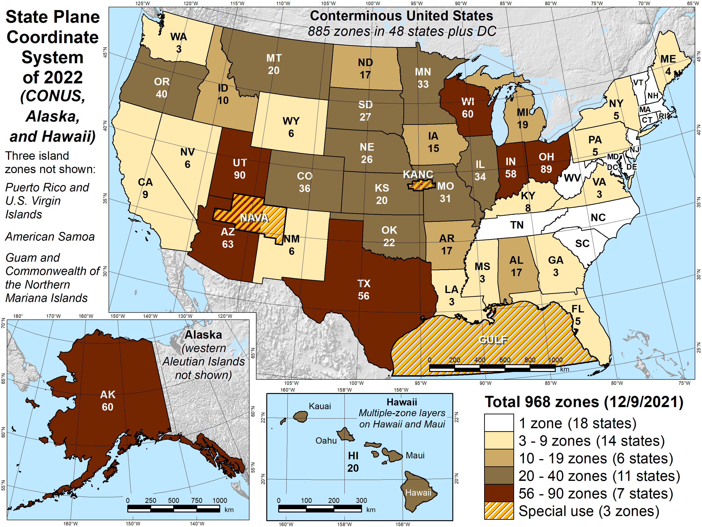

Slide 15
Map projection linear distortion
Map projection designed to minimize linear distortion on ellipsoid (at “sea level”)
Topographic surface
Horizontal ground distance
Projection surface
Grid (“map”) distance
Grid distance < ground distance
Ellipsoid surface (~“sea level”)
This design approach used for SPCS 27 and 83 (minimizes distortion with respect to ellipsoid)

Slide 16
Map projection linear distortion
Map projection designed to minimize linear distortion at ground surface
Topographic surface
Projection surface
Grid distance ≈ ground distance
Ellipsoid surface (~“sea level”)
This design approach is used for SPCS2022 (minimizes distortion with respect to topography)

Slide 17
Linear distortion performance
Cause of distortion can be split into 2 types:
Distortion due to Earth curvature
Distortion due to change in ellipsoid height
Both types contribute to total distortion
Curvature: increases with square of zone width
Height: increases linearly with change in height
Distortion may be low outside zone boundary
Can use a zone beyond its bounding polygon
It’s OK to “color outside the lines”

Slide 18
Linear distortion magnitudes
Parts per million | Centimeters per kilometer | Feet per mile | Dimensionless ratio
20 ppm | 2 cm/km | 0.1 ft/mile | 1:50,000
50 ppm | 5 cm/km | 0.3 ft/mile | 1:20,000
100 ppm | 10 cm/km | 0.5 ft/mile | 1:10,000
400 ppm | 40 cm/km | 2.1 ft/mile | 1:2,500

Slide 19
SPCS2022 zones designed by NGS
Linear distortion design criterion
e.g., ±20, ±50, ±100, ±400 ppm, etc.
Criterion must satisfy at least all of following:
90% of population
75% of all cities and towns (by location only)
50% of entire zone area
Limitations for designs by NGS
Minimum design criterion ±50 ppm (1:20,000)
May be less if existing zone small
Low distortion projections (LDPs)
Must be designed by others for distortion < ±50 ppm

Slide 20
Low distortion projections (LDPs)
What is an LDP?
Projection “grid” and “ground” distance nearly same
For SPCS2022, distortion < ±50 ppm (±0.3 ft/mile)
Common criterion is ±20 ppm (±0.1 ft/mile)
SPCS2022 includes LDPs
Designed by stakeholders
Coverage can be complete or partial (discontinuous)
Minimum zone width
50 km (31 miles) if height range <= 250 m
10 km (6 miles) if height range > 250 m

Slide 21
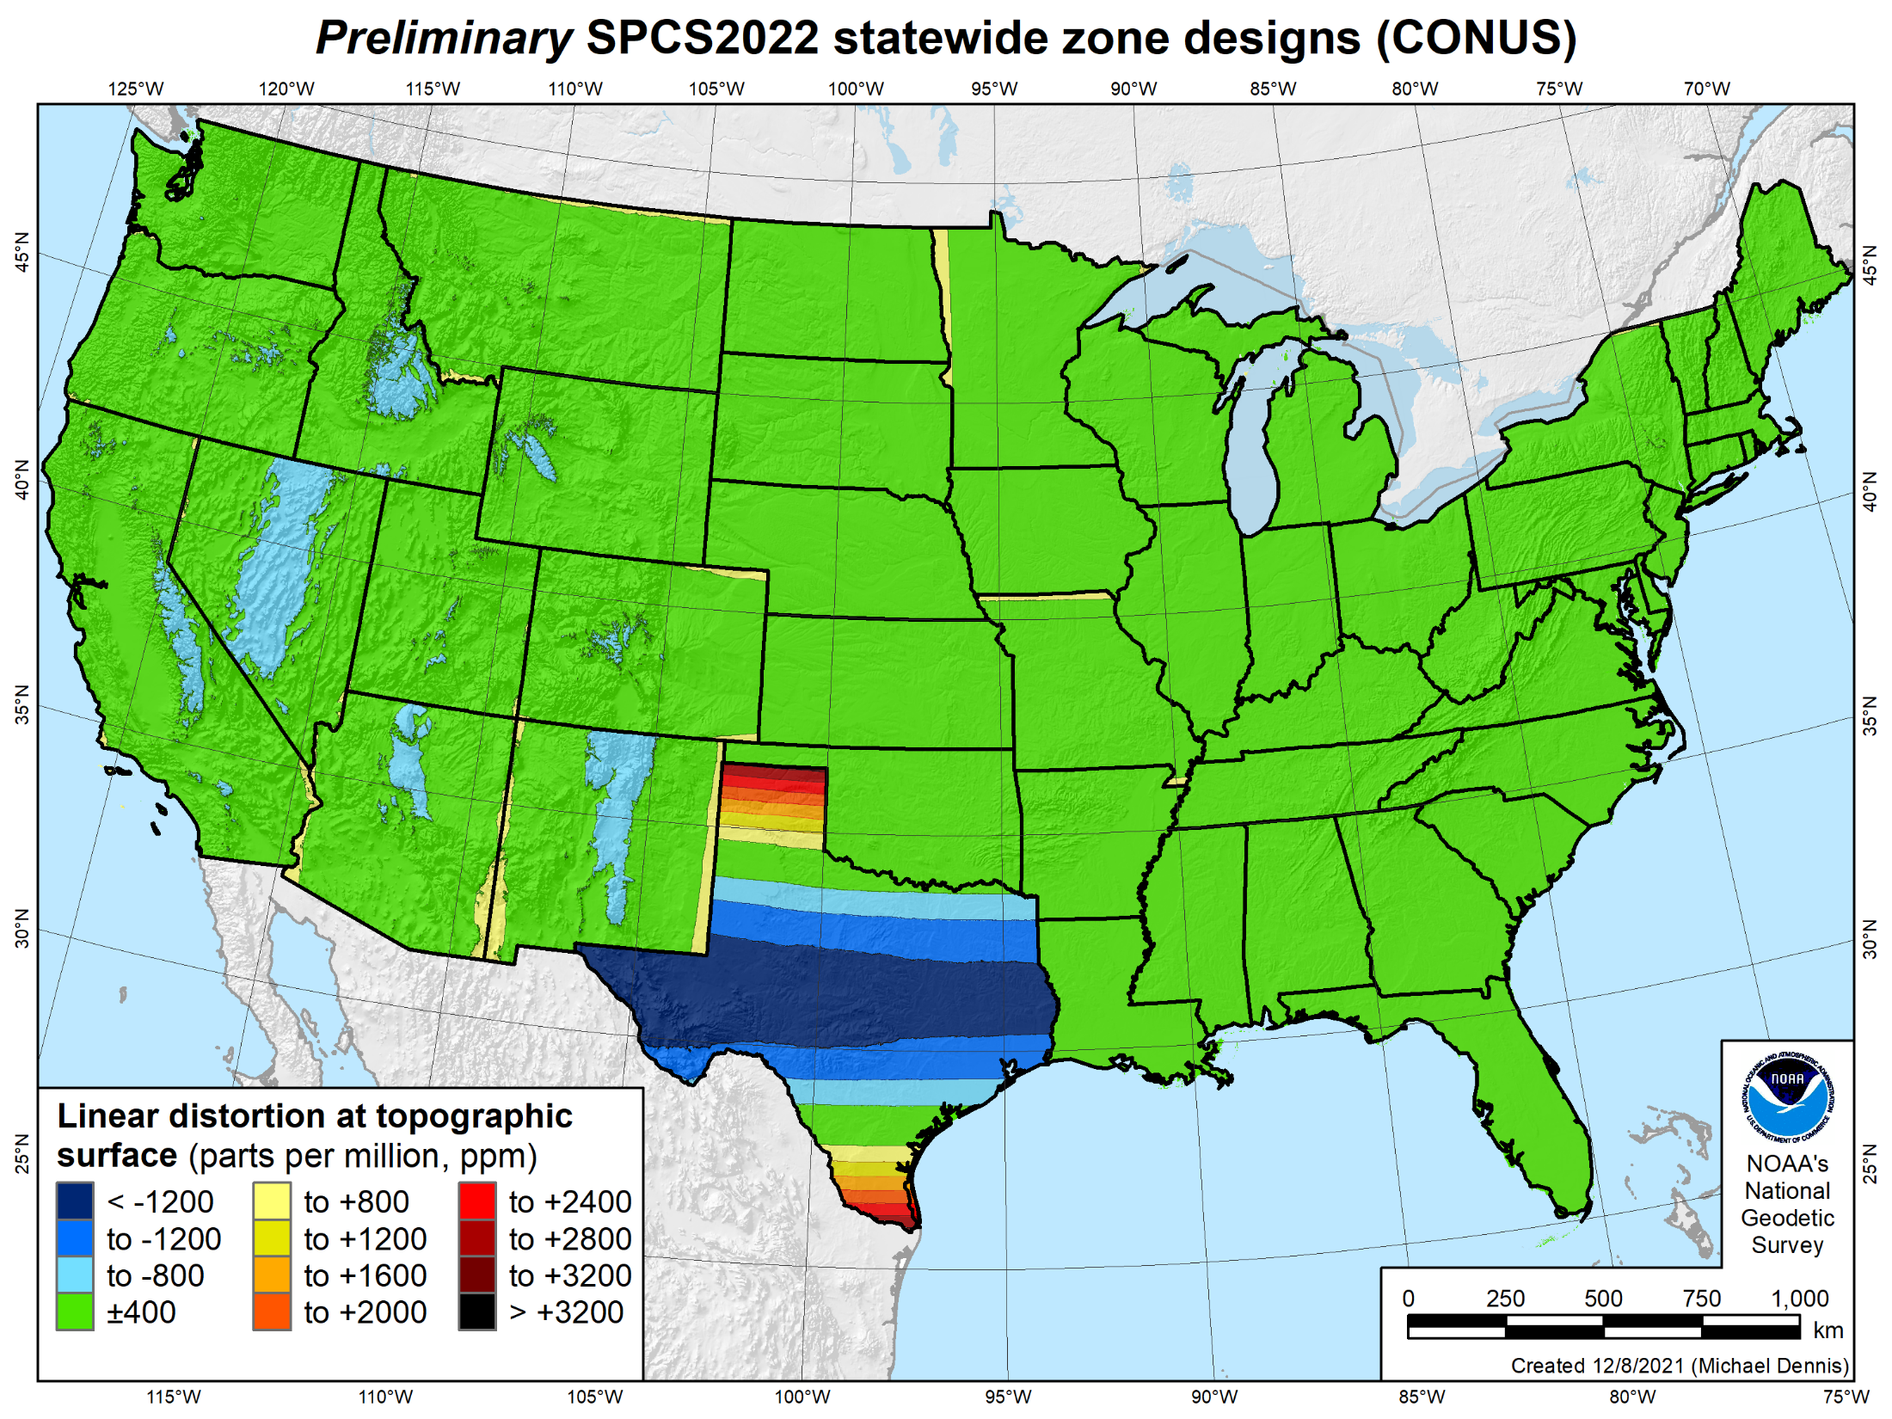
49 zones
Distortion increment 400 ppm (1:2,500 = 2.11 ft/mile)
Percent area within:
±20 ppm = 7%
±50 ppm = 18%
±100 ppm = 36%
±400 ppm = 88%

Slide 22
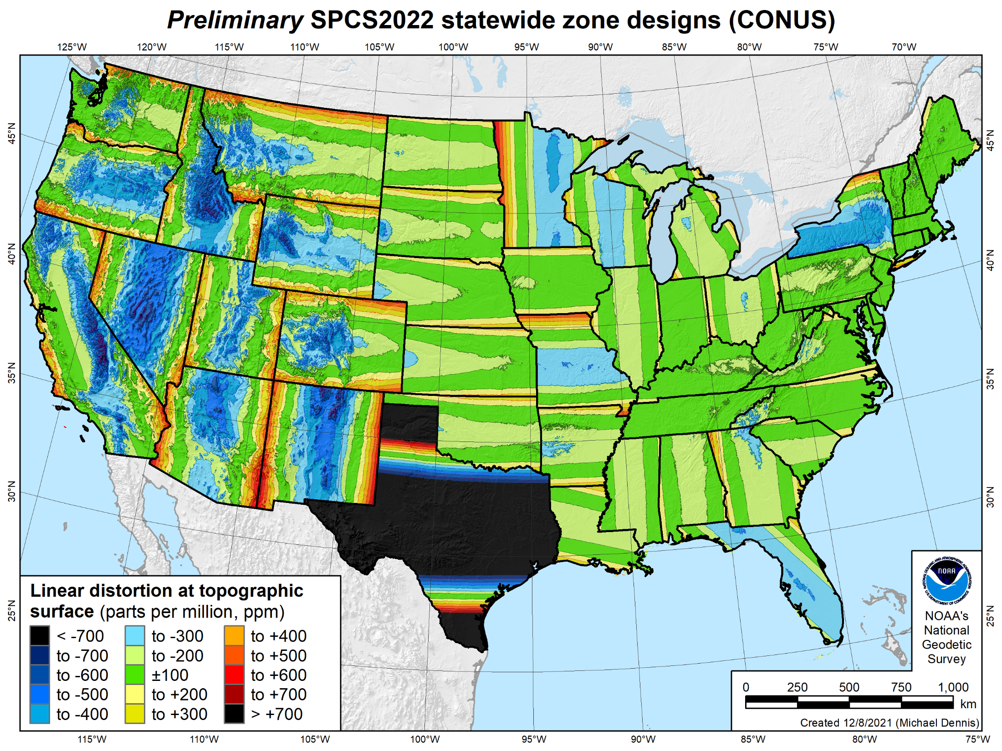
49 zones
Distortion increment 100 ppm (1:10,000 = 0.53 ft/mile)
Percent area within:
±20 ppm = 7%
±50 ppm = 18%
±100 ppm = 36%
±400 ppm = 88%

Slide 23
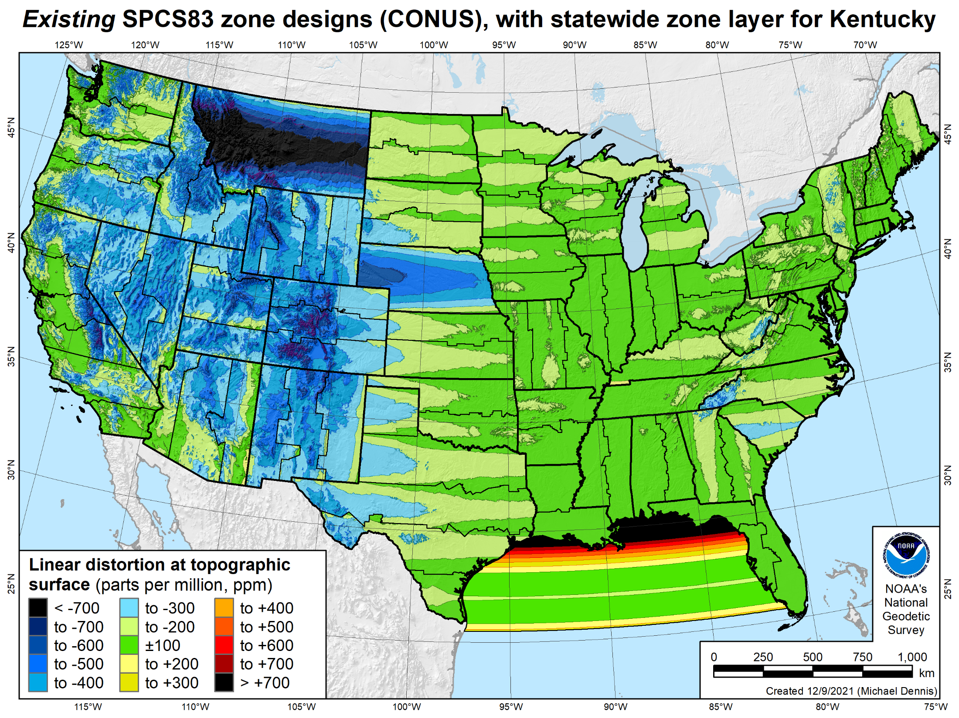
106 zones
Distortion increment 100 ppm (1:10,000 = 0.53 ft/mile)

Slide 24
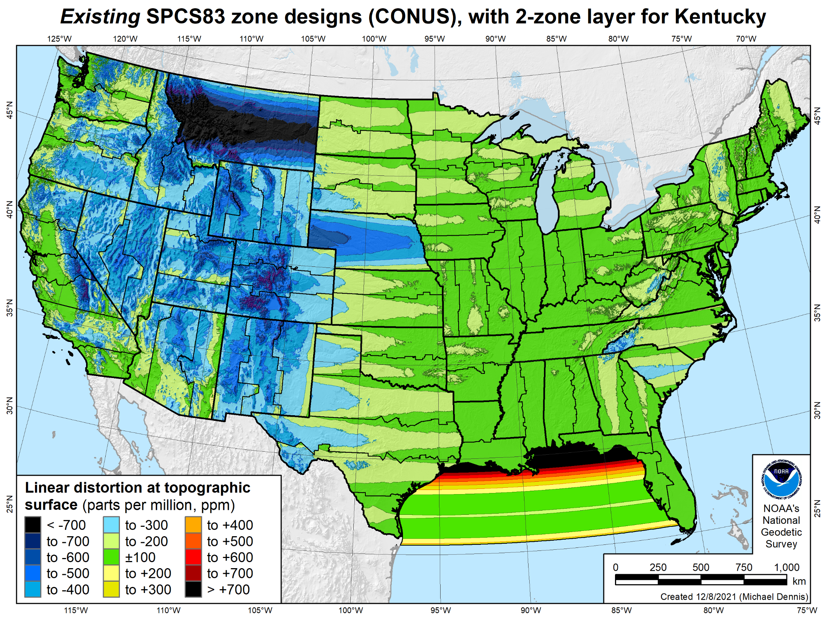
107 zones
Distortion increment 100 ppm (1:10,000 = 0.53 ft/mile)

Slide 25
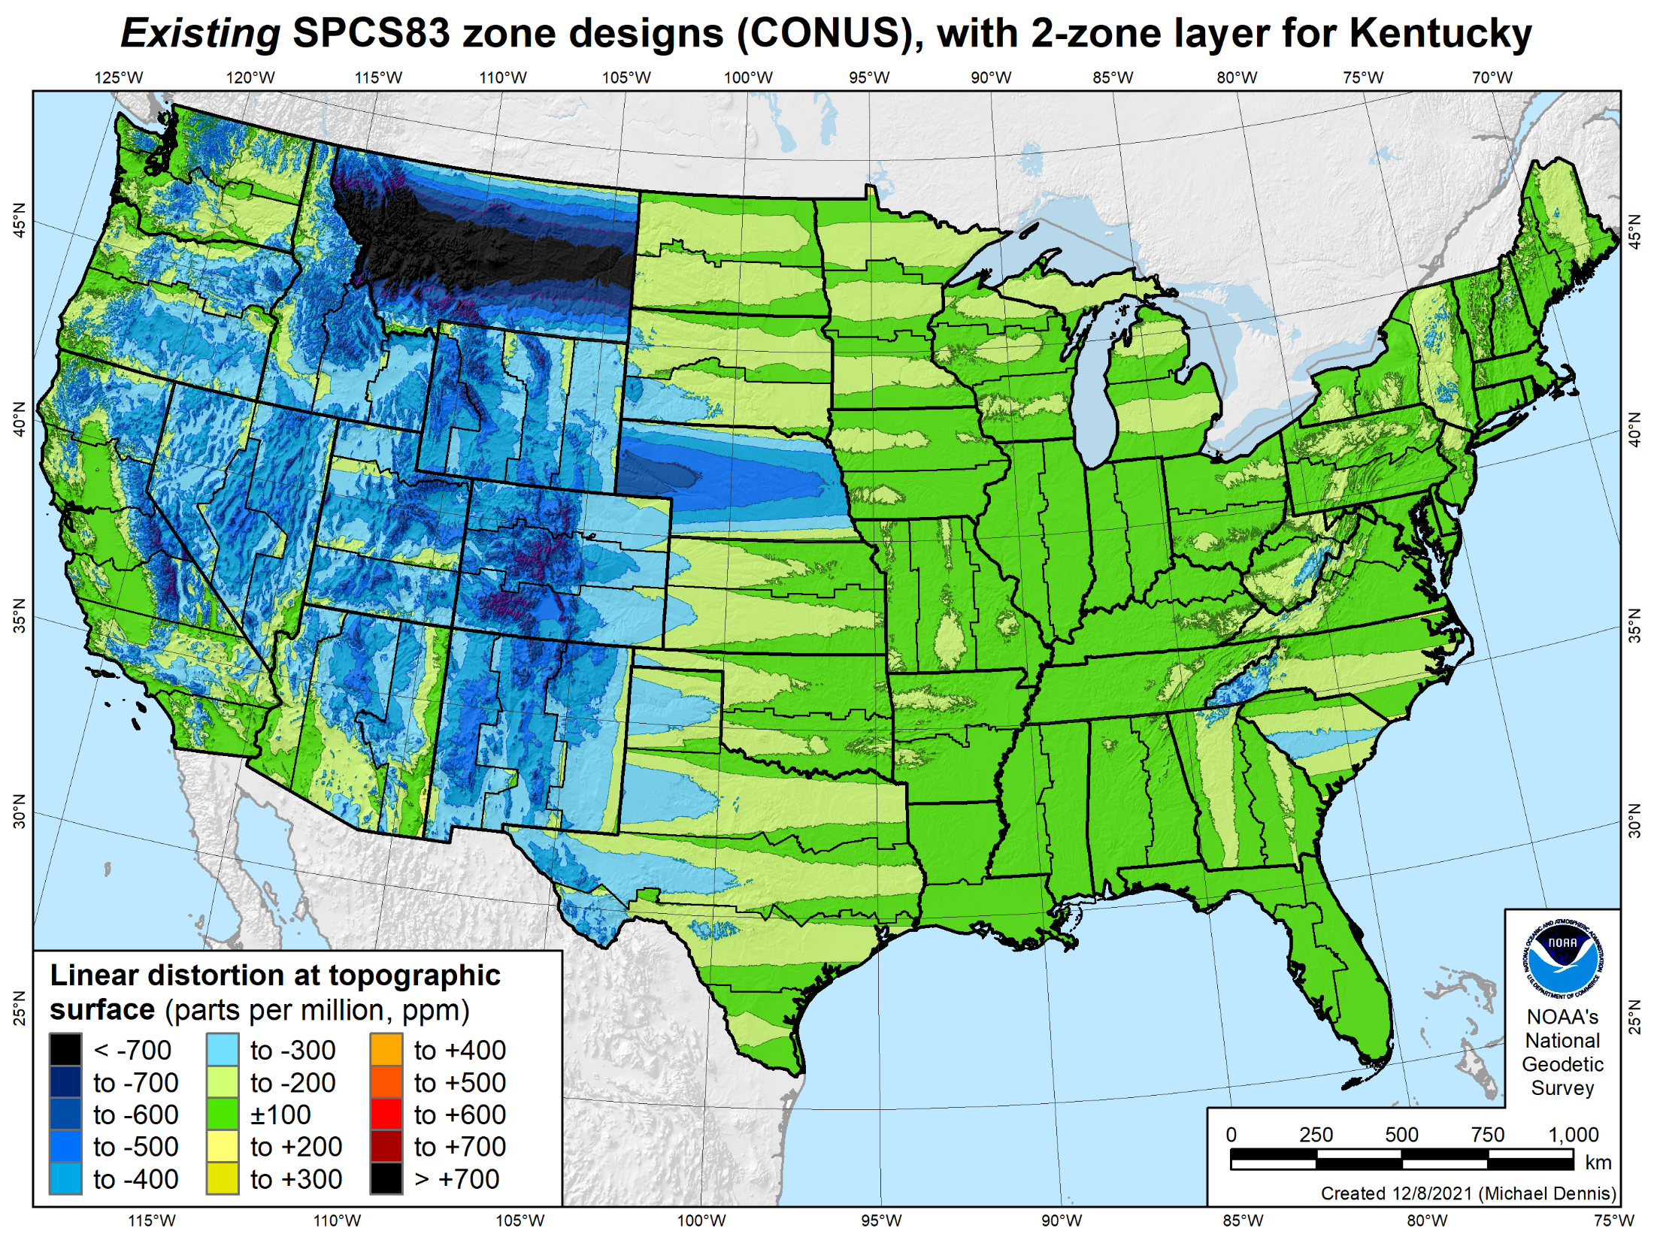
106 zones
Distortion increment 100 ppm (1:10,000 = 0.53 ft/mile)
Percent area within:
±20 ppm = 6%
±50 ppm = 17%
±100 ppm = 41%
±400 ppm = 91%

Slide 26
49 zones
Distortion increment 100 ppm (1:10,000 = 0.53 ft/mile)
Percent area within:
±20 ppm = 7%
±50 ppm = 18%
±100 ppm = 36%
±400 ppm = 88%

Slide 27
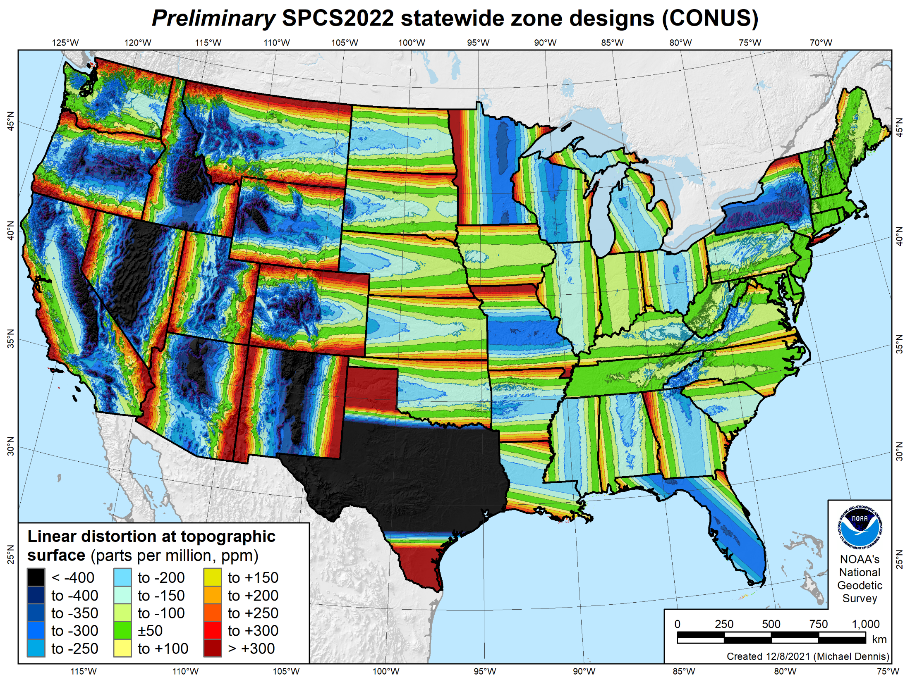
49 zones
Distortion increment 50 ppm (1:20,000 = 0.26 ft/mile)
Percent area within:
±20 ppm = 7%
±50 ppm = 18%
±100 ppm = 36%
±400 ppm = 88%

Slide 28
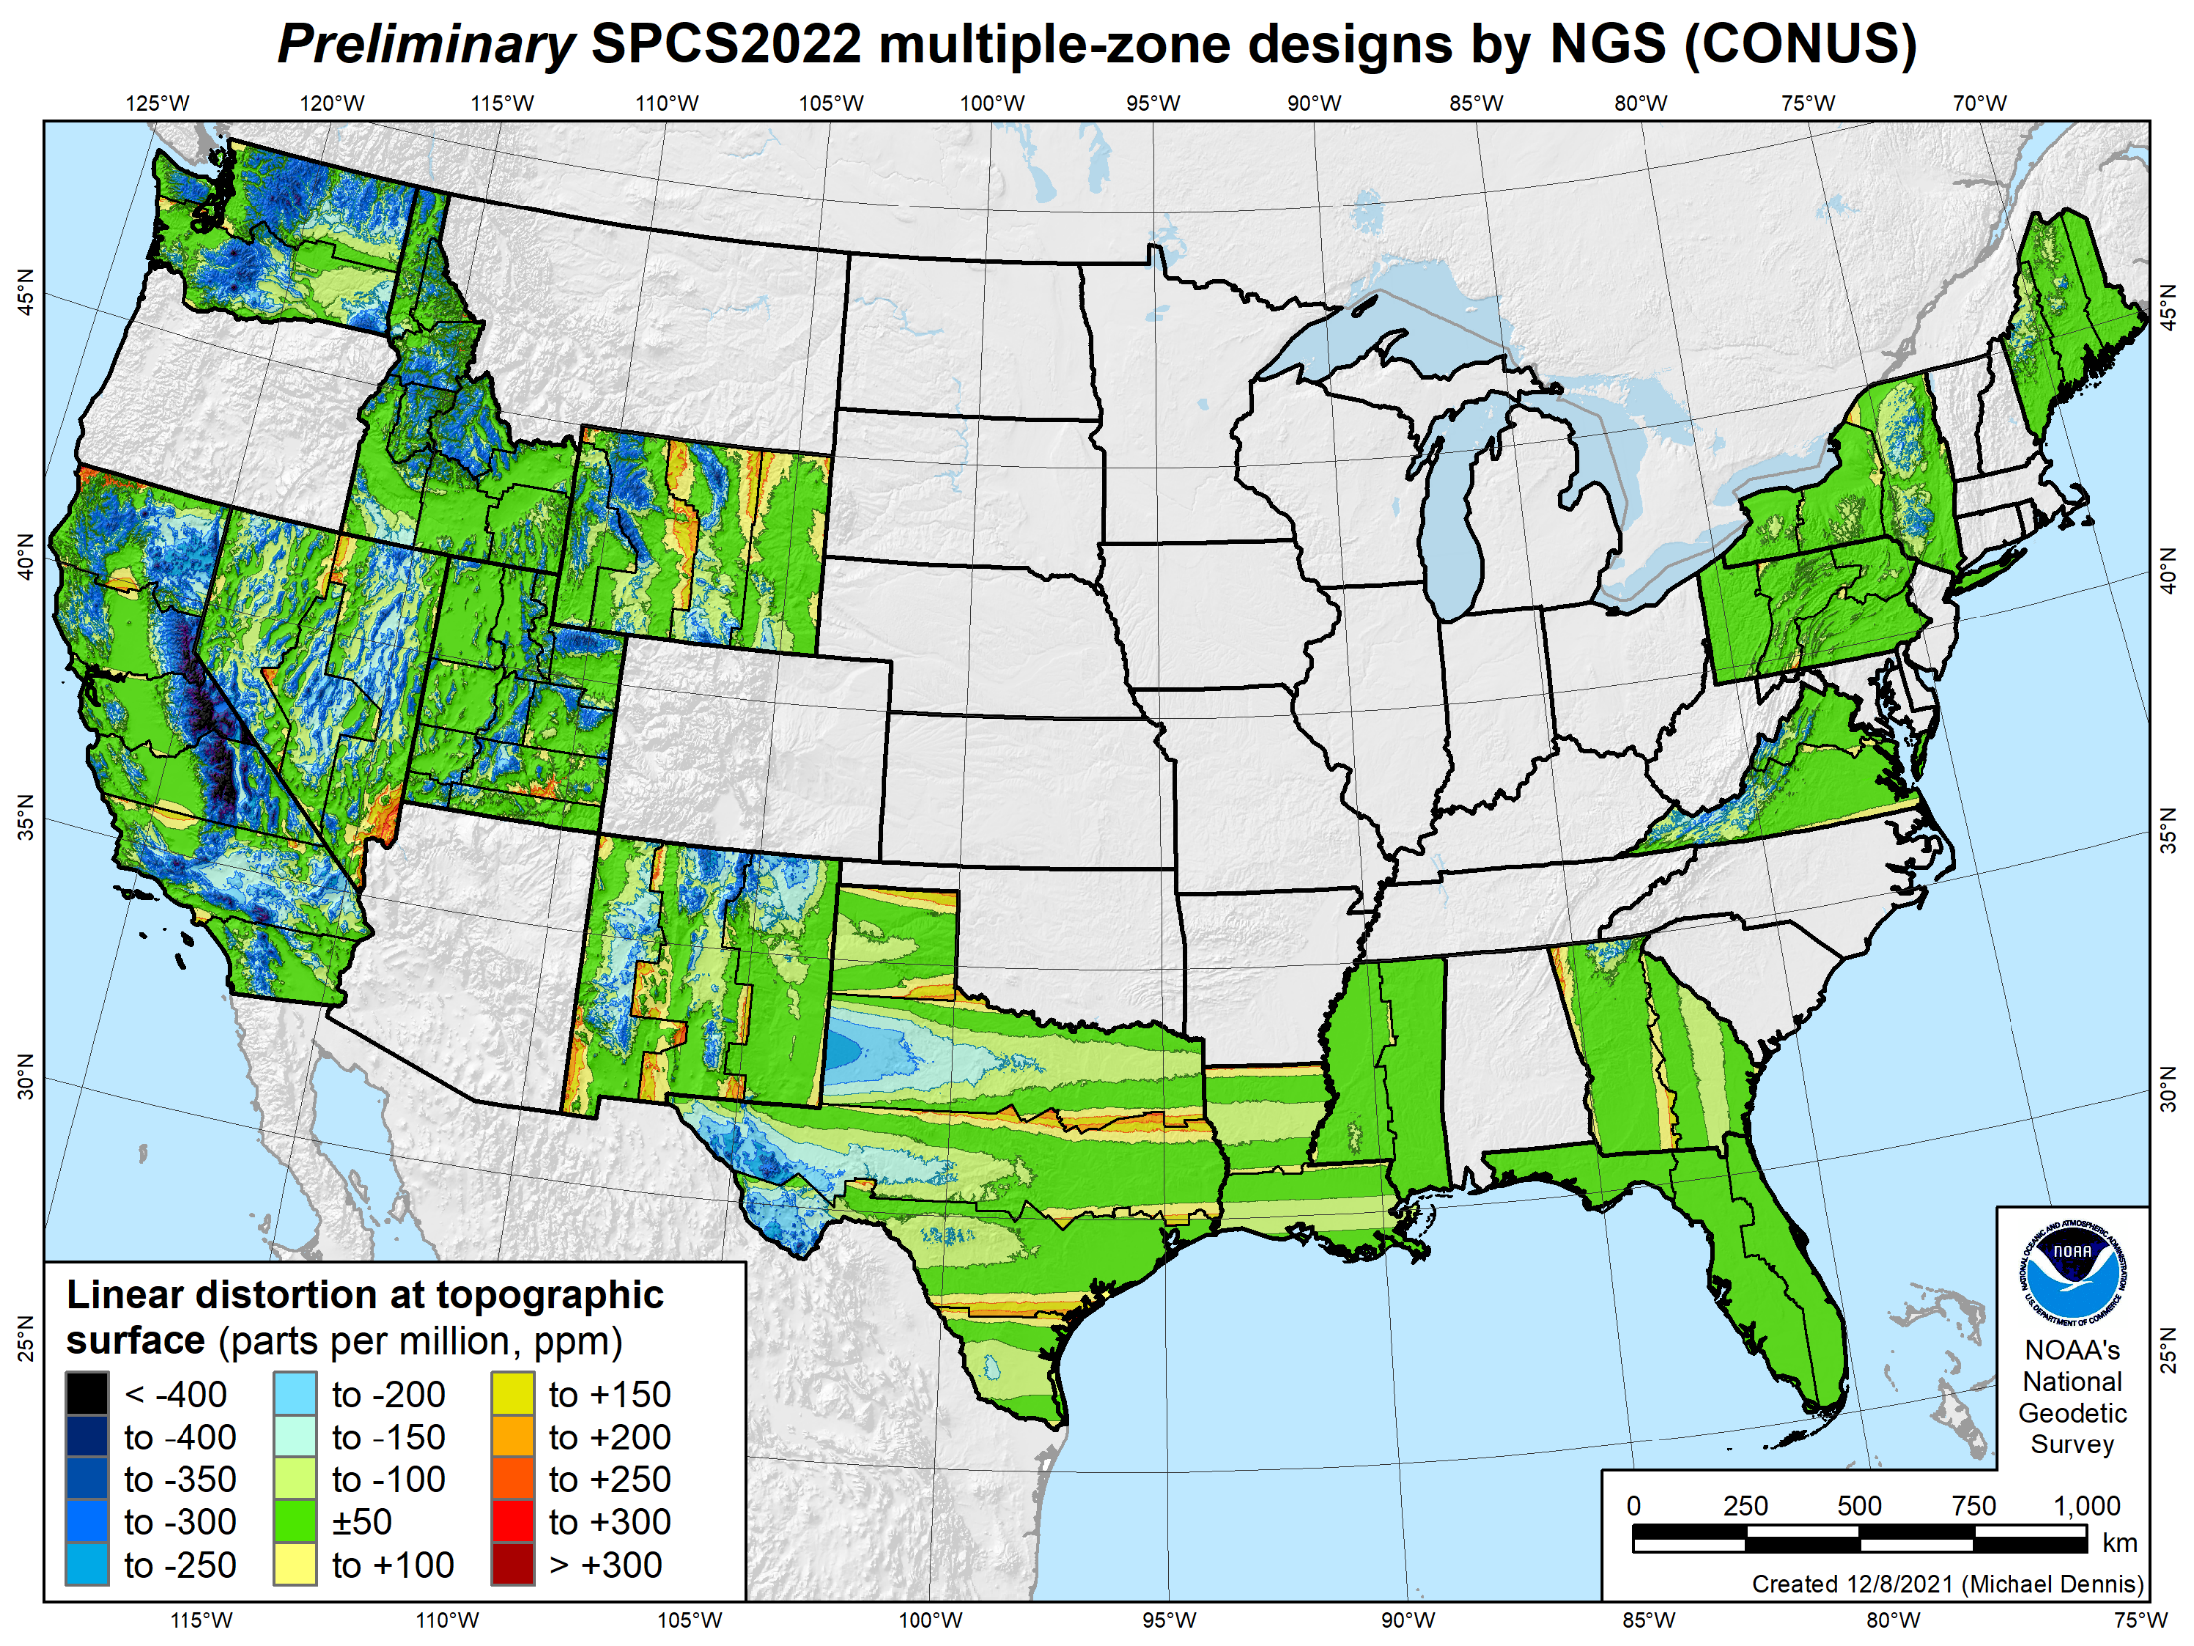
65 zones in 16 states
Distortion increment 50 ppm (1:20,000 = 0.26 ft/mile)
Percent area within:
±20 ppm = 26%
±50 ppm = 53%
±100 ppm = 79%
±400 ppm = 99.8%

Slide 29
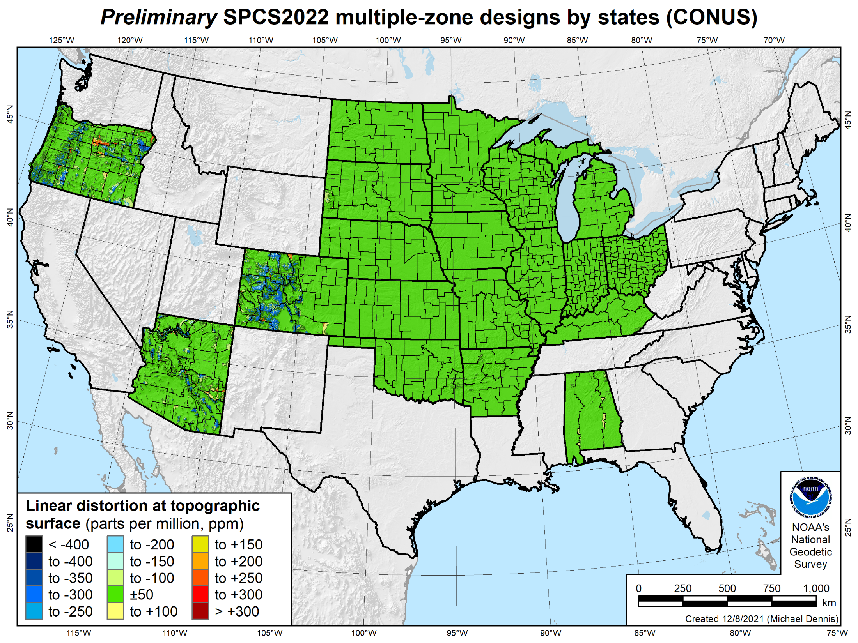
581 zones in 19 states
Distortion increment 50 ppm (1:20,000 = 0.26 ft/mile)
Percent area within:
±20 ppm = 84%
±50 ppm = 95%
±100 ppm = 98%
±400 ppm = 100%

Slide 30
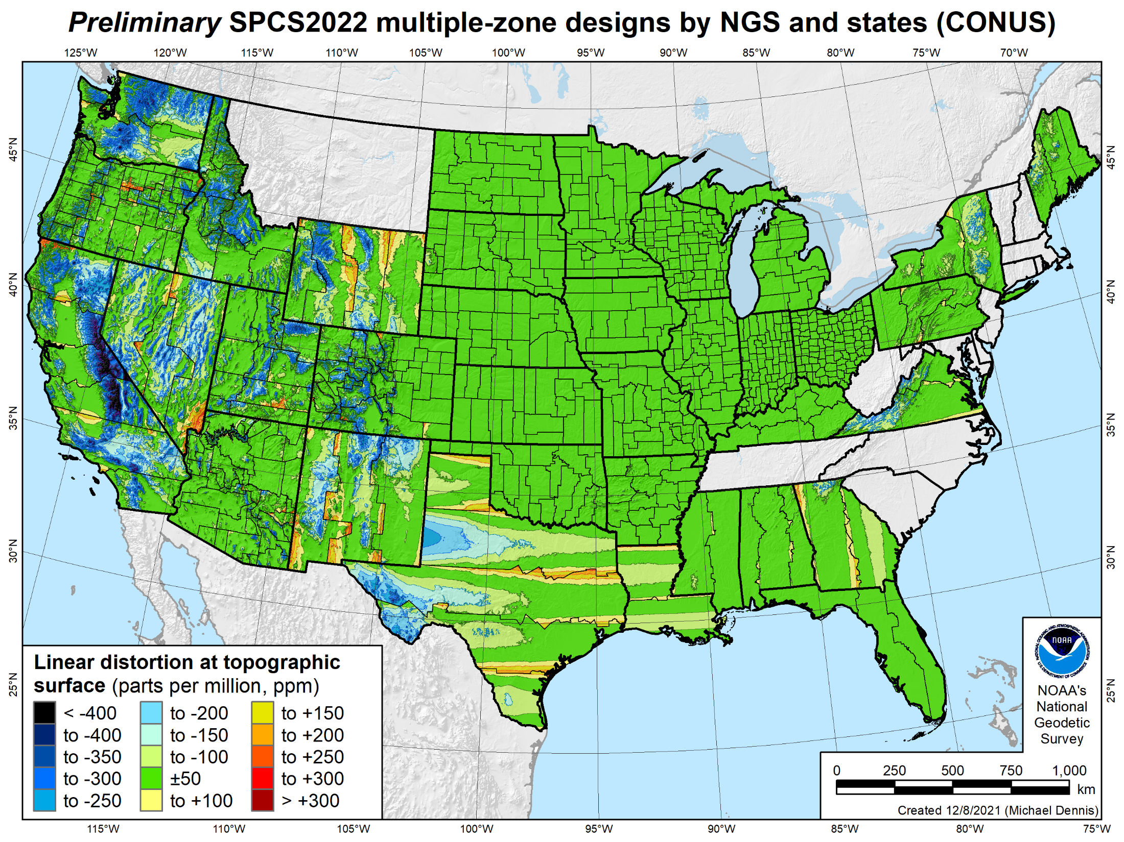
646 zones in 35 states
Distortion increment 50 ppm (1:20,000 = 0.26 ft/mile)
Percent area within:
±20 ppm = 54%
±50 ppm = 73%
±100 ppm = 89%
±400 ppm = 99.9%

Slide 31
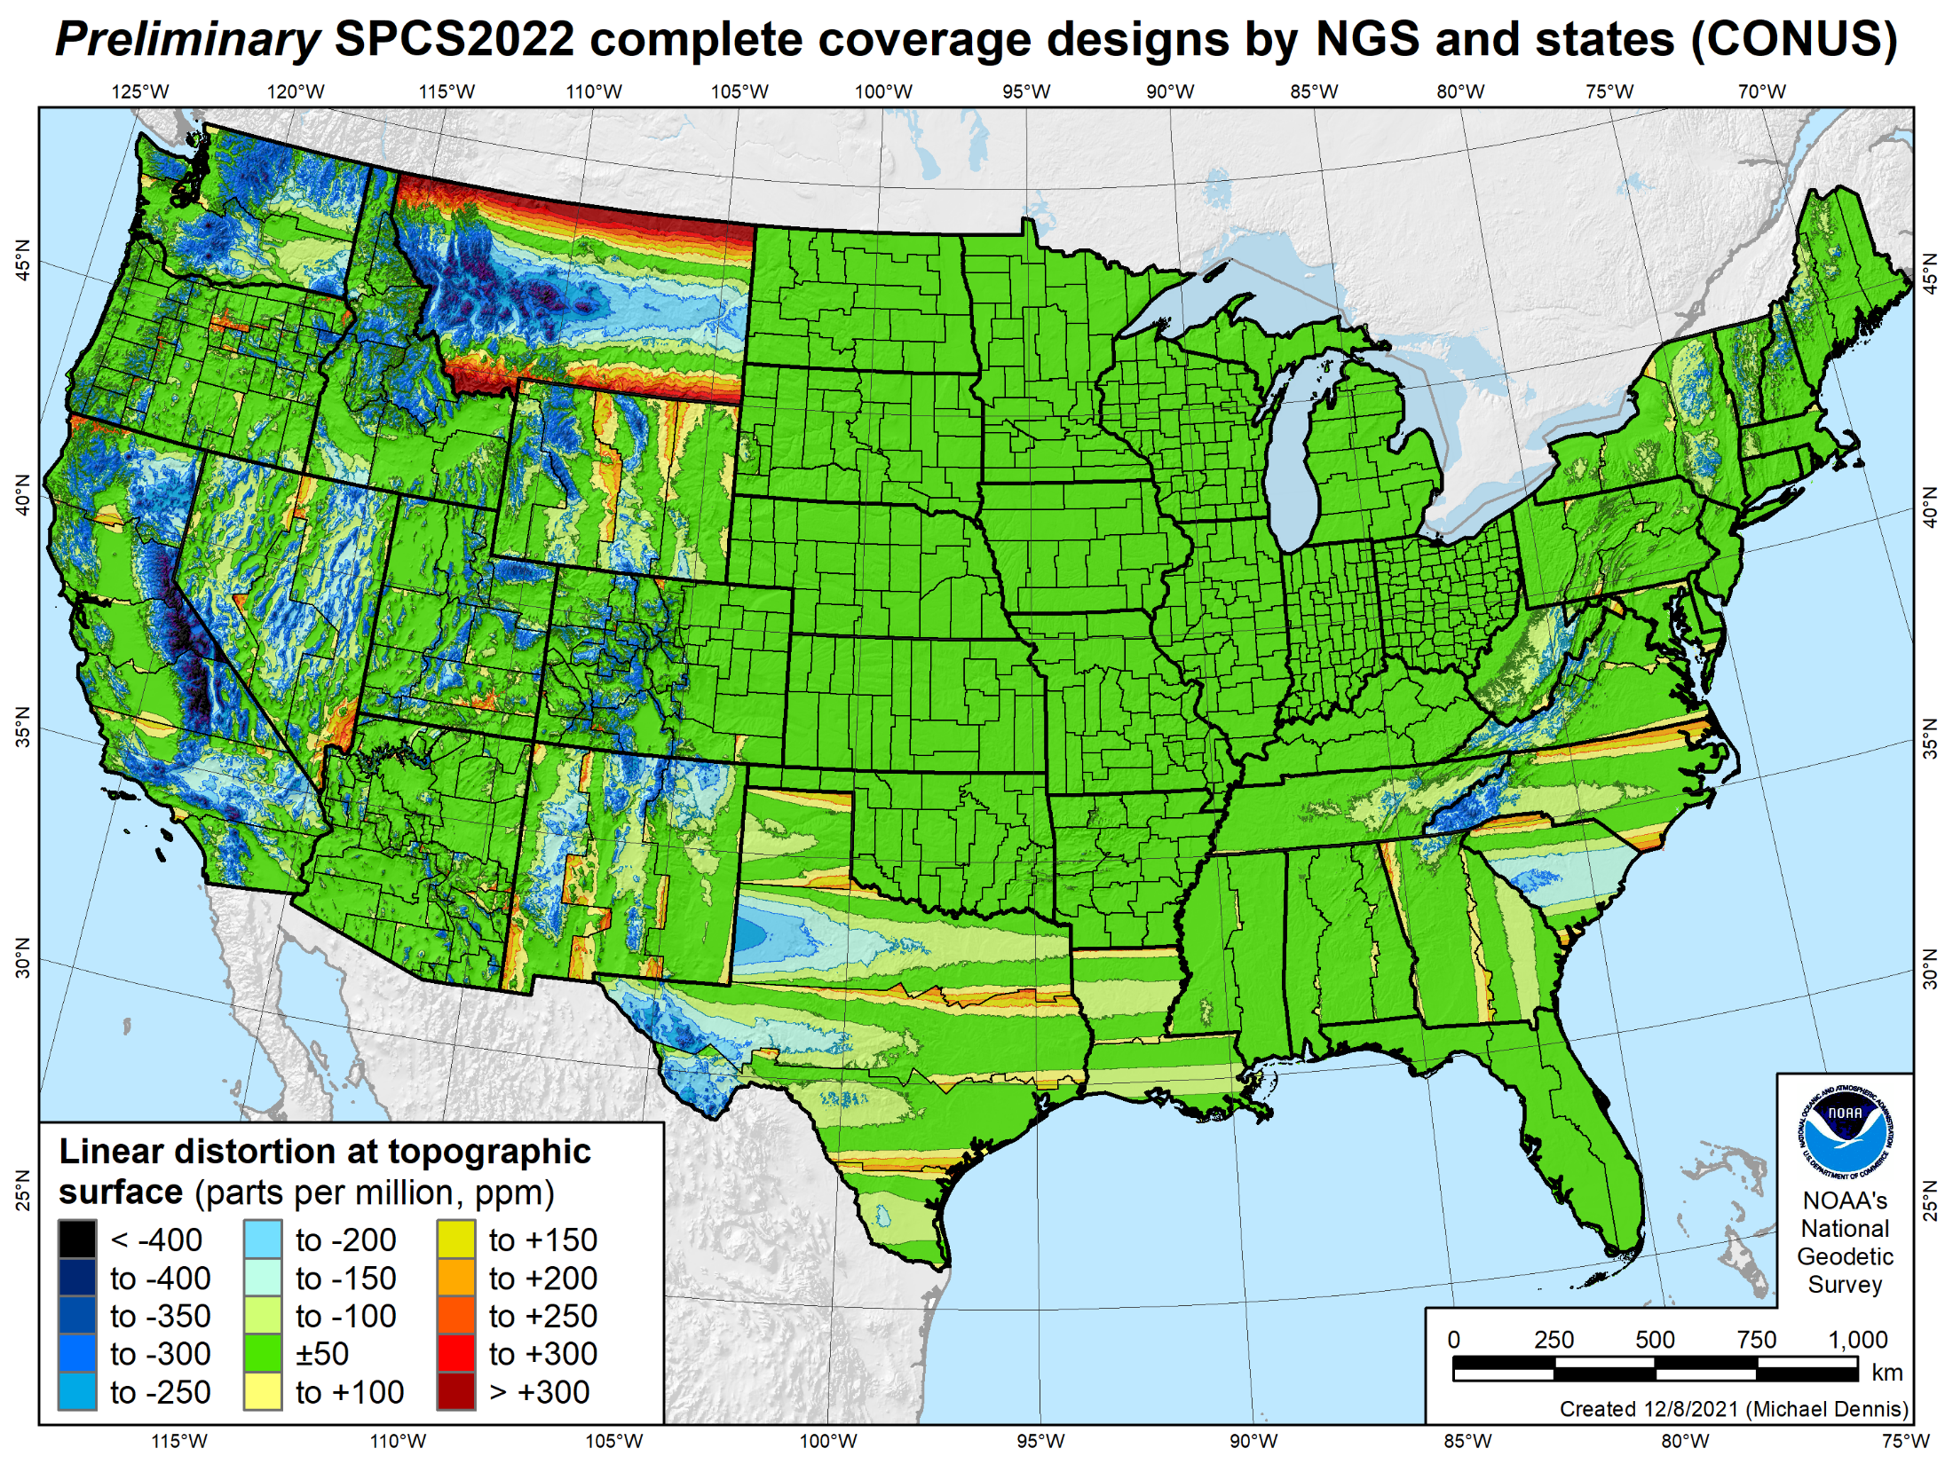
660 zones
Distortion increment 50 ppm (1:20,000 = 0.26 ft/mile)
Percent area within:
±20 ppm = 50%
±50 ppm = 69%
±100 ppm = 85%
±400 ppm = 99.7%

Slide 32
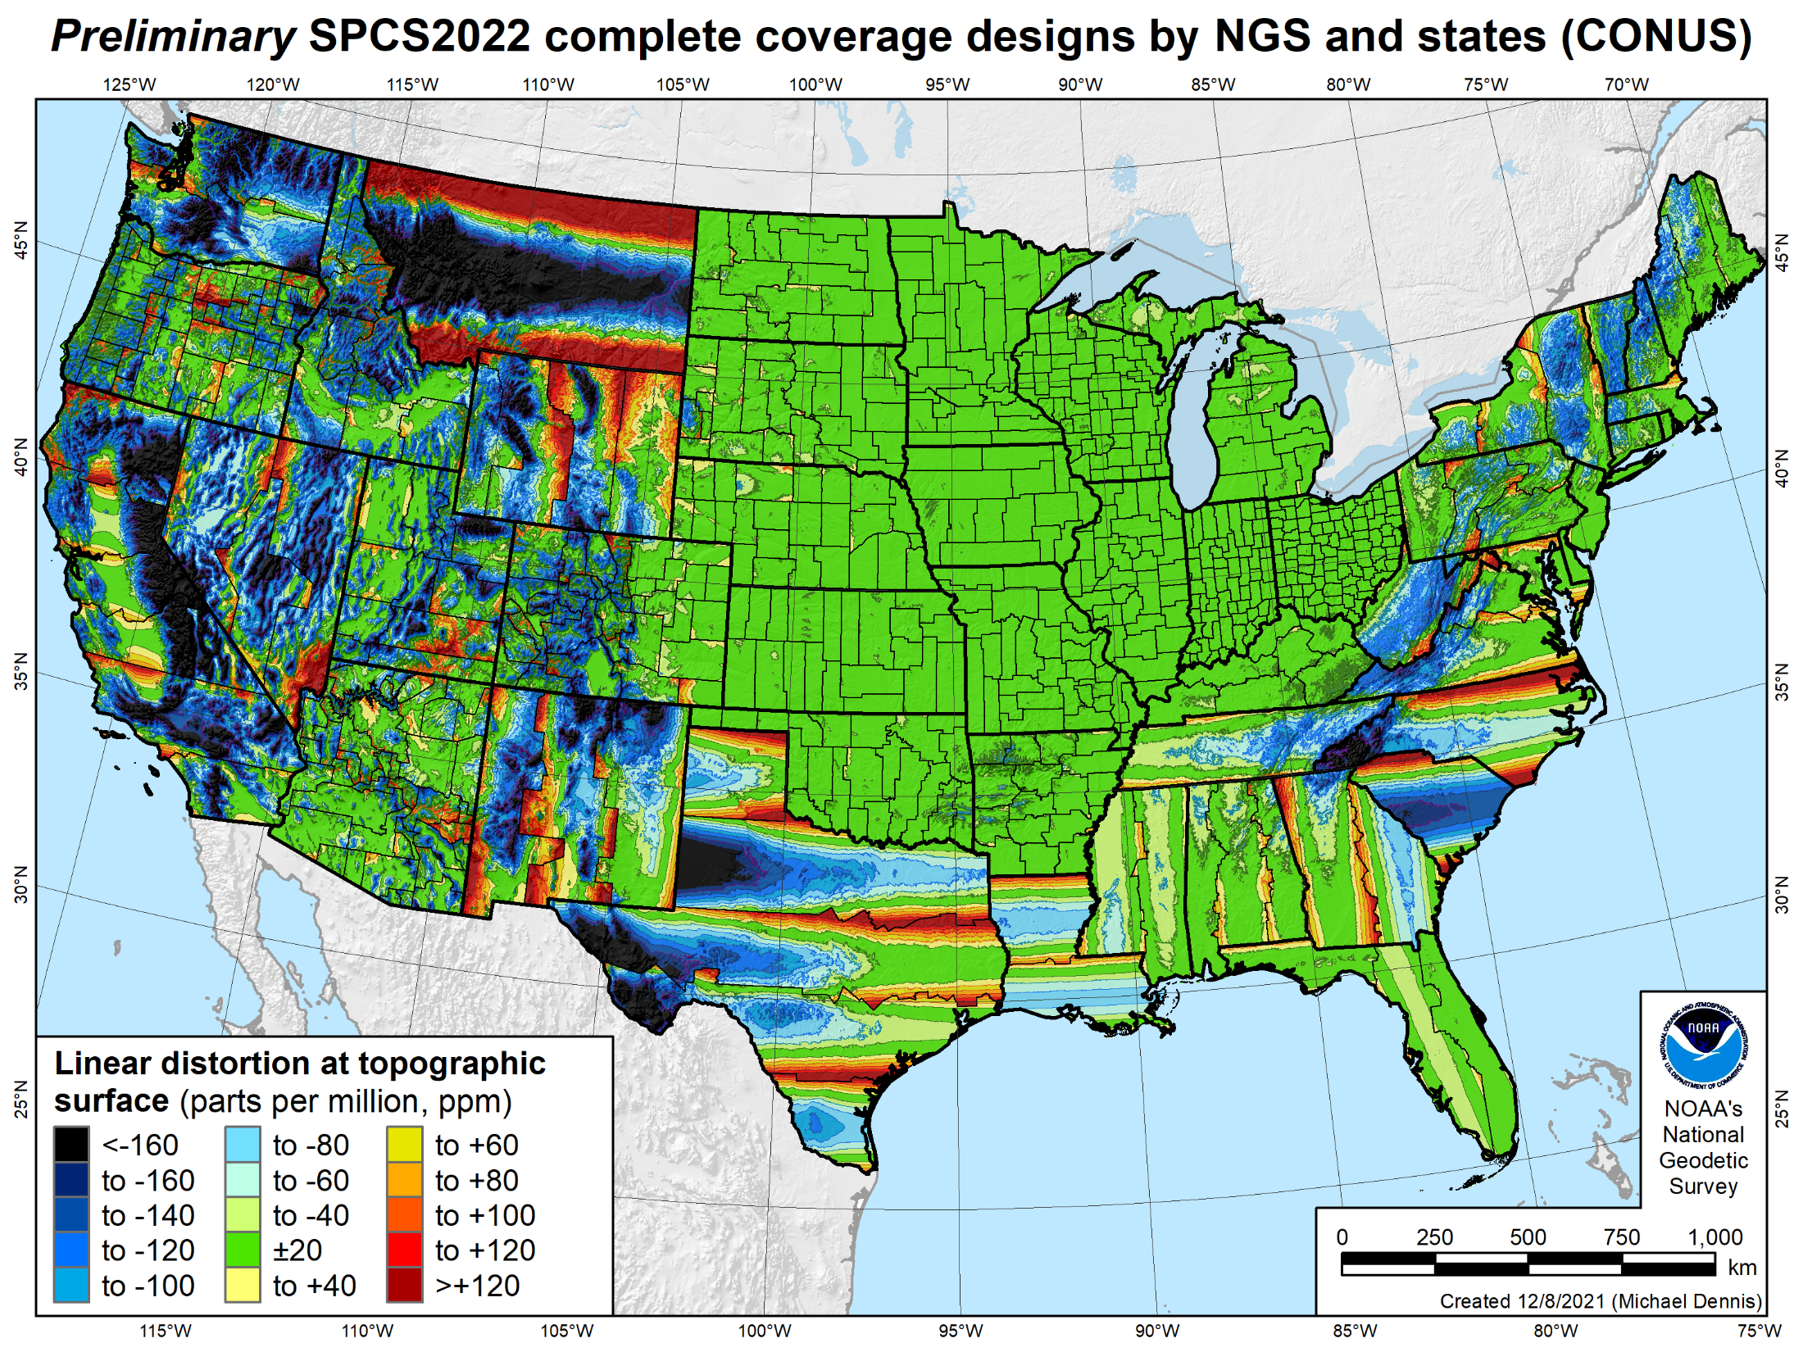
660 zones
Distortion increment 20 ppm (1:50,000 = 0.11 ft/mile)
Percent area within:
±20 ppm = 50%
±50 ppm = 69%
±100 ppm = 85%
±400 ppm = 99.7%

Slide 33
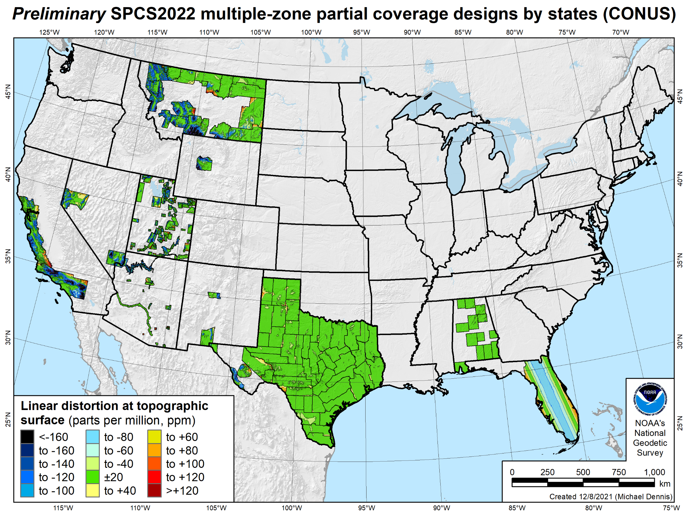
187 zones in 10 states
Distortion increment 20 ppm (1:50,000 = 0.11 ft/mile)
Percent area within:
±20 ppm = 73%
±50 ppm = 88%
±100 ppm = 97%
±400 ppm = 100%

Slide 34
660 zones
Distortion increment 20 ppm (1:50,000 = 0.11 ft/mile)
Percent area within:
±20 ppm = 50%
±50 ppm = 69%
±100 ppm = 85%
±400 ppm = 99.7%

Slide 35
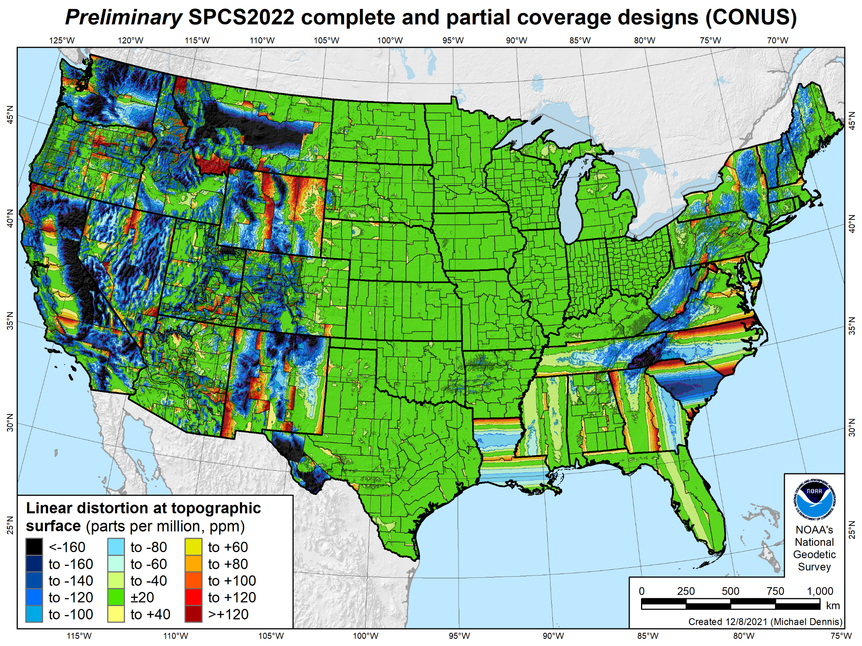
846 zones
Distortion increment 20 ppm (1:50,000 = 0.11 ft/mile)
Percent area within:
±20 ppm = 58%
±50 ppm = 76%
±100 ppm = 89%
±400 ppm = 99.9%

Slide 36
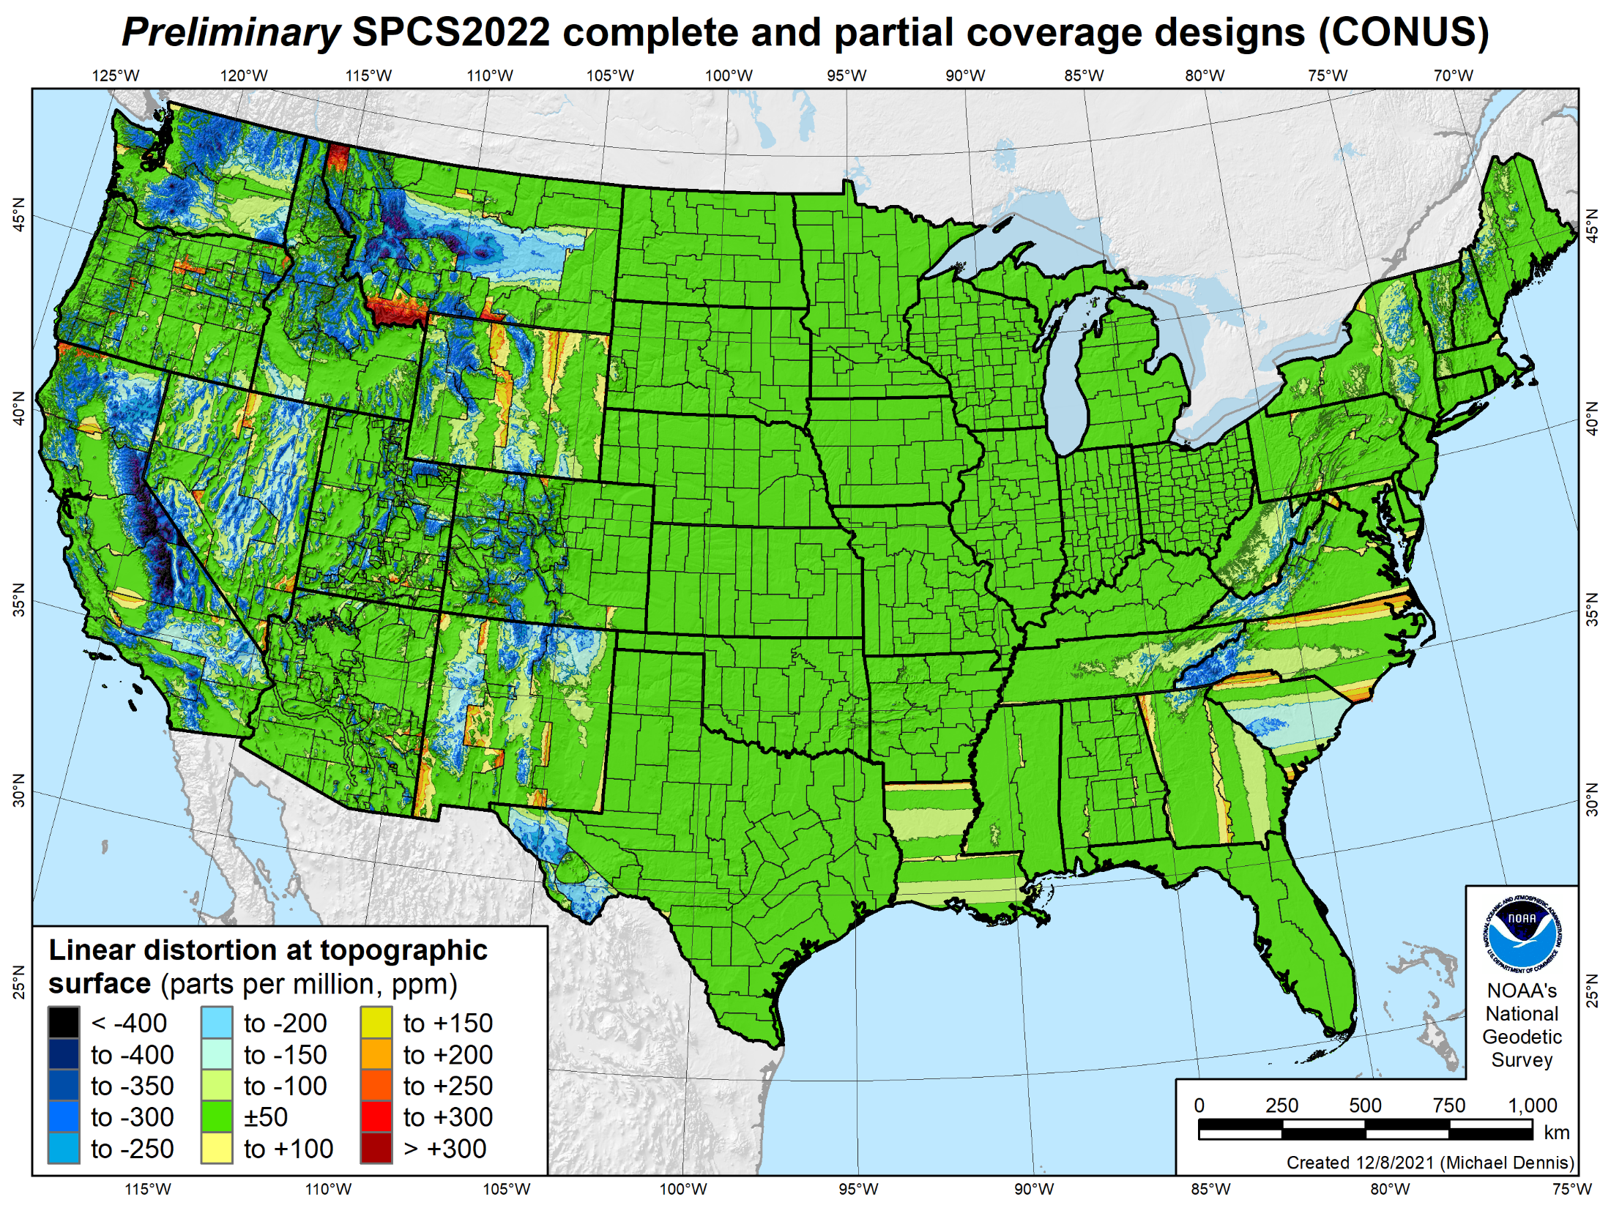
846 zones
Distortion increment 50 ppm (1:20,000 = 0.26 ft/mile)
Percent area within:
±20 ppm = 58%
±50 ppm = 76%
±100 ppm = 89%
±400 ppm = 99.9%

Slide 37
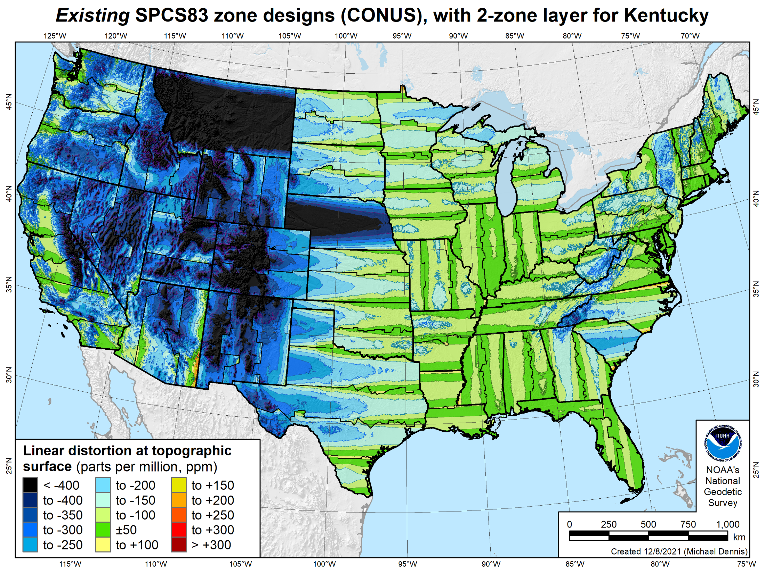
106 zones
Distortion increment 50 ppm (1:20,000 = 0.26 ft/mile)
Percent area within:
±20 ppm = 6%
±50 ppm = 17%
±100 ppm = 41%
±400 ppm = 91%

Slide 38
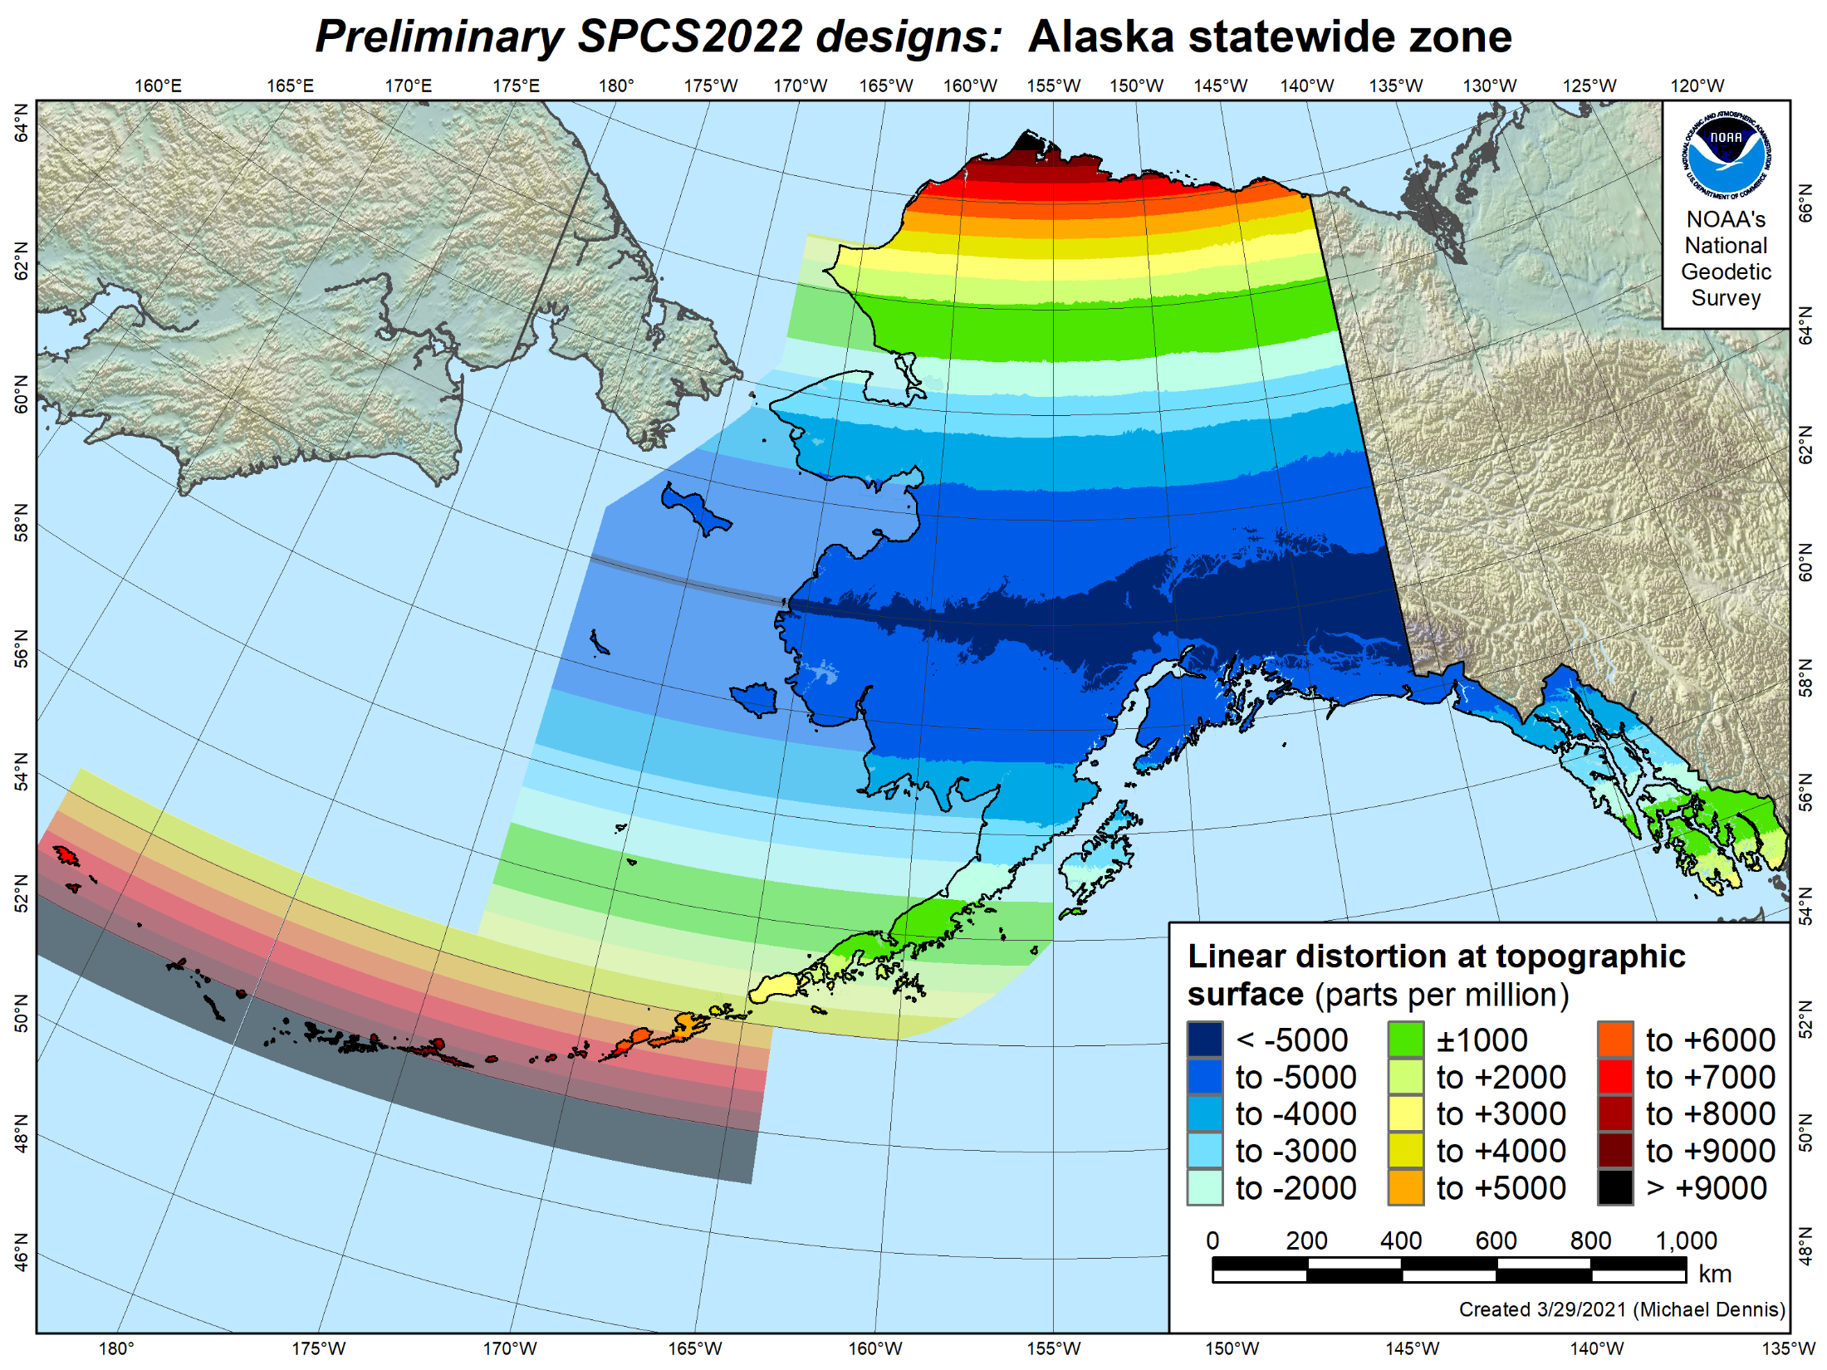
Percent land area within:
±20 ppm = 0.2%
±50 ppm = 0.5%
±100 ppm = 1%
±400 ppm = 4%
±1000 ppm = 11%
±5000 ppm = 82%

Slide 39
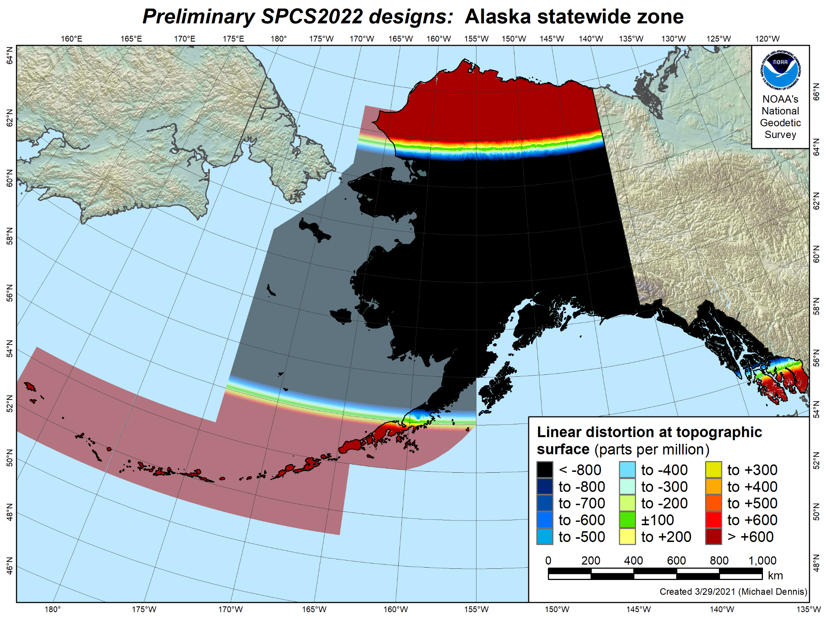
Percent land area within:
±20 ppm = 0.2%
±50 ppm = 0.5%
±100 ppm = 1%
±400 ppm = 4%
±1000 ppm = 11%
±5000 ppm = 82%

Slide 40
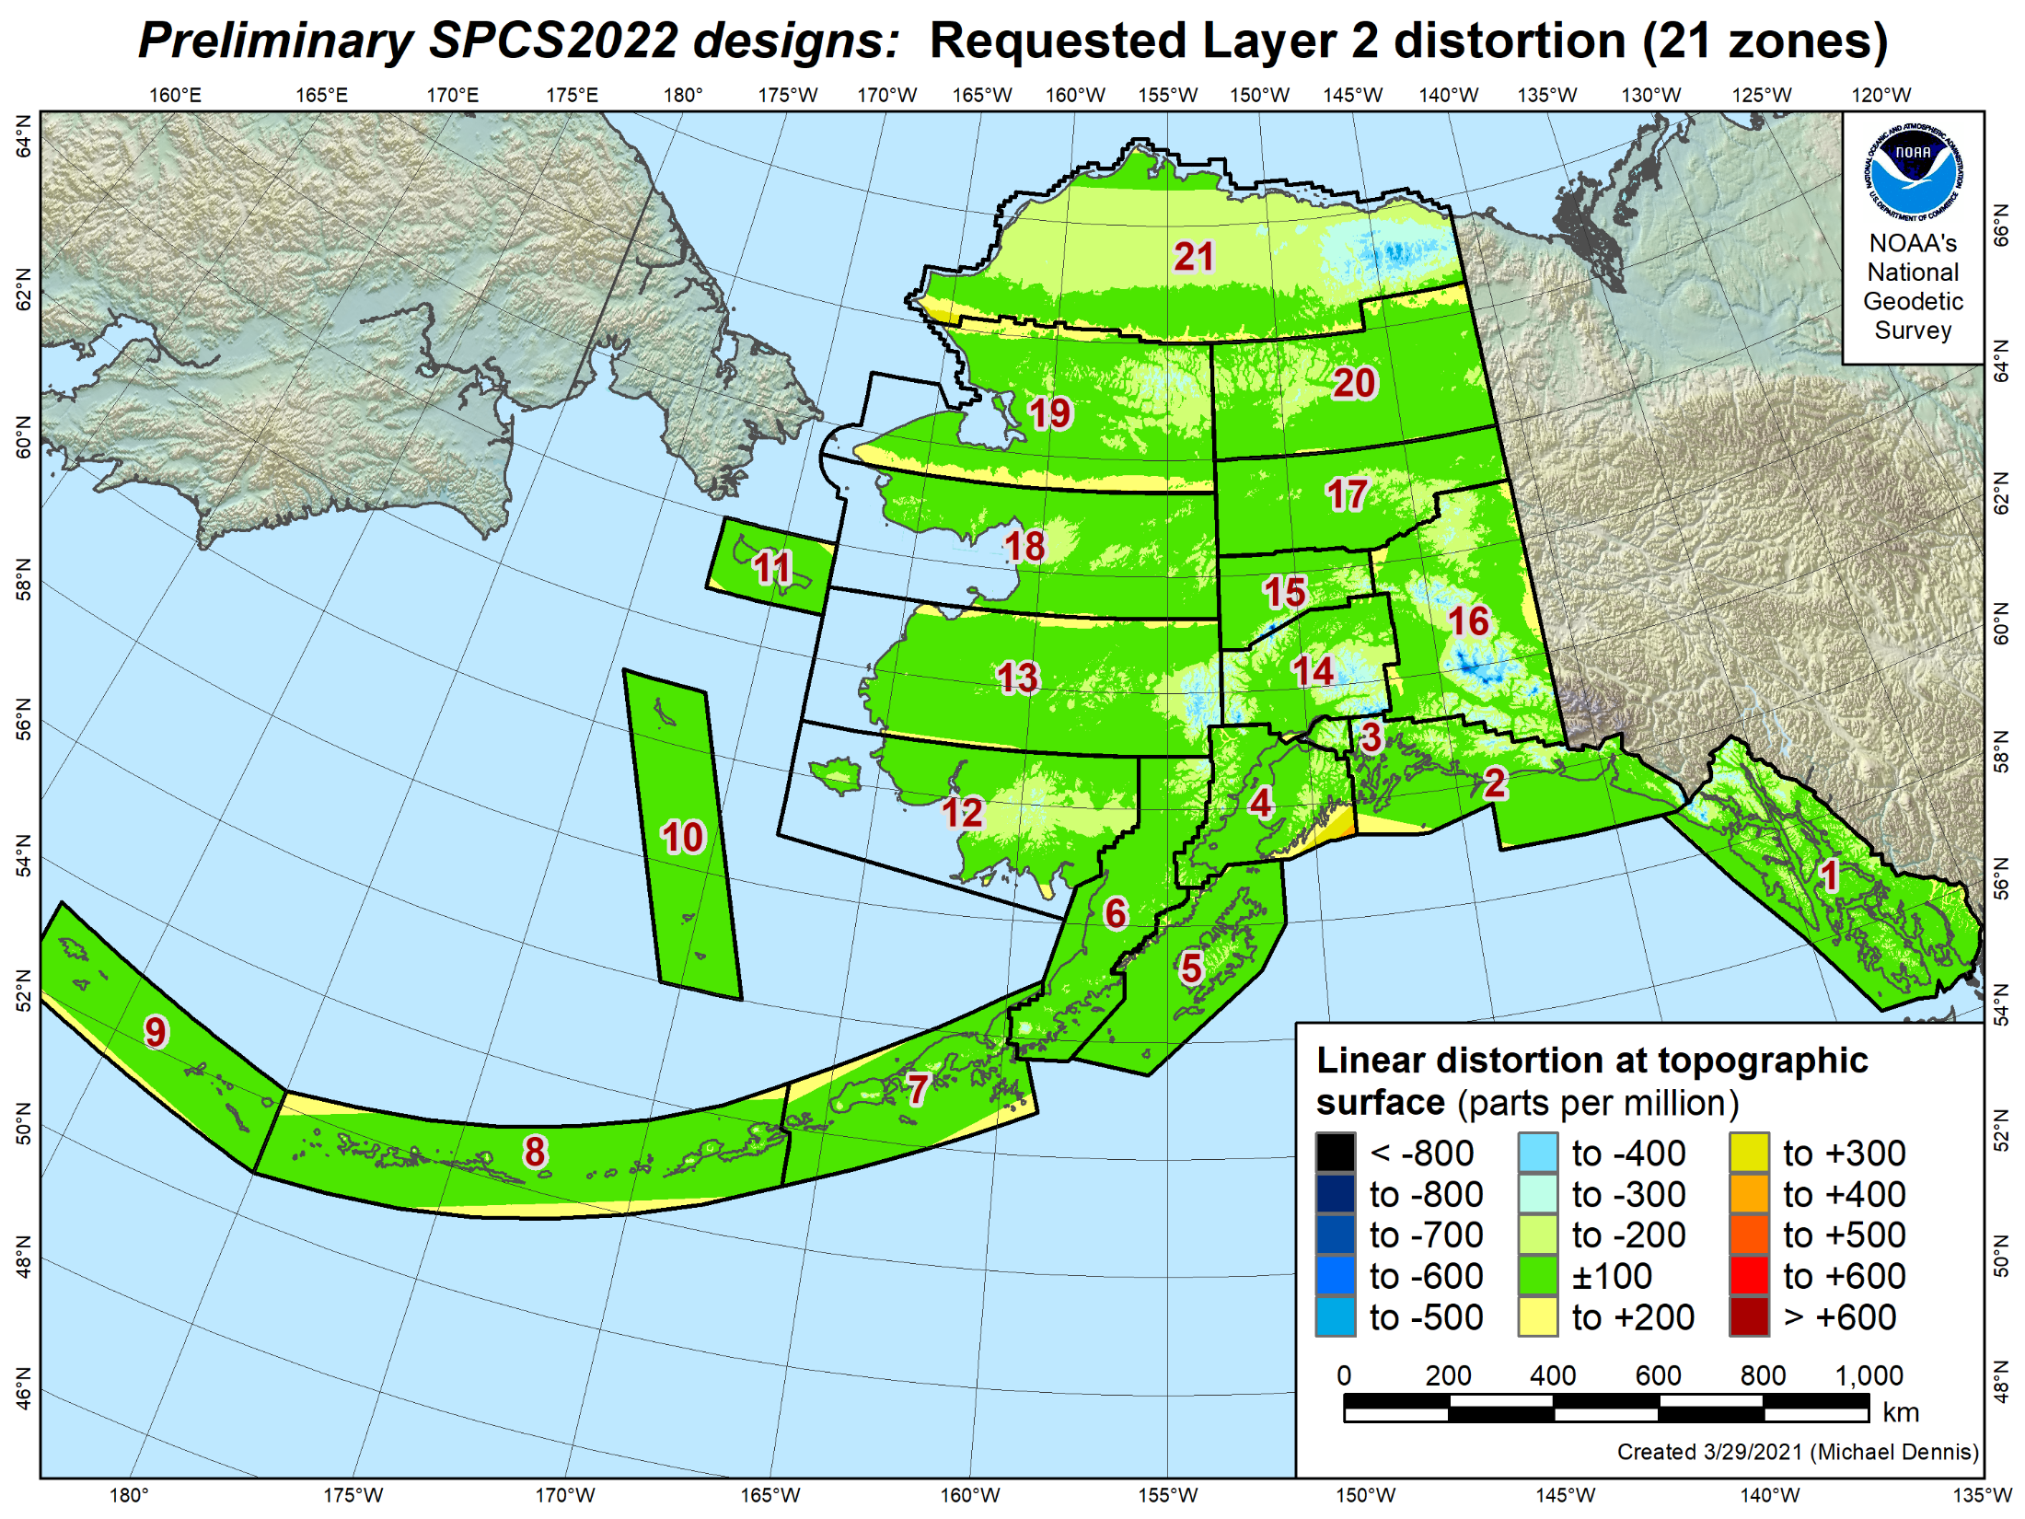
Percent land area within:
±20 ppm = 17%
±50 ppm = 38%
±100 ppm = 69%
±400 ppm = 99.8%

Slide 41
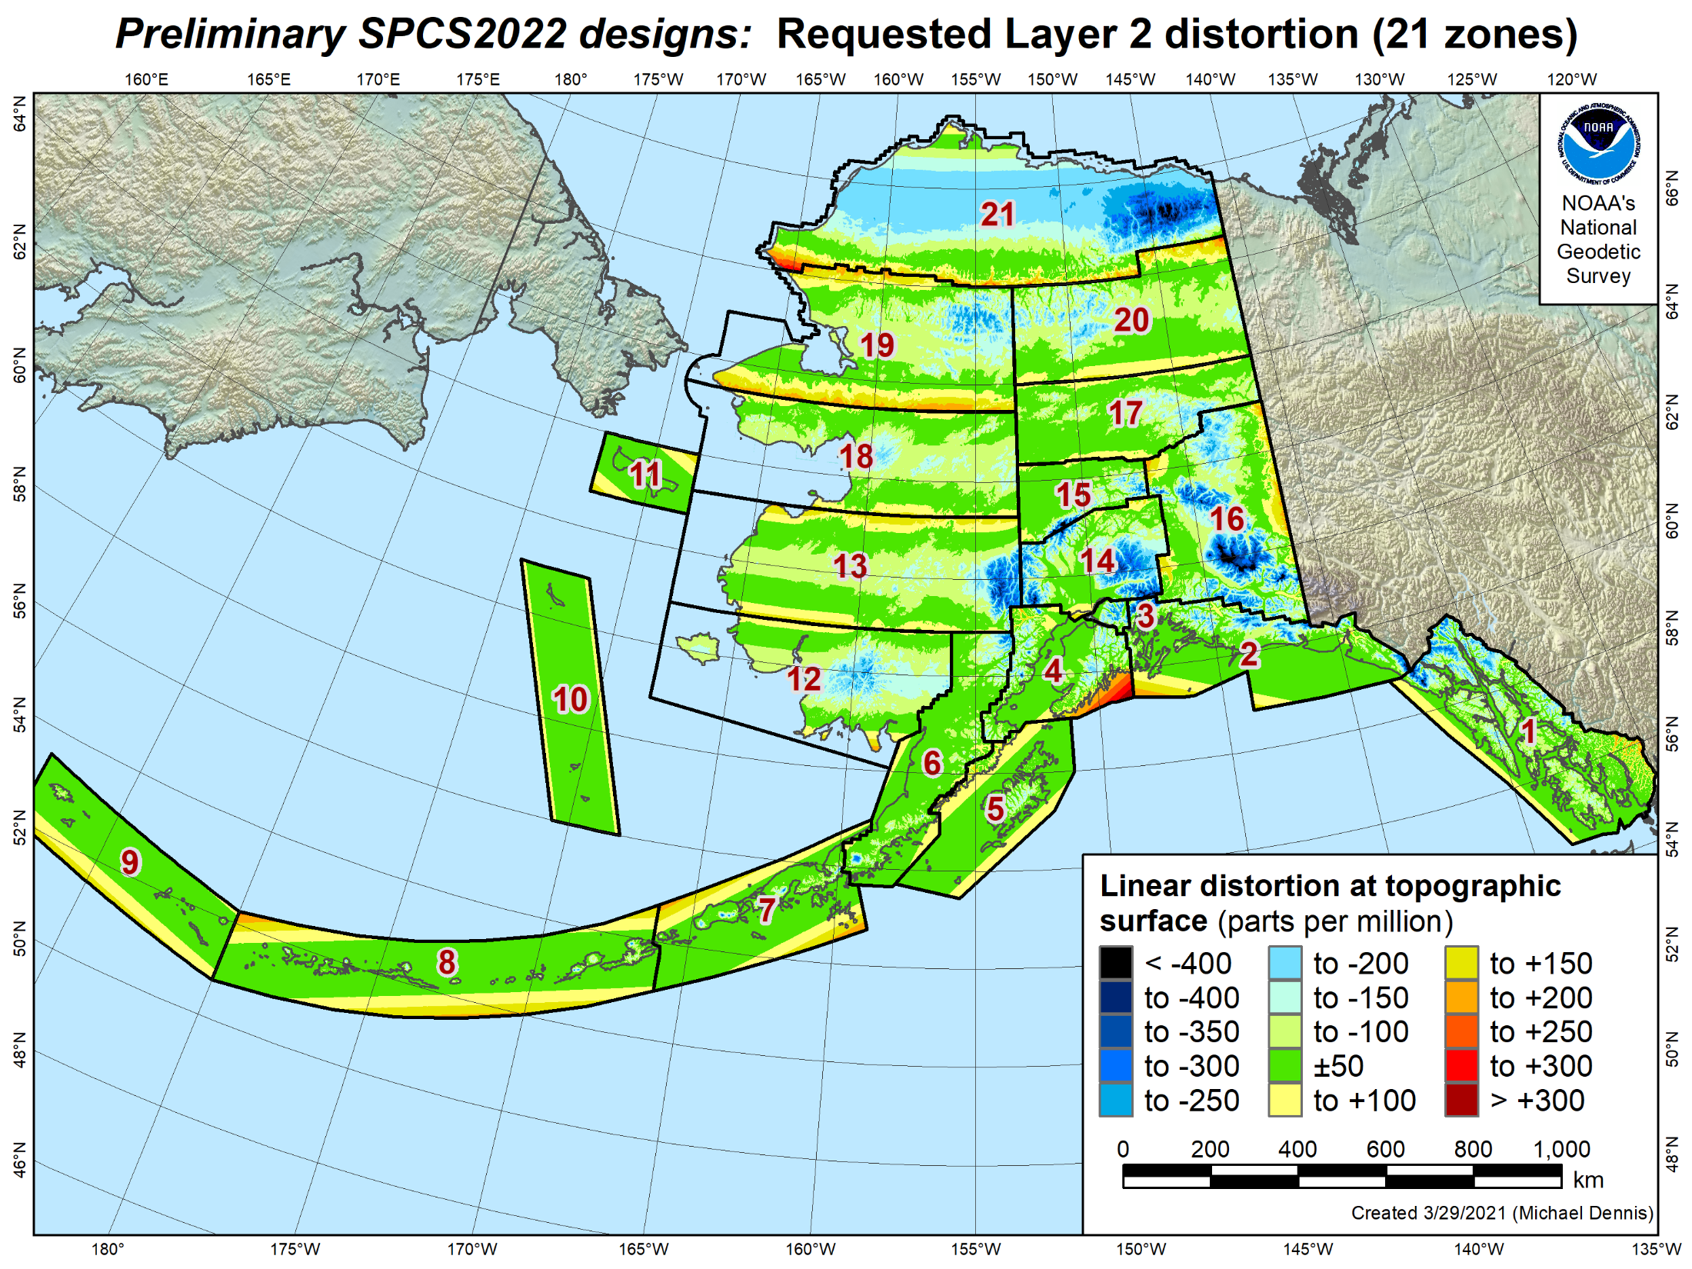
Percent land area within:
±20 ppm = 17%
±50 ppm = 38%
±100 ppm = 69%
±400 ppm = 99.8%

Slide 42
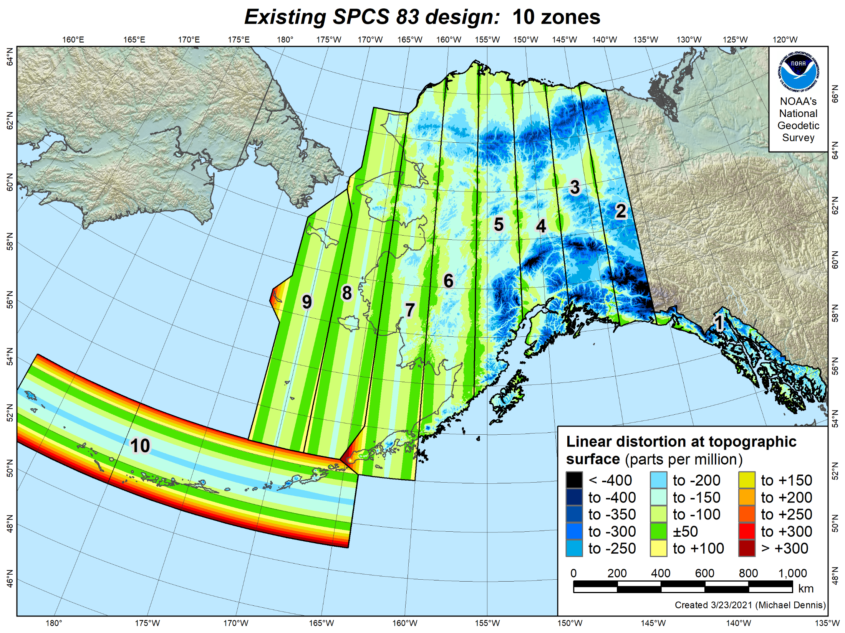
Percent land area within:
±20 ppm = 4%
±50 ppm = 11%
±100 ppm = 36%
±400 ppm = 99.1%

Slide 43
Percent land area within:
±20 ppm = 17%
±50 ppm = 38%
±100 ppm = 69%
±400 ppm = 99.8%

Slide 44
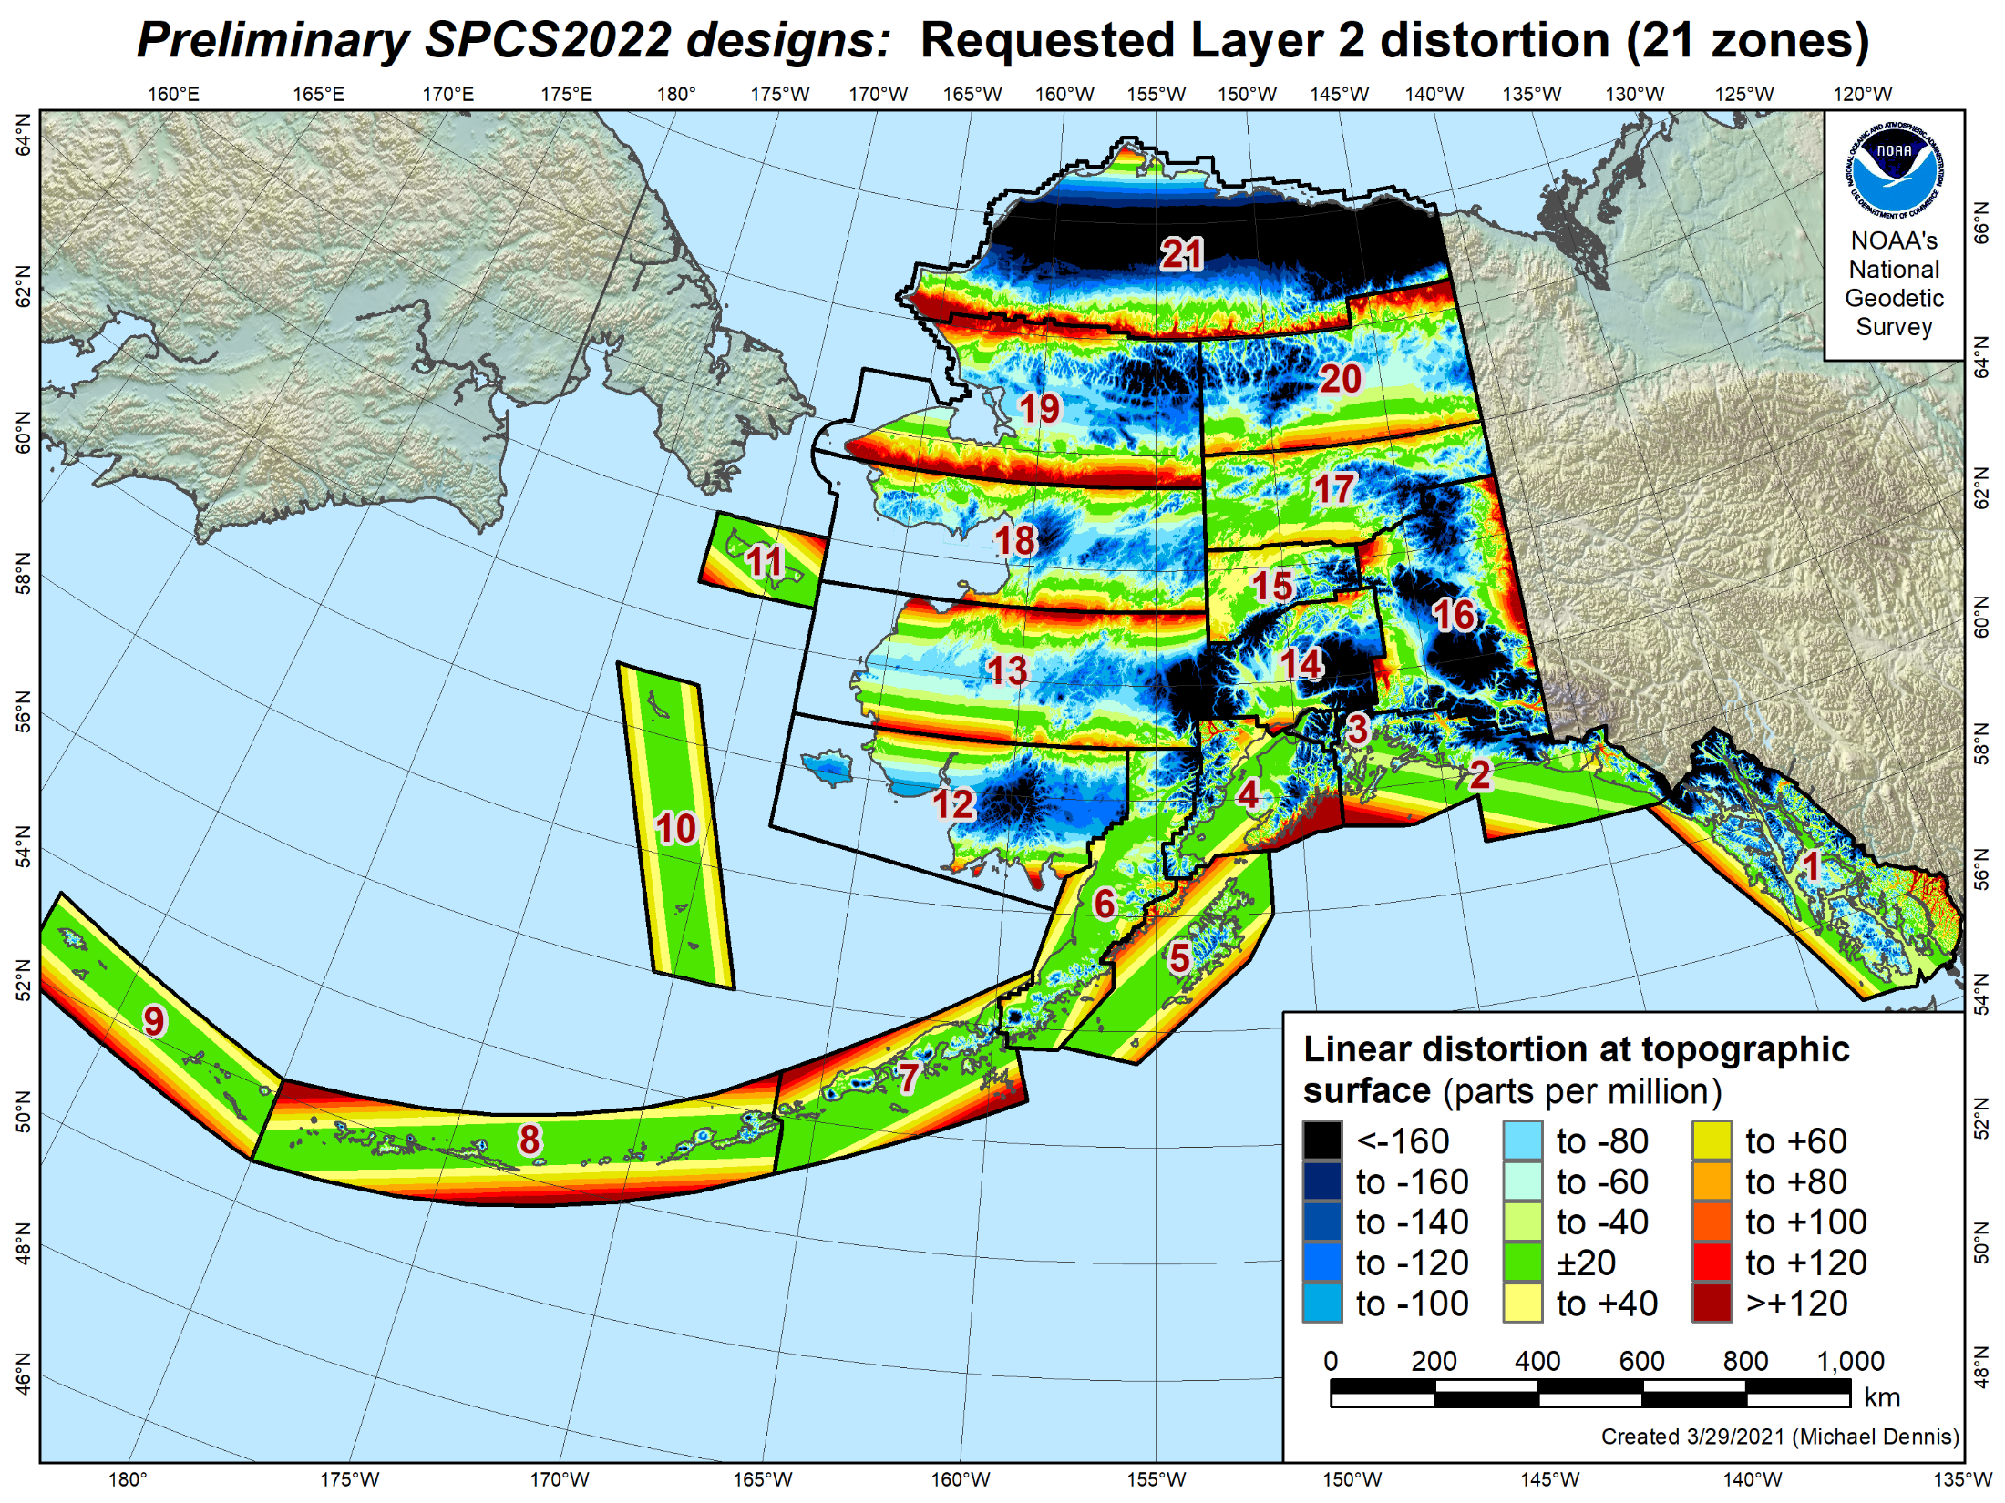
Percent land area within:
±20 ppm = 17%
±50 ppm = 38%
±100 ppm = 69%
±400 ppm = 99.8%

Slide 45
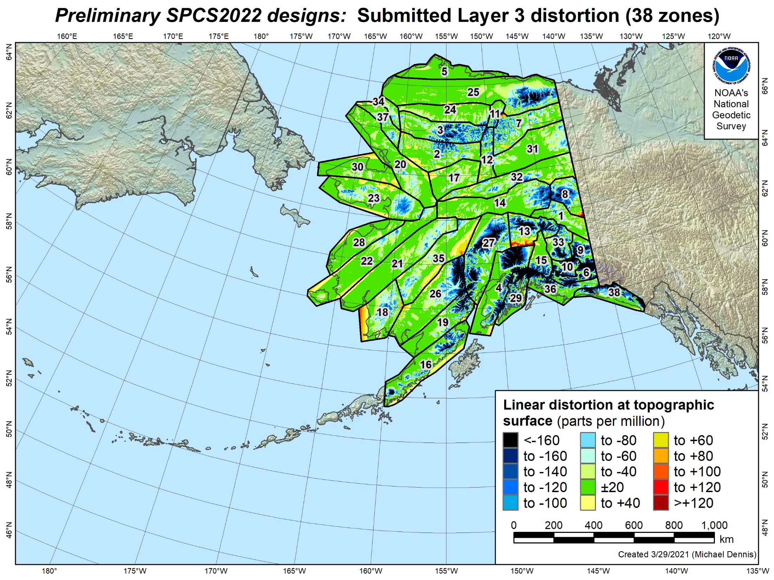
Percent land area within:
±20 ppm = 49%
±50 ppm = 74%
±100 ppm = 88%
±400 ppm = 99.9%

Slide 46
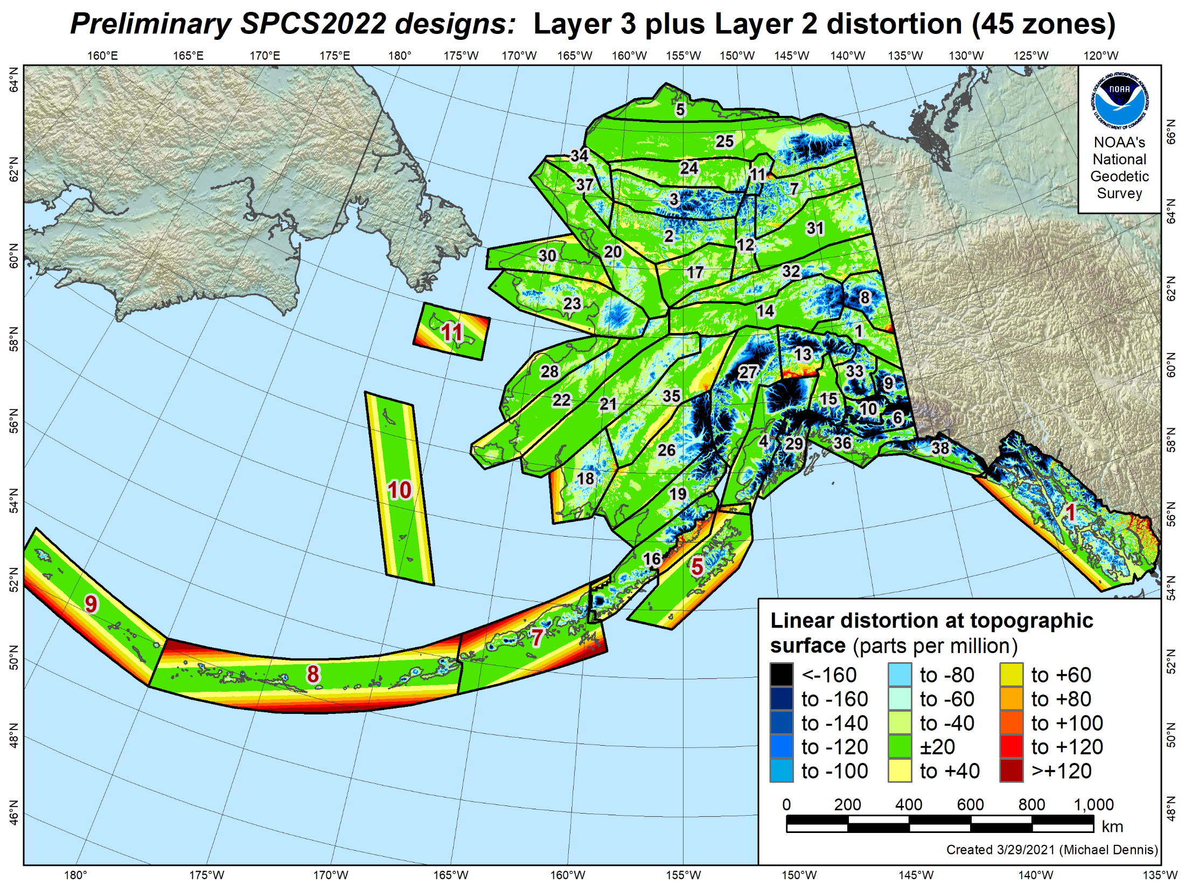
Percent land area within:
±20 ppm = 47%
±50 ppm = 73%
±100 ppm = 88%
±400 ppm = 99.9%

Slide 47
Poll Question
Most states will have more than one SPCS2022 “layer.” Which layer do you expect to use most often in your work?
427 of 604 attendees responded

Slide 48
About the timing of it all…
Finalize all designs in 2022
Other things in 2022
Provide machine-readable definitions
SPCS2022 report
Modify NGS algorithms (e.g., 1-parallel Lambert)
Release with rollout of modernized NSRS
Final definitions available in 2022
But will not release before new “datums”
Likely after 2025…

Slide 49
Likely after 2025?
Seriously?

Slide 50
But I want to use SPCS2022 now!

Slide 51
But I want to use SPCS2022 now!
Some want to use designs with NAD 83
Same reference ellipsoid
Near identical performance
Can reference to NAD 83, however:
Will not become part of SPCS 83
Will not be supported in NGS products & services
If you use designs with NAD 83:
Change grid origins by large amount
Will help avoid confusion with SPCS2022 version

Slide 52
Poll Question
Do you want to use the SPCS2022 zone designs with NAD 83, before the new reference frames (“datums”) are released?
434 of 604 attendees responded

Slide 53
What to expect for SPCS2022
Coordinates will change by at least 10,000 m
Latitude and longitude change about 1-2 m
Rest of change due to projection definition
Less difference between “grid” and “ground”
More than one zone layer in most states
Zones will be similar to SPCS 83 in some states
Zones will be very different in most states
Every state will have a statewide zone layer

Slide 54
SPCS2022 summary
Minimize distortion at topo surface, not ellipsoid
Up to 3 zone “layers” allowed
Some layers very similar to existing SPCS 83
Some layers very different
Total of 968 zones (likely will decrease somewhat):
54 statewide zones
911 zones that cover part of a state
3 special use zones
Will be implemented along with Modernized NSRS
Earlier usage with NAD 83 will not be supported by NGS
Can change/add/remove zones after modernized NSRS

Slide 55
geodesy.noaa.gov
Questions?

Slide 56
Poll Question
What is your profession?
266 registrants responded

