Slide 1

Positioning America
for the future
A New Geometric Datum for the U.S.
Michael Dennis (for Joe Evjen)
National Geodetic Survey, NOAA
Esri International User Conference
July 9, 2013

Slide 2
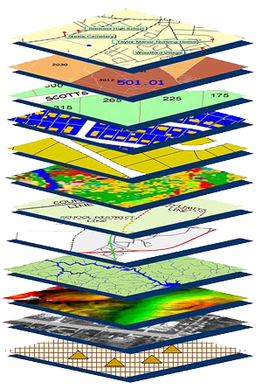
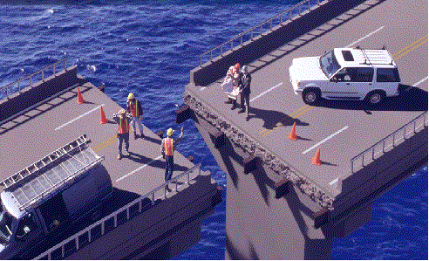
accurate positioning begins
with accurate coordinates
geodetic control (the NSRS) is the foundation for all geospatial products.
without Geodetic Control as a “base map” layer, GIS applications will not work properly
Source: Zurich-American Insurance Group

Slide 3
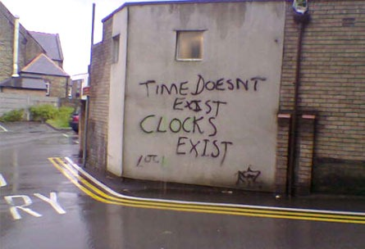
a 4-dimensional frame of reference
spatial reference system characteristics:
(ideal)
accessible
accurate
constant
seamless
simple
Notes:
I’ll make references to time, because they are similar, albeit 4-D vs 1-D.
Like map projection properties, there are desirable characteristics, but you have to compromise (Area, Shape, Direction, Bearing, Distance, Scale)

Slide 4






The National Spatial Reference System supports
Nautical charts, among many other geospatial applications
National Oceanic and Atmospheric Administration
Emergency Response Imagery,
Flood zones for the National Flood Insurance Program
Federal Emergency Management Agency
Levee Safety Program to determine levee heights & positions
United States Army Corps of Engineers
Topographic Maps and interior water data for the nation
United States Geological Survey
NSRS gravity data for the geospatial mission of NGA
National Geospatial-Intelligence Agency
Aeronautical Data Quality Assurance
Federal Aviation Administration

Slide 5
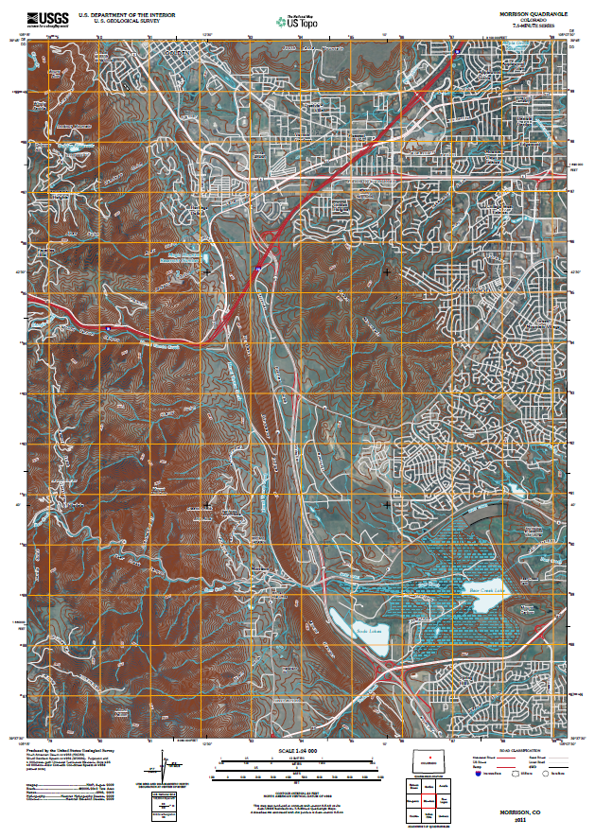

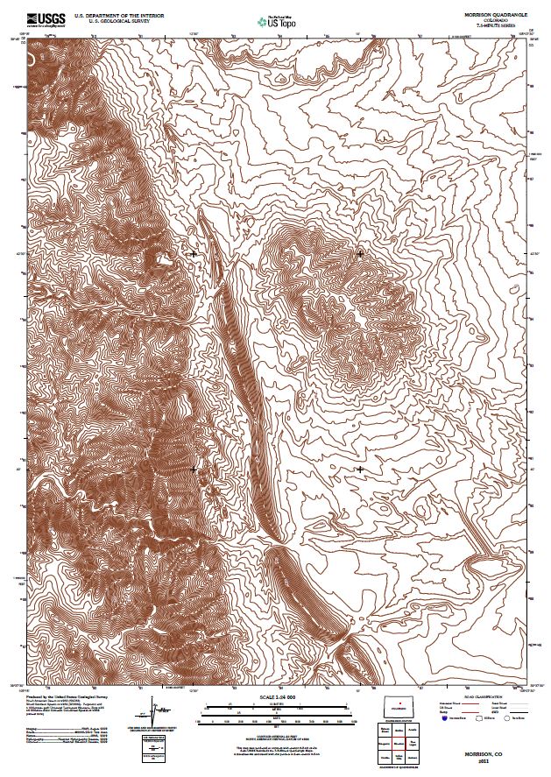
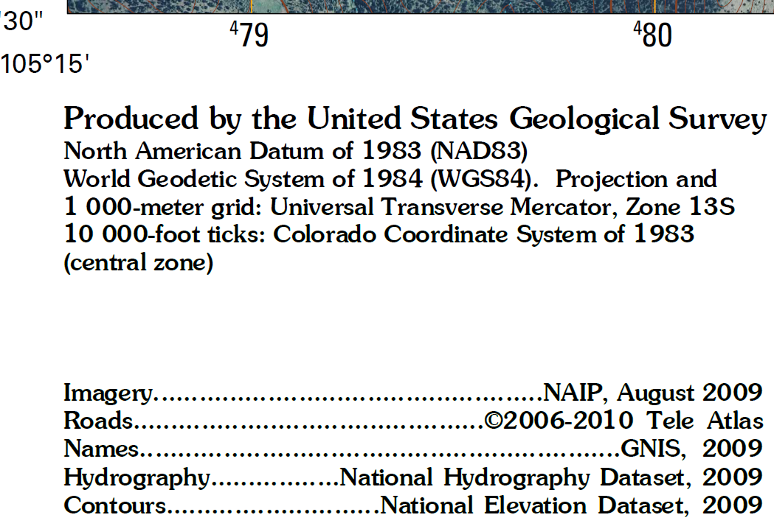
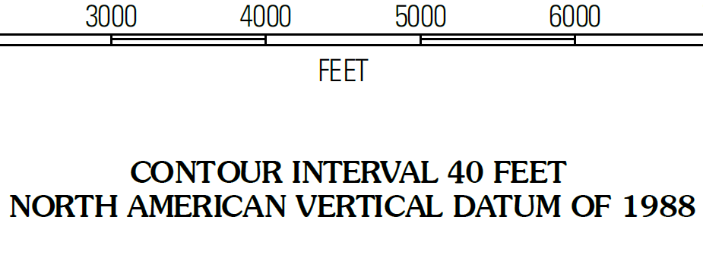
2011 US Topo Map
Slide by John Kosovich, USGS

Slide 6
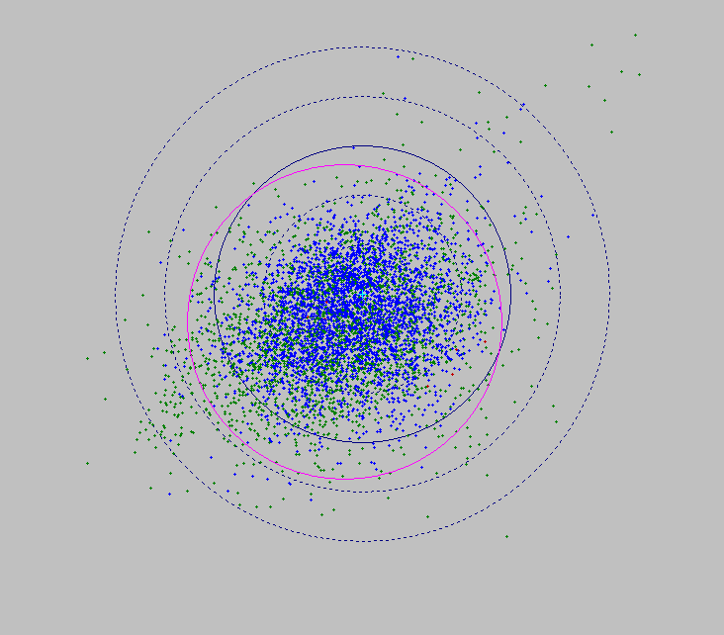

WGS84 and NAD 83 disagree
 accessible!
? accurate
? constant
 seamless
 simple
6.3 meters
5.0
3.8
WGS 84,
≈ ITRF
2.5
1.3
NAD 83
*

Slide 7
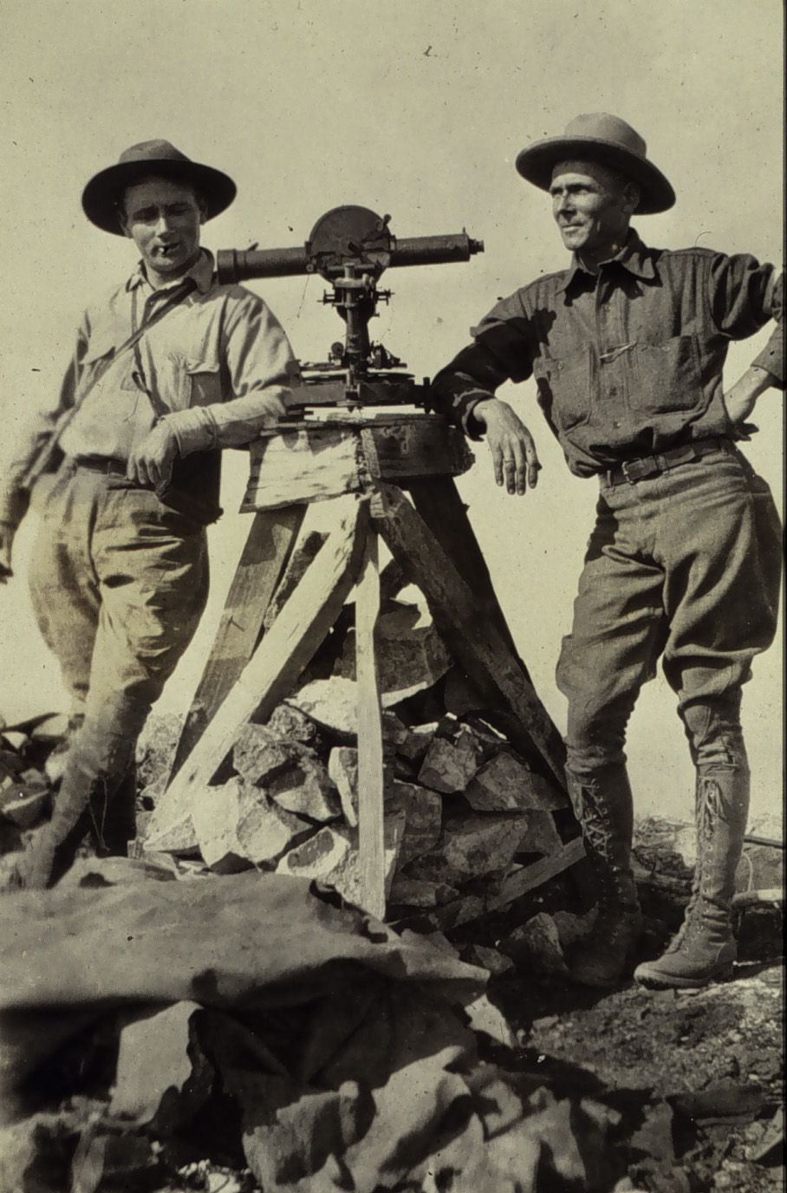
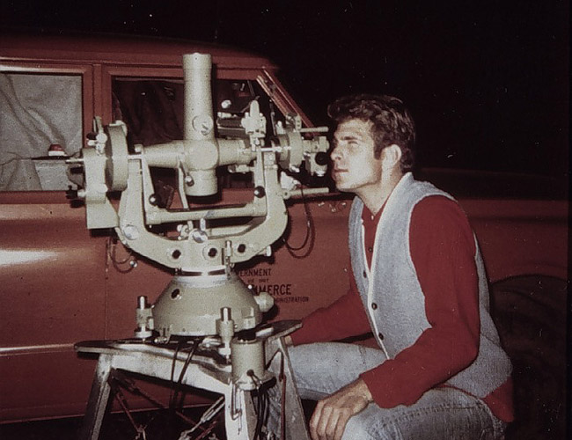
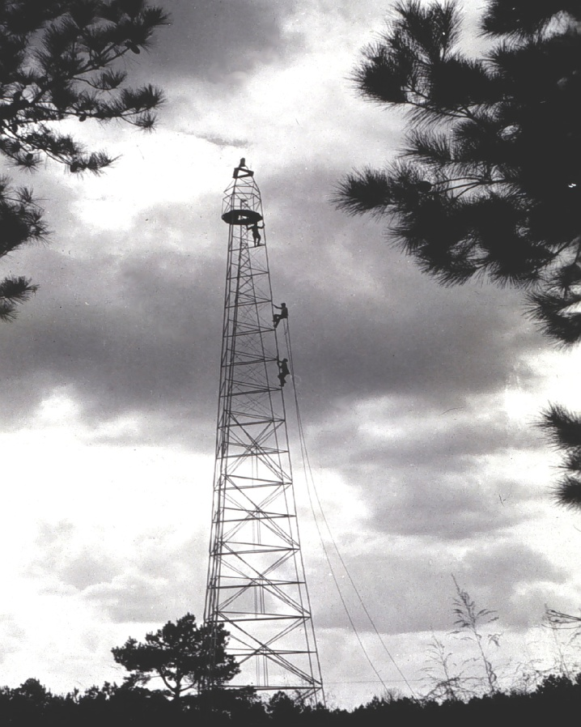
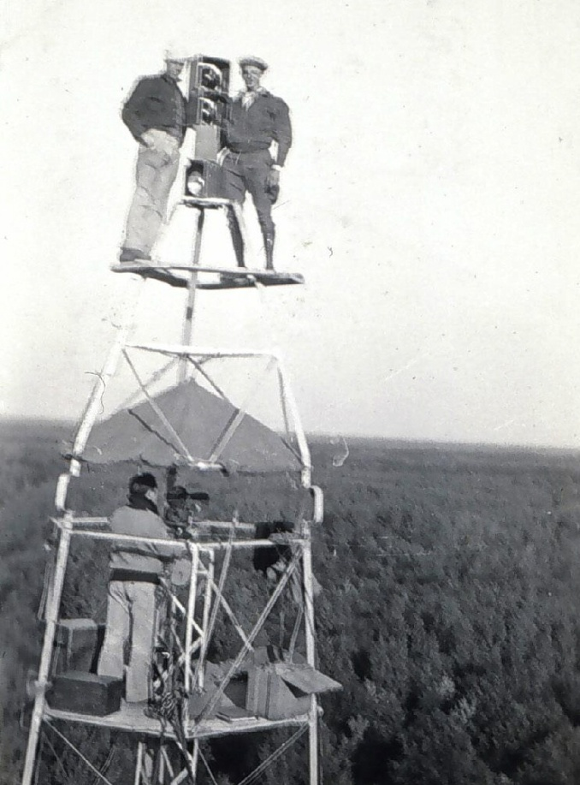
Notes:
Hassler’s Great Theodolite was used until 1873, when despite it 300 lbs. was picked up and tossed by a tornado. It didn’t works so well after that. Though the basic concept of a theodolite was still employed, fortunately advances were made in instrumentation which allowed for more accurate and less cumbersome instruments. Pictured is a Parkhurst Theodolite the workhorse used throughout the first part of the 20th century. The Parkhurst had a 9-inch circle a 2 micrometers. The Parkhurst required a 3-person observing crew. An observer, a recorder, and a light keeper. The recorder was also needed to read one of the micrometers on the Parkhurst.

Slide 8
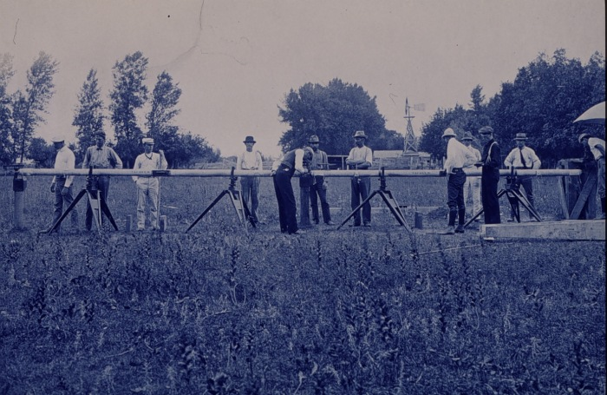
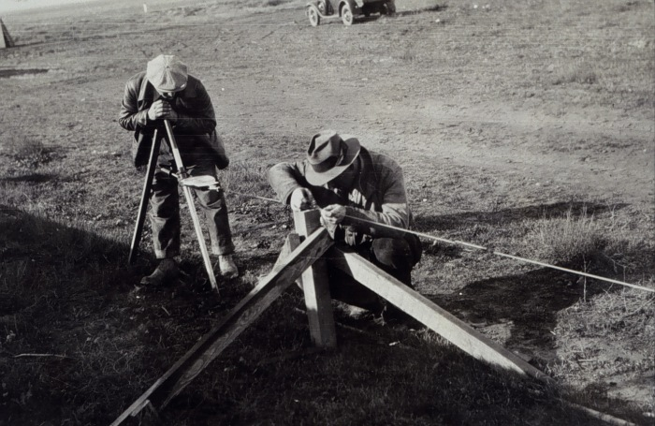
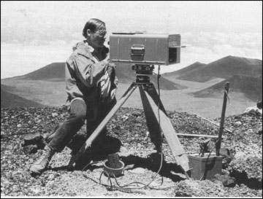
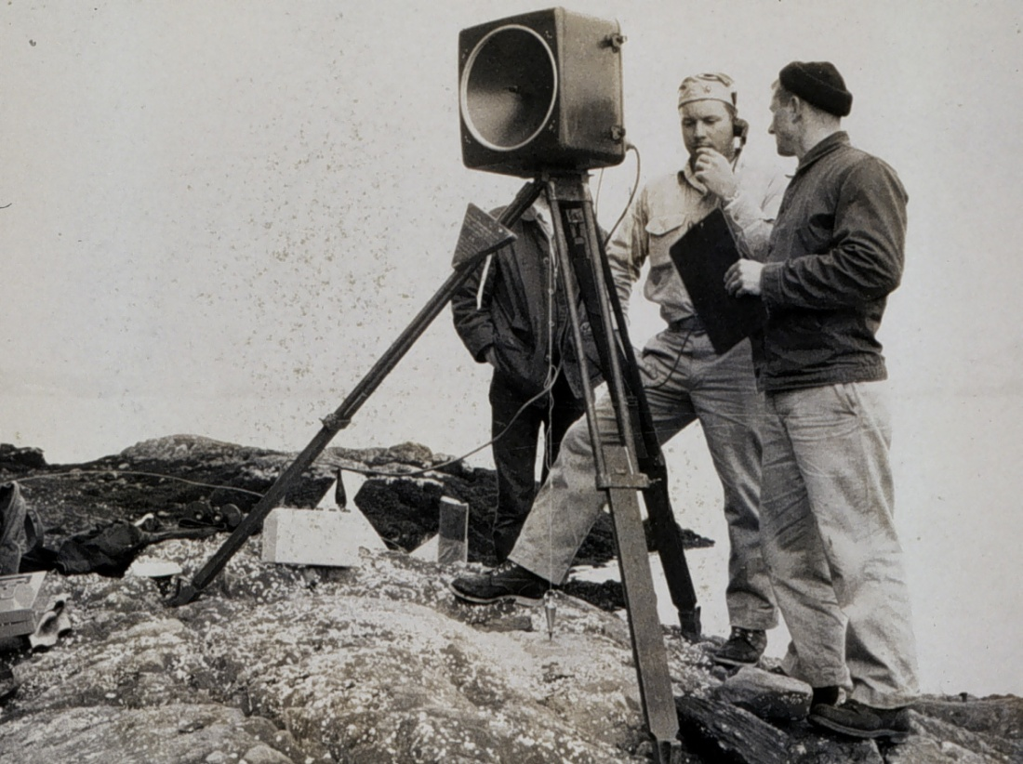
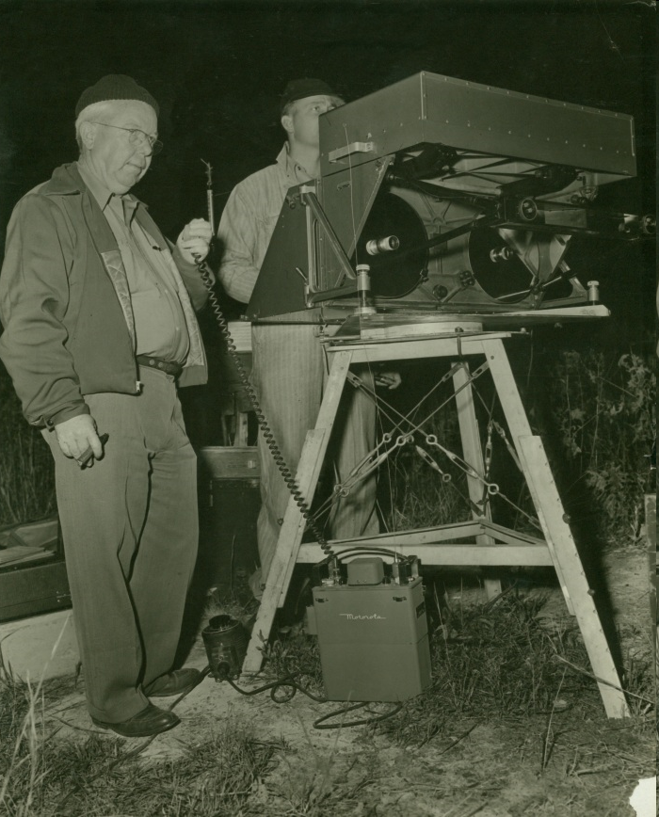
Notes:
Various Electronic Distance Measuring Instruments (EDMI) were developed in the mid-20th century. These used microwaves, infrared light, and lasers to send a beam from the instrument to a reflector and then receive the reflected signal. The device then calculated the distance. EDMI proved to be one of the greatest innovations in surveying.
Laser equipped geodimeters have been used to produce accuracies of better than one part per million (1 mm in a kilometer)

Slide 9
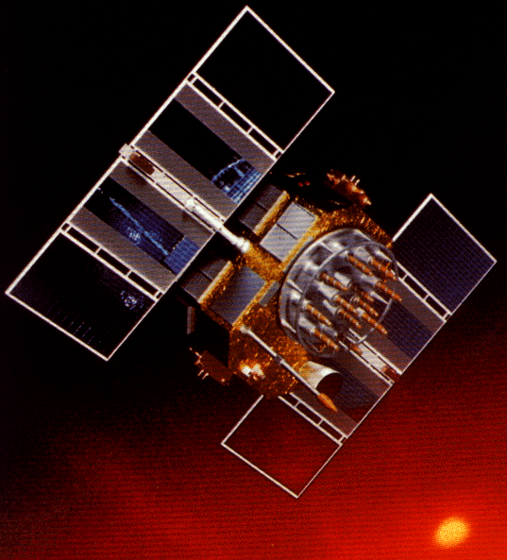
A (very) brief history of NAD 83
Original realization completed in 1986
  Consisted (almost) entirely of classical (optical) observations
“High Precision Geodetic Network” (HPGN) and “High Accuracy Reference Network” (HARN) realizations
  Most done in 1990s, essentially state-by-state
  GNSS based, with classical obs. incl. in adjustments
  Did NOT use CORS as constraints
National Re-Adjustment of 2007
  NAD 83(CORS96) and (NSRS2007)
  Simultaneous nationwide adjustment (GNSS only)
New realization: NAD 83(2011) epoch 2010.00

Slide 10
National Spatial Reference System (NSRS) Improvements over time
NETWORK TIME NETWORK LOCAL SHIFT
SPAN ACCURACY ACCURACY
NAD 27 1927-1986 10 meter s (1:100,000) 10-200 m
NAD83(86) 1986-1990 1 meter (1:100,000) 0.3-1.0 m
NAD83(199x)* 1990-2007 0.1 meter (1:1 million) 0.05 m
“HARN”, “FBN” (1:10 million)
NAD83(NSRS2007) 2007-2011 0.01 meter 0.01 meter 0.03 m
NAD83(NSRS2011) 2011 0.01 meter 0.01 meter 0.01 m

Slide 11
NAD 83 POSITIONAL CHANGES
NAD 27 to NAD 83 (1986) ~ 10 m to 200+ m
NAD 83 (1986) to NAD 83 (199x HPGN/HARN) ~ 0.3 to 1 m
NAD 83 (199x HPGN/HARN) to NAD 83 (2007) ~ 0.01 to 0.05 m

Slide 12
Standalone Positioning by 2017?
10-15 cm???
Better Resistance To Interference
Faster Ambiguity Resolution
C/A Code on L1
C/A Code on L2
New Code on L5
GPS Modernization

Slide 13
Simplified Concept of NAD 83 vs. ITRF2008
h₈₃
h₀₈
Earth’s
Surface
ITRF2008
Origin
2.2 meters
NAD 83
Origin
Notes:
ITRF (International Terrestrial Reference Frame) just has an origin; take NAD83 shaped ellipsoid centered at the ITRF origin to derive ITRF97 ellipsoid heights.
Ellipsoid heights NAD83 vs. ITRF97 - Defined origins are best estimate of the center of mass; NAD83 is not geocentric. Move origin; move ellipsoid surface as illustrated.
Ellipsoid height differences reflect the non-geocentricity of NAD83.

Slide 14
Earth-centered datums are stable

Slide 15
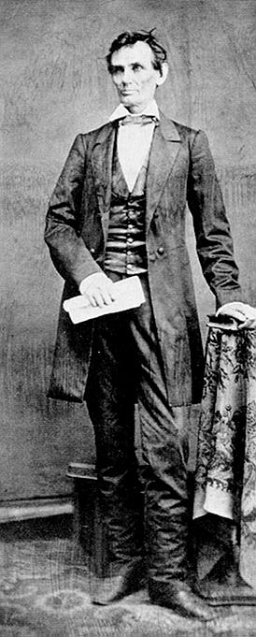
NAD 83 is approx. earth-centered

Slide 16
…and what about those new datums?
Planned implementation of new datums in 2022
  Geometric datum: Aligned with ITRF
  Vertical datum: Based on gravimetric geoid
How much will NSRS coordinates change?
  North America plate (CONUS and AK): Approx 0.8 to 1.6 m
  Caribbean plate: Approx 0.4 to 0.6 m
  Pacific plate: Approx 3.4 (Midway) to 4.3 m (American Samoa)
  Mariana plate: Approx 1.1 to 1.4 m
How much will NSRS ellipsoid height change?
  Approx -1.9 m (Puerto Rico) to +2.0 m (Guam)
How much will NSRS CONUS orthometric height change?
  Approx +0.1 m (Florida) to -1.3 m (Washington)

Slide 17
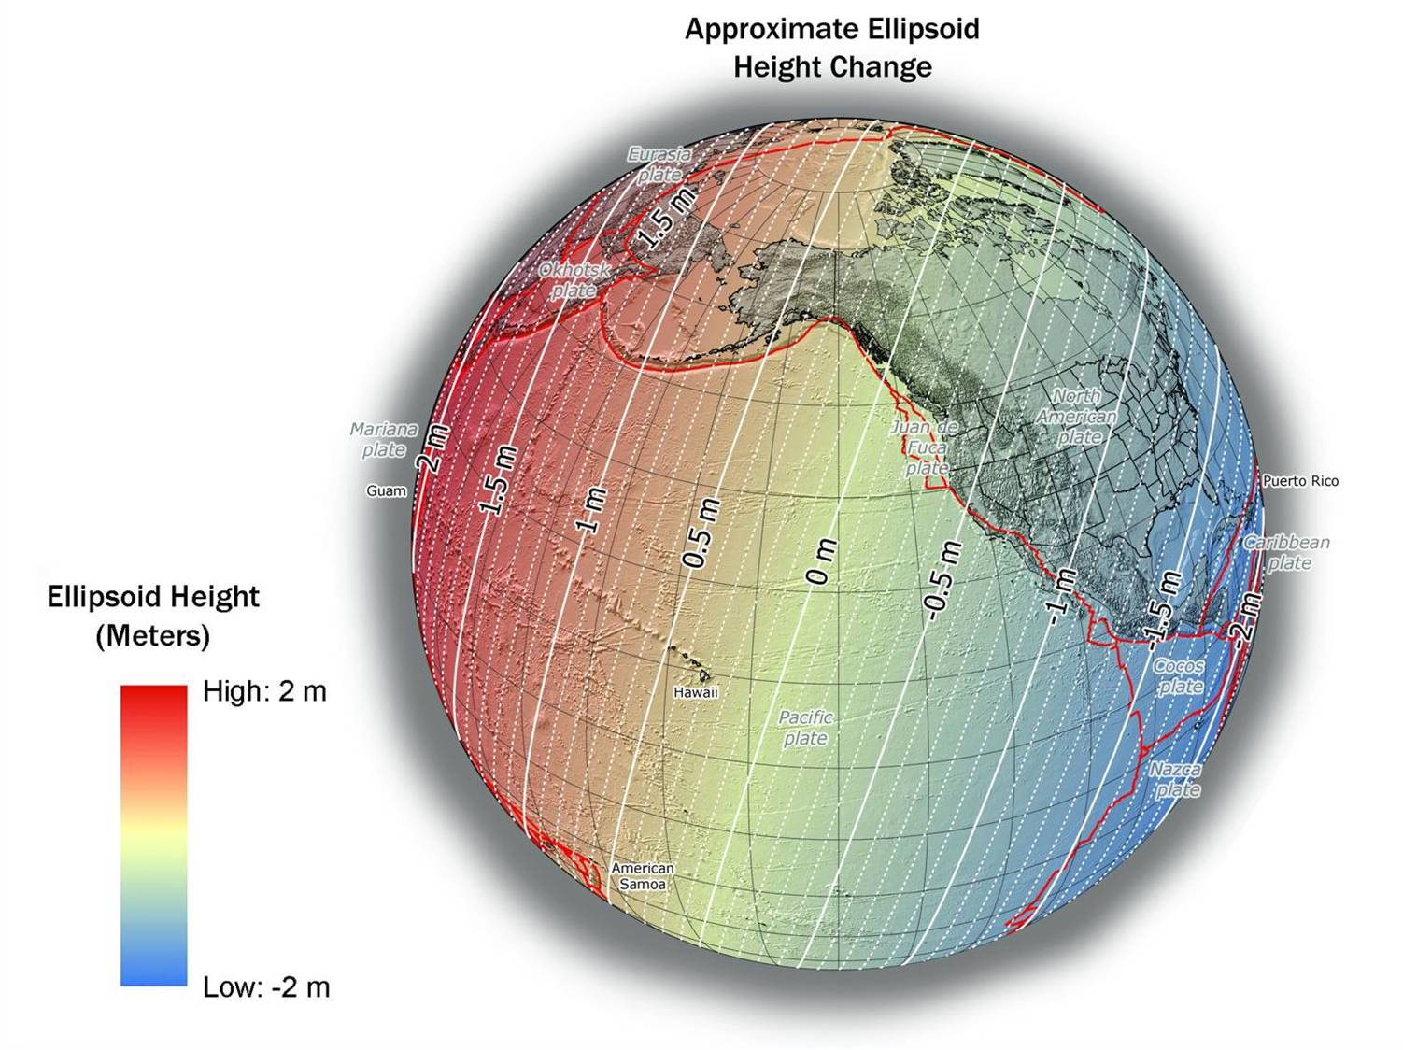
NAD 83(2011) to IGS08 at epoch 2022.0

Slide 18
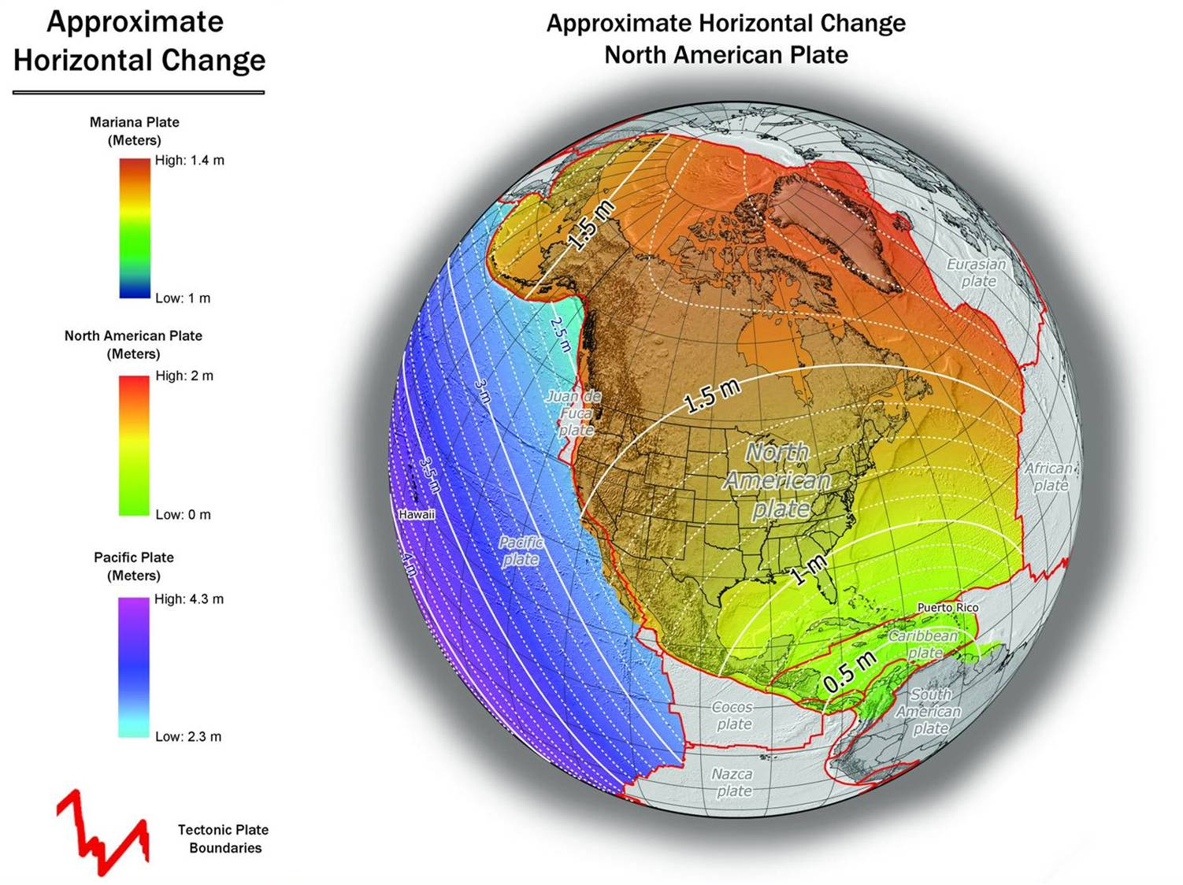
NAD 83(2011) to IGS08 at epoch 2022.0

Slide 19
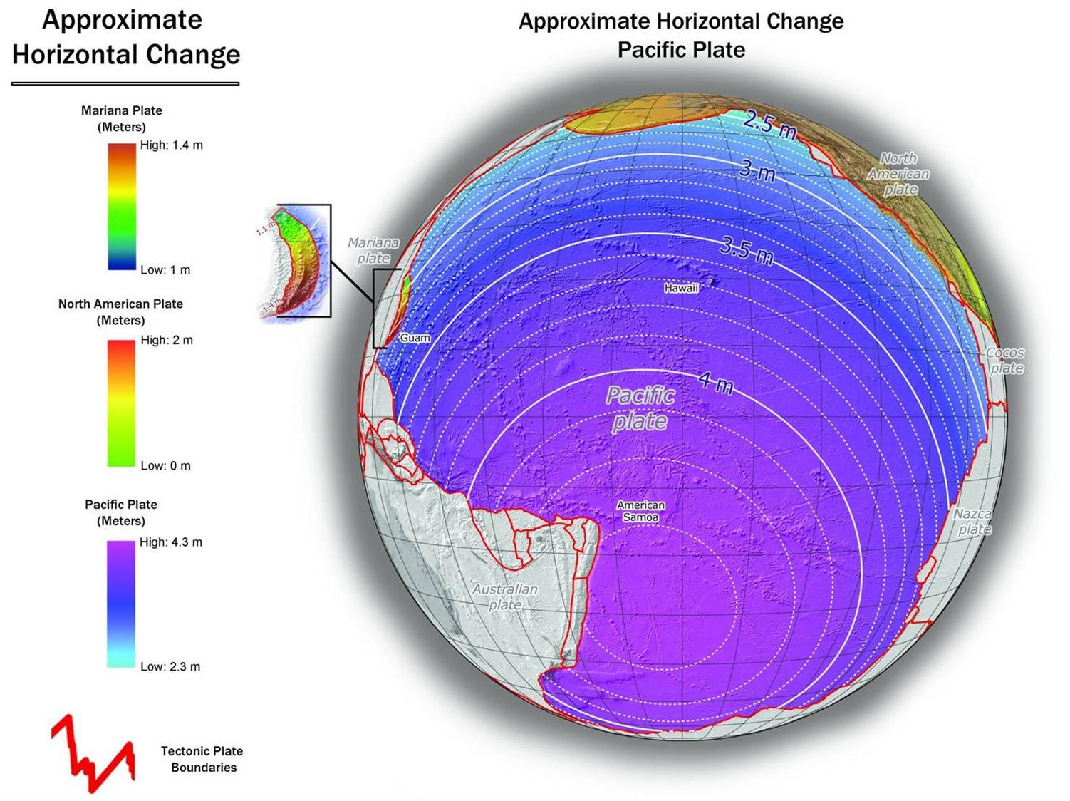
NAD 83(PA11) to IGS08 at epoch 2022.0

Slide 20
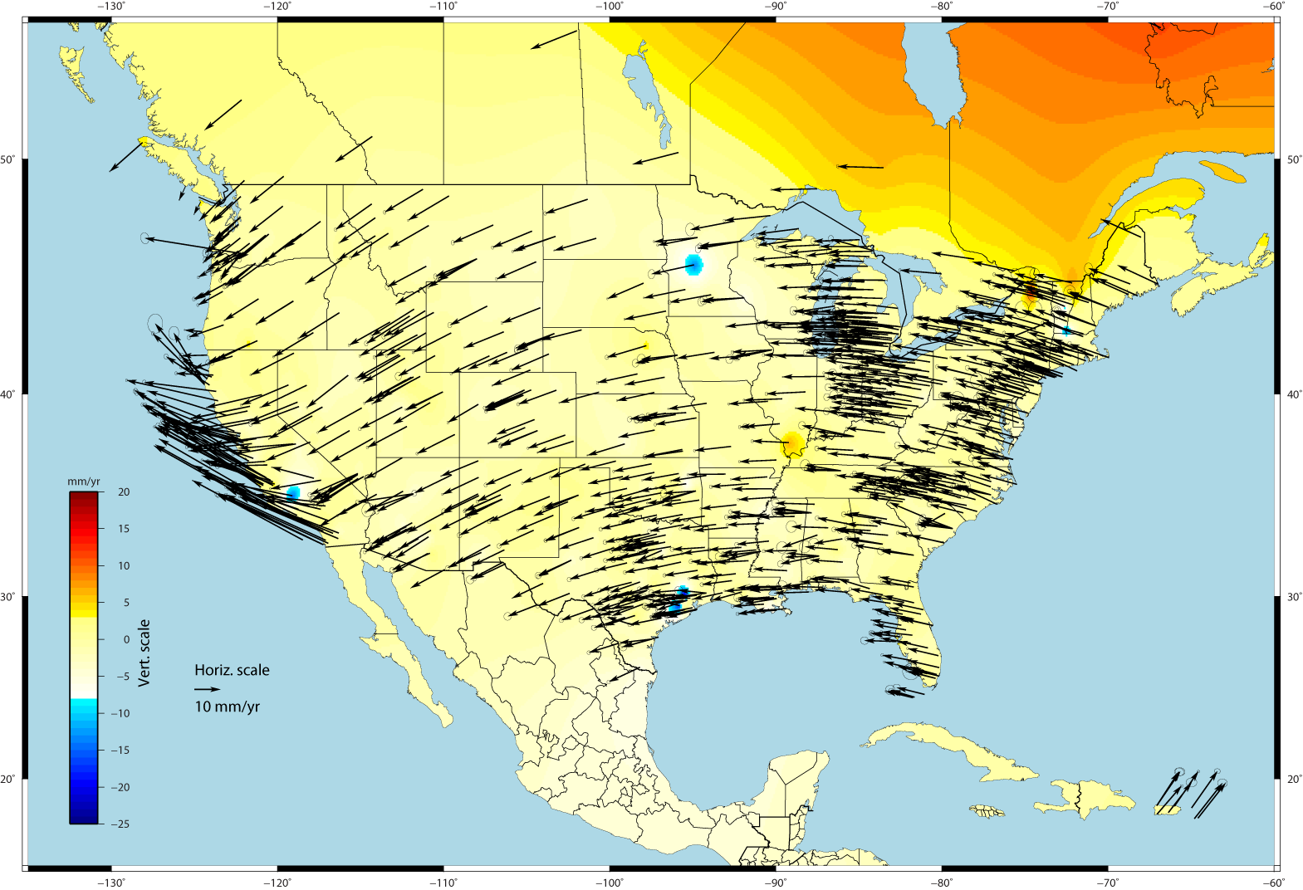
U.S. CORS Velocity Field – ITRF2008 (IGS08 epoch 2005.0)
accessible
accurate
constant
seamless
simple

Slide 21
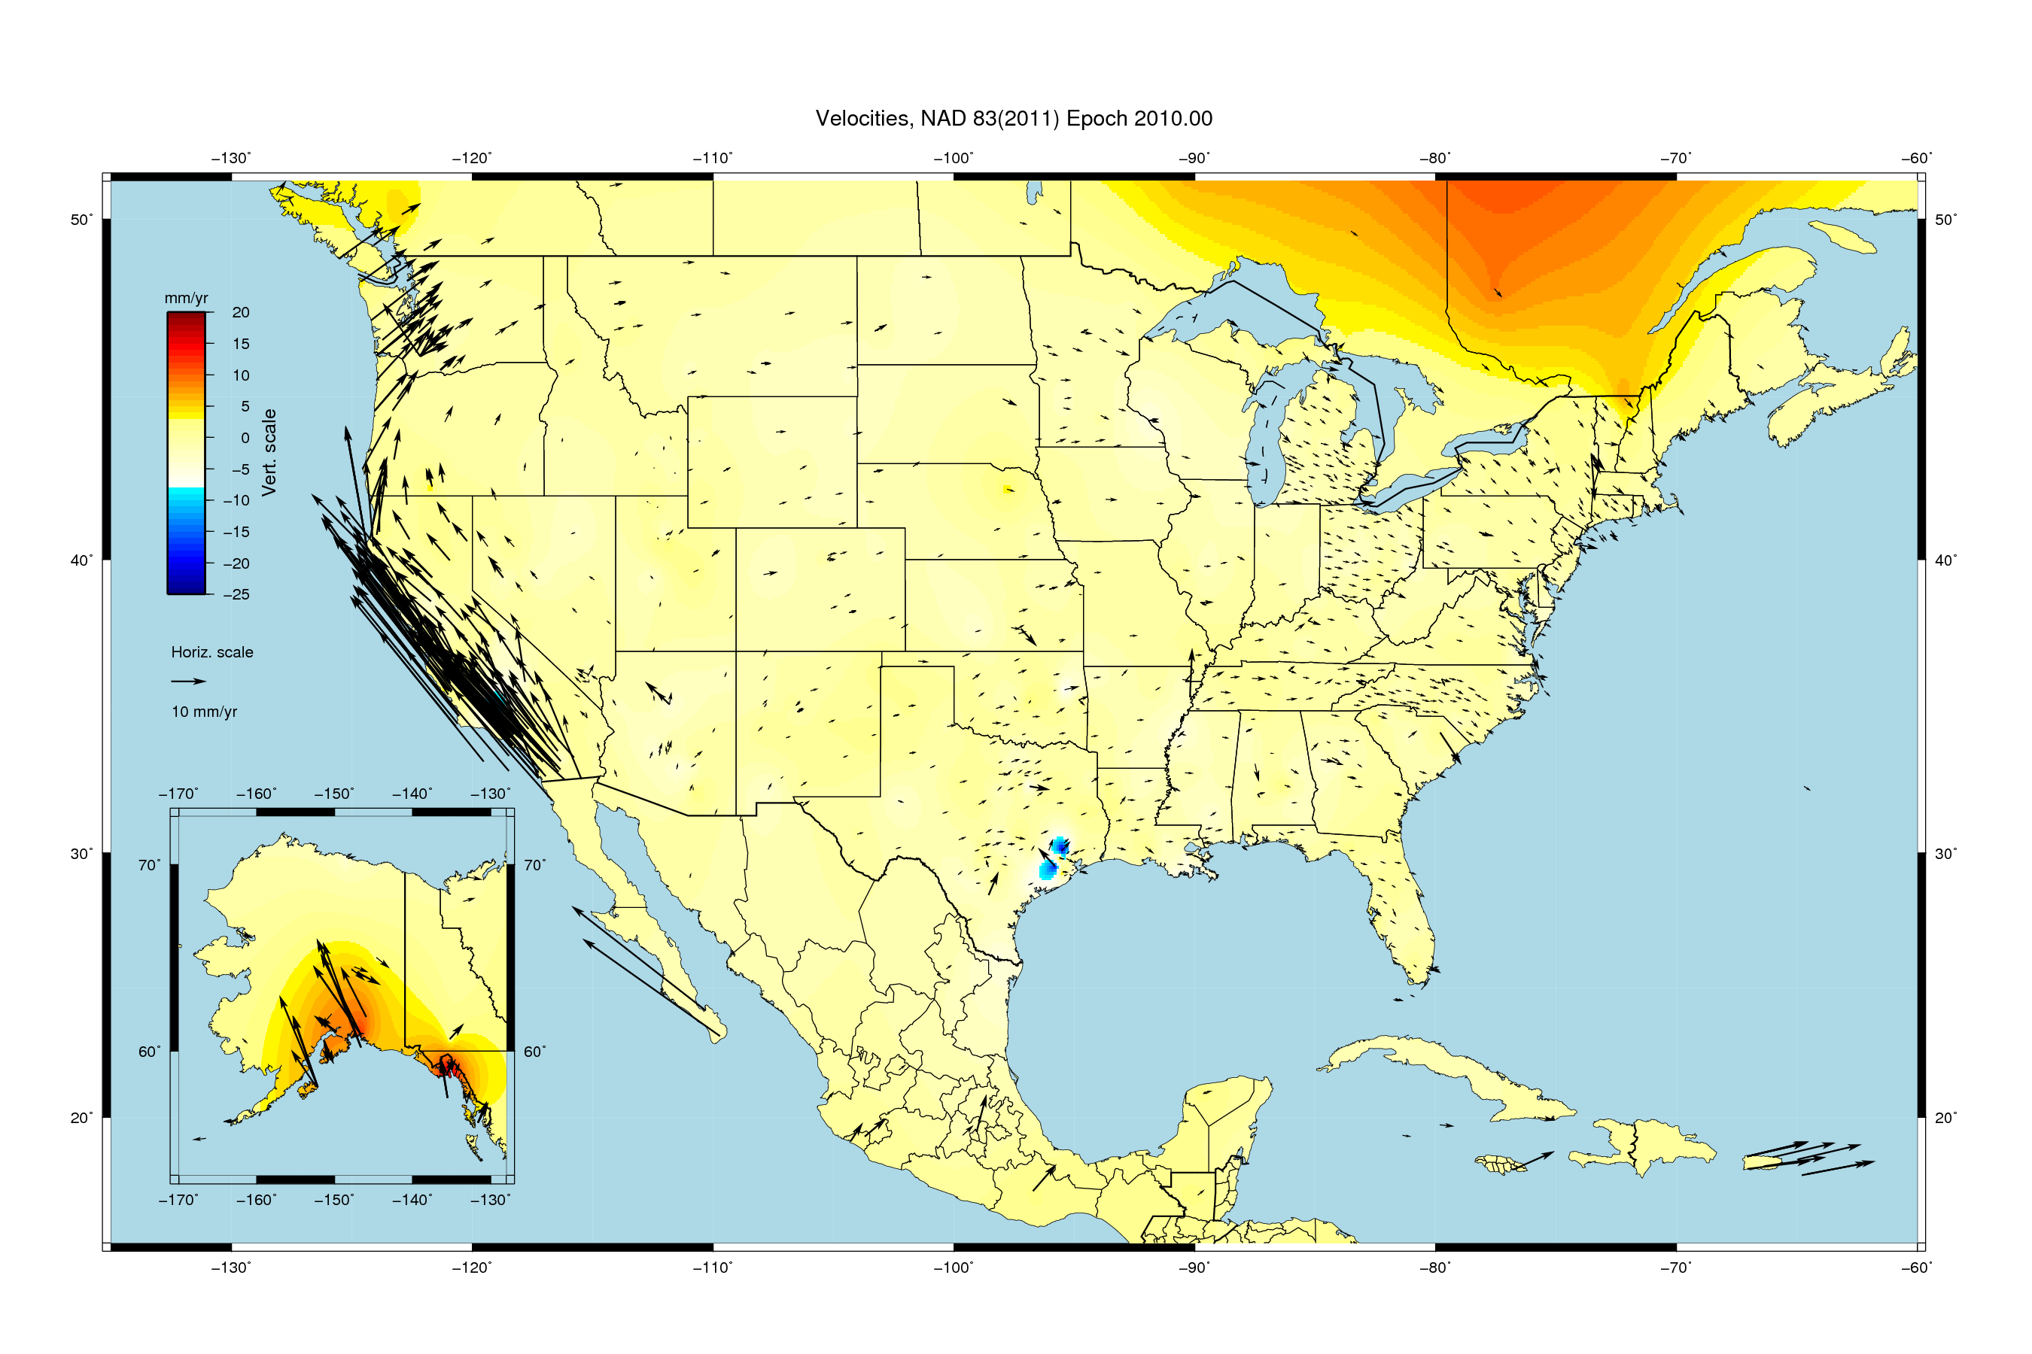
U.S. CORS Velocity Field - NAD83(2011) epoch 2010.0
accessible
accurate
constant
seamless
simple

Slide 22
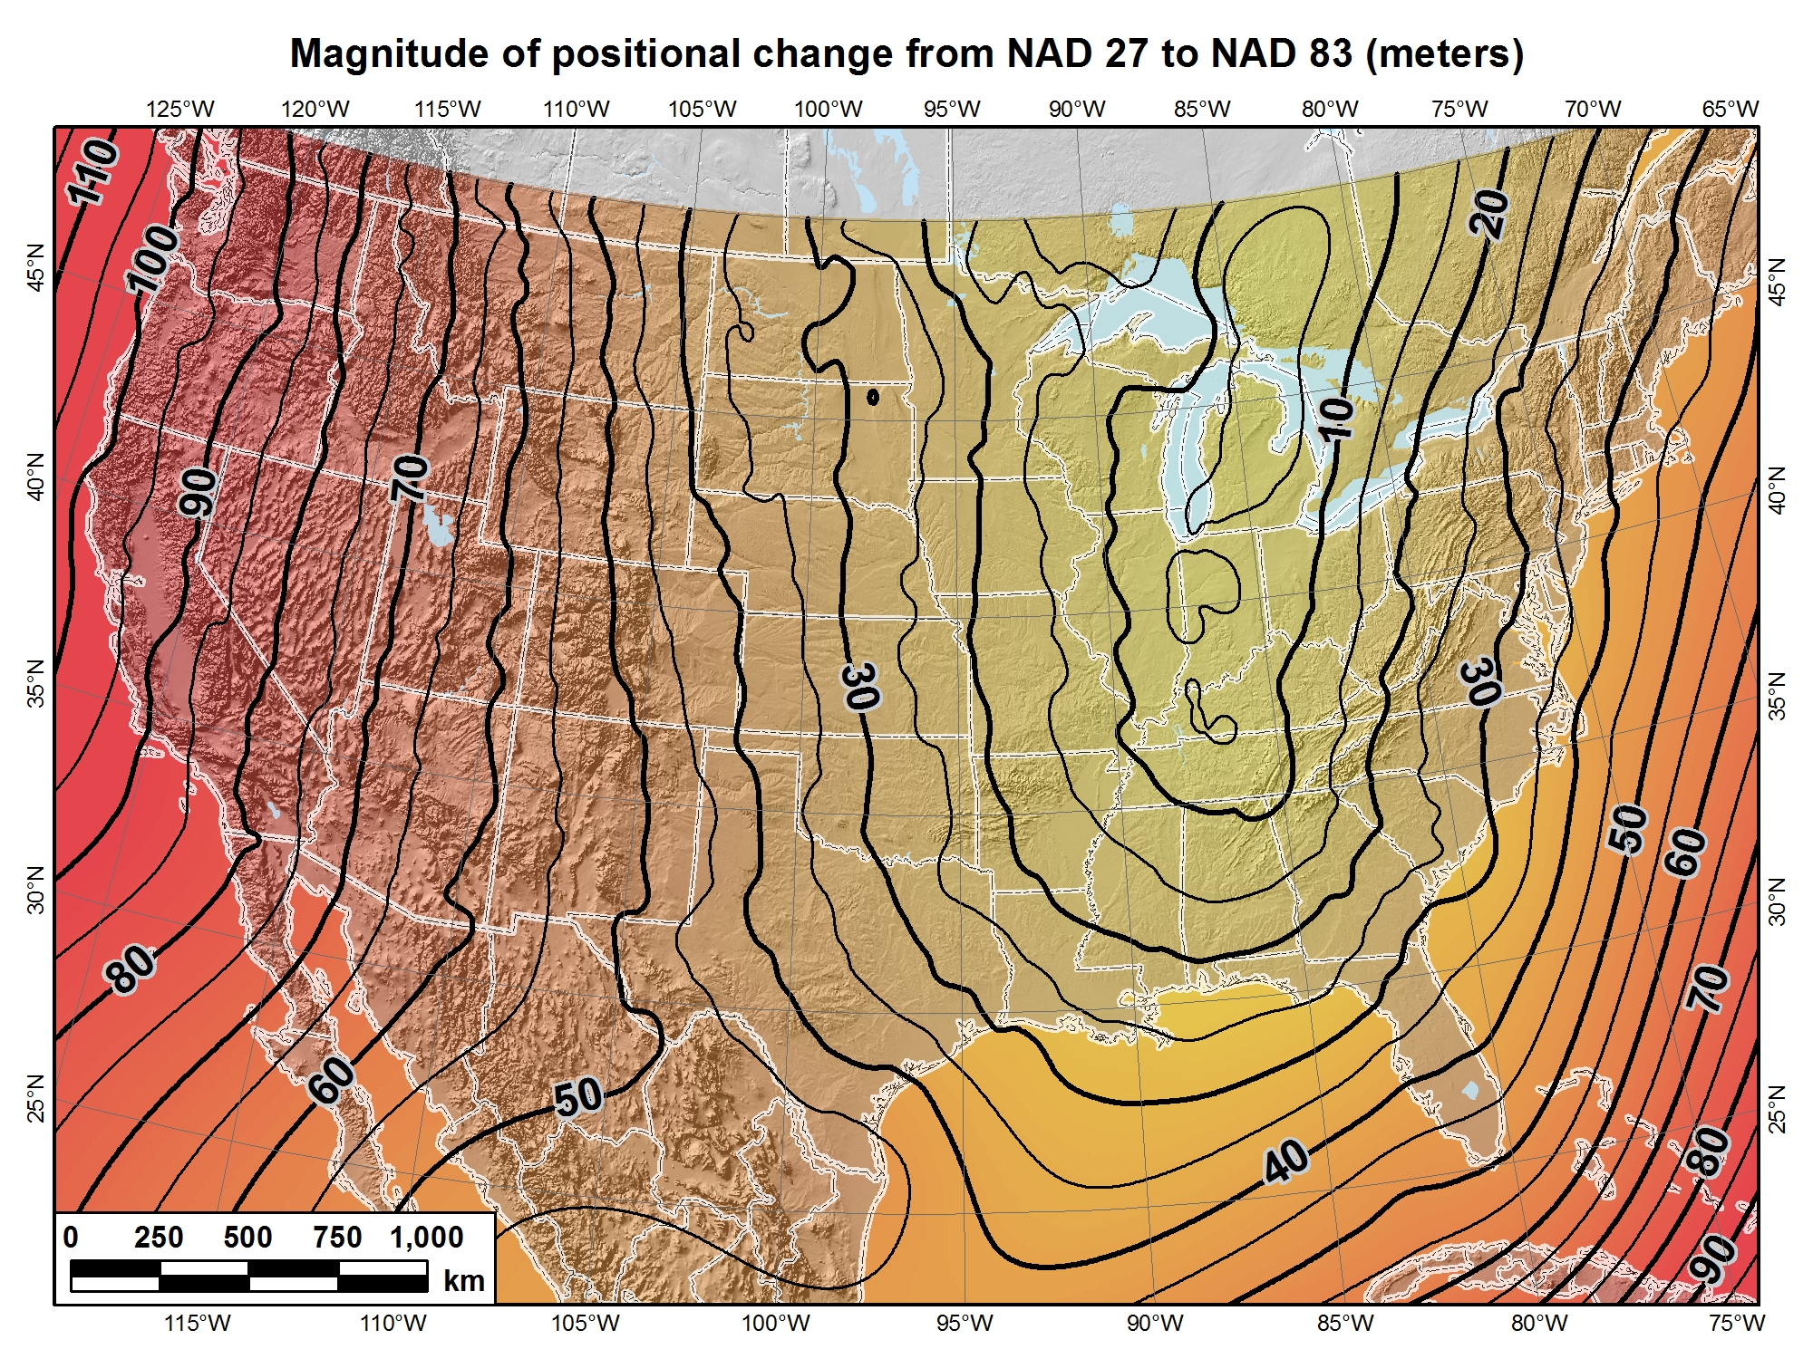

Slide 23
A man with one watch will always know the time, A man with two watches will always be in doubt.
accessible
accurate
constant
seamless
simple
Source: Zurich-American Insurance Group

Slide 24
metadata to the rescue
your positional metadata should include:
  datum
  epoch
  source
these will facilitate transforming from current to new datum
maintaining your original survey data will provide more accurate results

Slide 25
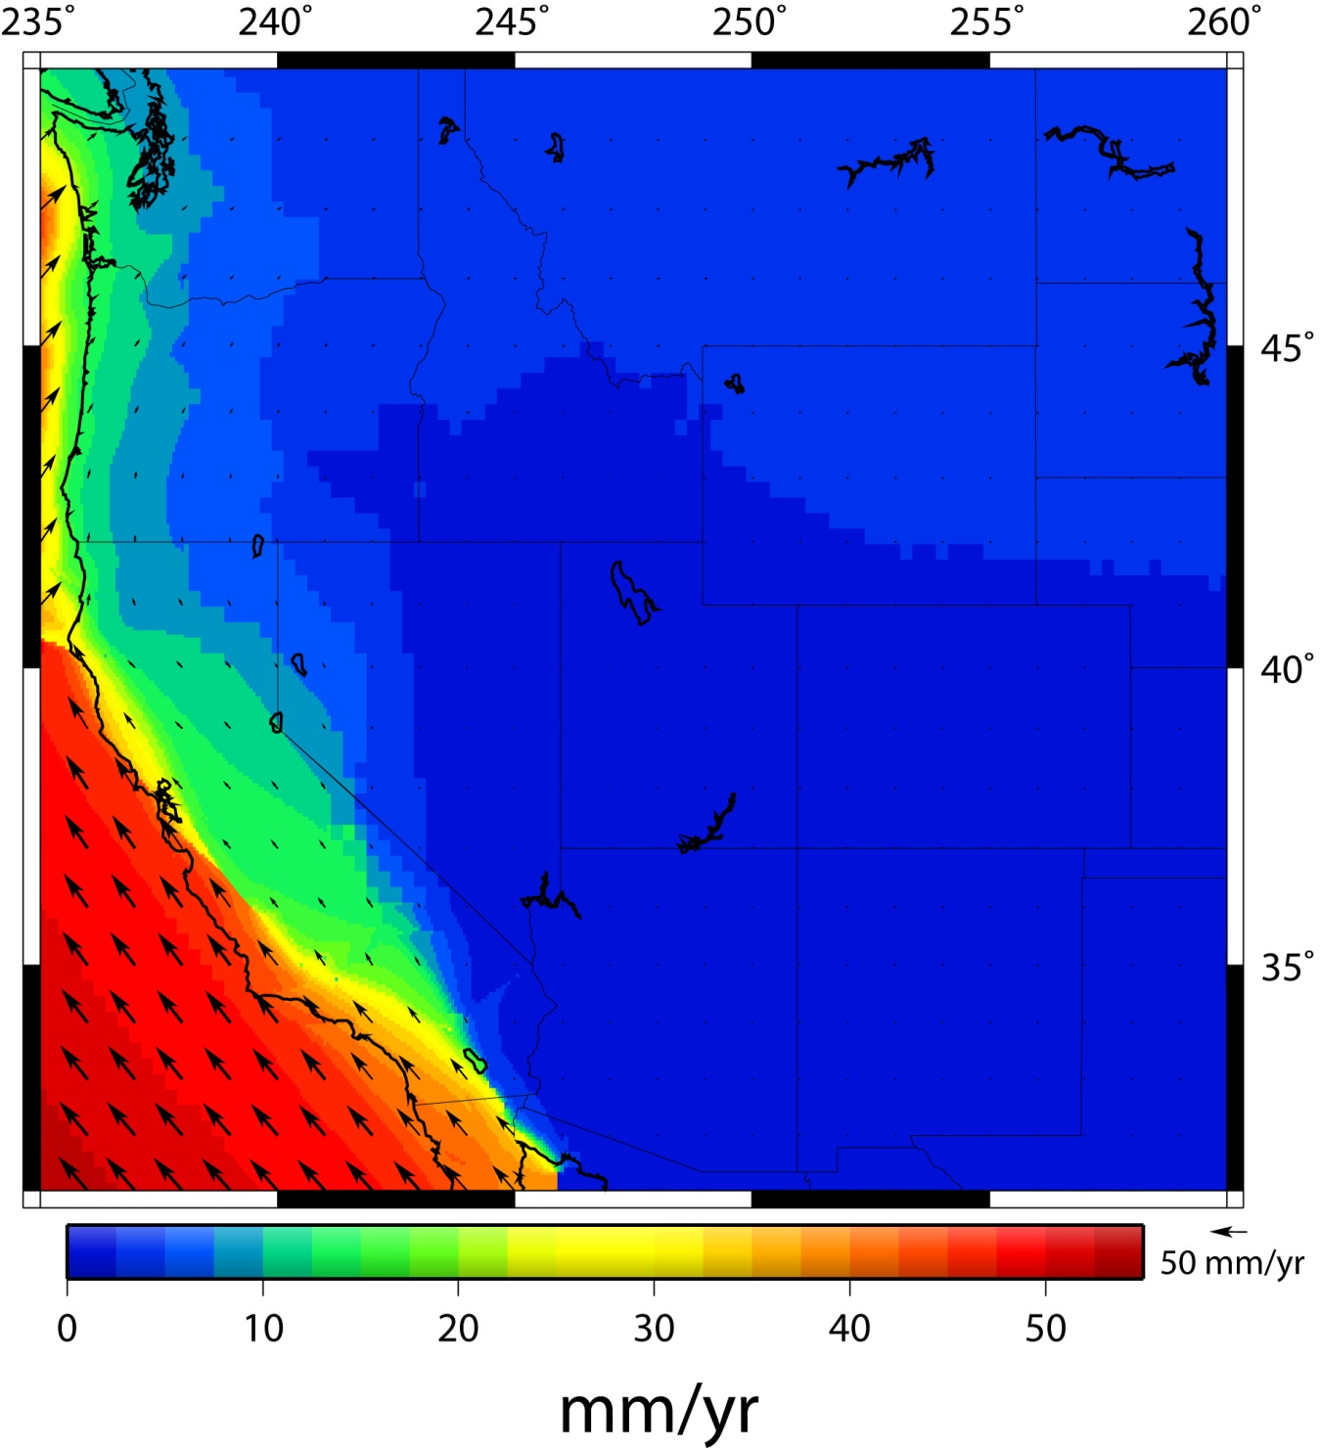
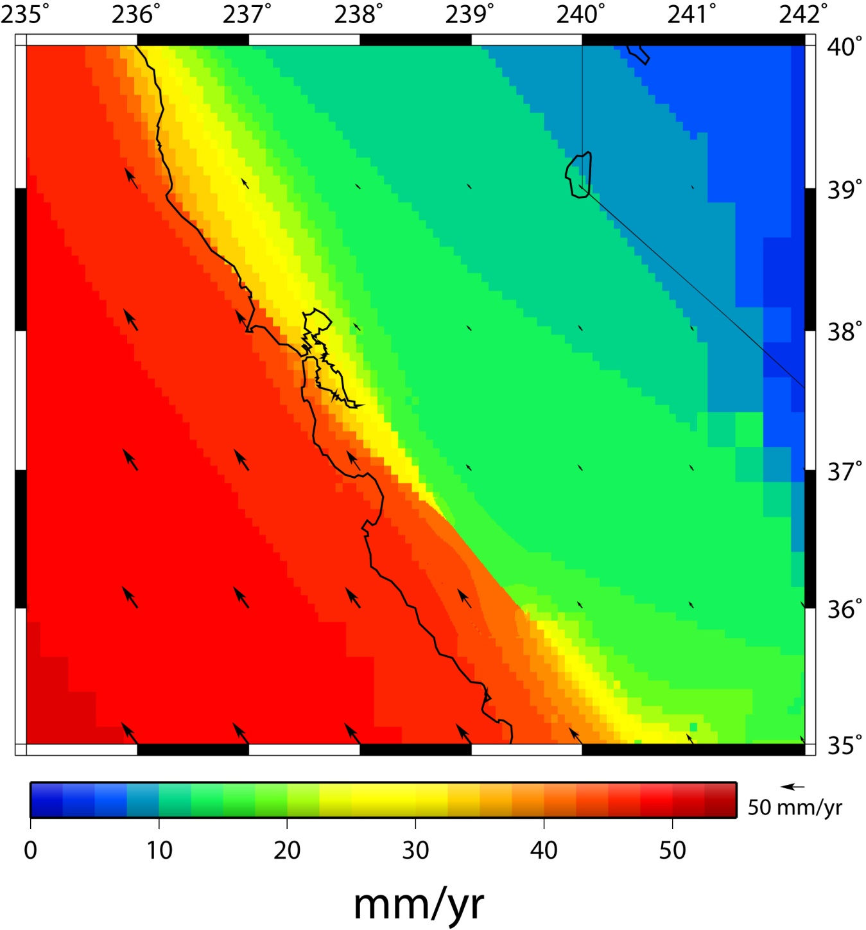
HTDP Grids
.01 Deg for slipping San Andreas
.0625 Deg for actively deforming region along West Coast
.25 Deg elsewhere
geodesy.noaa.gov/TOOLS/Htdp/Htdp.html

Slide 26
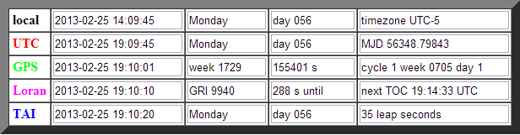
do you have the time? … which one?
Apparent solar time
Sidereal time
Mean solar time
Greenwich Mean Time (GMT)
Coordinated Universal Time (UTC)
Ephemeris, Terrestrial Time (TT)
Barycentric Coordinate Time (TCB)
Terrestrial Dynamic Time (TDT)
Barycentric Dynamical Time (TDB) Geocentric Coordinate Time (TCG)
Barycentric Coordinate Time (TCB)
International Atomic Time (TAI)
Coordinated Universal Time (UTC)
Standard or civil time
GPS time

Slide 27
SOME HORIZONTAL DATUMS OF THE UNITED STATES
Bessel Ellipsoid
Camp Colonna Datum
St. Paul Island Datum
New England Datum
Flaxman Island Datum
UnAlaska Datum
U.S. Standard Datum
Golofnin Bay Datum
Valdez Datum
North American Datum
Kripniyuk Datum
Yakutat Datum
North American Datum of 1927
Point Barrow Datum
Yukon Datum
Puerto Rico Datum
Port Clarence Datum
Johnson Island 1961
Old Hawaiian Datum
SE Alaska Datum
Midway Astro 1961
American Samoa Datum 1962
St. George Island Datum
Wake Island Astro 1952
Guam Datum 1963
St. Lawrence Island Datum
Barter Island Datum
St. Michael Datum
Notes:
27
There have been several different ellipsoids used for the horizontal datums of the United States. The Bessell 1841 ellipse was used from approximately 1845 until 1879. Clarke 1866, developed by the English Geodesist A. R. Clarke was adopted in 1879 following the completion of the great Transcontinental Arc of Triangulation as it most closely approximates the size and shape of North America. As part of the activity to complete the North American Datum of 1983 (NAD 83), In 1979, the National Geodetic Survey decieded to adopt the Geodetic Reference System 1980 (GRS 80) as recommended by the International Association of Geodesy, as it most closely reflects the size and shape of the entire globe. It should be noted that GRS80 is for all practical purposes, the same size and shape as the World Geodetic System of 1984 (WGS 84) ellipsoid used with the Global Positioning System (GPS). The small numerical differences in the flattening (1/f) amount to less than 0.1 millimeter from the most northern part of Alaska to the southern tip of Florida!!

Slide 28
Why change datums/Realizations
NAD27 based on old observations and old system
NAD83(86) based on old observations and new system
NAD83(92) based on old and new observations, same system
NAD83(96) based on newer observations, same system
NAD83(NSRS2007) new observations, same system, removed regional distortions and made consistent with CORS
NAD83(2011) based on new observations and same system. Kept consistent with CORS

Slide 29
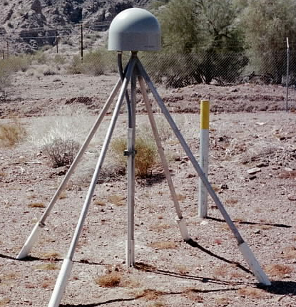
Evolution of Geodetic Datums: from NAD27/NGVD29 to NAD83/NAVD88 to ?/ ?
H + V
2 + 1
27, 29
H + V
2 + 1
83(86),88
GPS
H + V_{E} + V_{O}
2 + 1 + 1
83(92), 88
+VELOCITIES (time)
H + H_{t} + V_{E} + V_{O}
2 + 2 + 1+ 1
83(07)+HTDP, 88
H + H_{t} +V_{E}+ V_{Et}
2 + 2 + 1+ 1
GEOMETRIC
V_{E} + G_{t}
1 + 1
GEOPOTENTIAL
H + H_{t} +V_{E}+ V_{Et}
2 + 2 + 1+ 1
ITRF00 (2002.00)
+ GRAVITY
(geoid model)
Notes:
Conceptual: Generally, Orange represents ‘horizontal’ or NAD83 at present; yellow represents orthometric vertical.
1)moved fr non-geocentric to 2)geocentric as well as we knew at the time from early satellite technology (DOPPLER). And leveling efforts resulted in a national vertical datum with only one constraint, rather than 26 (tide gauges). 3)Static GPS exploded on the scene which 4) led to 5)the HARN networks and state-specific adjustment. With GPS surveying, we got V(E), vertical ellipsoid and V(O), vertical orthometric. 6)With the results of repeat static surveys and the advent of CGPS (Continuous CGPS), such as NGS’ National CORS, 7)the velocity of the earth’s crust relative to a reference frame, could be determined over time. 8)Using the crustal motion model HTDP for horizontal velocities on the West Coast, eg, the Pacific-North American Plates interface, NGS produced 9) a National Re-adjustment in the NAD83 (NSRS2007) datum. (No change to ortho.) However, 10)underlying the NAD83 adjustment are data and analysis referenced to ITRF00, epoch 2002.00, which does take into account both horizontal AND vertical ellipsoid velocities. (velocity=time related terms shown as italicized.) This is what we have now. 11) With better global gravity models and airborne gravity data collected by NGS, we will 12) move forward with 13) new datums BOTH referenced to an ECEF, earth-centered, earth-fixed datum which we are calling 14) Geometric, for the horizontal and ellipsoid height values, and Geopotential for the orthometric height values which will be based on a a geoid model and changes in gravity over time (G(t).

Slide 30






Find the article(s) in the Archives at:
http://www.amerisurv.com

Slide 31

NGS Ten Year Plan
Updated Plan
  Four main goals
  One enterprise goal
Replace NAVD 88 with a GPS/geoid datum
Replace NAD 83 with a geocentric GPS based datum
Implement New Datums in 2022
http://geodesy.noaa.gov/web/news/Ten_Year_Plan_2013-2023.pdf

Slide 32
questions?
GOOD COORDINATION BEGINS WITH
GOOD COORDINATES
GEOGRAPHY WITHOUT GEODESY IS A FELONY
joe.evjen@noaa.gov
michael.dennis@noaa.gov
Notes:
Thank you!

