Slide 1

OPUS-Projects for RTK/RTN Vectors
(OPUS-Projects 5.0)
Dan Gillins, Ph.D., P.L.S.
Geodesist, National Geodetic Survey
June 22, 2021

Slide 2
Objectives
Develop OPUS-Projects so that GNSS vectors from RTK surveys can be uploaded, checked, adjusted, and submitted to NGS
Develop a standard file format for GNSS vectors (GVX)
Develop tools for surveyors to combine vectors from RTK surveys with static GNSS data

Slide 3
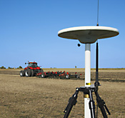
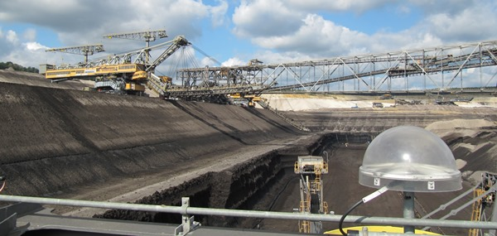
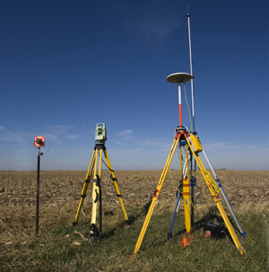
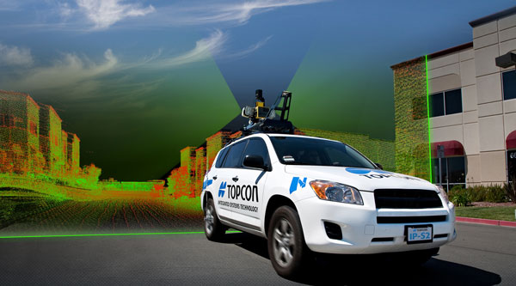
Real-Time Kinematic (RTK) Surveying
Conventional RTK
  Stationary single “base” station
  Transmits precise coordinates and GNSS observables to moving “rover”
  < 10-20 km baseline length
Applications
  Survey engineering
  Mobile mapping
  Precision agriculture
  Mining
  Construction
Base
Rover
www.alberding.eu
www.gcfarm.com
www.steckbeck.net
www.positionpartners.com.au
http://www.gcfarm.com/siteart/precision-farming/case-accuguide.jpg

Slide 4
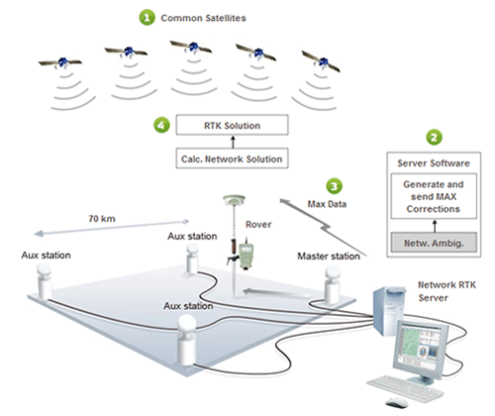
Real-Time Networks
Virtual Reference Stations (VRS)
Master-Auxiliary Concept (MAC)
Vector “tails” referenced to virtual base station
Base station position is variable
Vector “tails” connected to physical base station
Base station position is fixed
RTN Base
RTN Base
MUST store data as vectors!!
VRS
Control
Center
(Landau et al. 2002)
RTN Base
(Leica 2005)
Notes:
VRS
1.) Rover sends approx. position to RTN control center
2.) Control center assigns this position as the location of an imaginary base station and interpolates corrections at this virtual location
3.) These interpolated corrections are used to generate corrected pseudo-observables that are “transmitted” from the virtual base to the rover to be processed using conventional single-base RTK algorithms to solve for precise geodetic coordinates at the rover (Wang et al. 2010)
MAC
1.) The rover transmits an uncorrected point position to the central server, and then the server searches and selects a “cell” of reference stations for generating corrections
2.) The phase ranges from all selected stations are reduced to a common ambiguity level, and dispersive and nondispersive errors for each frequency and satellite-receiver pair are computed relative to the master station
3.) The residual corrections between the auxiliary stations and the master station, as well as the full corrections and published coordinates at the master station are transmitted to the rover. The rover then interpolates the received corrections and network information to derive its precise position (Janssen 2009).

Slide 5
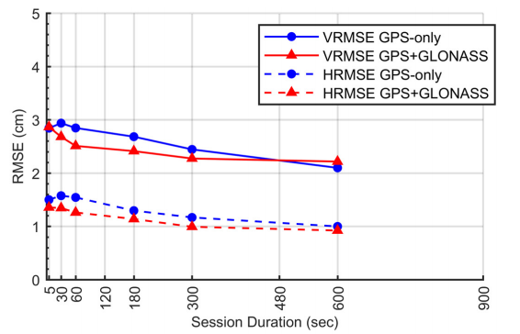
Empirical Evaluation of the Accuracy of RTNs
95% Confidence
± 5.0 cm, vertical
± 2.5 cm, horizontal
Or similar to accuracy of a 2-h OPUS-S solution!
Ellipsoid Height
Horizontal
[Allahyari et al. 2018]

Slide 6
GVX Flow Chart

Slide 7
GNSS Vector EXchange Format (GVX)
Website: https://www.ngs.noaa.gov/data/formats/GVX/index.shtml
Detailed documentation
Schema (XSD)
Example vector file
GVX is written in Extensible Markup Language (XML)
Designed to store and carry data in plain text format
Flexible representation of arbitrary data structures
Extensible – new elements can be added later without breaking applications
Both machine-readable and human-readable
Schemas can be used to define “must haves” and “should haves”

Slide 8










Industry Invited to Provide Feedback
Released GVX v. 1.0 released to industry on February 4, 2021
Over 30 people attended mtg

Slide 9
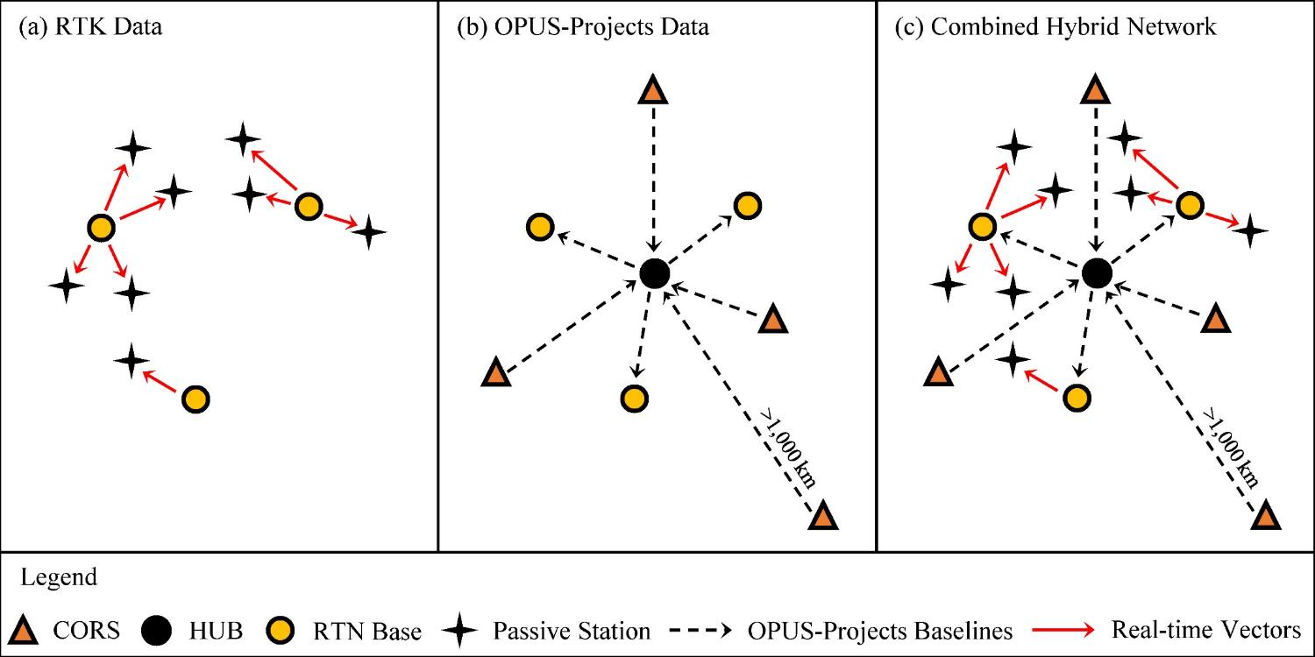
Design for OPUS-Projects and GVX
GVX file (from RTK survey or baseline processing in other software)
OPUS-Projects (from static GNSS session processing)
500-800 km
500-800 km
RTK Base or “From” Mark
RTK Rover or “To” Mark
Vector
Vector in GVX File
[Adapted from Weaver et al. 2018]

Slide 10
OPUS-Projects 5.0
Inclusion of previously processed GNSS vectors
  Single-base RTK vectors
  Network RTK vectors
  Vectors processed in other software
Automatically “weights” uploaded vectors in a network least squares adjustment
Final adjustment results can be submitted to NGS for publication
Will be released to BETA soon!
See May 21 webinar recording for more details!

Slide 11
Future Work
Encourage vendors to adopt GVX and build tools to export data to GVX!
Deploy OPUS-Projects 5.0 to Beta
Collect and respond to feedback from Beta testing of OPUS-Projects 5.0
Update the User Guide for OPUS-Projects
Write new specifications for establishing geodetic control with RTK/RTN data

