Slide 1

GPS on Bench Marks
for Better Tools and Models
August 2018 Update
National Geodetic Survey Webinar Series
August 9th, 2018 2:00 – 3:00 pm
Galen Scott – NGS Project Lead
Kevin Ahlgren – NGS Geoid Team

Slide 2
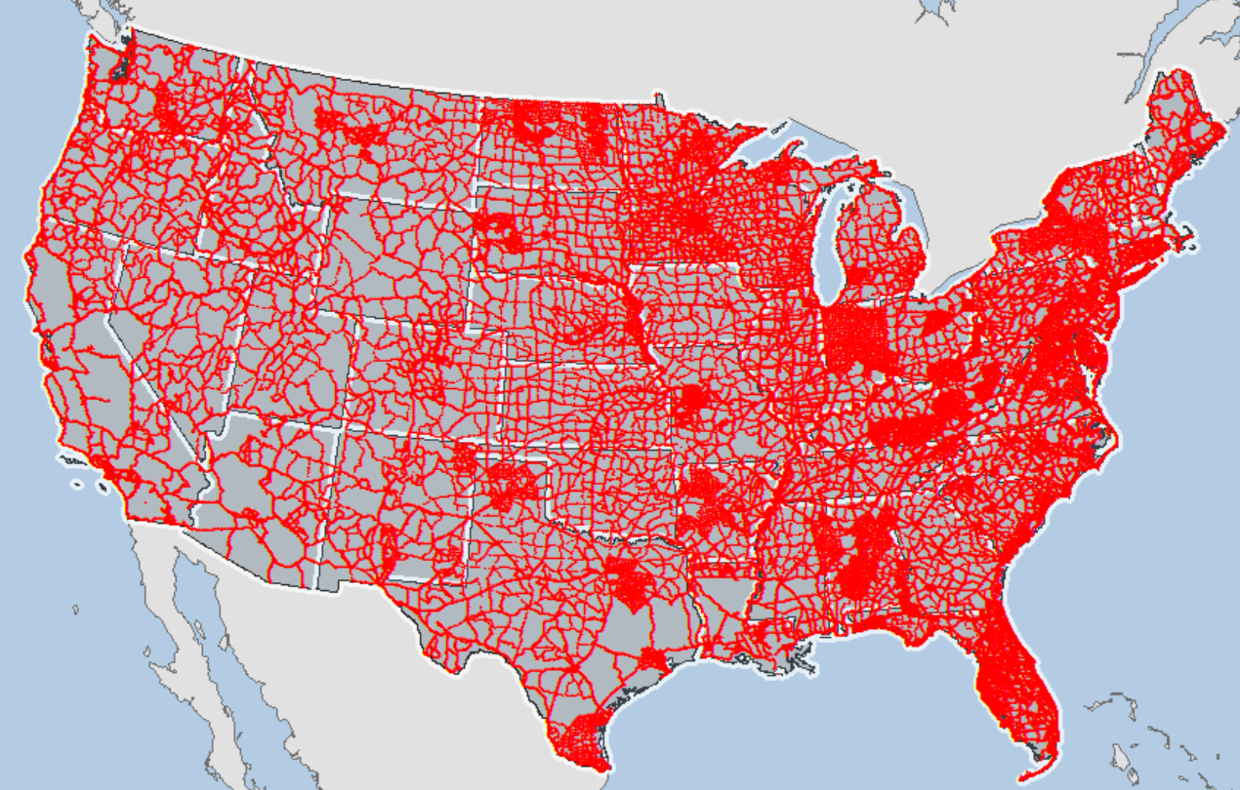
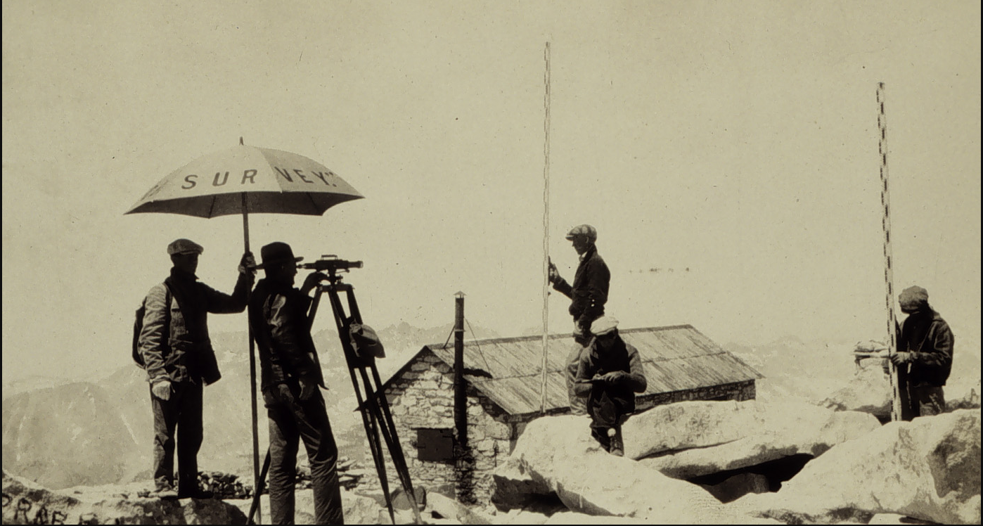
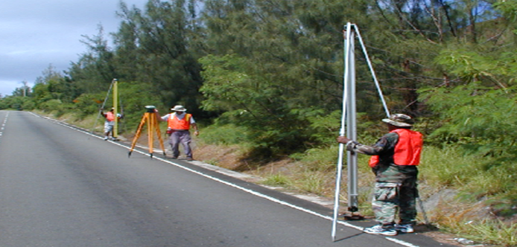
GPS Data on NAVD 88 leveled marks will support development of GEOID18 and the transformation tools to NAPGD2022
Notes:
NAVD 88 consists of about 800,000 benchmarks and ~2.2M km of leveling. Data was collecting over many decades by roving bands of surveyors who walked across the country multiple times over the years, east to west, north to south and back again. It is currently the official vertical datum of the US and is required for federal mapping projects.
GPS data on those leveled marks will be used to create GEOID18 – the model used to derive NAVD88 heights from GPS ellipsoid heights, as well as the transformation tools that will be released with NAPGD2022.

Slide 3
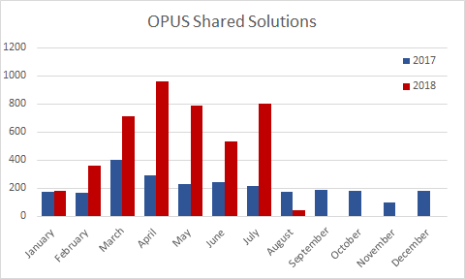
OPUS Share has broken records every month this year
Thanks to you!

Slide 4
GEOID 18 Project Time Line
Cut Off for Data Submission | 8/31/2018
Prioritize project loading into NGS IDB based on where we need data | 9/1/2018
Reprocess all OPUS data with IGS14 updated CORS | 9/14/2018
Final Data Pull | 9/21/2018
Final Data Review (tech team and advisors) | 10/15/2018
Create new geoid webpages in Dev | 11/1/2018
Beta Product and webpage Release | 12/15/2018
Outreach at Surveying Conferences | 2/28/2019
Incorporate feedback & make necessary fixes | 3/15/2019
Integrate new geoid into other NGS products (OPUS, datasheets) | 3/31/2019
Final Product Release | 4/15/2019

Slide 5
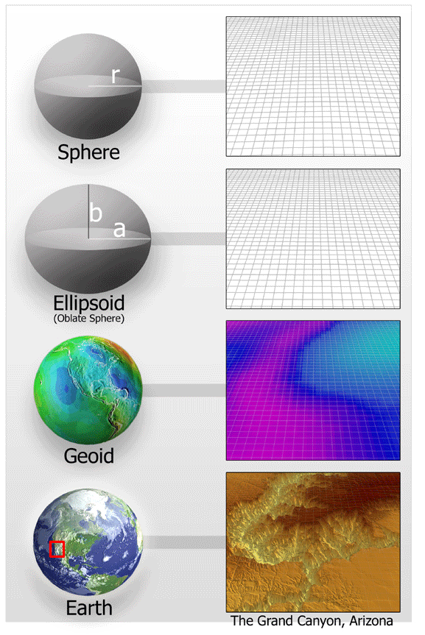
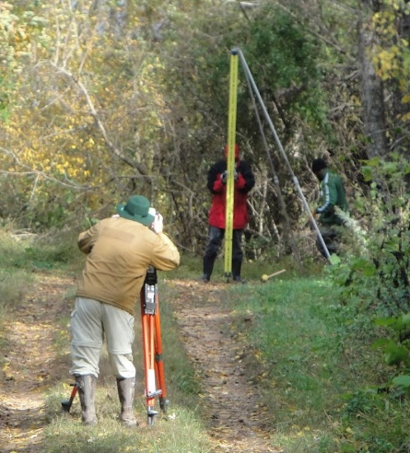
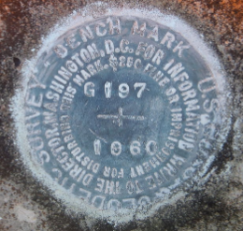
Residual = h - H - N
-
-
h is ellipsoid height measured using GPS
H is an NAVD 88 Orthometric Height from Leveling
N is from a geoid model
Theoretically, the difference between these three values should be zero. In practice, using actual observations gives a residual, or measure of the misfit between the three. We use the residual to evaluate the observations.

Slide 6
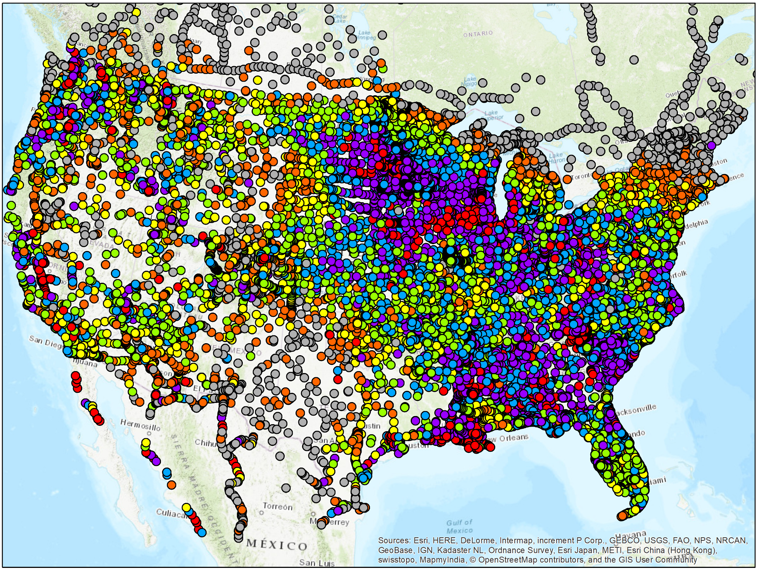
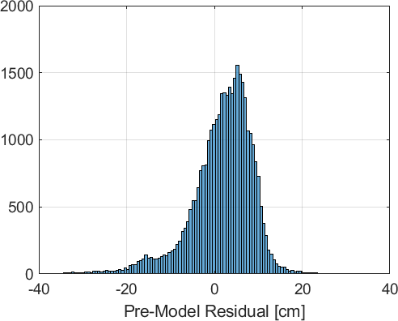
Pre-Model Residual
N is from xGEOID18 (gravimetric geoid model)

Slide 7
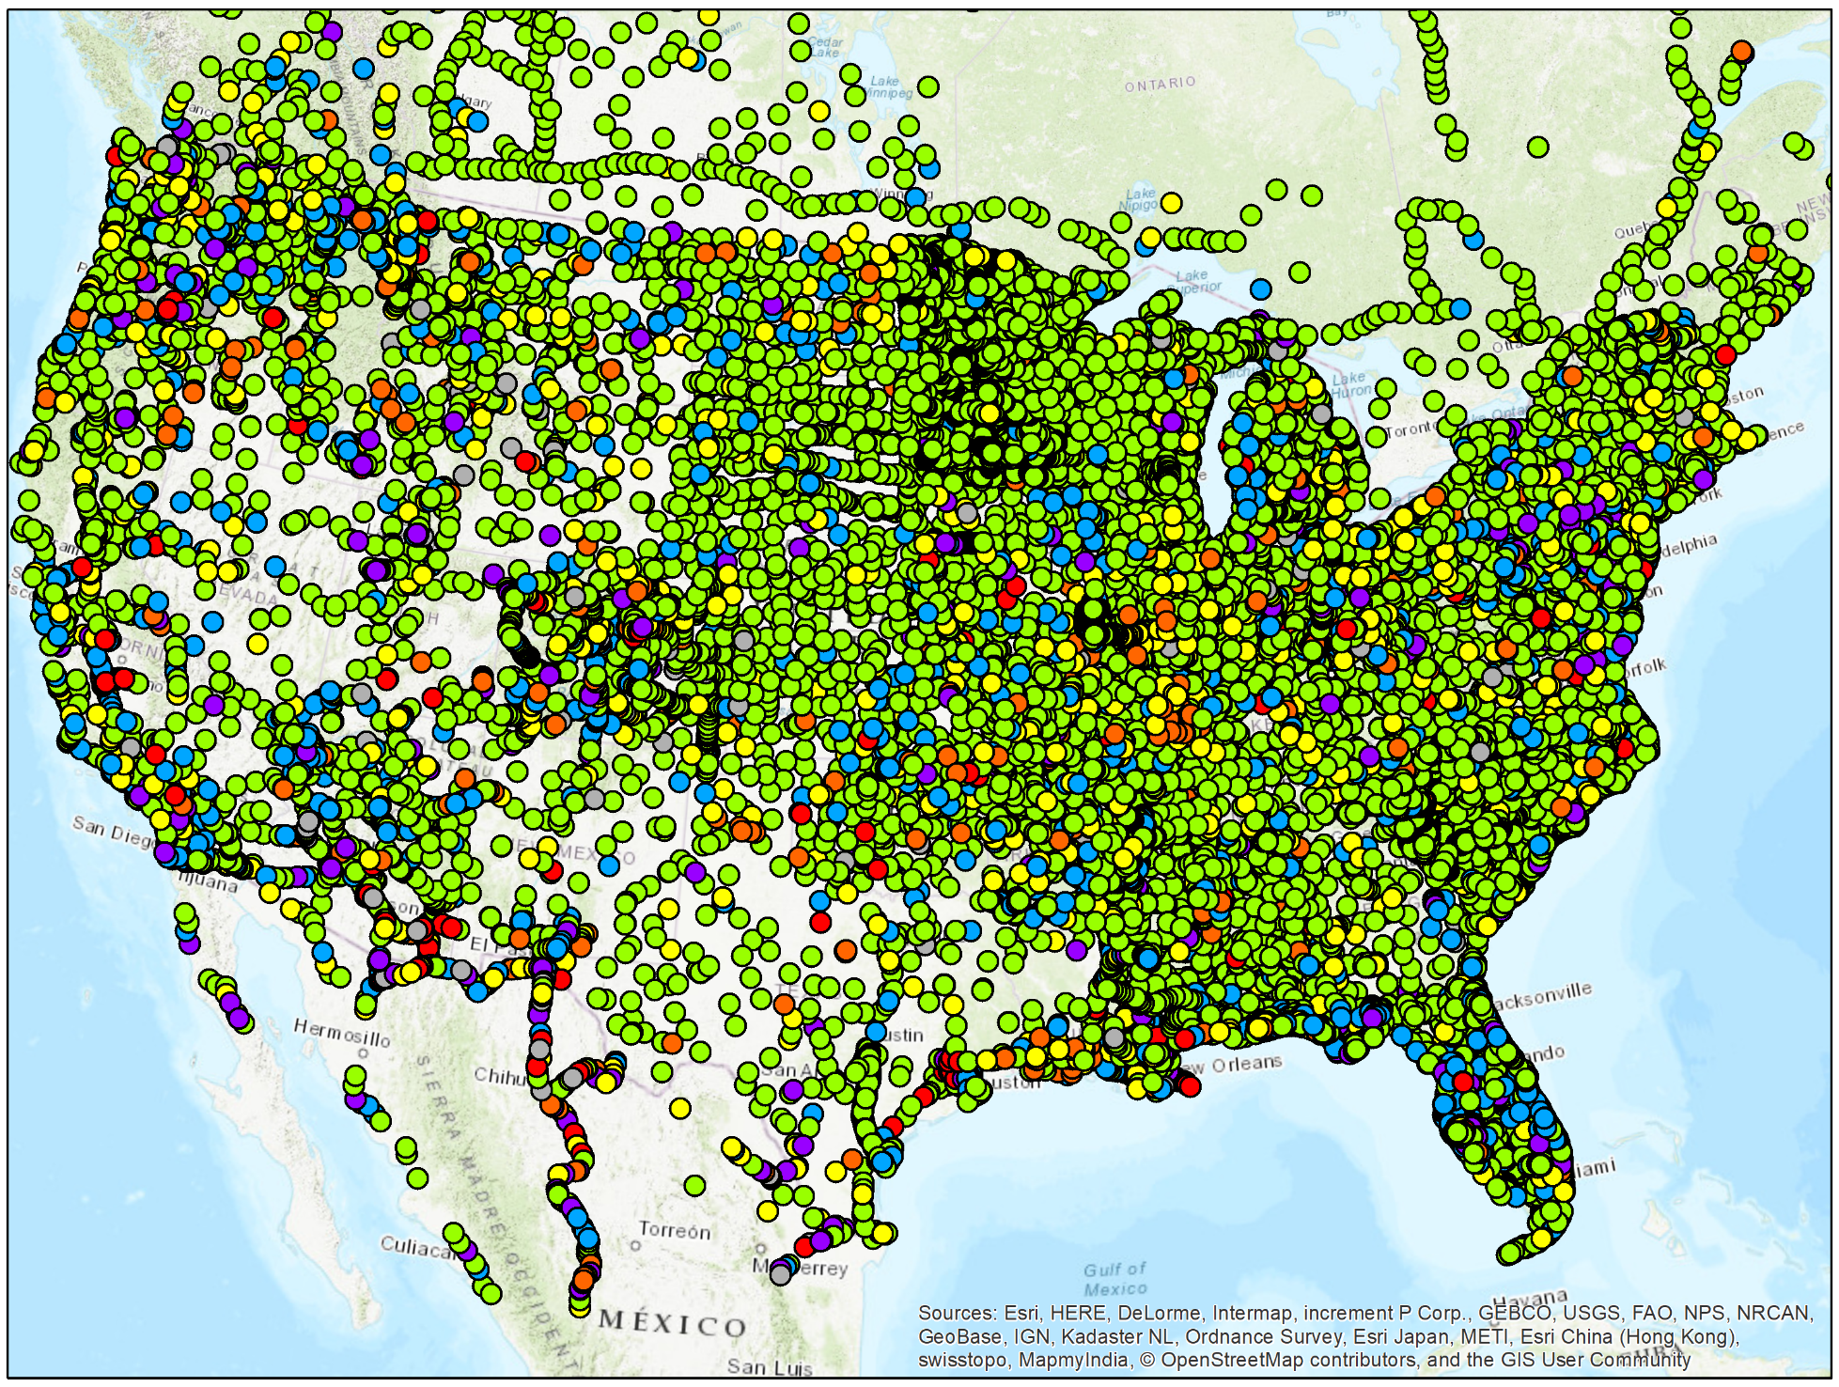
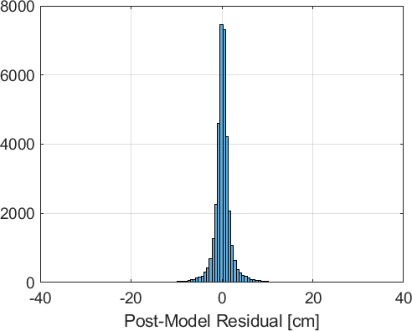
Post-Model Residual
N is from prototype hybrid geoid model

Slide 8
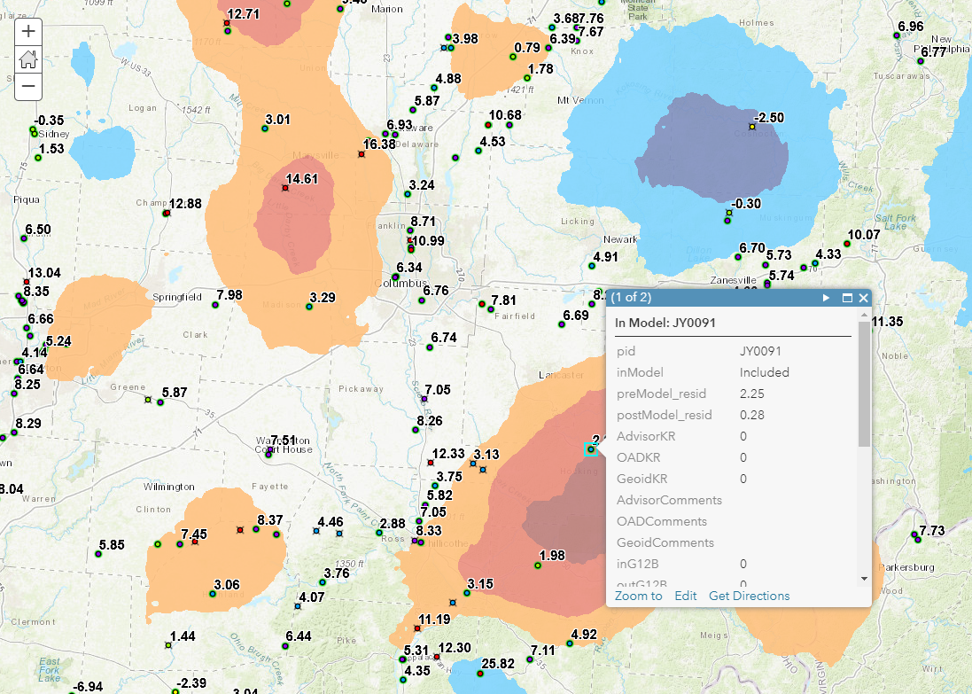
GEOID12B GeoPDF
ArcGIS Online Webmap

Slide 9
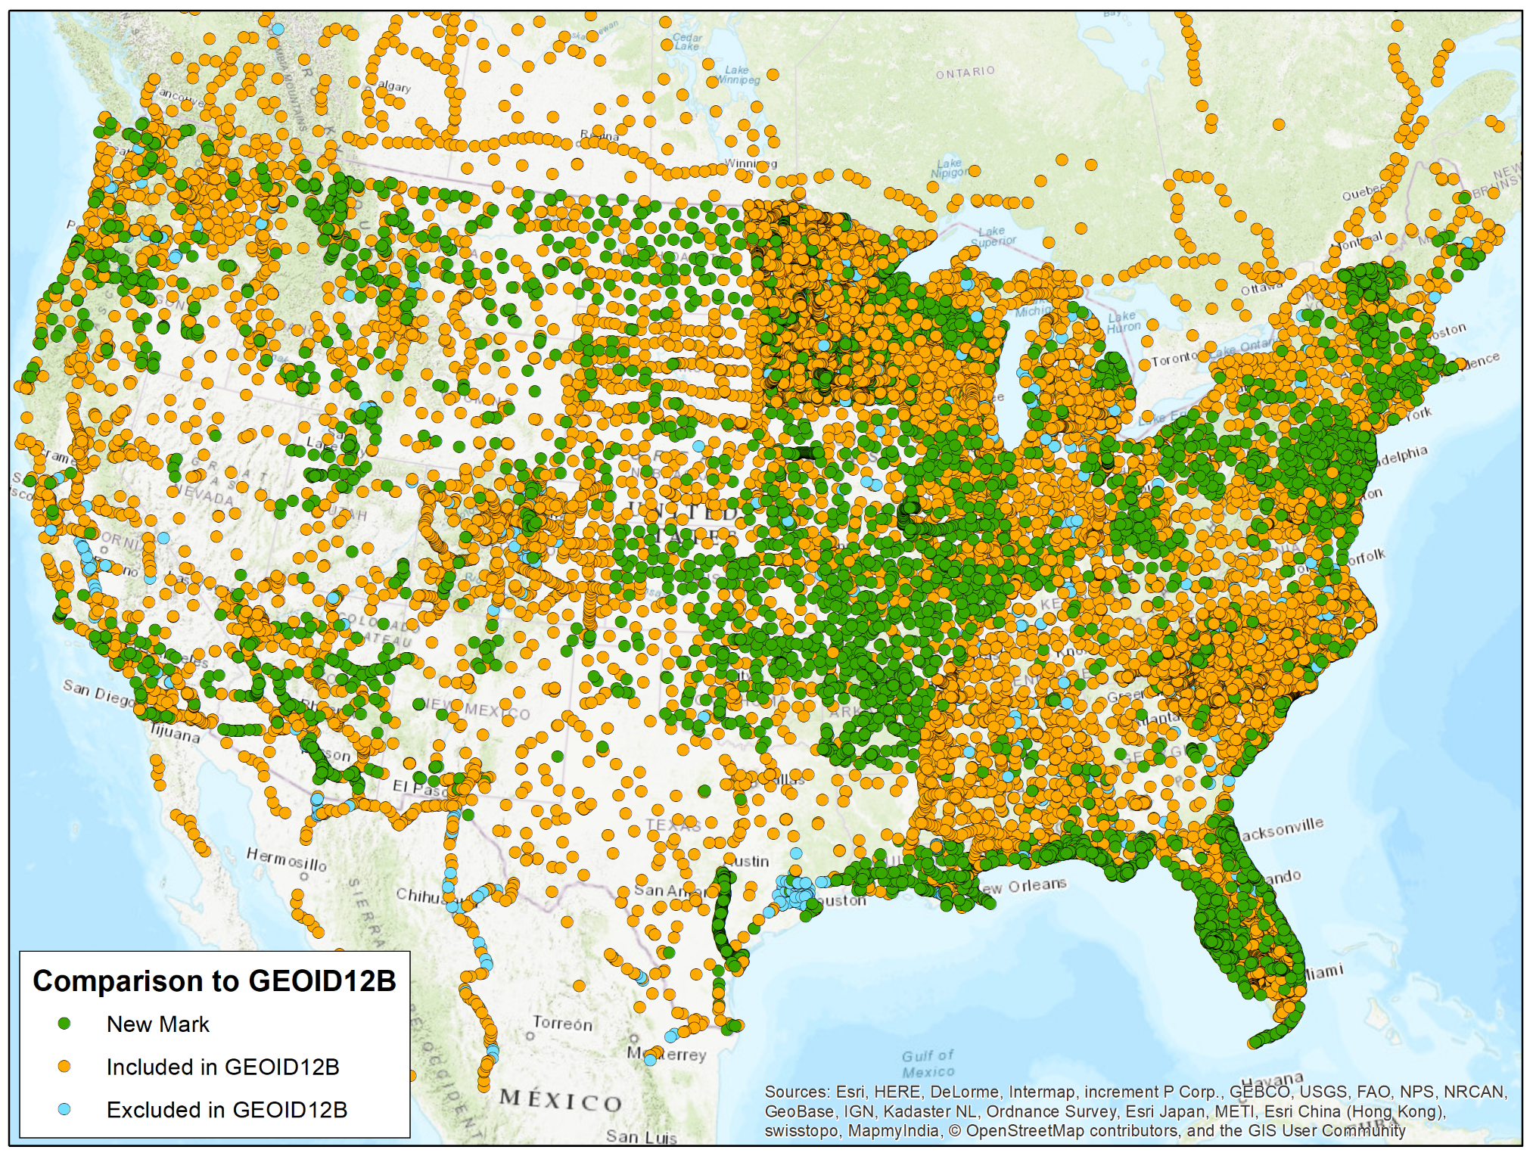
Prototype
Hybrid Geoid
(v5.1)
Similar construction as GEOID12B
Gravimetric Geoid Model: xGEOID17B (Interpolate)
GPS on Bench Marks (Constrain)

Slide 10
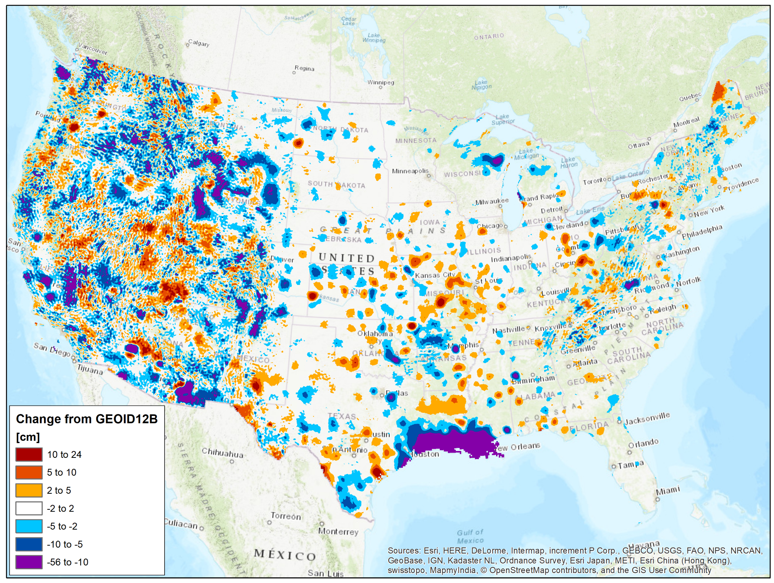
Prototype
Hybrid Geoid
(v5.1)
Similar construction as GEOID12B
Gravimetric Geoid Model: xGEOID17B (Interpolate)
GPS on Bench Marks (Constrain)

Slide 11
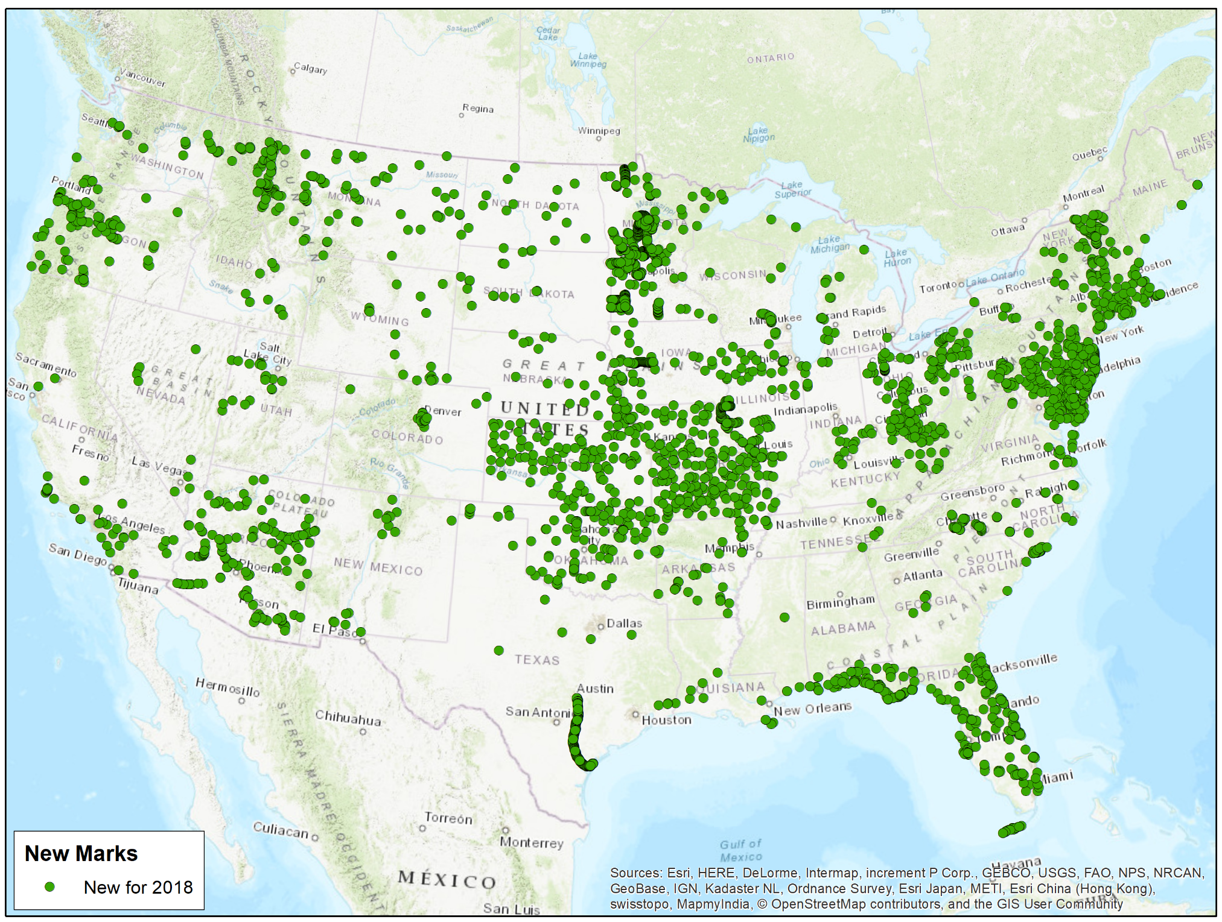
Prototype
Hybrid Geoid
(v5.1)
New marks since GPS on Bench marks Priority List (n = 3430)
NGS Integrated Database – GPS Projects or Leveling Projects
OPUS Share

Slide 12

Prototype Hybrid Geoid
(v5.1) Statistics
Data through 18 July 2018
GPS on BM | Available | Flagged as bad fit | Used in Model | Number since GEOID12B | Used since GEOID12B | Number since GPS on BM 2018 | Used from 2018 Points
NGS IDB: | 30,425 | 1,393(4.6%) | 29,032 | 6160 | 5894 | 1190 | 1190
OPUS Share: 2+ Obs. | 2,219 | 103(4.6%) | 2,116 | 2008 | 1967 | 1695 | 1693
OPUS Share: 1 Obs. | 2,560 | - | 0 | 2,286 | 0 | 545 | 0
Total: | 35,204 | 1496 | 31,148 | 10,454 | 7,861 | 3,430 | 2,883

Slide 13
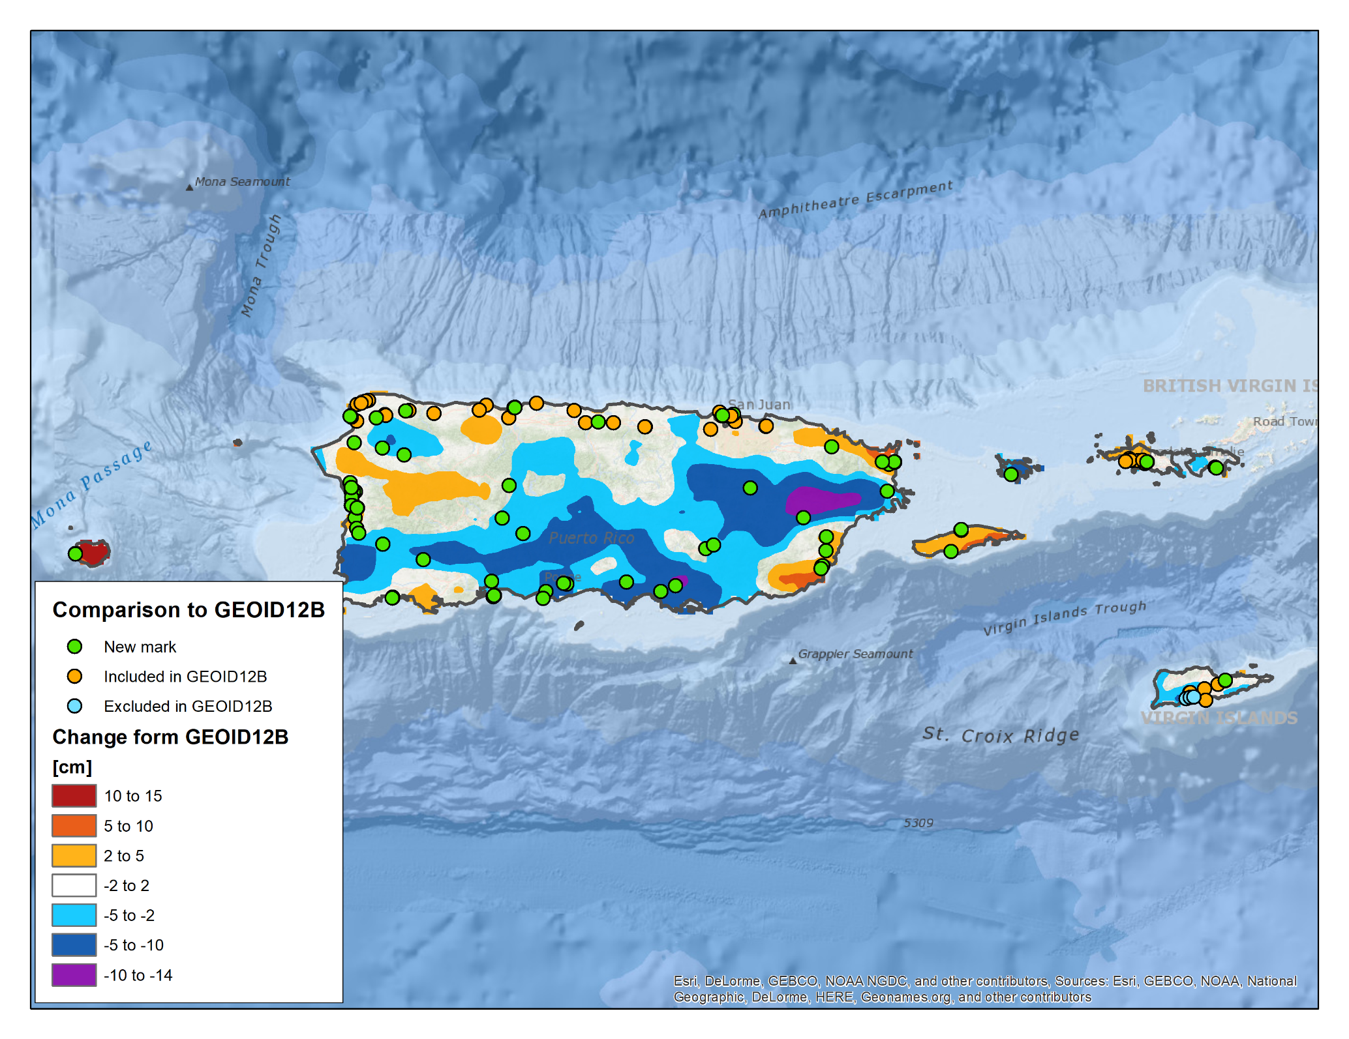
Puerto Rico /
U.S Virgin
Islands
What’s new?
141 GPS on Bench Marks (Constrain)
91 New Marks:
  IDB: 14
  OPUS Share: 77
Gravimetric Geoid Model: xGEOID17B (Interpolate)

Slide 14
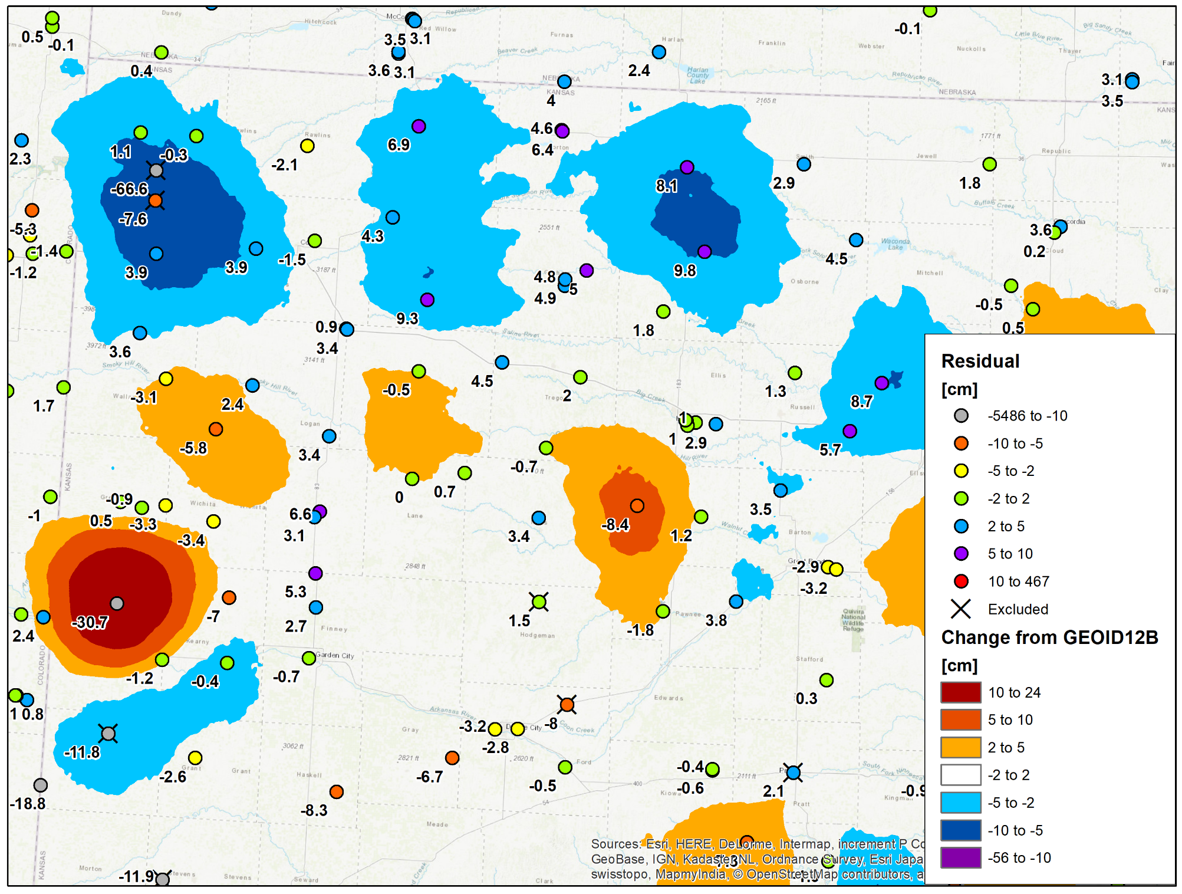
Western Kansas
Labels = Residuals in cm (r = H - h - N)
Gravimetric Geoid Model: xGEOID17B (Interpolate)
GPS on Bench Marks (Constrain)

Slide 15
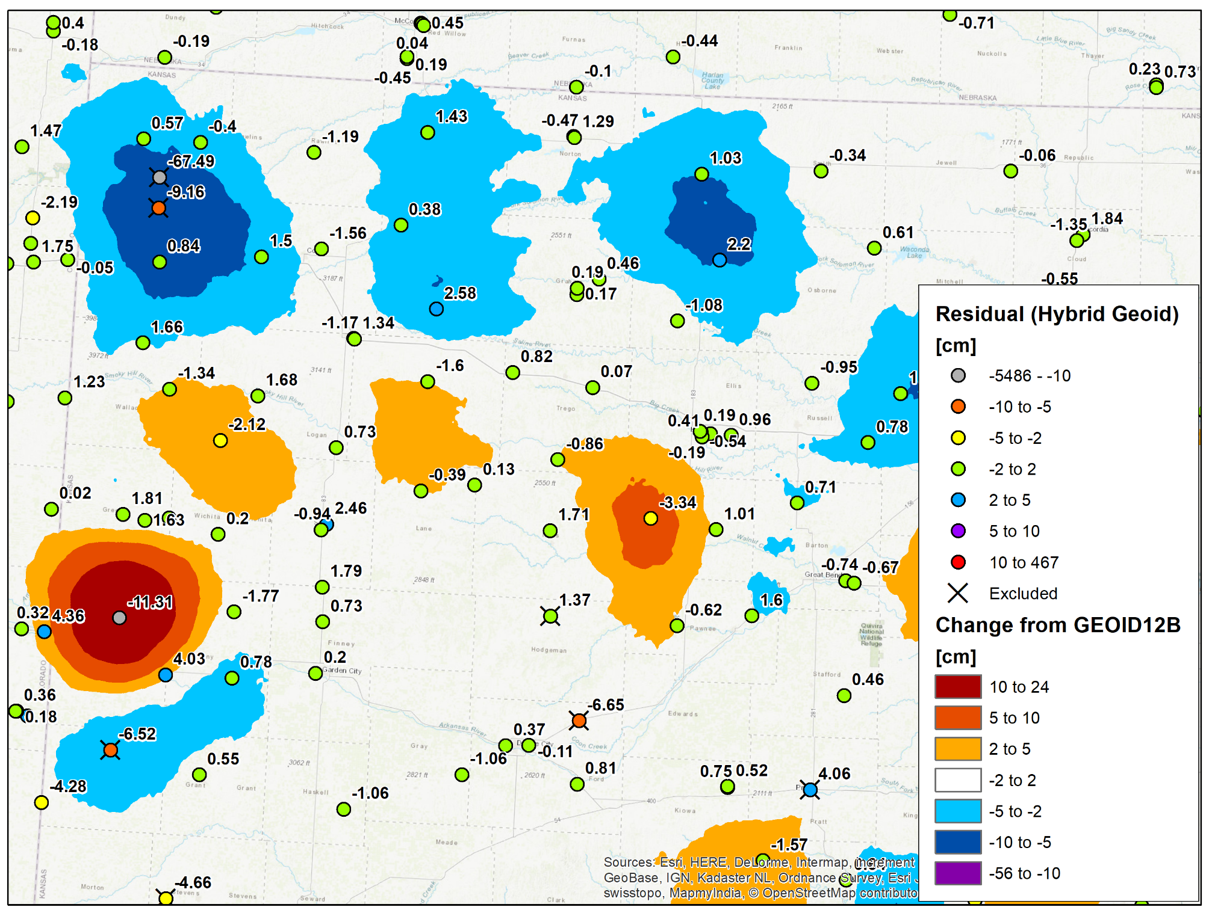
After Modeling:
Residuals to current prototype hybrid geoid model
Discrepancy that one would feel if you observed the bench mark
Labels = (postfit) Residuals in cm (r = H - h - N)

Slide 16

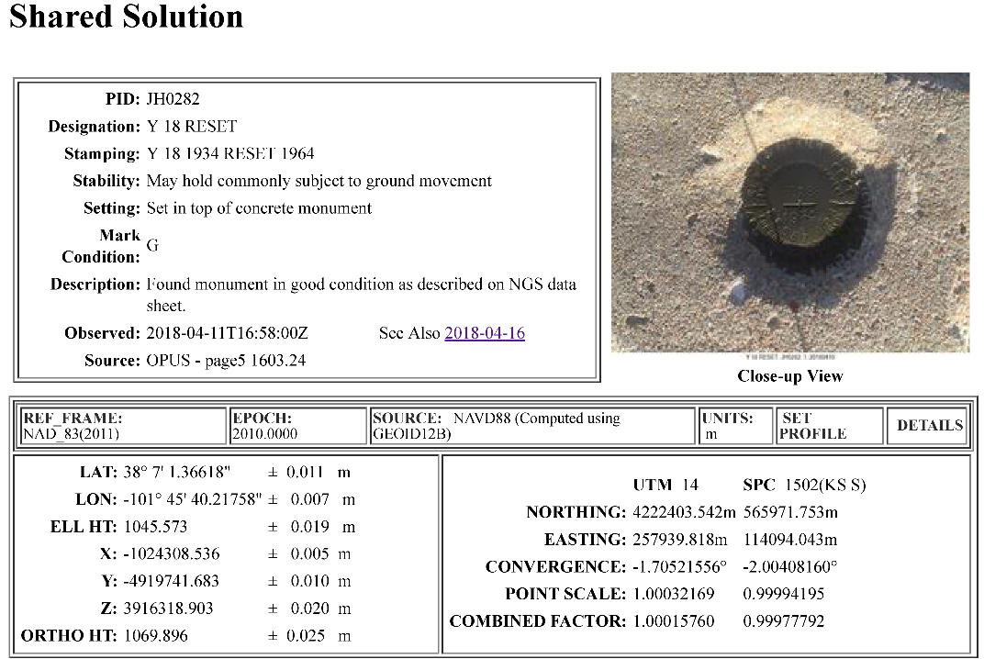
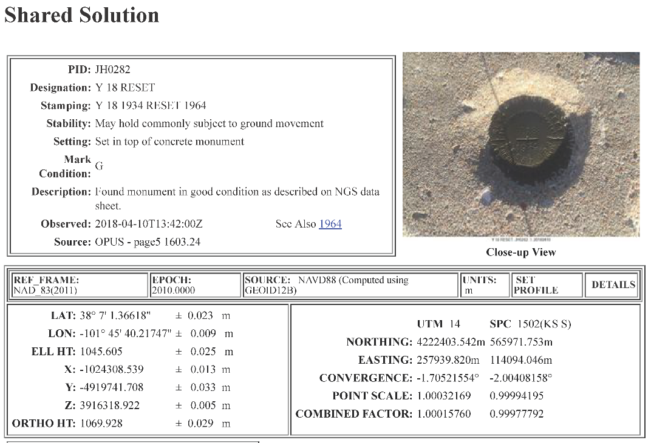
JH0282 ***********************************************************************
JH0282 DESIGNATION - Y 18 RESET
JH0282 PID - JH0282
JH0282 STATE/COUNTY- KS/HAMILTON
JH0282 COUNTRY - US
JH0282 USGS QUAD - PLUM CREEK SOUTH (1966)
JH0282
JH0282 *CURRENT SURVEY CONTROL
JH0282 ______________________________________________________________________
JH0282* NAD 83(1986) POSITION- 38 07 01.36 (N) 101 45 40.22 (W) HD_HELD1
JH0282* NAVD 88 ORTHO HEIGHT - 1069.61 (meters) 3509.2 (feet) RESET
JH0282 ______________________________________________________________________
JH0282 GEOID HEIGHT - -24.323 (meters) GEOID12B
JH0282 VERT ORDER - THIRD
JH0282
JH0282.The horizontal coordinates were determined by differentially corrected
JH0282.hand held GPS observations or other comparable positioning techniques
JH0282.and have an estimated accuracy of +/- 3 meters.
JH0282.
JH0282.The orthometric height was computed from unverified reset data.
Y 18 RESET -JH0282

Slide 17
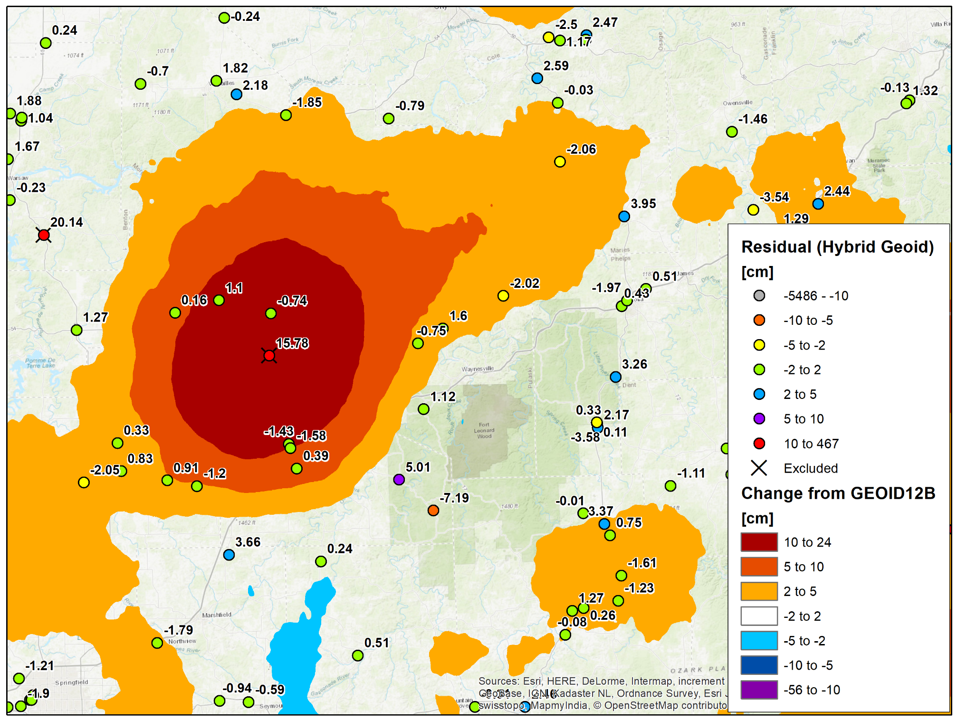
G 30 –
HD0371
Central Missouri (Lake of the Ozarks)
OPUS Solution from 2011 with ellip. ht = 262.737 m
OPUS Solution from 2016 with ellip. ht = 262.909 m
Requested another observation…
NEW OPUS Solution from 8/1/2018 confirming ellip. ht = 262.915 m
https://www.ngs.noaa.gov/OPUS/getDatasheet.jsp?PID=HD0371

Slide 18
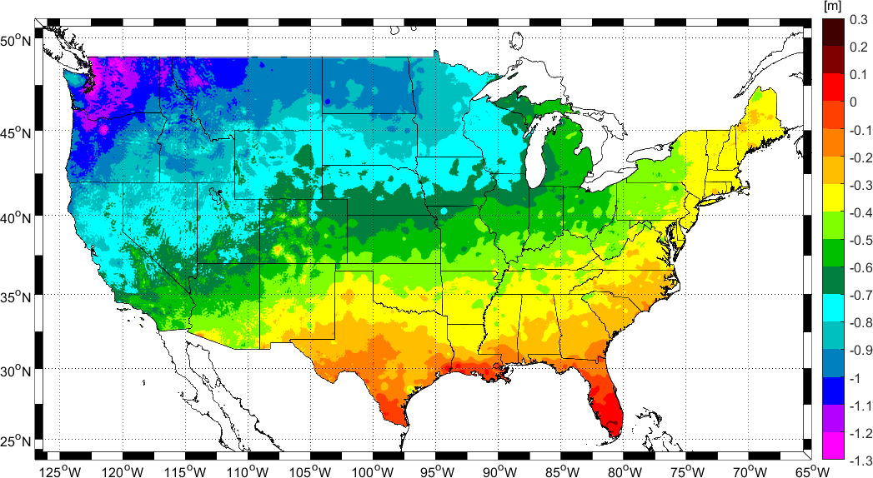
Change in Height from NAVD 88 to NAPGD2022

Slide 19
How you can help?
Download the prioritized list in your favorite format.
Check the Tracking Map to see what data we still need.
Find Bench Marks and submit mark recoveries using DSWorld.
Collect 4 or more hours of GPS data and submit to OPUS Share

Slide 20
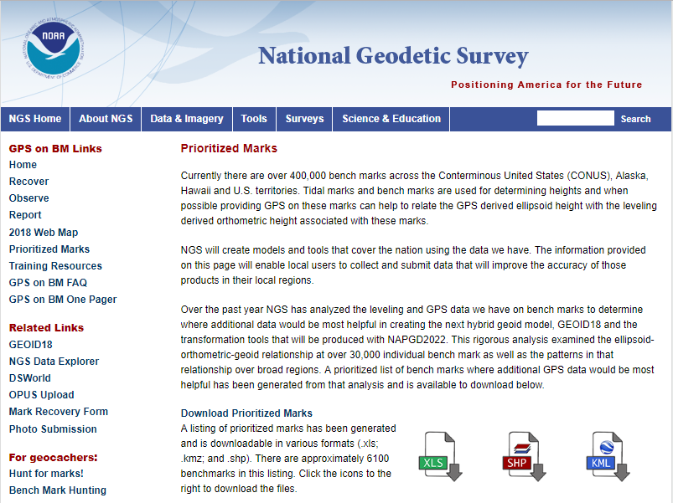
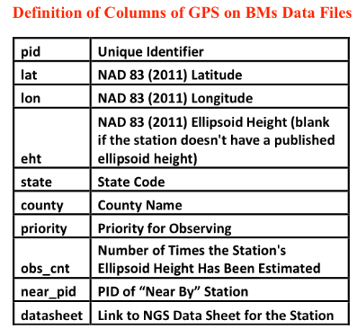
Prioritized List is available as excel file, ESRI shapefile, and Google Earth kmz file.
https://geodesy.noaa.gov/GPSonBM/prioritize.shtml
From Zilkoski GPS World 2/7/2018

Slide 21
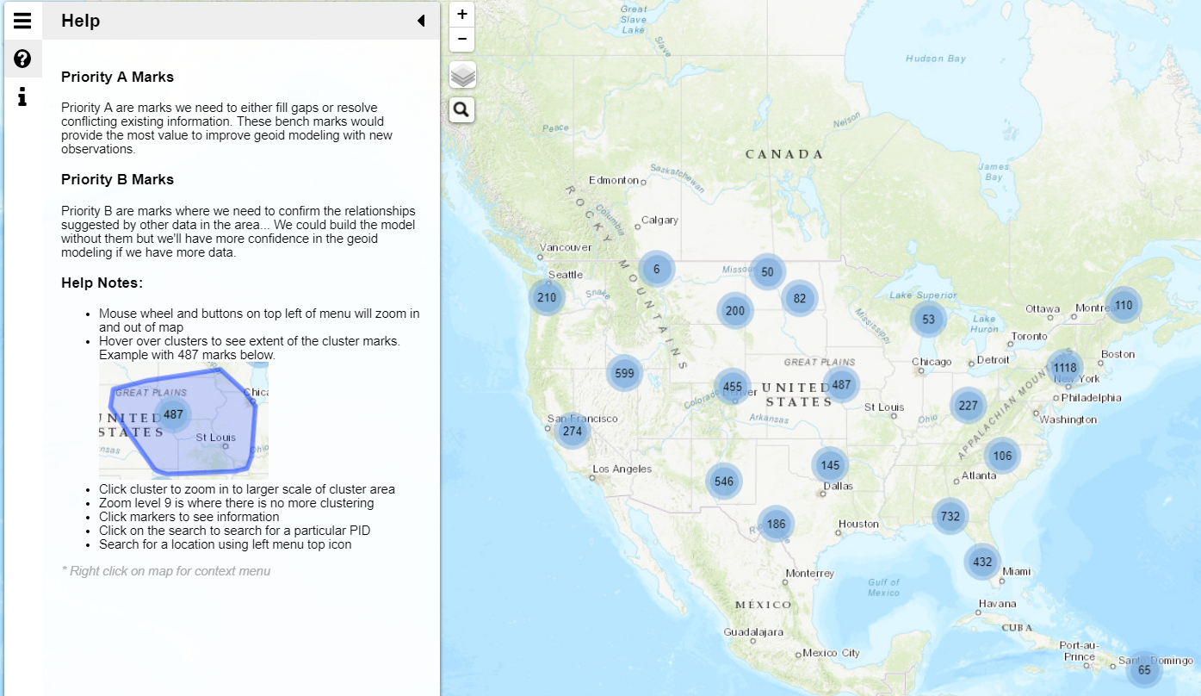
GPS on BM Tracking Map
Click on Clusters to Zoom In

Slide 22
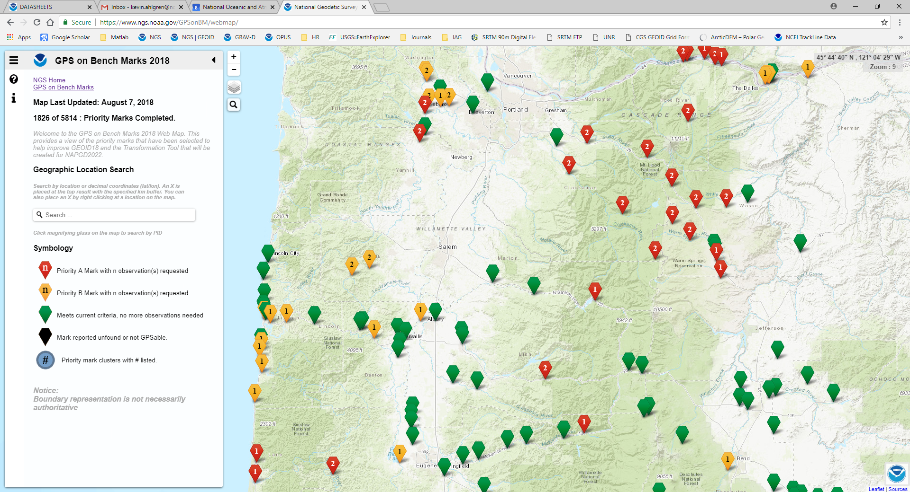

Slide 23
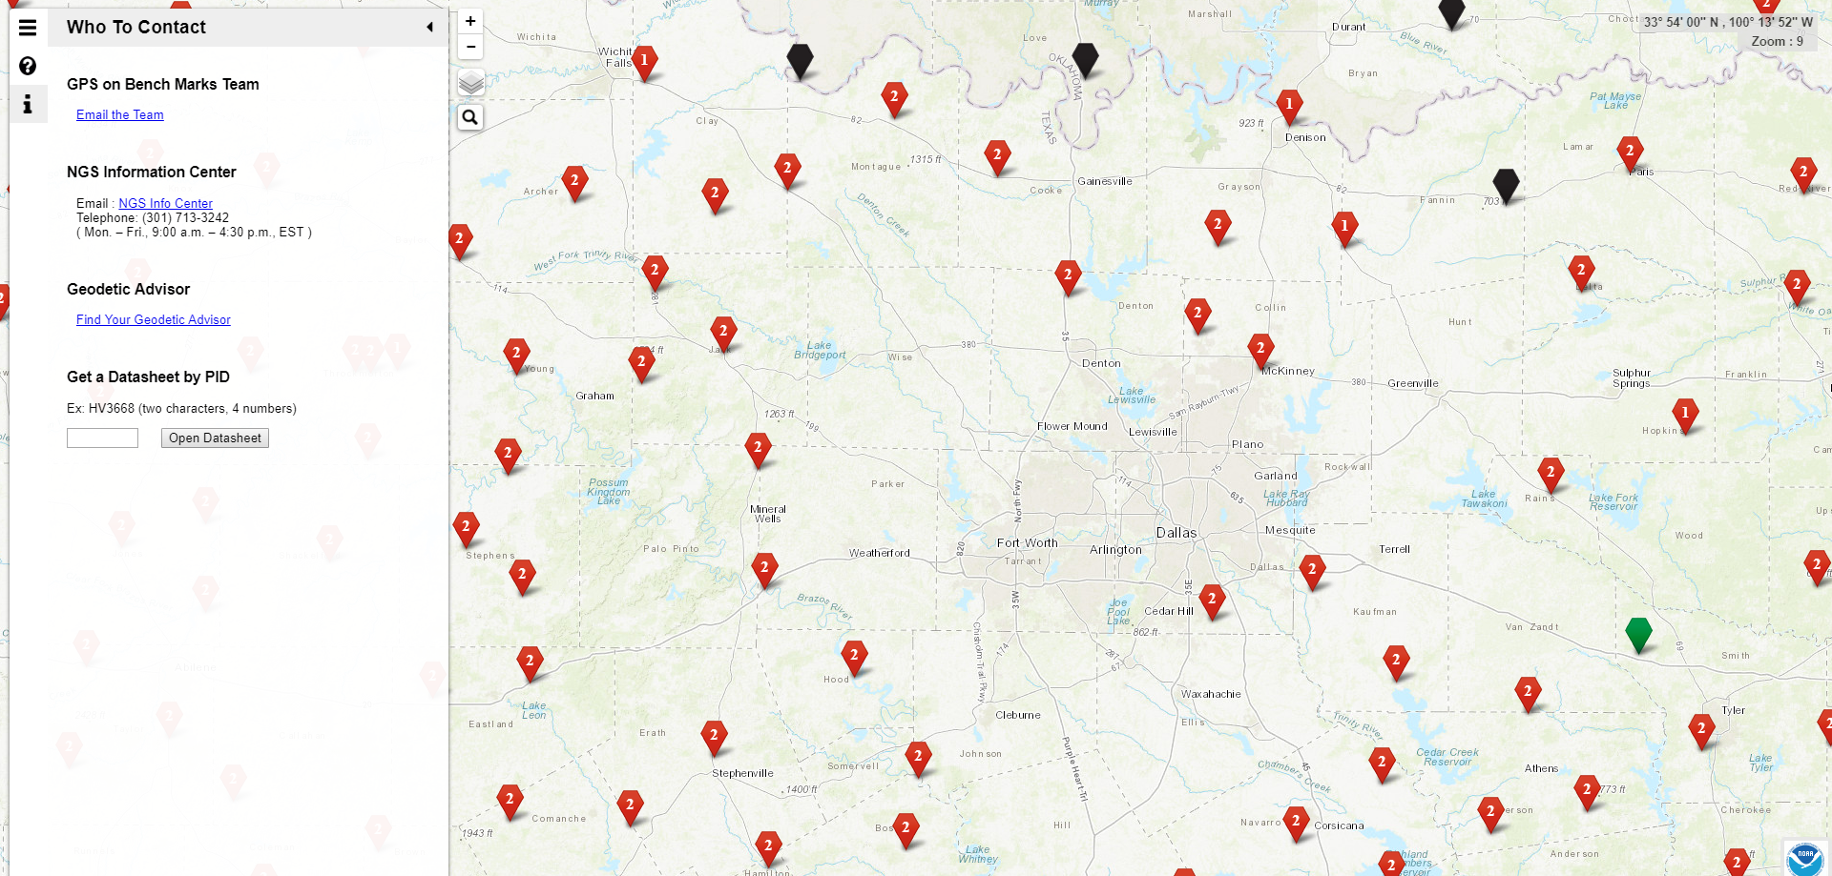
If you can not locate a mark, you can find and observe another nearby NAVD 88 adjusted bench mark
Please be safe and responsible. Avoid dangerous areas and be sure to obtain proper permissions before going to marks on private property

Slide 24

Submitting Mark Recoveries through DSWorld
DSWorld is a multifunction application that enables you to plot bench marks in Google Earth and submit bench mark recoveries to NGS.
Recovery information will let NGS and others know if the mark is still usable and pictures will make it easier to find.
https://geodesy.noaa.gov/PC_PROD/PARTNERS/

Slide 25
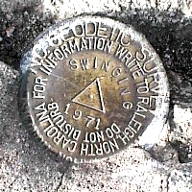
OPUS Requirements for Sharing
GPS Observation: Collect 4+ hours of data on a bench mark
Description: Provide details of how to locate mark (To Reach)
  Example: Located in the SW corner of a 2 ft square concrete pad projecting 0.3 ft above ground, 3.3 ft S from S edge of sidewalk...
Accurate antenna height and type values
2 photos:
  close-up photo (avoid dark/blurry/dirt-covered)
  horizon photo (show equipment in use)
Notes:
- We keep the minimum session time at 4 hours for OPUS share
- Longer sessions = better probability of fixing ambiguities and cancelling some errors in GNSS
Incorrect antenna height is often the cause of an inaccurate orthometric height
Example description at the top
OPUS share requirements
https://geodesy.noaa.gov/OPUS/about.jsp#sharing
OPUS webinar from Dec 2016
https://geodesy.noaa.gov/web/science_edu/webinar_series/understanding-opus.shtml

Slide 26
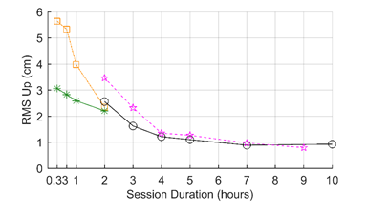

Why do we need 4 hours of data?
NGS is working on OPUS for RTK that will accept 3 minute observations, however the accuracy will NOT be as good as 4 hour observations.
1 sigma
Graph Courtesy of Dr. Daniel Gillins
Notes:
Better solutions with lower RMS are important for creating the hybrid geoid model. The Transformation Tools will need a higher density of data, so we are willing to trade a decrease in accuracy for the ability to get data on many more marks.

Slide 27
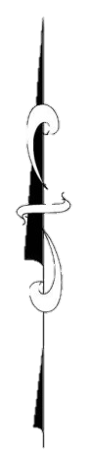
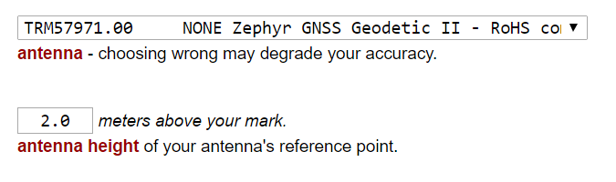
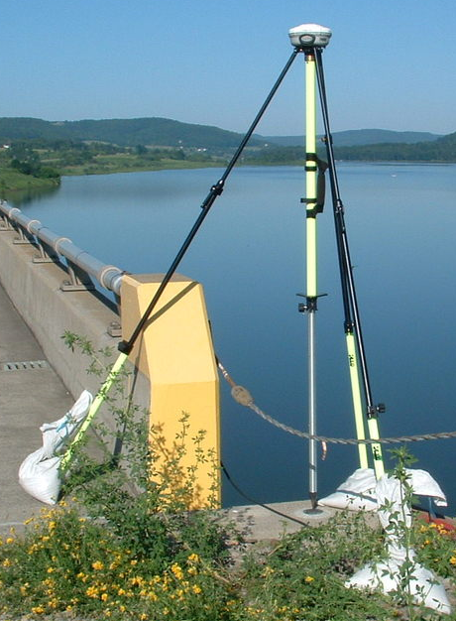
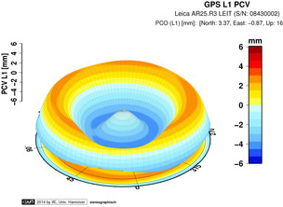
Antenna Type & Antenna Height are crucial for accurate results
rotate NRP to face true north
ARP
Each Antenna Type has unique biases
antenna height
For antenna calibrations, photos,
ARP and NRP diagrams, see geodesy.noaa.gov/ANTCAL/
mark
JGE, 2015

Slide 28

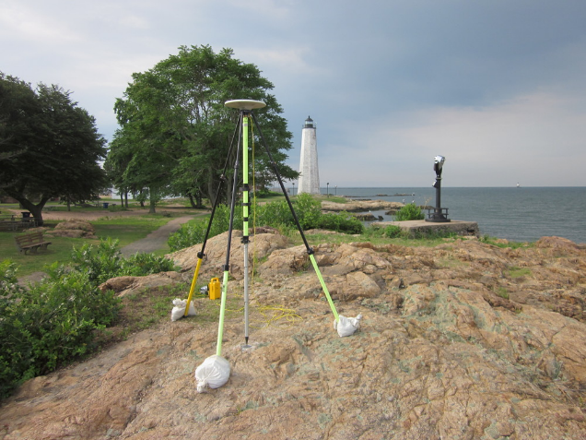
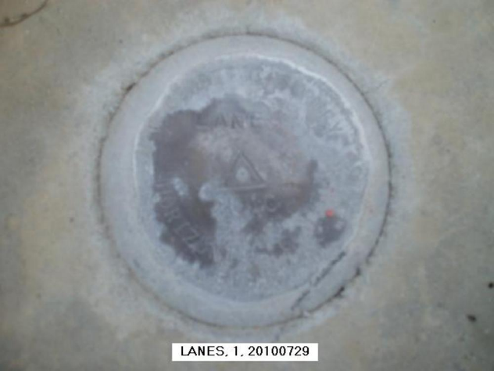
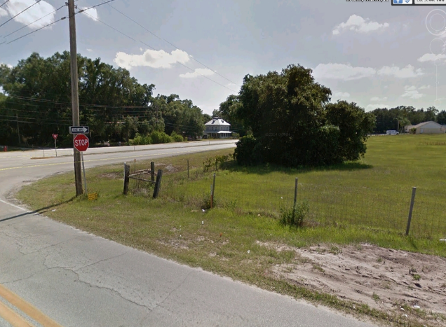
Best Practices for OPUS Share Photos
Best:
Clear, distinct close up and horizon photos
Stamping clearly visible
Equipment shown, location clear, mark distinct
Worst:
Equipment blocking stamping
Photo is blurry, stamping is difficult to read
Location of mark not clear in horizon photo

Slide 29
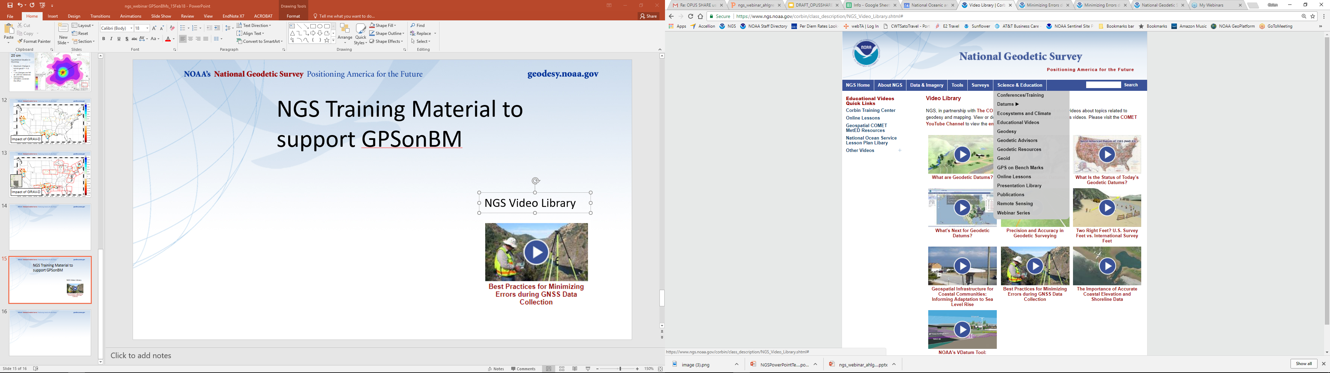
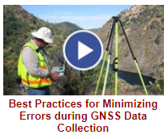

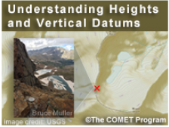
NGS Training Material
GPS on Bench Marks Webpages
NGS Video Library
NGS Online Lessons

Slide 30
Questions?
Contact the team:
ngs.gpsonbm@noaa.gov

