Slide 1
GPS on Bench Marks:
2022 Transformation Tool Campaign
2020.0 Update
NGS Webinar Series
February 13th, 2020
GPSonBM Team:
Galen Scott, Brian Shaw, & Kevin Ahlgren

Slide 2
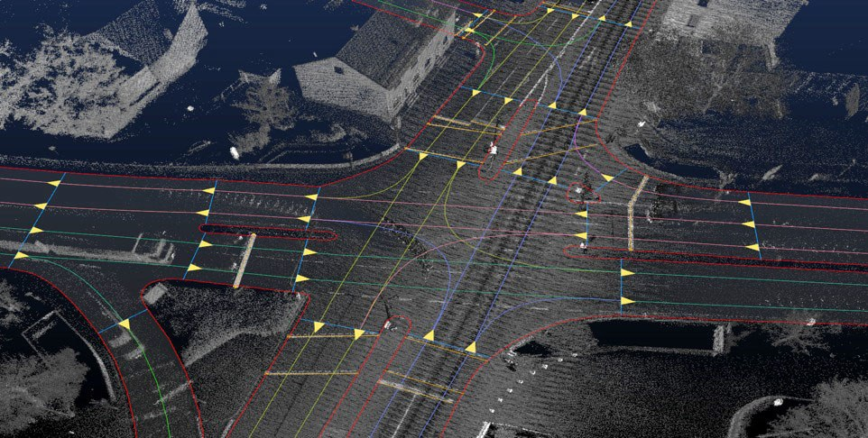
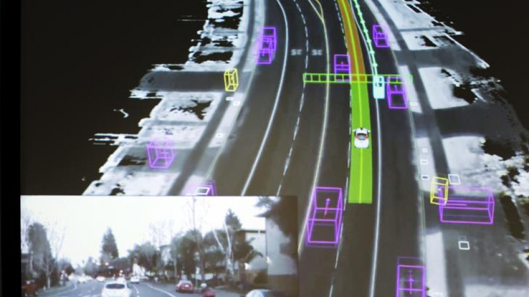
Modernized NSRS Use Case: Autonomous Vehicles
Consistent, accurate, and precise reference frame for navigation
NASA tests air traffic control system for drones
Autonomous Cars Will Require a Totally New Kind of Map
Autonomous Cars Infographic Workgroup
Credit: Elijah Nouvelage/Reuters

Slide 3
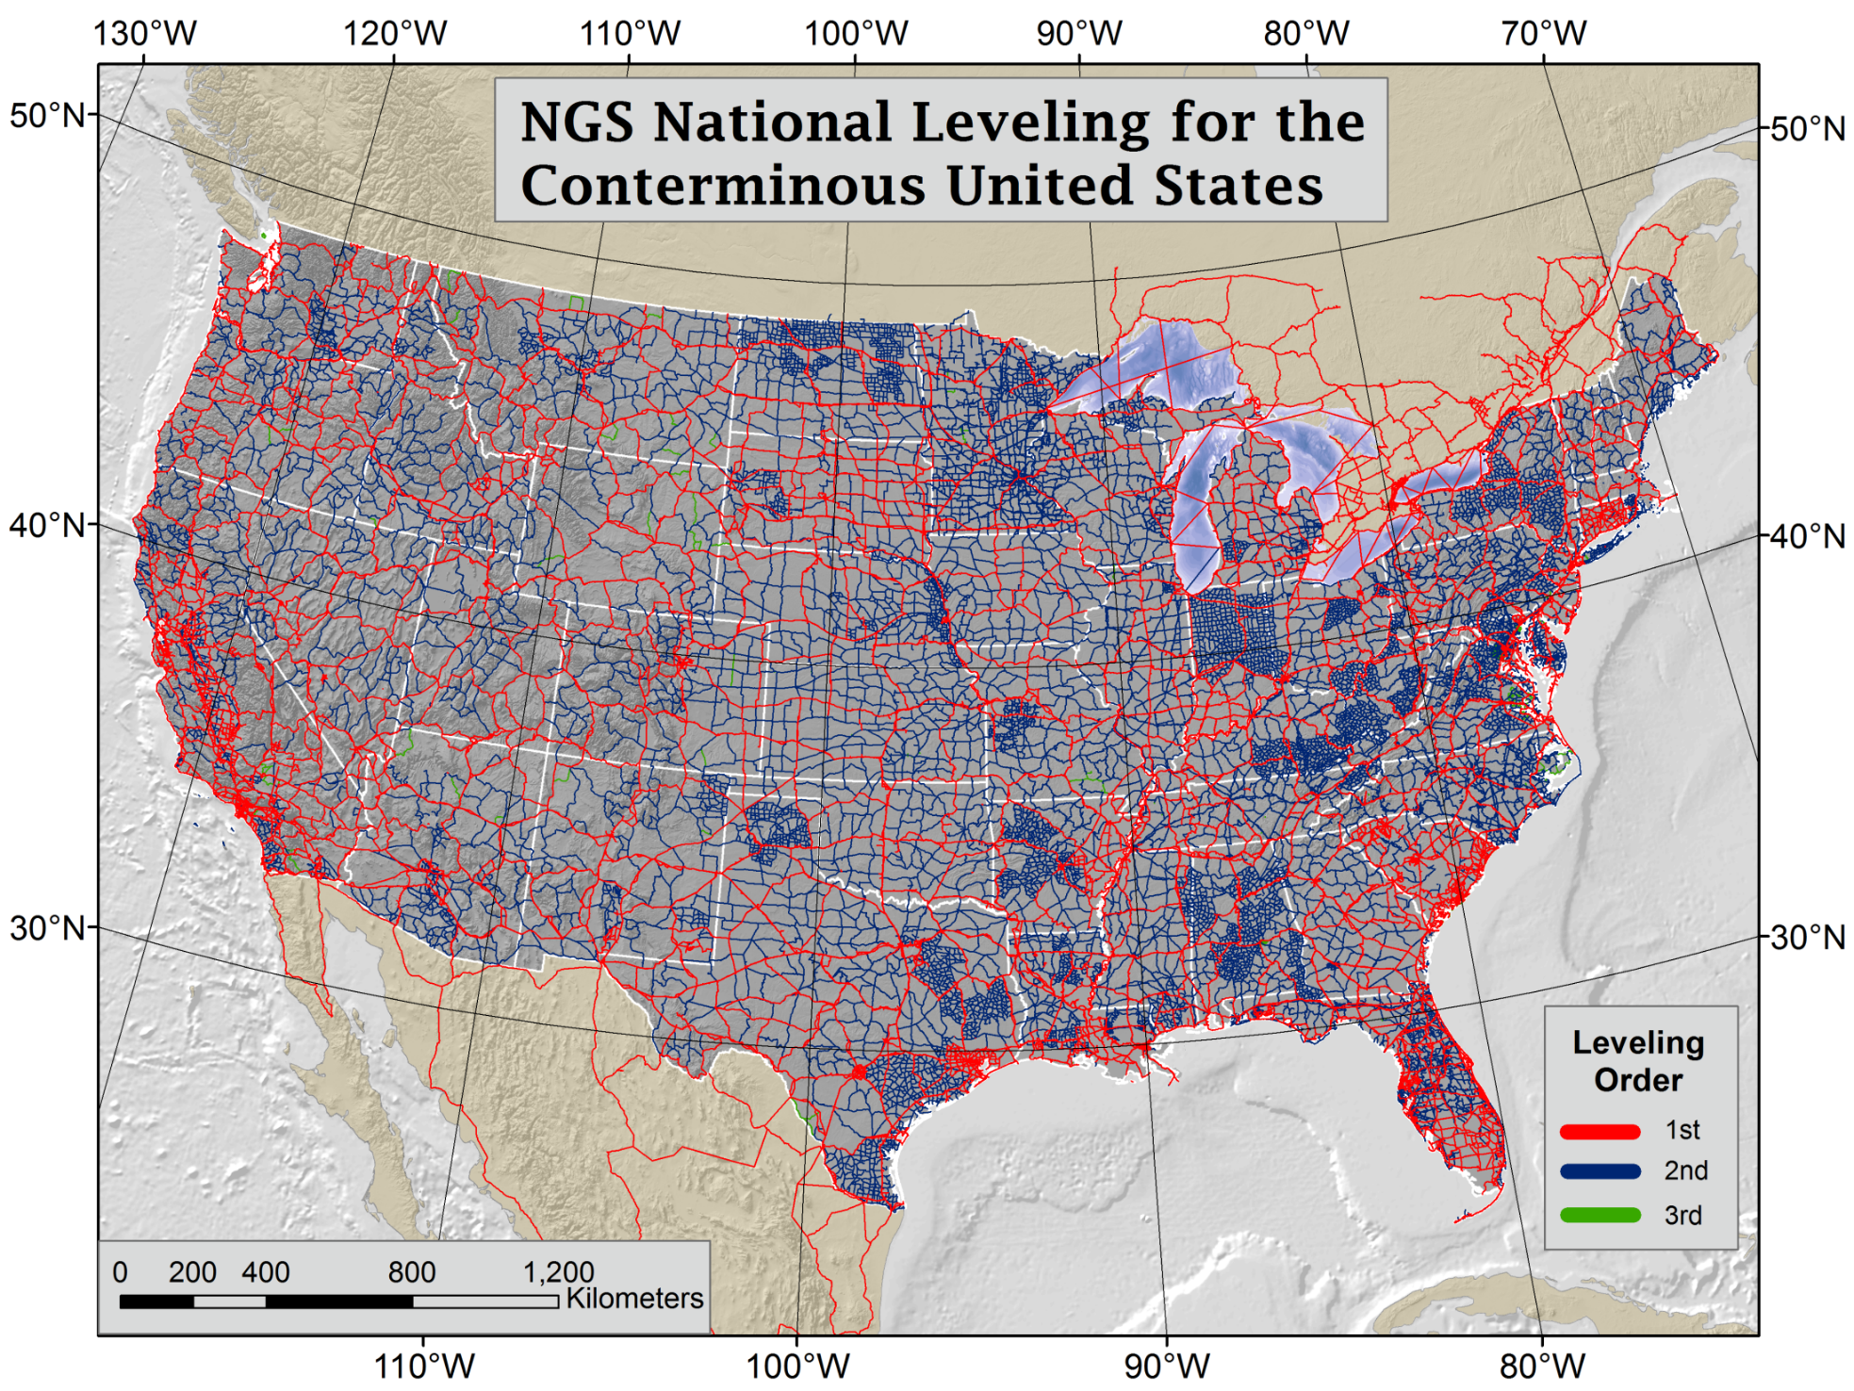
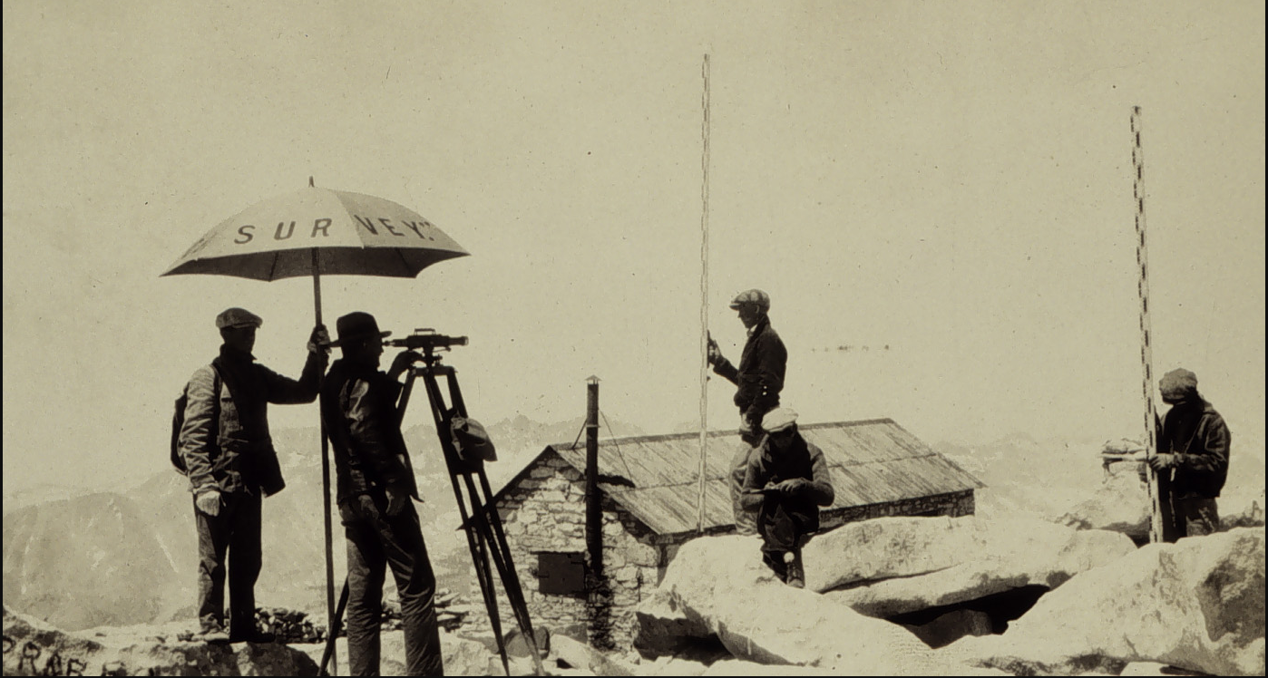
NAVD 88 is based on Geodetic Leveling and some GPS-derived orthometric heights (Height Mod)
Current Vertical Datums:
NAVD88
CONUS & AK
PRVD02
Puerto Rico
VIVD09
US Virgin Islands
GUVD04
Guam
NMVD03
Commonwealth of the Northern Marianas
The Transformation Tool will be built to reproduce existing published heights, both leveling and GPS-derived
Notes:
NAVD 88 consists of about 800,000 benchmarks and ~2.2M km of leveling. Data was collecting over many decades by roving bands of surveyors who walked across the country multiple times over the years, east to west, north to south and back again. It is currently the official vertical datum of the US and is required for federal mapping projects.
GPS data on those leveled marks will be used to create GEOID18 – the model used to derive NAVD88 heights from GPS ellipsoid heights, as well as the transformation tools that will be released with NAPGD2022.

Slide 4
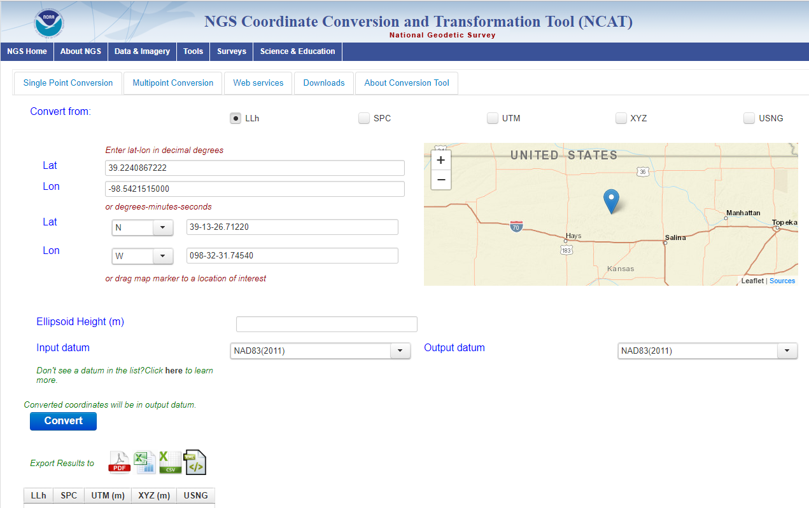
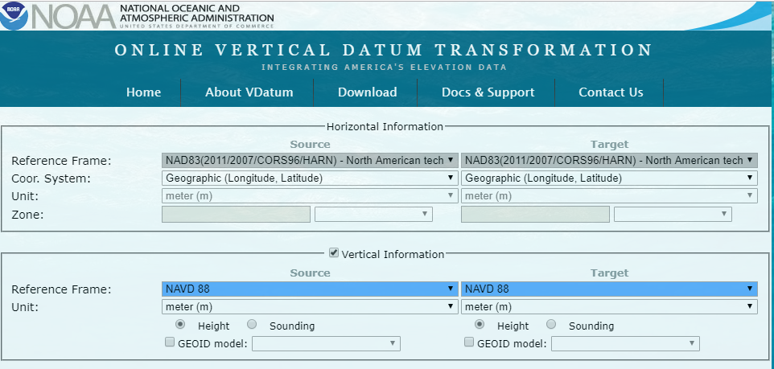
GPSonBM: 2022 Transformation Tool Campaign
NGS’ GPSonBM program is now requesting data to build the models that NCAT and VDatum will use to transform geospatial data from existing datums to the Modernized National Spatial Reference System

Slide 5
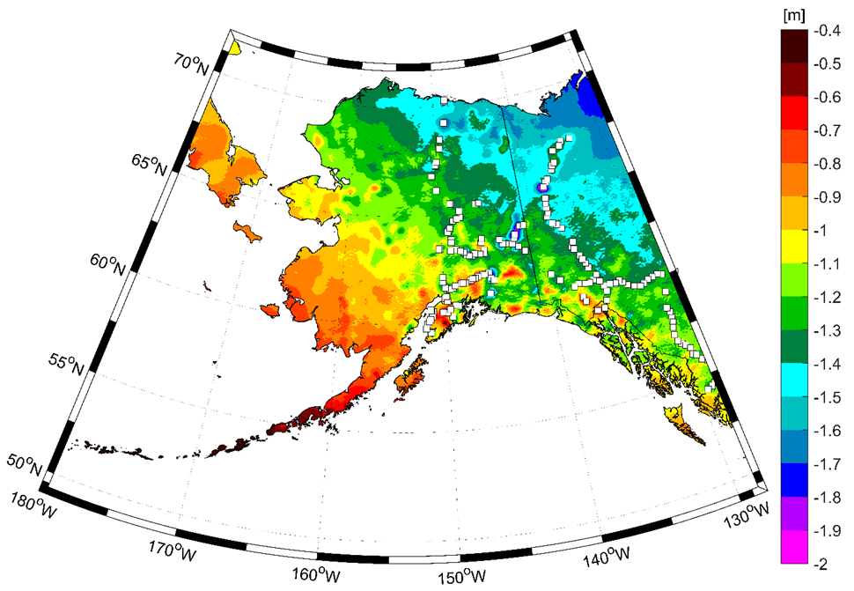
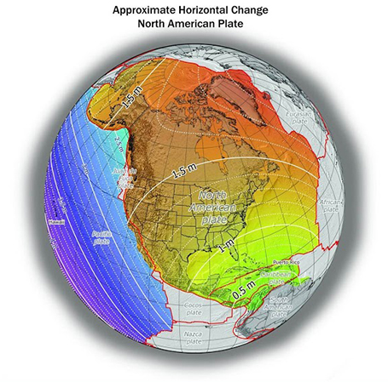
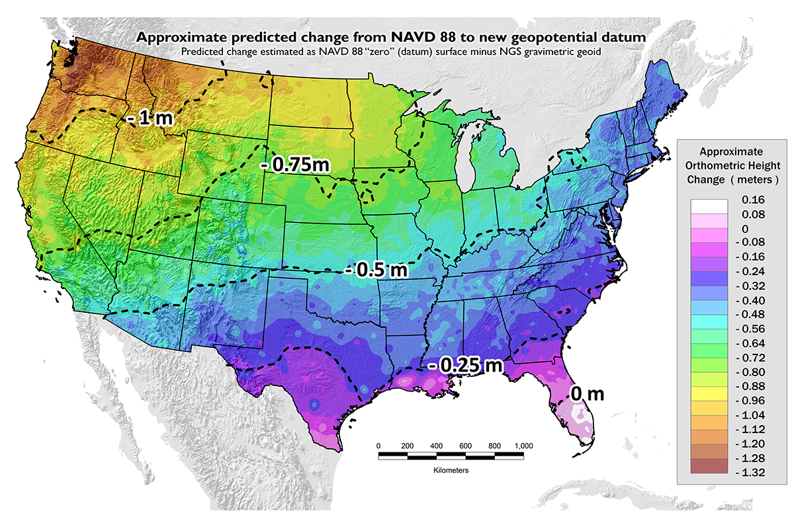
Approximate Predicted differences between Old & New:
NAVD 88 minus NAPGD2022
~0.4 to 2 meters in Alaska
~0 to 1.3 meters CONUS
GPSonBM data collection efforts are focused on the vertical datum transformations to resolve the irregular relationship between the surfaces.
Horizontal transformations are smooth and will be done primary with CORS data.
Notes:
New Datums What to expect https://geodesy.noaa.gov/datums/newdatums/WhatToExpect.shtml
NGS is not shifting the land, merely shifting the reference surfaces to which we reference the geospatial data to.

Slide 6
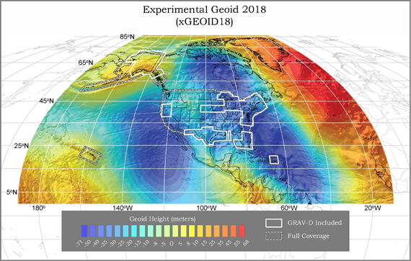
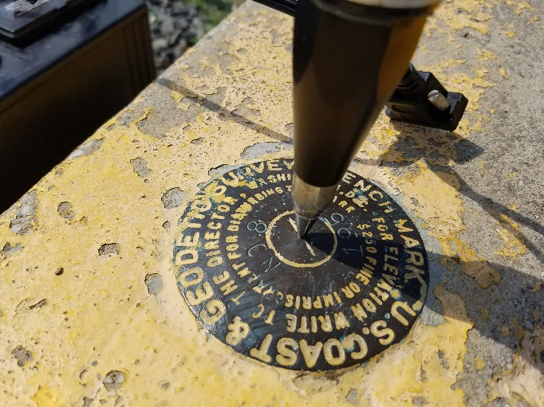
GPSonBM Connects Old & New Datums
Because the relationships between the old and new datums vary by location, the accuracy of the transformations in any particular place is directly related to the density of GPSonBM data available in that area.

Slide 7
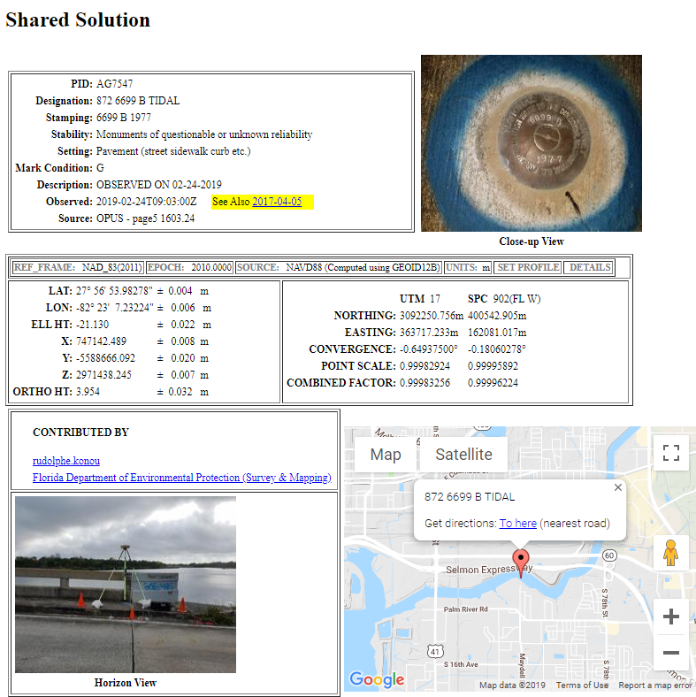
GPSonBM: Going From New Data to Better Models and Tools
Provide Data for GEOID18 DONE
Improve VDatum and NCAT
Update Passive Control Status
Automatic Reprocessing in 2022
Validate Static Gravimetric Geoid
Evaluate Intra-Frame Velocity Model (IFVM)
Identify marks suspected of movement
Establish RTN Check Stations

Slide 8
GPSonBM is Driving Surge in Shared OPUS Solutions
2018 GPSonBM GEOID18 Campaign Launch
2019 GPSonBM Transformation Tool Campaign Launch
Jan 2020
Transformation Tool Campaign:
June 2019 - December 31, 2021
Recent* Bluebooked & Shared OPUS Solutions will be used to compute 2020.0 Reference Epoch Coordinates in NAPGD2022

Slide 9
GEOID18 Model Improvements
32,357 GPS on Bench Marks data points were used to constrain the model to NAVD 88, PRVD02 and VIVD09, an increase of ~6,800 marks (26%) over GEOID12B
Significant new analysis of GPSonBM data resulted in a much cleaner dataset
Includes better elevation data and improved digital elevation modelling techniques
Uses better gravity data and improved geoid modeling techniques
New space-based gravity data from satellite gravity missions (GRACE & GOCE)
Includes all available airborne gravity data - 53 completed GRAV-D blocks
The overall fit of the final GEOID18 model to used bench marks is excellent. Over all of CONUS, the standard deviation is 1.27 cm
(GEOID12B was approximately 1.7 cm)

Slide 10
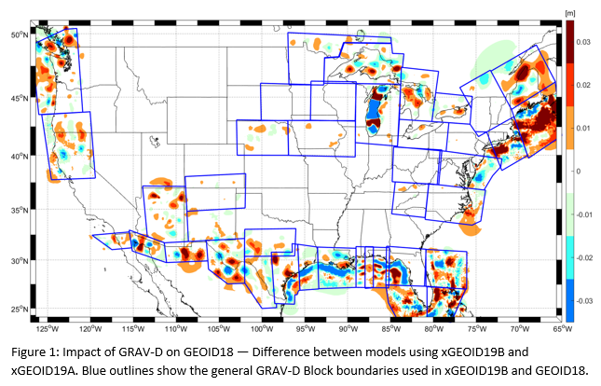
GEOID18 Technical Report
NGS will be releasing a Technical Report that describes the details of how the GEOID18 model was created, including:
Technical Specifications
Methodology
Input Data
Gravimetric Geoid Model
GPS on Bench Marks
Least Squares Collocation
Model Performance and Evaluation
Relative Accuracy
DEFLEC18

Slide 11
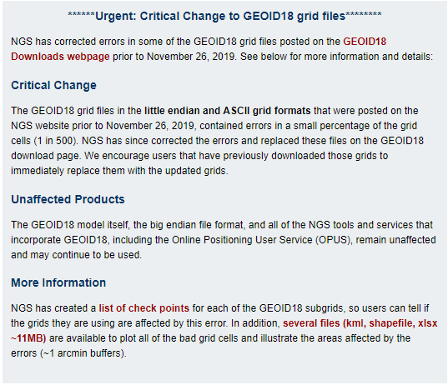
GEOID18 – Grid Check
https://www.ngs.noaa.gov/GEOID/GEOID18/
Check the GEOID18 webpage for important advisory.
Tools are available to check the GEOID18 grids you are using and to locate affected grid cells.
Check with your vendor to make sure you are using the latest files

Slide 12
2022 Transformation Tool Campaign Goals
NGS will make a national scale, mapping grade transformation tool with the data we have in the NGS Database or Shared through OPUS
To produce transformation results with an reasonable amount of uncertainty, NGS has a goal of GPSonBM data at 10 km spacing
We must interpolate over areas with data gaps
Uncertainties in the transformed coordinates will grow larger as the distance from a GPSonBM data point increases
Opportunity exists to densify local areas with data at up to 2 km spacing to increase accuracy and better resolve complex areas with topographic relief

Slide 13
Updates to GPSonBM Priority List
The priority list of marks was automated to select marks based on their metadata. This automated mark selection process has been updated and there have been some changes in the list.
Based on further discussions with transformation tool developers, we have removed all VERTCON marks from the priority list.
A new weighting scheme was implemented to make sure that ADJUSTED NAVD 88 marks are selected as top priority.
Users are encouraged to use their local knowledge to select marks to observe and submit if they know of better marks than those listed, or if the listed marks are no longer there

Slide 14
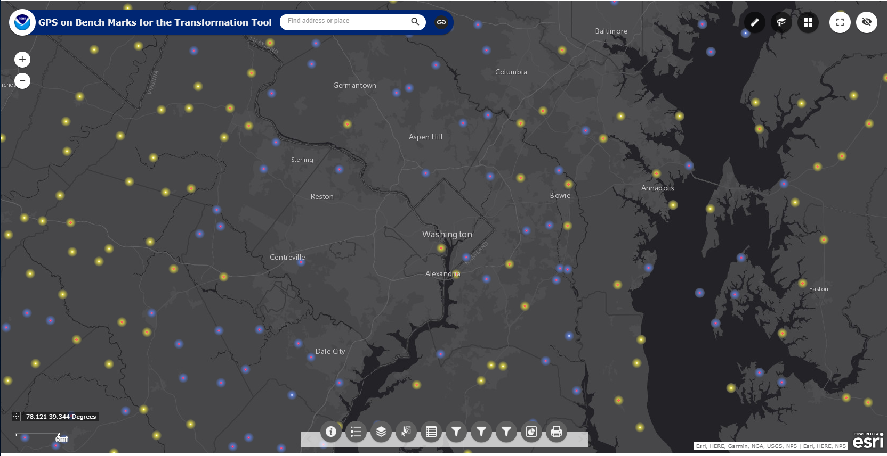
2022 Transformation Tool Campaign GPSonBM Web Map Application
The web map has several functions that allow users to search, explore, filter, and export the data.
For instructions, see website or refer to July 2019 GPSonBM webinar
Notes:
Move up to intro

Slide 15
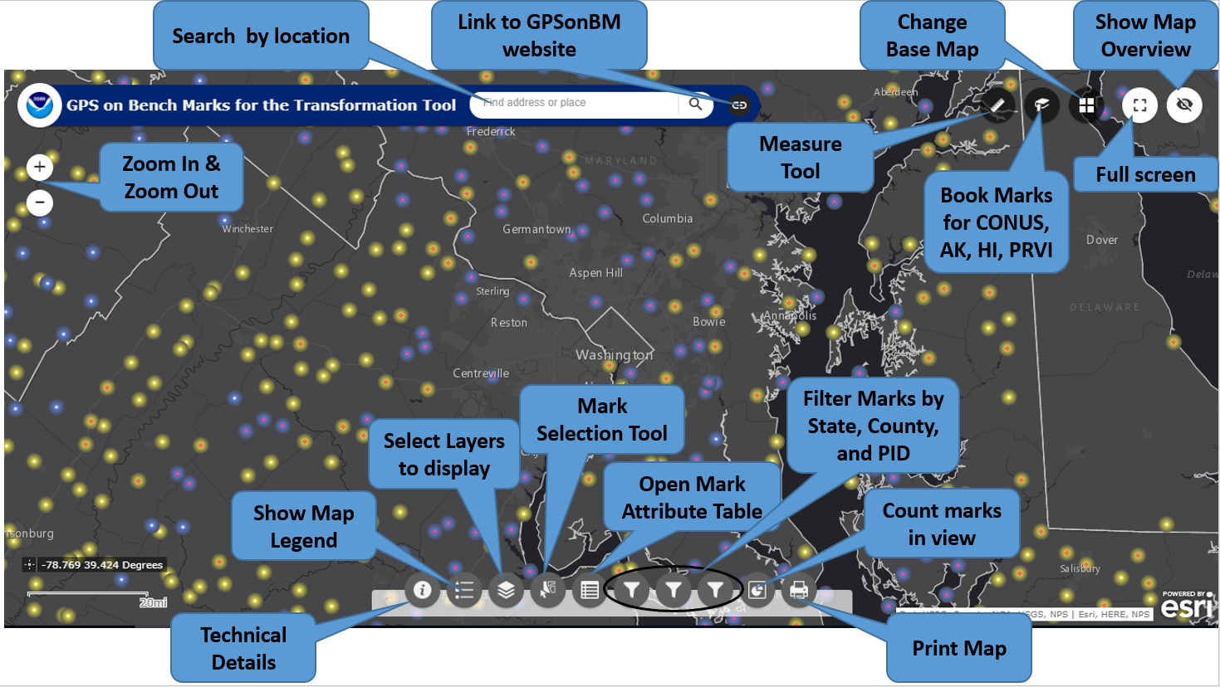
Notes:
Move up to intro

Slide 16
Which Marks First? How Many Observations?
Marks are classified as Priority A or B
Priority A marks meet quality standards for use in the transformation tool
Priority B marks are lower quality marks, less likely to be used to make the tool, but may be used to test the tool
NGS needs 2 consistent GPS observations on a mark to use it in the tool. At least one observation must be from 2014 or later
The list and map indicate whether 1 or 2 observations are requested

Slide 17
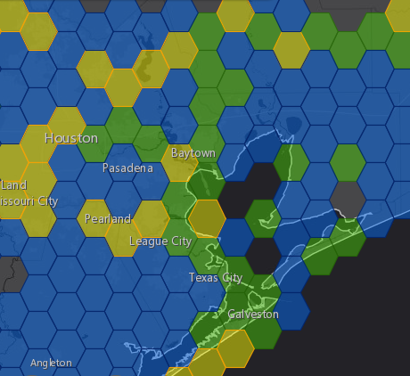
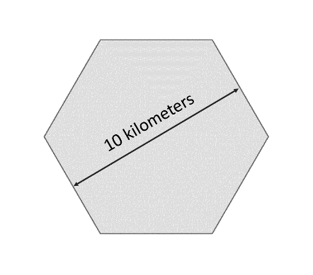
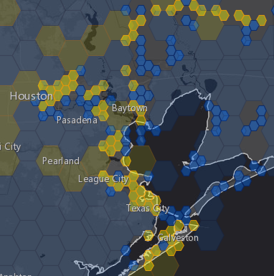
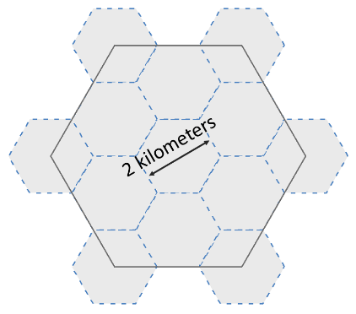
National Coverage and Local Densification
NGS has a National Coverage goal of 10 km spacing. 10 km hexagons illustrate this coverage on the map.
Priority marks within each hexagon are selected automatically based on their metadata
Once the 10 km goal is reached, the opportunity to densify the model and improve local results is unlocked. 2 km hexagons appear along with new priority marks within those hexagons
10 km
Priority A Hexagons are Gold
Hexagons where we have the data we need are marked Done and colored Green
Priority B hexagons are Blue
2 km

Slide 18
Update Frequency
To maximize efficiency for all contributors, the Priority List & Web Map will be updated regularly as new data comes in
Check the map prior to field work so your effort can be focused on marks that will make the biggest impact in your area
When time permits, NGS will release prototype transformation tools and accuracy grids to track improvements in accuracy as new data comes in, coverage expands, and densification takes place

Slide 19
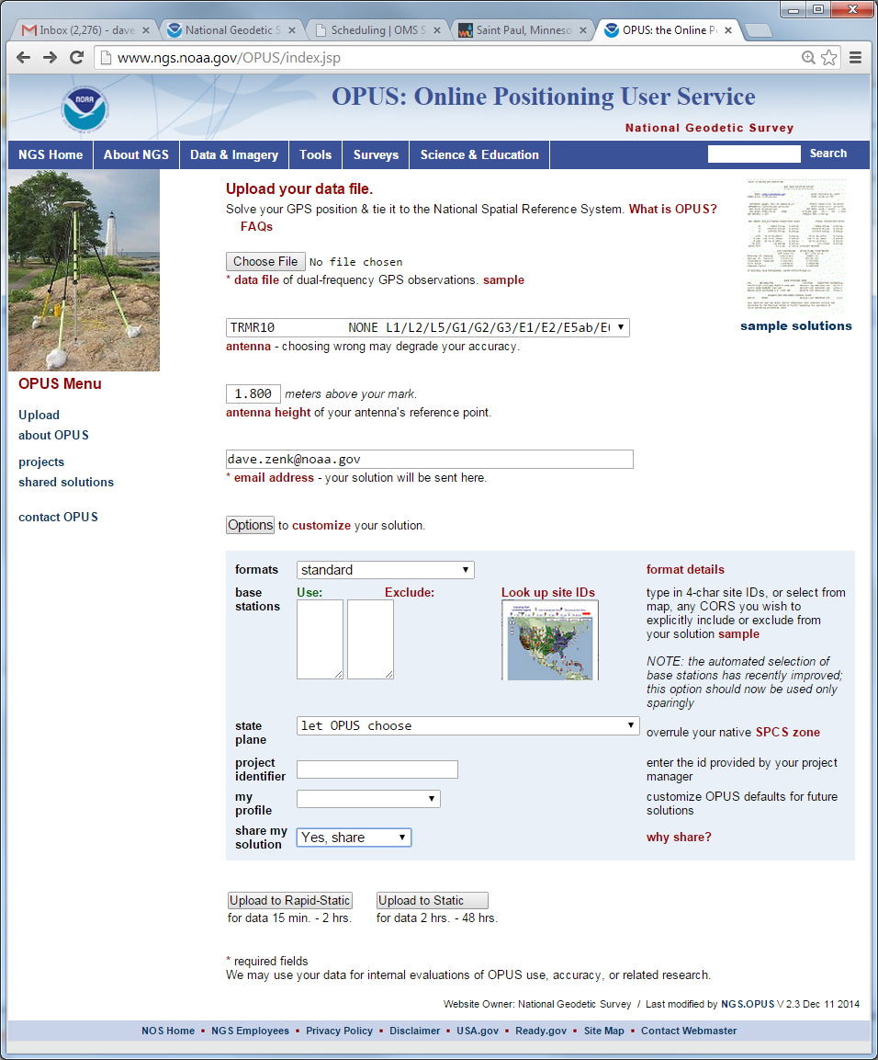
Share GPS observations through OPUS
Upload 4+hour GPS observation file
Provide antenna type, antenna height, and email address
Click “Options” & Select “Yes, Share”
Identify the Mark by PID
Write a “To Reach” description
Attach 2 photos: Close up & Horizon
Respond to confirmation email

Slide 20
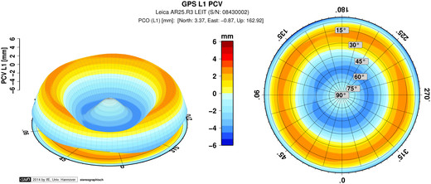
Antenna Type & Antenna Height are crucial for accurate results
rotate NRP to face true north
ARP
Each Antenna Type has unique biases
antenna height
mark
For antenna calibrations, photos, ARP and NRP diagrams, see geodesy.noaa.gov/ANTCAL/
JGE, 2015

Slide 21
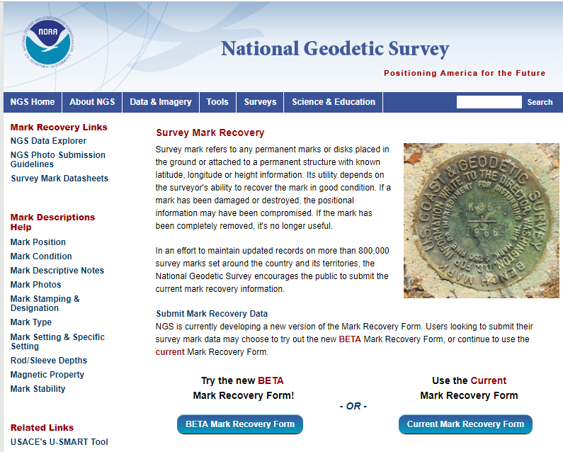
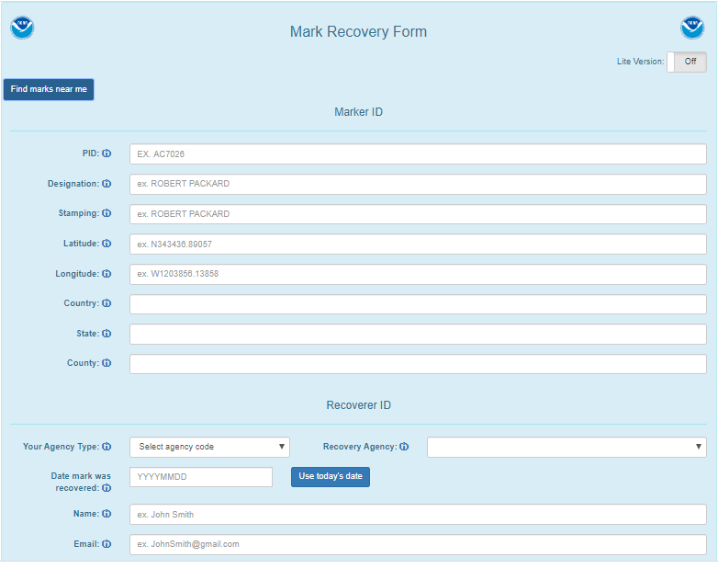
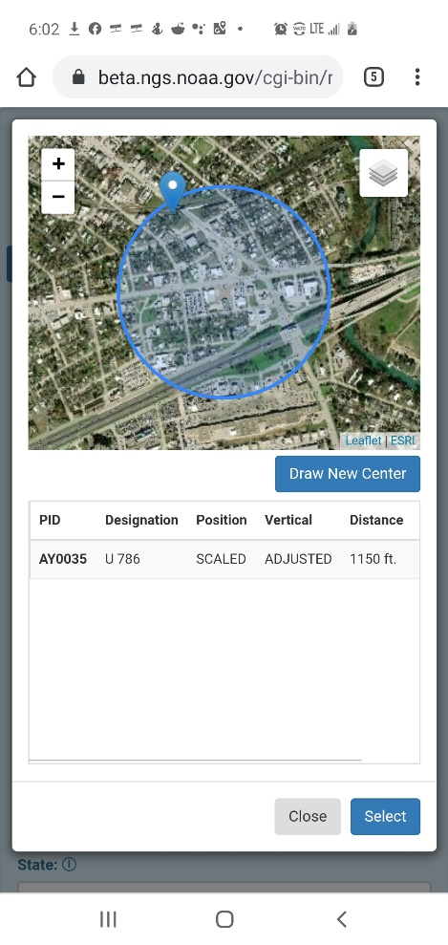
New Mark Recovery Webpage
Submitting recovery information will let NGS and others know if the mark is still usable and pictures will make it easier to find.
www.ngs.noaa.gov/surveys/mark-recovery

Slide 22
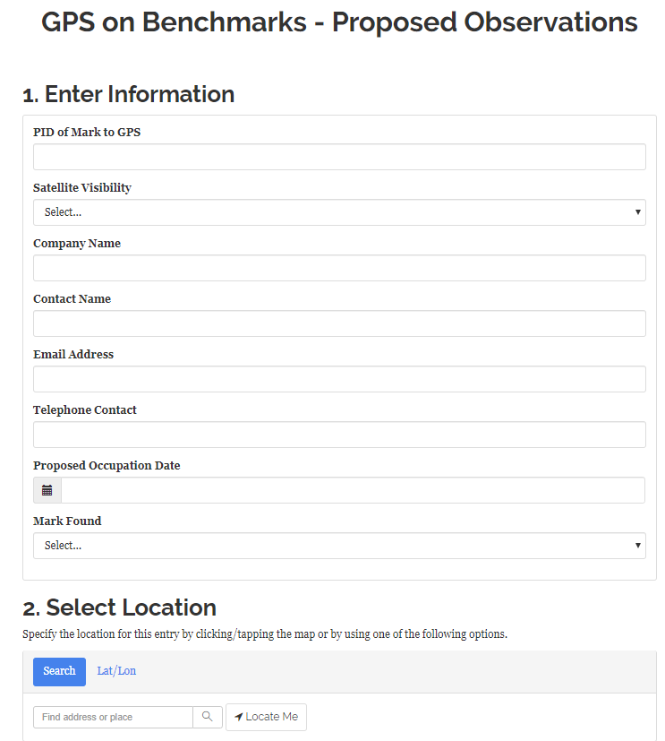
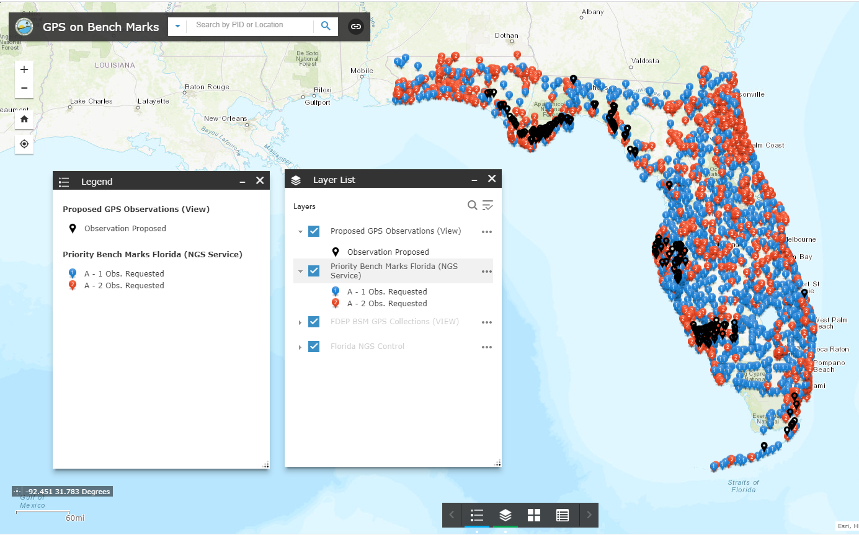
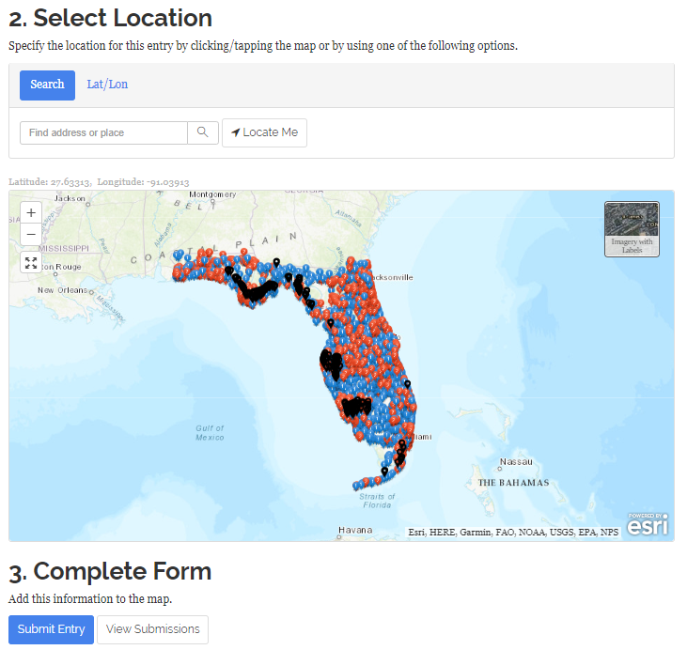
Regional Collaboration Example: Florida Web Map
Compliments of Bryan Shoaf, Florida DEP
Notes:
Better solutions with lower RMS are important for creating the hybrid geoid model. The Transformation Tools will need a higher density of data, so we are willing to trade a decrease in accuracy for the ability to get data on many more marks.

Slide 23
Why do we need 4 hours of data?
NGS is working on OPUS for RTK that will accept 3 minute observations, however the accuracy will NOT be as good as 4 hour observations.
1 sigma
Graph Courtesy of Dr. Daniel Gillins
Notes:
Better solutions with lower RMS are important for creating the hybrid geoid model. The Transformation Tools will need a higher density of data, so we are willing to trade a decrease in accuracy for the ability to get data on many more marks.

Slide 24
Coming April 2020: OPUS-Projects for RTK
NGS is proposing a new Standardized GNSS Vector EXchange Format (GVX) that will be used to ingest vectors into OPUS Projects

Slide 25
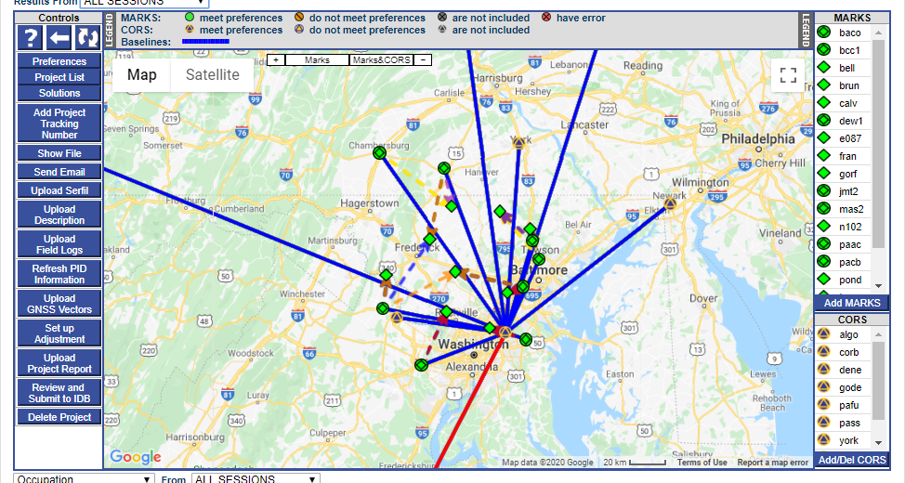
OPUS-Projects for RTK
Tune in for OPUS-Projects for RTK Vectors and GVX Format Webinar on April 9th, 2020
Notes:
GVX Contains:
Mark-to-mark ECEF vector components (dX, dY, dZ)
Standard deviations of vector components
Covariances of vector components
Reference frame
Start and stop time of observation
A-priori coordinates

Slide 26
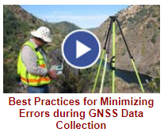
NGS Training Material
GPS on Bench Marks Webpages
NGS Video Library
NGS Online Lessons

Slide 27
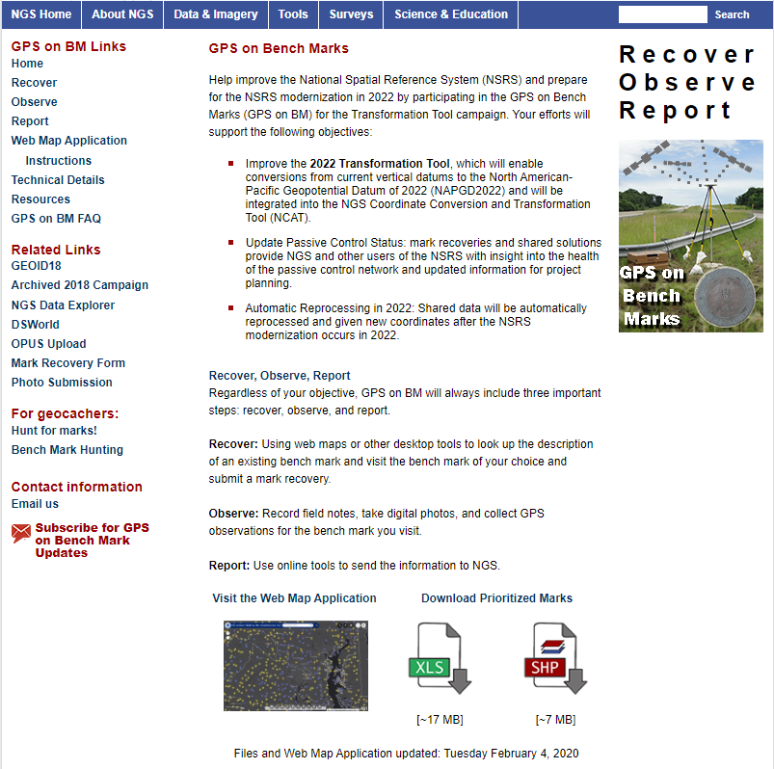
Visit the updated GPSonBM Webpage
www.ngs.noaa.gov/GPSonBM/index.shtml
Updated priority marks list
Interactive web map
Technical details explained
Links to OPUS and mark recovery form

Slide 28
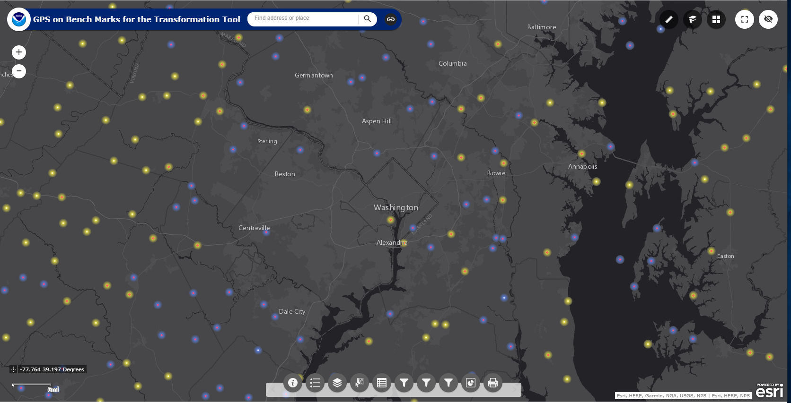
Get Involved!
Use the GPSonBM web map to find marks near you
Submit Mark Recoveries using the new Mark Recovery Form
Collect static GPS data and Share through OPUS

Slide 29
The future is already here —
it's just not very evenly distributed.
William Gibson
Provide Feedback:
ngs.feedback@noaa.gov
Contact the GPSonBM Team:
ngs.gpsonbm@noaa.gov

Slide 30
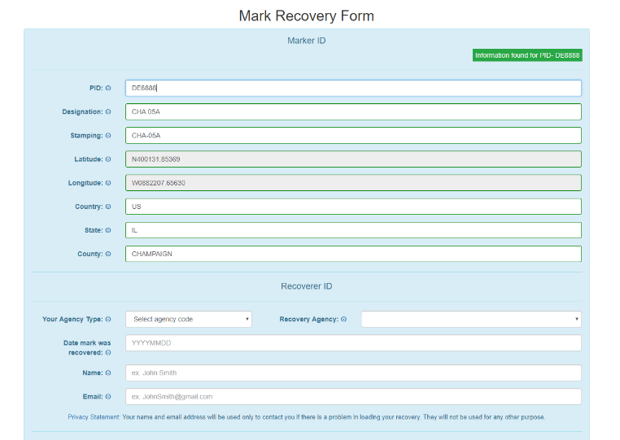
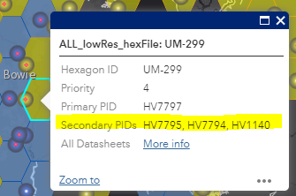
FAQ’s #1
Q: What is the deadline to submit GPSonBM for the Transformation Tool?
A: December 31, 2021 – so that observations can be used to create 2020.0 Reference Epoch Coordinates (See Blueprint 3 -Working in the Modernized NSRS)
Q: Can we submit previous observations?
A: Yes! Observations made within the past 3 years may be submitted if you have the required metadata and pictures.
Q: What do we do if we can’t find the priority mark or if it not observable with GPS?
A: 1) Submit a Mark Recovery with the new Mark Recovery Form.
2) Find and observe an secondary mark listed in the hexagon layer on the web map.

Slide 31
FAQ’s #2
Q: Can we submit offset observations for marks that are not GPS-able?
A: For now, only by following Mark Reset Procedures. In the future, will be able to use OPUS to process and adjust GPS, leveling, and total station observation together.
Q: Can we submit less than 4 hours of data?
A: Yes, but only by using OPUS Projects to Bluebook the data.
Q: Can we submit RTK observations?
A: Not yet, but soon. In April 2020, Beta OPUS Projects will enable processing of Hybrid Survey Networks that include both static and real-time observations.

