Slide 1
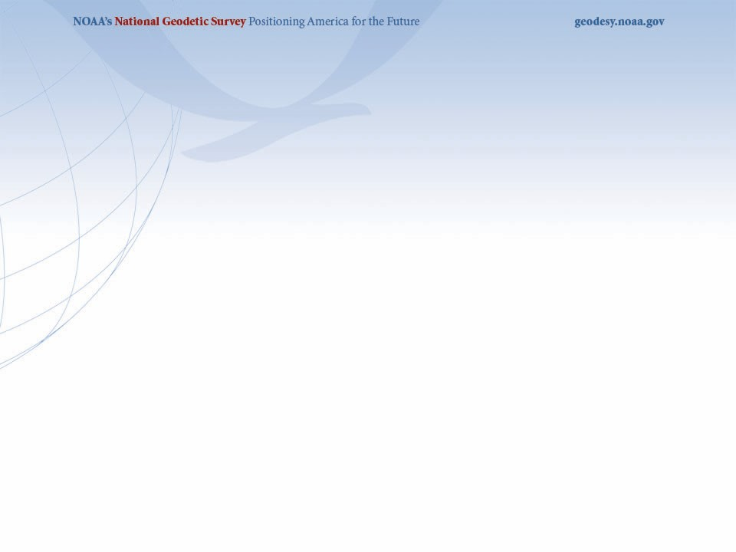


The New 2022 U.S. Datums and Preparing for Them
University of Florida Geomatics Program
2nd Annual NSRS 2022 Workshop
September 18, 2020
Denis Riordan, PSM
NOAA, National Geodetic Survey
denis.riordan@noaa.gov

Slide 2
Presentation Topics
1. Review of coming new Datums
2. Recent Announcements on the Modernization of the NSRS
3. Coordinate transformations - NCAT
4. Metadata and Preparing for 2022

Slide 3
2022 U.S. Geometric Datum

Slide 4
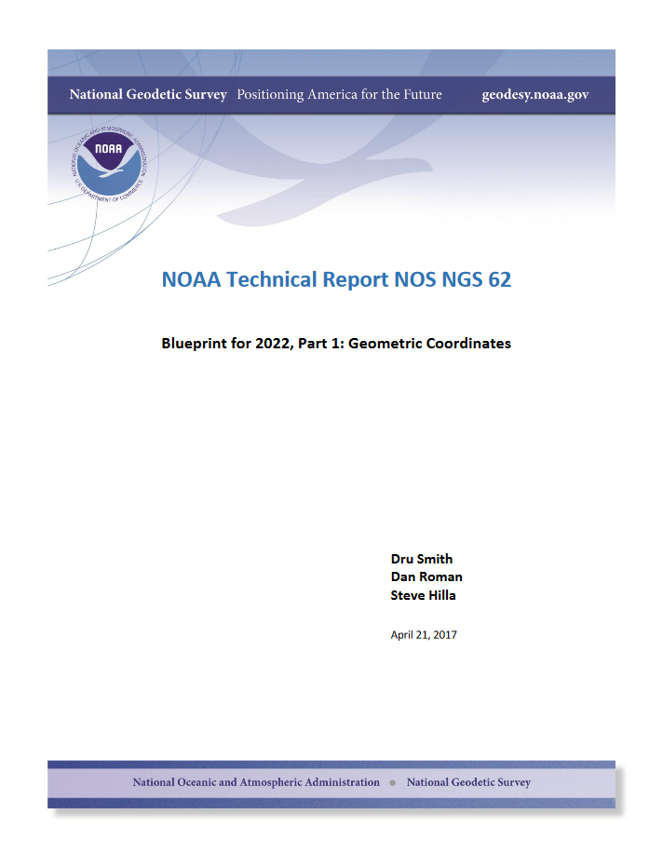
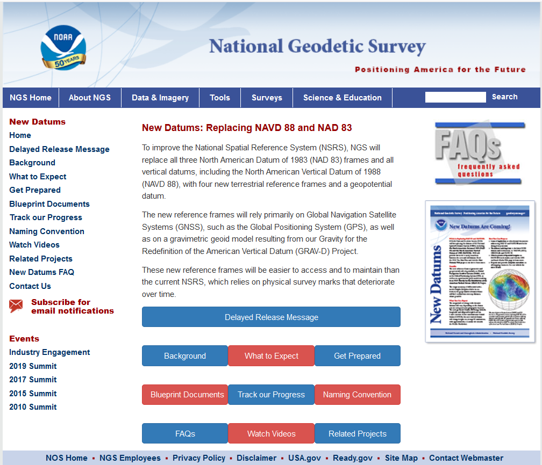

Slide 5
Names and Reference Frames
The Old:
NAD 83(2011)
NAD 83(PA11)
NAD 83(MA11)
The New:
The North American Terrestrial Reference Frame of 2022
(NATRF2022)
The Caribbean Terrestrial Reference Frame of 2022
(CATRF2022)
The Pacific Terrestrial Reference Frame of 2022
(PATRF2022)
The Mariana Terrestrial Reference Frame of 2022
(MATRF2022)

Slide 6
Replacing NAD83
Develop four "plate-fixed" reference frames
Remove non-geocentricity of NAD83
Align to ITRF2014 at epoch 2020.00
Remove most of tectonic plate rotation
from ITRF2014 via Euler Pole Parameters
(pronounced: “oiler”)
SHIFT
DRIFT

Slide 7
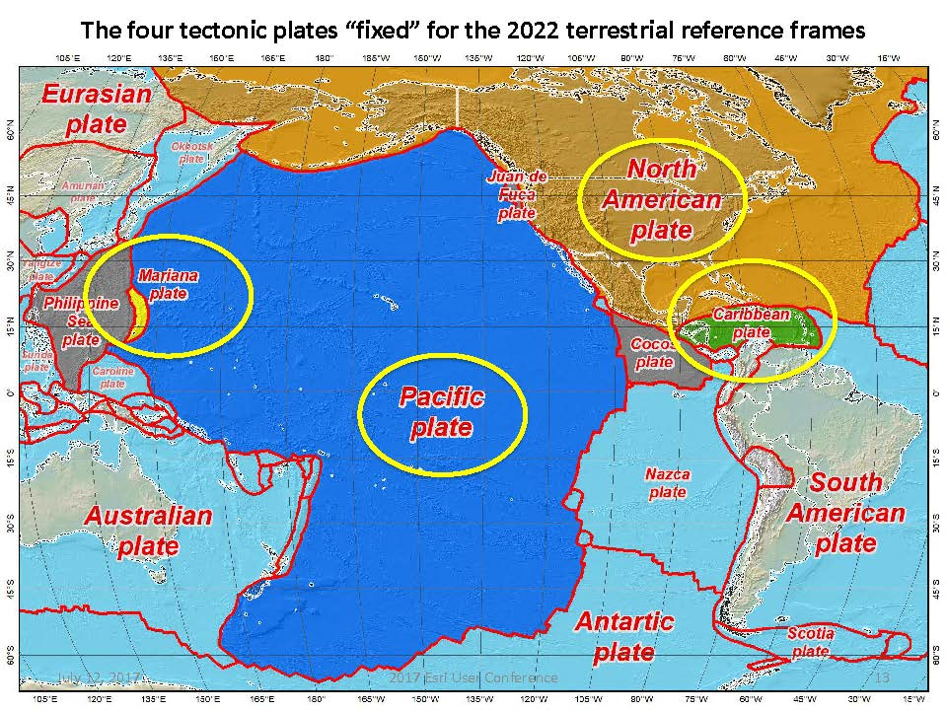
Drift…

Slide 8
The Non-Geocentricity of NAD83
The position for the center-mass of the earth has been held fixed
for all epochs of NAD83.
Earth’s
Surface
SHIFT
h₁₄
h₈₃
NAD83
origin
ITRF2014
origin
~2.2 meters
GRS80
ellipsoid

Slide 9
Two Types of Drift
Tectonic Plate Rotation
    horizontal
Everything Else
    residual motions left after rotation
    regional linear motions
    localized subsidence or uplift
simple to model
complex

Slide 10
NSRS Plate Rotation Modeling
Each frame will get 3 parameters
Euler Pole Latitude
Euler Pole Longitude
Rotation rate (radians / year)
This will be used to compute
time-dependent TRF2022
coordinates from time-dependent
IGS coordinates.
EPP = Euler Pole Parameters
* Will be an EPP for each
TRF.
EULER Pole
10

Slide 11
ITRF2014 + EPP2022 = TRF2022
EPP2022
Rotation of the
North American Plate
NATRF2022
CATRF2022
PATRF2022
MATRF2022
Rotation of the
Caribbean Plate
ITRF2014
Rotation of the
Pacific Plate
Rotation of the
Mariana Plate

Slide 12
Euler Poles and “Plate-Fixed”
ITRF
Frame = constant
NA Plate = rotating
NATRF
Frame = rotating
(relative to ITRF)
NA Plate = constant
(relative to NATRF2022)

Slide 13
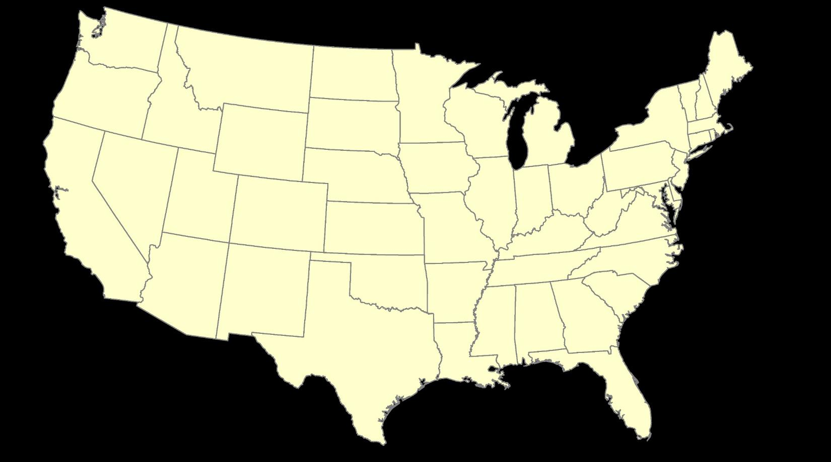
ITRF – constant frame, rotating plate

Slide 14
“Plate-Fixed”
NATRF – rotating frame, constant with plate

Slide 15
ITRF or NATRF – your choice, just use EPP

Slide 16
Two Types of Drift
Tectonic Plate Rotation
    horizontal
Everything Else
    residual motions left after rotation
    regional linear motions
    localized subsidence or uplift
simple to model
complex

Slide 17
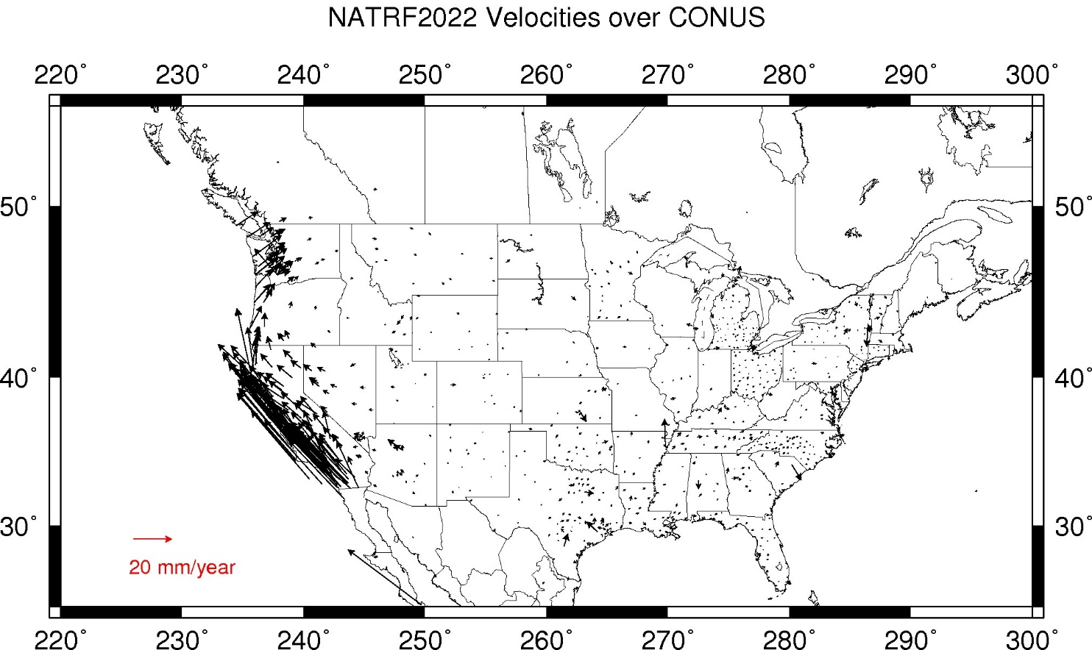
CORS Velocities – IGS08
Crustal motion to be removed by Intra Frame Velocity Models for each TRF.
Notes:
These velocities were arrived at by taking IGS08 velocities and removing the 3 parameter Euler Pole rotation of the North American plate as currently known (ITRF08 plate motion model).
These residual velocities will then be modeled into the IFVM for NATRF2022

Slide 18
Intra-Frame Velocity Model - IFVM
A model of all residual velocities, after removal of tectonic rotation via EPP:
  Horizontal residual motion
  Total vertical motion (ellipsoid heights)
  Replaces / Improves upon HTDP
IFVM2022 Model - Likely will be built upon CORS data, geodynamic models and InSAR, but not yet finalized
Given t₁ and t₂, compute Δλ, Δϕ, Δh at any point, accounting for all motions

Slide 19
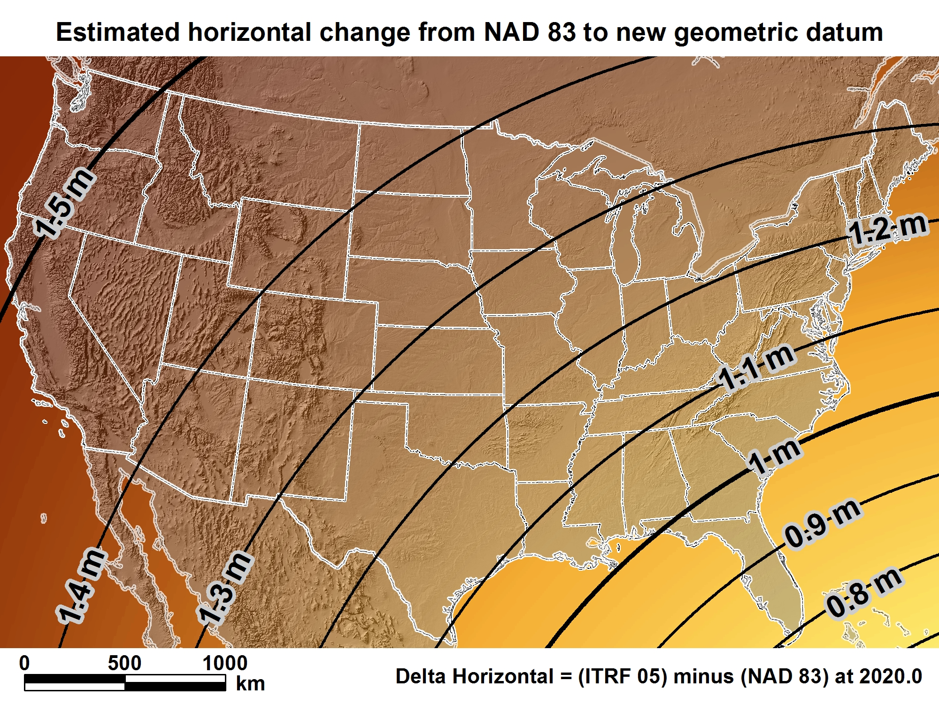
NATRF2022
New geometric datum minus NAD 83 (horizontal)
For Florida = 0.8 > 1.0 m (2.6 > 3.3 ft.)

Slide 20
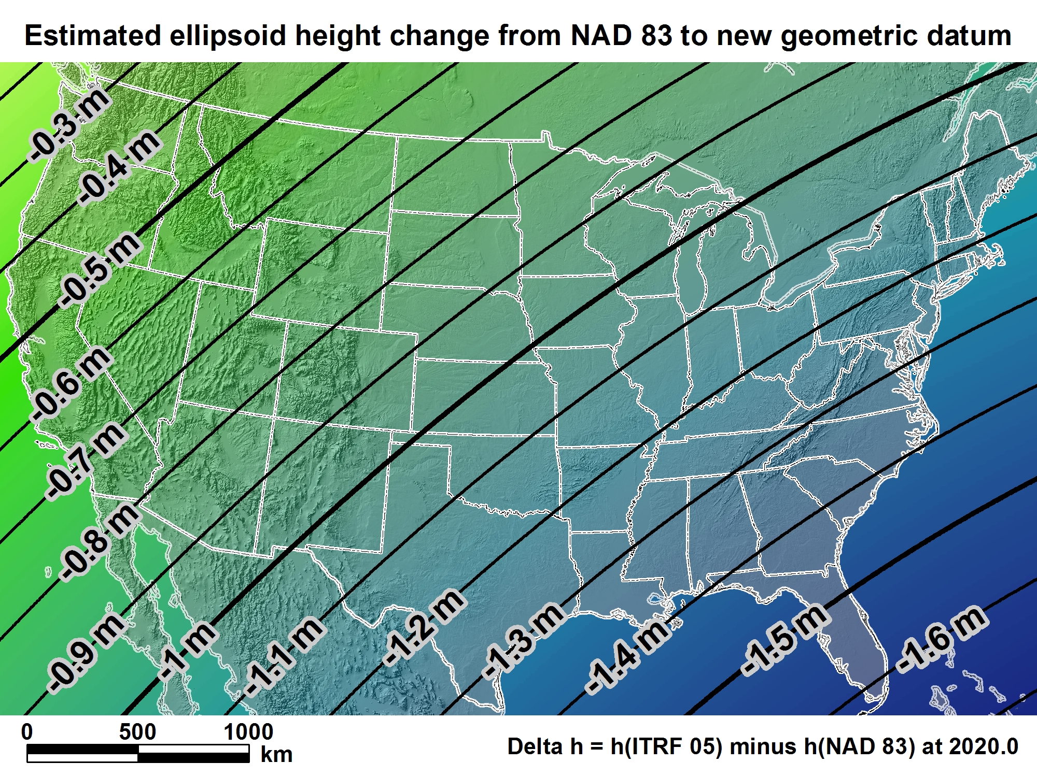
NATRF2022
For Florida = -1.4 > -1.6 m (- 4.5 > - 5.3 ft.)

Slide 21
2022 U.S. Vertical Datum

Slide 22

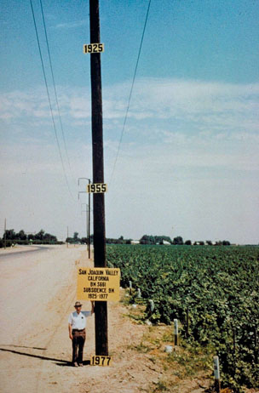
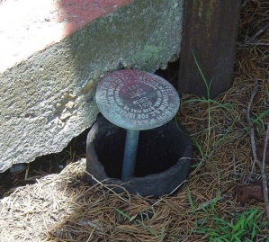
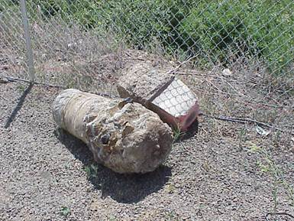
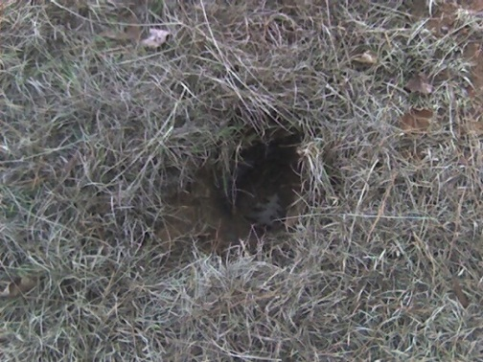
Why isn’t NAVD 88 good enough anymore?
* NAVD 88 is a terrestrial based vertical datum that changes as the land changes.
NAVD 88 suffers from use of bench marks that:
  Are almost never re-checked for movement
  Disappear by the thousands every year
  Are not funded for replacement
  Are not necessarily in convenient places
  Don’t exist in most of Alaska
  Were determined by leveling from a single point, allowing cross-country error build up

Slide 23
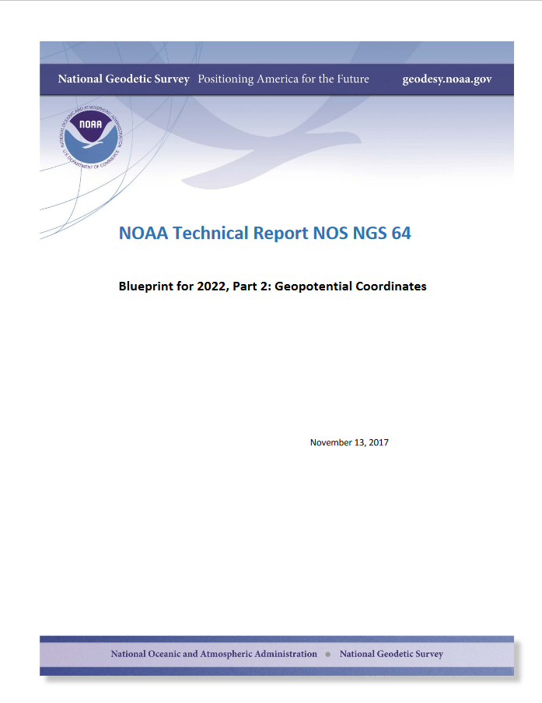

Slide 24
Names
  The Old:
  NAVD 88
  PRVD 02
  VIVD09
  ASVD02
  NMVD03
  GUVD04
  IGLD 85
  IGSN71
  GEOID12B
  DEFLEC12B
Orthometric
Heights
  The New:
  The North American-Pacific Geopotential Datum of 2022 (NAPGD2022)
Normal
Orthometric
Heights
Dynamic
Heights
Gravity
Geoid
Undulations
Deflections of
the Vertical

Slide 25
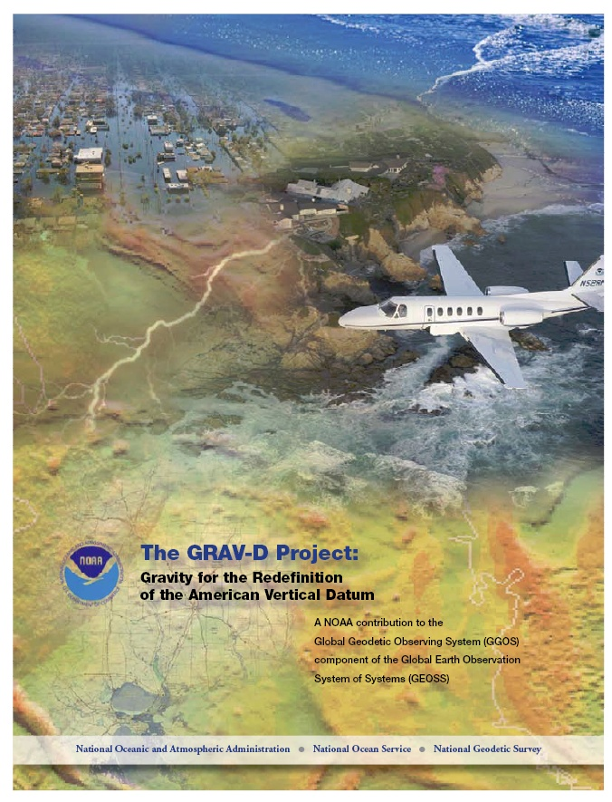
Gravity for the Redefinition of the American Vertical Datum (GRAV-D)
Replace the Vertical Datum of the USA by 2022 (at today’s funding)
GRAV-D is:
  An airborne gravity survey of the entire country and its holdings
  A 2022 gravimetric geoid accurate to 1 cm
  Long-term monitoring of geoid change over time
  Partnership surveys
Working to launch a collaborative effort with the USGS for simultaneous magnetic measurement
Acting Proj. Manager: Jeffery Johnson
Jeffery.Johnson@noaa.gov
Gravity and Heights are
inseparably connected
Notes:
GRAV-D is the NGS project designed to replace NAVD88 with a vertical datum based upon a gravimetric geoid accurate to 1 cm. Heights above this datum will be accessed via GNSS measurements. Three thrusts of project. Launch USGS collaboration for simultaneous mag measurement.

Slide 26
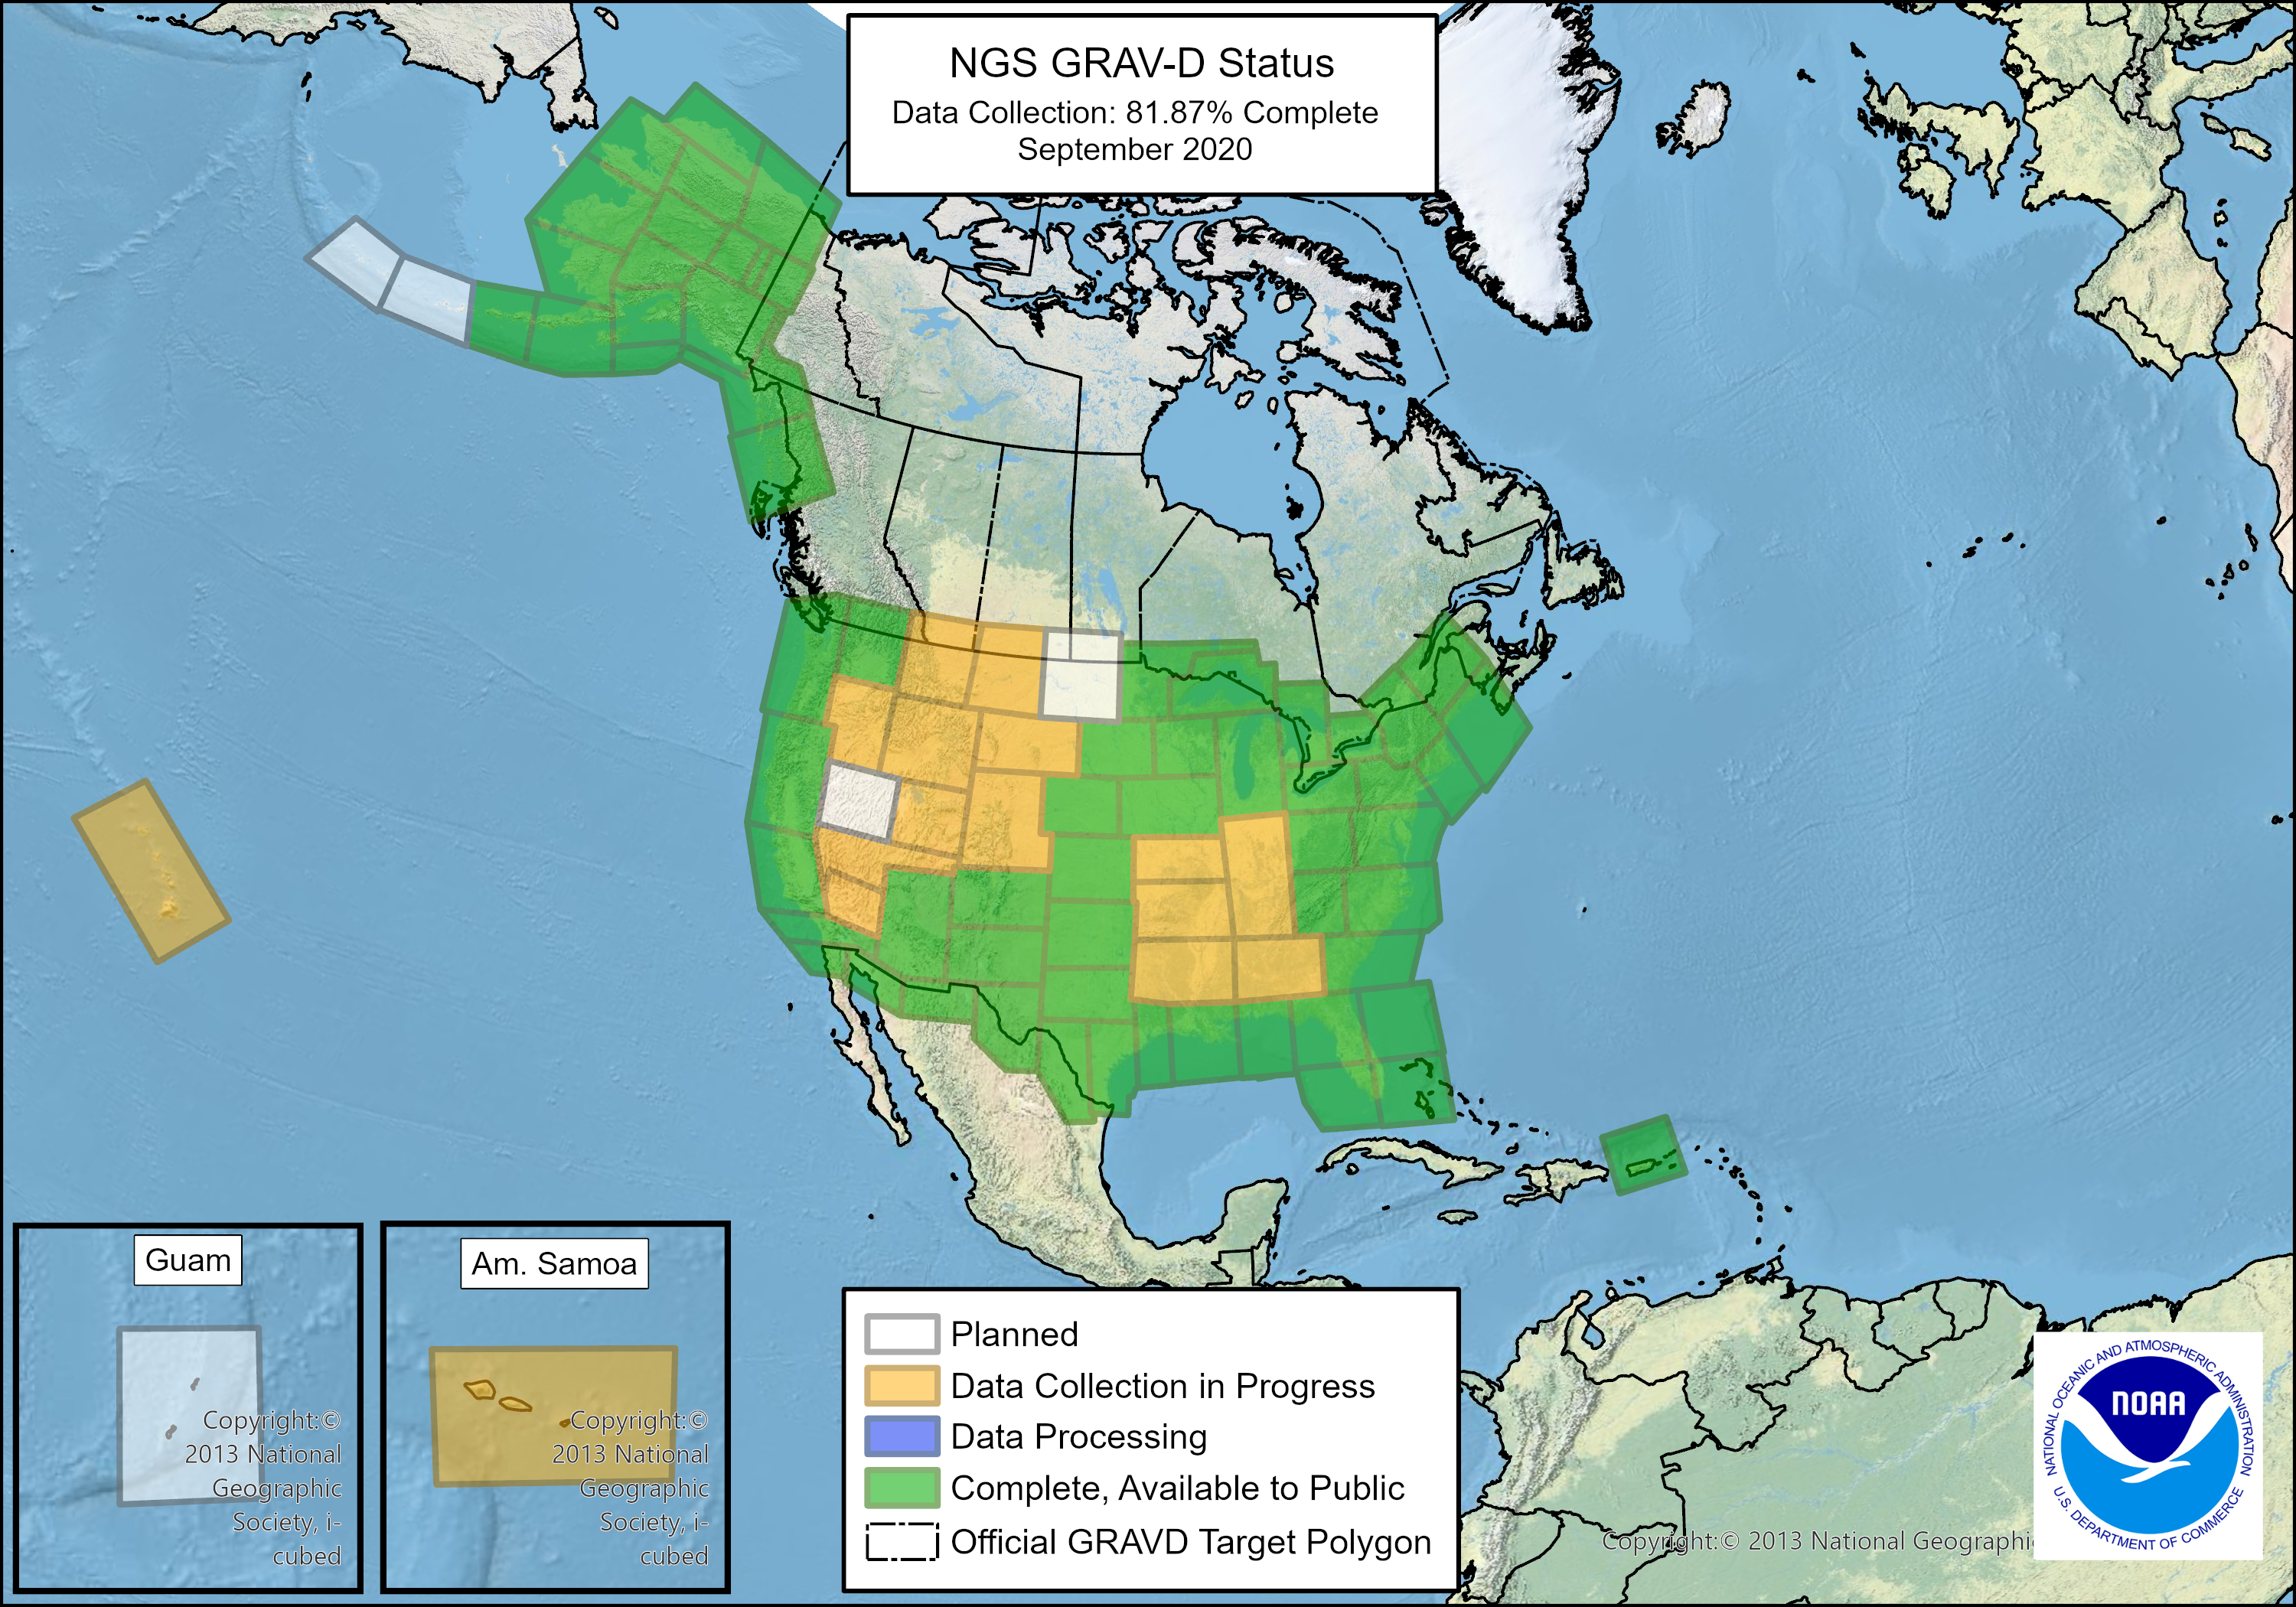
GRAV-D Status as of September 2020

Slide 27
Geoid Monitoring Service (GeMS)
Goal: Track all changes to the geoid which would prevent 1 cm accuracy
Aspects included:
  Shape, Secular: e.g. Hudson Bay
  Shape, Episodic: e.g. Massive Earthquakes
  W0, Secular: Global Sea Level Change (see next slides)
Examples of things excluded:
  Size, Secular: Mass quantity of Earth is effectively static
  Shape, Periodic: Seasonal glacier cycle
Bottom Line: An accurate, up-to-date, and maintainable vertical datum.

Slide 28
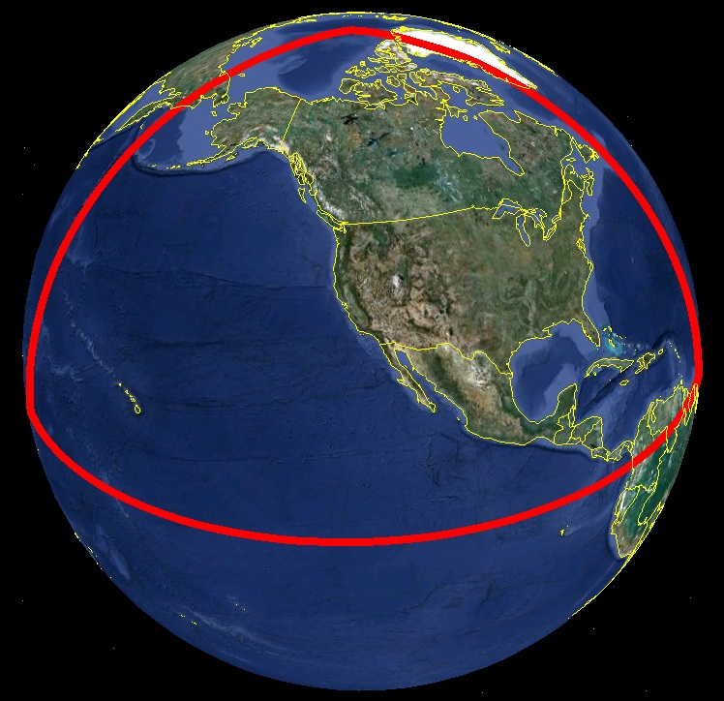
Extent of 2022 gravimetric geoid model used for NAPGD2022

Slide 29

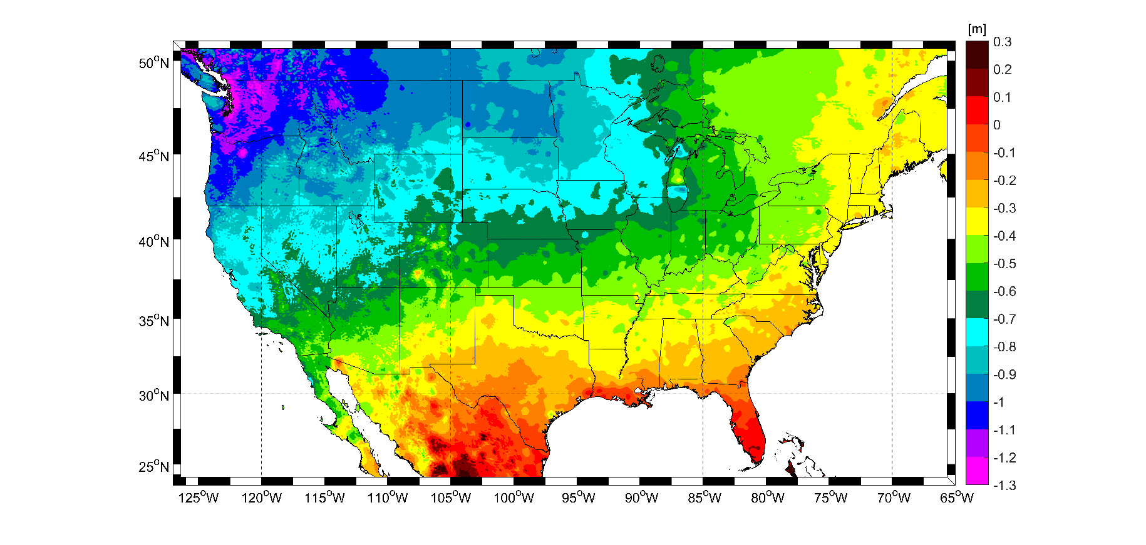
Expected changes to orthometric heights – NAVD88 to NAPGD2022
For Florida = 0.1 > -0.3 m (4 > -11 in.)

Slide 30
Recent 2022 Announcements

Slide 31
What is “the Modernized NSRS”?
It is a replacement for the entire current National Spatial Reference System (NSRS)
  Datums
  Coordinates
  Orbits
  Database
  Software
  Policies, procedures and philosophies
  And….skills! New hires, new training!

Slide 32
Original Timeline
In 2007, NGS assumed we would be done by 2018
  Optimistic GRAV-D planning
  Incomplete picture of the entire modernized NSRS
By 2013, a finish of 2022 seemed correct
  Still, the “big picture” wasn’t clear
  Optimism and enthusiasm within NGS was high for many years
By 2020 three issues derailed that date:
  Final clarity on the complexity of the task
  Loss of personnel without backfill
  “2020”
Notes:
A friend called 2020 “the longest decade of our lives”

Slide 33
Drivers of delay
Growing complexity
  As new components were thought of, they often led to additional projects and unforeseen work
  Example: “We need to have time-dependent coordinates”
    But the IDB doesn’t support this
      We need a new database!
        But we also need to define things like “adjustment windows” and “redundancy” and “simultaneous”
        And we need new least squares adjustment software which supports this
          But we have to treat leveling differently from GPS
            And speaking of which, why are we still a GPS-only shop?
              We need multi-GNSS software!
                But that’ll take years! Better get started!

Slide 34
Rebooting the timeline
The “long pole in the tent” is GRAV-D
  Much of the GRAV-D remaining work is in the Pacific, which raises the question of “phased rollouts”
  Pacific is expensive, difficult to schedule
Correct, On Budget, On Time: Pick two
  With the likelihood of a multi-year delay, we picked “Correct” and “On Budget”
    Do the work right
    Do it with the resources we have

Slide 35
Conclusion
The modernized NSRS is delayed beyond 2022
  2024-2025 most likely
There is no way to accelerate this
  Can’t make people work faster or harder when they are already at maximum capacity
  Can’t make the troubles of 2020 go away
Phased roll-outs have been considered
  For now, they are off the table

Slide 36
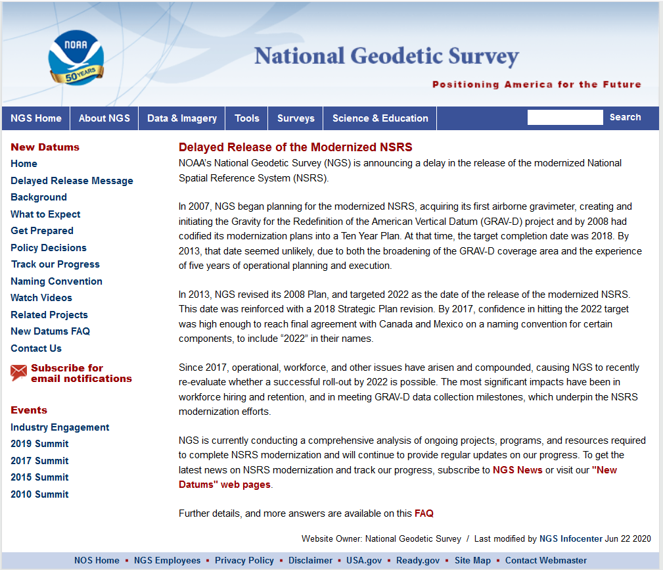

Slide 37
NGS Products Update
Coordinate Conversion and Transformation Tool – NCAT using NADCON v5.0

Slide 38
X, Y, Z
Region: CONUS
φ, λ, h
φ, λ, h
2022
X, Y, Z
SPC
UTM
USSD
USNG
UTM
φ, λ, h
GEOCON 11
φ, λ, h
NAD 27
NAD 83 (2011)
X, Y, Z
SPC
X, Y, Z
SPC
USNG
UTM
NADCON
GEOCON
USNG
UTM
NAD 83 (NSRS2007)
φ, λ, h
NAD 83 (1986)
φ, λ, h
NAD 83 (FBN)
NAD 83 (HARN)
φ, λ, h
X, Y, Z
SPC
X, Y, Z
SPC
φ, λ, h
USNG
UTM
USNG
UTM
X, Y, Z
SPC
X, Y, Z
SPC
USNG
UTM
USNG
UTM

Slide 39
X, Y, Z
Region: CONUS
φ, λ, h
φ, λ, h
2022
X, Y, Z
SPC
UTM
USSD
NCAT (NADCON 5)
USNG
UTM
φ, λ, h
φ, λ, h
NAD 27
NAD 83 (2011)
X, Y, Z
SPC
X, Y, Z
SPC
USNG
UTM
USNG
UTM
NAD 83 (NSRS2007)
φ, λ, h
NAD 83 (1986)
φ, λ, h
NAD 83 (FBN)
NAD 83 (HARN)
φ, λ, h
X, Y, Z
SPC
X, Y, Z
SPC
φ, λ, h
USNG
UTM
USNG
UTM
X, Y, Z
SPC
X, Y, Z
SPC
USNG
UTM
USNG
UTM

Slide 40
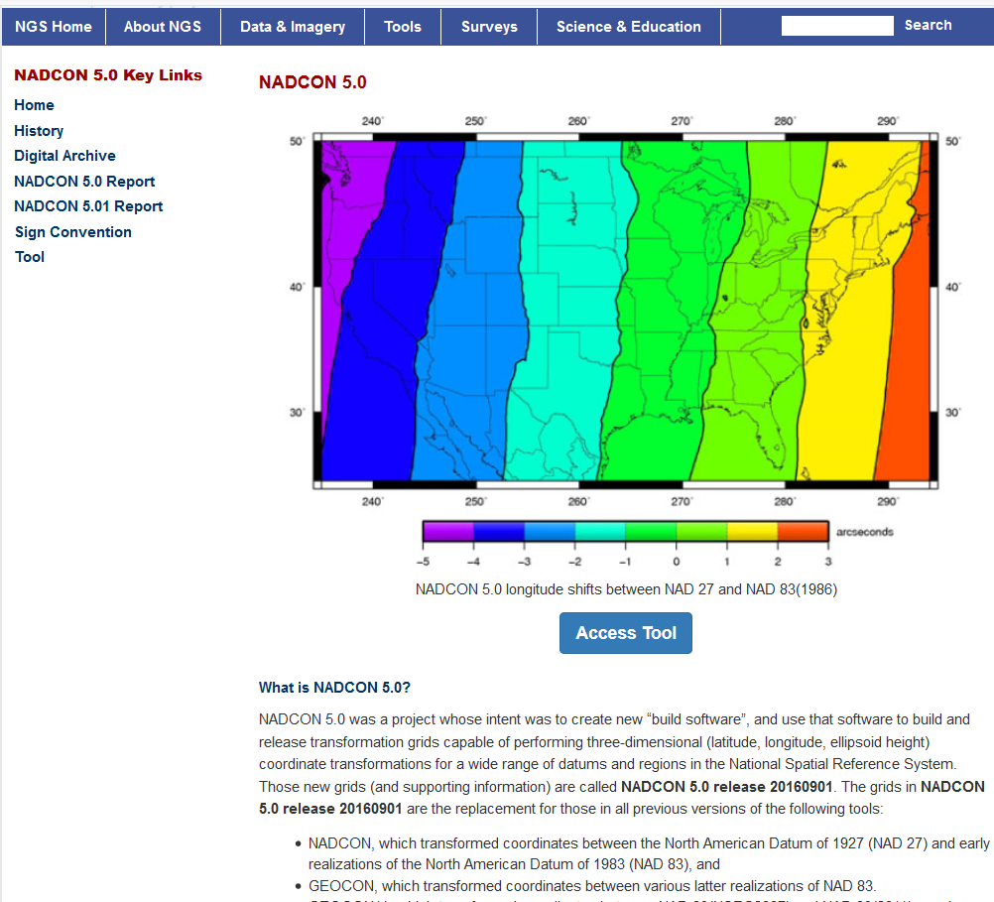
NADCON 5

Slide 41
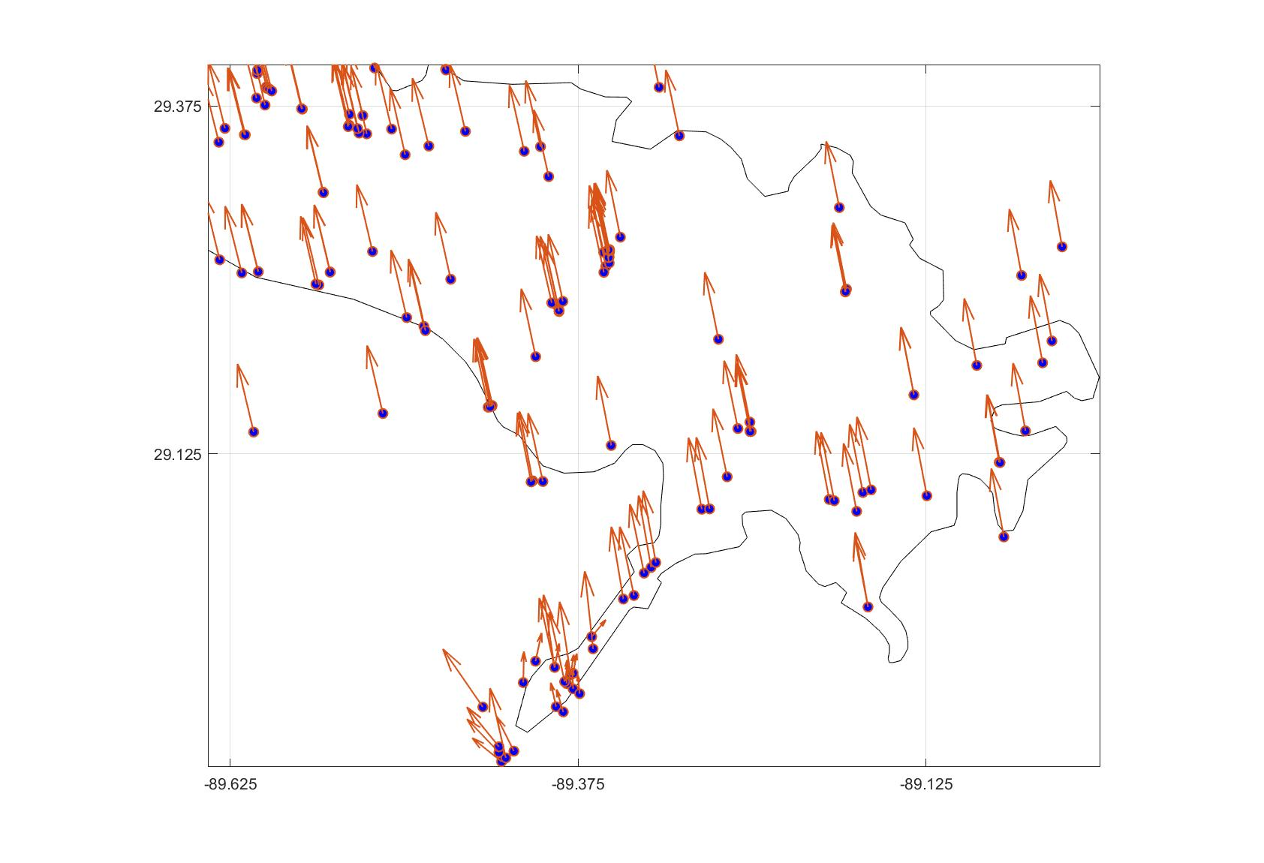
Example Grid of NADCON 5
* 15 minute cell size

Slide 42
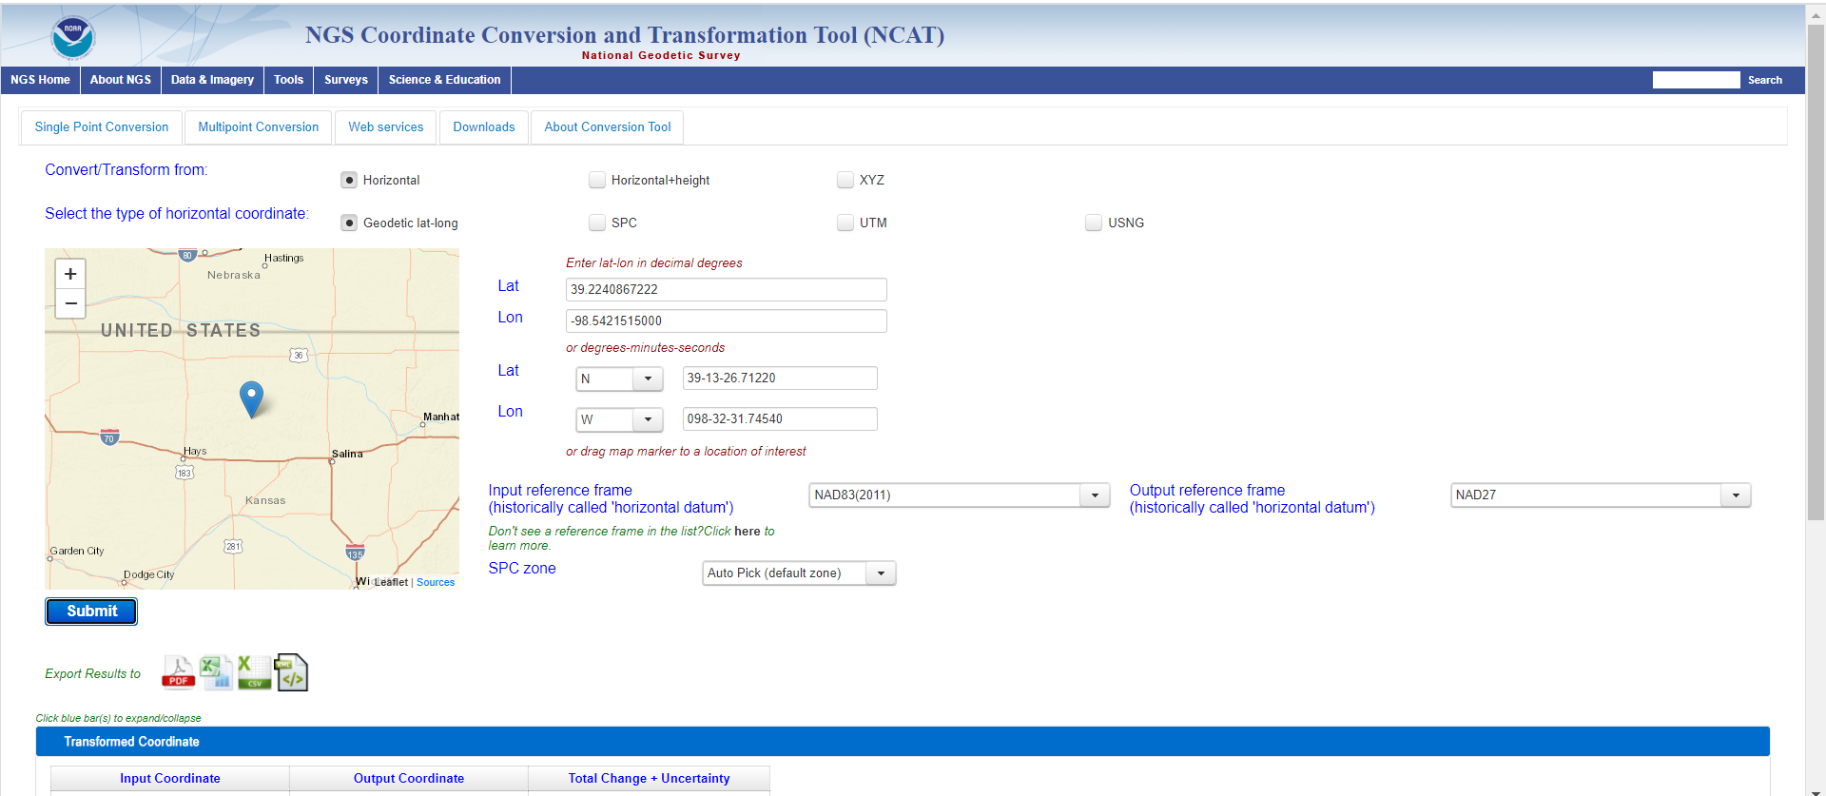
NCAT

Slide 43
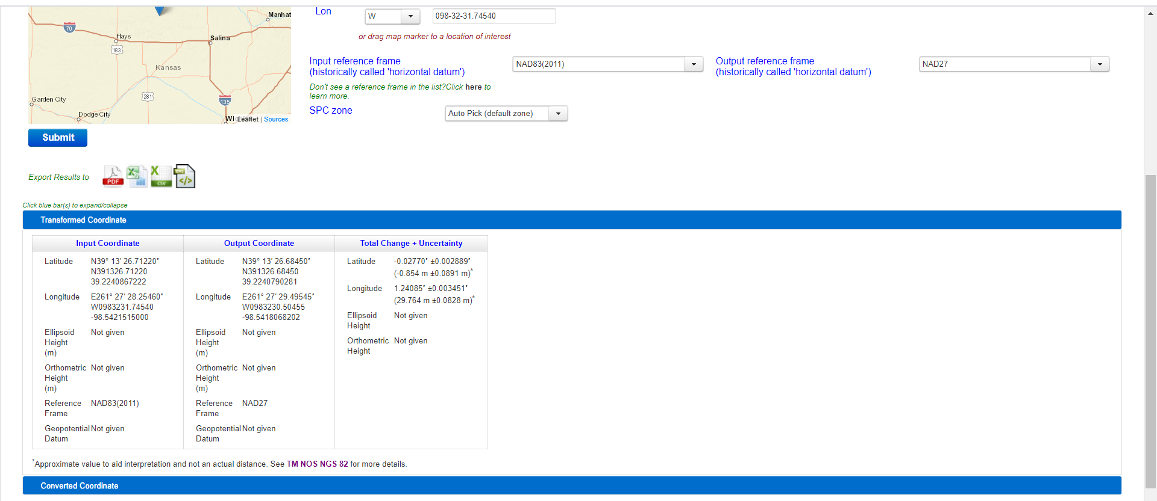
NCAT

Slide 44
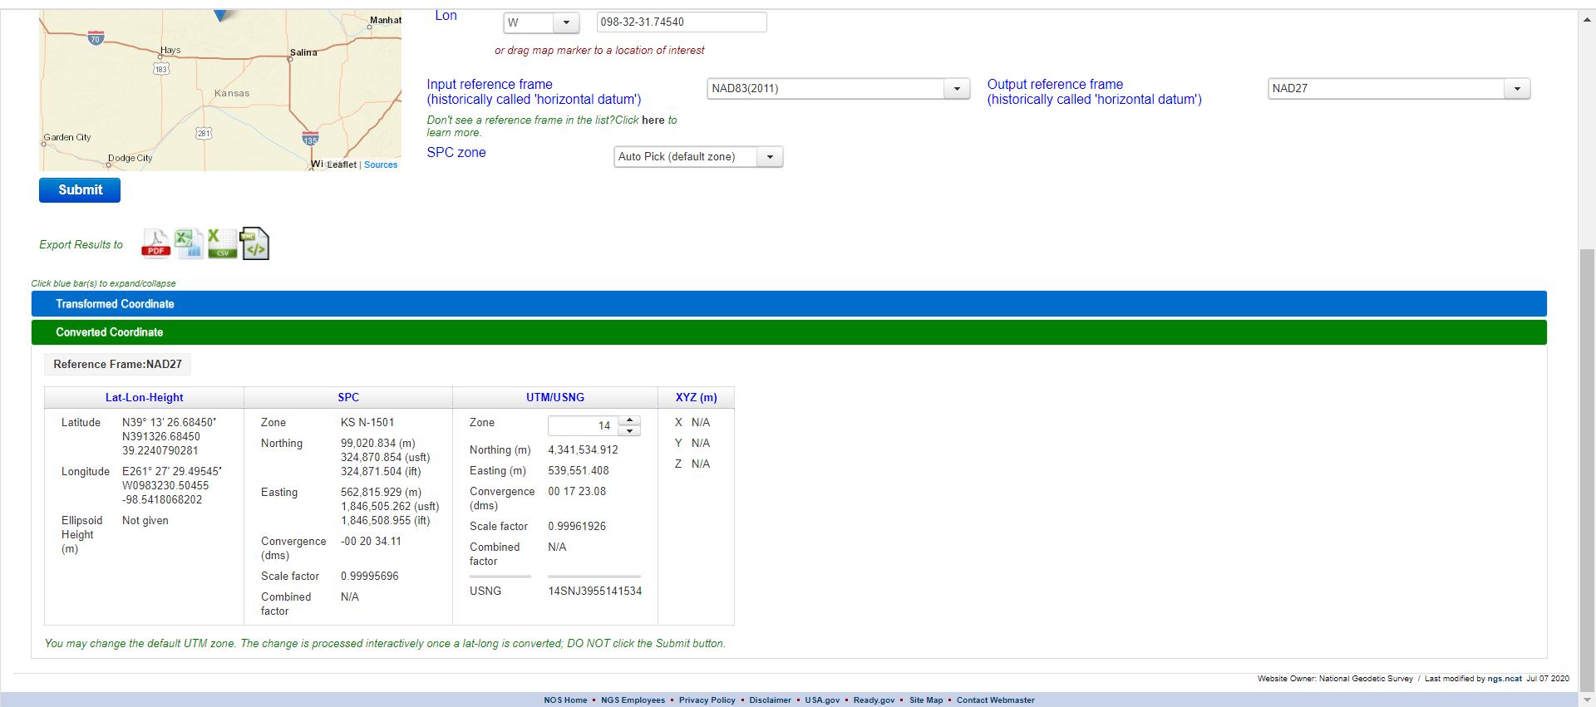
NCAT
Look for “converted” coordinates (state plane, etc.) under
the highlighted (green) Menu bar.

Slide 45
NCAT
NOTE: If input includes “heights”, NCAT utilizes VERTCON 3,
not the NGVD29 to NAVD88 VERTCON

Slide 46
Conversion or Transformation?
How NGS uses these terms:
  Conversion: Changing the type of coordinate without changing the datum or frame
    e.g. change NAD 83(1986) latitude and longitude to NAD 83(1986) State Plane Coordinates
  Transformation: Changing the datum or frame, without changing the type of coordinate
    e.g. changing an NAD 27 latitude & longitude to an NAD 83(1986) latitude & longitude

Slide 47
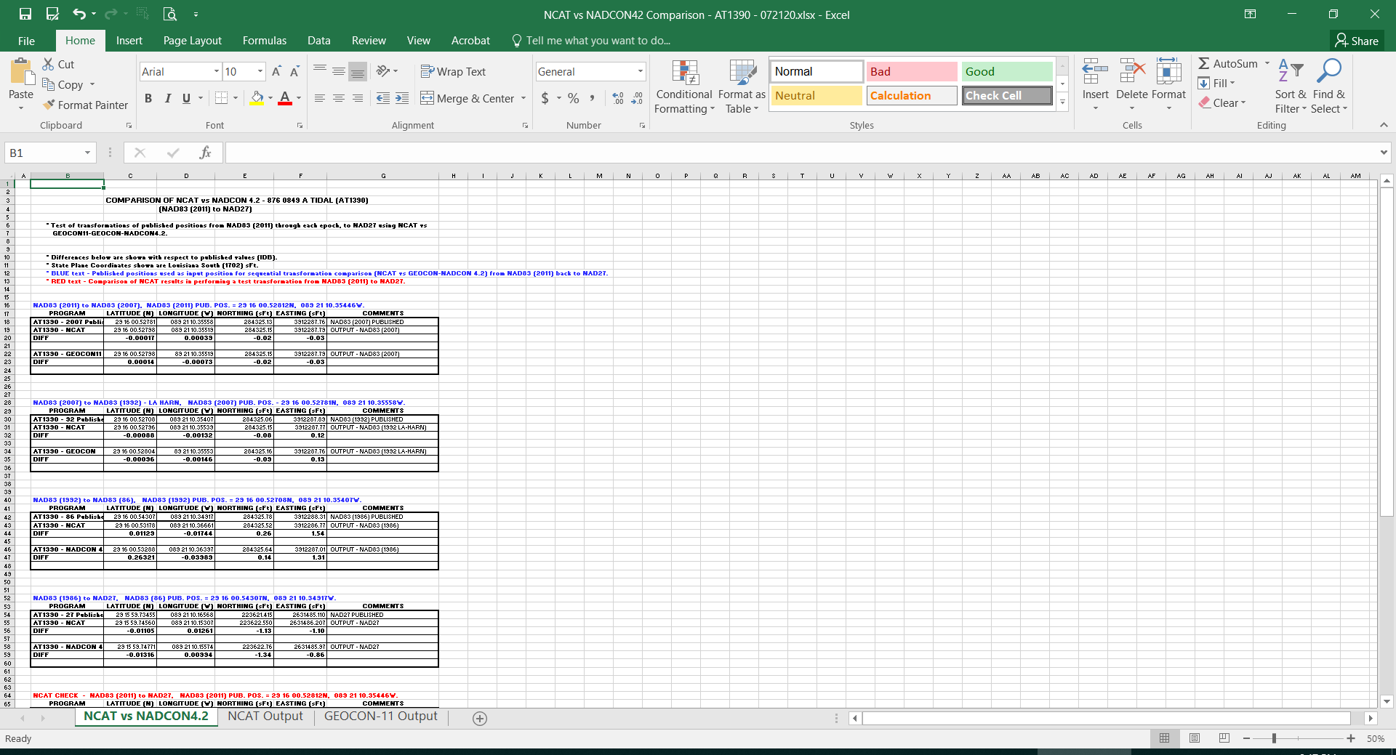
NCAT vs. CORPSCON (NADCON4.2)

Slide 48
NCAT vs. CORPSCON (NADCON4.2)

Slide 49
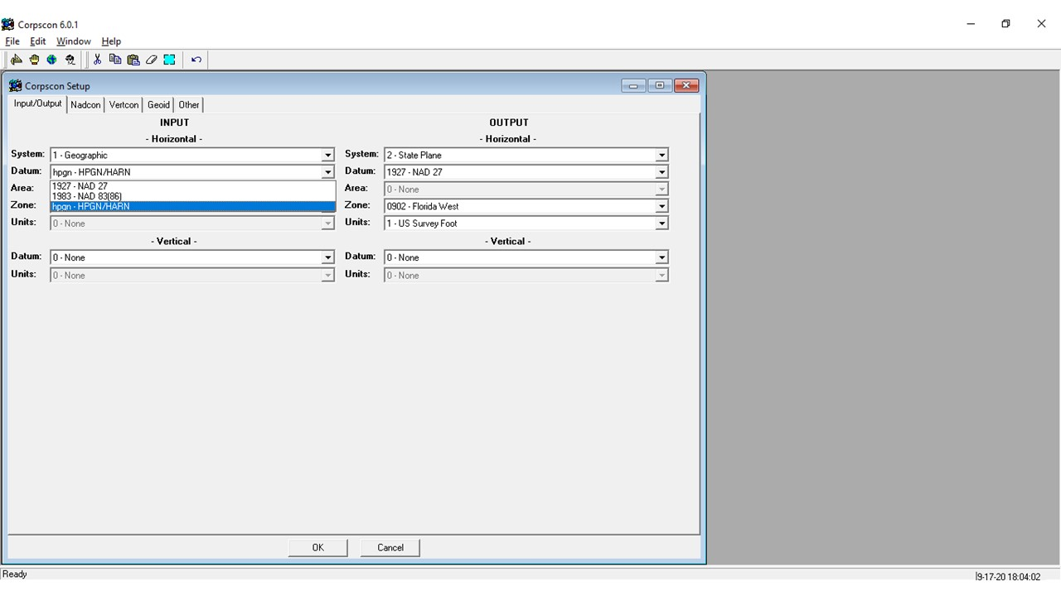
NCAT vs. CORPSCON (NADCON 4.2)
NADCON 4.2 (or earlier versions) was not designed to transform to any NAD83 epoch later than the HARN or FBN (depending on the State you are working in.

Slide 50
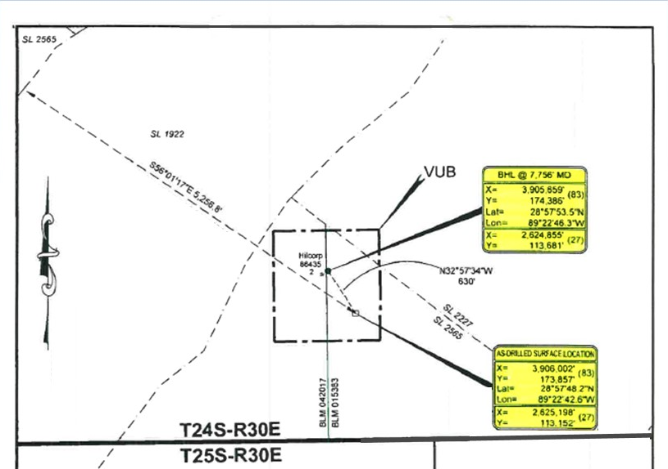
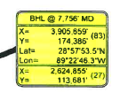
Is it NCAT or
METADATA ?
NAD83 (2011)
NAD83 (2007)
NAD83 (HARN)
NAD83 (86)
WHAT ARE THE UNITS?
NAD27 X & Y
FEET? → uSFt or Intl?
WHAT STATE?
WHAT ZONE?

Slide 51
How to Plan for 2022
Move to newest realizations
  NAD 83(2011) epoch 2010.00
  GEOID18 (hybrid geoid)
Move to NAVD 88
  understand the accuracy of VERTCON in your area
Utilize passive marks that are up to date
  Stay aware of what marks are included in datum updates
Uses NGS OPUS Share for out of date marks
  Observe marks with GPS and submit to OPUS Share to have up to date positions before the new dates are released.
Metadata
  Document positions in current datums to know what you have in the future.

Slide 52

? ? QUESTIONS ? ?
Denis.Riordan@noaa.gov

