Slide 1

Working with Real-Time Kinematic (RTK) Data in OPUS-Projects 5
Dan Gillins, Ph.D., P.L.S.
Geodesist, National Geodetic Survey
March 29, 2022

Slide 2
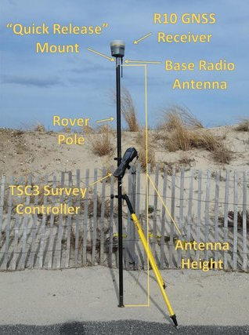
Outline
Background on RTK/RTN surveying
GVX file format and available GVX exporters
Discuss OPUS-Projects 5
Guidance for RTK/RTN surveying
Case study and demonstration
Steps for submitting a survey to NGS
Next steps and future directions

Slide 3
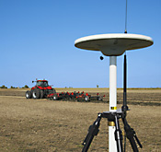
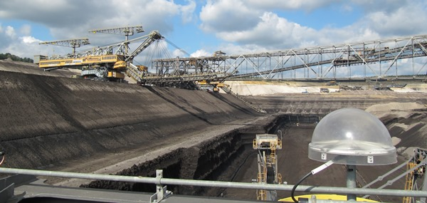
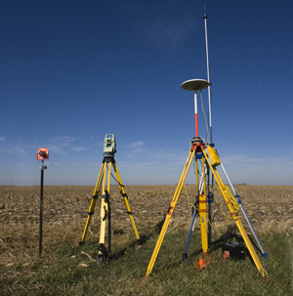
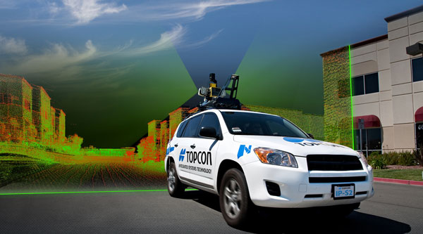
Real-Time Kinematic (RTK) Surveying
Conventional RTK
  Stationary single “base” station
  Transmits precise coordinates and GNSS observables to moving “rover”
  < 10-20 km baseline length
Applications
  Survey engineering
  Mobile mapping
  Precision agriculture
  Mining
  Construction
Base
Rover
www.alberding.eu
www.gcfarm.com
www.steckbeck.net
www.positionpartners.com.au
http://www.gcfarm.com/siteart/precision-farming/case-accuguide.jpg

Slide 4
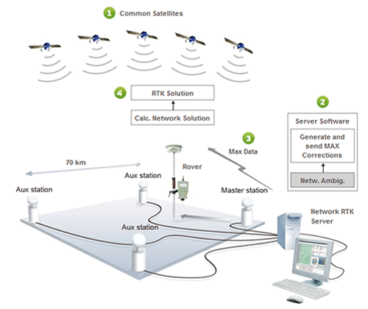
Real-Time Networks
Virtual Reference Stations (VRS)
Master-Auxiliary Concept (MAC)
Vector “tails” referenced to virtual base station
Base station position is variable
Vector “tails” connected to physical base station
Base station position is fixed
RTN Base
RTN Base
VRS
Control
Center
(Landau et al. 2002)
RTN Base
(Leica 2005)
Notes:
VRS
1.) Rover sends approx. position to RTN control center
2.) Control center assigns this position as the location of an imaginary base station and interpolates corrections at this virtual location
3.) These interpolated corrections are used to generate corrected pseudo-observables that are “transmitted” from the virtual base to the rover to be processed using conventional single-base RTK algorithms to solve for precise geodetic coordinates at the rover (Wang et al. 2010)
MAC
1.) The rover transmits an uncorrected point position to the central server, and then the server searches and selects a “cell” of reference stations for generating corrections
2.) The phase ranges from all selected stations are reduced to a common ambiguity level, and dispersive and nondispersive errors for each frequency and satellite-receiver pair are computed relative to the master station
3.) The residual corrections between the auxiliary stations and the master station, as well as the full corrections and published coordinates at the master station are transmitted to the rover. The rover then interpolates the received corrections and network information to derive its precise position (Janssen 2009).

Slide 5
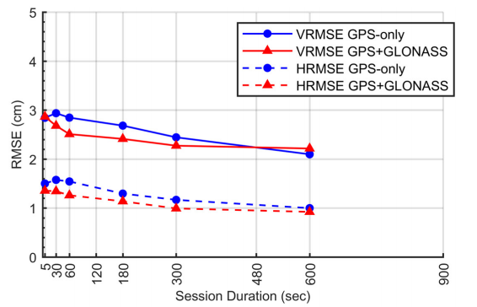
Empirical Evaluation of the Accuracy of RTNs
95% Confidence
± 5.0 cm, vertical
± 2.5 cm, horizontal
Or similar to accuracy of a 2-h OPUS-S solution!
Ellipsoid Height
Horizontal
[Allahyari et al. 2018]

Slide 6
GVX Flow Chart

Slide 7
GNSS Vector EXchange Format (GVX)
Website: https://www.ngs.noaa.gov/data/formats/GVX/index.shtml
Detailed documentation
Schema (XSD)
Example vector files
GVX is written in Extensible Markup Language (XML)
Designed to store and carry data in plain text format
Flexible representation of arbitrary data structures
Extensible – new elements can be added later without breaking applications
Both machine-readable and human-readable
Schemas can be used to define “must haves” and “should haves”

Slide 8










Industry Invited to Provide Feedback
Released GVX v. 1.0 released to industry on February 4, 2021
Over 30 people attended mtg

Slide 9
Status of GVX Exporters
Available Now
Trimble Business Center (TBC) 5.60 (11/15/2021)
Topcon MAGNET Field v. 7.2 (11/18/2021)
Coming Soon
Leica Infinity 4.0.0 (coming in May 2022)
i-GAGE X-PAD
JAVAD in Triumph-LS device

Slide 10
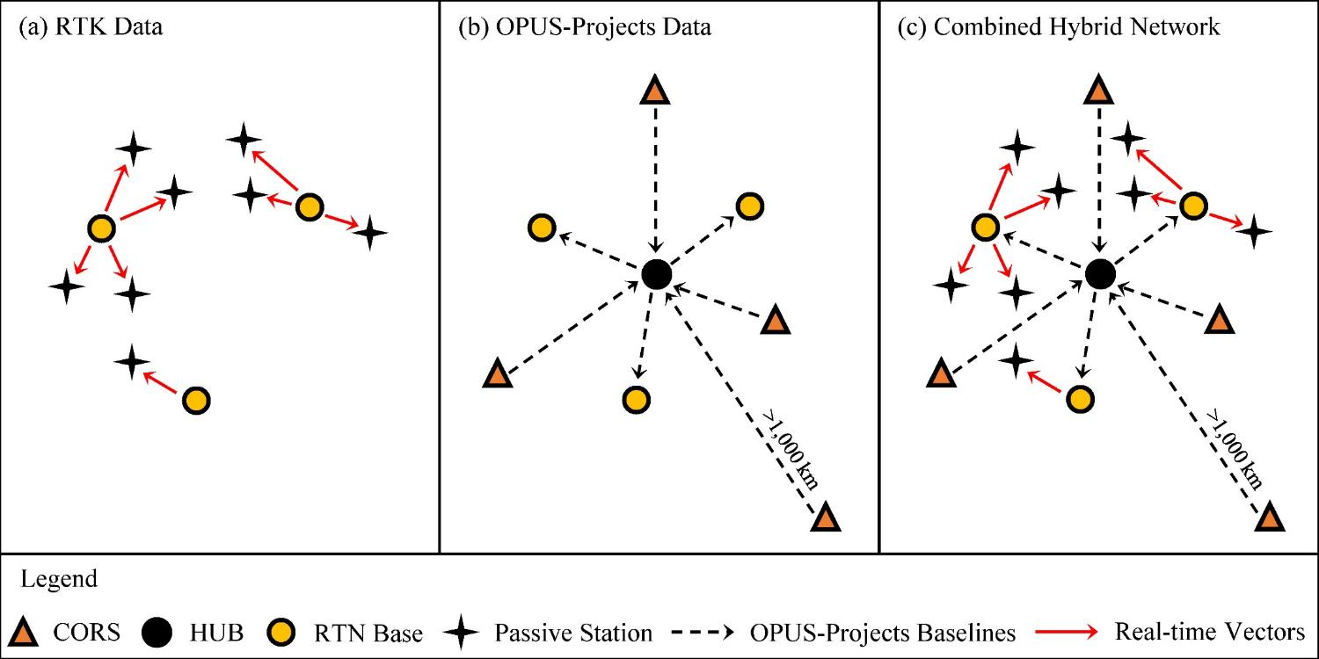
Design for OPUS-Projects and GVX
GVX file (from RTK survey or baseline processing in other software)
OPUS-Projects (from static GNSS session processing)
500-800 km
500-800 km
RTK Base or “From” Mark
RTK Rover or “To” Mark
Vector
Vector in GVX File
[Adapted from Weaver et al. 2018]

Slide 11
OPUS-Projects 5
Available on BETA at: https://beta.ngs.noaa.gov/OP-bluebook/OpusProjects.shtml
Continues to support static GPS baseline processing and network adjustments
Continues to prepares all files according to FGCS Bluebook for submission to NGS for loading in the NGS Integrated Database and publication on Datasheets
Supports GVX → uploading of previously processed GNSS vectors
  Single-base RTK vectors
  Network RTK vectors
  Vectors post-processed in other software
Automatically “weights” uploaded vectors in a network least squares adjustment

Slide 12
Why use OPUS-Projects?
Supports both static GPS and RTK GNSS surveys
Organizes data for multiple occupations on more than one mark
  Campaign-style surveys for control
Performs least squares adjustments of control survey networks
  Estimate relative accuracy between marks
Constrains NAVD 88 bench marks – check/establish NAVD 88 heights
Ensures survey is tied to the NSRS
  CORS data and published coordinates/heights
  Official models (HTDP, GEOID18)
Submits survey to NGS for review, loading in database, and publication on datasheets
  Establishment of geodetic control
  NGS will use data for making models (e.g., future transformation model for the new datums)

Slide 13
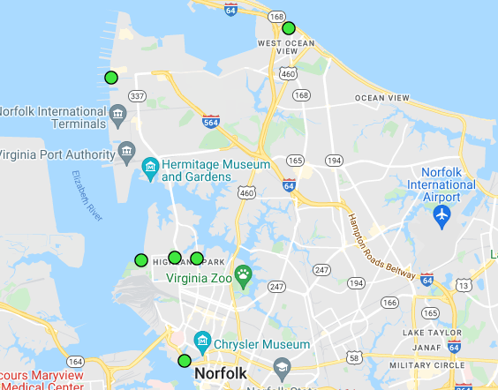
Case Study Example
Survey of 6 passive marks using Trimble KeyNetGPS Network in Virginia
Collected 5-min., GPS+GLONASS observations
  Trimble R10 rover
  Vectors tied to a physical reference station
Downloaded static data logged at base station from RTN provider’s FTP
Also collected static GPS on all 6 marks for comparison
  ~7-hour sessions for 3 days
Notes:
Open test project and discuss its contents, session processing already done, etc.
Discuss project preferences and epochs used versus duration
Upload GVX files for 3 days
Discuss symbols for lines, points, etc.
Discuss how PRS works, how it auto attaches, etc. as the surveyor does his/her work
Discuss how all vectors are “grouped” by baseline, and it doesn’t matter what the surveyor names their points
Zoom in and note that vectors attached to the CORS and other RTN base stations (automatically)
Show GVX table and discuss how it is arranged by baseline
Show statistics table for GVX
Discuss contents of the baseline webpage –go to baseline with high P2P
Remove the one vector – show how to disable it and save; show in table
Run adjustments; explain results and go over VVHU and outputs
Submit survey

Slide 14
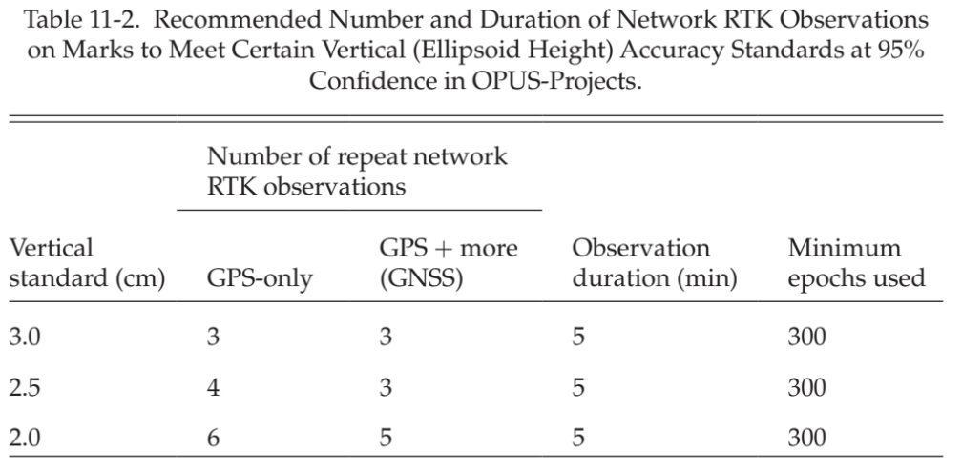
Guidance for RTK Surveys

Slide 15
Additional Guidance
Repeat occupations:
  Start time differs by > 3 hours
  Recommended allowable precision
Vertical Standard | Horizontal Precision (cm) | Vertical Precision (cm)
3.0 | 3.0 | 6.0
2.5 | 2.5 | 5.0
2.0 | 1.0 | 2.0

Slide 16
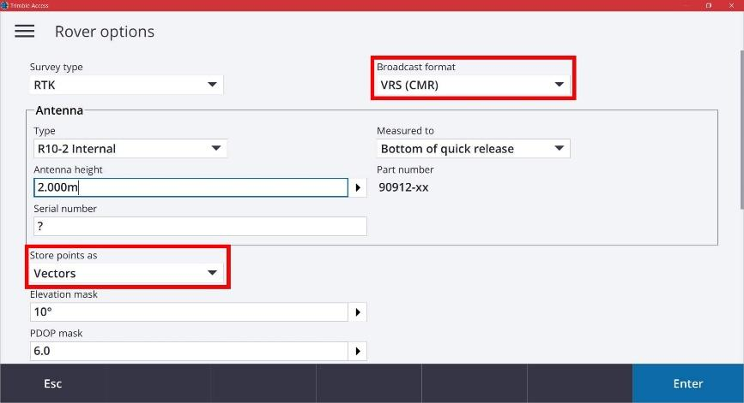
Equipment Setup
When using VRS, store points as vectors

Slide 17
Demonstration

Slide 18
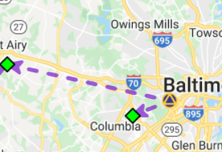
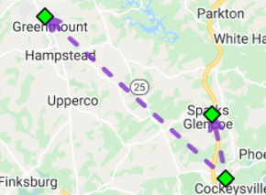
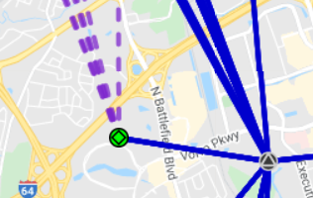
Three Cases for RTK/RTN Bases
RTN Base = CORS
Automatically attaches GVX vectors to official coordinates for CORS
Constrain CORSs
RTK/RTN Base = Not a CORS and new to NGS
Upload static GPS data logged at the base during the days of the RTK survey
Perform session baseline processing to connect to CORSs
Constrain CORSs
3. RTK/RTN Base = Not a CORS but has a datasheet
Could constrain coordinates on datasheet
Or, upload static data at the RTN base, logged during the days of the RTK survey; perform session baseline processing; constrain CORSs

Slide 19
Steps for Submitting a Survey to NGS
Submit a survey project proposal and obtain a project tracking ID
Create descriptions for marks in WinDesc. Tutorial video available
Upload all static data via Beta OPUS-S
Upload GVX file(s)
Upload description files from WinDesc
Perform session baseline processing
Run all 5 network adjustments
Upload 3 photos per mark (close-up of mark, horizon photo, and downward from eye-level)
Upload observation logs (as a single PDF), and a project report
Submit to NGS (button not enabled on Beta)
All but step 4 is currently explained in the OPUS-Projects User Guide!

Slide 20
Future Directions
Perform Beta Testing and respond to feedback from users
  Provide your feedback! NGS.Feedback@noaa.gov
Finish OPUS-Projects 5 development and enable “submit” button
Update OPUS-Projects User Guide materials to include GVX workflow
Draft new guidelines for surveying with RTK/RTN to replace NGS-58/59

Slide 21
For More Technical Details, Refer to…
Gillins, D.T., Kerr, D., and Weaver, B. (2019). “Evaluation of the Online Positioning User Service for Processing Static GPS Surveys: OPUS-Projects, OPUS-S, OPUS-Net, and OPUS-RS,” J. Surv. Eng. (ASCE), 145(3):05019002.
Gillins, D.T., Heck, J., Scott, G., Jordan, K., and Hippenstiel, R. (2019). “Accuracy of GNSS Observations from Three Real-time Networks in Maryland, USA,” Proc. 2019 FIG Working Week, Hanoi, Vietnam, April 2019, 15 pp.
Park, J., Kim, S., Shahbazi, A., Gillins, D., and Dennis, M. (2018). “Evaluation of Static GPS Surveying Campaigns Processed in OPUS-Projects,” Final Technical Report FY17 NA293P, National Geodetic Survey, 58 pp.
Jamieson, M., and Gillins, D.T. (2018). “Comparative Analysis of Online Static GNSS Post-Processing Services.” J. Surv. Eng. (ASCE), 144(4):05018002.
Allahyari, M., Olsen, M., Gillins, D.T., and Dennis, M. (2018). “A Tale of Two RTNs: Rigorous Evaluation of GNSS Survey Observations in Real-time Networks,” J. Surv. Eng. (ASCE), 144(2):05018001.
Weaver, B., Gillins, D.T., and Dennis, M. (2018). “Hybrid Survey Networks: Combining Real-time and Static GNSS Observations for Optimizing Height Modernization,” J. Surv. Eng. (ASCE), 10.1061/(ASCE)SU.1943-5428.0000244, 144(1):05017006.
Gillins, D., and Eddy, M. (2017). “Comparison of GPS Height Modernization Surveys using OPUS-Projects and Following NGS-58 Guidelines,” J. Surv. Eng. (ASCE)., 143(1):05016007.

