Slide 1
The Modernized National
Spatial Reference System (NSRS)
A brief summary for FEMA
Dru Smith
NSRS Modernization Manager
NOAA’s National Geodetic Survey

Slide 2
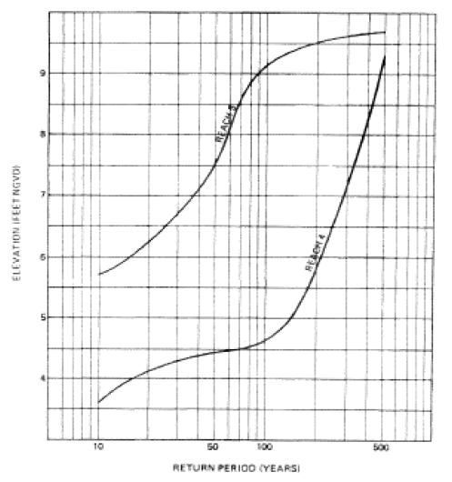
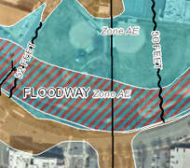
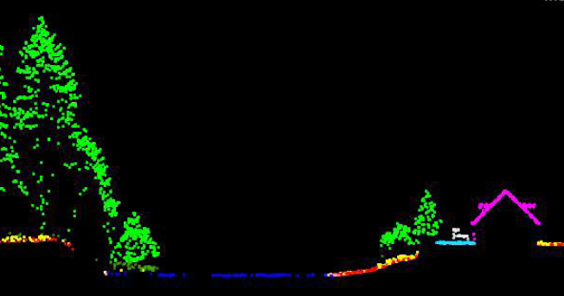
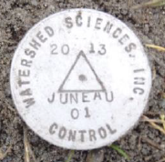
The National Spatial Reference System (NSRS)
A common and consistent geospatial framework to meet the economic, social, and environmental positioning needs of our Nation.
Foundational elements include:
Mostly the NSRS is:
NAD 83
(latitude and longitude)
NAVD 88
(heights)
Latitude • Longitude • Elevation • Gravity • Shoreline Position
+ changes over time
+
+
=
Reliable FIRMs require data from disparate sources and dates be consistently aligned
Notes:
The primary mission of NGS is to define, maintain, and provide access to the NSRS
NSRS is a consistent geospatial framework, common to all Federal agencies and other users
NSRS supports informed decision-making for mapping and charting, navigation, flood risk determination, transportation, land management, and more
Elements of NSRS include (but are not limited to): latitude, longitude, elevation, gravity, shoreline position + changes over time
→includes North American vertical datum of 1988
Example of why we need consistent coordinates (illustrated):
Just in the making of a single FIRM, data collected at different points in time using different methods (aerial lidar, stream hydrograph, elevation certificates) must be reliably aligned and combined with historical data (in both horizontal and vertical) to produce a final product in which all of this information is available in one place to assist the planner in appropriate flood mitigation.
→Reliable Flood Rate Insurance products rely on the NSRS

Slide 3
Federal Users of the NSRS
Notes:
Many of these users also sit on the Federal Geodetic Control Subcommittee, so there is a feedback loop between the providers of geodetic control (NGS) and the users of that control.

Slide 4
“Modernizing the NSRS” means…
Replacing NAD 83
Replacing NAVD 88
Re-inventing Bluebooking
Improving the Geodetic Toolkit
Better Surveying Methodologies
Blueprint for 2022, Part 1
Blueprint for 2022, Part 2
Blueprint for 2022, Part 3
Notes:
There are actually 3 “NAD 83”s, NAD 83(2011), NAD 83(PA11) and NAD 83(MA11)
There are also many more vertical datums than NAVD 88 in the NSRS, each one for specific states or territories that have no line of sight to CONUS/Alaska

Slide 5
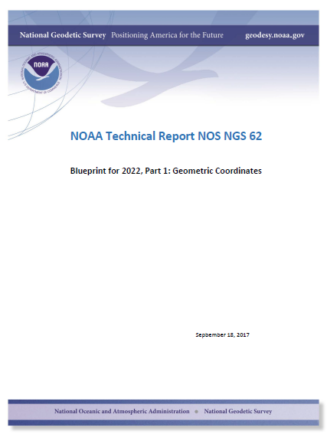
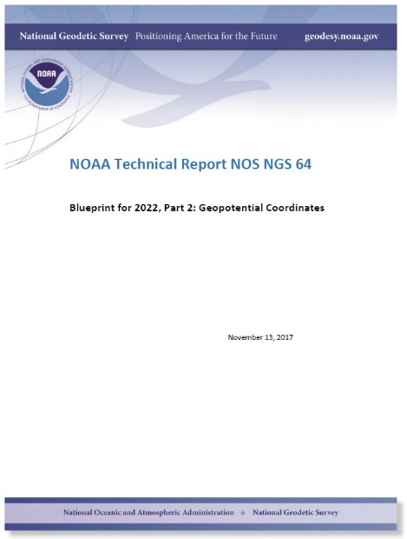
Modernizing the NSRS
The “blueprint” documents: Your best source for information
All three have been updated and will be released in late 2020 / early 2021
Geometric:
Sep 2017
NOAA TR NOS NGS 62
Geopotential:
Nov 2017
NOAA TR NOS NGS 64
Working in the modernized NSRS:
April 2019
NOAA TR NOS NGS 67

Slide 6
Replacing NAD 83
The Old:
NAD 83(2011)
NAD 83(PA11)
NAD 83(MA11)
The New:
The North American Terrestrial Reference Frame of 2022
(NATRF2022)
The Caribbean Terrestrial Reference Frame of 2022
(CATRF2022)
The Pacific Terrestrial Reference Frame of 2022
(PATRF2022)
The Mariana Terrestrial Reference Frame of 2022
(MATRF2022)

Slide 7
Replacing NAVD 88
The Old:
NAVD 88
PRVD 02
VIVD09
ASVD02
NMVD03
GUVD04
IGLD 85
IGSN71
GEOID12B
DEFLEC12B
The New:
The North American-Pacific Geopotential Datum of 2022 (NAPGD2022)
Will include:
GEOID2022
DEFLEC2022
GRAV2022
DEM2022
More
Orthometric
Heights
Normal
Orthometric
Heights
Dynamic
Heights
Gravity
Geoid
Undulations
Deflections of
the Vertical

Slide 8
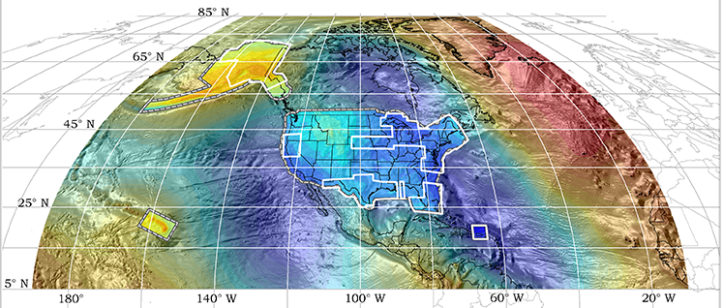
GRAV-D and the modernized NSRS
GRAV-D = Airborne collection of gravity
H(NAPGD2022) = h(NATRF2022) – N(GEOID2022)
(from GNSS)
(from NGS)
Earth’s Surface
H (NAPGD2022)
GEOID2022 = The official “zero elevation”
surface of the modernized NSRS
h (NATRF2022)
Geoid
N (GEOID2022)
GRS 80 Ellipsoid
Origin: ITRF2020

Slide 9
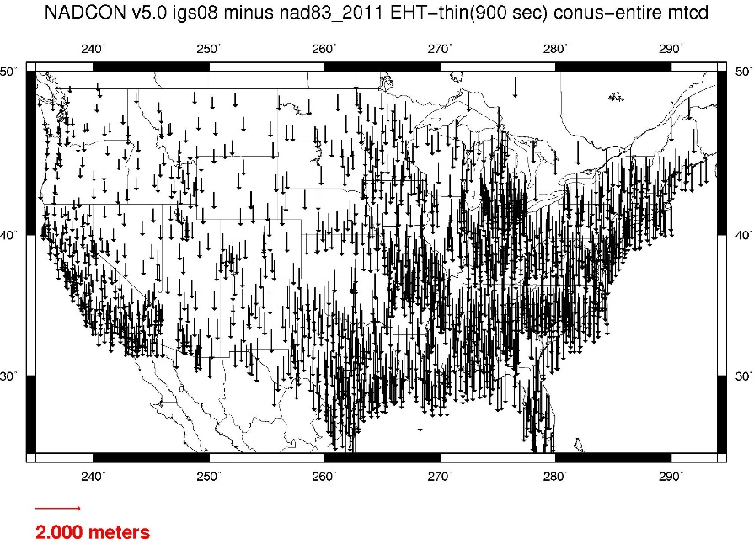
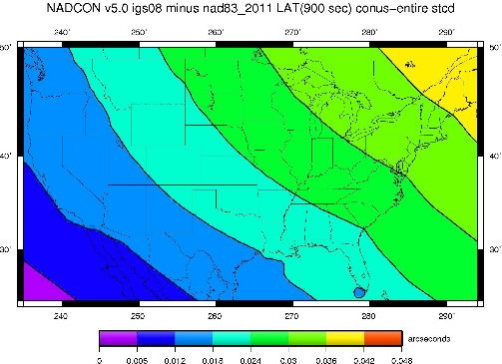
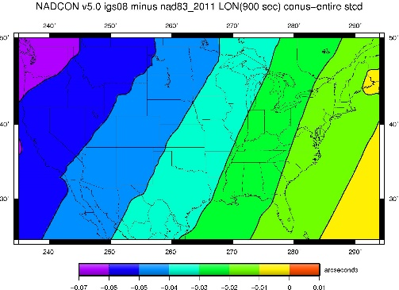
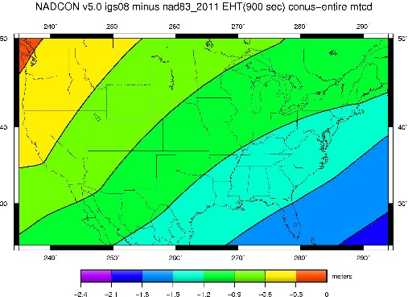
NAD 83(2011) epoch 2010.0 to NATRF2022 epoch 2020.00 (estimate)

Slide 10
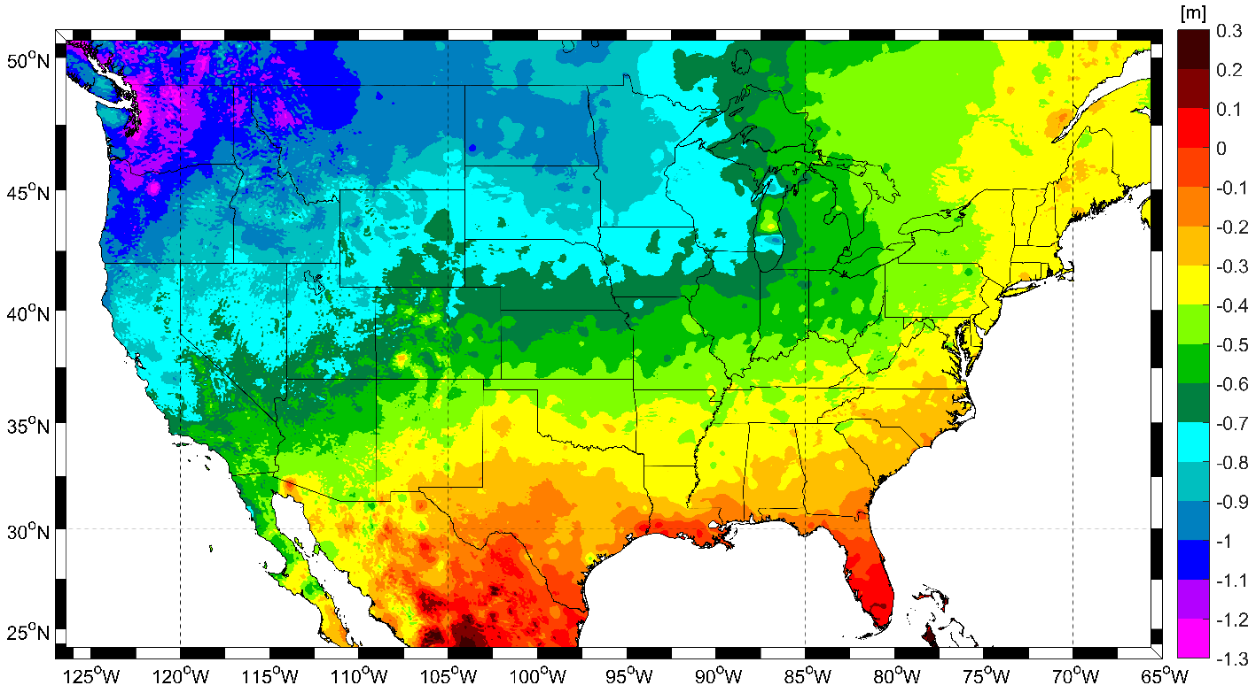
NAVD 88 to NAPGD2022 epoch 2020.00 (estimate)

Slide 11
Shift
One of the major changes you’ll see in 2022 is a shift in coordinates
Latitude, Longitude, Ellipsoid Height: -2 to +4 meters
Non-geocentricity of NAD 83
Orthometric Height: -0.5 to +2.0 meters
Bias and tilt in NAVD 88
Other shifts will occur in non-CONUS, non-Alaska regions of the USA
There will be outliers!
“Old” unsurveyed points might be off by meters if they’ve moved!

Slide 12
The preeminence of ITRF
Rotation of the
North American Plate
The North American Terrestrial Reference Frame of 2022
(NATRF2022)
The Caribbean Terrestrial Reference Frame of 2022
(CATRF2022)
The Pacific Terrestrial Reference Frame of 2022
(PATRF2022)
The Mariana Terrestrial Reference Frame of 2022
(MATRF2022)
Rotation of the
Caribbean Plate
ITRF2020
Rotation of the
Pacific Plate
Rotation of the
Mariana Plate
EPP2022
EPP for “Euler Pole Parameters”
(a way of describing a plate’s rotation)

Slide 13
A two-track approach
Reference Epoch Coordinates
Survey Epoch Coordinates
An estimated “snapshot” of entire network
Every 5 years
Similar to NAD 83(2011) epoch 2010.00
Answers: what were a mark’s coordinates when it was last surveyed?
Multiple SECs can show changes over time

Slide 14
Assume “H” was determined four different times:
1990: 2.100
1994: 2.110
2002: 2.190
2009: 2.180
2.250
2.200
H
2.150
2.100
2.050
2.000
1990
‘95
‘00
‘05
‘10
‘15
‘20
‘25
‘30
time

Slide 15
All measurements have error. Shown here are the same
Values of “H”, but with their error estimates.
1990: 2.100 +/- 0.0375 (3.75 cm)
1994: 2.110 +/- 0.0250 (2.50 cm)
2002: 2.190 +/- 0.0200 (2.00 cm)
2009: 2.180 +/- 0.0250 (2.50 cm)
2.250
2.200
H
2.150
In the modernized NSRS these time-dependent
coordinates, estimated at the actual date when
the surveys took place, will be called
“survey epoch coordinates (SECs)”
2.100
2.050
2.000
1990
‘95
‘00
‘05
‘10
‘15
‘20
‘25
‘30
time

Slide 16
In today’s NSRS, a height is held fixed until replaced.
So plotting the height as seen on a datasheet over time might look like this:
2.250
2.200
H
2.150
2.100
2.050
2.000
1990
‘95
‘00
‘05
‘10
‘15
‘20
‘25
‘30
time

Slide 17
In the modernized NSRS we will also have an estimate of
3-D crustal motion from IFVM2022
2.250
2.200
H
2.150
2.100
2.050
Combining survey data from SECs with IFVM2022 allows
NGS to estimate reference epoch coordinates (RECs)
2.000
1990
‘95
‘00
‘05
‘10
‘15
‘20
‘25
‘30
time

Slide 18
2.250
2.200
H
2.150
2.100
In the absence of new survey data, error estimates will
grow through time.
2.050
2.000
1990
‘95
‘00
‘05
‘10
‘15
‘20
‘25
‘30
time

Slide 19
The (in)ability of current approach to
properly inform users of the height of
this mark can be seen in green below.
2.250
2.200
H
2.150
2.100
2.050
2.000
1990
‘95
‘00
‘05
‘10
‘15
‘20
‘25
‘30
time

Slide 20
Leveling: GNSS strongly encouraged
For the immediate years following 2022, NGS will strongly encourage that all leveling projects processed in OPUS have GNSS on primary control
Minimum of 3 points
Maximum spacing of 30 km
At least two occupations for leveling projects > 1 month:
+/- 14 days of beginning of leveling
+/- 14 days of ending leveling
If leveling exceeds 6 months, should have a 3rd, middle occupation
A GNSS “occupation” can mean “RTK/N”!

Slide 21
What can everyone do?
Be aware and help spread the word about upcoming NSRS modernization:
Proactively ask agencies, surveyors, and engineers about what preparations they are taking to learn about and prepare for the upcoming changes
Reach out to NGS for support as needed
Lead by example and exercise best metadata practices
Notes:
Coordinate
Spread the word and tell others about NSRS Modernization
Educate
Review materials and ask for support from NGS
Prepare
Lead by example and use best metadata practices

Slide 22
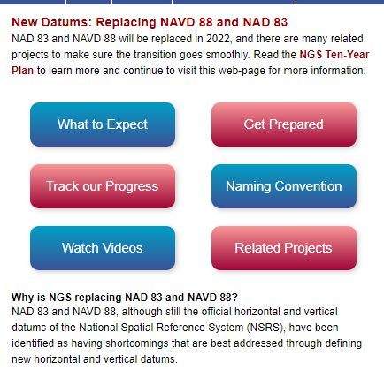
Get Prepared
More active NSRS users
Metadata, metadata, metadata..
Use current datums / realizations
Keep original (“raw”) GNSS observation files
https://www.ngs.noaa.gov/datums/newdatums/index.shtml
Notes:
More active NSRS users
Metadata, metadata, metadata..
Require/provide complete metadata for all mapping contracts.
How did they get the positions/heights? Document it!
Lead by example and use best metadata practices
Use current datums / realizations.
NAD 83(2011) epoch 2010.00
USGG12 (gravimetric geoid) / GEOID12B(hybrid geoid)
NAVD 88 (get off of NGVD 29)
Keep original (“raw”) GNSS observation files. This will improve quality of future transformations.

Slide 23
Thank you!

Slide 24
Questions?

