Slide 1

OPUS-Projects for RTK Vectors and the
GVX File Format
Dan Gillins, Ph.D., P.L.S.
Geodesist, National Geodetic Survey
NGS Webinar Series
April 9, 2020

Slide 2
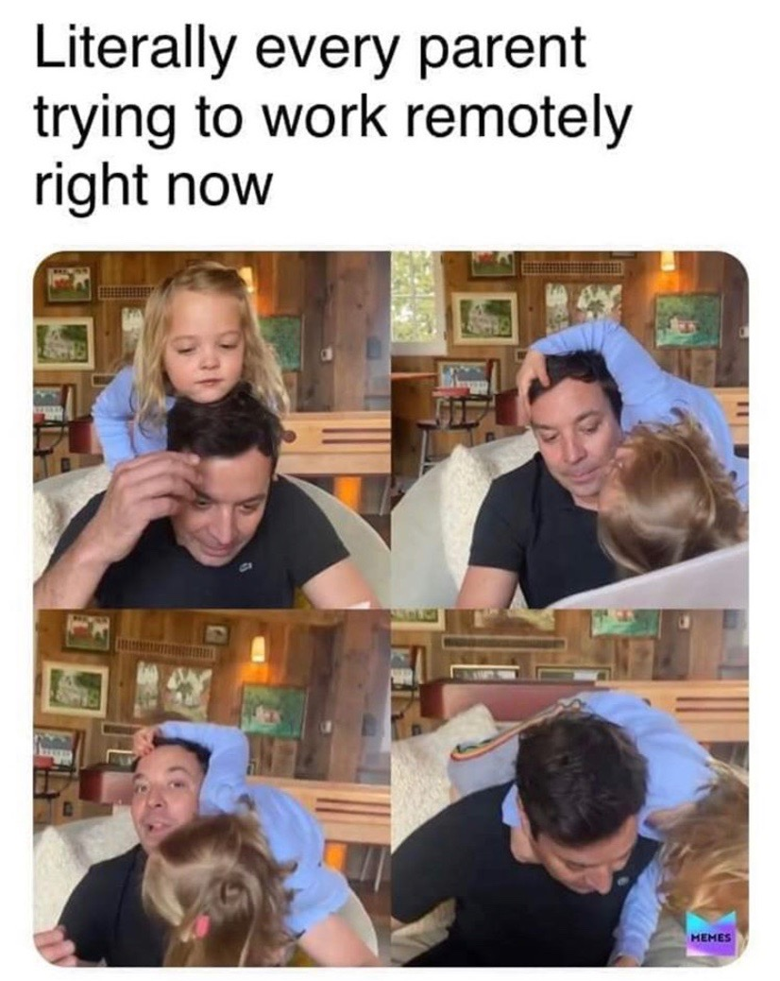
Greetings from Home!

Slide 3
Acknowledgements
Development Team:
Ira Sellars
Mark Schenewerk
Weibing Wang
Jay Howard

Slide 4
Outline
Introduction on the Real-Time Kinematic (RTK) Technique and Real-Time Networks (RTNs)
Problem Statement
Objectives
Background on OPUS-Projects
GVX File Format
Demonstration of Creating a GVX File
Demonstration of Development to OPUS-Projects
Next Steps and Future Plans

Slide 5
GNSS Errors
Clock biases
Orbit errors
Tropospheric delays
Ionospheric delays
Dilution of precision

Slide 6
Brief on Terminology
Baseline: the line connecting two GNSS marks
Vector: a mathematical representation of a measurement of the baseline, expressed in delta X,Y,Z components (along with error estimates)
So, one baseline measured repetitively seven times will have seven vectors

Slide 7
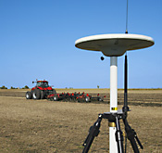
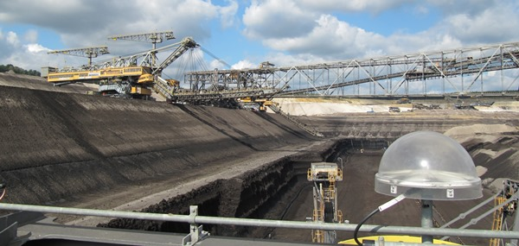
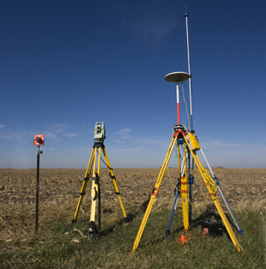
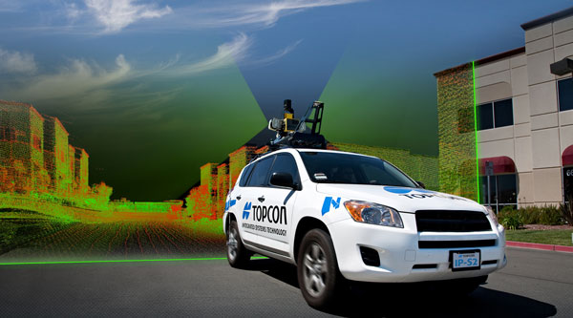
Real-Time Kinematic (RTK) Surveying
Single-Base RTK
  Single “base” or reference station
  Transmits precise coordinates and GNSS observables to moving “rover” using wireless communication
  Baselines processed in “real-time” and stored on a data collector
  Produces vectors from base to rover
  < 20 km baseline length
Base
Rover
www.alberding.eu
www.gcfarm.com
www.steckbeck.net
www.positionpartners.com.au
http://www.gcfarm.com/siteart/precision-farming/case-accuguide.jpg
Notes:
Applications
Survey engineering
Mobile mapping
Precision agriculture
Mining
Construction

Slide 8
Real-Time Networks (RTNs)
Network of “permanent” GNSS base stations
  < 70 km spacing between base stations
  < 40 km maximum baseline length
Atmospheric and orbital corrections are transmitted to rover via mobile data link
RTN Base
RTN Base
VRS
Control
Center
(Landau et al. 2002)
RTN Base
Notes:
RTN Correction modeling:
Dispersive = Ionosphere
Non-dispersive = Troposphere and Orbital Errors
Minimize distance-dependent errors
Baseline length:
Single-base 10-20 km
Network < 40 km

Slide 9
Pros and Cons of RTNs
Benefits | Concerns
FAST. Could reduce field observations from several hours to just a few minutes | RTN may not be aligned with the National Spatial Reference System
Can evaluate data quality in real time | Ideally, survey should be tied to NOAA CORS Network
Easy to obtain additional observations | More prone to multipathing errors
Only a single receiver (i.e., rover) is needed during a session | Baselines must be kept short (i.e., < 40 km)

Slide 10
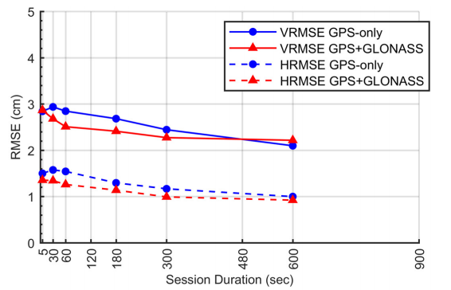
Empirical Evaluation of the Accuracy of RTNs
95% Confidence
± 5.0 cm, vertical
± 2.5 cm, horizontal
Or similar to accuracy of a 2-h OPUS-S solution!
[Allahyari et al. 2018]

Slide 11
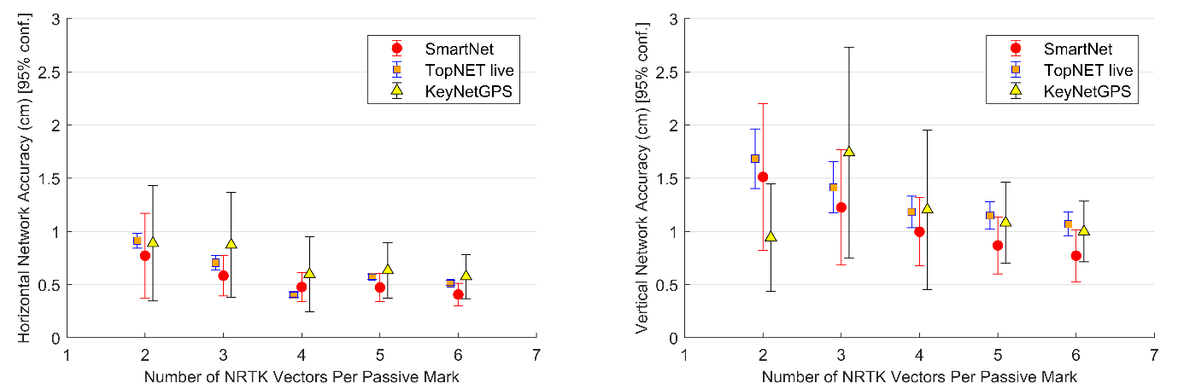
Formal Error Propagation via Survey Network Least Squares Adjustment
[Gillins et al. 2019]

Slide 12
Problem Statement
NGS does not have a simple mechanism for accepting data resulting from Real-time Kinematic (RTK) surveys
RTK surveys are very popular (more than static surveys)
  Highly efficient—measurements done in seconds to minutes
RTK vectors and metadata are generally stored in a proprietary format
There lacks an industry standard file format for any type of GNSS vector, whether the vector was derived in real-time or by post-processing

Slide 13
Objectives
Develop a standard file format for GNSS vectors
  Open-source, machine-readable, human-readable
  Must include all of the necessary information for performing a least squares adjustment
  Must include important metadata for quality control
Develop OPUS-Projects so that GNSS vectors from RTK surveys can be uploaded, checked, adjusted, and submitted to NGS

Slide 14
OPUS-Projects
Free, web-based software
Designed for managing campaign-style GPS surveys
  Multiple repeat occupations of several marks
Ability to add GPS data from NOAA CORS Network
Session baseline processing using PAGES
Customize tropospheric delay models, elevation cutoff masks, constraint weighting
Network least squares adjustments of multiple sessions
Choice of reference frames and geoid models
Currently requires ≥ 2-hour static GPS observation for post-processing

Slide 15
Beta OPUS-Projects
https://beta.ngs.noaa.gov/OPUS-Projects/
New version of OPUS-Projects (v. 4)
Buttons for users to upload photos and descriptions
Prepares files for Bluebooking
Ability to run ADJUST within OPUS-Projects
Button to submit survey to NGS for review and publication in NGS Integrated Database

Slide 16
OPUS-Projects
CORS
CORS
"Hub design" recommended by NGS
Hub to project marks recommended to be ~100 km
Use multiple CORSs
Use one very long baseline from hub to CORS (improves tropospheric modeling)
OPUS-Projects does session baseline processing
24hr
Hub
24hr
CORS
≥2hr
≥2hr
24hr
CORS
Notes:
Hub is an active station within 100 km of the project marks.

Slide 17
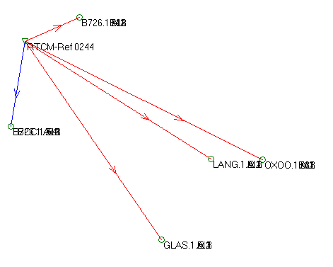
Example: Conduct RTK Survey and Download Data
BASE
(LCS1)
Store your RTK measurements as vectors and not just points!
Notes:
Download RTN data from a data collector to software. Then, identify which base stations were chosen by the RTN as references during the survey. Go to an FTP or website to download the static data logged at the base stations on the day(s) of the RTN survey. Upload this static data (preferably as 24-h files) to OPUS-Projects.

Slide 18
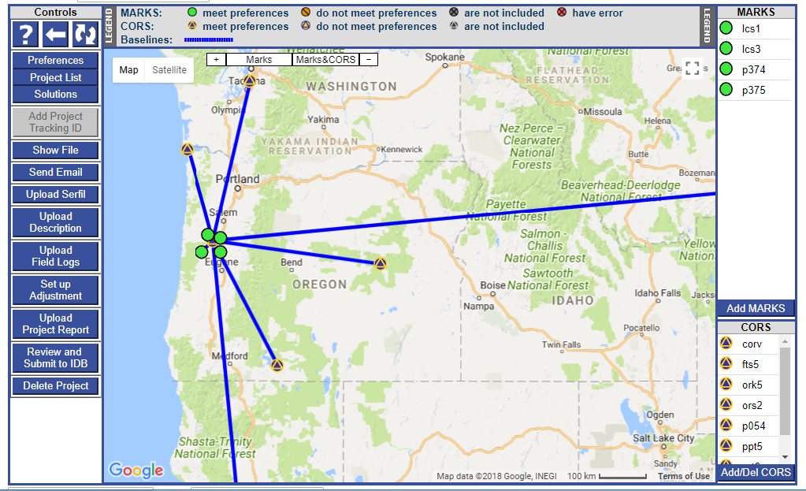
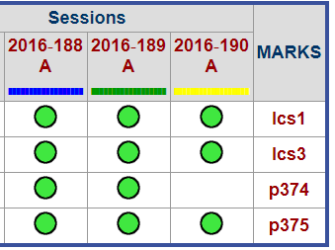
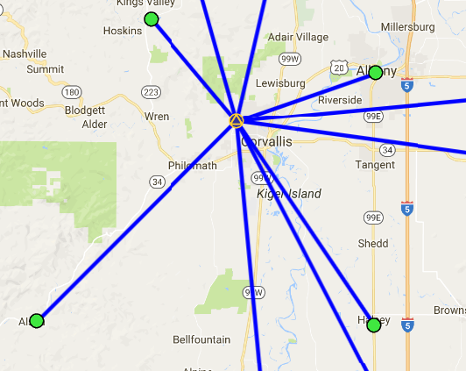
Example: Process Base Data in OPUS-Projects
Upload Vectors

Slide 19
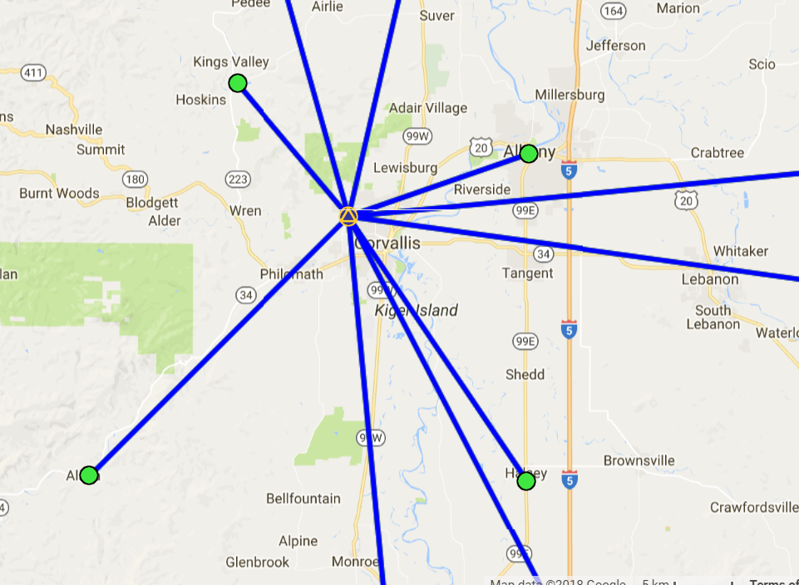
Example: Upload RTK Vectors to OPUS-Projects
LEGEND
CORS
User Mark
Processed Vector (OPUS-Projects)
Uploaded Vector
Upload Vectors

Slide 20
But but but…
Differing GNSS equipment and software vendors output data in varying file formats (often proprietary, closed-source)

Slide 21
Examples of Standard File Formats
RINEX = Receiver Independent Exchange Format
  Version 1 proposed in 1989 by Werner Gurtner (University of Bern)
  Version 2 proposed in 1990 by Gurtner and Gerald Mader (NGS)
  Aimed for the easy exchange and processing of raw GNSS data
  GNSS carrier-phase and pseudorange (code) measurements, and time
LAS = LASer format
  Proposed by the American Society of Photogrammetry and Remote Sensing (ASPRS) in 2003
  Open format used for exchanging point cloud data

Slide 22
Why Standard File Formats?
Standardization benefits:
  Broadens use; easier to work with by others who will use the data
  Easier to share with others
  Reduces the need to convert from one format to another
  Data in proprietary format can be converted to open, standard format
  Increases likelihood critical metadata is captured and accurate; significant figures are preserved
  Lengthens the preservation of the data
  Can be made machine-readable

Slide 23
GNSS Vector EXchange Format (GVX)
Website: https://www.ngs.noaa.gov/data/formats/GVX/index.shtml
Detailed documentation
Schema (XSD)
Example vector file
GVX is written in Extensible Markup Language (XML)
Designed to store and carry data in plain text format
Flexible representation of arbitrary data structures
Extensible – new elements can be added later without breaking applications
Both machine-readable and human-readable
Schemas can be used to define “must haves” and “should haves”

Slide 24










Industry Invited to Provide Feedback

Slide 25
GVX Remains Under Development
Received feedback from numerous individuals, companies, governments, and organizations
Revising GVX to address this feedback
Desire to make it compatible with GeodesyML (international efforts)
Stay tuned!

Slide 26
GNSS Vector EXchange Format (GVX)
SOURCE_DATA
  Information on the source of the GVX file, such as the name of the original data file, conversion software to make the GVX file, etc.
PROJECT_INFORMATION
  Information on the survey project, points of contact, start and end date of the survey
REFERENCE_SYSTEM
  Specifies the reference frame and units for data in the file

Slide 27
GNSS Vector EXchange Format (GVX)
EQUIPMENT
  Defines all GNSS equipment utilized to create the data in the file, including all antennas and receivers, serial numbers, firmware versions, antenna phase center calibration models
SURVEY_SETUP
  Information on how the vectors were collected or derived, such as settings for single-base RTK, RTN settings, post-processing settings, etc.
  Operator name(s)

Slide 28
GNSS Vector EXchange Format (GVX)
POINT
  Geodetic coordinates for all start and end points of every vector
  Names/codes
  Antenna heights
  Point type (fixed/float/code/keyed-in, etc.)

Slide 29
GNSS Vector EXchange Format (GVX)
GNSS_VECTOR
  IDs for starting and ending points of the vector
  ID for survey setup
  Start and end time of the observation
  Differential, mark-to-mark vector components (ECEF) or dX, dY, dZ
  Variance and covariance values
  QA/QC metadata
    DOP, RMS, mask settings, number of satellites used by GNSS type, orbit types and sources, RTCM age

Slide 30
And and and…
Although the original objective was to develop tools for RTK surveys, GVX supports all types of GNSS vectors
Real-time vectors
Post-processed vectors

Slide 31
GVX Flow Chart

Slide 32
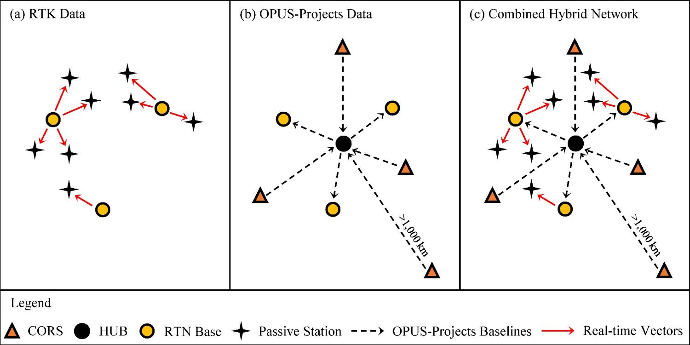
Design for OPUS-Projects and GVX
GVX file (from RTK survey or baseline processing in other software)
OPUS-Projects (from static GNSS session processing)
RTK Base or “From” Mark
RTK Rover or “To” Mark
Vector
Vector in GVX File
[Adapted from Weaver et al. 2018]

Slide 33
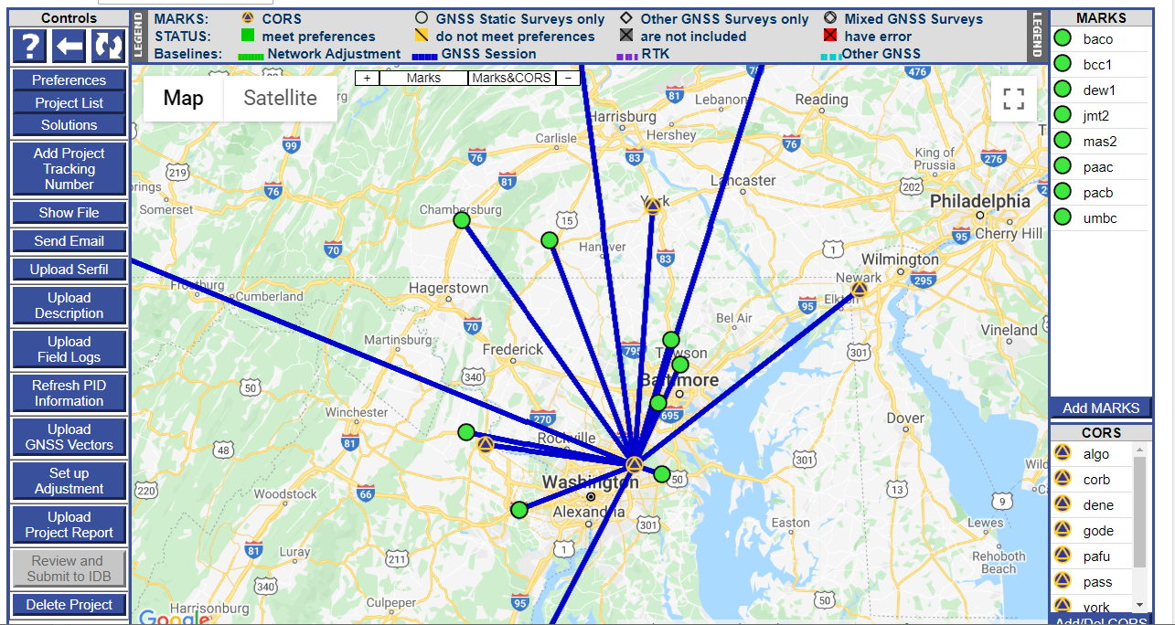
Step 1: Upload Static GNSS Data Collected at Base Stations; Post-process with CORSs

Slide 34
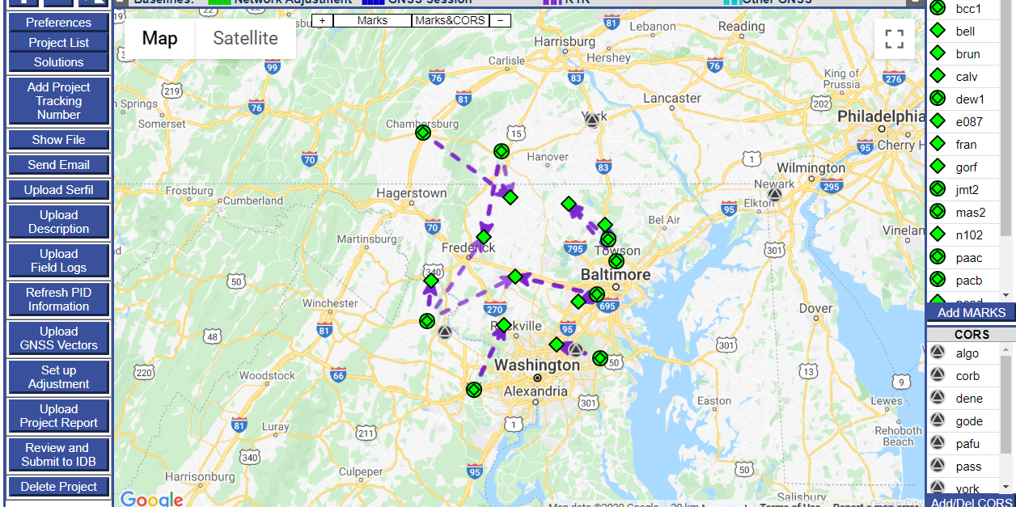
Step 2: Upload GVX Files (Vectors)

Slide 35
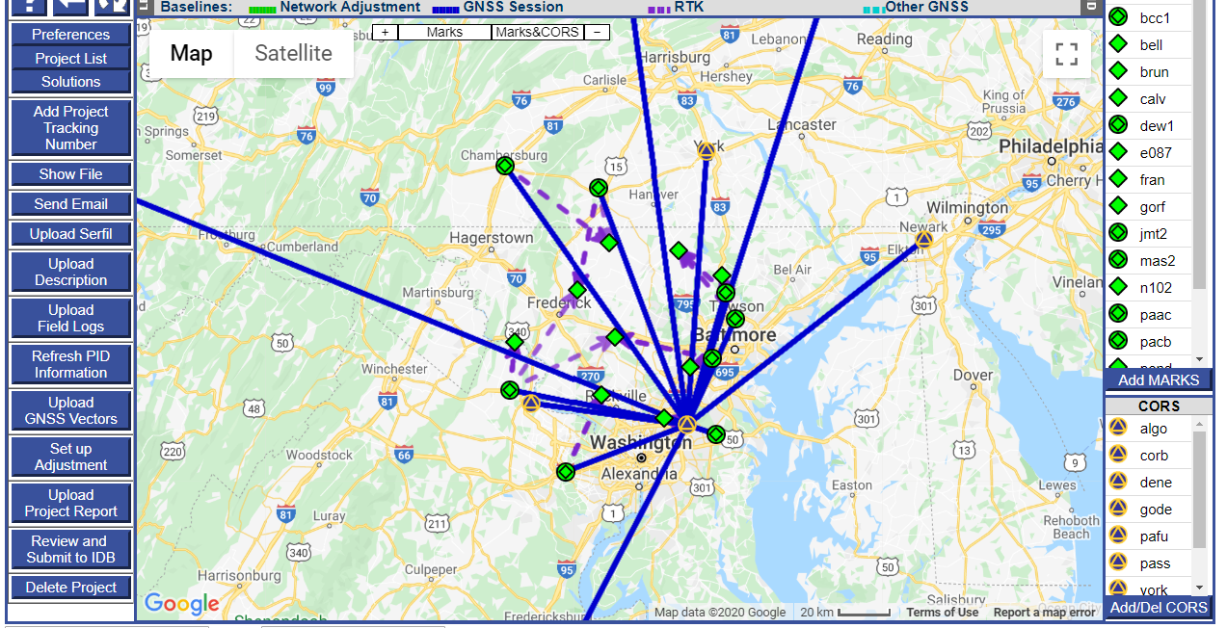
Step 3: Combine Post-processed Vectors and Uploaded Vectors (from GVX) in Survey Network for Adjustment

Slide 36
Example: Adjust Static + RTN Network
Run least squares adjustment(s) of the combined static data and RTN vectors in the survey network
Hold CORS (and possibly other published coordinates on passive marks) as control in network adjustments
Check quality of results
Submit survey project to NGS for review and publication in national database

Slide 37
Demonstration
Web tool for creating GVX file from a Trimble JXL file
Development of OPUS-Projects
  Upload GVX files
  QA/QC tools
  Setting up for an adjustment

Slide 38
Ongoing and Future Work
Continue coding of the adjustments of networks with GVX files (est. July 2020)
Release newly developed OPUS-Projects to Beta for public commenting (est. Summer 2020)
Update OPUS-Projects User Manual
Finish writing new specifications for establishing geodetic control with static GNSS and/or RTK/RTNs

Slide 39
Future Standard File Formats
Total stations
Digital automatic levels

Slide 40
How to Move Forward?
Provide feedback! Send to ngs.feedback@noaa.gov
  What are we missing?
  What is unnecessary?
  How can GVX be improved?
  How can OPUS-Projects be further developed for uploaded GNSS vectors?

Slide 41
For More Technical Details, Refer to…
Gillins, D.T., Kerr, D., and Weaver, B. (2019). “Evaluation of the Online Positioning User Service for Processing Static GPS Surveys: OPUS-Projects, OPUS-S, OPUS-Net, and OPUS-RS,” J. Surv. Eng. (ASCE), 145(3):05019002.
Gillins, D.T., Heck, J., Scott, G., Jordan, K., and Hippenstiel, R. (2019). “Accuracy of GNSS Observations from Three Real-time Networks in Maryland, USA,” Proc. 2019 FIG Working Week, Hanoi, Vietnam, April 2019, 15 pp.
Park, J., Kim, S., Shahbazi, A., Gillins, D., and Dennis, M. (2018). “Evaluation of Static GPS Surveying Campaigns Processed in OPUS-Projects,” Final Technical Report FY17 NA293P, National Geodetic Survey, 58 pp.
Jamieson, M., and Gillins, D.T. (2018). “Comparative Analysis of Online Static GNSS Post-Processing Services.” J. Surv. Eng. (ASCE), 144(4):05018002.
Allahyari, M., Olsen, M., Gillins, D.T., and Dennis, M. (2018). “A Tale of Two RTNs: Rigorous Evaluation of GNSS Survey Observations in Real-time Networks,” J. Surv. Eng. (ASCE), 144(2):05018001.
Weaver, B., Gillins, D.T., and Dennis, M. (2018). “Hybrid Survey Networks: Combining Real-time and Static GNSS Observations for Optimizing Height Modernization,” J. Surv. Eng. (ASCE), 10.1061/(ASCE)SU.1943-5428.0000244, 144(1):05017006.
Gillins, D., and Eddy, M. (2017). “Comparison of GPS Height Modernization Surveys using OPUS-Projects and Following NGS-58 Guidelines,” J. Surv. Eng. (ASCE)., 143(1):05016007.

Slide 42
Questions?
Dan Gillins
Daniel.Gillins@noaa.gov

Slide 43
Summary
All results based on GPS-only and for Oregon case study

