Slide 1
NSRS Modernization
Dru Smith
NSRS Modernization Manager
NOAA’s National Geodetic Survey

Slide 2
Outline
BLUF
Refresher
Blueprint Part 1
Blueprint Part 2
Blueprint Part 3
Terminology
New Types of Coordinates
New way of operating The CORS Network
New Way for USERS to Process GNSS Projects
New way of processing Leveling projects
New Way for NGS to Process and store GNSS Data
Final Discrete Coordinates
New Way for NGS to Process and store GNSS Data
Reference Epoch Coordinates
Miscellaneous / TBD

Slide 3
Bottom Line, Up Front
If you do geospatial work in the USA…
and you work in the National Spatial Reference System..
every product you’ve ever made…
every survey…
every map…
every lidar point cloud…
every image…
every DEM…
WILL have the wrong coordinates on it in 4 years.
Let’s talk about what this means, why it is happening, and how it will affect things going forward

Slide 4
Refresher

Slide 5
“Modernizing the NSRS” means…
Replacing NAD 83
Replacing NAVD 88
Re-inventing Bluebooking
Improving the Geodetic Toolkit
Better Surveying Methodologies
Blueprint for 2022, Part 1
Blueprint for 2022, Part 2
Blueprint for 2022, Part 3
Notes:
There are actually 3 “NAD 83”s, NAD 83(2011), NAD 83(PA11) and NAD 83(MA11)
There are also many more vertical datums than NAVD 88 in the NSRS, each one for specific states or territories that have no line of sight to CONUS/Alaska

Slide 6
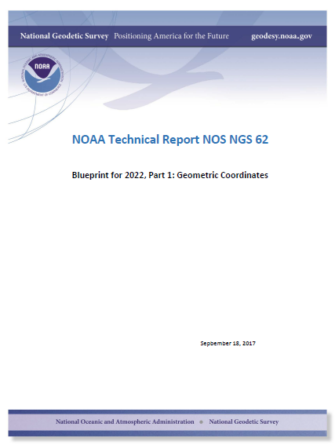
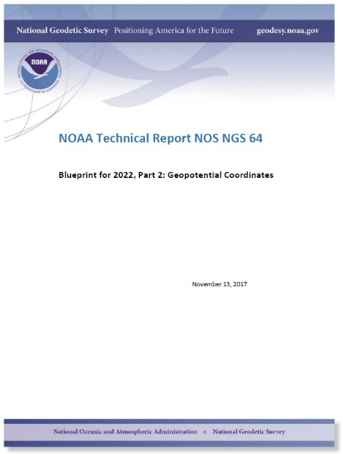
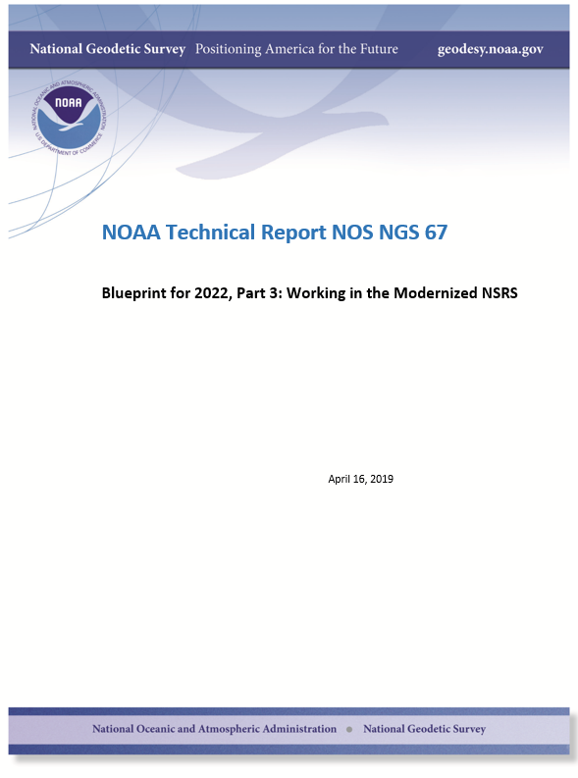
Modernizing the NSRS
The “blueprint” documents: Your best source for information
Geometric:
Sep 2017
Geopotential:
Nov 2017
Working in the
modernized NSRS:
April 2019

Slide 7
Replace (the) NAD 83s
See: Blueprint for 2022, Part 1

Slide 8
Replacing the NAD 83’s
The Old:
NAD 83(2011)
NAD 83(PA11)
NAD 83(MA11)
The New:
The North American Terrestrial Reference Frame of 2022
(NATRF2022)
The Caribbean Terrestrial Reference Frame of 2022
(CATRF2022)
The Pacific Terrestrial Reference Frame of 2022
(PATRF2022)
The Mariana Terrestrial Reference Frame of 2022
(MATRF2022)

Slide 9
NAD 83’s non-geocentricity
Earth’s Surface
h_{NAD83}
φ_{NAD83} – φ_{ITRF2014}
λ_{NAD83} – λ_{ITRF2014}
h_{NAD83} – h_{ITRF2014}
all vary
smoothly by latitude
and longitude
h_{ITRF2014}
ITRF2014 origin
same
GRS-80
ellipsoid
~2.2 m
NAD 83 origin

Slide 10
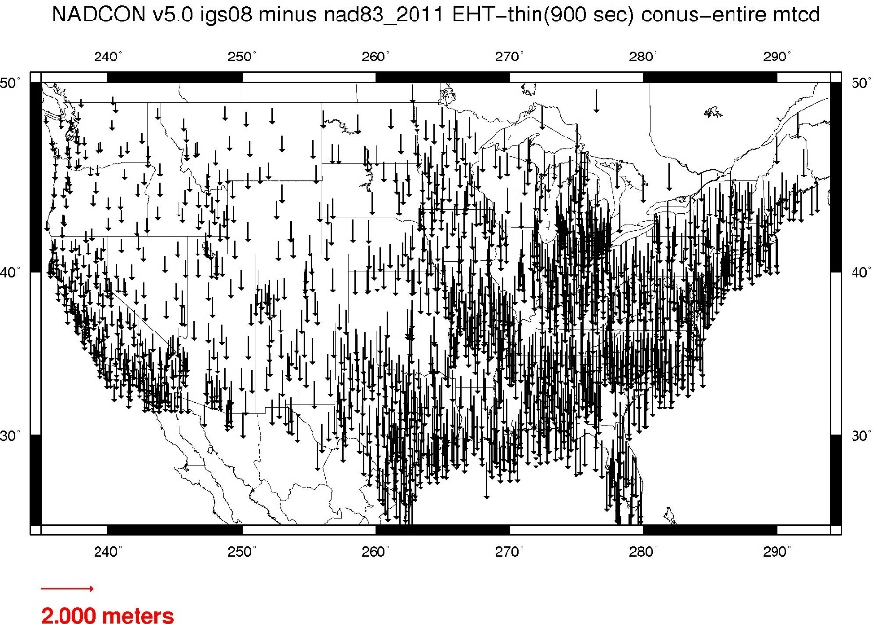
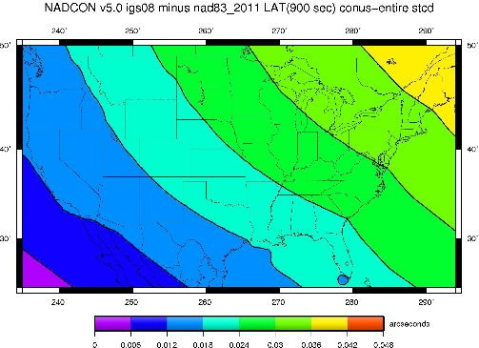
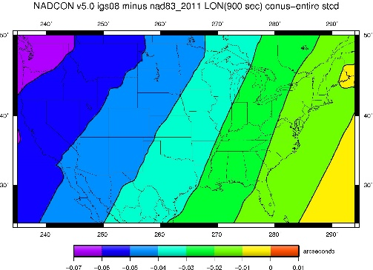
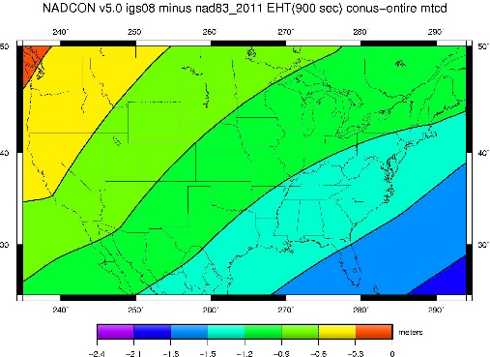
NAD 83(2011) epoch 2010.0 to NATRF2022 epoch 2020.00

Slide 11
Plate-(pseudo)fixed frames
NAD 83(2011) minus NAD 83(NSRS2007)
NAD 83(NSRS2007)
Epoch 2002.0
NAD 83(2011)
Epoch 2010.0
If NAD 83 were truly “plate
fixed” then an 8 year
epoch change would not
yield the systematic
plate rotation seen here.
(*)TRF2022 will determine
a new Euler Pole rotation
for each of 4 plates.
(*)=NA, CA, MA or PA

Slide 12
Replace NAVD 88 (and ASVD02, PRVD02, NMVD03, GUVD04, VIVD09, all geoid models, all deflection of the vertical models, all surface gravity models, and IGLD85)
See: Blueprint for 2022, Part 2

Slide 13
Replacing NAVD 88
The Old:
NAVD 88
PRVD 02
VIVD09
ASVD02
NMVD03
GUVD04
IGLD 85
IGSN71
GEOID12B
DEFLEC12B
The New:
The North American-Pacific Geopotential Datum of 2022 (NAPGD2022)
Will include:
GEOID2022
SGEOID2022: The geoid in 2020.00
DGEOID2022: Time-dependent geoid changes from 2020.00
DEFLEC2022
SDEFLEC2022: The DoVs in 2020.00
DDEFLEC2022: Time-dependent DoV changes from 2020.00
GRAV2022
SGRAV2022: Surface gravity in 2020.00
DGRAV2022: Time-dependent surface gravity changes from 2020.00
More
Orthometric
Heights
Normal
Orthometric
Heights
Dynamic
Heights
Gravity
Geoid
Undulations
Deflections of
the Vertical

Slide 14
Geopotential Basics
Why isn’t this a vertical datum?
Because it contains more than heights
And therefore NGS wants to be accurate in its name

Slide 15
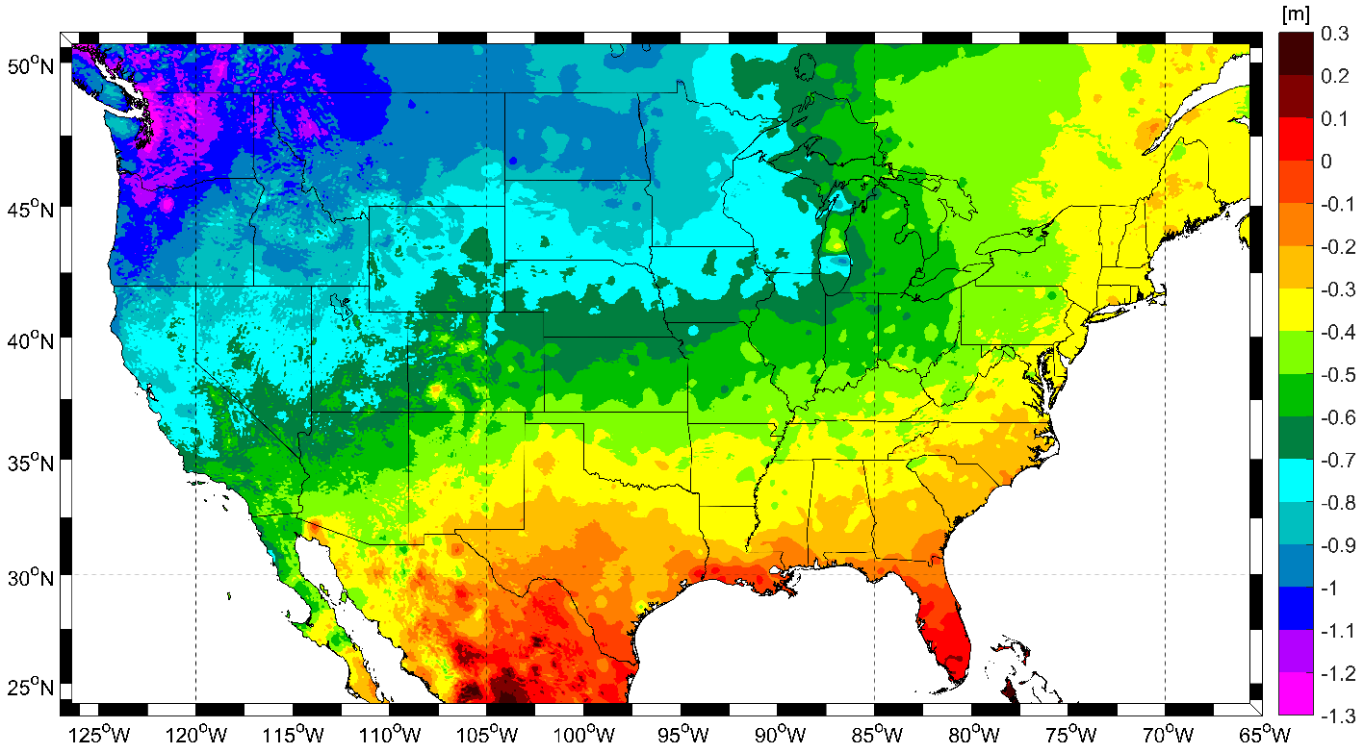
Expected changes to orthometric heights

Slide 16
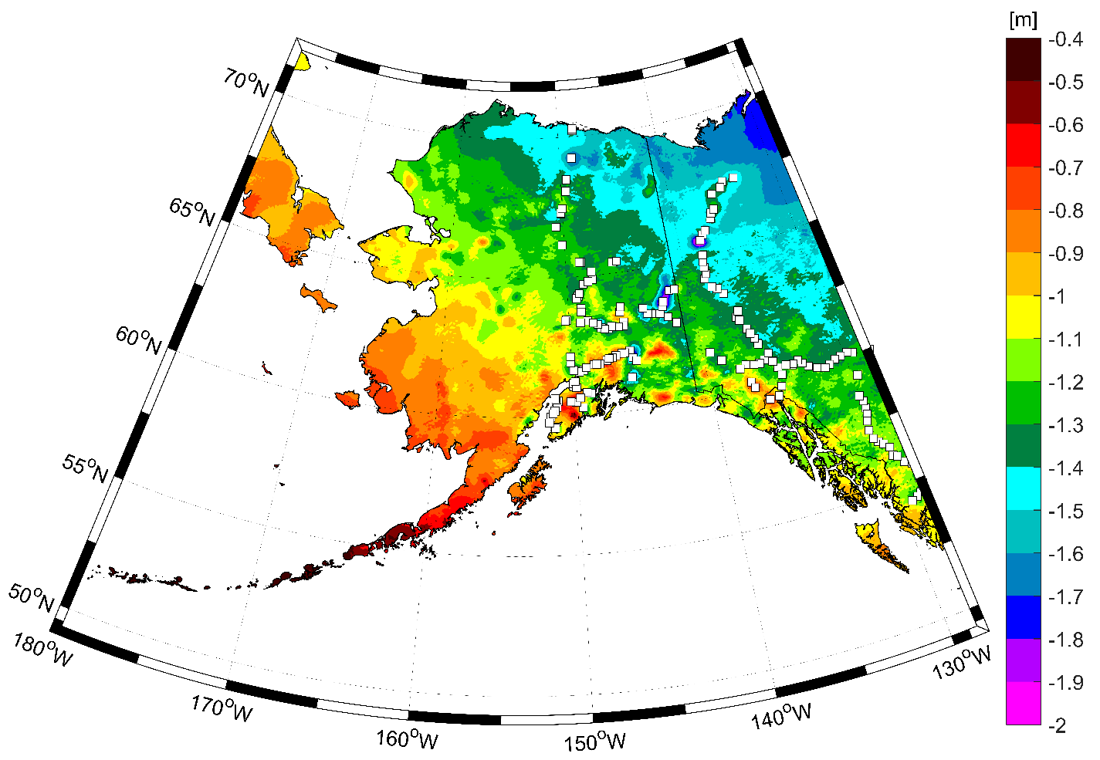
Expected changes to orthometric heights

Slide 17
Definitional Relationship
$H_{NAPGD2022}(t)≡h_{∗TRF2022}(t)−N_{GEOID2022}(t)$
Time-dependent ellipsoid heights
come from time-dependent
CORS coordinates which serve as control for your time-dependent GNSS survey.
They will be modeled in the IFVM
Time-dependent geoid undulations
are modeled in the dynamic component of GEOID2022 (“DGEOID2022”), which will come from the geoid monitoring service, or GeMS.

Slide 18
Geoid Monitoring Service
Goal: Track all changes to the geoid which would prevent 1 cm accuracy
Three major aspects:
Secular Shape: Hudson Bay
Episodic Shape: Massive Earthquakes
Geoid relation to Sea level: Global Sea Level Change

Slide 19
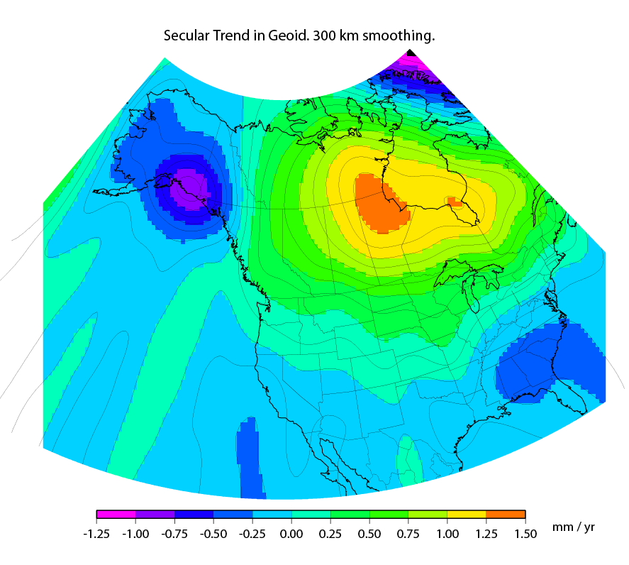
Secular Mass Movement
Notes:
There are two manifestations of the growing mass in the deep mantle under Hudson Bay:
Geometric – a GPS receiver will see the crust uplifting as the increase in mantle mass pushes the crust up in a displacement.
Geopotential – a gravimeter on the surface will sense the growing mass as an increase in the acceleration of gravity, BUT this will be slightly tempered by a reduction in gravity as well (because the gravimeter on the surface is getting farther from the Earth’s center). Still, the gain (from mass increase) is larger than the loss (from geometric movement) for a net gain. Because the net gain in gravity is not caused purely by being at a new crustal height, this translates into an increase in geoid undulations, or a “swelling” of the geoid in this region.
This is different than a purely geometric change caused by a compression of the crust. In that case, no significant mass is entering or leaving the region so, while GPS might sense a subsidence and a surface gravimeter might sense a slight increase as it moves closer to the Earth’s center, the geoid would not actually change.

Slide 20
High resolution products
GEOID2022
Official converter of *TRF2022 ellipsoid heights into NAPGD2022 orthometric heights
DEFLEC2022
Surface deflections of the vertical in N/S and E/W
GRAV2022
Surface acceleration of gravity
DEM2022
Official DEM used in creation of all above products
All will be 1 x 1 arcminute grids
All will cover three finite regions of the globe
All will have a static and dynamic component
Dynamic surface gravity and DEM not expected to be ready by 2022

Slide 21
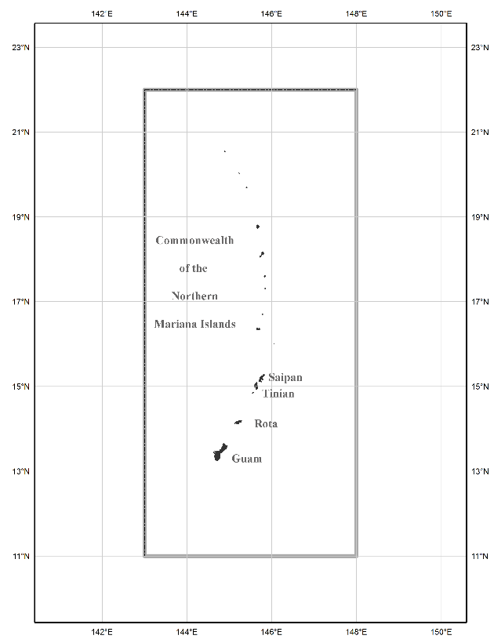
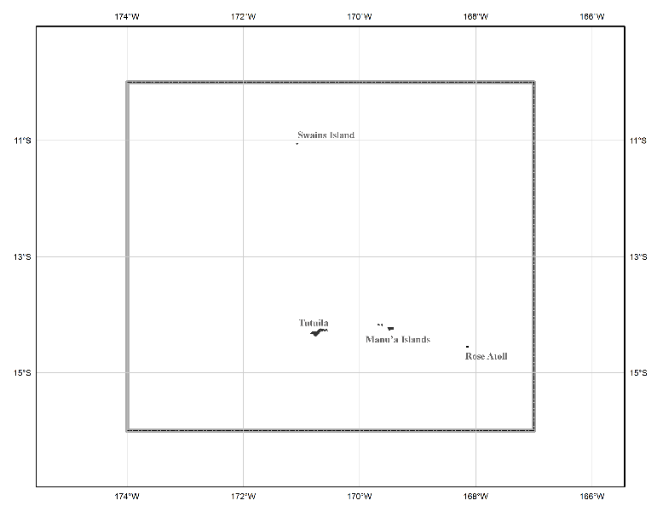
The three gridded regions
“North American region”
¼ of the Earth
“Guam/CNMI region”
“American Samoa region”

Slide 22
Blueprint for 2022, Part 3 Released April 25, 2019

Slide 23
Re-invent Bluebooking (including fully embracing time-dependent coordinates while recognizing a user community that prefers time-static coordinates for now, building a new database, making it easy for users to submit data to us, and being meticulous about terminology)
See: Blueprint for 2022, Part 3

Slide 24
Improve the Toolkit (including the deprecation of FORTRAN and .EXE files, fully integrating that which can be integrated, and generally being better organized)
See: Blueprint for 2022, Part 3

Slide 25
Better Surveying (meaning leading the way by testing and documenting entirely new ways of performing geodetic surveys in a modernized NSRS, and not letting manuals sit unchanged for 22 years)
See: Blueprint for 2022, Part 3

Slide 26
Acknowledgments
Blueprint for 2022, Part 3 is the result of significant TEAM efforts over 18 months
GNSS SOP Team
Choi, Roman, Jalbrzikowski, Sun, Dennis, Prusky, Gillins, W. Wang, Saleh, Yoon, Damiani, Kanazir, Evjen, Sellars, Schenewerk, Caccamise, Heck, Hilla, Bilich, McFarland
Leveling SOP Team
Zenk, Kanazir, Dennis, Breidenbach, Fancher, Hanson, Hensel, Paudel, Ward, Zilkoski, Gillins, Geoghegan
BP3 Writing Team
Kinsman, Kanazir, Hensel, Jordan, Stone, Vogel, Heck, Dennis, Fromhertz, Winester, Zenk, Silagi, Roman, Grosh, Ahlgren
It is a team document, with input from dozens of individuals around NGS

Slide 27
What is BP3?
BP3 is a companion to BP1 (geometric) and BP2 (geopotential), both released in 2017
It is about “re-inventing bluebooking”
It’s about how NGS will provide the frames/datum in the future
It’s about how YOU will use the frames/datum in BP1 and BP2

Slide 28
Terminology

Slide 29
Terminology
The following terms (and more) are defined meticulously in BP3 in a coordinated effort within NGS and with the IERS:
Point, Mark, Station, Site, ARP, GRP, Site Marker, CORS, The NOAA CORS Network
GRP = Geometric Reference Point – the official point on a station to which all coordinates refer
As a direct fallout: NGS will no longer provide CORS coordinates at an ARP, only to a GRP
An antenna has an ARP.
A CORS only sometimes has an antenna.
Therefore a CORS only sometimes has an ARP.
But it always has a GRP.
The ARP and GRP are only sometimes coincident in space when the antenna is mounted at a CORS
The GRP gets a PID

Slide 30
Terminology
“CORS” is an acronym
It is singular (S means “Station”, not “Stations”)
It will no longer be used to describe the network of all such stations
That will, for now, be called the NOAA CORS Network, or NCN
Which has a subset of stations called the NOAA Foundation CORS Network, or NFCN
Its plural form is CORSs
No apostrophe, No “es” and no skipping the “s”
GODE is a CORS
Not “a CORS site”
And definitely NOT “a CORS Station”
That’s like “an ATM machine”
GODE and 1LSU are CORSs
GODE and 1LSU belong to the NOAA CORS Network
TMG2 is a NOAA Foundation CORS
TMG2 and FLF1 are NOAA Foundation CORSs
TMG2 and FLF1 belong to the NOAA Foundation CORS Network

Slide 31
Terminology
“OPUS”
Online Positioning User Service
Adopted as the general term for all of our online positioning software
Rather than “-Projects” , “-S” , etc
Basically “do it with OPUS” should be applicable to a wide variety of tasks
Recon, Mark Recovery, GPS, Leveling, Gravity, Classical

Slide 32
Terminology
“GPS Month”
A span of four consecutive GPS weeks, where the first GPS week in the GPS month is an integer multiple of 4
GPS Month 0 = GPS weeks 0, 1, 2 and 3
GPS Month 1 = GPS weeks 4, 5, 6 and 7
Etc.

Slide 33
New Types of Coordinates

Slide 34
New Types of Coordinates
Reported
“These are from any source where the coordinate is directly reported to NGS without the data necessary for NGS to replicate the coordinate.”
Scaled
From NCAT or VDatum
Hand Held / Smartphone
Reported directly from an RTK rover without data files

Slide 35
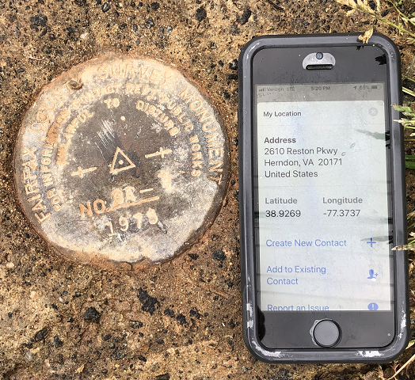
Reported Coordinates

Slide 36
New Types of Coordinates
Preliminary
“These are coordinates at survey epoch that have been computed from OPUS, but not yet quality checked and loaded into the NSRS DB.”
User-computed values, such as they might get today from either OPUS-S or OPUS-Projects
“Preliminary” coordinates are the only coordinates a user will get directly from OPUS

Slide 37
New Types of Coordinates
Reference Epoch
“These are coordinates which have been estimated by NGS, from time-dependent (final discrete and final running) coordinates, at an Official NSRS Reference Epoch (ONRE)”
NAD 83(2011) epoch 2010.00 (sort of) would’ve fallen under this category
These will be computed by NGS every 5 years
On a schedule 2-3 years past ONRE
2020.00 coordinates are computed in CY 2022, etc

Slide 38
New Types of Coordinates
Final Discrete
“These are coordinates computed by NGS using submitted data and metadata, checked and adjusted and referenced to one survey epoch.”
These represent the best estimates NGS has of the time-dependent coordinates at any mark
Could be a:
Daily solution on one CORS
The single adjusted value coming from one or more occupations on a passive mark within 1 GPS Month
*
*
More on that in a moment…

Slide 39
New Types of Coordinates
Final Running
“Of all types of coordinates on a mark, these are the only ones which will have a coordinate at any time.”
At a CORS GRP, they will be the coordinate function
Which will be generated by a “fit” to regularly computed Final Discrete coordinates on a TBD basis, perhaps daily, perhaps weekly
On a passive mark, they will come from a mixture of Final Discrete coordinates and the IFVM (and possibly the GeMS)

Slide 40
New Way of Operating the NOAA CORS Network

Slide 41
New Way of Operating the NOAA CORS Network
Each CORS will get a coordinate function
Actually three functions, X(t), Y(t), Z(t), in the ITRF2014 frame
In the strict mathematical definition of “function”
For any given “t”, there is one and only one X , Y and Z
We actually do this today, just that the functions are piecewise linear
We are NOT limiting our “modernized NSRS” discussions of CORS coordinate functions to linear functions only!
But have made no further decisions yet

Slide 42
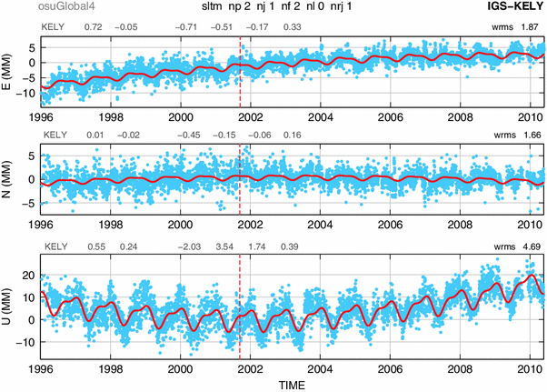
Examples of what non-linear CORS coordinate functions look like

Slide 43
New Way of Operating the NOAA CORS Network
Philosophy:
The NOAA CORS Network will be self-consistent, meaning:
The impact of a user’s CORS choices within their project will not exceed a small, statistically acceptable value:
Horizontal < 5 mm, Vertical < 10 mm
On a daily basis NGS must be able to detect, and react to, persistent disagreements as well as catastrophic outliers between daily solutions and the current “coordinate function” assigned to any CORS in the NOAA CORS Network

Slide 44
Persistent Disagreement
The point:
It’s not enough to say “each CORS is good to 1 cm in ellipsoid height”.
That phrase is vague, lacking what it means to be “good to 1 cm”.
NGS will define “persistent disagreement”
And NGS will define what happens when a CORS reaches “persistent disagreement”

Slide 45
New Way for USERS to Process GNSS Projects

Slide 46
GNSS: Time Span…
GNSS projects have no time limit.
(Leveling does. More on that later)
But they will be processed by NGS in GPS Months
*

Slide 47
GNSS: Processing by users in OPUS
*
GNSS projects must always be processed by GPS month as a first step
Multiple occupations on a point within a GPS month will be adjusted together to get one “final discrete coordinate” set on that mark for the mean occupation epoch within that GPS month
Coordinate functions from the IGS network or The NOAA CORS Network are the only allowable control

Slide 48
GNSS: Processing by users in OPUS
As a second step, a user may do many alternative things…
Adjust to some epoch that is convenient to them…
Hold any CORSs or passive control as constraints…
This two-step approach is a form of sequential adjustments and allows a win-win:
NGS gets to see the user-computed time-dependent “preliminary” coordinates, which have been computed by GPS Month
Which will be checked against “final discrete” coordinates computed by NGS
The user gets whatever adjustment and/or coordinates fulfill their contractual needs
Redundancy checks can occur both within a GPS month (at step 1, if multiple occupations occur in 1 GPS month) and across GPS months (at step 2, if occupations occur in different GPS months)

Slide 49
New Way of Processing Leveling Projects

Slide 50
Leveling: Time Span…
Leveling projects must not exceed 12 sequential months
Longer projects must be broken into sub-projects each spanning less than 12 sequential months
A compromise between:
Treating “1 GPS Month” as “Simultaneous” in the GNSS arena, and
Acknowledging that leveling surveys often take weeks to months to conduct
Mixed with the reality that:
You can’t solve for time-dependent orthometric heights in most leveling projects

Slide 51
Leveling: GNSS required
For now, NGS will require that all leveling projects turned in have GNSS on primary control
Minimum of 3 points
Maximum spacing of 30 km
At least two occupations:
+/- 14 days of beginning of leveling
But also within the same GPS month
+/- 14 days of ending leveling
But also within the same GPS month
If leveling exceeds 6 months, must have a 3rd, middle occupation
A GNSS “occupation” can mean “RTK/N”!

Slide 52
Leveling: Step 1 Identify project marks

Slide 53
Leveling: Step 2 Identify primary control marks (PCM)
Each PCM is within 30 km of at least one other PCM
< 30 km
< 30 km
< 30 km
< 30 km

Slide 54
Leveling: Step 2 Identify primary control marks (PCM)
No point over 30 km from a PCM

Slide 55
Leveling: Step 3 Initial GNSS on all PCMs
All PCMs, required: within +/- 2 weeks of the start of leveling
Each PCM, required: 2+ occupations within the same GPS month
All PCMs, recommended: Use the same GPS month

Slide 56
Leveling: Step 4 Leveling
Finished in under 12 months
If greater than 6 months, need a mid-project GNSS set on PCMs

Slide 57
Leveling: Step 5 (if 6-12 months) Mid-project GNSS on all PCMs
All PCMs, recommended: Near midpoint of project
Each PCM, required: 2+ occupations within the same GPS month
All PCMs, recommended: Use the same GPS month

Slide 58
Leveling: Step 6 Final GNSS on all PCMs
All PCMs, required: within +/- 2 weeks of the end of leveling
Each PCM, required: 2+ occupations within the same GPS month
All PCMs, recommended: Use the same GPS month

Slide 59
Leveling: Processing
All GNSS data processed into GPS months, as per normal processing
These are then adjusted to a mean epoch of the entire leveling survey to yield “representative” orthometric heights that serve as control over the entire leveling project
Stochastic but no time dependency

Slide 60
Leveling: Processing
The pre-computed GNSS-based orthometric heights are held as stochastic constraints in the adjustment of leveling data
Use math model from NOAA TM NOS NGS 74
Separates out errors in GNSS from Leveling:
Absolute heights will have standard deviations that are “at GNSS accuracy levels”
Differential heights will have standard deviations that are “at leveling accuracy levels”

Slide 61
Leveling: Absolute errors
Consider this quote from a concerned user:
“In the old NSRS, I could pull the datasheet for a point in California and see that NGS trusted the NAVD 88 height to 1 millimeter. Now, you’re telling me to use RTN to establish orthometric heights in the same area, and I’m getting heights with 4 cm standard deviations! Why are your heights less accurate today than in the past?”

Slide 62
New Way for NGS to Process and store GNSS Data: Final Discrete Coordinates

Slide 63
GNSS: Monthly workflow…
Every GPS month (say the first Monday of that GPS month), NGS will “process the GPS month of 12-16 weeks ago” by doing the following:
Ensure that the “final” IGS orbits for the GPS month that spans 12-16 weeks prior are available
If not, hold off on this until they are
Create an in-house project named for that prior GPS month
Farm all data (collected during that GPS month) from all projects submitted to NGS, and put them all into the in-house project

Slide 64
Processing by GPS Month…
GPS Month 587
GPS Month 588
GPS Month 589
GPS Month 590
GPS Month 591
GPS Month 592
GPS Month 593
GPS Month 594
All GNSS data collected in this
GPS month…
…are processed in this GPS month…
…to create Final Discrete coordinates for
this GPS month….
…which are loaded into the
NSRS database in this GPS month.

Slide 65
Processing by GPS Month…
GPS Month 587
GPS Month 588
GPS Month 589
GPS Month 590
GPS Month 591
GPS Month 592
GPS Month 593
GPS Month 594
All GNSS data collected in this
GPS month…
…are processed in this GPS month…
…to create Final Discrete coordinates for
this GPS month….
…which are loaded into the
NSRS database in this GPS month.

Slide 66
GNSS: Monthly workflow…
Adjust all that data together
Take the results of this adjustment and load them into the NSRS database as “final discrete” coordinates

Slide 67
GNSS: Monthly workflow…
Q: What about users’ projects that span more than 12-16 weeks?
A: NGS will provide a way for a user to “allow NGS to farm my data as it is loaded to my ongoing project”
Thus NGS needn’t wait for them to finish their project and click “submit”.
Will require some sort of metadata validity statement from the user for each data file uploaded

Slide 68
GNSS: Monthly workflow…
Q: What if a user turns in data more than 12-16 weeks after it was collected?
A: NGS will have a “holding bin” for such data. Occasionally, but not more than 1/year, NGS will sweep up all data in the holding bin, and put that data into the proper in-house GPS-month-based projects, depending on the GPS month of that data.
Since those in-house projects have already been adjusted once before using data that WAS submitted within the 12-16 week limit, and “final discrete” coordinates were computed on those early-submitted data, NGS will hold the “final discrete” coordinates on that early-submitted data as “fixed”, and adjust the later-submitted data only.

Slide 69
New Way for NGS to Process and store GNSS Data: Reference Epoch Coordinates

Slide 70
GNSS: Every five years…
Official NSRS Reference Epochs (ONREs) will happen every five years, beginning with 2020.00.
Every ONRE will have a project associated with it
To estimate the Reference Epoch (RE) Coordinates (RECs) at each RE
That project will begin 2 years after the RE and will end 3 years after it
Thus the project to create 2020.00 RECs will run January 1-December 31, 2022
Using data collected through the end of 2021
Error estimates in RECs will grow larger every five years for those points which are not regularly observed
Once computed, the REC at an ONRE for a point will stand forever, unless corrected for a blunder

Slide 71
Miscellaneous

Slide 72
Miscellaneous
OPUS-RS will be modified to work in the modernized NSRS online, but will not be used to populate the NSRS Database
To use the new terminology: it will provide preliminary coordinates
To acknowledge the problems with integrating this software with any other version of OPUS
In preparation for its eventual mothballing / replacement by the new multi-GNSS PAGES

Slide 73
Future discussions: What will be the nature of the “coordinate functions” at each CORS? How will those functions be used to detect, and correct, persistent deviations between daily(?) final discrete coordinates and the coordinate functions?

Slide 74
CORS Processing
This is from the most recent
“short term” plots of GODE

Slide 75
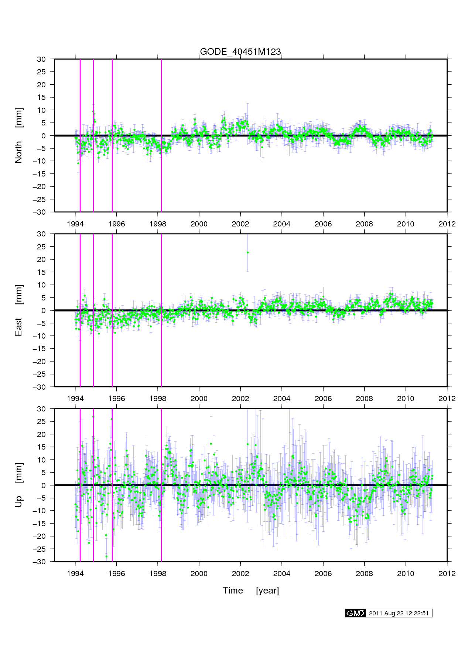
CORS Processing
This is from the most recent
“long term” plots of GODE

Slide 76
CORS Processing
An example of
how OSU processes
daily data (blue) into
“coordinate functions”
(red).
Coordinate functions
contain:
Linear terms
Polynomials (to 4)
Annual/Semi-Annual
Exponentials
Discontinuities

Slide 77
CORS Processing
An example of
how OSU processes
daily data (blue) into
“coordinate functions”
(red).

Slide 78
Thank you!

Slide 79
Questions?

Slide 80
Extra Slides

