Slide 1
How to Transition to the 2022 National Coordinate System Without Getting Left Behind
Modernizing the National Spatial Reference System
Dr. Dru Smith, NSRS Modernization Manager
NOAA’s National Geodetic Survey

Slide 2
Bottom Line, Up Front

Slide 3
B.L.U.F.
If you do geospatial work in the USA…
and you work in the National Spatial Reference System..
(that includes State Plane Coordinates!)
every product you’ve ever made…
  every survey…
  every map…
  every lidar point cloud…
  every image…
  every GNSS occupation…
  WILL have the wrong coordinates on it in 4 years.
  Let’s talk about what this means, why it is happening, and how it will affect things going forward

Slide 4
Part 1: The “what”
What is NGS?
What is the NSRS?
What is NOT the NSRS?

Slide 5
National Geodetic Survey
U.S. Government/Executive Branch
  Department of Commerce
    National Oceanic and Atmospheric Administration
      National Ocean Service
        National Geodetic Survey
The government’s oldest scientific agency
  Survey of the Coast (1807)
  Coast Survey (1836)
  Coast and Geodetic Survey (1878)
  National Geodetic Survey (1970)

Slide 6
NGS Mission
To define, maintain, and provide access to the National Spatial Reference System to meet our nation’s economic, social, and environmental needs

Slide 7
The National Spatial Reference System (NSRS)
Coordinate system
  Latitude, Longitude, Height, etc
  Projected coordinates too:
    UTM
    State Plane
    U.S. National Grid
Federal civilian agencies

Slide 8
NGS and the NSRS – legal context
OMB Circular A-16 (revised 2002)*:
  Requires all federal civilian geospatial agencies to use geodetic control
  Puts DOC/NOAA (=NGS) in charge of that control
  NGS has defined that control as the NSRS
  FGCS has issued requirements via FRNs to use the most recent components of the NSRS
    1989: NAD 83
    1993: NAVD 88
    2009: ASVD02, NMVD03, GUVD04
    2011: VIVD09
    2012: PRVD02
* Some of OMB A-16 was codified into law in the Geospatial Data Act of 2018 –
A full analysis of the implications of that act have not yet been performed

Slide 9
NGS and the NSRS – legal context
FGCS requirements do not apply to:
  Military/Intelligence federal agencies
  State and local governments
  Private individuals and companies
But these groups often do adopt all or part of the NSRS to be compatible with most federal geospatial data
  Could lead to mixing NSRS and non-NSRS information.
    Fine, but has to be done right.

Slide 10
So what is and is not the NSRS?
If NGS (or its predecessors*) did not make it, it is not in the NSRS**
* Survey of the Coast (1807-1836)
Coast Survey (1836-1878)
Coast and Geodetic Survey (1878-1970)
** The term “NSRS” was adopted in 1994, but today is used to encompasses all historic datums of NGS and its predecessors, though the FGCS regularly adopts the latest components

Slide 11
These are part of the NSRS
Hor Datums / Geometric Reference Frames | Vertical Datums | Great Lakes Datums | Geoid Models | Transformations / Conversions
USSD | NGVD 29 | IGLD55 | GEOID90 | NADCON
NAD 27 | NAVD 88 | IGLD85 | GEOID93 | VERTCON
NAD 83 | PRVD02 |  | ALASKA94
 | ASVD02 |  | GEOID96 | SPCS 27
 | NMVD03 |  | GEOID99 | SPCS 83
 | GUVD04 |  | GEOID03
 | VIVD09 |  | GEOID06
 |  |  | GEOID09
 |  |  | GEOID12(A,B)

Slide 12
These are not part of the NSRS
Hor Datums / Geometric Reference Frames | Vertical Datums | Great Lakes Datums | Geoid Models | Transformations / Conversions
WGS 84 | IHRS |  | OSU91A | CORPSCON
ITRF |  |  | EGM96 | Appendix B.6 of DMA TR 8350.2 (WGS 84)
IGS |  |  | EGM2008 | Oregon Coordinate Reference System
 |  |  |  | The Kansas Regional Coordinate System

Slide 13
Mixing NSRS and non-NSRS?
Just do it right
Right:
  The Oregon CRS has a mathematically defined relationship to the NSRS
Wrong:
  “WGS 84 is the same as NAD 83”
  “WGS 84 is the same as the ITRF”
  “You can get sub-meter accuracy using WGS-84”
    Such statements gloss over critical facts about history, accuracy and application

Slide 14
Accuracy
Consider your accuracy needs
  3 Meters?
    Then WGS 84 is NAD 83
    Global 14 parameter transformations will suffice
  3 Decimeters?
    Then NAD 83(2011) is NAD 83(NSRS2007)
      But NAD 83(1986) is not the same as NAD 83(HARN)
    NADCON will suffice as a transformation
  3 Centimeters?
    Every detail matters

Slide 15
Part 2: The “why”
Why is NGS modernizing the NSRS?
(AKA: Why are you doing this to us?)

Slide 16
Drivers of change
The current NSRS has issues:
  Non-geocentricity of ellipsoid
  Outdated geoid as the zero height surface
  Does not account for time change
  Significant dependence upon passive marks
More details available in Appendix A of the proceedings of the 2010 Geospatial Summit:
  https://www.ngs.noaa.gov/library/pdfs/SP_NOS_NGS_10.pdf
Fixing these will cause a “jump”
Fixing this will cause a “drift”

Slide 17
Non-geocentricity
Earth’s Surface
h_{NAD83}
h_{ITRF2014}
φ_{NAD83} – φ_{ITRF2014}
λ_{NAD83} – λ_{ITRF2014}
h_{NAD83} – h_{ITRF2014}
all vary
smoothly by latitude
and longitude
ITRF2014 origin
same
GRS-80
ellipsoid
~2.2 m
NAD 83 origin

Slide 18
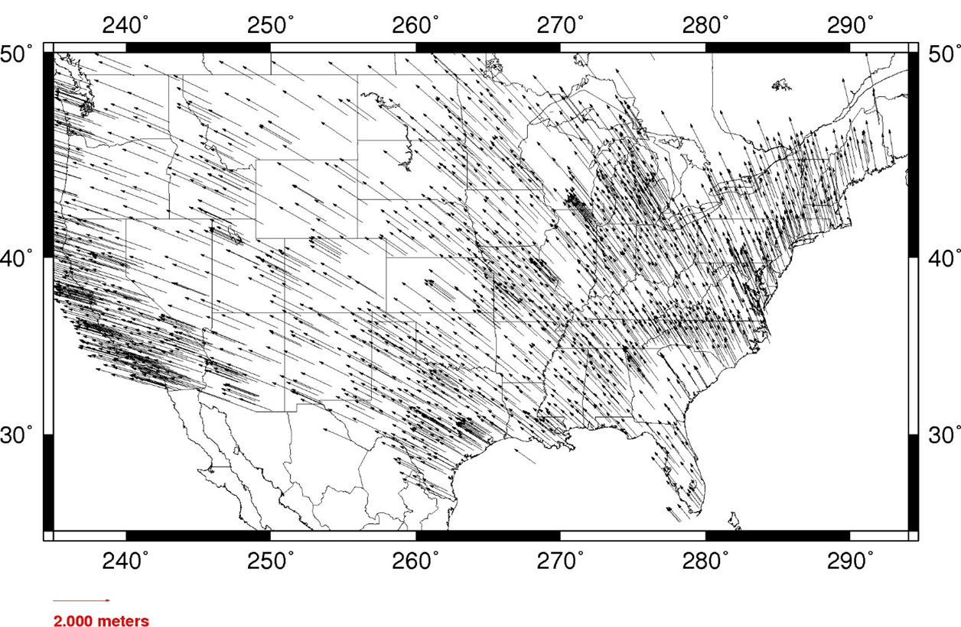
The “jump”: Instantaneous change based on fixing the non-geocentricity of NAD 83

Slide 19
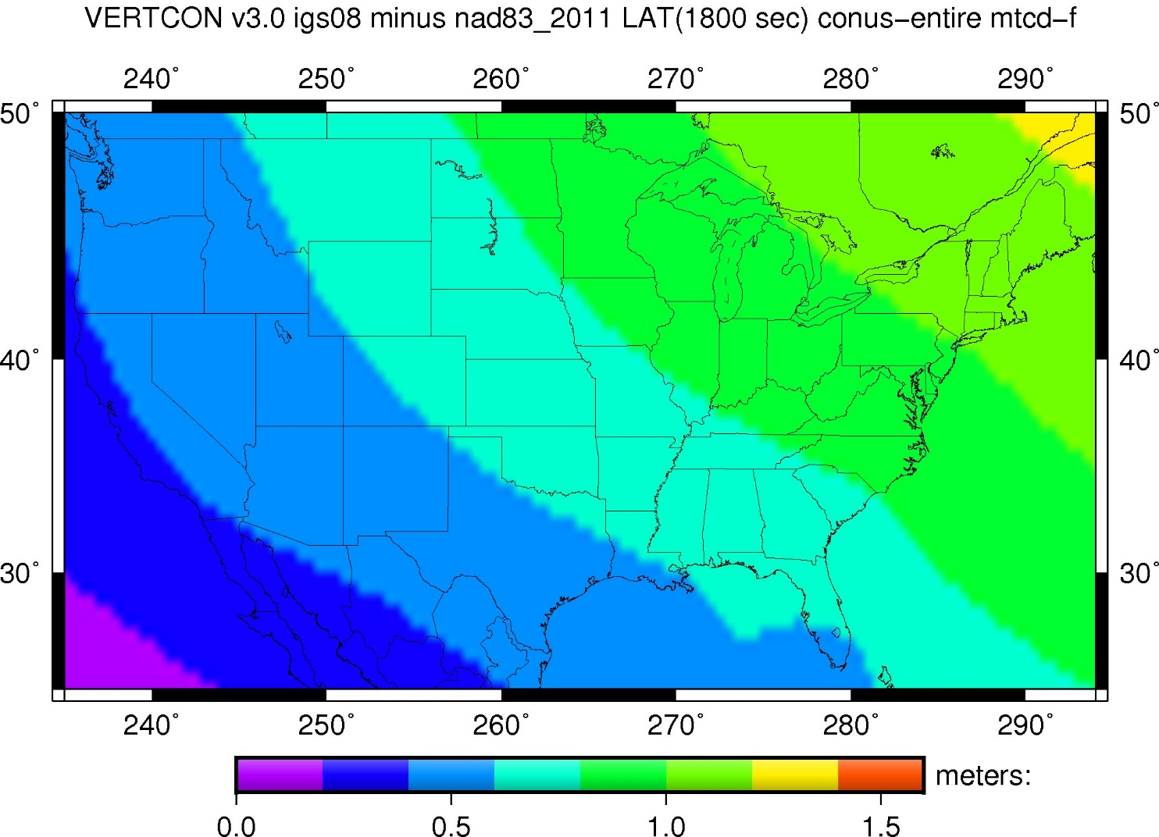
The “jump” : Latitude

Slide 20
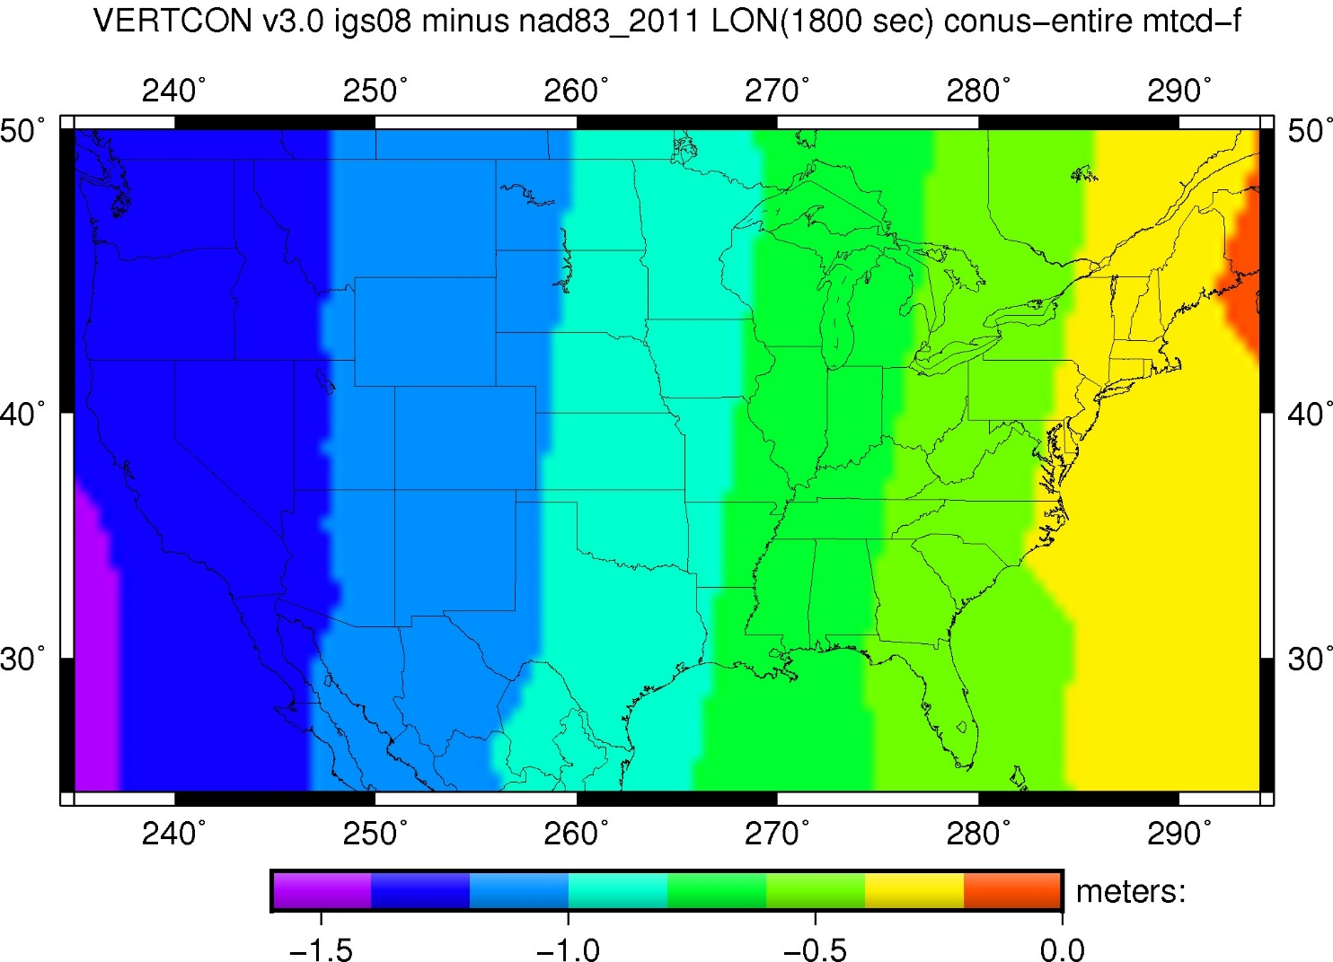
The “jump” : Longitude

Slide 21
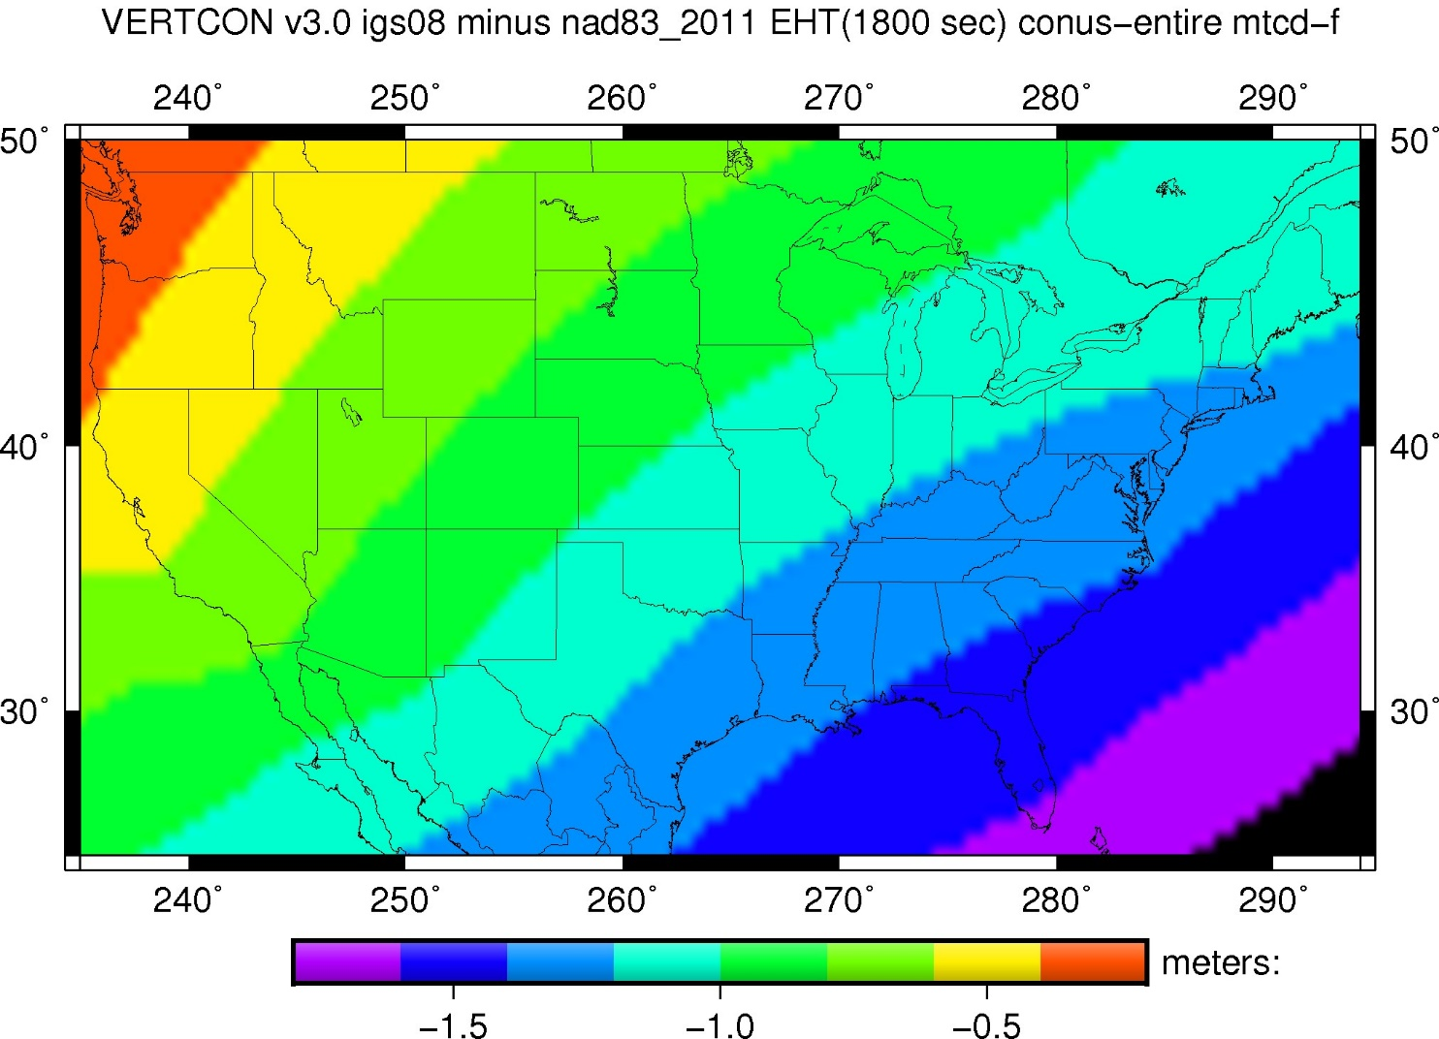
The “jump” : Ellipsoid Height

Slide 22
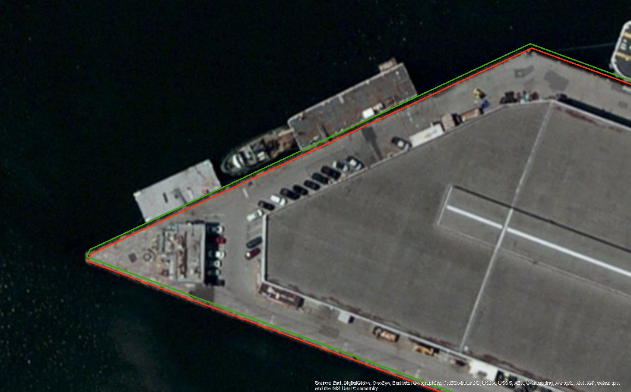
Everything must shift!

Slide 23
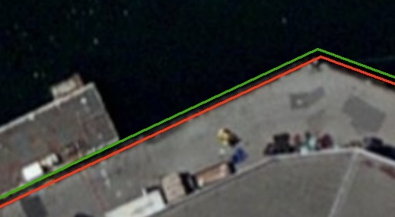
Everything must shift!
RED: NAD 83 coastline against NAD 83 imagery
GREEN: Coastline shifted into NATRF2022 but
the imagery remains on NAD 83
Shifts ~1 meter

Slide 24
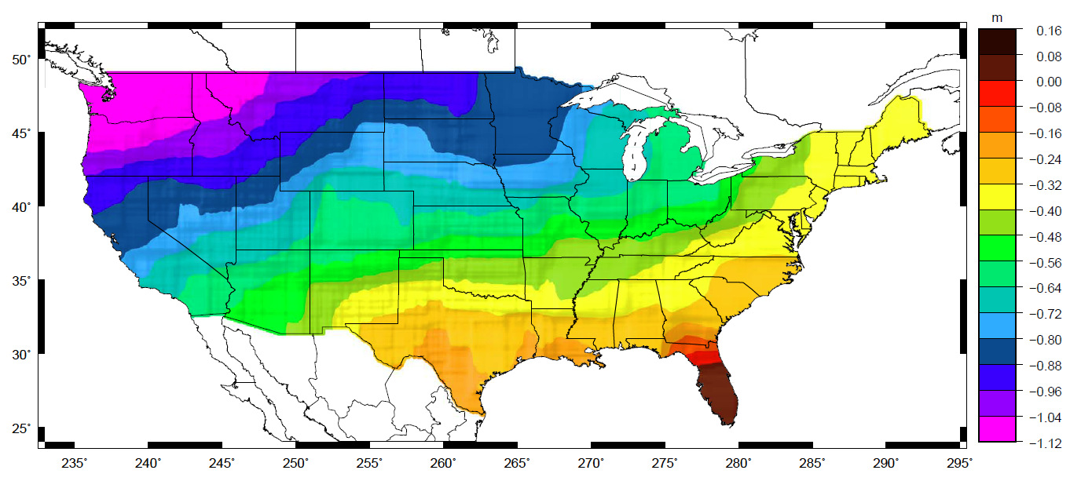
The “jump”: Instantaneous change based on fixing the zero-height surface of NAVD88

Slide 25
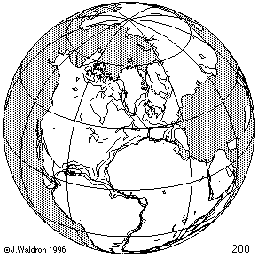
Time Changes - Horizontal
Watch the grid!

Slide 26
Time-Dependency
The ITRF2014 frame is not beholden to any tectonic plate
  Thus the four plates with U.S. populations will have time-dependent latitudes/longitudes in ITRF2014:
    North America: 1-3 cm / year (CONUS, Alaska)
    Pacific: 7-8 cm / year (Hawaii, AS)
    Caribbean: 1-2 cm / year (PR, USVI)
    Mariana: 1-4 cm / year (Guam, CNMI)

Slide 27
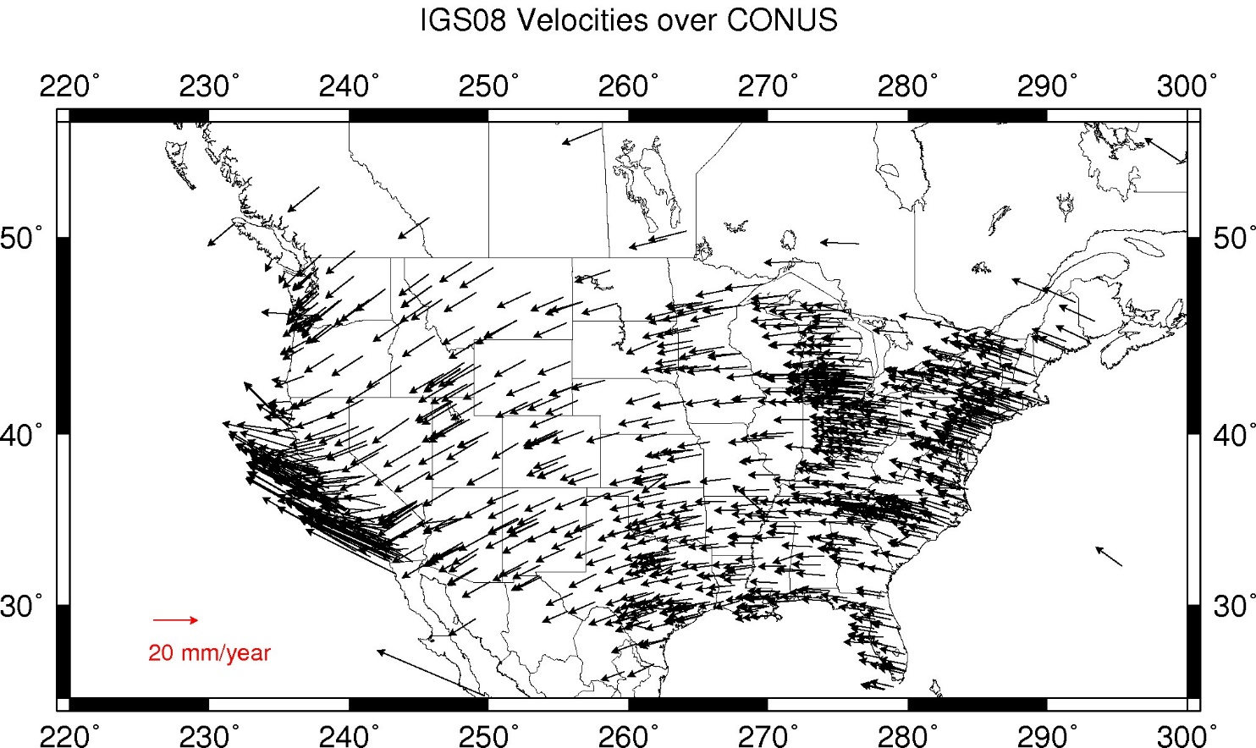
The “drift”: Annual change to ITRF2014 coordinates

Slide 28
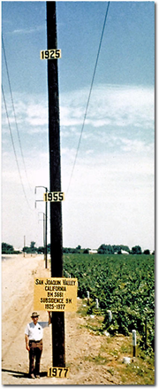
Time Changes - Vertical
Crust uplifts and subsides
  Wide variety of spatial and temporal scales
  GIA is uplifting much of the Northeast corner of CONUS
  Agricultural water withdrawal subsides the crust (see left)
  Etc

Slide 29
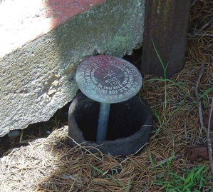
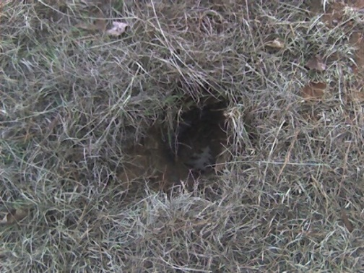
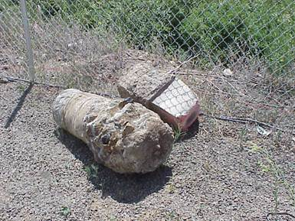
Passive Control
The NSRS suffers from use of passive control marks that:
  Are almost never re-checked for movement
  Disappear by the thousands every year
  Are not funded for replacement
  Are not necessarily in convenient places
  Don’t exist in most of Alaska

Slide 30
Part 3a: The “how”
How is NGS modernizing the NSRS?

Slide 31
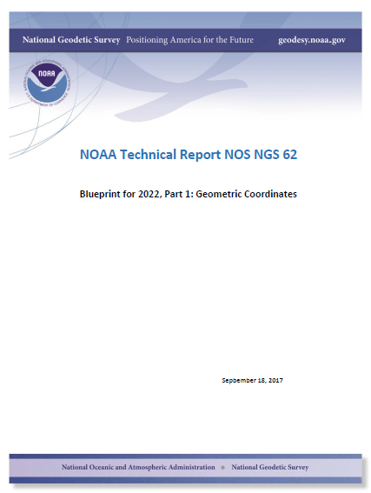
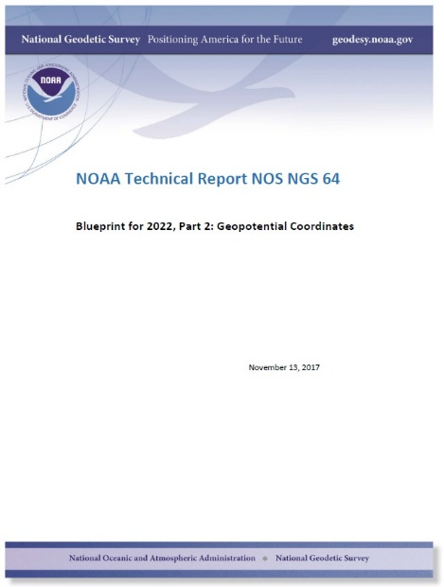
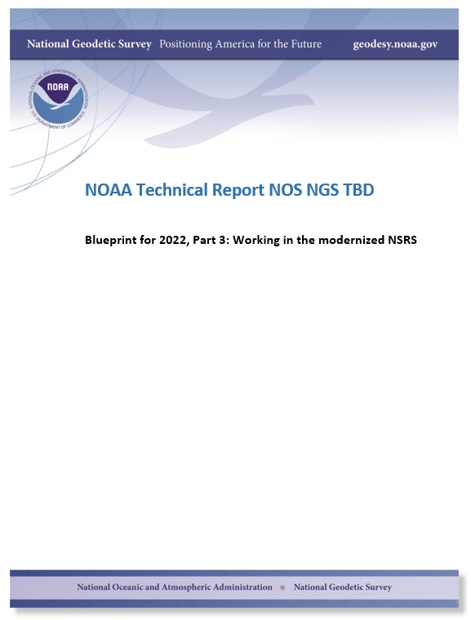
Modernizing the NSRS
The “blueprint” documents: Your best source for information
Geometric:
Sep 2017
Geopotential:
Nov 2017
Working in the
modernized NSRS:
May 2019

Slide 32
“Modernizing the NSRS” means…
Replacing NAD 83
Replacing NAVD 88
Re-inventing Bluebooking
Improving the Geodetic Toolkit
Better Surveying Methodologies

Slide 33
Replacing the NAD 83’s
The Old:
NAD 83(2011)
NAD 83(PA11)
NAD 83(MA11)
The New:
The North American Terrestrial Reference Frame of 2022
(NATRF2022)
The Caribbean Terrestrial Reference Frame of 2022
(CATRF2022)
The Pacific Terrestrial Reference Frame of 2022
(PATRF2022)
The Mariana Terrestrial Reference Frame of 2022
(MATRF2022)

Slide 34
Replacing the NAD 83’s
Three plate-(pseudo)fixed frames will be replaced with four plate-fixed reference frames
  N. Amer., Pacific, Mariana, Caribbean(new!)
Fixed: NAD 83 isn’t geocentric
Fixed: NAD 83 doesn’t rotate properly with its plates
Method: Define each of the 4 new frames equal to ITRF2014 @ 2020
  Define each frame’s movement by a plate rotation only
  Put another way: “The frame rotates so your coordinates don’t have to”

Slide 35
35
The relation of five global reference
frames through time.
NATRF2022
MATRF2022
Rotations are not to scale
CATRF2022
Rotation of North American Plate
PATRF2022
Rotation of Pacific Plate
ITRF2014 frame
ITRF2014 frame through time
ITRF2014 frame
Rotation of Caribbean Plate
PATRF2022
CATRF2022
Rotation of Mariana Plate
NATRF2022
Time “t ” when
all four TRFs and
ITRF2014 are identical.
(2020.0)
0
MATRF2022
t=t - Δt
(“the past”)
t=t + Δt
(“the future”)
0
0

Slide 36

The “drift”: Annual change to ITRF2014 coordinates

Slide 37
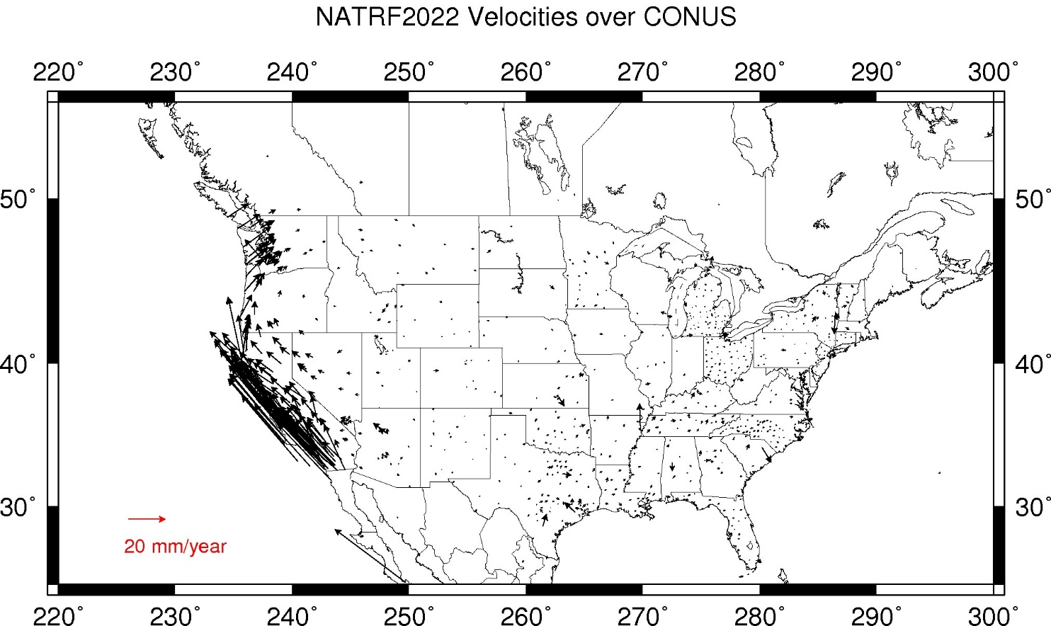
The “drift”: Annual change to NATRF2014 coordinates

Slide 38
What does it mean to provide time-dependent coordinates in 5 frames?

Slide 39
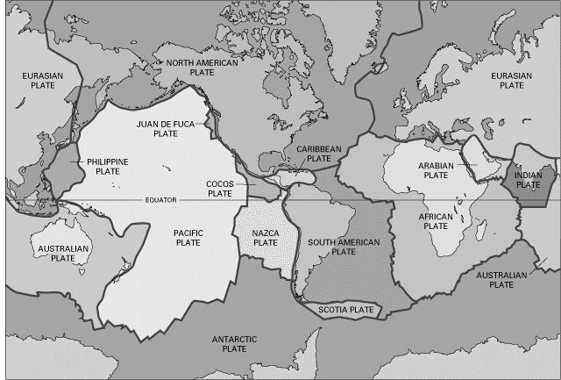
BSMK (North Dakota)

Slide 40
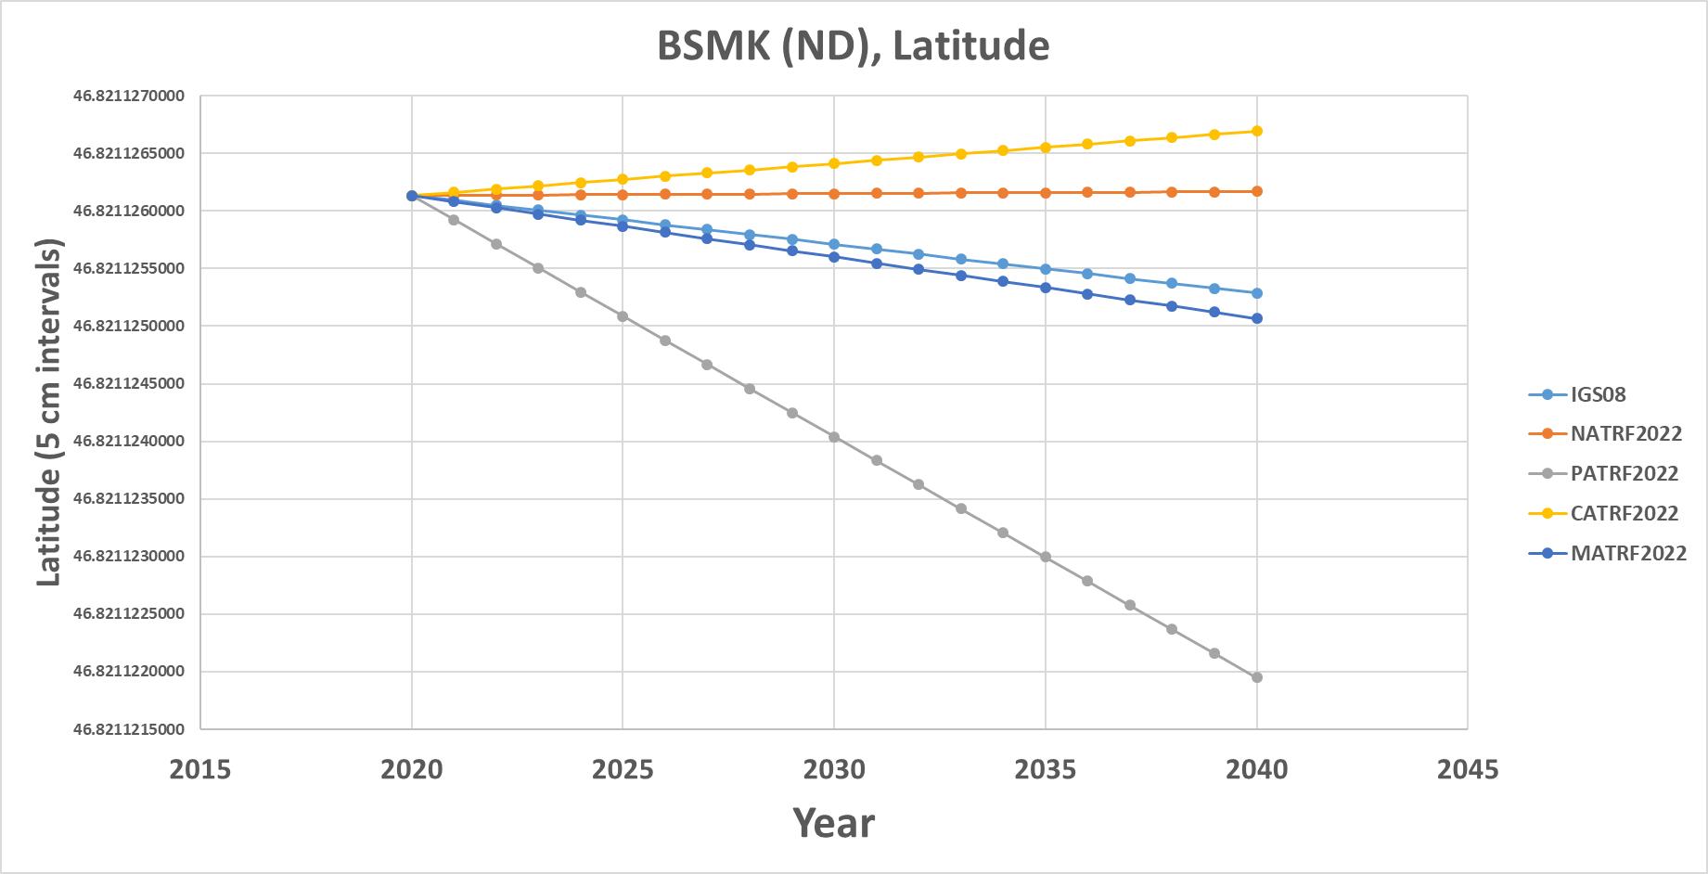
BSMK (North Dakota)
As per NGS policy decision circa 2018:
t₀ = 2020.0
NATRF2022 Latitude is CONSTANT over time

Slide 41
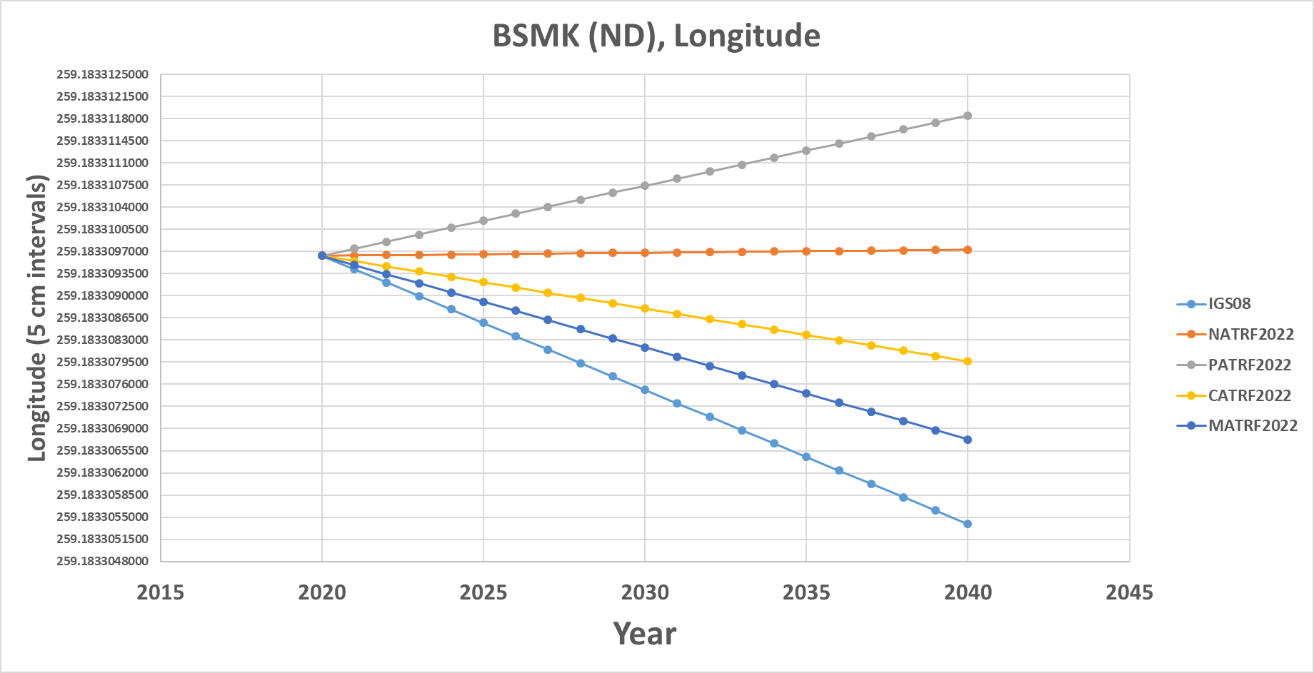
BSMK (North Dakota)
NATRF2022 Longitude is constant over time

Slide 42
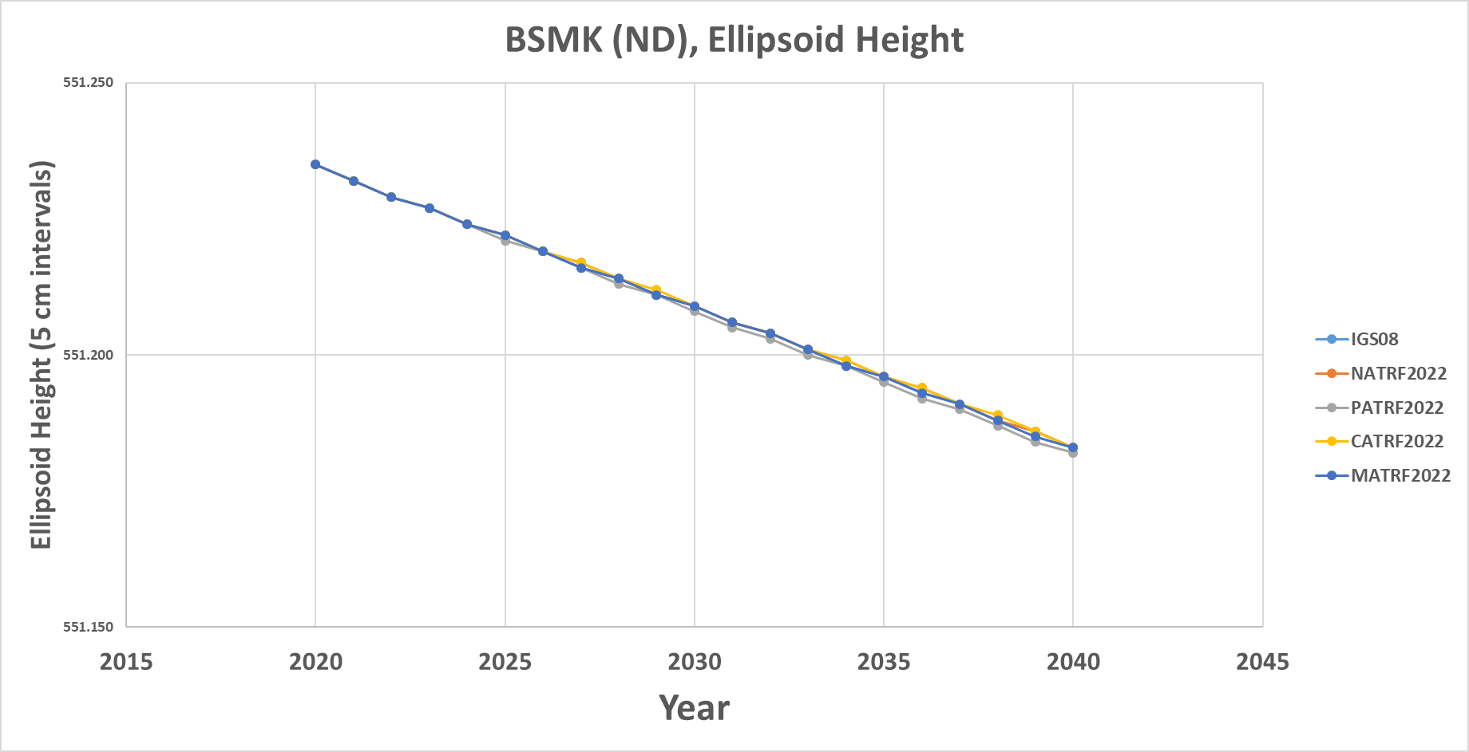
BSMK (North Dakota)
No matter WHAT frame, the ellipsoid height is dropping over time

Slide 43
PIN1 (S. California)

Slide 44
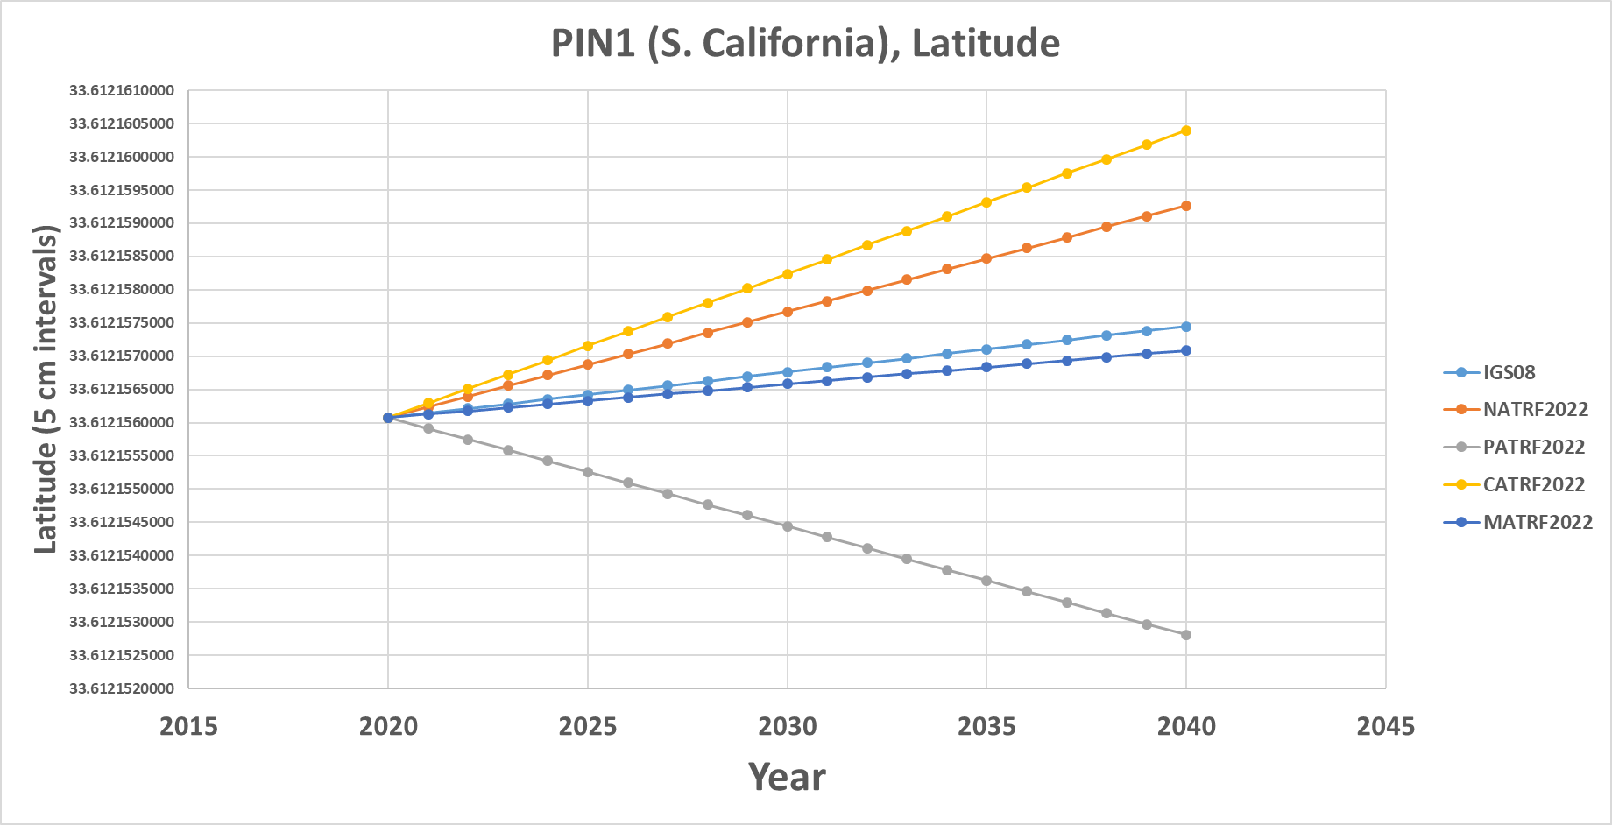
PIN1 (S. California)
Latitude in NATRF2022 and PATRF2022 change over time

Slide 45
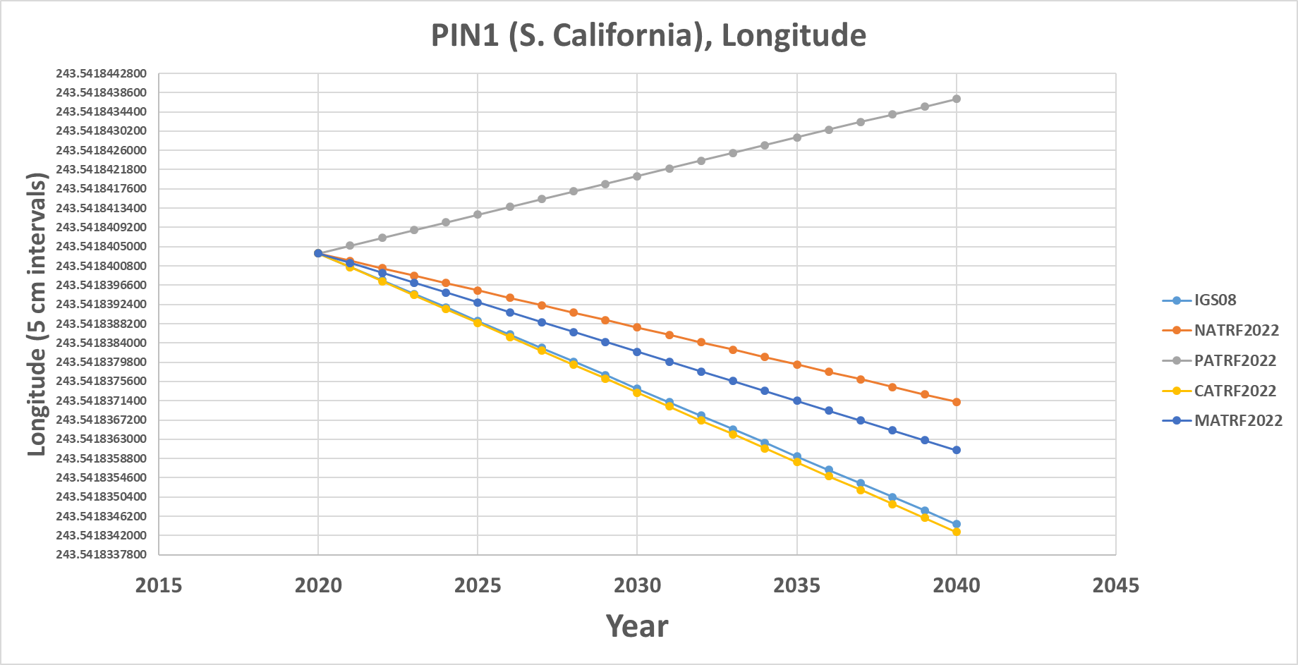
PIN1 (S. California)
Longitude in NATRF2022 and PATRF2022 change over time

Slide 46
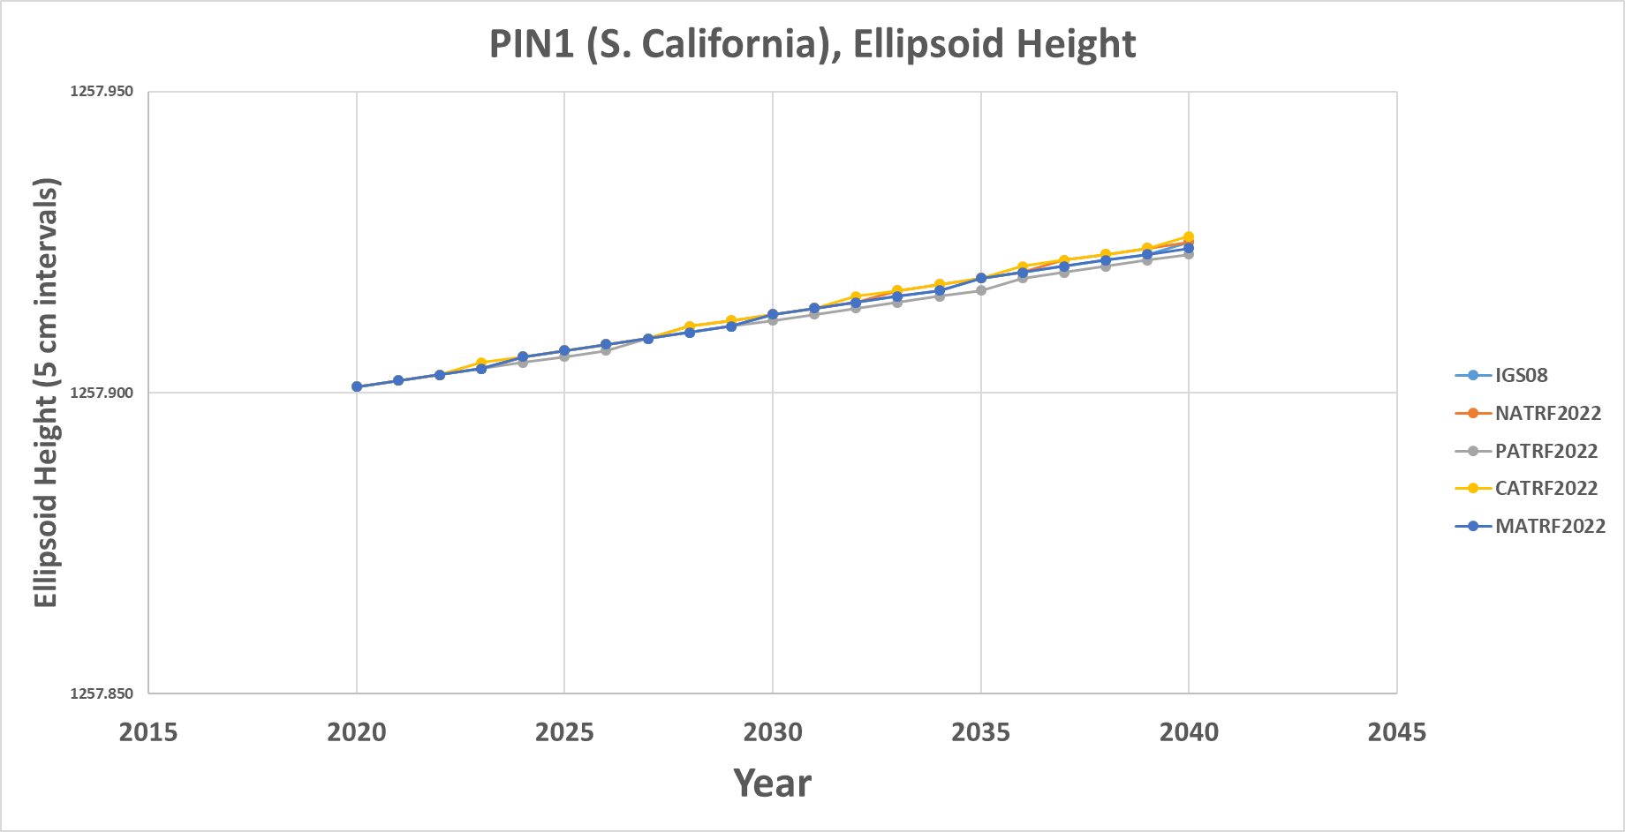
PIN1 (S. California)
No matter WHAT frame, the ellipsoid height is rising over time

Slide 47
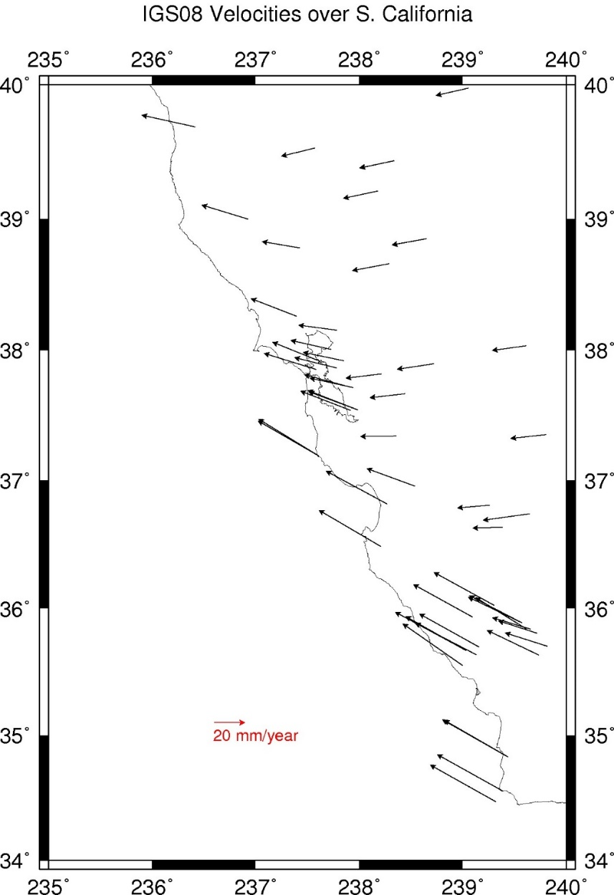
Velocities (ITRF2014)

Slide 48
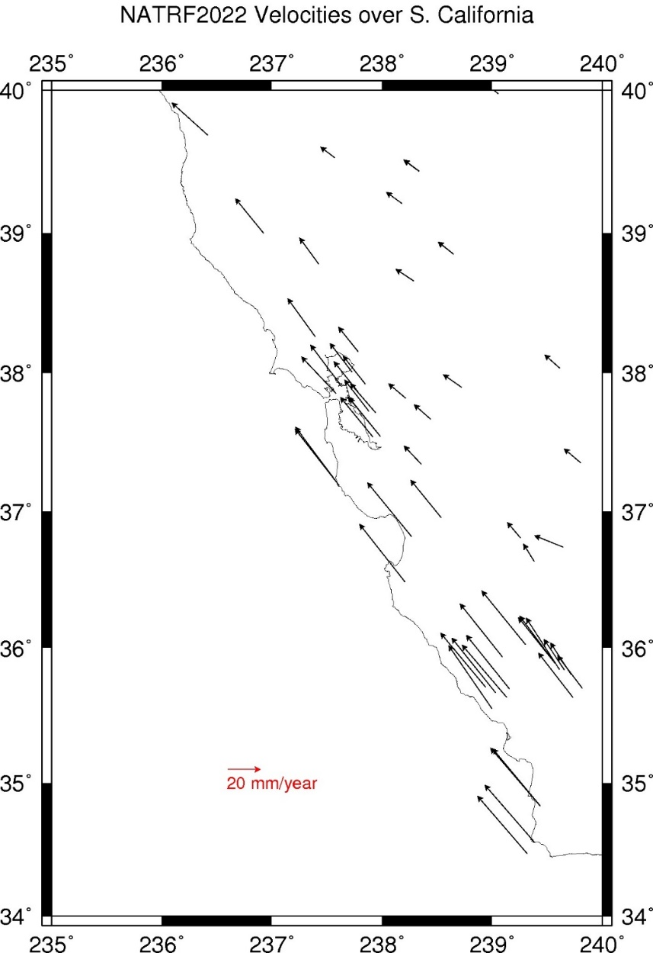
Velocities (NATRF2022)

Slide 49
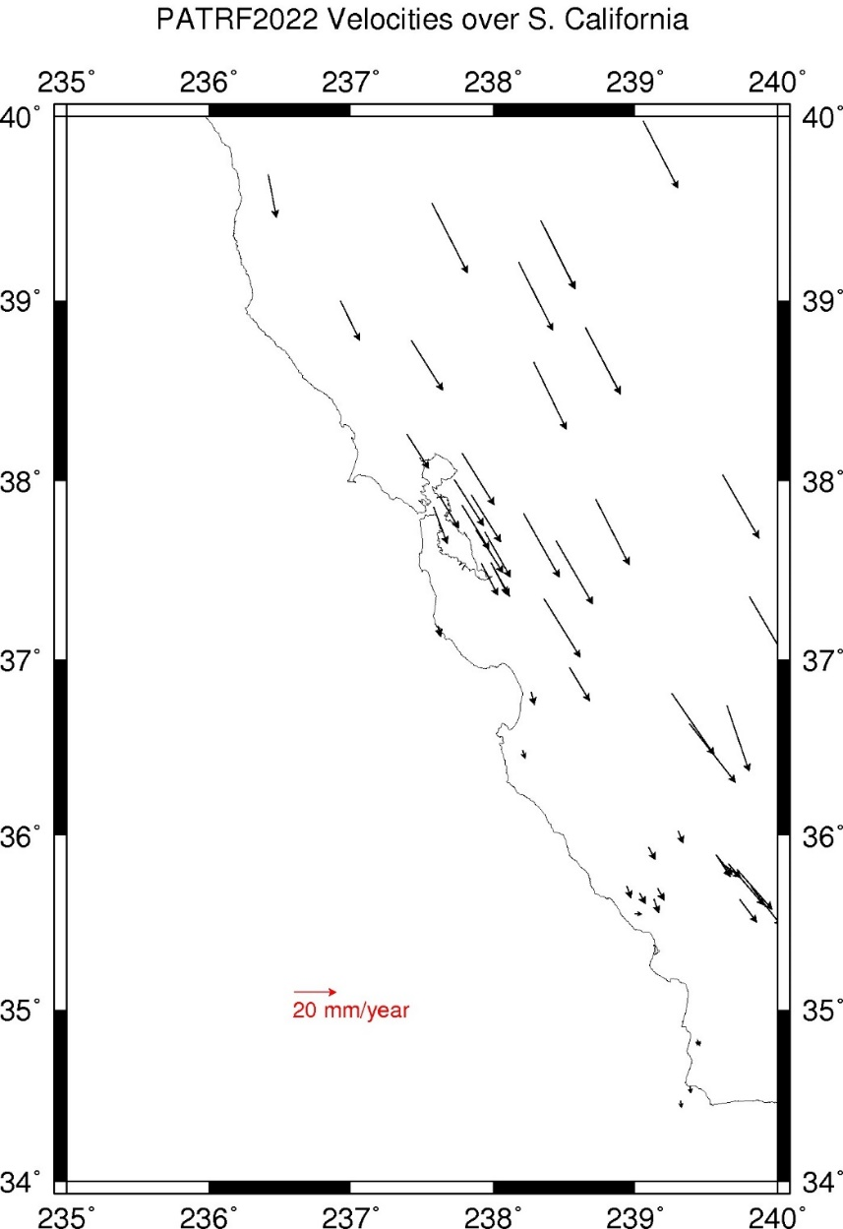
Velocities (PATRF2022)

Slide 50
Intra-Frame Velocity Model
A model of all residual velocities, after removal of tectonic rotation:
  Horizontal residual motion
  Total vertical motion (ellipsoid heights)
Given t₁ and t₂, compute Δφ, Δλ, Δh at any point, accounting for drifts, earthquakes, etc. (all motions)
  Replaces / Improves upon the old HTDP program of NGS
Will likely be built upon CORS data, geodynamic models and satellite SAR repeat images

Slide 51
Orthometric Heights
(“Sea Level Heights”) and other gravity-related quantities

Slide 52
Replacing NAVD 88
  The Old:
  NAVD 88
  PRVD 02
  VIVD09
  ASVD02
  NMVD03
  GUVD04
  IGLD 85
  IGSN71
  GEOID12B
  DEFLEC12B
Orthometric
Heights
  The New:
  The North American-Pacific Geopotential Datum of 2022 (NAPGD2022)
  - Will include GEOID2022
Normal
Orthometric
Heights
Dynamic
Heights
Gravity
Geoid
Undulations
Deflections of
the Vertical

Slide 53
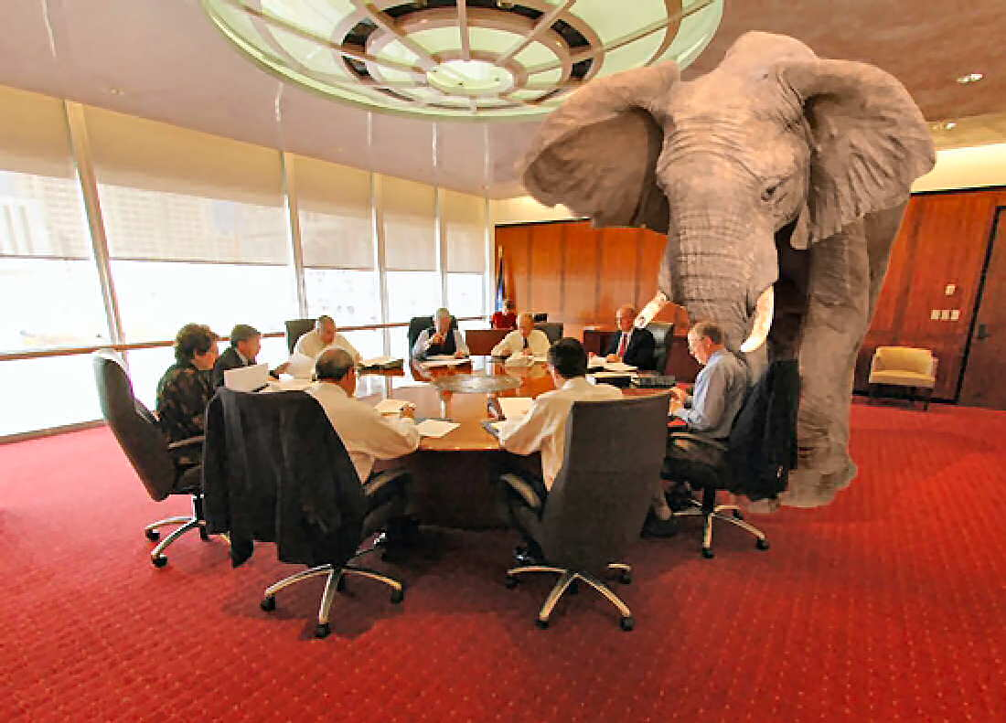
Geopotential Basics
Why isn’t this a vertical datum?
  Because it contains more than heights
    And therefore NGS wants to be accurate in its name

Slide 54
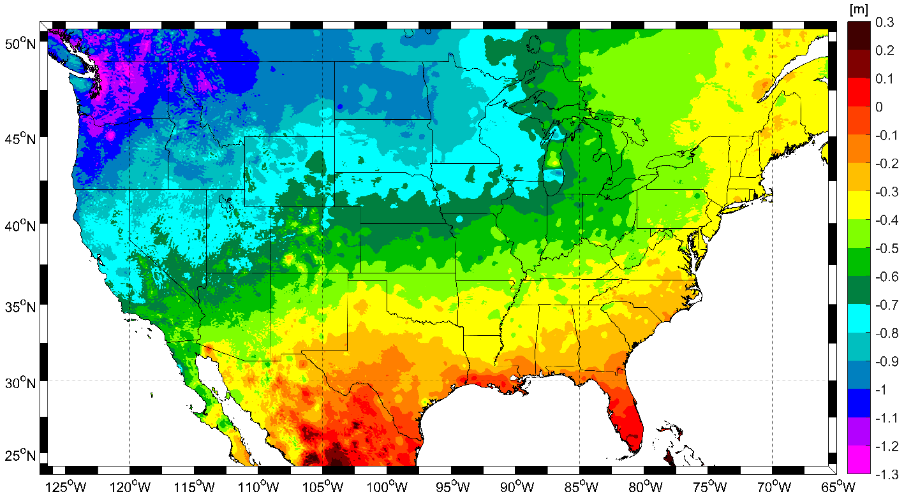
Expected changes to orthometric heights

Slide 55
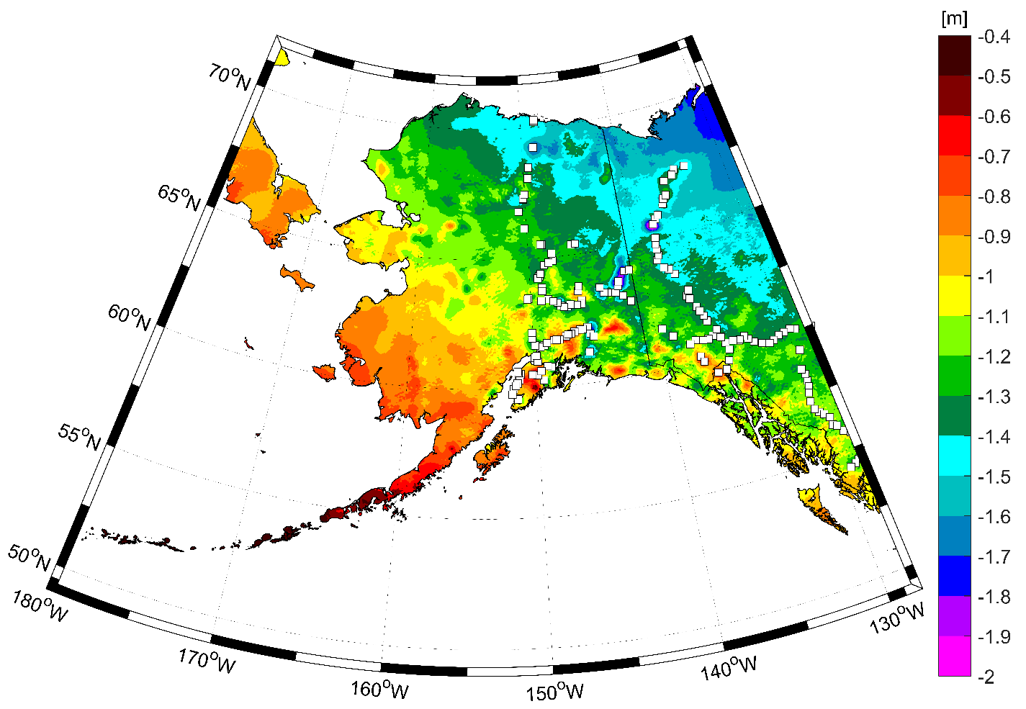
Expected changes to orthometric heights

Slide 56
Definitional Relationship
$H_{NAPGD2022}(t)≡h_{∗TRF2022}(t)−N_{GEOID2022}(t)$
Time-dependent ellipsoid heights
come from time-dependent
CORS coordinates which serve as control for your time-dependent GNSS survey.
They will be modeled in the IFVM
Time-dependent geoid undulations
are modeled in the dynamic component of GEOID2022 (“DGEOID2022”), which will come from the geoid monitoring service, or GeMS.

Slide 57
Geoid Monitoring Service (GeMS)
Goal: Track all changes to the geoid which would prevent 1 cm accuracy
Three major aspects:
  Secular Shape: Hudson Bay
  Episodic Shape: Massive Earthquakes
  Geoid relation to Sea level: Global Sea Level Change

Slide 58
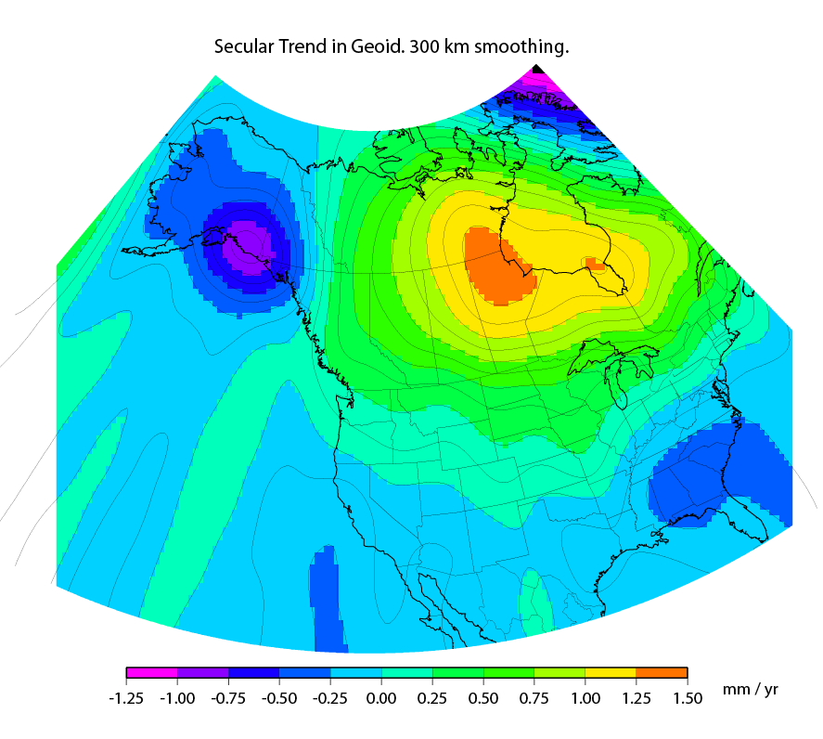
Secular Mass Movement

Slide 59
High Resolution Products
GEOID2022
  Official converter of *TRF2022 ellipsoid heights into NAPGD2022 orthometric heights
DEFLEC2022
  Surface deflections of the vertical in N/S and E/W
GRAV2022
  Surface acceleration of gravity
DEM2022
  Official DEM used in creation of all above products
All will be 1 x 1 arcminute grids
All will cover three finite regions of the globe
All will have a static and dynamic component
  Dynamic surface gravity and DEM not expected to be ready by 2022

Slide 60
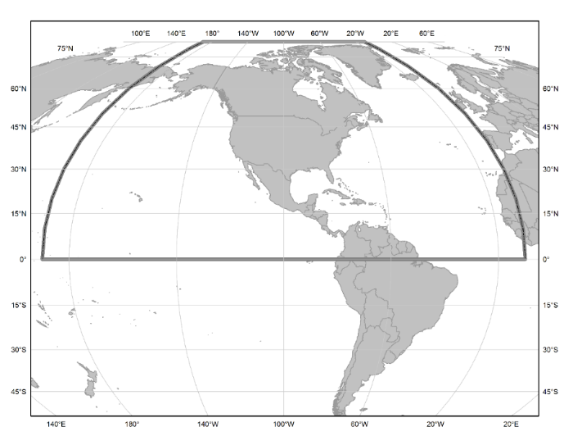
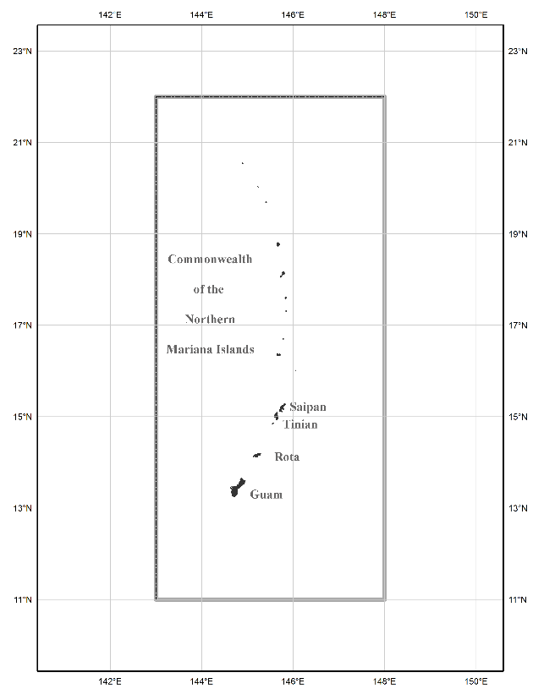
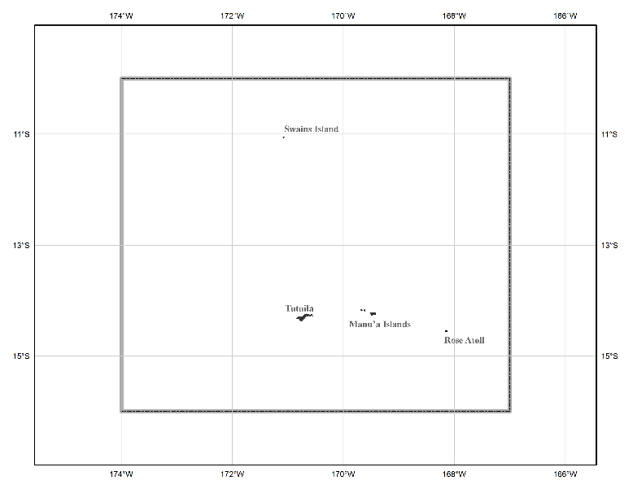
Three gridded regions
“North American region”
¼ of the Earth
“Guam/CNMI region”
“American Samoa region”

Slide 61
Converting NAD 83 and NAVD 88 geospatial data into
NATRF2022/PATRF2022/CATRF2022/MATRF2022 and
NAPGD2022

Slide 62
Two options: NCAT and VDatum
Currently semi-independent programs
Being merged behind the scenes when calling identical routines, such as “NADCON 5.0”
  NCAT will remain “purely geodetic”
  VDatum will be “NCAT plus tidal datums”
Both will get “VERTCON 3.0” in late 2018
Both will run in 3 modes:
  Web services, Browser interactive, Downloadable

Slide 63
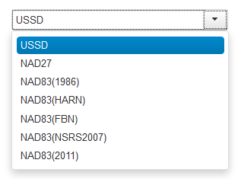
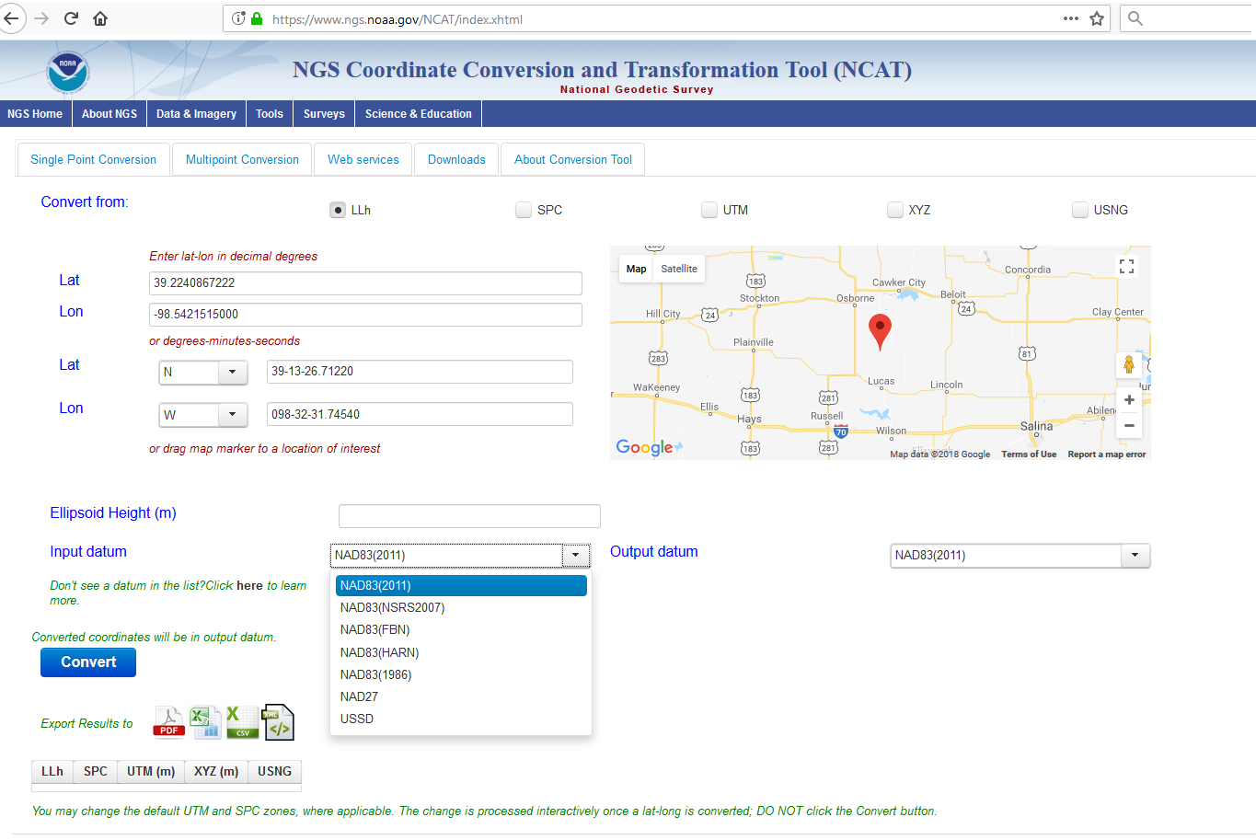
NGS Coordinate Conversion and Transformation Tool (NCAT)
www.ngs.noaa.gov/NCAT/

Slide 64
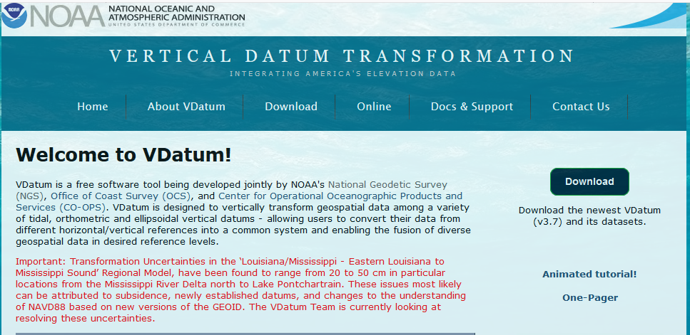
VDatum
vdatum.noaa.gov

Slide 65
Updating OPUS-Projects
OPUS-Projects is NGS’s workhorse survey adjustment suite
Currently 2 hour GPS sessions only
End of 2018: GPS + RTK/N
In 2019-2020: Leveling
Future: Multi-constellation GNSS, Classical, Gravity

Slide 66
Coming up in 2019…
NGS will build “alpha” versions of all aspects of the 2022 modernization, including:
    Intra-Frame Velocity Model
    Passive mark “datasheets” drawn from a completely new database of re-processed GPS data to show time-dependent coordinates on passive marks
    CORS/OPUS running in the four TRFs
    State Plane Coordinate system of 2022
After alpha testing, these will be publicly available in beta form for testing.
OPUS-Projects with RTK/N
A three-country (USA/Mexico/Canada) produced single geoid model
A new surface gravity interpolation tool

Slide 67
Part 3b: The “how”
How can I transition to the modernized NSRS without getting left behind?

Slide 68
How to transition to 2022…
Embrace the dynamic planet upon which you work
Re-establish coordinates on passive marks every time you use them!
Use GPS in every project!
Rely upon the CORS
  They are the only primary access point to the NSRS after 2022!
  I promise you, the WILL be much better before 2022
    My job kinda depends upon it…

Slide 69
How to transition to 2022 (cont.)
Use whatever frame is best for you!
  ITRF if you can live with changing coordinates
  NATRF2022/etc if you need stability and don’t live near a deformation zone
Embrace the idea of RTN Alignment to the NSRS
Use OPUS, or not, but just submit those projects!
  NGS will provide QC on anything submitted
  It’ll go in the database for permanent archive and use by others!
Bring all of your old data forward using NGS tools (NCAT and/or Vdatum)

Slide 70
Summary
All aspects of the NSRS will change in 2022!
Everything comes from GNSS
  OPUS will provide everything in 5 frames (ITRF2014 + TRFs)
  OPUS will provide orthometric heights and other geopotential values
Look for new manuals for leveling and GPS-derived heights in the next year

Slide 71
Thank you!

Slide 72
Questions?

Slide 73
Extra Slides

Slide 74

Velocities (NAD 83(2011))

