Slide 1
Modernizing the National Spatial Reference System
Dru Smith
NSRS Modernization Manager
NOAA’s National Geodetic Survey

Slide 2
Outline
BLUF
What?
Why?
How?

Slide 3
Bottom Line, Up Front
If you do geospatial work in the USA…
and you work in the National Spatial Reference System..
every product you’ve ever made…
every survey…
every map…
every lidar point cloud…
every image…
every DEM…
WILL have the wrong coordinates on it in 4 years.
Let’s talk about what this means, why it is happening, and how it will affect things going forward

Slide 4
What…
…is NGS?
…is the NSRS?
…is not the NSRS?

Slide 5
National Geodetic Survey
U.S. Government/Executive Branch
Department of Commerce
National Oceanic and Atmospheric Administration
National Ocean Service
National Geodetic Survey
The government’s oldest scientific agency
Survey of the Coast (1807)
Coast Survey (1836)
Coast and Geodetic Survey (1878)
National Geodetic Survey (1970)

Slide 6
NGS mission
To define, maintain, and provide access to the National Spatial Reference System to meet our nation’s economic, social, and environmental needs
Notes:
Our mission statement is widely available on various NGS web pages. But how did we get here?

Slide 7
The National Spatial Reference System (NSRS)
Coordinate system
Latitude, Longitude, Height, etc
Projected coordinates too:
UTM
State Plane
U.S. National Grid
Federal civilian agencies – mandated
Lots of other users too

Slide 8
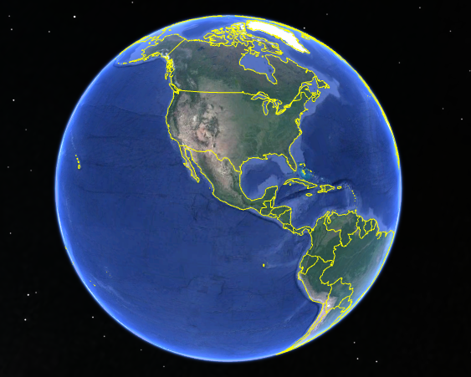
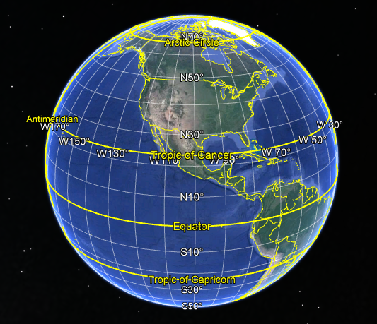

Slide 9
NGS and the NSRS – legal context
OMB A-16:
Requires all federal civilian geospatial agencies to use geodetic control
Puts DOC/NOAA (=NGS) in charge of that control
NGS has defined that control as the NSRS
FGCS has issued requirements via FRNs to use the most recent components of the NSRS
1989: NAD 83
1993: NAVD 88
2009: ASVD02, NMVD03, GUVD04
2011: VIVD09
2012: PRVD02

Slide 10
NGS and the NSRS – legal context
FGCS requirements do not apply to:
Military/Intelligence federal agencies
State and local governments
Private individuals and companies
But these groups often do adopt all or part of the NSRS to be compatible with most federal geospatial data
Could lead to mixing NSRS and non-NSRS information.
Fine, but has to be done right.

Slide 11
So what is and is not the NSRS?
If NGS (or its predecessors*) did not make it, it is not in the NSRS**
* Survey of the Coast (1807-1836)
Coast Survey (1836-1878)
Coast and Geodetic Survey (1878-1970)
** The term “NSRS” was adopted in 1994, but today is used to encompasses all historic datums of NGS and its predecessors, though the FGCS regularly adopts the latest components

Slide 12
These are part of the NSRS
Hor Datums / Geometric Reference Frames | Vertical Datums | Great Lakes Datums | Geoid Models | Transformations / Conversions
USSD | NGVD 29 | IGLD55 | GEOID90 | NADCON
NAD 27 | NAVD 88 | IGLD85 | GEOID93 | VERTCON
NAD 83 | PRVD02 |  | ALASKA94
 | ASVD02 |  | GEOID96 | SPCS 27
 | NMVD03 |  | GEOID99 | SPCS 83
 | GUVD04 |  | GEOID03
 | VIVD09 |  | GEOID06
 |  |  | GEOID09
 |  |  | GEOID12(A,B)
These are select entries, not a complete list

Slide 13
These are not part of the NSRS
Hor Datums / Geometric Reference Frames | Vertical Datums | Great Lakes Datums | Geoid Models | Transformations / Conversions
WGS 84 | IHRS |  | OSU91A | CORPSCON
ITRF |  |  | EGM96 | Appendix B.6 of DMA TR 8350.2 (WGS 84)
IGS |  |  | EGM2008 | Oregon Coordinate Reference System
 |  |  |  | The Kansas Regional Coordinate System
These are select entries, not a complete list

Slide 14
Mixing NSRS and non-NSRS?
Just do it right
Right:
The Oregon CRS has a mathematically defined relationship to the NSRS
Wrong:
“WGS 84 is the same as NAD 83”
“WGS 84 is the same as the ITRF”
“Sub-meter accuracy is possible using WGS 84”
Such statements gloss over critical facts about history, accuracy and application

Slide 15
Accuracy
Consider your users’ accuracy needs
3 Meters?
Then WGS 84 is NAD 83
Global 14 parameter transformations will suffice
3 Decimeters?
Then NAD 83(2011) is NAD 83(NSRS2007)
But NAD 83(1986) is not the same as NAD 83(HARN)
NADCON will suffice as a transformation
3 Centimeters?
Every detail matters

Slide 16
Why…
…is NGS modernizing the NSRS?

Slide 17
Drivers of change
The current NSRS has issues:
Non-geocentricity of ellipsoid
Outdated geoid as the zero height surface
Does not account for time change
These first 3 are larger than available positioning accuracy today and can not be “hidden in the noise”
Significant dependence upon passive marks
More details available in Appendix A of the proceedings of the 2010 Geospatial Summit:
https://www.ngs.noaa.gov/library/pdfs/SP_NOS_NGS_10.pdf

Slide 18
NAD 83’s non-geocentricity
Earth’s Surface
h_{NAD83}
φ_{NAD83} – φ_{IGS14}
λ_{NAD83} – λ_{IGS14}
h_{NAD83} – h_{IGS14}
all vary
smoothly by latitude
and longitude
h_{IGS14}
IGS14 origin
same
GRS-80
ellipsoid
~2.2 m
NAD 83 origin

Slide 19
Effect upon latitude/longitude

Slide 20
Non-Geocentricity: Latitude

Slide 21
Non-Geocentricity: Longitude

Slide 22
Non-Geocentricity: Ellipsoid Height

Slide 23
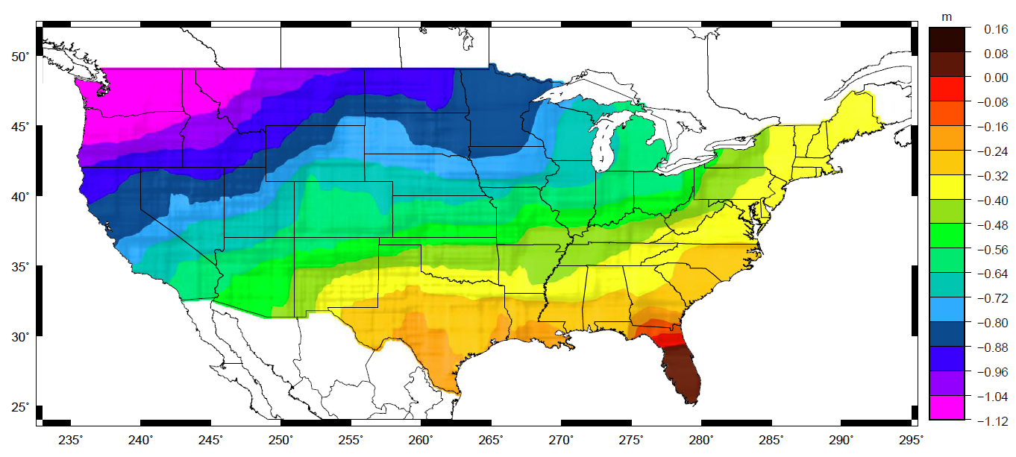
Outdated geoid
Approximate level of geoid mismatch known to exist in the NAVD 88 zero surface:

Slide 24
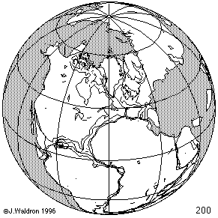
Time Changes - Horizontal
Watch the grid!

Slide 25
Time-Dependency
The IGS14 frame is not beholden to any tectonic plate
Thus the four plates with U.S. populations will have time-dependent latitudes/longitudes:
North America: 1-3 cm / year (CONUS, Alaska)
Pacific: 7-8 cm / year (Hawaii, AS)
Caribbean: 1-2 cm / year (PR, USVI)
Mariana: 1-4 cm / year (Guam, CNMI)

Slide 26
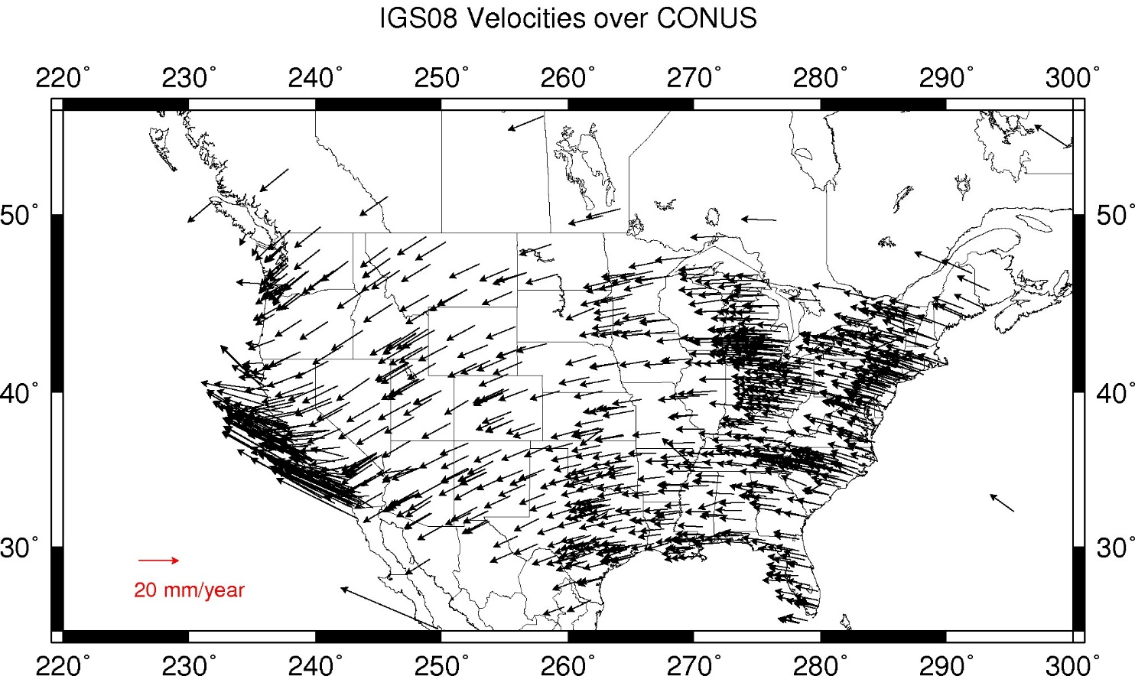
Change to lat/lon every year

Slide 27
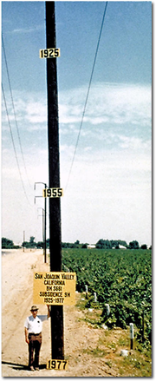
Time Changes - Vertical
Crust uplifts and subsides
Wide variety of spatial and temporal scales
GIA is uplifting much of the North half of CONUS
Agricultural water withdrawal subsides the crust (see left)
Etc

Slide 28
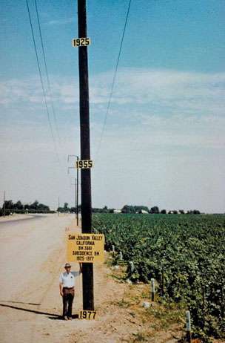
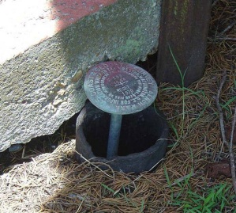
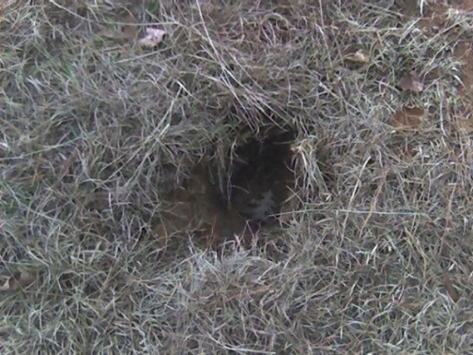
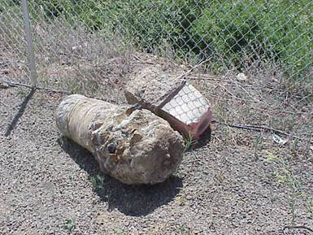
Passive Control
The NSRS suffers from use of passive control marks that:
Are almost never re-checked for movement
Disappear by the thousands every year
Are not funded for replacement
Are not necessarily in convenient places
Don’t exist in most of Alaska
PID: EZ0840

Slide 29
How…
…will NGS modernize the NSRS?
…will this affect me?

Slide 30
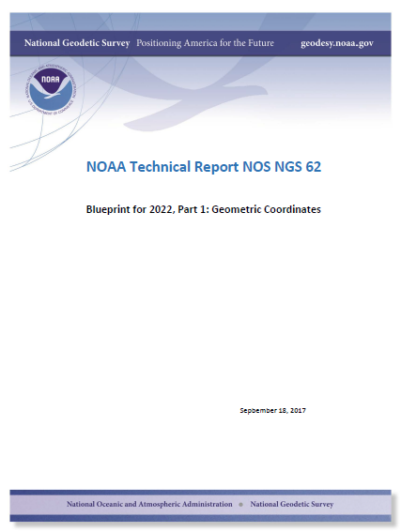
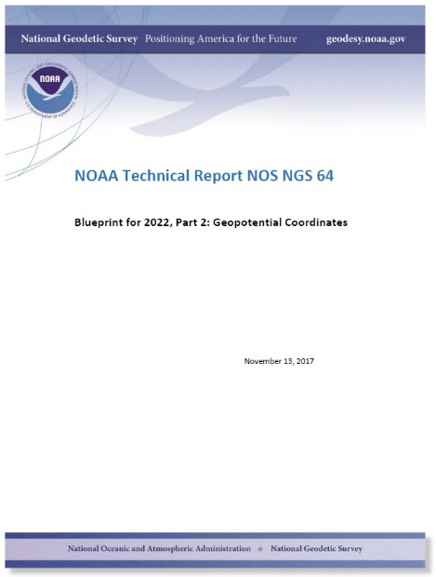
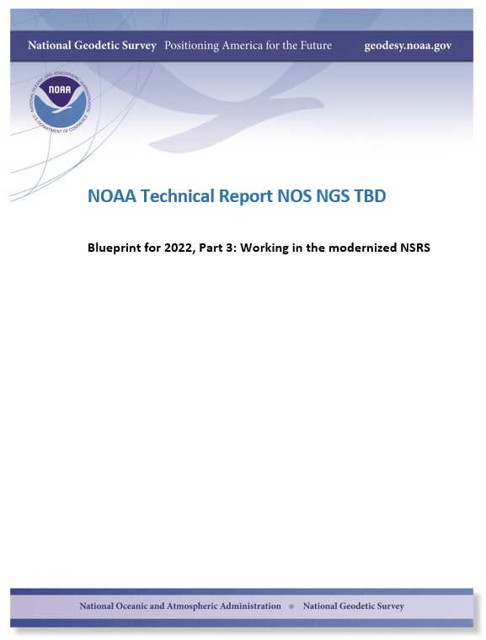
Modernizing the NSRS
The “blueprint” documents: Your best source for information
Geometric:
Sep 2017
Geopotential:
Nov 2017
Working in the
modernized NSRS:
May 2019

Slide 31
“Modernizing the NSRS” means…
Replacing NAD 83
Replacing NAVD 88
Re-inventing Bluebooking
Improving the Geodetic Toolkit
Better Surveying Methodologies
Notes:
There are actually 3 “NAD 83”s, NAD 83(2011), NAD 83(PA11) and NAD 83(MA11)
There are also many more vertical datums than NAVD 88 in the NSRS, each one for specific states or territories that have no line of sight to CONUS/Alaska

Slide 32
Latitude, Longitude
& Ellipsoid Heights

Slide 33
Replacing the NAD 83’s
The Old:
NAD 83(2011)
NAD 83(PA11)
NAD 83(MA11)
The New:
The North American Terrestrial Reference Frame of 2022
(NATRF2022)
The Caribbean Terrestrial Reference Frame of 2022
(CATRF2022)
The Pacific Terrestrial Reference Frame of 2022
(PATRF2022)
The Mariana Terrestrial Reference Frame of 2022
(MATRF2022)

Slide 34
Replacing the NAD 83’s
Three plate-(pseudo)fixed frames will be replaced with four plate-fixed reference frames
N. Amer., Pacific, Mariana, Caribbean(new!)
Fixed: NAD 83 isn’t geocentric
Fixed: NAD 83 doesn’t rotate properly with its plates
Method: Define each of the 4 new frames equal to IGS14 @ 2020
Define each frame’s movement by a plate rotation only
Put another way: “The frame rotates so your coordinates don’t have to”

Slide 35
The relation of five global reference
frames through time.
NATRF2022
MATRF2022
Rotations are not to scale
CATRF2022
Rotation of North American Plate
PATRF2022
Rotation of Pacific Plate
IGS14 frame
IGS14 frame through time
IGS14 frame
Rotation of Caribbean Plate
PATRF2022
CATRF2022
Rotation of Mariana Plate
NATRF2022
Time “t ” when
all four TRFs and
IGS14 are identical.
(2020.0)
MATRF2022
0
t=t - Δt
(“the past”)
t=t + Δt
(“the future”)
0
0

Slide 36
What does it mean to provide time-dependent coordinates in 5 frames?

Slide 37
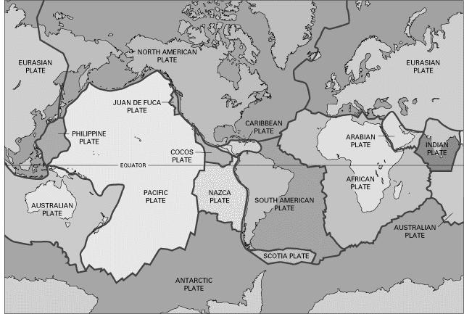
BSMK (North Dakota)

Slide 38
BSMK (North Dakota)
As per NGS policy decision circa 2018:
t₀ = 2020.0
NATRF2022 Latitude is CONSTANT over time

Slide 39
BSMK (North Dakota)
NATRF2022 Longitude is constant over time

Slide 40
BSMK (North Dakota)
No matter WHAT frame, the ellipsoid height is dropping over time

Slide 41
PIN1 (S. California)

Slide 42
PIN1 (S. California)
Latitude in NATRF2022 and PATRF2022 change over time

Slide 43
PIN1 (S. California)
Longitude in NATRF2022 and PATRF2022 change over time

Slide 44
PIN1 (S. California)
No matter WHAT frame, the ellipsoid height is rising over time

Slide 45
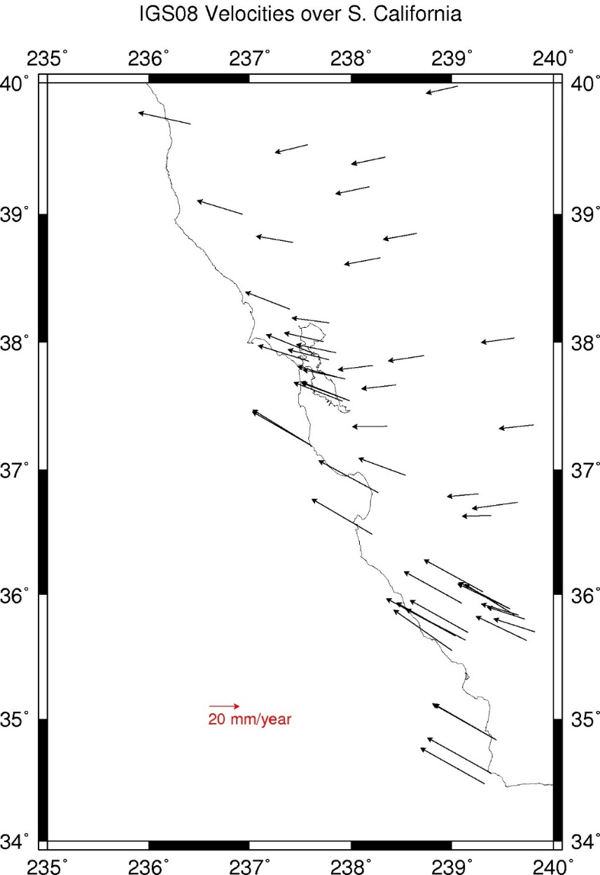
CORS Velocities – IGS08

Slide 46
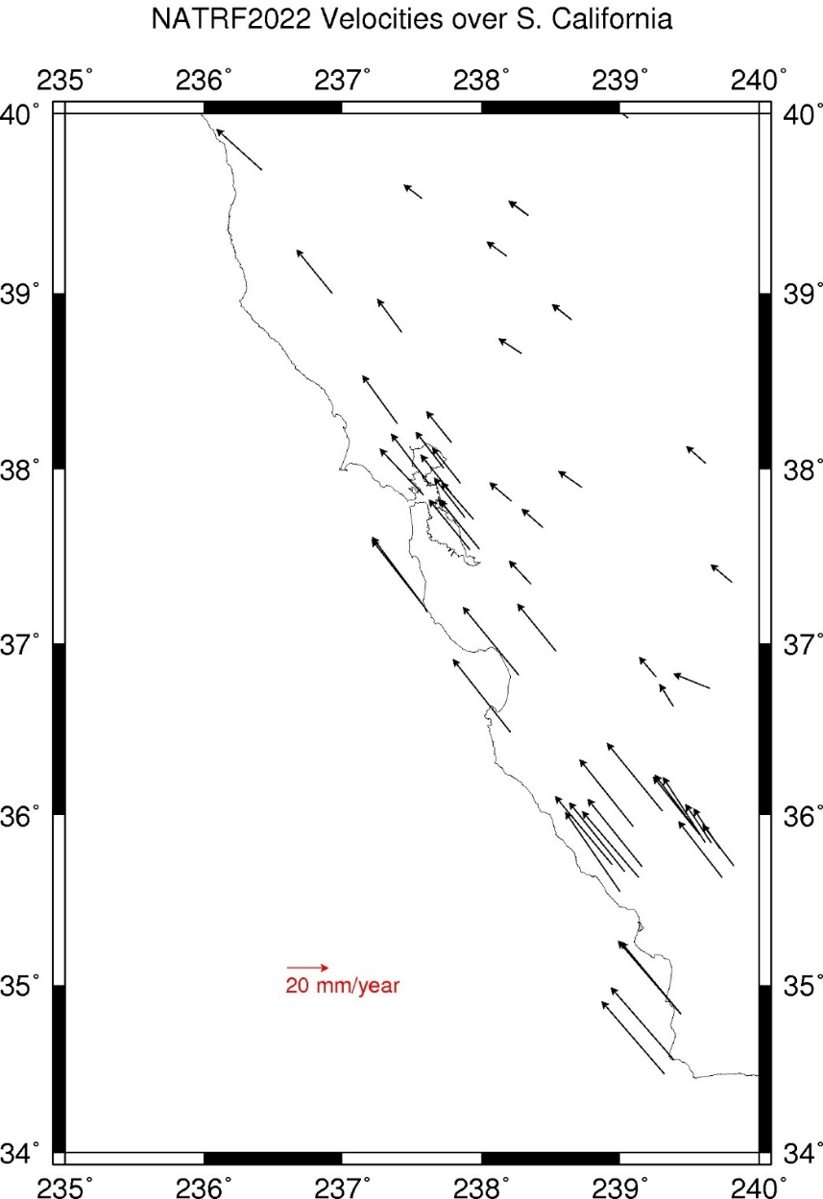
CORS Velocities – NATRF2022

Slide 47
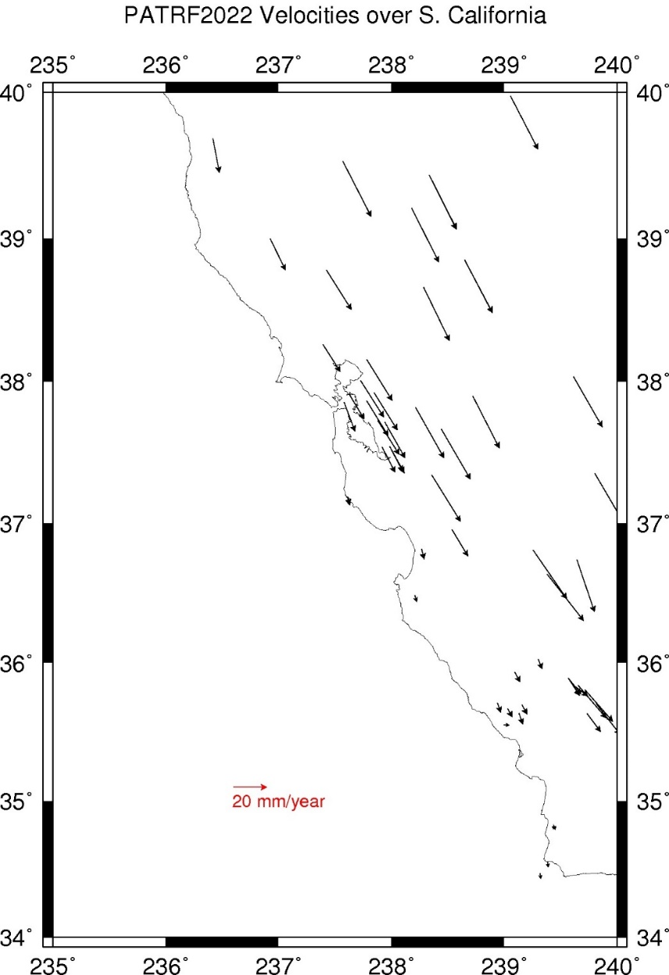
CORS Velocities – PATRF2022

Slide 48
CORS Velocities – NAD 83(2011)

Slide 49
Orthometric Heights
(“Sea Level Heights”) and other
gravity-related quantities

Slide 50
Replacing NAVD 88
The Old:
NAVD 88
PRVD 02
VIVD09
ASVD02
NMVD03
GUVD04
IGLD 85
IGSN71
GEOID12B
DEFLEC12B
Orthometric
Heights
The New:
The North American-Pacific Geopotential Datum of 2022 (NAPGD2022)
- Will include GEOID2022
Normal
Orthometric
Heights
Dynamic
Heights
Gravity
Geoid
Undulations
Deflections of
the Vertical

Slide 51
Geopotential Basics
Why isn’t this a vertical datum?
Because it contains more than heights
And therefore NGS wants to be accurate in its name

Slide 52
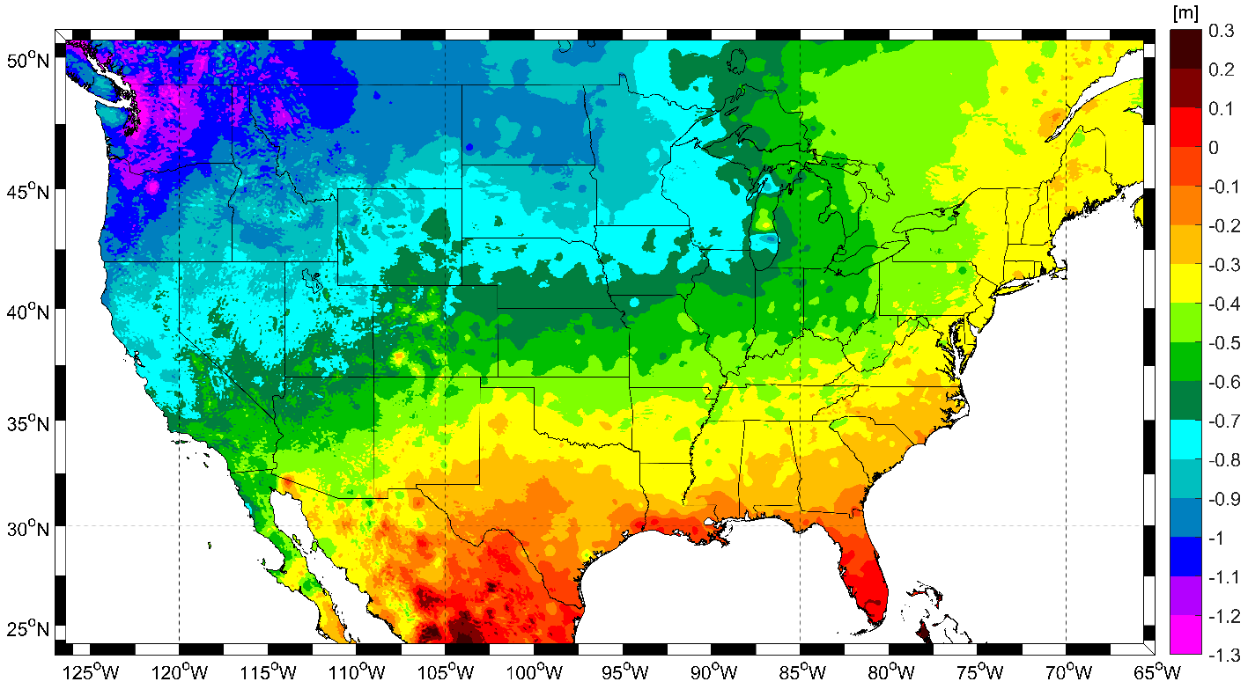
Expected changes to orthometric heights

Slide 53
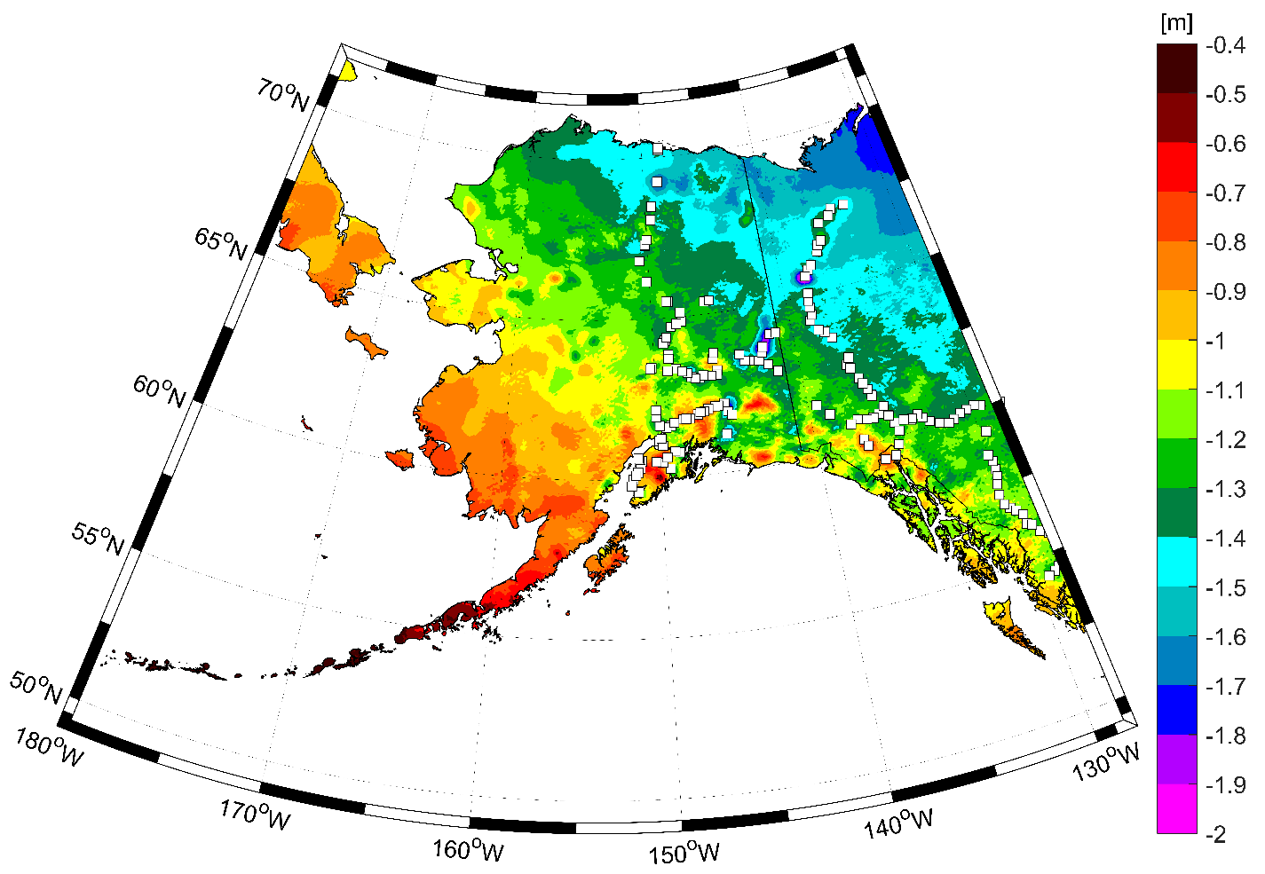
Expected changes to orthometric heights

Slide 54
Definitional Relationship
$H_{NAPGD2022}(t)≡h_{∗TRF2022}(t)−N_{GEOID2022}(t)$
Time-dependent ellipsoid heights
come from time-dependent
CORS coordinates which serve as control for your time-dependent GNSS survey.
They will be modeled in the IFVM
Time-dependent geoid undulations
are modeled in the dynamic component of GEOID2022 (“DGEOID2022”), which will come from the geoid monitoring service, or GeMS.

Slide 55
Geoid Monitoring Service
Goal: Track all changes to the geoid which would prevent 1 cm accuracy
Three major aspects:
Secular Shape: Hudson Bay
Episodic Shape: Massive Earthquakes
Geoid relation to Sea level: Global Sea Level Change

Slide 56
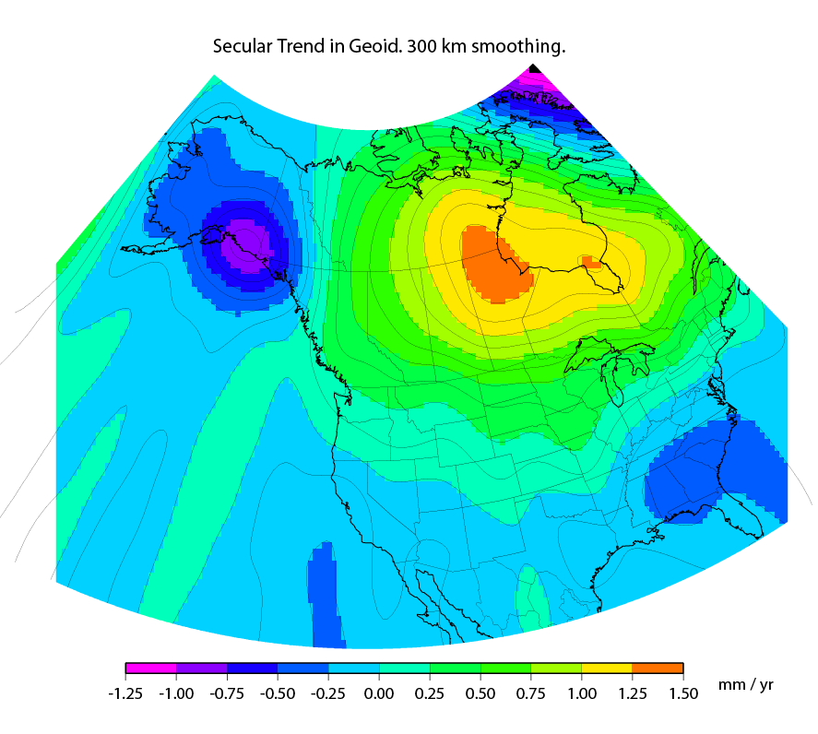
Secular Mass Movement
Notes:
There are two manifestations of the growing mass in the deep mantle under Hudson Bay:
Geometric – a GPS receiver will see the crust uplifting as the increase in mantle mass pushes the crust up in a displacement.
Geopotential – a gravimeter on the surface will sense the growing mass as an increase in the acceleration of gravity, BUT this will be slightly tempered by a reduction in gravity as well (because the gravimeter on the surface is getting farther from the Earth’s center). Still, the gain (from mass increase) is larger than the loss (from geometric movement) for a net gain. Because the net gain in gravity is not caused purely by being at a new crustal height, this translates into an increase in geoid undulations, or a “swelling” of the geoid in this region.
This is different than a purely geometric change caused by a compression of the crust. In that case, no significant mass is entering or leaving the region so, while GPS might sense a subsidence and a surface gravimeter might sense a slight increase as it moves closer to the Earth’s center, the geoid would not actually change.

Slide 57
High resolution products
GEOID2022
Official converter of *TRF2022 ellipsoid heights into NAPGD2022 orthometric heights
DEFLEC2022
Surface deflections of the vertical in N/S and E/W
GRAV2022
Surface acceleration of gravity
DEM2022
Official DEM used in creation of all above products
All will be 1 x 1 arcminute grids
All will cover three finite regions of the globe
All will have a static and dynamic component
Dynamic surface gravity and DEM not expected to be ready by 2022

Slide 58
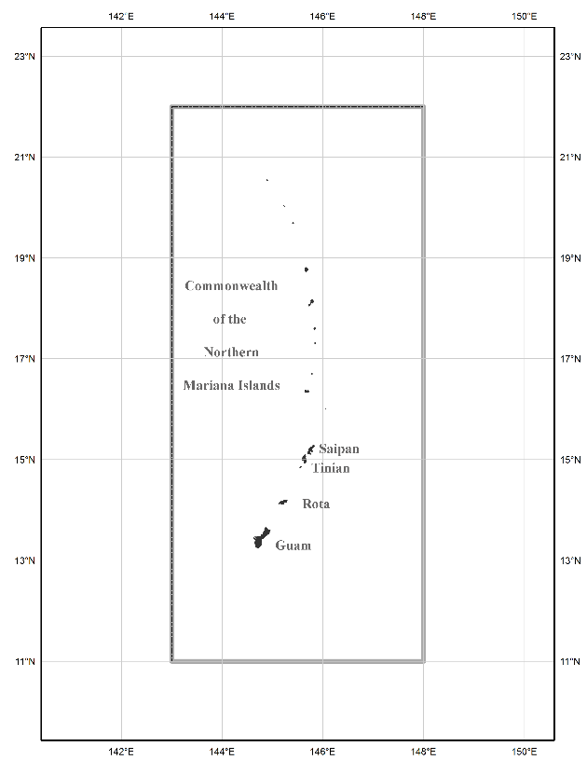
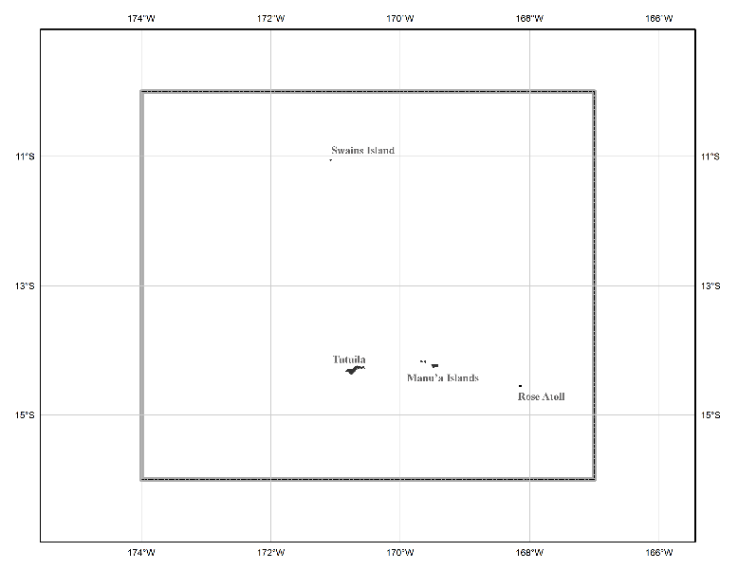
The three gridded regions
“North American region”
¼ of the Earth
“Guam/CNMI region”
“American Samoa region”

Slide 59
Converting NAD 83 and NAVD 88
geospatial data into
NATRF2022/PATRF2022/
CATRF2022/MATRF2022
and NAPGD2022

Slide 60
Two options: NCAT and VDatum
Currently semi-independent programs
Being merged behind the scenes when calling identical routines, such as “NADCON 5.0”
NCAT will remain “purely geodetic”
VDatum will be “NCAT plus tidal datums”
Both will get “VERTCON 3.0” in late 2018
Both will run in 3 modes:
Web services, Browser interactive, Downloadable

Slide 61
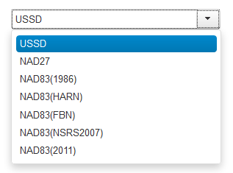
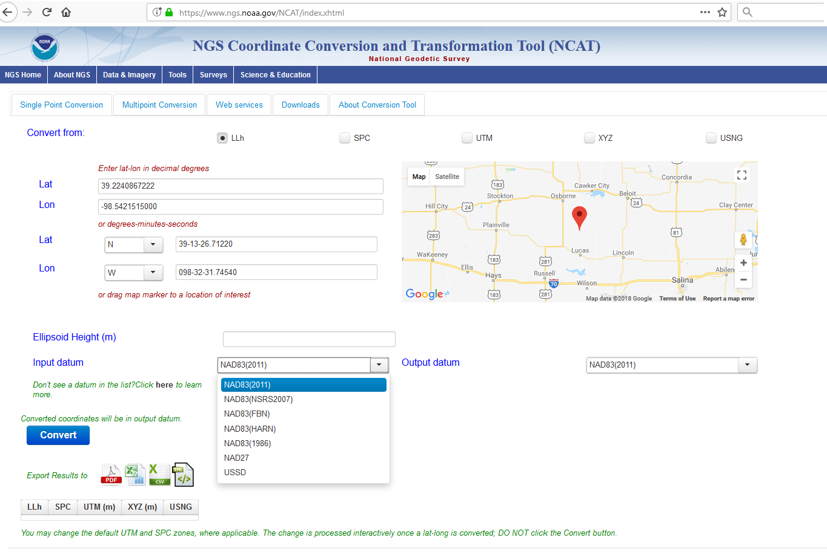
NGS Coordinate Conversion and Transformation Tool (NCAT)
Now with
NADCON 5!
www.ngs.noaa.gov/NCAT/

Slide 62
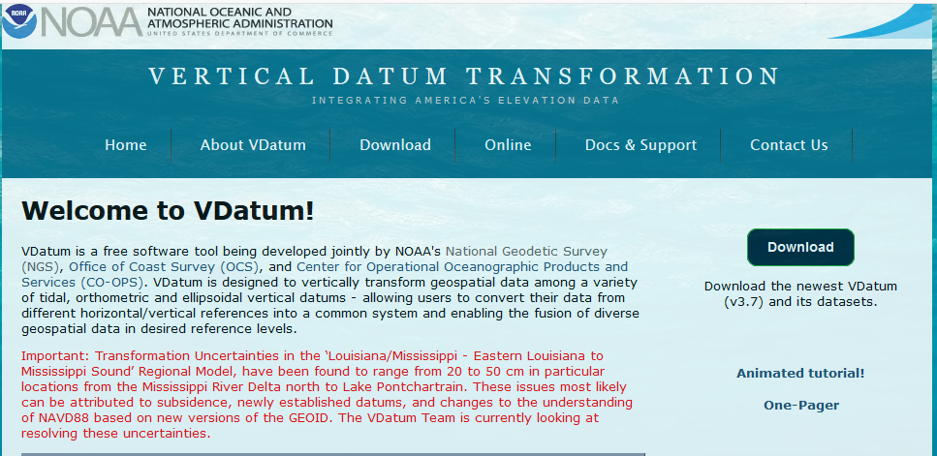
VDatum
vdatum.noaa.gov

Slide 63
Thank you!

Slide 64
Questions? FYI: ASPRS/ILMF will hold a panel session on modernizing the NSRS Denver, January 28-30

