Slide 1
The 2013-2014 Survey of the Washington Monument
Dr. Dru Smith
Chief Geodesist
NOAA’s National Geodetic Survey

Slide 2
Why?

Slide 3
Construction of the Washington Monument

Slide 4
Construction
1799-1833 – Congressional promises for a monument fail to yield material action
1833: The Washington National Monument Society is formed by private citizens upset at Congressional inaction
1833-1848: Fundraising by the Society

Slide 5
Construction
1848 – Construction begins
Foundation first
Cornerstone with time capsule set in foundation
1854 – Construction ceases
Funds depleted and pre-war tensions
152 feet high
Two doors: East & West
Today there is only an East door

Slide 6
1854-1878: Unfinished
Notes:
Library of Congress (photograph BH823-2).

Slide 7
Construction
1854-1876 – The embarrassing pause
Politics within the Society
Civil War
Repeated inquiries about the foundation’s strength
All claim that no serious issues exist
1876 – Congress appropriates re-start funds
First time that taxpayer funds were used

Slide 8
Construction
1876 – Re-studying the foundation
All previous reports of the foundation being “safe” are rejected
Nine inches of settlement had been overlooked in previous reports because of “using the wrong stone as a bench mark for measuring the settlement of the structure”
Decision: Strengthen the foundation
1878 – Additional Congressional Appropriation

Slide 9
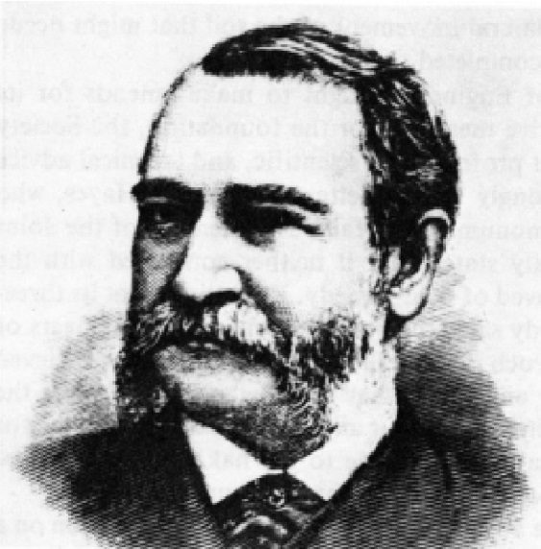
Construction
1878 – Lt Col Thomas Casey takes charge
First step: Strengthen foundation

Slide 10
Strengthening the Foundation
“Babcock Lake”
North of the WM
(since drained)
From the South
August 14, 1879
Notes:
The water behind (to the North of) the monument is “Babcock Lake”, which was later drained and filled to protect the foundation’s stability.

Slide 11
Strengthening the Foundation
From the South East
January 20th, 1880

Slide 12
Strengthening the Foundation
“Completed
May 28th, 1880”

Slide 13
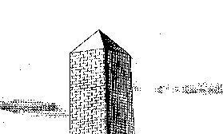
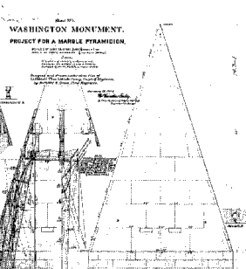
Construction
1880 – Work on the main obelisk resumes
Significant loss of plans since 1854
1884 – Decision to make pyramidion stone, rather than metal and change its shape

Slide 14
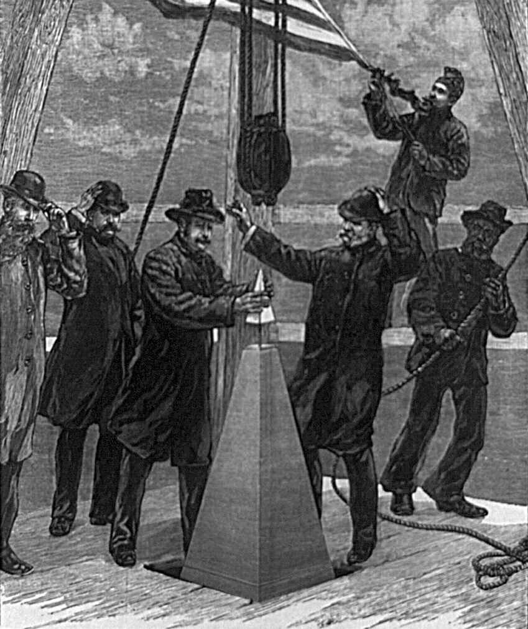
The aluminum apex
Dec 6, 1884 – Finished!*
Casey sets the aluminum
apex.
Aluminum apex
To be a lightning rod
* Windows still not installed,
plus other finishing touches

Slide 15
“As finished the Monument is 555 feet 5 1/8 inches in height”
- Lt Col Thomas L. Casey

Slide 16
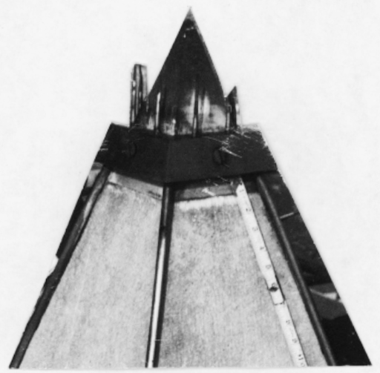
Immediate Changes
Jun 8, 1885: Lightning strike damaged stones in pyramidion
Installation of lightning “band”
sitting directly on aluminum
apex
Luckily the platform was still
in place from Dec 1884!

Slide 17
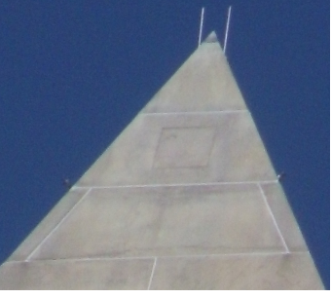
Accessing the top
1885
2014
Notes:
Left: Picture from 1885, showing the top platform still in place.
Right: Picture from 2015, showing the south face of the pyramidion containing the “secret door” (also the new Lightning Protection System installed in 2014)

Slide 18
Surveying

Slide 19
1885-1934: USC&GS
The US Coast and Geodetic Survey
Leveling (height difference surveys) around the base and grounds of the WM since 1885. Useful for detecting subsidence.
The peak of the WM, sighted from the ground, was a prominent landmark, useful for traverse(latitude and longitude) surveys around the DC area, but a survey instrument had never been used atop the WM itself

Slide 20
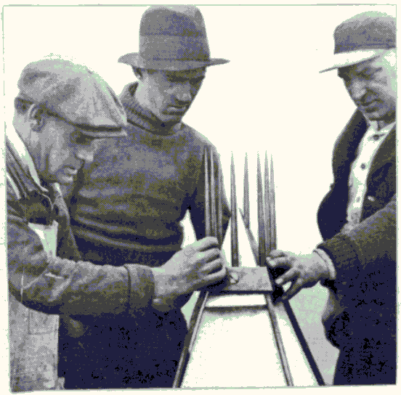
1934
Monument in disrepair
“Public Works Act”
Scaffolding
Lightning Protection System
Same band as 1885, but added new rods
Aluminum Apex:
New engraving, “quietly” done
With scaffolding up, C&GS is granted approval to occupy the WM peak for a triangulation survey

Slide 21
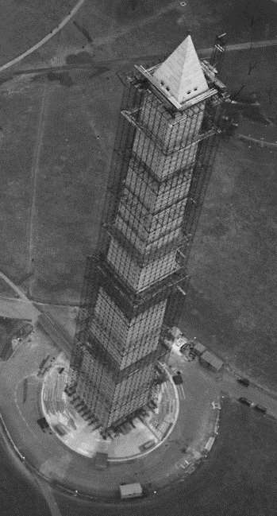
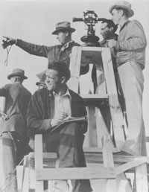
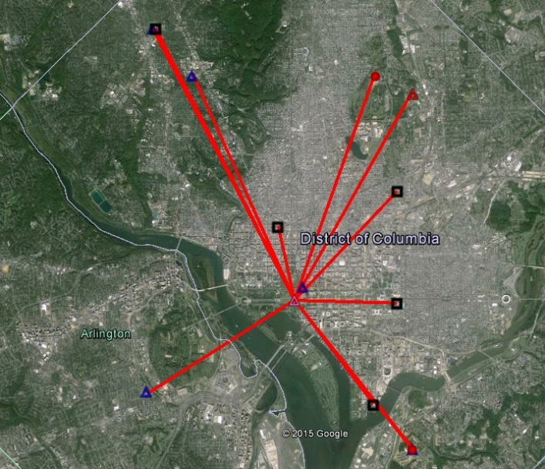
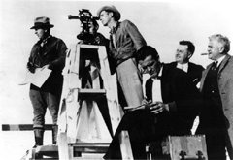
1934
“…tip has apparently been burned by lightning, as the top is about ½ inch square…”
…and somewhere, a young
man named Don Breidenbach
was born.
Notes:
As the peak of the WM had been sighted to as a survey point for decades, the USC&GS was granted permission to access the peak during the 1934 restoration project and actually occupy it for a triangulation survey, to accurately position it in latitude and longitude. There is no evidence that a height survey was performed.

Slide 22
1934-1999
USC&GS (becoming the National Geodetic Survey in the 1970s) continues leveling surveys on and around the WM grounds
1999 – A new round of renovations are proposed, and NGS seeks a chance to position the peak again, this time with GPS

Slide 23
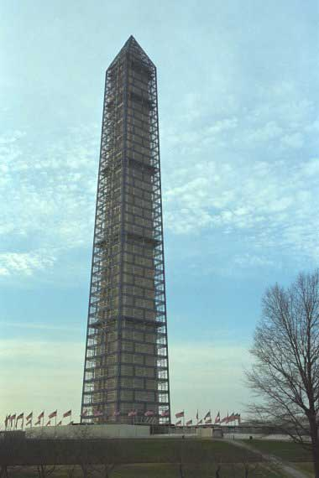
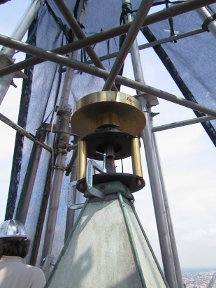
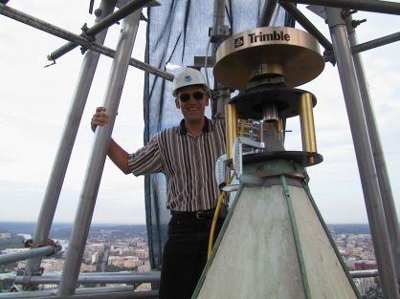
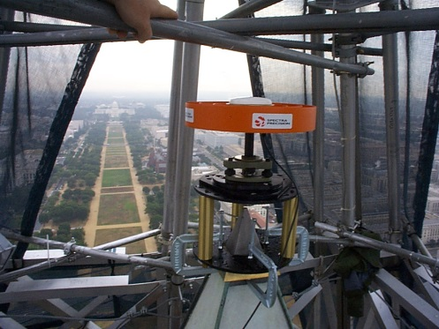
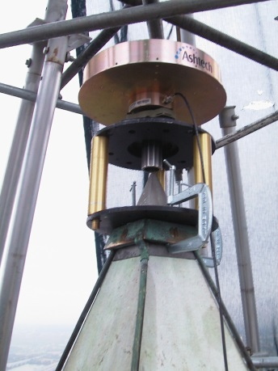
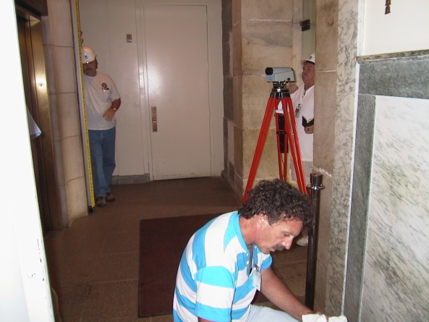
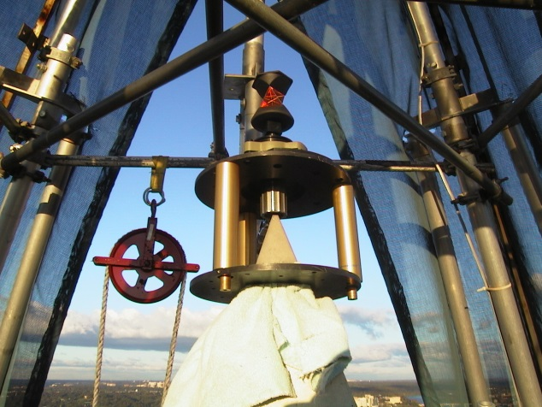
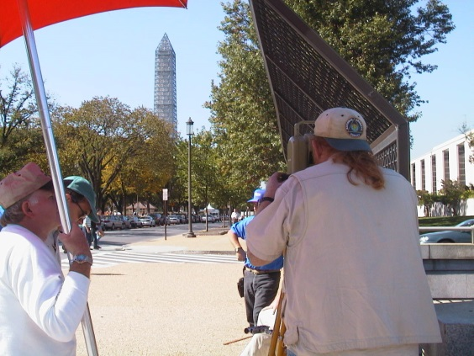
1999
Notes:
A “who’s who” of GPS recievers are allowed to occupy the peak, in an attempt to determine the height of the

Slide 24
1999: Geodetic forensics (2014)
GPS
Bad environment, but lots of data helped!
Leveling
Nothing published about floor connections
Vertical angles
Non-reciprocal, no metadata
Architectural Height
Never finalized
Notes:
No formal report of the 1999 survey could be found by 2014, so everything that is known about that survey was done through geodetic forensics, including:
Talking with individuals involved
Investigating values in the NGS IDB
Inspecting the GPS files saved in archives
Reading preliminary reports

Slide 25
2011 - August 23 at 1:51:04 p.m

Slide 26
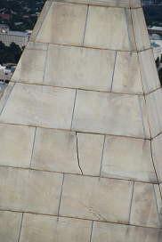
Earthquake Damage
Federal Funds: $7.5 M
David M. Rubenstein: $7.5 M

Slide 27
2013: Request
Post-Earthquake repairs: Same scaffolding as 1999. NGS reaches out to NPS to request a new geodetic survey of the peak
Goal: More accuracy in latitude, longitude, elevation of the WM peak than before
By-product: Architectural height determination

Slide 28
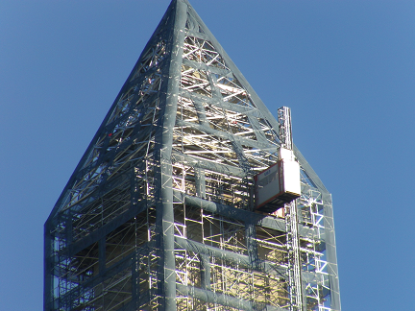
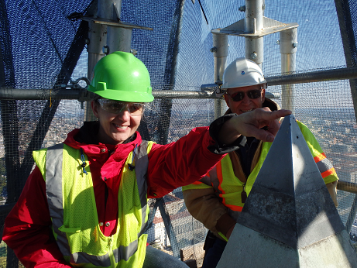
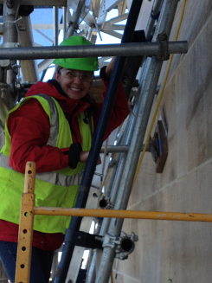
Reconnaissance
Don Breidenbach!
Lightning collar off for the
first time in 128 years!

Slide 29
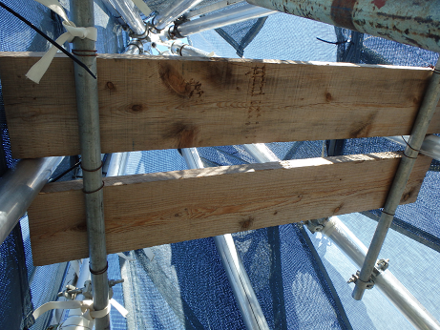
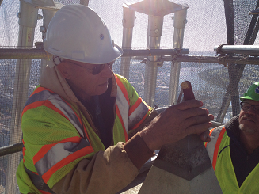
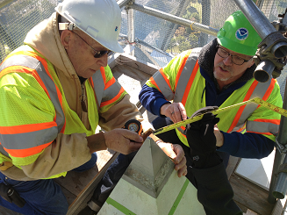
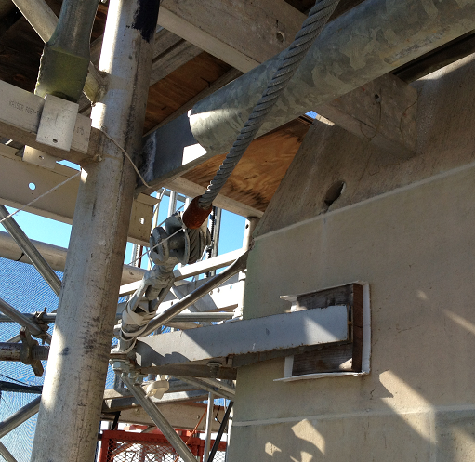
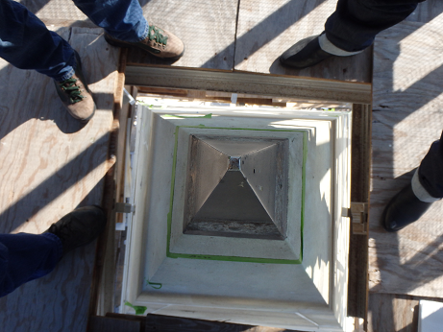
Reconnaissance
Up-view from peak.
Bad for GPS!
Hole for
cords!
Rare down-view over peak

Slide 30
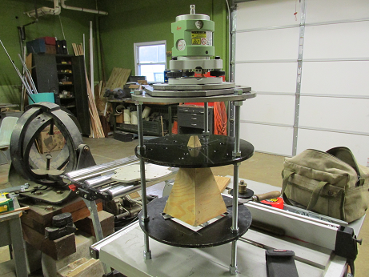
Preparation
Adapter from NIST, ca: 1999
Unavailable ca: 2013
Also, the lightning collar is off
and staying off! What to do?
Ask Don Breidenbach (and his
son Steve!) to design and build a new
one. Turnaround: 5 days!

Slide 31
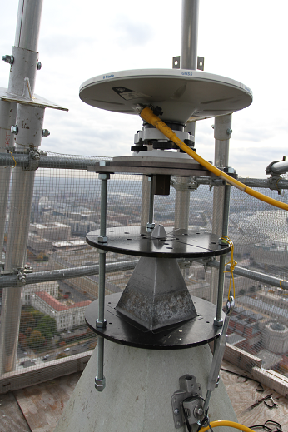
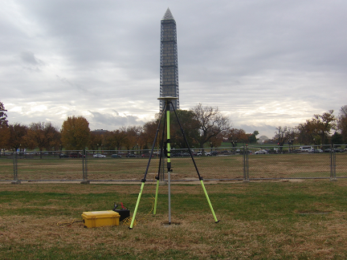
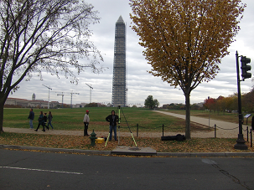
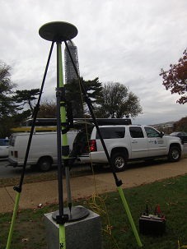
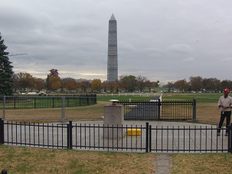
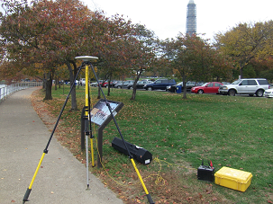
GPS
Despite expected difficulties,
decided to begin with GPS
WASHINGTON MONUMENT
Meridian Stone
W M WEST
USFS Commemorative Mark
Zero Milestone
W M SOUTH

Slide 32
Traverse
Simultaneous Reciprocal vertical angles and distances
Measure vertical angles and slope distances from peak-to-ground and ground-to-peak at almost the same time
Horizontal angles (triangulation)
Between ground marks and from ground marks to peak, and from peak to ground marks

Slide 33
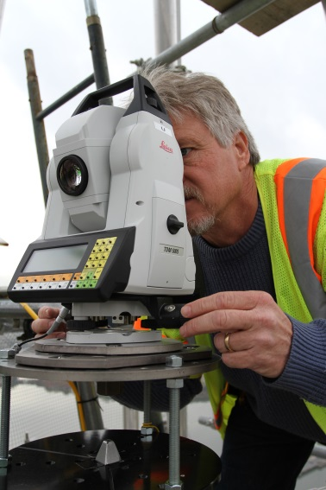
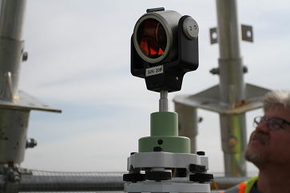
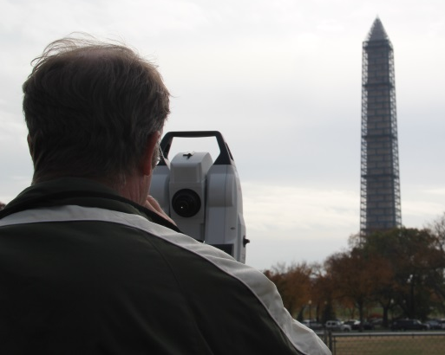
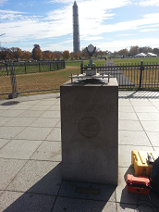
Traverse
Simultaneous
within minutes
Reciprocal
peak → ground
and
ground → peak

Slide 34
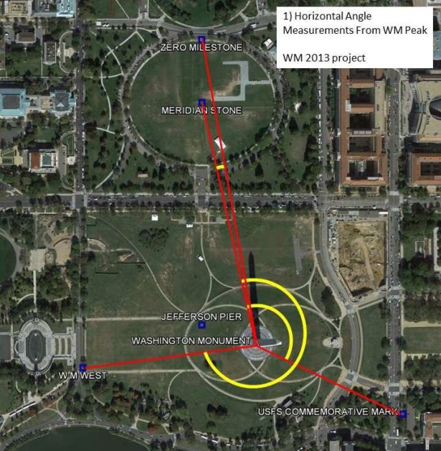
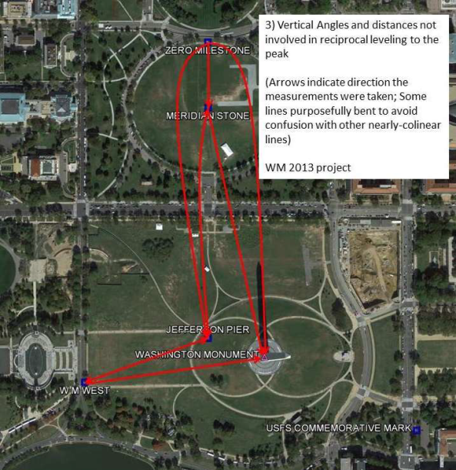
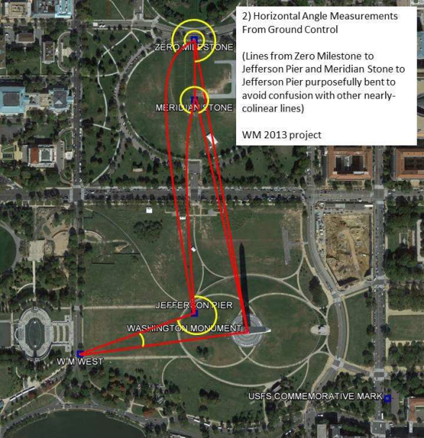
Traverse

Slide 35
Traverse

Slide 36
Leveling
Height difference calculator
H(A) = 100.000 m
+ Backsight = + 1.700 m
“Level Rod”
“Level”
B
A

Slide 37
Leveling
Height difference calculator
H(A) = 100.000 m
+ Backsight = + 1.700 m
- Foresight = - 0.800 m
H(B) = 100.900 m
B
A

Slide 38
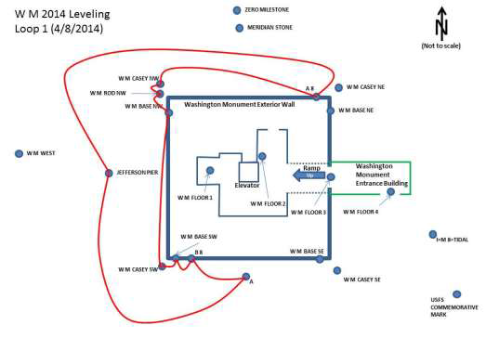
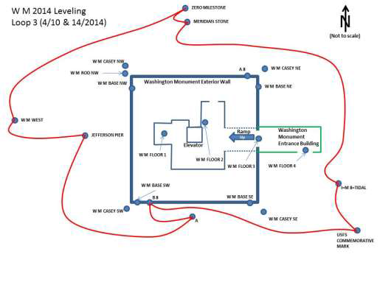
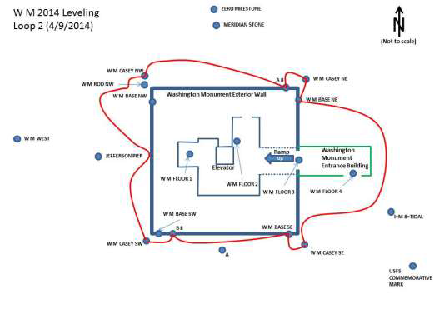
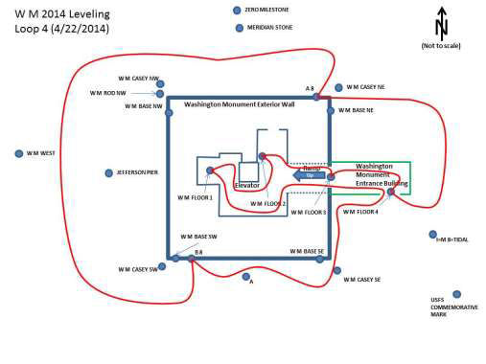
Leveling
4 days to
compute/confirm
NAVD 88 heights on
points
1 day to connect
to “floor level” to
determine architectural
height

Slide 39
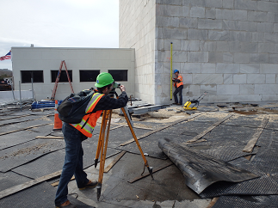
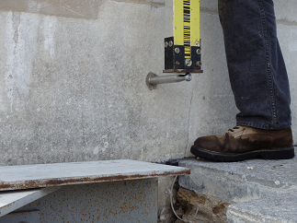
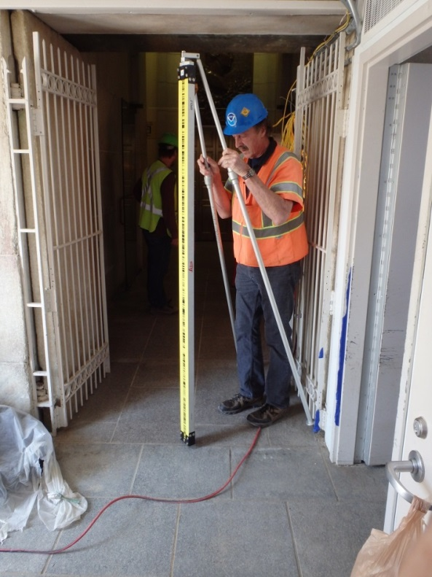
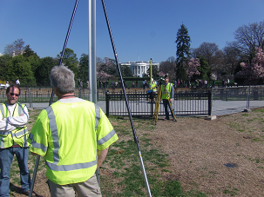
Leveling
“W M FLOOR 3”

Slide 40
CTBUH
Council on Tall Buildings and Urban Habitat
International arbiters of building heights
Measure to the “threshold of the lowest significant open-air pedestrian entrance”
CTBUH says: “use W M FLOOR 3”

Slide 41
Putting it all together
Published coordinates:
Ground points with latitude, longitude (NAD 83) and orthometric height (NAVD 88)
Leveling:
Confirm/Compute NAVD 88 heights and “architectural heights” (relative to W M FLOOR 3) on all ground points.
Traverse (angles and distances):
Transfer both types of heights to the peak and compute latitude and longitude at the peak
GPS:
Far too noisy too use as primary methodology. Kept in reserve.

Slide 42
NSRS Computed Values
Coordinate Type | Value | Standard Deviation | Datum
Latitude | N 38° 53’ 22.08257” | 2.0 mm | NAD 83(2011)
Longitude | W 77° 02’ 06.86428” | 1.0 mm | NAD 83(2011)
Ellipsoid Height | 149.172 m | 1.0 mm | NAD 83(2011)
Orthometric Height | 181.261 m | 1.0 mm | NAVD 88

Slide 43
Yes, yes, yes that’s all very interesting…but how tall is it?

Slide 44
Historical Detective Work
Level 4: 24”
Level 3: 24”
Level 2: 24”
Level 1: 30”
Notes:
According to a photo taken in 1879, the lowest blocks appear to be 25% taller than the next three layers above them. As the heights of blocks in the 2nd and 3rd layers may be easily measured today at 24”, this implies that the lowest block must have been 30” high.
Also, specific patterns in the stone help correlate specific parts of the monument in pictures taken over a century apart.

Slide 45
Historical Detective Work
Level 4
Level 3
Level 2
Level 1
Notes:
In a leveling picture from 1999, one can easily distinguish the same “stain” pattern in the rock that was seen in the 1879 photo.

Slide 46
The SW corner - 1879
Hole for post
Eyebolt

Slide 47
The SW corner - 2014
Eyebolt
Round Hole
(3 ¼” diam,
gravel
filled)
“W M CASEY SW”

Slide 48
W M CASEY SW
One of four such marks found in 1999
Named by NGS:
W M CASEY NW
W M CASEY SW
W M CASEY SE
W M CASEY NE

Slide 49
PAVERS vs Foundation
24”
24”
24”
CASEY SW
(at bottom of PVC tube)
~16”
~14”
Notes:
Here, in a photo from the 2014 leveling campaign, one can discern that about 14” (nearly half) of the lowest block is actually below “paver level” today.

Slide 50
The CASEY Marks
The National Archives contain all of the materials written by Casey
Haven’t yet seen a reference to where Casey chose to measure 555’ 5 1/8 inches from
Some evidence points to these four marks re-discovered in 1999
Leveling proves all four are within 4 mm of each other in height
Averaging them for references

Slide 51
Foundation vs Threshhold
Level 1: 30”
Blue: 21”
Yellow: 9”
Notes:
Although this appears to be the WEST entrance (eventually sealed shut), if one presumes that its general construction and dimensions are identical to the EAST entrance, then this photograph shows a clear difference between the level of the FOUNDATION and the level of the THRESHOLD of the door. Knowing that the first level of stone is 30” high, a simple measurement of the actual photograph yields a difference in heights of about 9.35 inches. This approximation is in reasonable agreement with the 8 43/64 inches (8.67 inches) difference between the height of “W M FLOOR 3” (set at the East doorway threshold) and the average heights of the four CASEY monuments (set more or less flush with the foundation).

Slide 52
Final Architectural Heights
By Casey’s (presumed) method:
1885: 555’ 5 1/8 inches (to a pointed peak)
1999: 555’ 3 5/8 inches* (to a rounded peak)
2014: 555’ 4 1/64 inches* (to a rounded peak)
By CTBUH standards in 2014:
554’ 7 11/32 inches (to a rounded peak)
(a difference from the 1885 value of over 9.75”)
* Presumes Casey’s method was to use the average level of the four “Casey marks” as a starting point.

Slide 53
Relationship to past values
Why isn’t the building 555’ 5 1/8 inches?
How was the above value computed?

Slide 54
Why the disagreement?
If the 4 CASEY marks are where Lt Col Casey measured his height, why did we get 555’ 4 1/64 inches, when he got 555’ 5 1/8 inches?
Two reasons
Rounding of the peak
Measurement error

Slide 55
Rounding of the peak
Approximately 3/8 inch of the 1 1/8 inch disagreement comes from
height loss due to rounding of the peak

Slide 56
Magnitudes of contributions
Reason | Inches
1) A different starting point | 8 43/64
2) Rounding of the aluminum apex | 3/8
3) Measurement Error in 1884 and 2014 | 47/64
Combined | 9 25/32

Slide 57
How things stack up: 2014 values
3/8”
554’ 7” 11/32
555’ 4” 1/64
(8 + 43/64)”
Doorway
Pavers
“W M FLOOR 3 Level”
“Average CASEY level”
Foundation
~14”
Average all 4 “CASEY marks

Slide 58
Summary
NGS determined the latitude, longitude, ellipsoid height and orthometric height of the peak of the WM to 1-2 mm
Baseline for future monitoring surveys
NGS computed the architectural height of the WM to modern international standards to +/- 1.0 mm
Disagrees with the historic 1885 height by almost 10 inches
Of that 10 inches, all by ¾ inch are immediately explainable
The ¾ inch remainder is likely measurement error from 1885 or errors in our assumption about how the 1885 height was determined

Slide 59
All that hard work…

Slide 60
Gee…thanks Dave…

Slide 61
Questions?
http://www.ngs.noaa.gov/surveys/ngs/wm2013/

Slide 62
Thank you!

Slide 63
Extra Slides

Slide 64
Doorway changes
1885 – By Casey’s order:
West entryway sealed off
East entryway reduced to 8’ high
East entryway to have 2 marble doors

Slide 65
Aluminum Apex

