Slide 1
Progress Toward a Unified Geoid-Based Vertical Datum for North America
D Smith¹, M Véronneau², D. Avalos-Naranjo³,
D Roman¹, Y M Wang¹ and J Huang²
XXV IUGG General Assembly
July 4, 2011
Melbourne, Australia
¹National Geodetic Survey ²Natural Resources Canada ³Instituto Nacional de Estadística y Geografía
d
Notes:
This presentation was given at the IUGG General Assembly, July 4, 2011 in Melbourne, Australia.

Slide 2
Overview
Status of the North American Vertical Datums (VD)
NAVD88, CGVD28 and IGLD85
Plans and suggested procedures for the unification
Convergence of geoid modeling
Fundamental constants/parameters/models
Relationship between North American VD and the World Height System, existing VDs and ITRFs
Summary

Slide 3
Current Vertical Datums and Geoid Models used in North America
**
USA (incl. Alaska) | Canada | Mexico | Puerto Rico (USA)
NAVD88 IGLD85 | CGVD28 IGLD85 | NAVD88 | PRVD 02
GEOID09 (USGG2009*) | HTv2.0 (CGG2010*) | GGM10* | GEOID09
* Gravimetric Geoid Models
Notes:
Hybrid geoids (GEOID09 and HTv2.0) convert between official “h” and “H” datums. Gravimetric geoid models make no attempt to tie to the official
datums, but rather just model the geoid as well as possible.

Slide 4
Current Vertical Datums and Geoid Models used in North America
Hawaii (USA) | Virgin Islands (USA) | Caribbean Nations | Central American Nations
None (HIVD15? pending) | None (VIVD09 pending) | Various | Various
GEOID09 | GEOID03 (’09 pending) | CARIB97* / EGM08* | Various
* Gravimetric Geoid Models
Notes:
Canada and USA provide hybrid geoid models to go directly from ellipsoidal heights to national vertical datum, but the problem is that the hybrid models includes the errors of the official datum. Hybrid models allows users to combine modern technologies (e.g., GNSS) with traditional realized datum (levelling). Unfortunately, this mixture is sometime more problematic than useful.

Slide 5
Problems in NAVD 88
A North American realization through spirit leveling networks
Pre-satellite era product (625,000 km of leveling added to the NGVD29)
Height information through passive bench marks whose positions change constantly in our changing world (e.g., PGR, subsidence, earthquakes, …)
The geoid differences between NAVD 88 and GRACE are in meter range: compare to ±2-3 cm error in typical GPS ellipsoidal heights

Slide 6
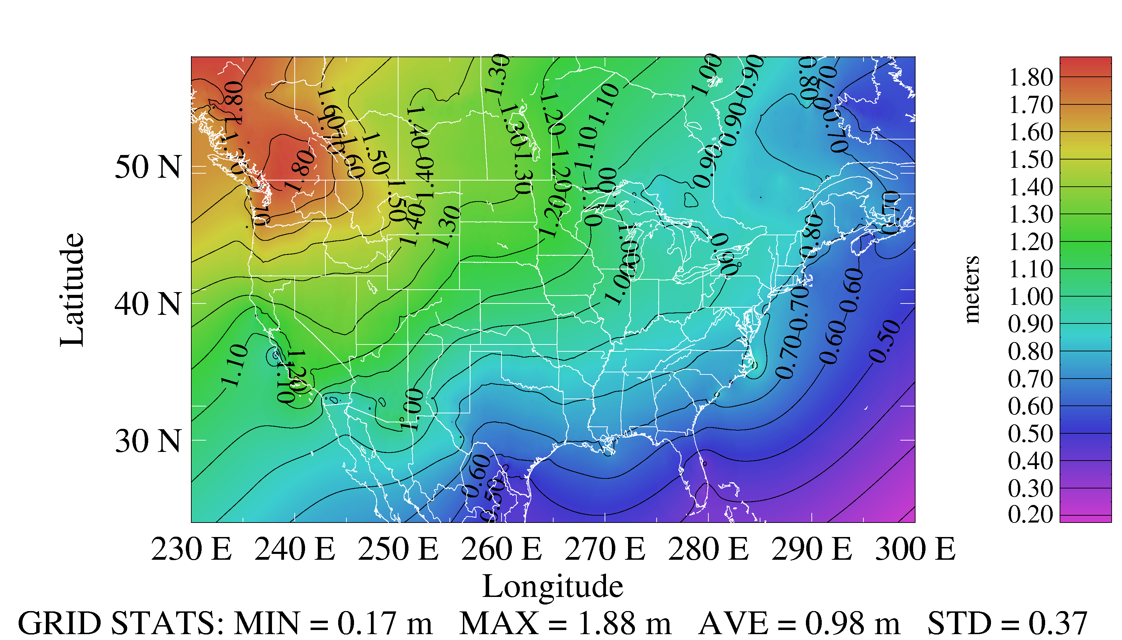
Datum difference (GGM02S-NAVD88)

Slide 7
Problems in CGVD28
Pre-satellite era product: Still based on the initial adjustment from 83 years ago
Several local piecemeal adjustments since 1928
Does not make use of any actual gravity (normal gravity only)
Still neglects several systematic errors (Sea level rise, post-glacial rebound, systematic corrections to leveling measurements)
Analysis indicates that the national distortion ranges from -65 cm (Halifax, NS) to 35 cm (Banff, AB), representing about a one-meter distortion nationally

Slide 8
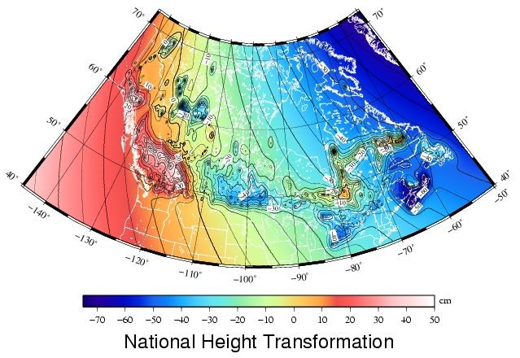
Datum difference (CGG2010-CGVD28)
W_{CGG2010} = 63636855.69 m² s⁻²
Mean W_{CGVD28} = 63636856.8 m² s⁻²
+35 cm
-65 cm
GRID STATS: MIN = -0.824 m MAX = 0.680 m AVE = -0.114 m STD = 0.283 m

Slide 9
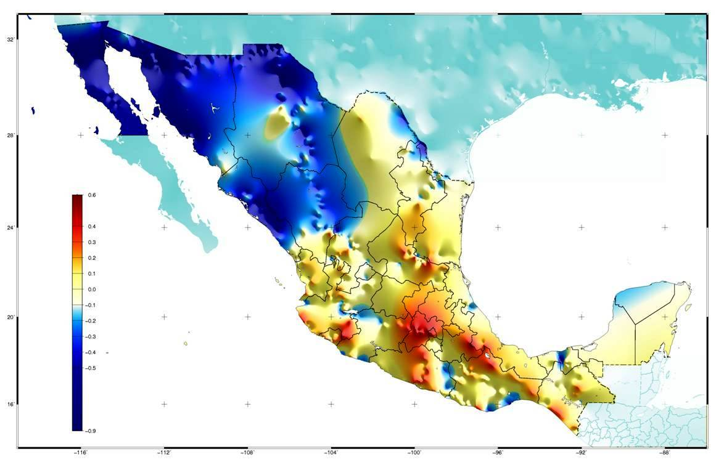
Datum difference (GGM10-NAVD88)
0.6 m
-0.9 m
Notes:
Note that this is the difference between GGM10, which is based off of both GRACE and terrestrial gravity data, of which there is significant gaps in the NW mountains of Mexico that may be causing some of these large discrepancies.

Slide 10
Plans and suggested procedures
for vertical datum unification

Slide 11
The GRAV-D Project
A US NGS lead gravity project for improving American geoid model
Redefinition of the vertical datum of the US by 2022
Airborne gravity “snapshot”
Geophysical modeling and in-situ based geoid change monitoring in out-years
Notes:
GRAV-D is about data collection, geoid modeling and geoid monitoring so that
the geoid may serve as the fundamental surface of a new vertical datum.

Slide 12
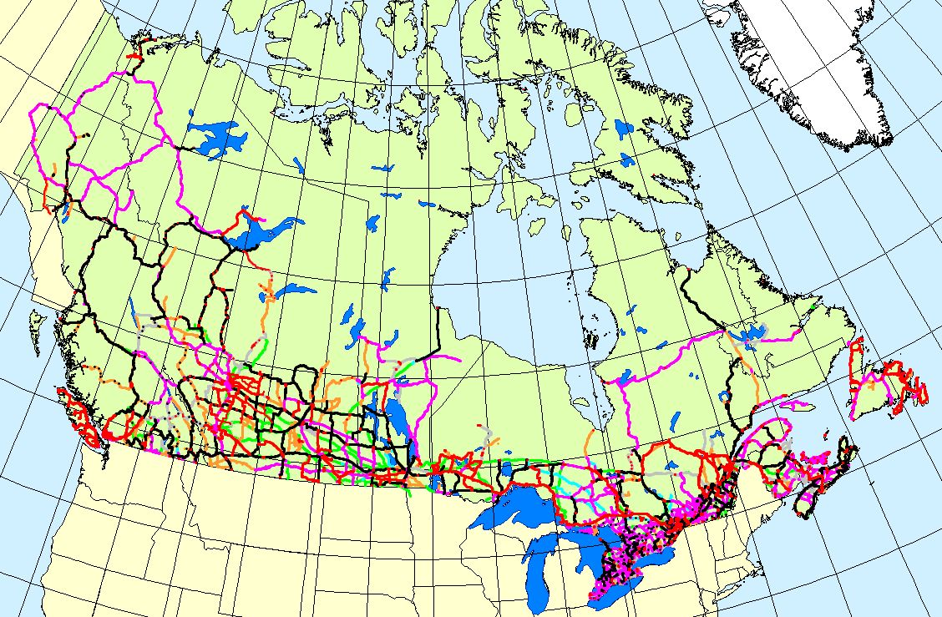
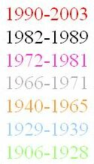
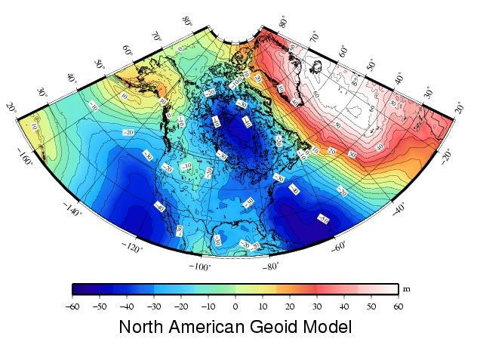
Canada Height Modernization - 2013
The geoid model:
1. Entire coverage of the
Canadian territory
(land, lakes and oceans)
2. Compatible with space-
based positioning
(e.g., GNSS, altimetry)
3. Less expensive for
maintenance
4. Fairly stable reference
surface
Levelling Networks:
1. Established over the
last 100 years
2. 120,000 km of levelling
lines
3. Some 80,000
benchmarks
4. Time consuming
5. Expensive
6. Limited coverage
7. BMs are unstable
8. BMs disappear
9. Local networks
H = h_{GNSS} – N_{Model}

Slide 13
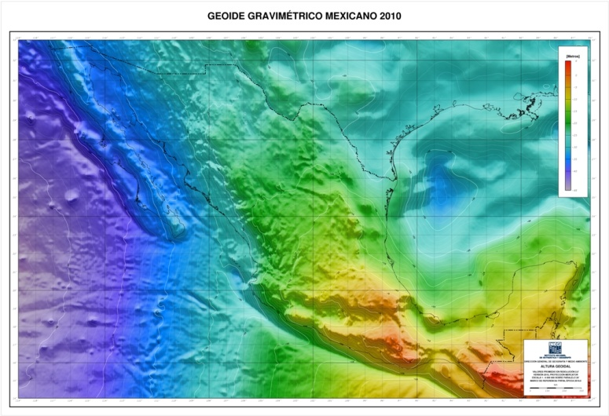
Geoid model improvement in Mexico
Geoid and its relations to NAVD88 are modeled to make the link between GNSS technology and the official reference frame.
Improvements are sought now from building a new gravimetric network to mitigate all errors in data source for geoid modeling.
Modernization in
fundamental data.
For better products.
In Mexico, the geoid is regarded as a real alternative for referencing heights in the future.
Notes:
Despite the fact that NAVD88 is the reference in Mexico, the geoid is still important to link GNSS data to the vertical datum. In this sense the geoid modeling is being supported to continue improvements. However the national geoid model is proving to be consistent enough in absolute and relative senses to become the best alternative for referencing heights.
There have been detected significant errors in the gravity data sources and therefore the geoid group in Mexico collaborates in an effort to modernize the fundamental gravity network. The expectations are to take advantage of better accuracy in both, terrestrial and reference satellite gravity information on the near future.

Slide 14
Convergence of geoid
theory and modeling

Slide 15
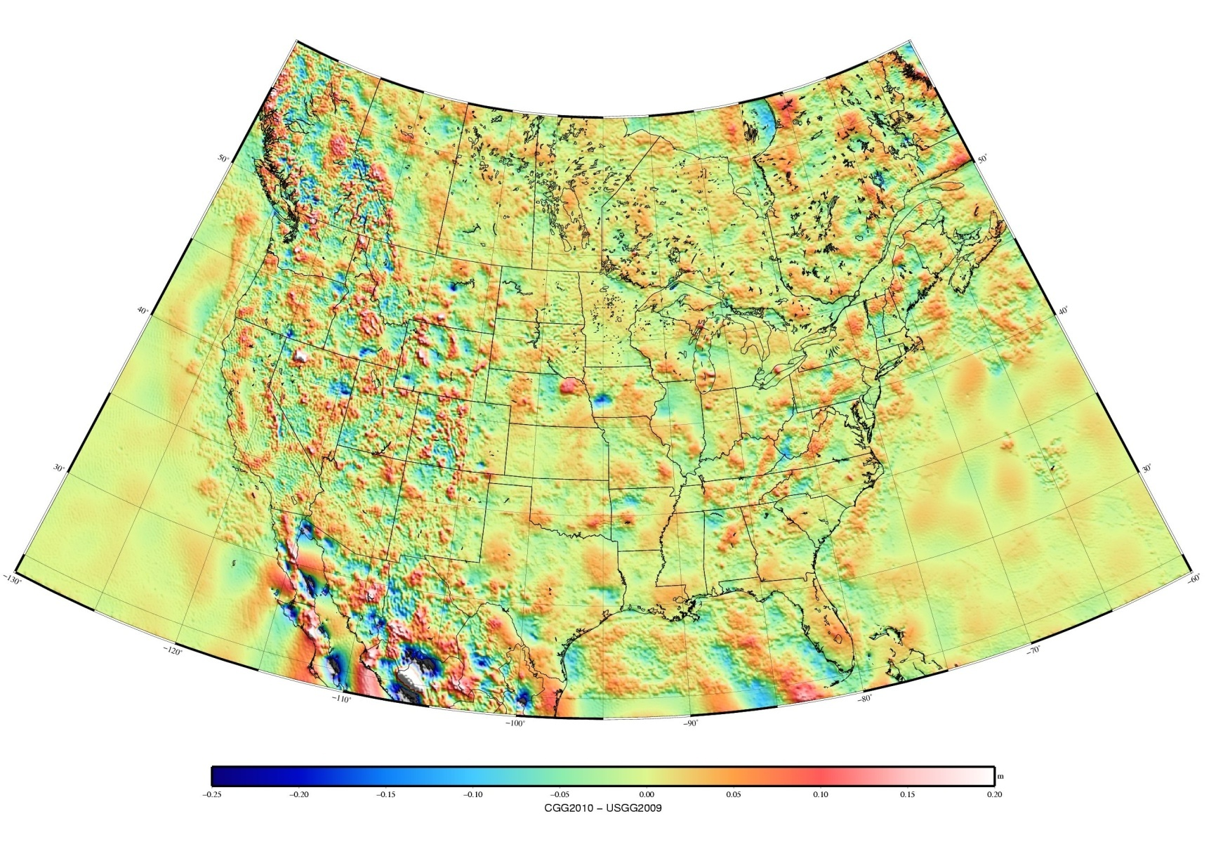
CGG2010 – USGG2009
St. Dev. for BC/AB (filter)
346 GPS on BM stations
CGG2010: 4.5 cm (4.4 cm)
USGG09 : 6.7 cm (6.4 cm)
EGM08 : 6.5 cm (6.2 cm)
Errors come from levelling, GPS, geoid and marker stability
St. Dev. for Rockies (filter)
102 GPS on BM stations
CGG2010: 5.3 cm (5.1 cm)
USGG09 : 8.6 cm (8.3 cm)
EGM08 : 8.7 cm (8.5 cm)
CGG10 – USGG09
Min.: -0.771 m
Max.: 0.933 m
Mean: 0.002 m
StDev: 0.038 m
St. Dev. for Colorado (filter)
602 GPS on BM stations
CGG2010: 7.4 cm (6.2 cm)
USGG09 : 8.5 cm (7.5 cm)
EGM08 : 8.9 cm (7.8 cm)
St. Dev. for Florida (filter)
2275 GPS on BM stations
CGG2010: 6.7 cm (3.1 cm)
USGG09 : 7.2 cm (3.9 cm)
EGM08 : 7.3 cm (4.2 cm)
-20 cm
-10 cm
0 cm
10 cm
20 cm
Notes:
The most recent realization of the geoid models in Canada and USA are converging. The difference has a 3.8 cm RMS.
Canadian solution could be improved by having access to gravity measurements in Mexico. Canadian and American solutions could be improved by exchanging/updating their data sets on a yearly basis. It would allow the correction of the largest discrepancies which are data related.

Slide 16
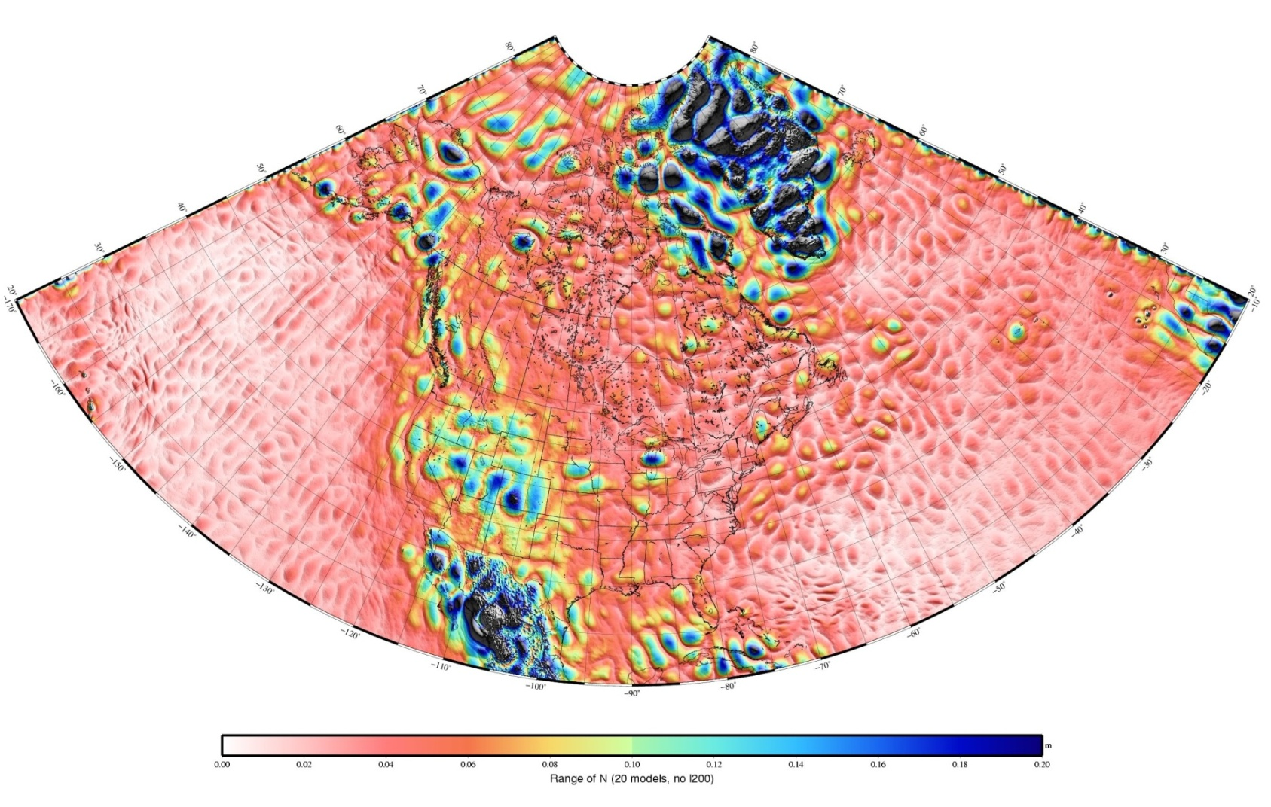
Repeatability of 20 different solutions (common terrestrial dataset)
Five different global models
- EGM08 (GRACE + Terrestrial)
+ D360 and D2190
- GOCO1S (GRACE, GOCE)
+ D224 and ext. D360
- EGM08/GOCO01S
+ D2190
Four degrees of modification
- 60 (335 km)
- 90 (220 km)
- 120 (165 km)
- 140 (140 km)
Statistics
Min.: 0.002 m
Max.: 1.288 m
Mean: 0.068 m
StDev: 0.066 m
Image depicts basically the gravity field difference between the GRACE/GOCE and Terrestrial data for the 60-140 frequency band.
5 cm
10 cm
20 cm
Range of the 20 solutions at each node
Notes:
We did not test modification for degree 150 and 160, but we tested 170. At 170, the degree of modification bring frequency noise into the solution.
It will be interesting to see the contribution of GRAV-D in Alaska. Would the blue colors disappear over Alaska after including GRAV-D? You can also see problems over Lake Michigan. GRAV-D should be beneficial for the Great Lakes.

Slide 17
Comparison of N.A. plans (Geopotential Reference System)
Canada and USA agreed to move to a geoid-based datum
USA: Replace NAVD 88 (and VIVD09, PRVD02 and HIVDyy) with one geoid-based vertical datum at completion of GRAV-D (2022). Similarly for Guam and American Samoa, but with special Pacific geoid models for them.
Canada: Replace CGVD28 with geoid-based vertical datum as early as 2013.
USA and Canada will use a common geoid in 2022
Negotiations require agreement on W₀ value and other issues
Mexico has no program in place to replace NAVD88, but engaging with USA and Canada in realizing a N.A. geoid model
Other countries: No plans to participate or adopt a N.A. datum
Notes:
The 2022 alignment may depend on the impact of height change in Canada.

Slide 18
Comparison of N.A. plans (Geometric Reference System)
USA: Replacement of NAVD88 coincides with replacing NAD83 with a new “horizontal” (e.g. “geometric”) datum
Removes the non-geocentricity of NAD 83
Canada: No plans to replace NAD 83(CSRS)
Mexico: Already works in ITRF08 epoch 2010.0, alleviating the non-geocentricity issue

Slide 19
NAVRS: Fundamental concepts
NAVRS: North American Vertical Reference System (singular vertical datum circa 2022)
Defined according to international standards:
IAG ICP1.2 Conventions for the Definition and Realization of a CVRS
An equipotential surface (W₀, Unit: m² s⁻²)
To be realized by a geoid model (N, Unit: m)
A dynamic surface (N^{dot}, Unit: mm/yr)

Slide 20
NAVRS: Requirements
One geoid model for North America: Canada, United States (including Alaska and Hawaii), Mexico, Caribbean Islands and Central America (possible expansion to include Greenland … South America?)
Accuracy
±1 - 2 cm absolute accuracy in coastal and flat areas;
±3 - 5 cm in mountainous regions
A dynamic surface
Will be updated at certain time interval (time-tagged model)
Will realize a velocity model of the geoid
Notes:
It is required to produce both: velocity model and updated version. The updated version is required to represent the geoid variation for a new epoch AND the improvement due to better theory and data sets since the last realization. The velocity models are required to show users how the geoid change in time and inform them if they should consider or not the dynamic aspect of the geoid. Note: the error of the static geoid model will be probably much larger than the velocity of the geoid.

Slide 21
Required parameters for a geoid model
Geoid model parameters
Potential (e.g., W₀ = 62636855.69 m²/s²)
Reference ellipsoid (e.g., GRS80)
Geometric frame (e.g. NAD83(CSRS), ITRF2008)
Boundaries (North/South/West/East)
Grid Interval (ΔLat , ΔLon)
Geocentric gravitational constant (GM)
Epoch
Tidal System (Tide free, zero tide or mean tide)
Node: Point or mean values / Center or Corner
Supplemental data
Error estimates for geoid heights (σ_{N})
Geoid vertical velocity (N^{dot})
Error estimates of velocities (σ_{N-dot})

Slide 22
Challenges in the 1-cm geoid realization
Theories (more terms = more accurate?)
All computation methods are theoretically equivalent, but not equal. Identical starting equations lead to different realizations and approximations.
Models computed from the same data sets using different methods may differ from cm to dm
How to judge a geoid computation method is superior over others?
How to quantify and verify geoid accuracy (relative and absolute)?

Slide 23
NAVRS: Realization
Realization of the vertical reference system
Ellipsoidal harmonic approach (USA)
Stokes Integral; modified kernel (Canada)
Single datum origin point no longer needed
Data
GRACE (long), GOCE (middle), airborne and ground gravity (short), DEM (very short)
Validation
CORS, CACS, CBN, Benchmarks
No levelling surveys are conducted for the maintenance of the 1st-order network
Deflections of the vertical (astronomical and airborne)
Oceanographic SST models
Including GPS at water and tide gauges

Slide 24
NAVRS: Maintenance
Three options
Define to the best potential value representing the geoid
Advantage: Datum always represent global MSL
Disadvantage: no consistency for heights as W₀ may change significantly
Define to a fixed potential value
Advantage: Possible height consistency if model is at correct surface
Disadvantage: Not necessary consistent with global MSL
Define by the same initial equipotential surface
Advantage: Height consistency; even correct for computational error
Disadvantage: Not consistent with global MSL
Geoid model parameters would allow advanced users to convert data to any datums
Not accounting for Sea Level Change
Favoured option in Canada

Slide 25
Geoid change monitoring
Long wavelength changes can be monitored by satellite gravity missions
as long as a GRACE follow-up or equivalent mission is available
If not, national GNSS network (e.g, CORS, ACS, CBN) with absolute gravity measurements and a geophysical model (a challenging approach)
Medium to short wavelength (e.g., 5-100km) changes may be monitored by combination of GNSS measurements, surface gravity measurements and Deflections of the Vertical for regions of high interest and rapid change
Provide a velocity model of geoid variation
Notes:
NGS and GSD should provide a velocity model of the geoid to indicate to users how the geoid behaves in time. This is in addition to provideinga time-tag geoid model on a regular basis (e.g., 5 years, 10 years, …) or whenever it warrants an update due to new information (data, theory) that provides a more accurate model. With ground technologies, it will not be feasible to monitor short to medium wavelengths across North America; it has to be target areas.

Slide 26
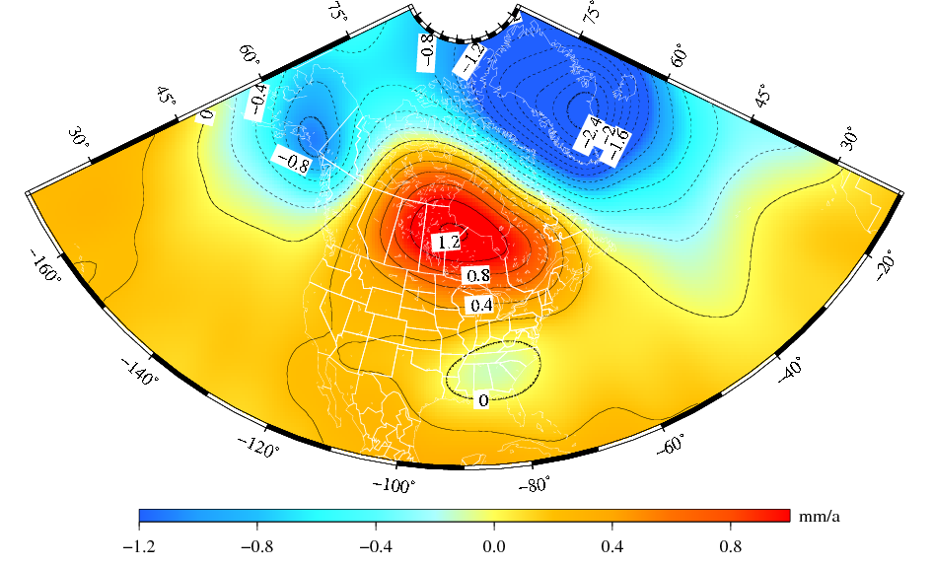
The “secular” geoid change from the monthly GRACE models (2002-2008).
Deglaciation
The solution represents the effect due to total mass changes.
The solution uses a 400-km Gaussian filter.
Glacial Isostatic
Adjustment
Drought
Notes:
Secular is between quotation marks because only GIA is secular, the deglaciation and drought are currently more recent multi-year systematic variations of the geoid. I used the term “secular” not to confuse with seasonal variations of the geoid.

Slide 27
Relationships between WHS, existing VDs and NAVRS
The relationship is through conversion surfaces:
NAVRS ↔ WHS
Should be zero or a potential constant if WHS and NAVRS does not adopt the same equipotential surface
No WHS is established by IAG yet
NAVRS ↔ Levelling datums (NAVD88, CGVD28 and NGVD29)
Use of a hybrid geoid model to convert between geoid and levelling datum
NAVRS ↔ IGLD
Software to convert from orthometric heights to dynamic heights for proper water management of the Great Lakes and St-Lawrence Seaway or any drainage basins

Slide 28
Summary
North America would benefit from a unified vertical datum
NAVRS is to be realized through a geoid model with well established parameters
The geoid model is required to have an absolute accuracy of ±1-2 cm in coastal and flat areas and ±3-5 cm in mountainous regions
Challenges
Canada and USA do not have the same implementation date
Technical aspects
Data accuracy and coverage
Computation methods
Validation and verification
Long-term maintenance of the NAVD
No definition of a WHS yet

Slide 29
Extra Slides

