Slide 1
NGS Status Report to GGOS Bureau for Networks and Communications
Dru Smith
Kendall Fancher
Giovanni Sella

Slide 2
2010 Activities
GGAO Survey
Research
Brewster Recon
Foundation CORS
NGS Policy

Slide 3
GGAO Survey
Notes:
Late In 2009, an NGS survey crew visited GGAO and performed a terrestrial survey of the various space geodetic techniques. The primary purpose of the survey was to research methodologies for local tie determination using readily available instrumentation and data reduction software and renew the capability for conducting such surveys by NGS field crews.

Slide 4
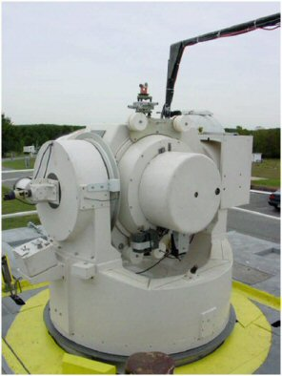
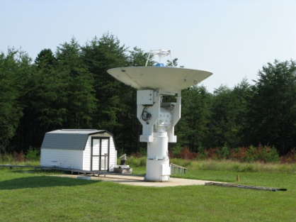
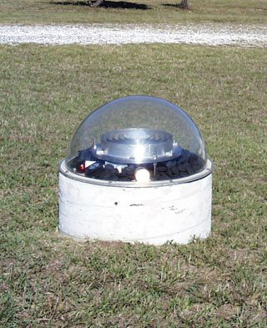
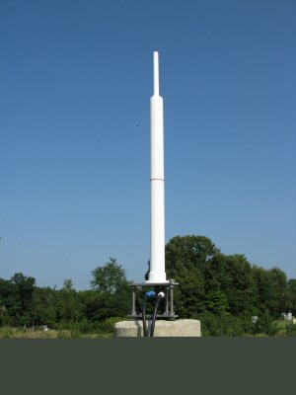
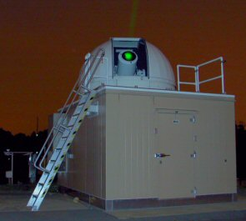
GGAO
Notes:
Terrestrial site surveys have been previously conducted at the GGAO. With the exception of the NG-SLR local ties have been previously determined for the geodetic techniques collocated at the GGAO.

Slide 5
GGAO Control Network
Notes:
NGS field crews incorporated some of the existing geodetic monuments located at the GGAO into the terrestrial survey, but did not attempt to re-observe the historical geodetic network in its entirety. The intent of the NGS terrestrial survey was to bring a fresh approach to determination of the tie vectors and not simply repeat the work previously done by others.

Slide 6
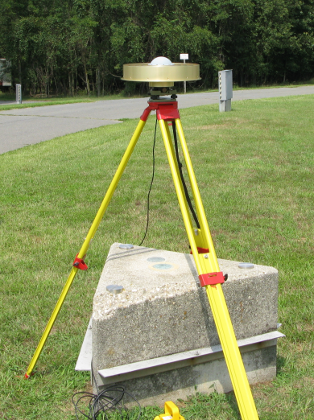
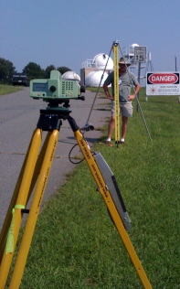
GGAO Survey Equipment
GPS
Trimble R7 GNSS receivers
Javad Ringant-DM GNSS antenna
Leveling
Leica DNA03 digital level
2-meter Invar staff
Angles and Distances
Leica TDMA 5005 total station
Leica GPH1P precision reflectors
Notes:
NGS field crews used surveying instrumentation possessing the highest level of precision currently available. Field data was recorded and processed using commercially available data collection and reduction software.

Slide 7
Status of GGAO Project
GPS data analysis completed
Tie vector data analysis completed
Some problems were encountered
Data collection software used for the survey truncated digits.
Level of achieved precision associated with field measurements was not retained in the final computed coordinates.
Data reduction/adjustment software used for the survey did not allow for creation of variance co-variance matrix.
Unable to generate SINEX file.
Report will be issued
Will provide an independent comparison to previous tie vector information.
Will provide tie vector information for the NG-SLR
The survey provided NGS with an excellent learning opportunity for reacquiring skills necessary to conduct these type surveys.

Slide 8
NGS Research
A robotic precision prism has been developed to allow for remotely controlled pointing of the reflector back to the instrument.
Field procedures are being refined at the NGS Instrumentation & Methodologies Branch facility.
Data collection software is being developed.
Data reduction & adjustment software are being evaluated.

Slide 9
Brewster Recon
Notes:
In July 2010, an NGS crew performed reconnaissance at the Brewster VLBA site in preparation for a terrestrial survey
tie between VLBA and GPS.

Slide 10
Brewster Recon
VLBA, GPS
Notes:
Three existing monuments were recovered during reconnaissance.
Three new “concrete post” type monuments were established during reconnaissance.
All six of the monuments will be utilized during the terrestrial survey.

Slide 11
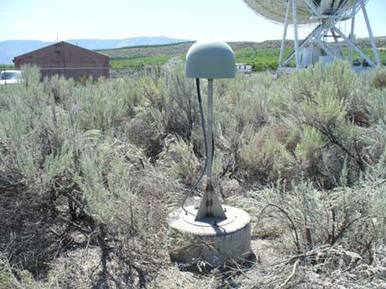
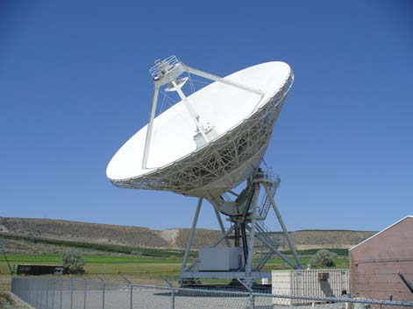
Brewster Recon
CORS ARP will be determined indirectly by intersection. The ARP is inaccessible due to existing GPS antenna radome.
VLBA invariant point will be determined indirectly utilizing robotic prisms and a circle fitting routine.

Slide 12
Foundation CORS
The NGS Executive Steering Committee approved the initiation of the Foundation CORS project
NGS owned and operated sites
Highest quality equipment mounted on deep drill braced quadrapods (as needed)
Five year implementation plan being finalized
Government cost

Slide 13
Foundation CORS
Five year implementation plan being finalized
CONUS points likely to be first
Ongoing internal NGS discussions focused on:
Priority order of site installation
Installation responsibility and costs:
Contract vs NGS-performed
Notes:
Dru’s opinion: NGS will install at least one Foundation CORS site in 2011, but the internal discussions must be resolved quickly.

Slide 14
NGS Policy Commitment
In November 2010, the NGS Executive Steering Committee approved our official engagement in IERS co-location site surveys
Program Lead: Kendall Fancher
(kendall.fancher@noaa.gov)
Details on level of commitment to be worked out in 5 year project plan

Slide 15
NGS Policy Commitment
Over next 5 years, here are the proposed resource commitments:
Travel to appropriate meetings
Surveys at all Foundation CORS sites as installed
One additional non-Foundation CORS survey
Could be international
Based on IERS priority list and available NGS resources

