Slide 1
The 2022 GNSS Survey for a New International Great Lakes Datum
Overcoming Challenges with International Planning and Digital Tools
Ryan HIPPENSTIEL, John MAY, and Jacob HECK, United States, Michael CRAYMER and Rachel VAN HERPT, Canada

Slide 2
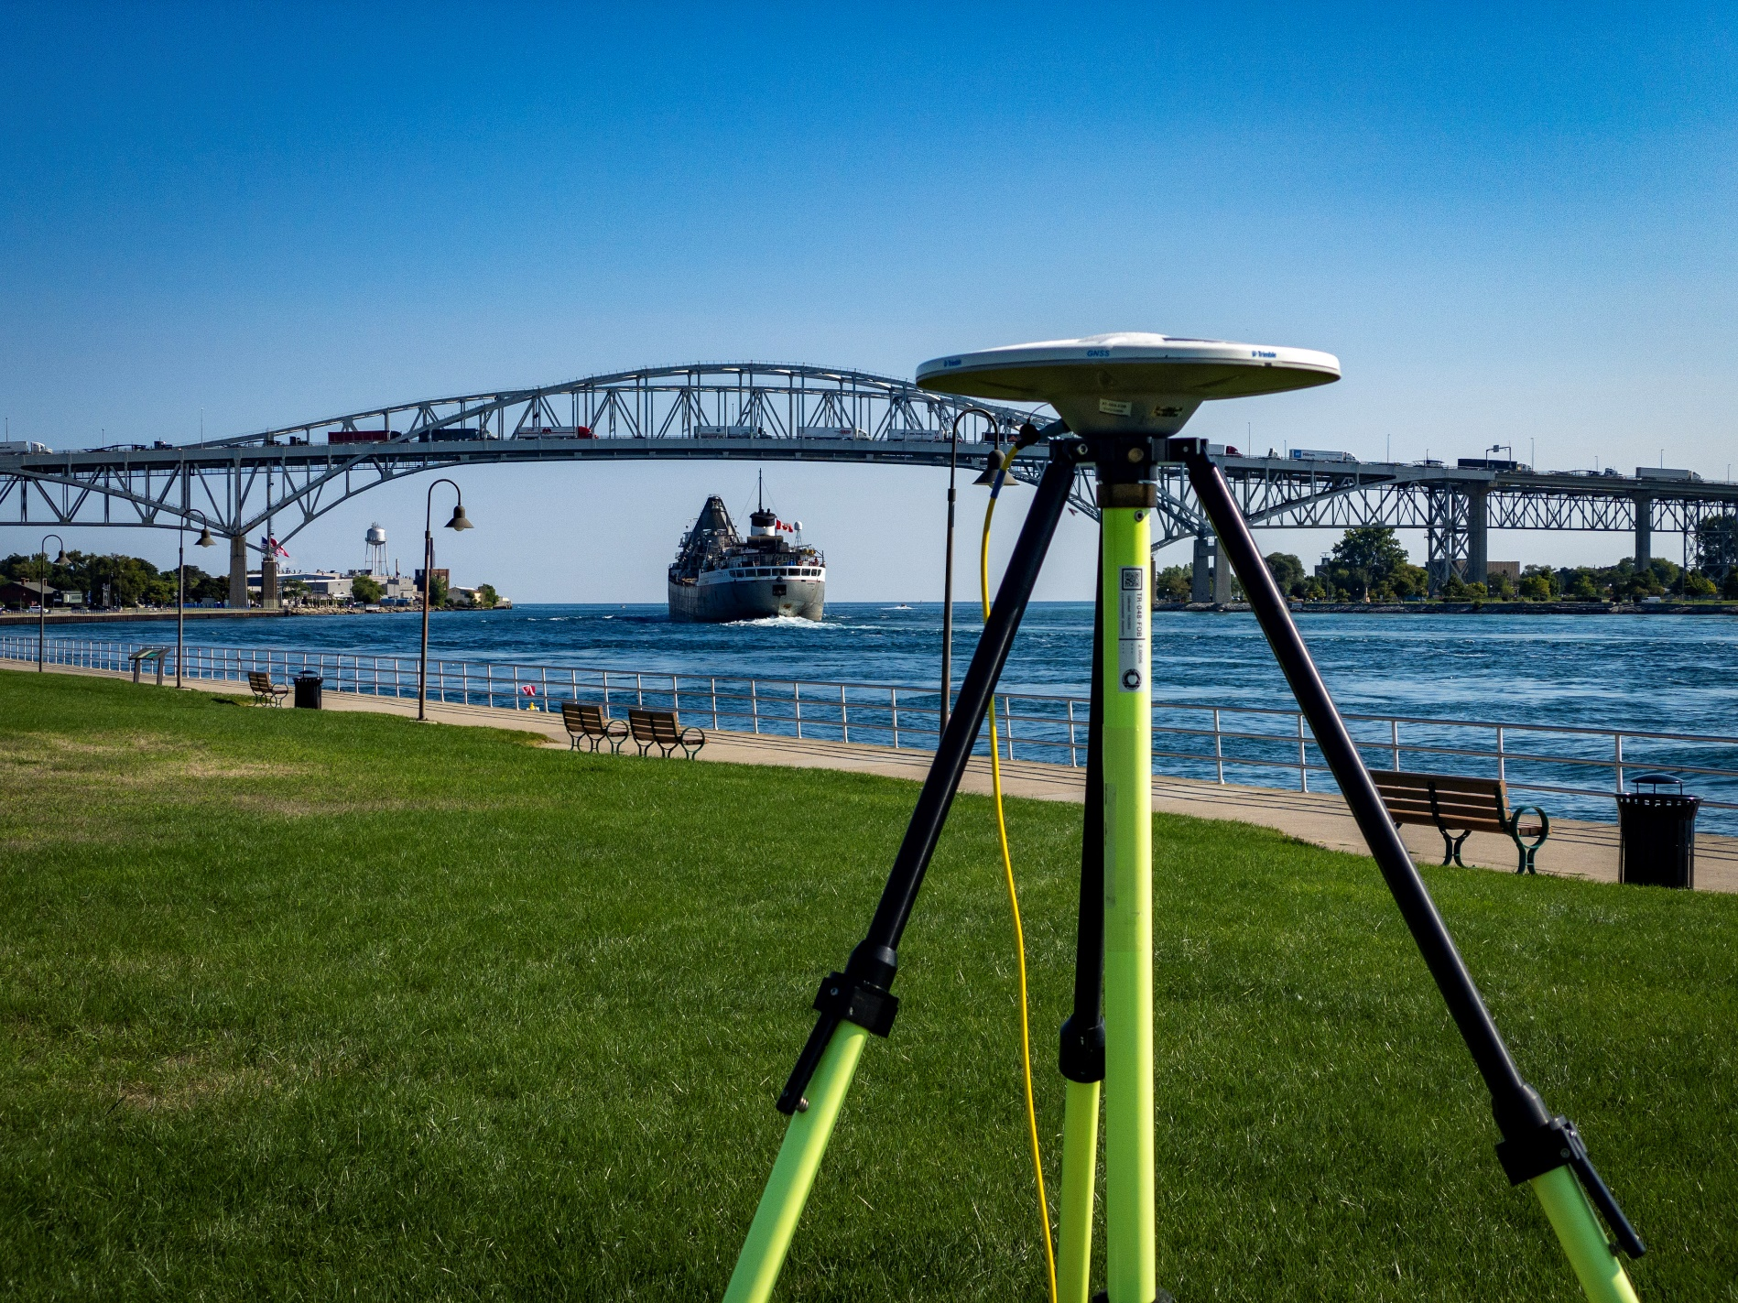
International Cooperation
Surveyors from the US and Canada collaborated in support of the International Great Lakes Datum (IGLD)
The survey collected over 19,000 hours of GNSS over the span of 6 weeks each

Slide 3
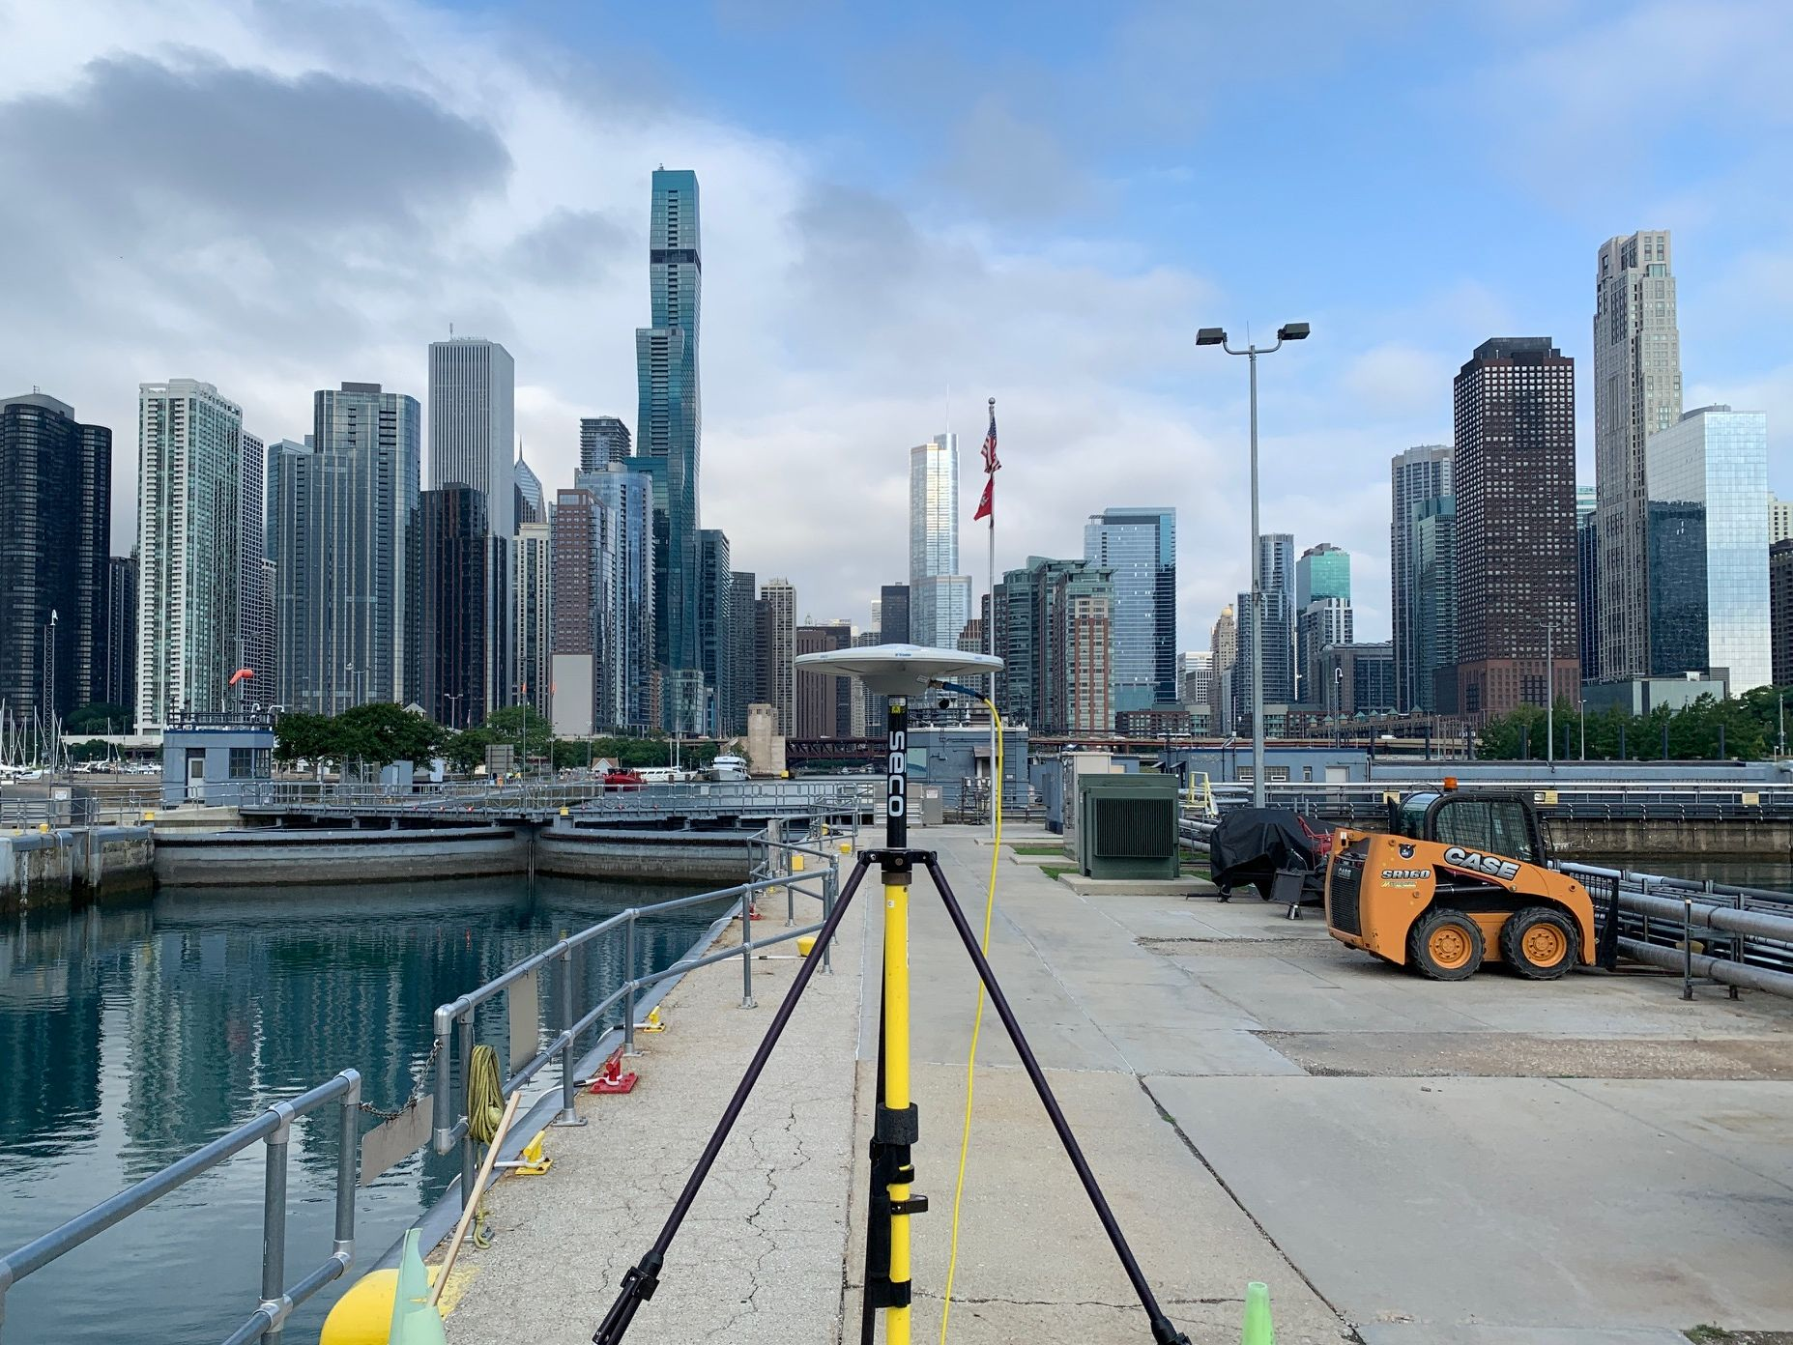
Background
The Great Lakes region is one of the largest freshwater resources on Earth
It is affected by crustal motion largely due to glacial isostatic adjustment (GIA)
The IGLD accounts for such changes to provide a consistent water level datum
IGLD is updated every 25-30 years and a new update is currently underway

Slide 4
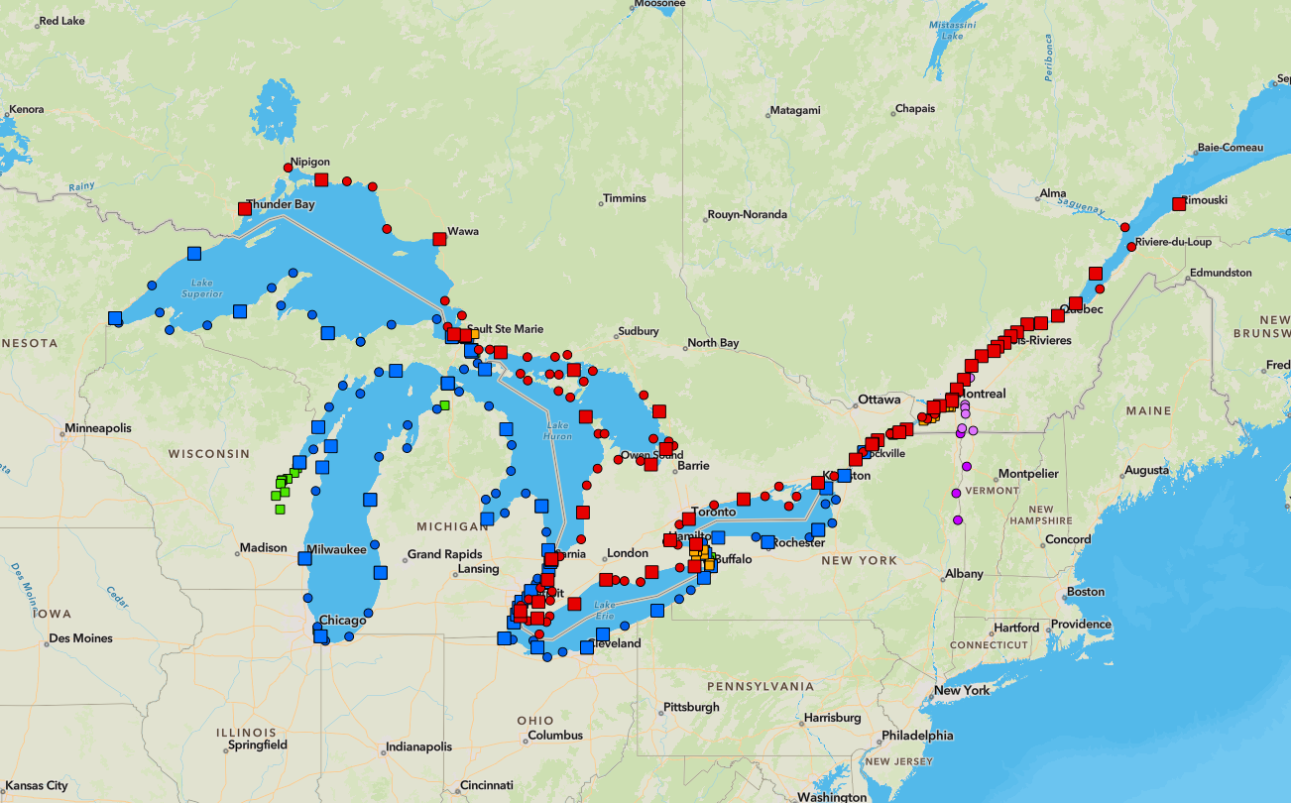
GNSS surveys
GNSS data on ground marks is combined with geodetic leveling data to the water level stations to create datum products
Previous GNSS surveys were completed in 1997, 2005, 2010, and 2015
The 2022 survey was the largest, observing at permanent and seasonal water level stations - 365 bench marks

Slide 5
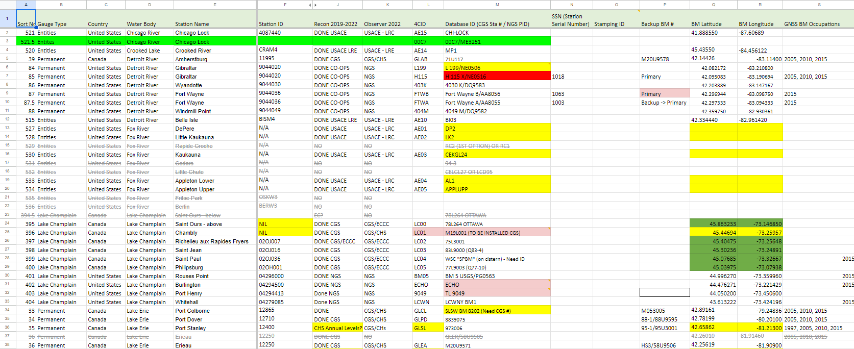
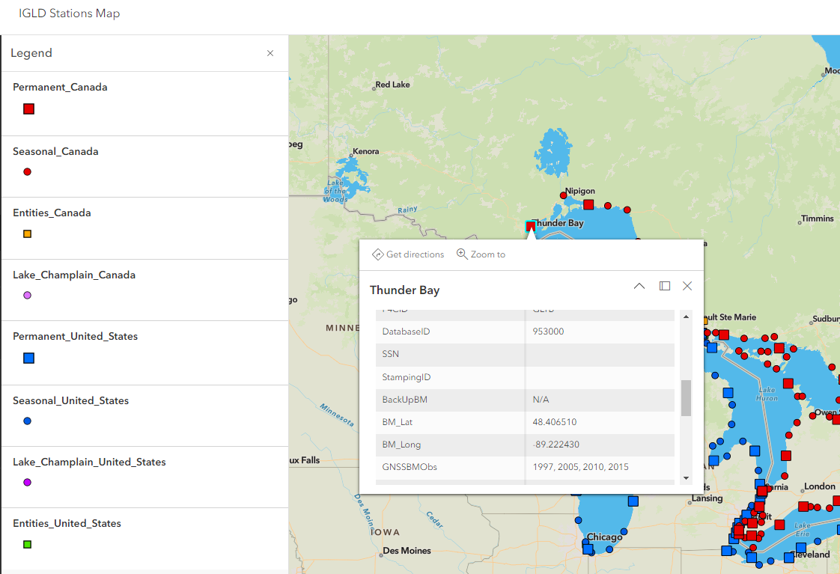
Planning
Geodetic and water level partners from both nations planned the work
Stations and marks to survey were agreed upon
Visualization through web mapping improved planning efforts

Slide 6
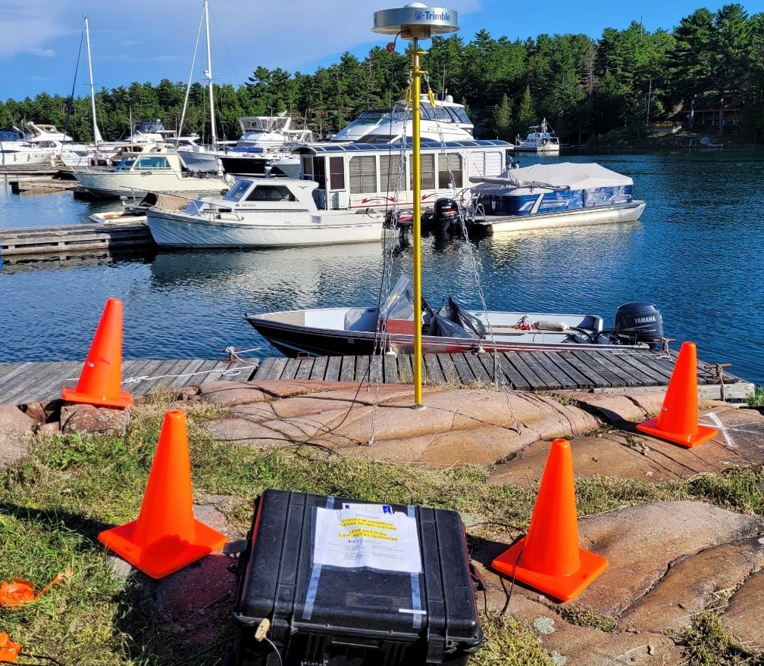
Planning
Binational specifications were written to improve field protocols and account for equipment differences
Details on duration, rate of collection, metadata, quality of equipment were established
Desired accuracy was a minimum of 2 cm at each benchmark

Slide 7
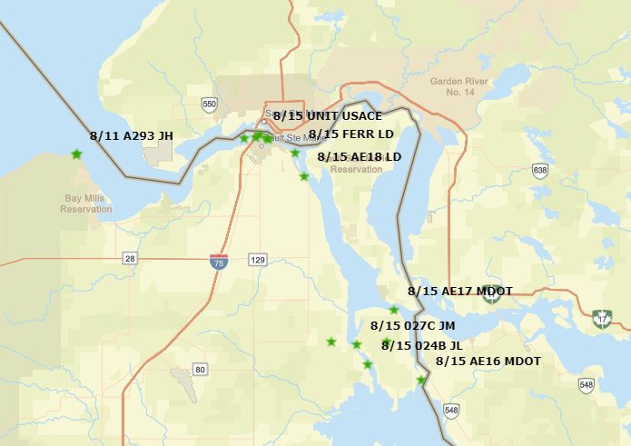
Planning
Two 24-hour static GNSS observations were to be collected on each mark
US and Canada surveyors developed a schedule to maintain pace with each other
Consistent conditions and ”cross-lake” observations were important

Slide 8
Canadian Partners | United States Partners
NRCan - Canadian Geodetic Survey (CGS) | NOAA – National Geodetic Survey (NGS)
DFO - Canadian Hydrographic Service (CHS) | NOAA – Center for Oceanic and Operation Products (CO-OPS)
ECCC - National Hydrological Service (NHS) | US Army Corp of Engineers (USACE)
Ontario Power Generation (OPG) | Michigan Department of Transportation (MDOT)
Saint Lawrence Seaway Management Corporation (SLSMC) | New York Power Authority (NYPA)
Hydro Québec (HQ) | Great Lakes St. Lawrence Seaway Development Corporation (SLSDC)
 | Wisconsin Department of Transportation (WisDOT)
 | Darin J. Henkel, PLS
Execution
Multiple partners assisted with mark reconnaissance and observation
Survey was completed on schedule with limited disruptions
Successful planning and preparations led to efficient adjustments

Slide 9
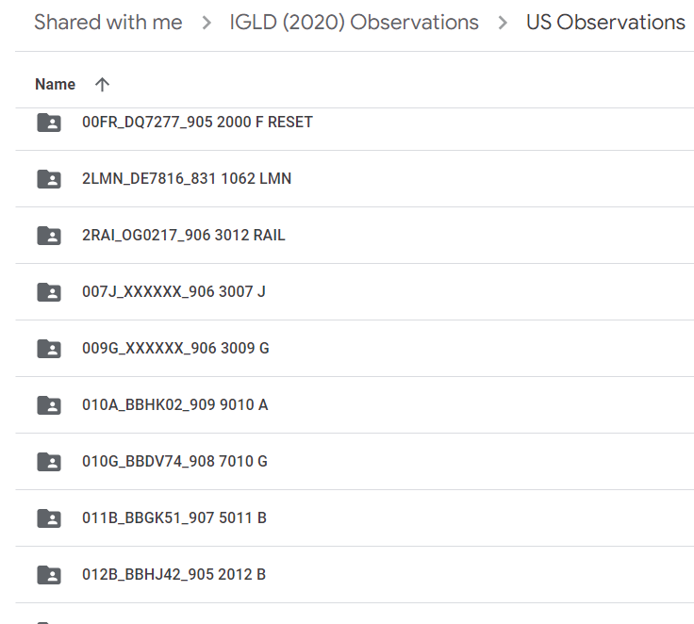
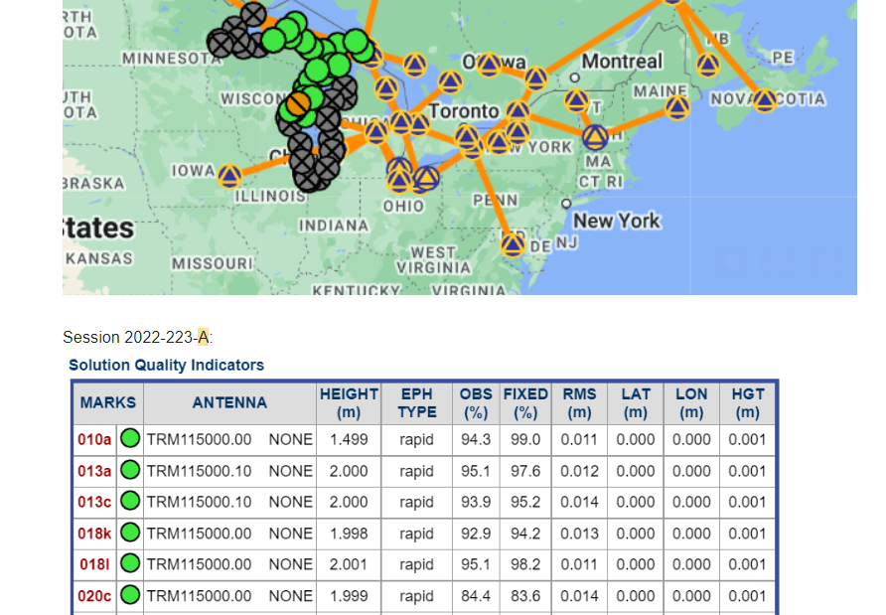
Execution
Both US and Canada implemented protocols for communication and data storage
Established start/stop times worked well for traversing between points and transferring data
Early QA/QC was performed to ensure data quality

Slide 10
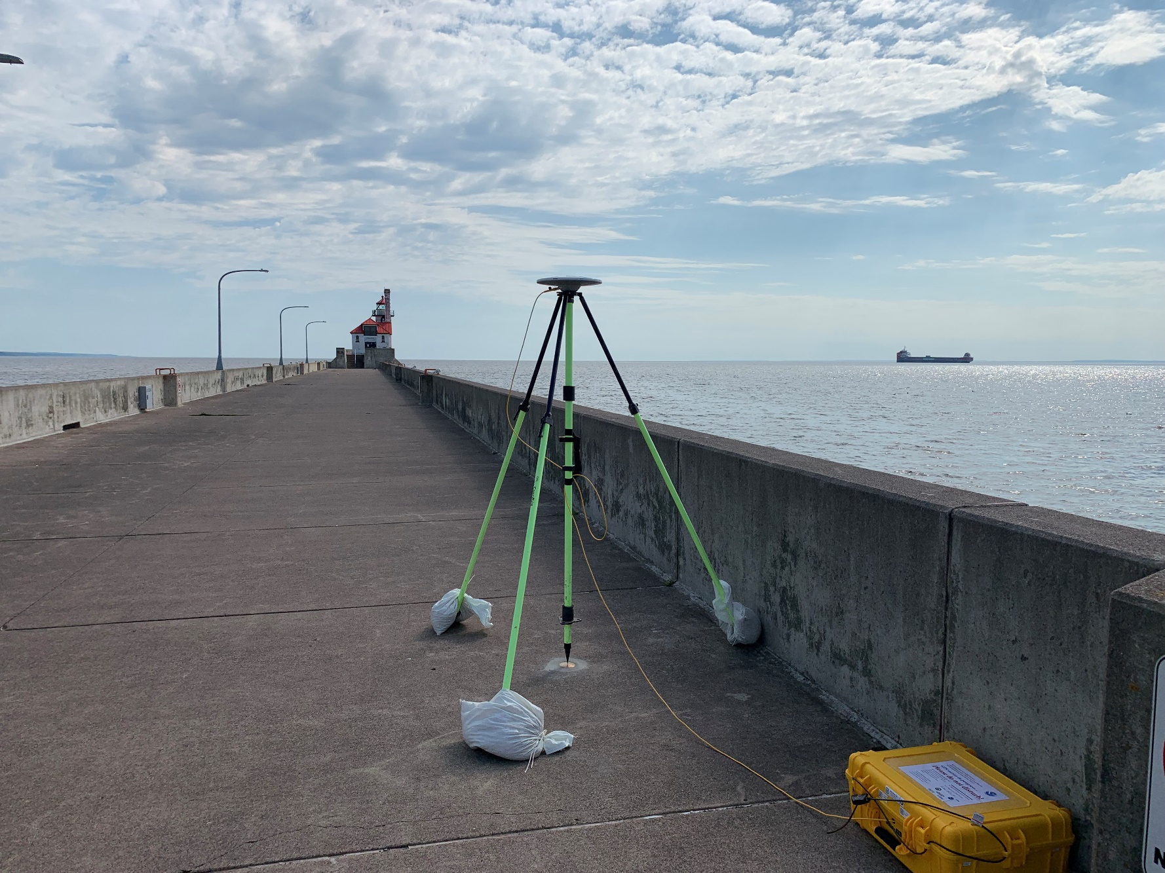
Results
Over 19,000 hours of static GNSS data collected by ~25 observers
Metadata including photos, equipment, mark information, weather, and obstructions delivered
Sub-cm repeatability exceeded goals
Full data processing and adjustment is underway

Slide 11
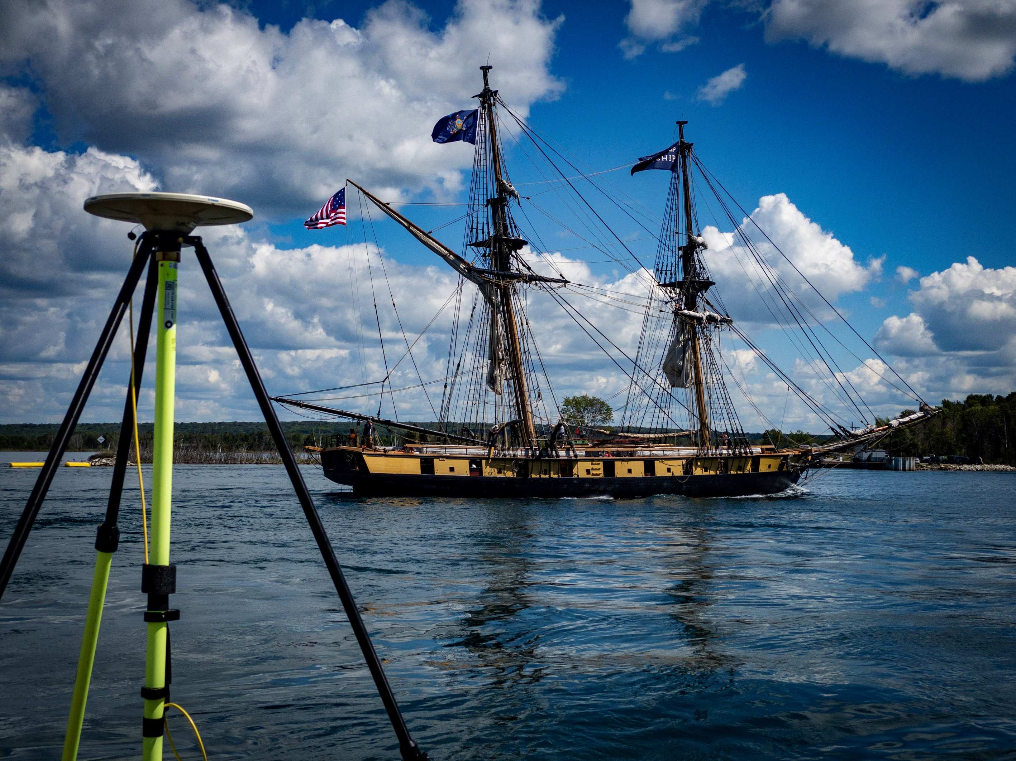
Thank you!
For more information about the IGLD update, visit:
https://GreatLakesCC.org

