Slide 1
NSRS 2022 Update Preparing for NSRS 2022 - What Should You Do Now?
by
Dave Zenk
National Geodetic Survey
Northern Plains Regional Advisor
(MN, ND, SD, NE, IA)
Notes:
NSRS 2022 Update Preparing for NSRS 2022 - What Should You Do Now?
by
Dave Zenk
National Geodetic Survey
Northern Plains Regional Advisor
(MN, ND, SD, NE, IA)

Slide 2
NSRS Background
The National Spatial Reference System (NSRS) consists of the nation’s latitude, longitude, height, scale, gravity, orientation, and how these values change over time.
https://geodesy.noaa.gov/INFO/OnePagers/NSRSOnePager.pdf
Notes:
The National Spatial Reference System (NSRS) consists of the nation’s latitude, longitude, height, scale, gravity, orientation, and how these values change over time.

Slide 3
NSRS Background
Background: Why is NGS replacing NAD 83 and NAVD 88?
NAD 83 and NAVD 88, although still the official horizontal and vertical datums of the National Spatial Reference System (NSRS), have been identified as having shortcomings that are best addressed through defining new horizontal and vertical datums. See the white paper:
Improving the National Spatial Reference System (12 pages)
https://geodesy.noaa.gov/2010Summit/Improving_the_NSRS.pdf
Specifically:
NAD 83 is non-geocentric by about 2.2 meters.
NAVD 88 is both biased (by about one-half meter) and tilted (by about 1 meter coast to coast) relative to the best global geoid models available today.
These issues derive from the fact that both datums were defined primarily using terrestrial surveying techniques at passive geodetic survey marks.
This network of survey marks deteriorates over time (both through unchecked physical movement and destruction), and resources are not available to maintain them.
Notes:
The NGS is replacing NAD 83 and NAVD 88
because they have shortcomings that are best addressed through defining new horizontal and vertical datums.
See the white paper:
Improving the National Spatial Reference System (12 pages)
https://geodesy.noaa.gov/2010Summit/Improving_the_NSRS.pdf
Specifically:
NAD 83 is non-geocentric by about 2.2 meters.
NAVD 88 is both biased (by about one-half meter) and tilted (by about 1 meter coast to coast) relative to the best global geoid models available today.
These issues derive from the fact that both datums were defined primarily using terrestrial surveying techniques at passive geodetic survey marks.
This network of survey marks deteriorates over time (both through unchecked physical movement and destruction), and resources are not available to maintain them.

Slide 4
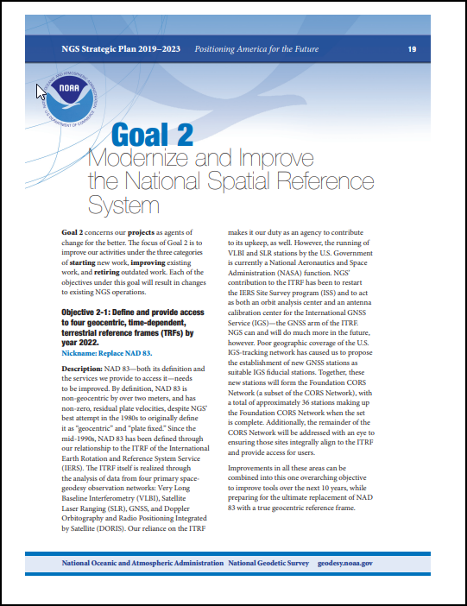
The NGS Stategic Plan
The NGS Strategic Plan - Goal 2: Modernize the NSRS.
https://www.ngs.noaa.gov/INFO/tenyearfinal.shtml
Notes:
The NGS Strategic Plan - Goal 2 specifically addresses the NSRS Modernization Plan.

Slide 5
Needed Research and Development
Major decisions needed to be made regarding how to define and maintain the modernized NSRS.
These are documented. See the following reports:
NOAA Technical Report NOS NGS 62
Blueprint for 2022, Part 1: Geometric Coordinates (61 pages)
NOAA Technical Report NOS NGS 64
Blueprint for 2022, Part 2: Geopotential Coordinates (53 pages)
NOAA Technical Report NOS NGS 67
Blueprint for 2022, Part 3: Working in the Modernized NSRS (133 pages)
https://geodesy.noaa.gov/library/
Notes:
Major decisions needed to be made regarding how to define and maintain the modernized NSRS.
These are documented. See the following reports:
NOAA Technical Report NOS NGS 62
Blueprint for 2022, Part 1: Geometric Coordinates (61 pages)
NOAA Technical Report NOS NGS 64
Blueprint for 2022, Part 2: Geopotential Coordinates (53 pages)
NOAA Technical Report NOS NGS 67
Blueprint for 2022, Part 3: Working in the Modernized NSRS (133 pages)

Slide 6
Recent Progress at NGS
Geoid Slope Validation Success
GSVS11 (Texas), GSVS14 (Iowa), GSVS17 (Colorado)
validates H = h-N
GRAV-D completion
Vertical Datum Transformation Tool (GPS on BM Campaign)
NCAT Improvements
M-Pages
NOS NGS 92
Let’s take a brief look at these projects.
Notes:
Several enabling projects are needed for successful Modernization.
These include:
3 Geoid Slope Validation Surveys
GSVS11 (Texas), GSVS14 (Iowa), GSVS17 (Colorado)
to validate H = h-N
GRAV-D completion
Vertical Datum Transformation Tool (GPS on BM Campaign)
NCAT Improvements
M-Pages
NOS NGS 92
Let’s take a brief look at these projects

Slide 7
Geoid Slope Validation Success
NGS needed to prove that defining heights using gravity and a high-precision geoid model would be able to acceptably duplicate the results of traditional leveling.
Put in algebraic terms H = h - N:
Orthometric height (H) = Ellipsoid Height (h) – Geoid Model (N)
Ellipsoid Height (h) will be measured using GPS
Geoid Model (N) will be computed from the global gravity field
Orthometric Height (H) will be computed.
“the gravimetric geoid used in defining the NSRS should have an absolute accuracy of 1 centimeter at any place and at any time.”
- the NGS 10 Year Plan
Notes:
NGS needed to prove that defining heights using gravity and a high-precision geoid model would be able to acceptably duplicate the results of traditional leveling.
Quoting the NGS 10 Year Plan in part:
…the gravimetric geoid used in defining the NSRS should have an absolute accuracy of 1 centimeter at any place and at any time.”
Put in algebraic terms:
Orthometric height (H) = Ellipsoid Height (h) – Geoid Model (N)
Ellipsoid Height (h) will be measured using GPS
Geoid Model (N) will be computed from the global gravity field
Orthometric Height (H) will be computed.

Slide 8
Geoid Slope Validation Success
Success, essentially complete!
See NGS Presentations Library:
“Geoid Slope Validation Surveys - Ground Truth Tests of the Models” by Derek van Westrum
https://geodesy.noaa.gov/web/science_edu/presentations_library/files/vanwestrum_gsvssummary.pptx
Notes:
NGS has produced a summary slide set on the success of the GEOID Slope Validation Surveys.
You can view the slides at the NGS Presentation Library.

Slide 9
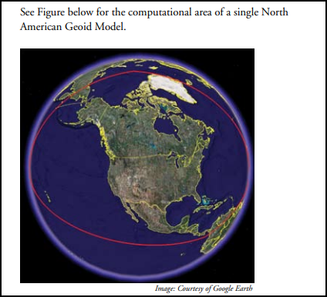
GRAV-D
Flying an airborne gravity meter at 20,000 feet.
Measure the Earth’s gravity field with sufficient density and accuracy to create a “geoid model” over ¼ of the Earth – to cover the USA.
Success, essentially complete!
https://www.ngs.noaa.gov/GRAV-D/pubs/GRAV-D_v2007_12_19.pdf
Notes:
The GRAV-D Mission required
Flying an airborne gravity meter at 20,000 feet to measure the Earth’s gravity field with sufficient density and accuracy to create a “geoid model” over ¼ of the Earth – to cover the USA.
The GRAV-D Mission passed the 99% complete status in October 2023.

Slide 10
Geoid Model (N)
GSVS proved that we are able to compute an acceptably accurate geoid model if we have adequate gravity field measurements.
Completion of GRAV-D provided the needed gravity field measurements.
Result: NGS can now compute the needed Geoid Model (N)
Success, essentially complete!
Success, essentially complete!
Success, essentially complete!
Notes:
GSVS proved that we are able to compute an acceptably accurate geoid model if we have adequate gravity field measurements.
Completion of GRAV-D provided the needed gravity field measurements.
With the result that NGS can now compute the needed Geoid Model (N)

Slide 11
GPS on BM Campaign
The NGVD29 and NAVD88 heights were defined by leveling, and NAPGD2022 heights will be defined by H=h-N.
So, there is a need to transform heights in the former vertical datums to heights in the new datum.
A sample point for the transformation tool must have a published height from leveling (NGVD29 or NAVD88) and an ellipsoid height from GPS.
Since the presence of such marks is variable across the USA, NGS launched a GPS on BM Campaign to densify the collection of sample points.
Notes:
The NGVD29 and NAVD88 heights were defined by leveling, and NAPGD2022 heights will be defined by H=h-N.
So, there is a need to transform heights in the former vertical datums to heights in the new datum.
A sample point for the transformation tool must have a published height from leveling (NGVD29 or NAVD88) and an ellipsoid height from GPS.
Since the presence of such marks is variable across the USA, NGS launched a GPS on BM Campaign to densify the collection of sample points.

Slide 12
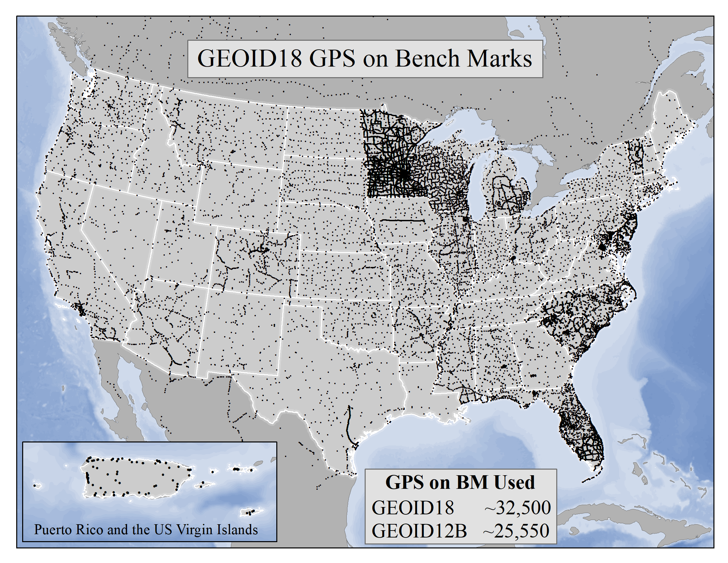
GPS on BM Campaign
Variable spacing of GPS on BM in USA for GEOID18
Notes:
This map shows the variable spacing of marks across the USA that were used in creating the GEOID18 Model.
The GSVS in Texas and in Iowa are included.

Slide 13
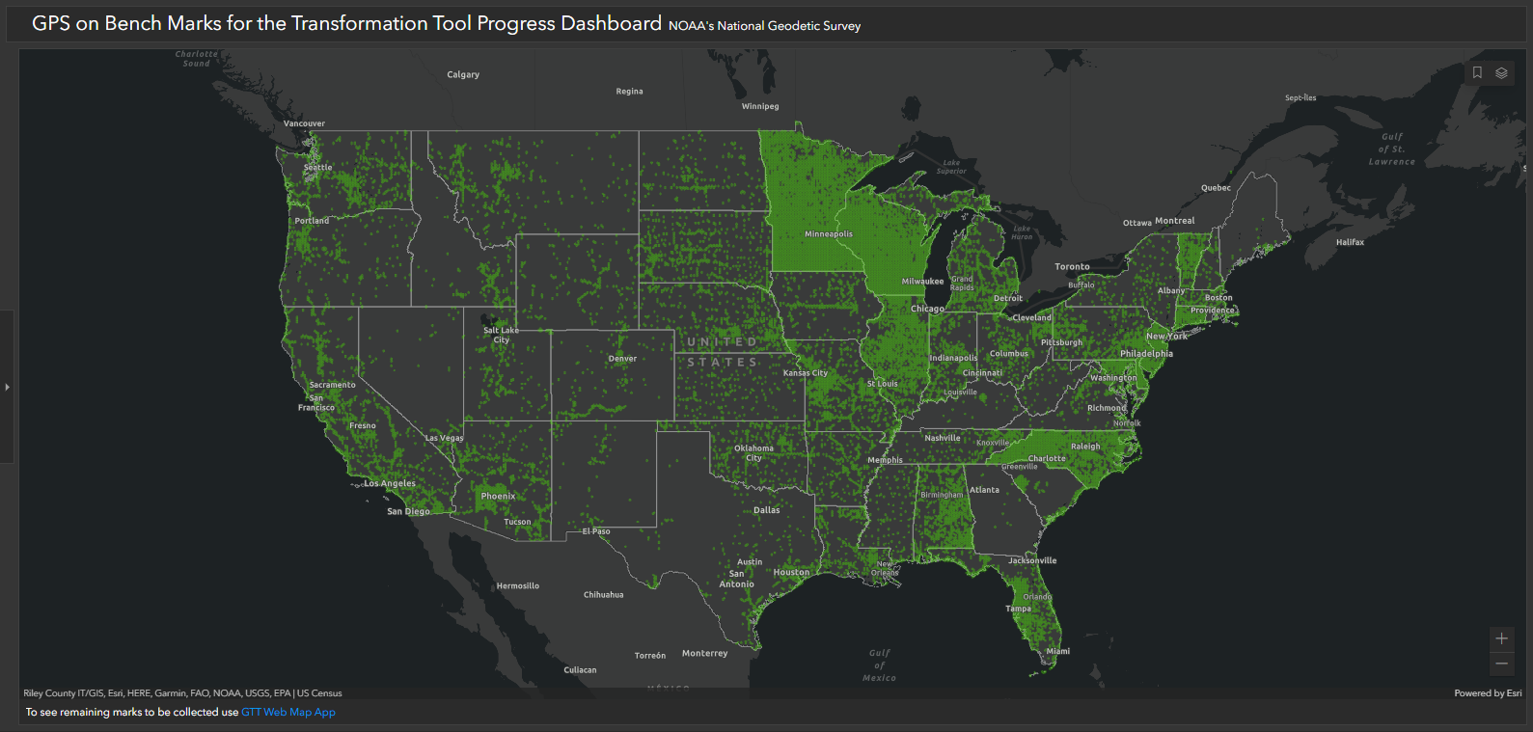
GPS on BM Campaign
Variable spacing of GPS on BM in USA persists.
October 11, 2023
Notes:
To increase the density of GPS on BM points for future geoid models, the GPS on BM Campaign was initiated.
Comparing this slide to the previous slide shows increased density in many areas.
Notably,
Northeastern Iowa
Southern Nebraska
Western South Dakota
Central North Dakota
Most of Minnesota and Wisconsin

Slide 14
GPS on BM Campaign
Q) Is it “too late” to densify the collection of GPS on BM in the state?
A1) The “deadline” was September 30, 2023 to guarantee that submitted data WOULD be included in the transformation tool.
A2) Data submitted after the deadline MAY be included up until a final data pull is made and the transformation tool is created.
No, it’s not “too late”.
Notes:
Q) Is it “too late” to densify the collection of GPS on BM in the state?
The simple answer is
No, it’s not “too late”.
A1) The “deadline” was September 30, 2023 to guarantee that submitted data WOULD be included in the transformation tool.
A2) Data submitted after the deadline MAY be included up until a final data pull is made and the transformation tool is created

Slide 15
GPS on BM Campaign
Even if you miss the GPS on BM “cutoff” date, it is still valuable to submit observations.
…Adding GPS data on these marks allows them to be used in the modernized NSRS…
Means that observations on existing marks and new marks will pre-populate the NSRS2022 in your community!
Notes:
Even if you miss the GPS on BM “cutoff” date, it is still valuable to submit observations.
Quoting the GPS on BM One Pager in part:
…Adding GPS data on these marks allows them to be used in the modernized NSRS…
Means that observations on existing marks and new marks will pre-populate the NSRS2022 in your community!
And the recoveries you submit will help perpetuate the existing passive marks network.

Slide 16
GPS on BM Campaign
If you have access to dual-frequency GPS equipment, you can submit data to the GPS on BM Campaign and to OPUS Share.
https://geodesy.noaa.gov/GPSonBM/GPSonBM-one-pager2022.pdf
Notes:
If you have access to dual-frequency GPS equipment, you can submit data to the GPS on BM Campaign and to OPUS Share.

Slide 17
GPS on BM Campaign
GPS on BM requires
a mark recovery
2 OPUS Share Observations
Helpful 10 minute video
https://geodesy.noaa.gov/corbin/class_description/opus-share-tutorial/
Notes:
GPS on BM requires
a mark recovery and
2 OPUS Share Observations
Helpful 10 minute video is available:
How to Submit an OPUS Share Observation

Slide 18
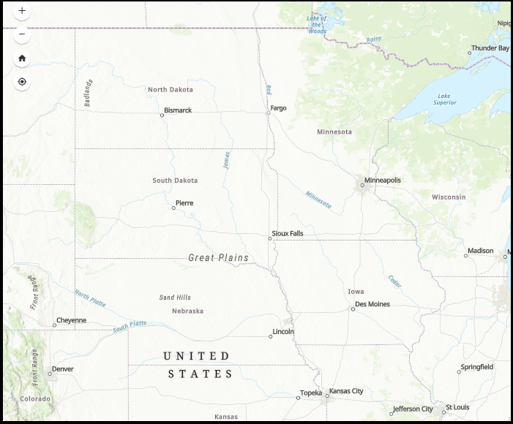
GPS on BM Campaign
Where are the NGS Passive Marks in Your State?
Pre-populate the future NSRS2022 in your local area.
You can use GPS on BM and OPUS Share to add new passive marks in your local area in preparation for NSRS2022.
You are in control of where, when, and how many geodetic control marks are in your community.
Notes:
You can use GPS on BM and OPUS Share to add new passive marks and thereby pre-populate the future NSRS2022 in your local area.
You are in control of where, when, and how many geodetic control marks are in your community.
So, where are the NGS Passive Marks in Your State?

Slide 19
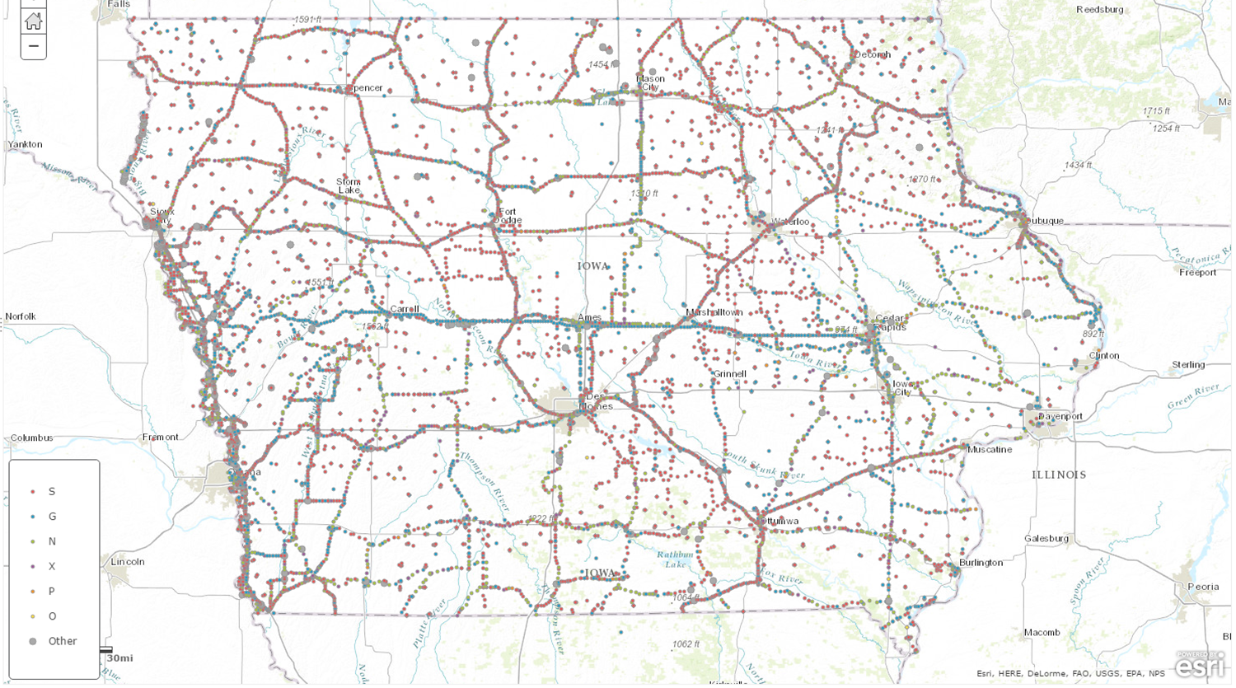
Iowa Passive Mark Network
Shows only NGS Database marks.
Local marks exist, too
Closely-spaced symbols = benchmarks along lines of leveling.
Notes:
This is a map of the Iowa Passive Mark Network.
The closely-spaced symbols = benchmarks along lines of leveling.

Slide 20
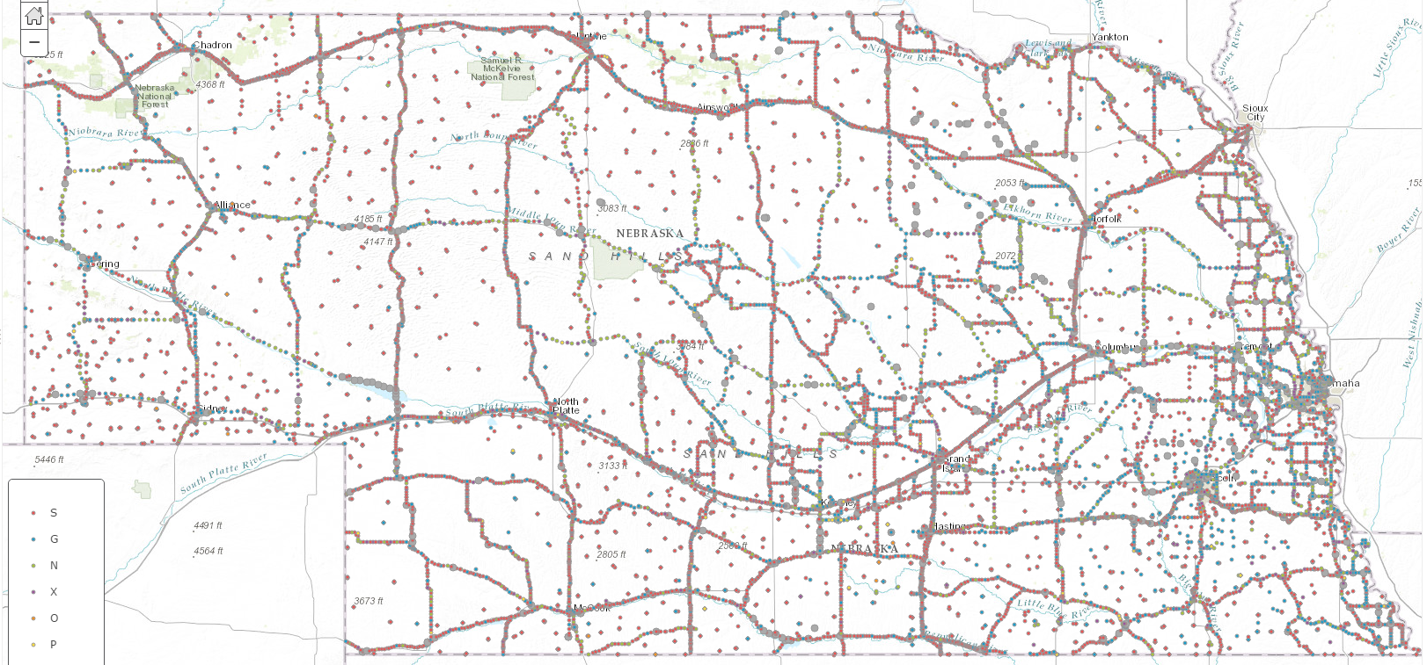
Nebraska Passive Mark Network
12 mile radius
Shows only NGS Database marks.
Local marks exist, too
Notes:
The Nebraska Passive Mark Network.
This map, like the others, shows that there are many areas where NAD83 and NAVD88 marks are not available.
By participating in the GPS on BM and OPUS Share Campaigns, you can pre-populate the future NSRS2022 in your local area and provide more readily-available passive marks in your community.

Slide 21
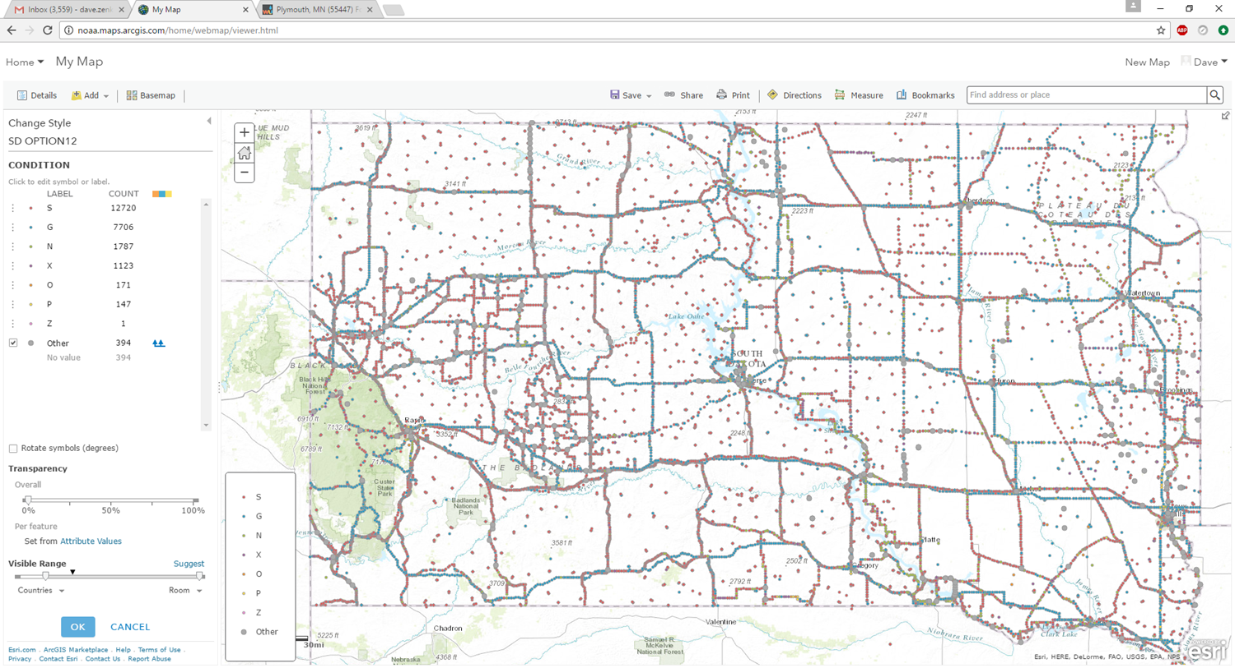
South Dakota Passive Mark Network
12 mile radius
Shows only NGS Database marks.
Local marks exist, too
Notes:
The South Dakota Passive Mark Network.

Slide 22
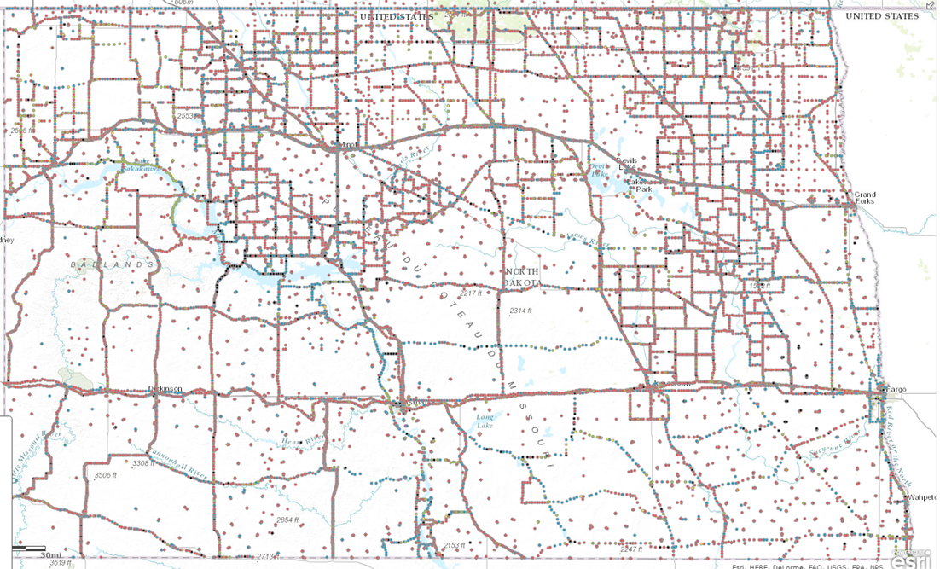
North Dakota Passive Mark Network
12 mile radius
Shows only NGS Database marks.
Local marks exist, too
Notes:
The North Dakota Passive Mark Network.

Slide 23
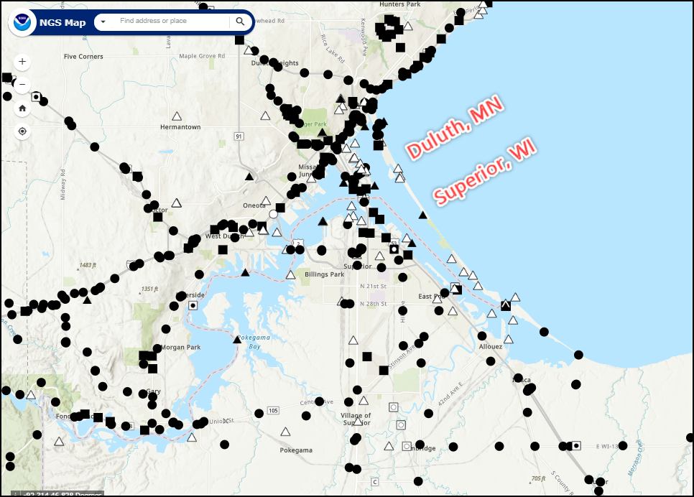
Minnesota Passive Mark Network
Use the NGS Map to zoom in on a local area
https://geodesy.noaa.gov/datasheets/
Shows only NGS Database marks.
Local marks exist, too
Notes:
The Minnesota Passive Mark Network.
Note that the NGS Passive Mark Map tool allows you to zoom in on any local area.

Slide 24
Coordinate Shifts
It is expected that all 3 components of position (Lat/Lon/Ellht) will be different in the NATRF2022 datum.
The Orthometric height will also be different in the NAPGD2022 datum.
The NGS “New Datums” page has some diagrams for the expected differences (next 3 slides).
Notes:
It is expected that all 3 components of position (Lat/Lon/Ellht) will be different in the NATRF2022 datum.
The Orthometric height will also be different in the NAPGD2022 datum.
The NGS “New Datums” page has some diagrams for the expected differences (next 3 slides).

Slide 25
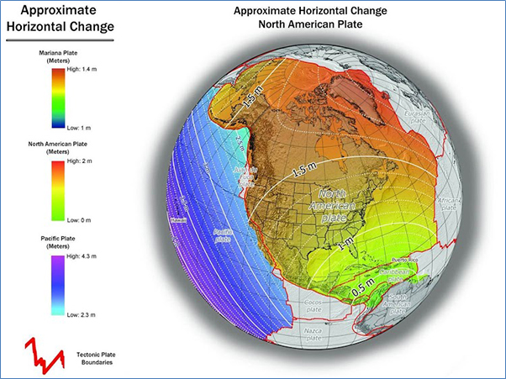
Coordinate Shifts
Ames IA
about 1.25 meters
Notes:
The approximate Horizontal Change varies, in Ames IA it will be about 1.25 meters

Slide 26
Coordinate Shifts
Ames IA
about -1.0 meters
Notes:
The approximate Ellipsoid Height Change varies, in Ames IA it will be about -1.0 meters

Slide 27
Coordinate Shifts
Ames IA
about -0.75 meters
Notes:
The approximate Orthometric Height change varies, in Ames IA it will be about -0.75 meters

Slide 28
Coordinate Shift
The OPUS Static solution contains a preview of the future coordinates. Example: Ames IA
REF FRAME: NAD_83(2011)(EPOCH:2010.0000) ITRF2014 (EPOCH:2023.7484)
X: -294704.762(m) 0.006(m) -294705.729(m) 0.006(m)
Y: -4737326.292(m) 0.009(m) -4737324.953(m) 0.009(m)
Z: 4246573.802(m) 0.003(m) 4246573.704(m) 0.003(m)
LAT: 42 0 34.52731 0.004(m) 42 0 34.55266 0.004(m)
E LON: 266 26 24.96815 0.006(m) 266 26 24.92261 0.006(m)
W LON: 93 33 35.03185 0.006(m) 93 33 35.07739 0.006(m)
EL HGT: 266.500(m) 0.008(m) 265.486(m) 0.008(m)
ORTHO HGT: 296.411(m) 0.045(m)
[NAVD88 (Computed using GEOID18)]
APPROX ORTHO HGT: 295.660(m) [PROTOTYPE (Computed using xGeoid19B,GRS80,ITRF2014)]
Diff LAT = 0.75 meters northerly
Diff LON = 1.04 meters westerly
Diff Ellht = - 1.014 meters
Diff Ortho = - 0.751 meters
Notes:
The OPUS Static solution contains a preview of the future coordinates. Example: Ames IA

Slide 29
NCAT
NGS Coordinate Conversion and Transformation Tool (NCAT)
Transforms between several existing HORIZ and VERT datums.
You can use this tool now!
Notes:
The NGS Coordinate Conversion and Transformation Tool (NCAT)
transforms between several existing HORIZ and VERT datums.
The NCAT Tool is available for you to use now.

Slide 30
NCAT
NGS Coordinate Conversion and Transformation Tool (NCAT)
Will provide the needed transformation tool to transform heights in former datums to heights in the new datum.
Also provides the transformation tool to transform lat/lon/ellht in former datums to lat/lon/ellht in the new datum.
Notes:
The NCAT Tool
Will provide the needed transformation tool to transform heights in former datums to heights in the new datum.
Also provides the transformation tool to transform lat/lon/ellht in former datums to lat/lon/ellht in the new datum.

Slide 31
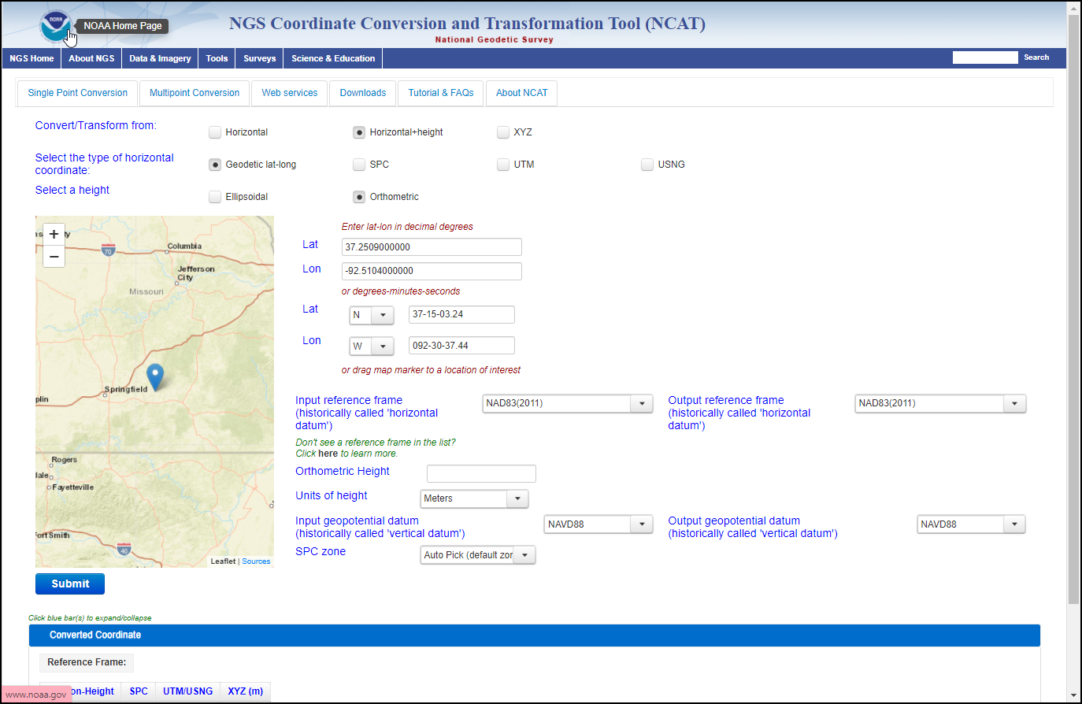
NCAT
NCAT allows
Single point conversion
Multipoint conversion
API-web services
Downloadable version
You can use this tool now!
Notes:
The NCAT tool allows
Single point conversion
Multipoint conversion
API-web services, and a
Downloadable version for large datasets

Slide 32
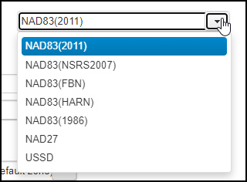
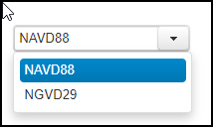
NCAT
Current datum selections
You can use this tool now!
Notes:
The current datum selections are available now for your use

Slide 33
NCAT
NCAT will include NSRS2022
Future datum selections
NCAT will include NAPGD2022
Notes:
Future datums selections for NSRS2022 and NAPGD2022 will be added.

Slide 34
M-PAGES
NGS is developing a multi-constellation processor to replace its GPS-only software known as PAGES.
PAGES is the software behind OPUS and other NGS applications.
The replacement software, called M-PAGES, will facilitate shorter observation times in more difficult conditions and provide more robust solutions.
Notes:
NGS is developing a multi-constellation processor to replace its GPS-only software known as PAGES.
PAGES is the software behind OPUS and other NGS applications.
The replacement software, called M-PAGES, will facilitate shorter observation times in more difficult conditions and provide more robust solutions

Slide 35
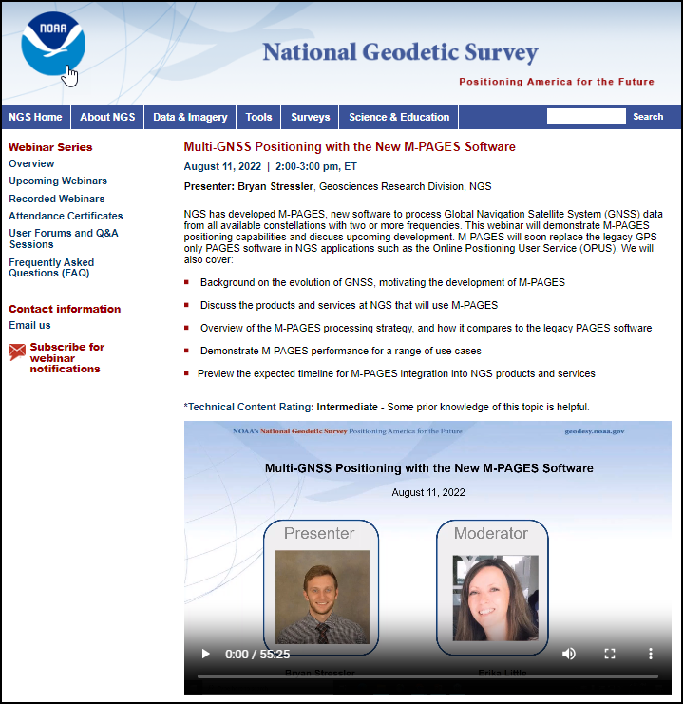
M-PAGES
View recorded webinar on M-PAGES
M-PAGES is not yet implemented.
https://geodesy.noaa.gov/web/science_edu/webinar_series/multi-ngss-world-at-ngs.shtml
Notes:
You can view a recorded webinar on M-PAGES.
Note that M-PAGES is not yet implemented.

Slide 36
NOS NGS 92
NOAA Technical Memorandum NOS NGS 92
Sets Standards and Specifications for surveys that will be submitted to NGS for inclusion in the NGS Integrated Database (NGSIDB).
This is important to the success of NSRS2022 because it facilitates establishment and publication of local geodetic control (Lat/Lon/EllHt/OrthoHt) by engineers and surveyors.
Puts you in control of where, when, and how many geodetic control marks are in your community.
Notes:
NOAA Technical Memorandum NOS NGS 92
Sets Standards and Specifications for surveys that will be submitted to NGS for inclusion in the NGS Integrated Database (NGSIDB).
This is important to the success of NSRS2022 because it facilitates establishment and publication of local geodetic control (Lat/Lon/EllHt/OrthoHt) by engineers and surveyors.
Puts you in control of where, when, and how many geodetic control marks are in your community.

Slide 37
NOS NGS 92
To be released in draft form for public review and comment.
The important tables are already available (subject to change).
NGS Presentations Library
https://geodesy.noaa.gov/web/science_edu/presentations_library/files/nos_ngs_92_webinar_2023-04-13.pptx
Recorded Webinar
https://geodesy.noaa.gov/web/science_edu/webinar_series/videos/classifications-standards-specs-OP5-1.mp4
Notes:
NOS NGS 92 is to be released in draft form for public review and comment.
The important tables are already available (subject to change).
You can view the recorded April 13, 2023 NGS 92 webinar and download the slides.

Slide 38
Preparation Steps You Can Take
Everyone’s situation is different, so no set of steps is universal.
However, a listing of positive, pro-active plans and actions can be suggested for consideration.
Notes:
Everyone’s situation is different, so no set of steps is universal.
However, a listing of positive, pro-active plans and actions can be suggested for consideration.

Slide 39
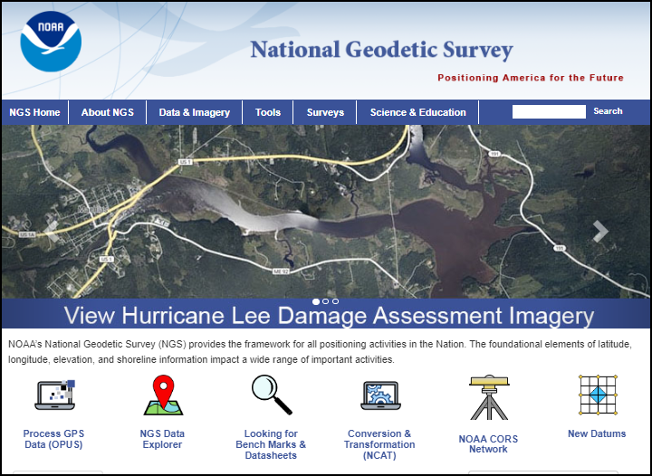
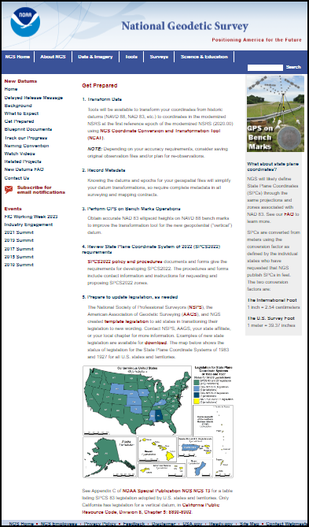
Preparation Steps You Can Take
NGS has listed 5 such steps on its New Datums page.
Notes:
NGS has listed 5 such steps on its New Datums page.

Slide 40
Preparation Steps You Can Take
1. Transform Data
Tools will be available to transform your coordinates from historic datums (NAVD 88, NAD 83, etc.) to coordinates in the modernized NSRS at the first reference epoch of the modernized NSRS (2020.00) using NGS Coordinate Conversion and Transformation Tool (NCAT).
Now would be a good opportunity to transform data collections from their legacy datums to the current datums (NAVD88 and NAD83) using NCAT.
NOTE: Depending on your accuracy requirements, consider saving original observation files and/or plan for re-observations.
Notes:
1. Transform Data
Tools will be available to transform your coordinates from historic datums (NAVD 88, NAD 83, etc.) to coordinates in the modernized NSRS at the first reference epoch of the modernized NSRS (2020.00) using NGS Coordinate Conversion and Transformation Tool (NCAT).
Now would be a good opportunity to transform data collections from their legacy datums to the current datums (NAVD88 and NAD83) using NCAT.
NOTE: Depending on your accuracy requirements, consider saving original observation files and/or plan for re-observations.

Slide 41
Preparation Steps You Can Take
2. Record Metadata
Inventory the metadata of your existing geospatial files to enable prioritizing their transformations
Knowing the datums and epochs for your geospatial files will simplify their datum transformations
Require complete metadata in all surveying and mapping contracts.
Metadata is essential for efficient file management and transformational certainty.
Notes:
2. Record Metadata
Inventory the metadata of your existing geospatial files to enable prioritizing their transformations
Knowing the datums and epochs for your geospatial files will simplify their datum transformations
Require complete metadata in all surveying and mapping contracts.

Slide 42
Preparation Steps You Can Take
3. Perform GPS on Bench Mark Observations
Obtain accurate NAD 83 (Lat/Lon/EllHt) on benchmarks, thus densifying the local geodetic network for use today.
The NAD 83 ellipsoid heights on NAVD 88 bench marks will improve the transformation tool for the new geopotential “vertical” datum (NAPGD2022).
These observations will also pre-populate your location with NSRS2022 positions (Lat/Lon/EllHt/OrthoHt) without further action on your part.
Notes:
3. Perform GPS on Bench Mark Observations
You will obtain accurate NAD 83 (Lat/Lon/EllHt) on benchmarks, thus densifying the local geodetic network for use today.
The NAD 83 ellipsoid heights on NAVD 88 bench marks will improve the transformation tool for the new geopotential “vertical” datum (NAPGD2022).
And, these observations will also pre-populate your location with NSRS2022 positions (Lat/Lon/EllHt/OrthoHt) without further action on your part.

Slide 43
Preparation Steps You Can Take
4. Review State Plane Coordinate System of 2022 (SPCS2022) requirements
SPCS2022 policy and procedures documents and forms give the requirements for developing SPCS2022. The procedures and forms include contact information and instructions for requesting and proposing SPCS2022 zones.
Low-Distortion Projections (LDPs) have been designed and adopted for all states.
Many NGS webinars are available for viewing – see:
NGS Presentations Library
NGS Recorded Webinar
Notes:
4. Review State Plane Coordinate System of 2022 (SPCS2022) requirements
SPCS2022 policy and procedures documents and forms give the requirements for developing SPCS2022. The procedures and forms include contact information and instructions for requesting and proposing SPCS2022 zones.
Low-Distortion Projections (LDPs) have been designed and adopted for all states.
Many NGS webinars are available for viewing – see:
NGS Presentations Library
NGS Recorded Webinar

Slide 44
Preparation Steps You Can Take
5. Prepare to update legislation, as needed
The National Society of Professional Surveyors (NSPS), the American Association of Geodetic Surveying (AAGS), and NGS created template legislation to aid states in transitioning their legislation to new wording.
Notes:
5. Prepare to update legislation, as needed
The National Society of Professional Surveyors (NSPS), the American Association of Geodetic Surveying (AAGS), and NGS created template legislation to aid states in transitioning their legislation to new wording.

Slide 45
Preparation Steps You Can Take
Deprecation of US Survey Foot
Review the excellent “Fate of the US Survey Foot” webinar by Dr. Michael Dennis
https://www.ngs.noaa.gov/web/science_edu/webinar_series/fate-of-us-survey-foot.shtml
Notes:
Deprecation of US Survey Foot
Review the excellent “Fate of the US Survey Foot” webinar by Dr. Michael Dennis

Slide 46
Preparation Steps You Can Take
Deprecation of US Survey Foot
NGS will support legacy US Ft units for SPCS 83
NGS will use only Intl Ft in NSRS2022, SPCS2022, and LDPs
The Meter can be correctly used in older and newer SPCS.
NIST Table of Conversions
Ratio = 1.000002 or 0.999998
https://www.nist.gov/pml/us-surveyfoot/revised-unit-conversion-factors
Notes:
Deprecation of US Survey Foot
NGS will support legacy US Ft units for SPCS 83
NGS will use only Intl Ft in NSRS2022, SPCS2022, and LDPs
The Meter can be correctly used in older and newer SPCS.

Slide 47
Preparation Steps You Can Take
Deprecation of US Survey Foot
Unit Conversions can be easily confused.
If the conversion ratio between US Survey Feet and International Feet is near unity, then it is easy to multiply or divide by mistake, since the end result is so close to the starting values.
NIST Table of Conversions
Ratio = 1.000002 or 0.999998
https://www.nist.gov/pml/us-surveyfoot/revised-unit-conversion-factors
Notes:
Deprecation of US Survey Foot
Unit Conversions can be easily confused.
If the conversion ratio between US Survey Feet and International Feet is near unity, then it is easy to multiply or divide by mistake, since the end result is so close to the starting values.

Slide 48
Preparation Steps You Can Take
Deprecation of US Survey Foot
For small distances, such as building dimensions, lot dimensions on plats, and heights, there is very little impact.
That’s because
1.00000 Meter = 3.280833333 US Survey Feet
1.00000 Meter = 3.280839895 International Feet
Or put another way:
100.00000 US Survey Feet = 100.00020 International Feet
5280.00000 US Survey Feet = 5280.01056 International Feet
The International Foot
1 inch = 2.54 centimeters
1 meter = 39.370078740 inches
The U.S. Survey Foot
1 meter = 39.37 inches
Ratio = 1.000002 or 0.999998
Should I multiply or divide by which ratio to convert one to the other?
Easy to confuse.
Notes:
Deprecation of US Survey Foot
For small distances, such as building dimensions, lot dimensions on plats, and heights, there is very little impact.
That’s because
1.00000 meter = 3.280833333 US Survey Feet
1.00000 meter = 3.280839895 International Feet
Or put another way:
100.000 US Survey Feet = 100.0002 International Feet
5280.00000 US Survey Feet = 5280.01056 International Feet
Ratio = 1.000002 or 0.999998
Should I multiply or divide by which ratio to convert one foot unit to the other?
Easy to confuse.

Slide 49
Preparation Steps You Can Take
Deprecation of US Survey Foot
However, when using State Plane Coordinates or Low Distortion Projection Coordinates, the coordinate values are large numbers, so it is imperative to keep your UNITS correct in the metadata.
Example:
350,000.000 US Ft = 350,000.700 Intl Ft
The International Foot
1 inch = 2.54 centimeters
1 meter = 39.370078740 inches
The U.S. Survey Foot
1 meter = 39.37 inches
Notes:
Deprecation of US Survey Foot
However, when using State Plane Coordinates or Low Distortion Projection Coordinates, the coordinate values are large numbers, so it is imperative to keep your UNITS correct in the metadata.
Example:
350,000.000 US Ft = 350,000.700 Intl Ft

Slide 50
Preparation Steps You Can Take
Deprecation of US Survey Foot
For maximal clarity and least confusion, consider switching all future measurements and future stored data to METRIC Units.
Since the Meter is easily and correctly convertible to US Ft or Intl Ft, it will be less likely to be wrongly done.
People are not machines, they often duck the metadata and fail to label the dimensions as US Ft or Intl Ft, instead labeling as simply Ft, leading to mistakes.
The International Foot
1 inch = 2.54 centimeters
1 meter = 39.370078740 inches
The U.S. Survey Foot
1 meter = 39.37 inches
Definition of Meter not changed since 1792.
https://www.nist.gov/si-redefinition/meter
Notes:
Deprecation of US Survey Foot
For maximal clarity and least confusion, consider switching all future measurements and future stored data to METRIC Units.
Since the Meter is easily and correctly convertible to US Ft or Intl Ft, it will be less likely to be wrongly done.
People are not machines, they often duck the metadata and fail to label the dimensions as US Ft or Intl Ft, instead labeling as simply Ft, leading to mistakes.

Slide 51
Unit Cancellation
My college professor did not like Unit Conversion Factor Tables.
Professor showed us that if we only knew a few conversion ratios, that they could be multiplied together in strings, like fractions, and cancellation of units would help prevent errors.
Cancel units in numerator and denominator like fractions.
Seems like the simplest things cause the most trouble.
I don’t know if this will help you, but it was a real help to me at the time.
Notes:
Seems like the simplest things cause the most trouble.
My college professor did not like Unit Conversion Factor Tables.
Professor showed us that if we only memorized a FEW known conversion ratios, that they could be multiplied together in strings, like fractions, and cancellation of units would help prevent errors.
Cancel units in numerator and denominator like fractions.
I don’t know if this will help you, but it was a real help to me at the time.

Slide 52
Unit Cancellation
If a = b, then a/b = 1 and b/a = 1
1 US Ft = 12 US Inches
Since all correct conversion ratios = 1, they can be used as multipliers without changing the equivalency.
But caution, the conversion ratios must in fact be correct.
1 US Ft
12 US Inches
=
1
12 US Inches
1 US Ft
=
1
Notes:
If a = b, then a/b = 1 and b/a =1
1 US Ft = 12 US Inches, can be expressed as inverse ratios, each equal to 1.
Since all correct conversion ratios = 1, they can be used as multipliers without changing the equivalency.
But caution, the conversion ratios must in fact be correct.

Slide 53
Unit Cancellation
Conversion Factors – how do avoid errors?
You only need to KNOW a few, but then combine them as needed. Use UNIT CANCELLATION.
Memorize a few Known Unit Conversions:
1 US Ft = 12 US Inches
1 Intl Ft = 12 Intl Inches
1 Meter = 100 Centimeters
1 Intl Inch = 2.54 Centimeters
1 Meter = 39.37 US Inches
Express as a ratio:
1 US Ft
12 US Inches
or
12 US Inches
1 US Ft
The International Foot
1 inch = 2.54 centimeters
The U.S. Survey Foot
1 meter = 39.37 inches
These factors are all definitional and exact.
Notes:
Conversion Factors – how do avoid errors?
You only need to KNOW a few, but then combine them as needed. Use UNIT CANCELLATION.
Memorize a few Known Unit Conversions, then express them as RATIOs

Slide 54
Unit Cancellation
Example of Unit “cancellation” (numerator and denominator) - convert US Ft to Meters
1,306.247 US FT
x
12 US Inches
1 US Ft
x
1 Meter
39.37 US Inches
=
398.1449 Meters
Correct answer, units cancel
1,306.247 US FT
x
1 US Ft
12 US Inches
x
39.37 US Inches
1 Meter
=
Wrong answer, not all units cancel
NIST Table of Conversions
https://www.nist.gov/pml/us-surveyfoot/revised-unit-conversion-factors
Notes:
Example of Unit “cancellation” (numerator and denominator) - convert US Ft to Meters

Slide 55
Unit Cancellation
Example of Unit “cancellation” (numerator and denominator) - convert US Ft to Intl Ft
x
12 US Inches
1 US Ft
x
1 Meter
39.37 US Inches
x
100 Centimeters
1 Meter
x
1,306.247 US FT
1 Intl Inch
2.54 Centimeters
x
1 Intl Ft
12 Intl Inches
=
1306.24961249 Intl Ft
Correct answer, units cancel
NIST Table of Conversions
https://www.nist.gov/pml/us-surveyfoot/revised-unit-conversion-factors
Notes:
Example of Unit “cancellation” (numerator and denominator) - convert US Ft to Intl Ft

Slide 56
NSRS 2022 Update
Questions

