Slide 1
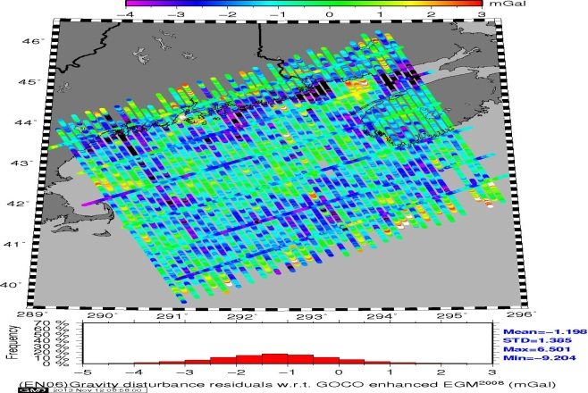
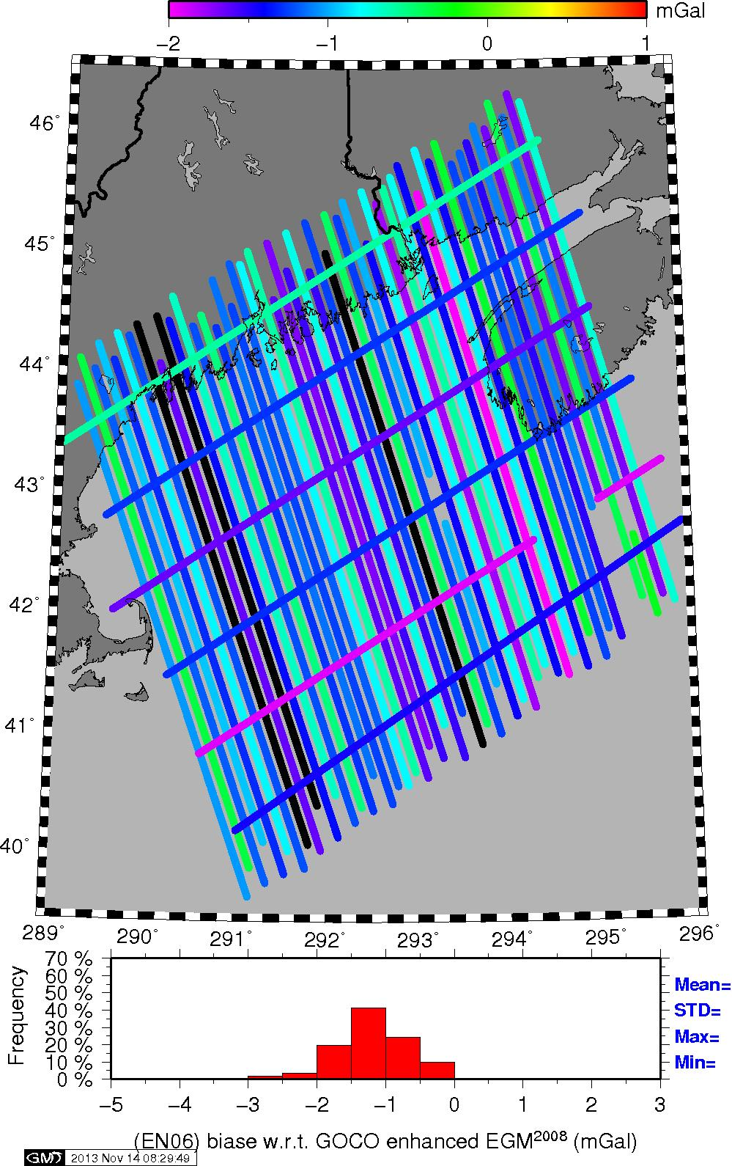
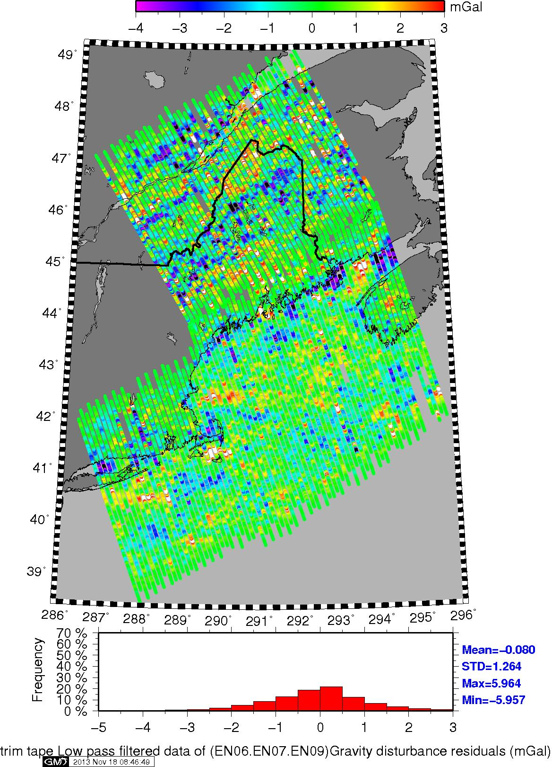
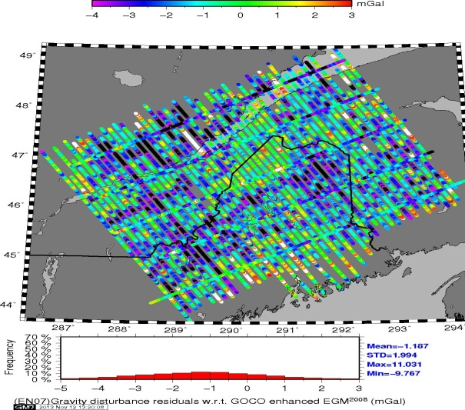
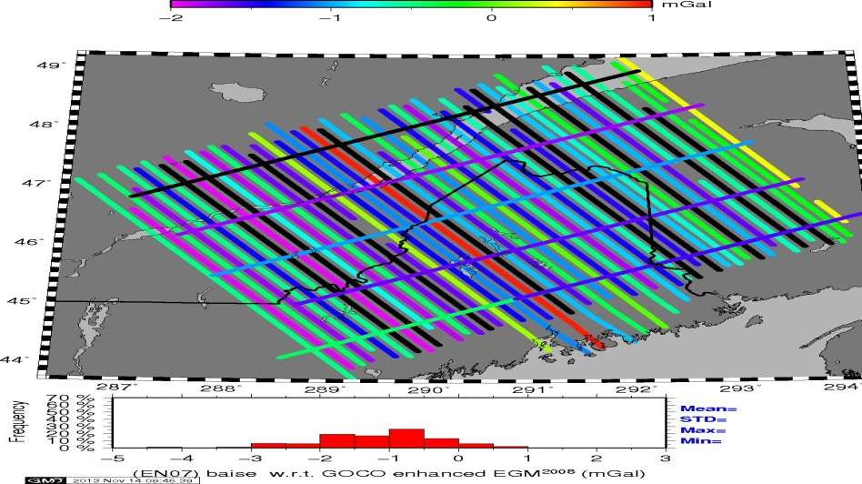
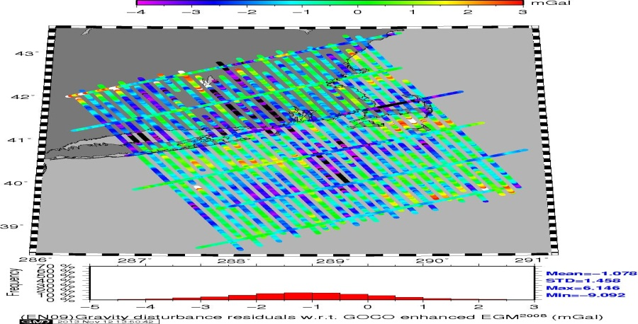
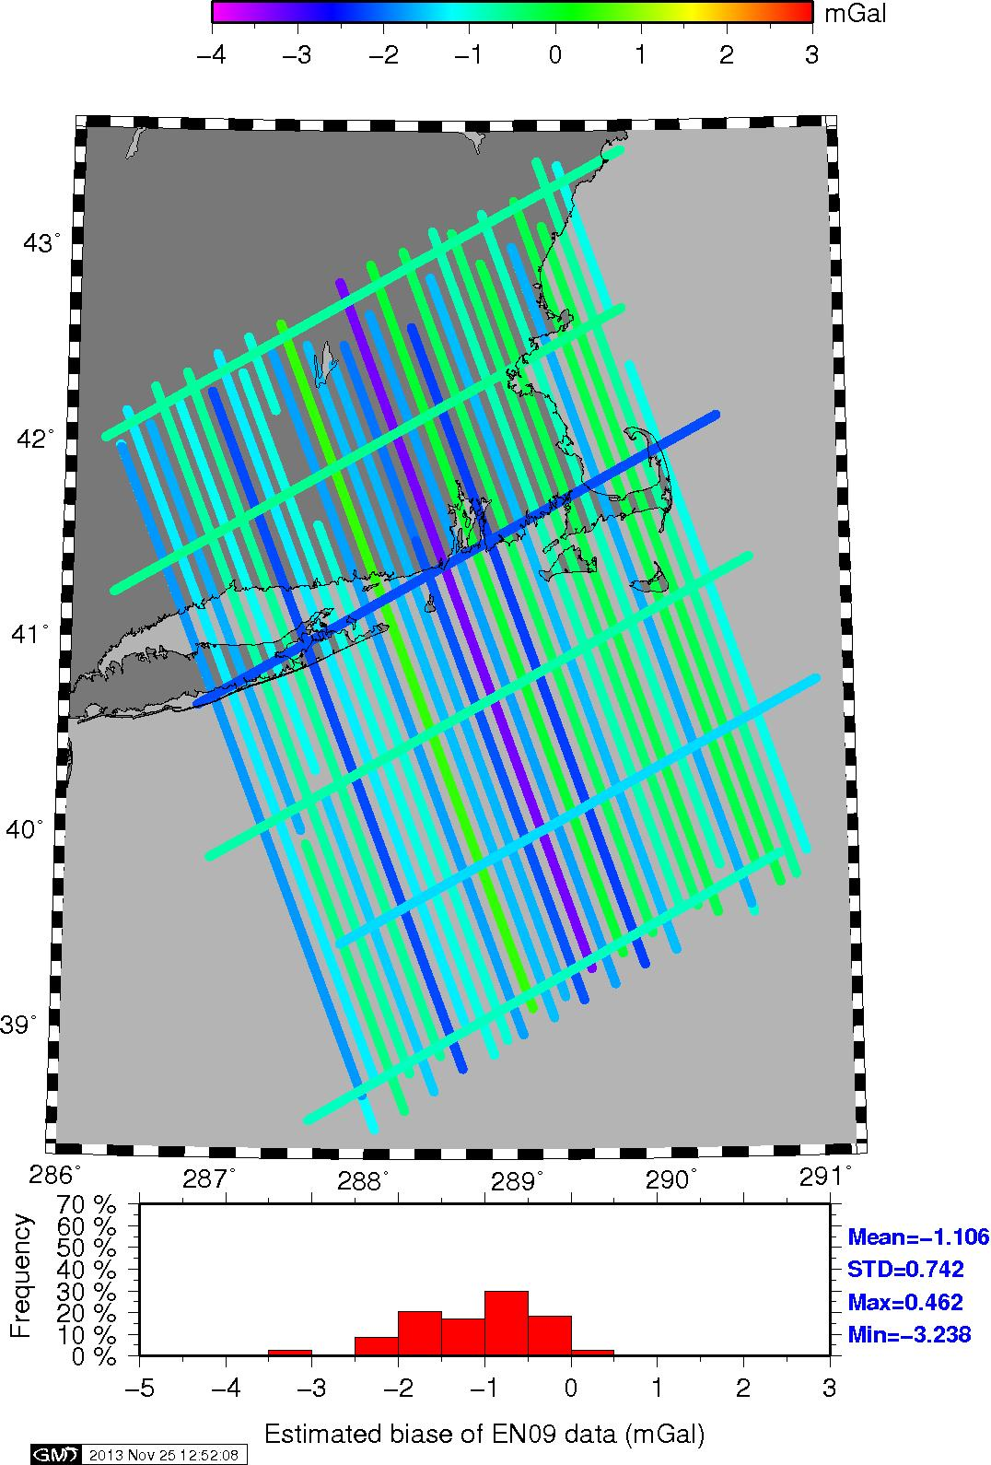
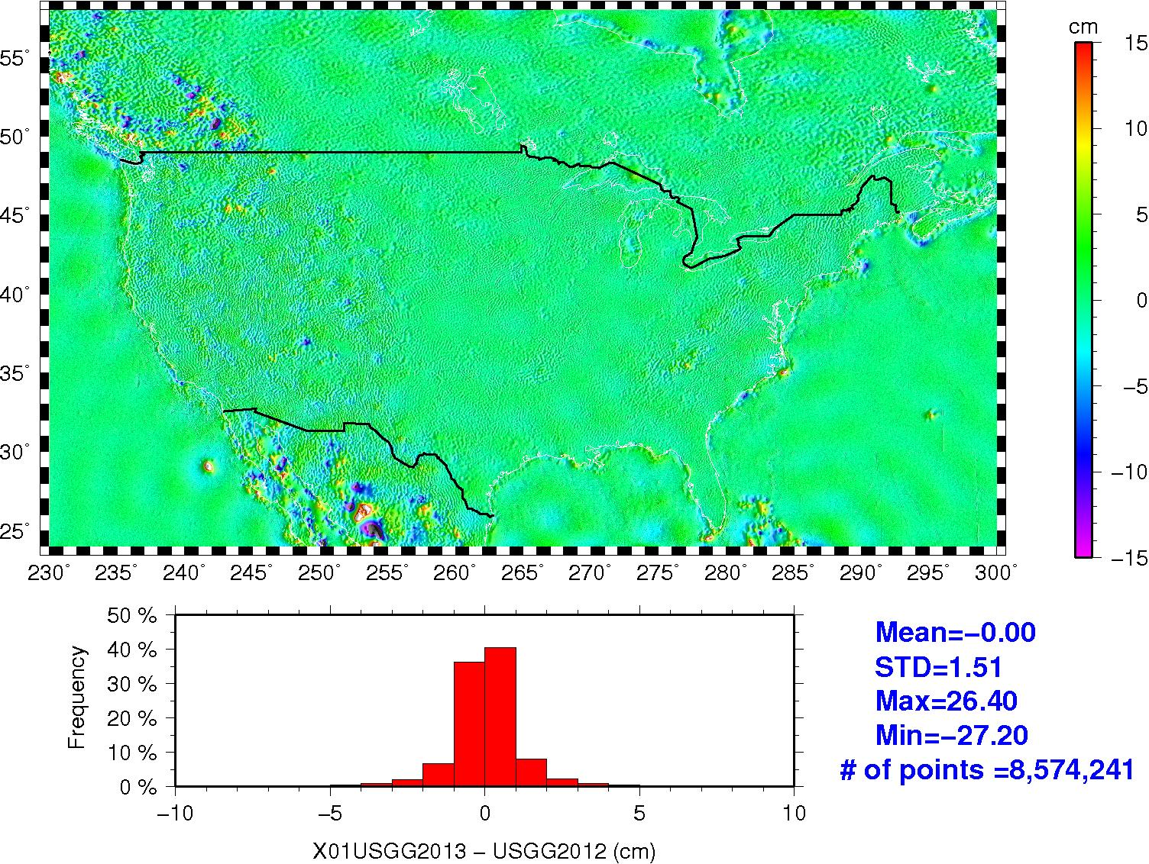
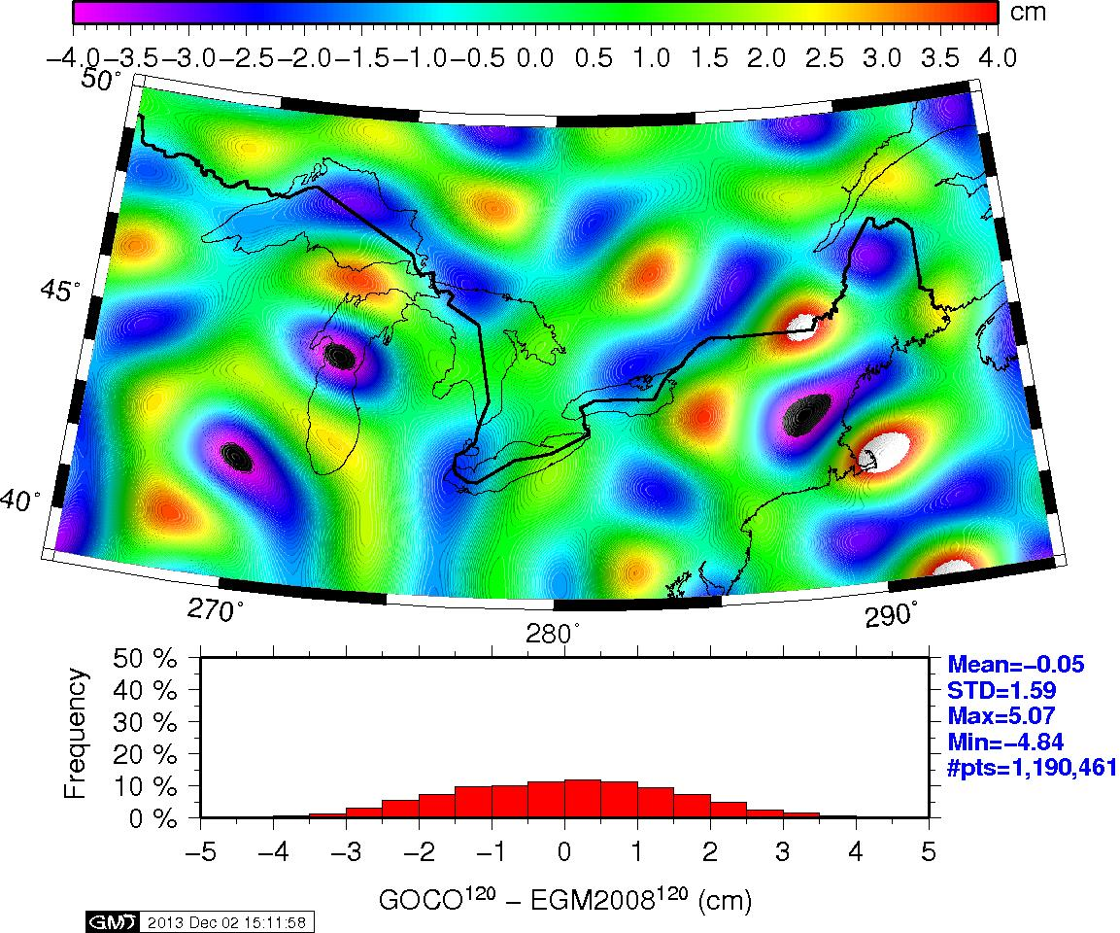
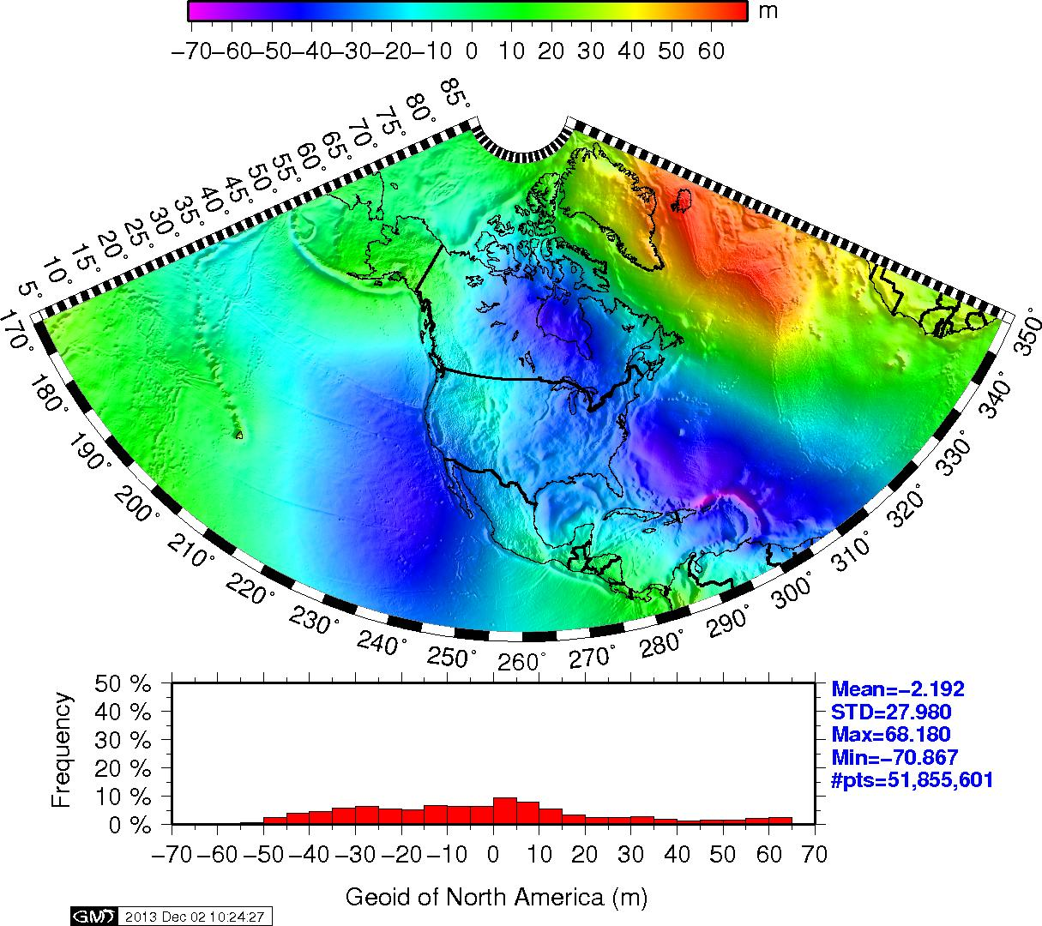
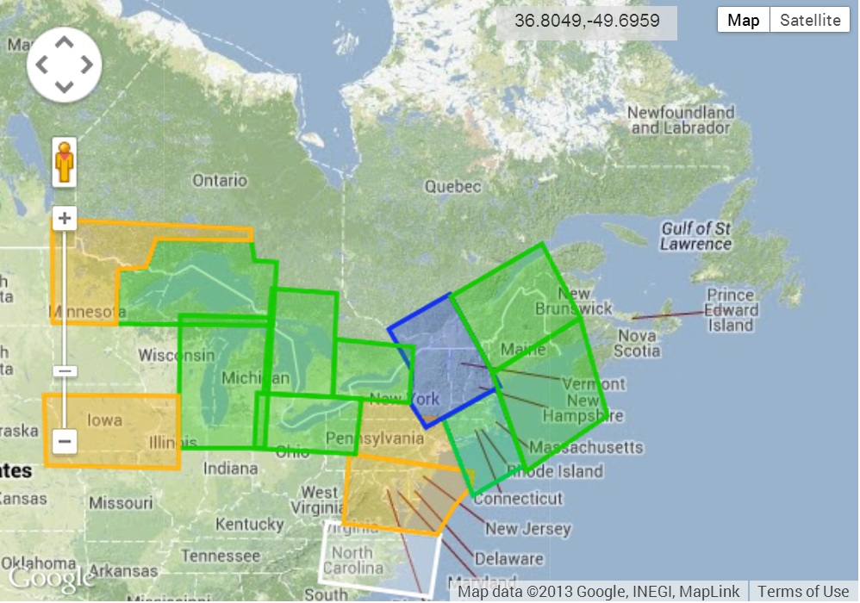
G11A-0891: Regional geoid height models developed using aerogravity
Daniel R Roman¹ Xiaopeng Li² and Dru A. Smith¹ 1. NOAA's National Geodetic Survey, Silver Spring, MD, United States. ² Earth Resource Technology, Inc. Silver Spring, MD 20910
ABSTRACT
The techniques employed during the development of the Geoid Slope Validation Study of 2011 (GSVS 11) were adapted to modeling of regional geoid height models. Aerogravity from the Gravity for the Redefinition of the American Vertical Datum (GRAV-D) Project was first evaluated with respect to satellite gravity field models developed from both GRACE and GOCE data to establish long wavelength consistency and remove biases in individual survey lines. In turn, the airborne and satellite gravity were then combined to evaluate surface gravity data from around 1400 separate surveys over the conterminous United States (CONUS). These surveys can span anywhere from 10's to 100's of kilometers and comprise the surface gravity database held by the U.S. National Geodetic Survey. These surface data have been used as-is in the development of previous gravimetric geoid models. With the availability of aerogravity, these surveys were examined to detect and mitigate potential biases that can create artifacts in geoid height models. About 5% of these surveys exhibit significant biases of 3-5 mGals, which equate to 10-20 cm errors in subsequent geoid height models. Given the requirement for cm-level accuracy in a future vertical datum based on geoid height models, these errors must be addressed. GSVS 11 demonstrated that it is possible to combine satellite, airborne and surface gravity to achieve cm-level accuracy over a limited locale. This study demonstrates that this can also be achieved over more regional scales. While not all of the CONUS has yet been flown by the GRAV-D Project, significant portions have been flown and those regions have been evaluated here. In the GSVS 11 study, external metrics were collected simultaneously to permit evaluation of the overall error. Such data is generally not available on a national basis, but comparisons are made with the GSVS 11 data, tidal benchmarks in combination with ocean topography models, and astrogeodetic deflection of the vertical data.
COMPARISON TO USGG2012
The current regional gravimetric geoid model for CONUS is USGG2012 and is available for download on the NGS Geoid page: www.ngs.noaa.gov/GEOID/
Since essentially the same techniques were applied to determine the image in Figure 1 as were used in determining USGG2012, a comparison of the two is warranted. Figure 2 shows the difference between the new model (Figure 1) and USGG2012. While everything is close to zero, not everything is. Further examination determined that some additional data had been used – namely, the second entry in Table 2. While less than 6000 points in total, their distribution was significant in that regions where sparse data previously existed might suddenly have a few new points added. In particular this was true for Mexico and the Canadian Rockies. Most of these points were actually added in CONUS. However, these were overwhelmed by the shear number present in the third and fourth entries in Table 1. For all intents and purposes, the methods used to develop previous NGS gravimetric geoid models has been migrated to a much larger region that will serve as the base model for evaluation of the impacts of adding aerogravity from the GRAV-D project.
Figure 4. Aerogravity profiles for surveys EN06, EN07, & EN09. Residuals from removing a GOCO02S/EGM2008 model (left), estimated biases by line (middle), and composite of residuals with biases removed (right).
Note the remaining systematic features along the shoreline and parallel to it inland. These signals are coherent – showing up in adjacent tracks with significant lateral extents. This indicates the aerogravity observed signal not present in the reference model. Of note here, is that significant overlap likely exists in the surface gravity data sets that went into EGM2008. Certainly all the data held by NGS was available to NGA when EGM2008 was developed. Likely more data was used that was not available to NGS, but it would be illustrative to see if such features highlights above can be detected in individual data tracks from surface gravity surveys.
Certainly a comparison of EGM2008 to GOCO02S highlights significant long wavelength disagreements. Figure 5 takes the EGM2008 model as published (i.e., GRACE only with no GOCE data) and compares to GOCO02S in the Great Lakes and NE CONUS region. It is filtered to show only the effects through degree 120. Many features are seen that, like that seen in Figure 4, likely represent significant systematic differences. Certainly Figure 5 argues for why GOCE data should be included when evaluating EGM2008. However, the thesis of GRAV-D is that the satellite models by themselves are not sufficient to resolve all the significant features.
INTRODUCTION
This poster presents the status of research as a part of the Gravity for the Redefinition of the American Vertical Datum (GRAV-D) Project. In 2022, The National Geodetic Survey (NGS) will be adopting new geometric and geopotential datums to replace the existing North American Datum of 1983 (NAD 83) and North American Vertical Datum of 1988 (NAVD 88). The new geometric datum will be accessed using GNSS technology processed through software such the Online Positioning User Service (OPUS) and further refined by other tools such as OPUS-Projects. The aim of such tools is to provide geometric positioning at cm-level accuracy both horizontally and vertically.
In turn, the geopotential datum will be accessed using the geometric coordinates in combination with a high accuracy gravimetric geoid model of one arc-minute data spacing. Current Remove-Compute-Restore techniques achieve this using a reference global model, available surface gravity data, and residual terrain models determined from available DEM’s. Figure 1 shows a regional geoid model determined from models and data sets to which NGS has access. The reference model was determined by spectrally blending GOCO02S between degrees 100 to 200 with a harmonic model of the surface gravity signal of EGM2008 (Pavlis et al. 2012). This effectively enhanced the lower degree harmonic wavelengths with information from the GOCE mission (Drinkwater et al. 2006) and follows similar techniques discussed in Smith et al. (2013). A residual terrain model was generated using 3” DEM’s from SRTM, CDED (Canadian DEM), NED, and Aster GDEM v.2 (ASTER GDEM is a product of METI and NASA) differenced with the EGM2008 5’ DEM. The reference model and RTM values were then determined and removed from available surface gravity data (Table 1) to form a residual gravity grid. In turn this was processed using a modified Stokes kernel at degree 180 to generate a residual geoid, which was then combined with a geoid determined from the reference model.
This regional geoid model serves as a base model that spans a far larger region than just the conterminous United States (CONUS), thereby permitting comparisons in heights between Hawaii, Alaska, CONUS, and Puerto Rico & the U.S.V.I. It also greatly facilitates comparisons with neighboring countries (e.g., Canada & Mexico) as well as others nations in the Central American and Caribbean regions. In fact, the southern extent is also intended to provide sufficient overlap with the future geopotential model being developed by SIRGAS in South America to ensure continuity in the models across all of the Americas.
Figure 2. Differences between the larger regional model shown in Figure 1 and the USGG2012 model. Differences arise from inclusion of a new subset of gravity data (second entry in Table 2).
GRAV-D
If the NGS held terrestrial data were of sufficient quality, then this would have marked the end of the required development for a replacement geopotential datum. However, an exhaustive study of the existing data given in Table 1 was documented in Saleh et al. (2013). This analysis showed that several significant errors exist internal to the 1400 surveys that comprise the surface gravity as well as between overlapping surveys. Several surveys were shown to have 6 mGal biases with respect to each other and EGM2008. To best incorporate the surface gravity, these systematic errors must be detected and somehow eliminated or reduced.
Hence, some further information is required to mitigate these errors. This is where aerogravity collected as a part of the GRAV-D program are used. A typical survey will span about 400 km width and be comprised of 500 km long lines. Typical elevations vary but have recently been collected at abut 6.7 km (20,000 ft). Correlated signal across these profiles derives from the common geophysical sources (mass distributions) beneath the profiles. Such signal can be detected down to about 40 km based on the collection altitude and along track filtering of the signal. When combined with satellite gravity signal, this effectively extends the reference gravity field to 40 km resolution – more than sufficient to analyze most surface gravity surveys for systematic biases.
Figure 3 shows a recent pull from the GRAV-D website focused on collection efforts in the NE CONUS region. Green boxes denote those surveys where initial level one products are available for download. These have only had minimal filtering applied to ensure maximum signal retention. Crossover analysis of these data sets demonstrates that they are accurate to about 2-3 mGals RMSE. Data over the Great Lakes have also been processed (Green boxes) and both clusters of data will be examined here.
Figure 5. GOCO02S minus EGM2008 (d/o 2-> 120). Note significant systematic differences between the models 300 km scales.
METHOD
To detect and possibly mitigate systematic effects caused by surface gravity data such as those seen in Figure 5, the aerogravity shown in Figure 4 must be reduced to the surface and then compared against individual surface profiles. The data given in Table 1 generally have limited metadata. Hence, there are great difficulties in trying to determine potential errors by returning to the raw surface gravity observables. Many of these data exist simply as is in a database.
One piece of surviving information for all the NGS data is the associated survey number. Of the nearly 1400 surveys studied by Saleh et al. (2013), relatively few had significant systematic effects that were evaluated. Only where two surveys existed in the same space was it possible to determine a relative difference. What is desirable here is to use aerogravity data to establish a more absolute accuracy.
To that end, point aerogravity data determined along the profiles have biases removed as shown in Figure 4. The data are gridded (Figure 6) to facilitate a harmonic capture of the signal using previously established techniques presented in Smith et al. (2013). Subsequent comparison (Figure 7) between the harmonically captured signal and the original residuals shows that most of signal was captured.
This harmonic signal is then downward continued to the surface Figure 8), where the signal is then truncated at the boundary edges of the surveys to remove ringing artifacts resulting harmonic capture of a signal at less than global scales over a narrow spectral bandwidth. For comparisons sake, an equivalent residual geoid model is also provided (Figure 9) to provide context to the expected impact of including aerogravity data.
While only the grids for the NE region (Figure 4) are detailed here, similar steps were taken for those over the Great Lakes region to develop a gravimetric geoid model that spans the Great Lakes – NE CONUS region (Figure 10).
The downward continued gravity grids can also be interpolated to the locations of the surface gravity data and comparisons made by survey. Since the Aerogravity were reduced by the GOCO02S/EGM2008 reference model, the surface gravity data will also be reduced to facilitate comparisons.
EN07
EN09
EN06
Figure 1. Regional Geoid model determined from combination of EGM2008, GOCO02S, available surface gravity data , and a residual terrain model. Grid resolution is one arcminute (1’). W0=62,636,855.69 m²/s².
Figure 3. Airborne data in the Northeast and Great Lakes regions . Green boxes are available data sets. Image pulled in December 2013 from the GRAV-D Data Products page at: http://www.ngs.noaa.gov/GRAV-D/data_products.shtml
Table 1. List of surface gravity data sets and associated metadata used in Figure 1.
Latitude bounds are all North. Longitude is all East.
 | File Unit | File Name | No. of Points | Boundaries |  |  |  | Description
 |  |  |  | N | S | W | E
NGS Held Data | 1 | ASCII_GRAVITY_table | 6,262 | 48 | 24 | 237 | 293 | Monumented
 | 2 | ASCII_GRAVITY_TMP_table | 5,986 | 82 | 14 | 2 | 356 | New Data
 | 3 | ASCII_NGSGRAVITY_SPOT_GRAVITY_table | 2,693,709 | 89 | 2 | 106 | 350 | Original NGS
 | 4 | ASCII_DMAGRAVITY_SPOT_GRAVITY_table | 2,065,540 | 76 | 7 | 186 | 304 | Received from DMA
 | 5 | ASCII_gCDN.lst.20061227 | 743,942 | 89.9 | 30 | 71 | 339 | Canada
NGA | 6 | ArcGP-fa.txt/ ArcGP-el.txt | 1,347,840 | 90 | 64 | 0 | 360 | ArcGP^{5’x5’}
DTU | 7 | DTU¹⁰ |  | Global |  |  |  | Altimetry
GRAV-D GRIDS in NE CONUS
Three surveys in the NE CONUS are examined here: EN06, EN07, and EN09. In Figure 4, the left column shows residuals values formed by removing a GOCO02S enhanced version of EGM2008. This represents the raw differences between aerogravity provided on the website versus the reference field. The biases by line were then determined. While this is not completely rigorous, it does serve as a first attempt to ensure that the aerogravity profiles are consistent with longer wavelength signal determined from GOCE data. With the biases removed, the remaining signal of the residual profiles is shown in the composite image on the right side of Figure 4.

Slide 2
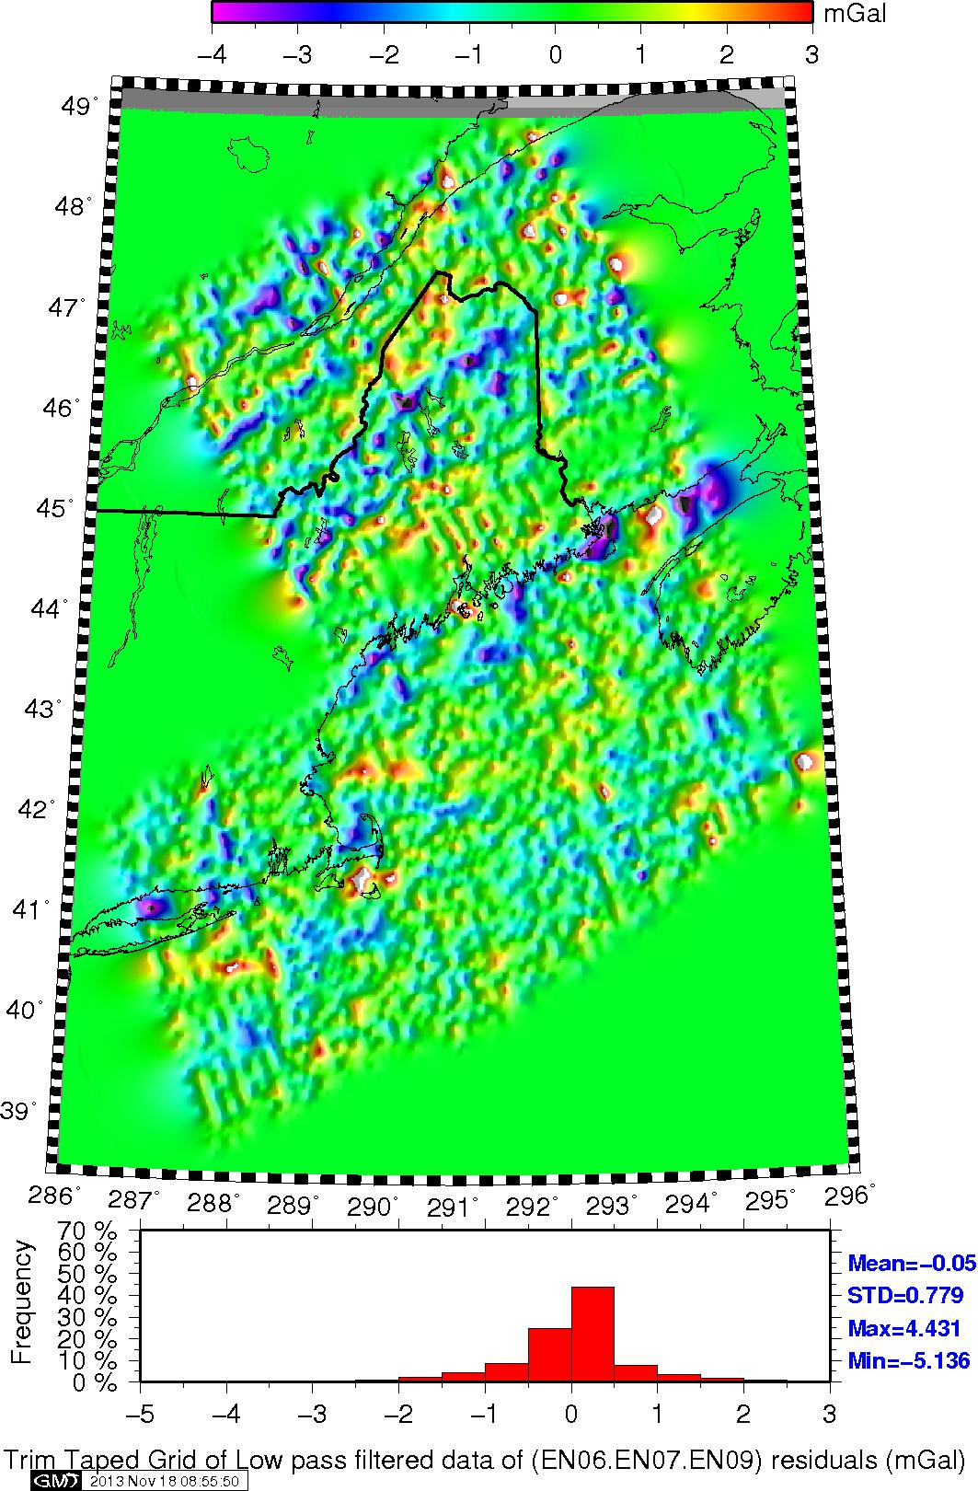
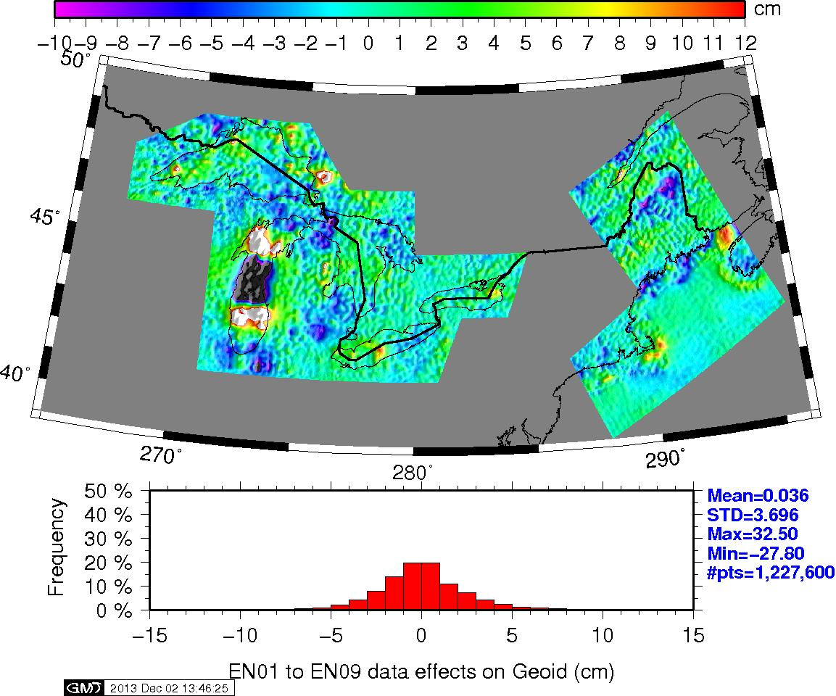
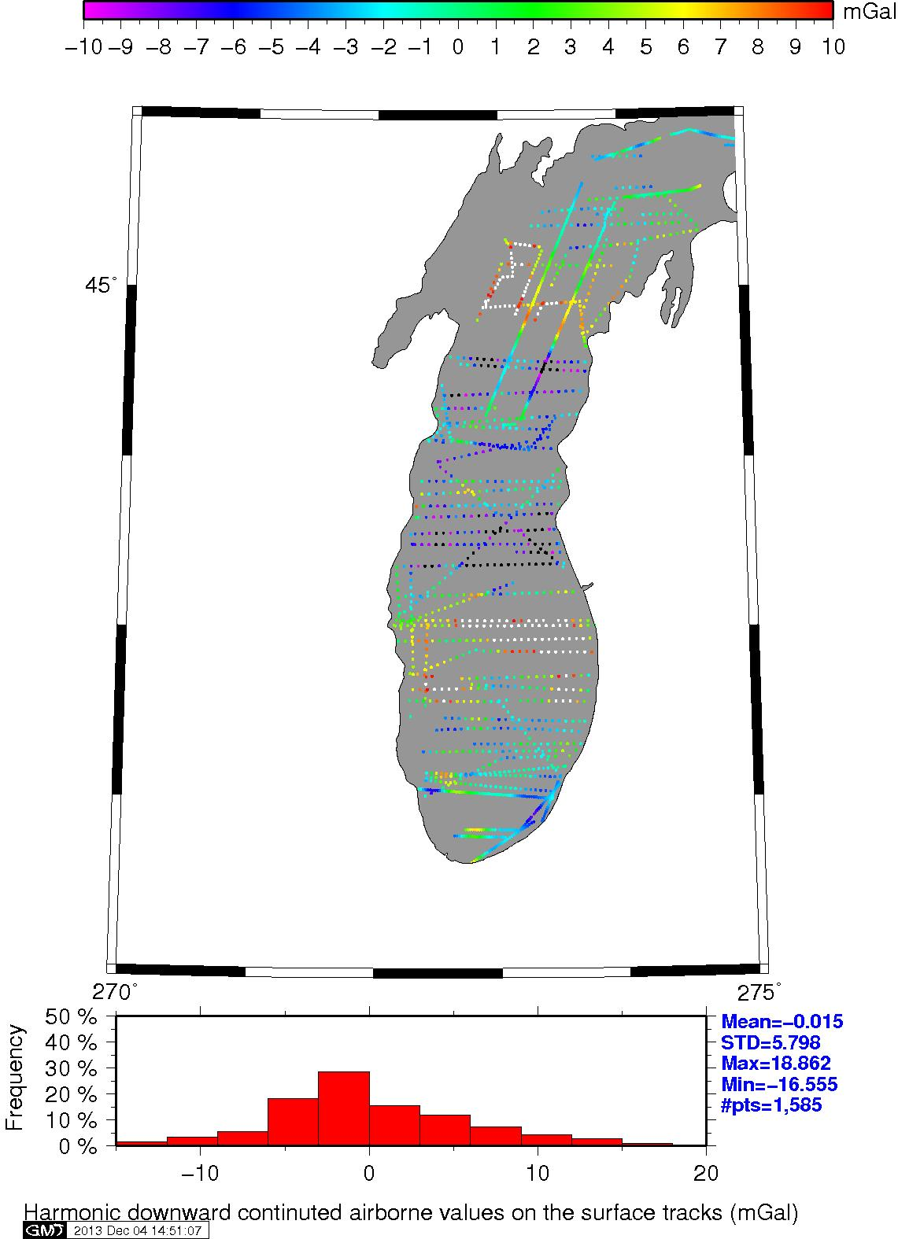
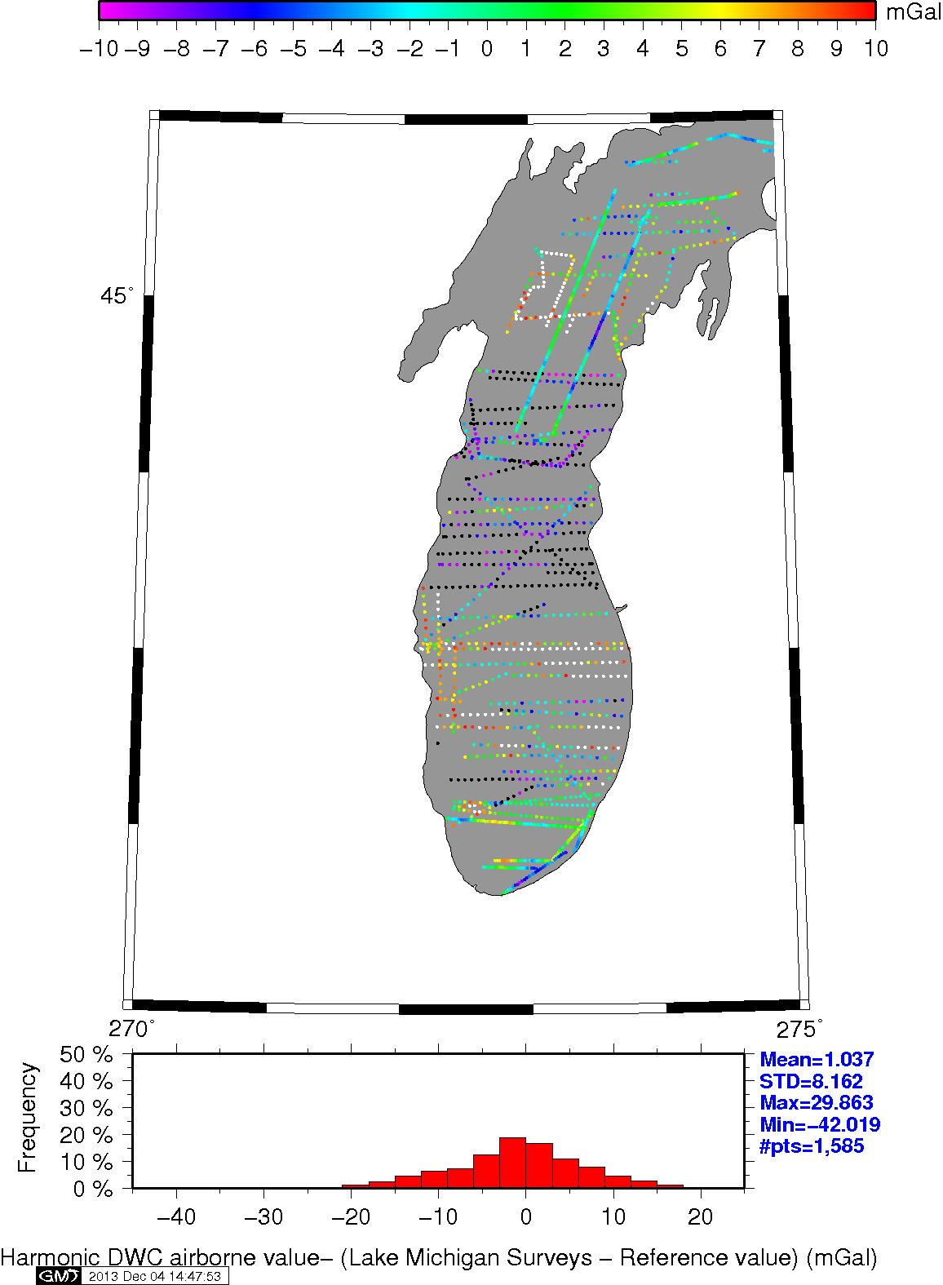
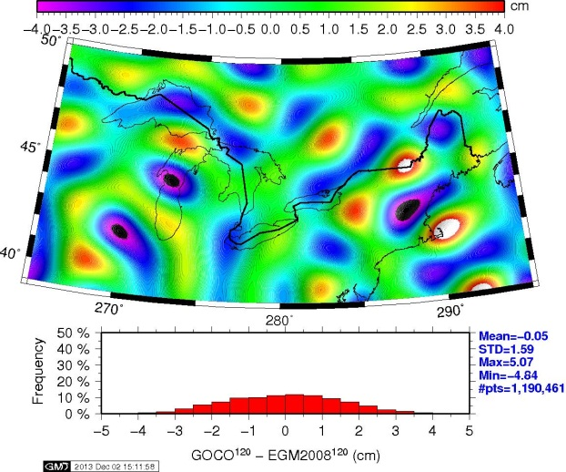
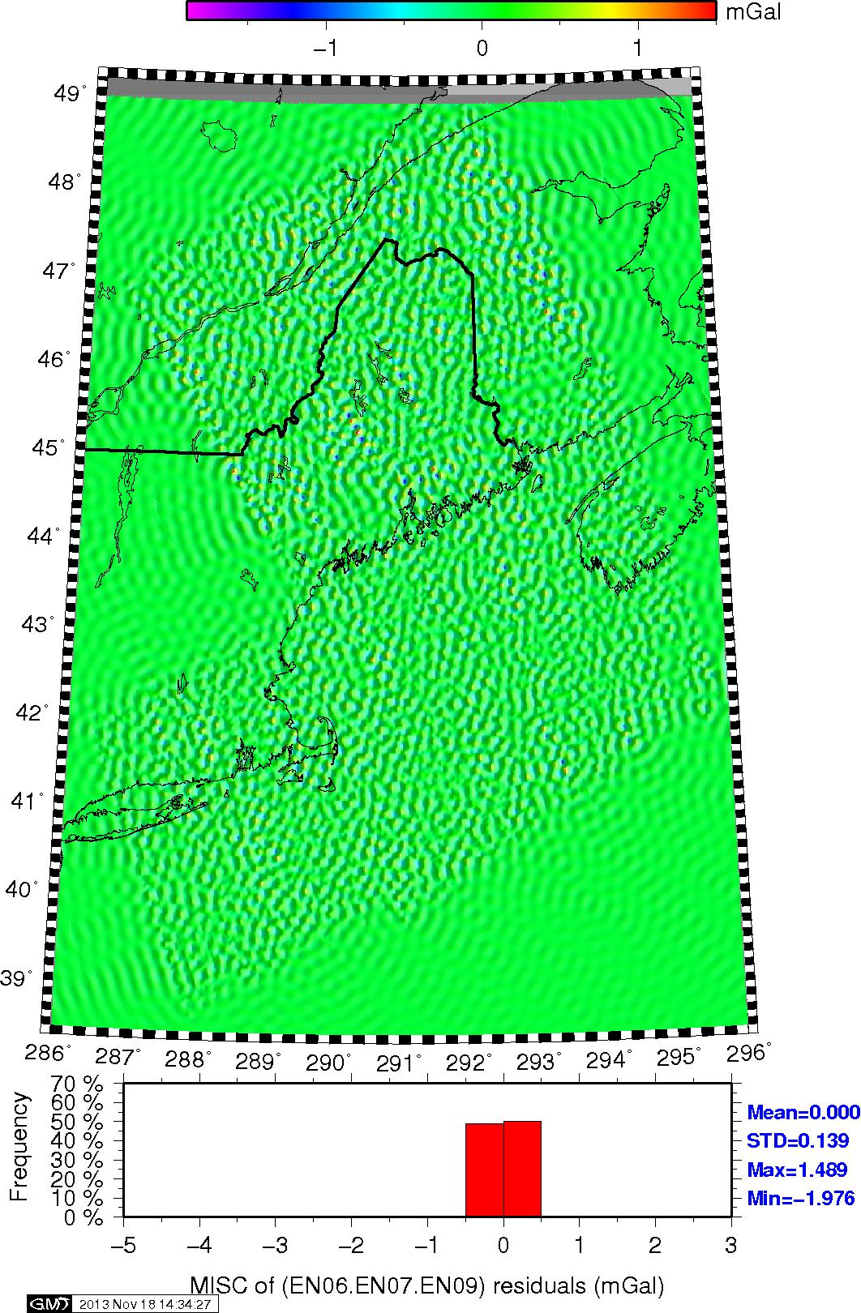
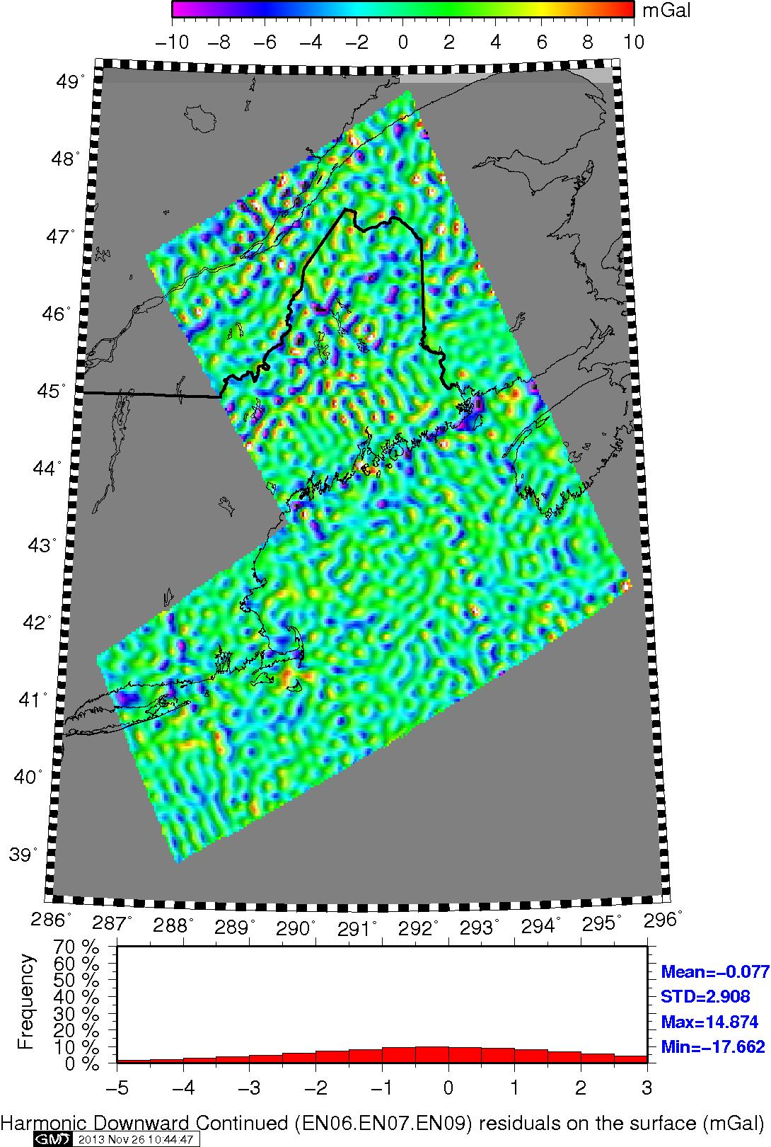
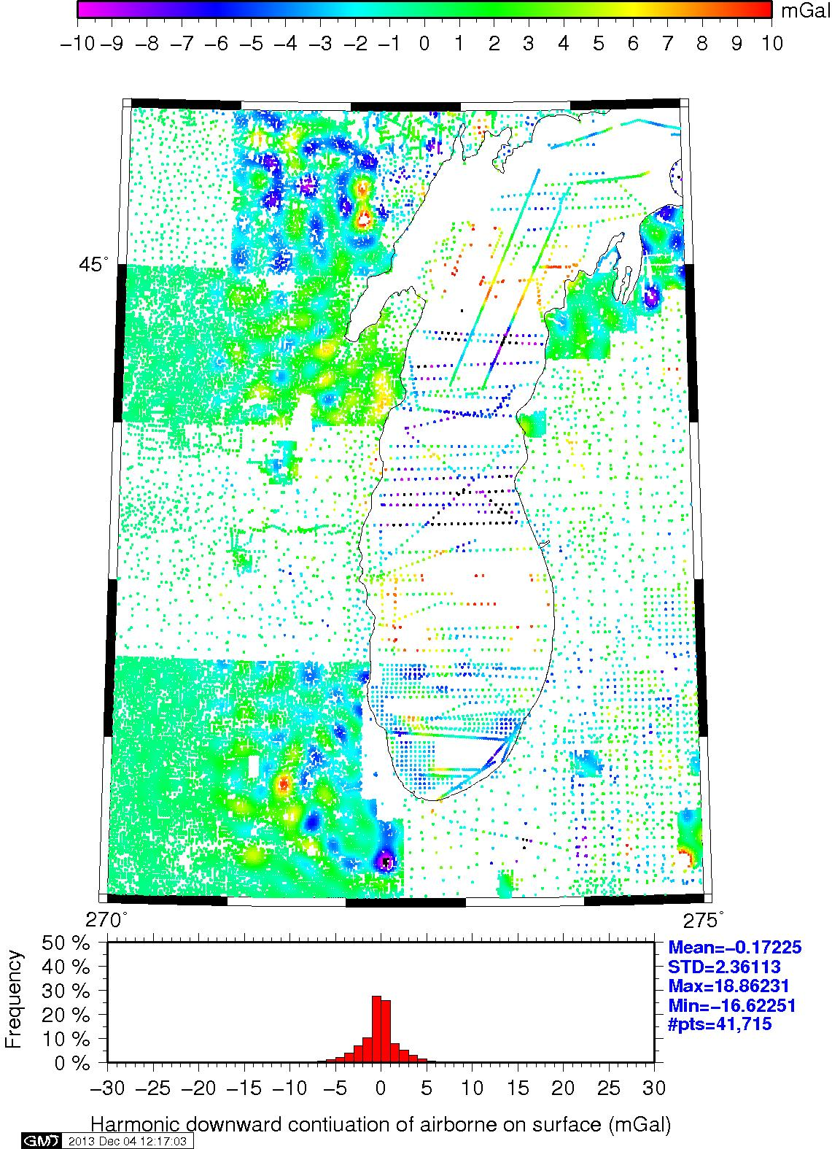
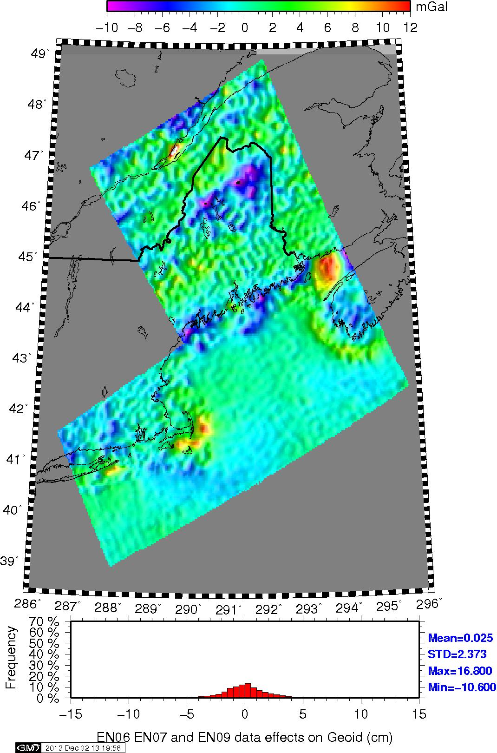
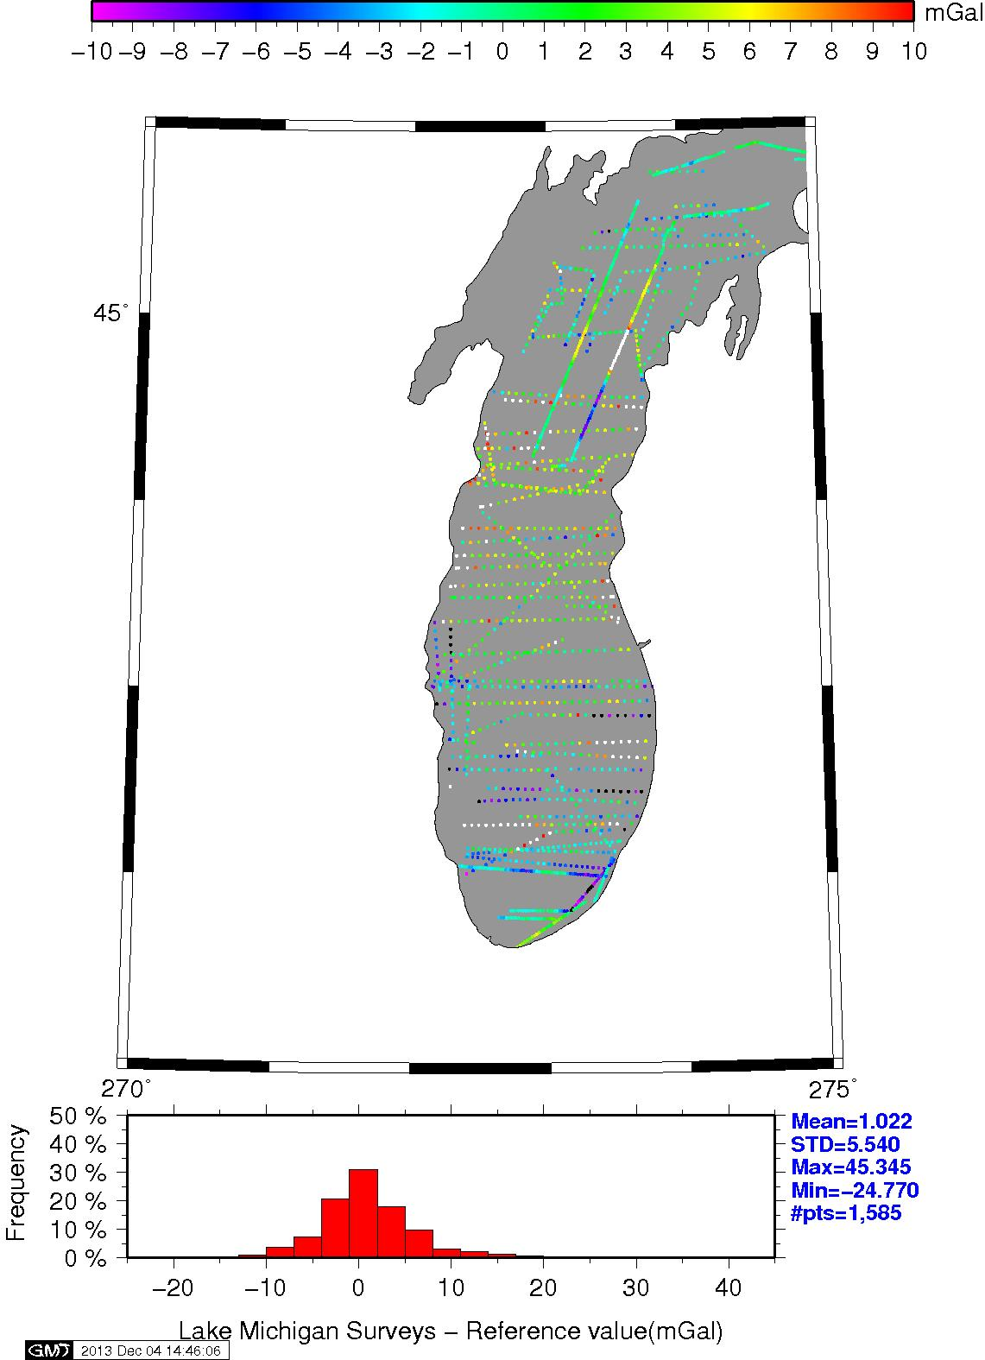
Figure 13. Subset of Figure 11 for comparison with Figure 12.
Figure 10. Regional plot of Survey blocks EN01 through EN09. The region now includes the five blocks over the Great Lakes. Note the prominent feature over Lake Michigan.
Figure 6. Grid of the edited residual data for spherical harmonic capture
ANALYSIS OF SURFACE GRAVITY
While there is certainly great number of differences that could be explored in the data along the East Coast, the most prominent discrepancy by far in Figure 10 is that over central Lake Michigan. This is the same location as that seen in Figure 5. Hence, this bears further investigation since incorporating GOCO02S into the reference model should have mitigated this.
As mentioned above, the harmonic downward continued data will be used to assess the quality of surface gravity profiles. For this analysis, the profiles over the Lake Michigan region will be used. Figure 11 shows the interpolated values for the harmonic downward continued aerogravity residuals. While the image they are drawn from is not shown here, these would be equivalent to interpolating Figure 8. Examination of the residual values in the center of the Lake shows significant residual values with very negative numbers seen in the center and higher values in profiles surround that central cluster.
Figure 12 shows the difference between the existing surface gravity data along the tracks and the reference model. Statistics of these differences show a mean of 1 mGal and a STD of 5.5 mGal. There are some anomalies but mainly the surface gravity data and the reference model are consistent. Figure 13 shows the differences between the harmonic downward continued gravity residuals on the tracks as a subset of those given in Figure 11. Recall that these residuals were formed by removing the same reference field. Hence these profiles should show the same signal as in Figure 12. While both have similar statistics, the residuals are seen to be more systematic with entire profiles showing extreme negative (black) or positive (white) values beyond the previous data range. Both Figures 12 and 13 are on the same color scale. Clearly the aerogravity are showing something more systematic in the behavior of the track profiles.
Figure 14 shows the difference between Figures 12 and 13 and highlights the difference between the surface tracks and the aerogravity. About 14 profiles can be seen to range in color from black to purple indicating biases of -10 mGal and beyond. Just north of this central cluster are four profiles all white indicating a bias out +10 mGal or higher. Likewise there four more profiles to the south also with biases of +10 mGal and beyond. This step from +10 to -10 to +10 mGal biases from north to south over a space of about 250-300 km is clearly seen in Figure 10. By using the aerogravity, it is possible to detect which specific tracks have biases. Compare this feature to that in Figure 5 (but also shown again here in the inset).
What is worth noting in this comparison is that while GOCE detected these apparent bias problems, it was unable to provide sufficient resolution to detect which surface tracks were suspect.
Figure 14. Difference between Figures 13 and 12.
SUMMARY AND FUTURE WORK
NGS has generated a gravimetric geoid model spanning a much larger region than previous models such as USGG2012. This single model will eventually replace the existing vertical datum in about 2022. Using existing techniques and data, the model is consistent with previous efforts. However, previous studies have demonstrated that the existing data is prone to systematic effects that may impact the ability to achieve cm-level accuracy.
Aerogravity has been collected as a part of the GRAV-D Project with the intent being that the aerogravity will bridge the gap between the satellite gravity missions and the surface gravity observations. While some features can be detected by GOCE, the resolution of the model is insufficient for identifying specific tracks and potentially fixing them.
One surprising aspect is that the residuals are still so large even after GOCO02S has been combined with EGM2008. Figure 5 highlighted the differences between EGM2008 and GOCO02S. Possibly during the melding process the GOCO02S was down-weighted. Future research will explore using a higher cutoff than the degree 100-200 transition used here.
Additional work will be to find better methods for filtering and removing suspect artifacts in the aerogravity. The bias removal technique used here was fairly simplistic and worked well primarily because the magnitude of the biases was so large in many cases. More subtle biases may not be as easily removed and may result in a washboard effect in the final products.
Additional exploration will needed for methods for cleaning the surface gravity data as well optimal methods for combing satellite models (which provide the unifying backbone), aerogravity and surface gravity all at varying degrees of quality and resolution. Particularly, it would be most desirable to move away from use of EGM2008, since at least part of the data that NGS would be using is already incorporated into it.
There is a definite horizon for trying to accomplish all these tasks. Thus far, nearly 40% of the aerogravity has been collected. Processes must be put in place to use these data to clean and incorporate the two million surface gravity observations available to NGS.
A near term goal as been established to incorporate the aerogravity along the eastern states in the region affected by Hurricane Sandy. These data will be built into a model spanning the region shown in Figure 1. While not all of the region seen in Figure 1 will have aerogravity, those regions where it has been incorporated will have access to a tool for checking the revised heights by June 2013. By 2022, the entire model should be complete and the new vertical datum implemented.
Figure 7. Residuals of spherical harmonic capture. Amplitude and scale of unmodeled signal is very low. Since these data will be processed to create a residual geoid, the effects are even further reduced.
Figure 8. Harmonic Downward Continuation of airborne data on the surface
References
Drinkwater MR, R Haagmans, D Muzi, A Popescu, R Floberghagen, M Kern, and M Fehringer (2007) Proceedings of 3rd International GOCE User Workshop, 6-8 November, 2006, Frascati, Italy, ESA SP-627.
Mayer-Gürr T, D Rieser, E. Hoeck, JM Brockman, W-D Schuh, I Krasbutter, J Kusche, A Maier, S Krauss, W Hausleitner, O Baur, A Jaeggi, U Meyer, L Prange, R Pail, T fecher, and T Gruber. (2012) The new combined satellite only model GOCO03s. Paper S2-183, GGHS Meeting in Venice, Italy 9-12 OCT 2012.
Saleh J, X Li, YM Wang, DR Roman, and DA Smith (2013) Error analysis of the NGS’ surface gravity database, J. Geodesy, 87 (3), 203-221.
Smith D (2007) The GRAV-D project: gravity for the redefinition of the 324
American Vertical Datum. Available online at: http://www.ngs.noaa.gov/GRAV-D/pubs/GRAV-D_v2007_12_19.pdf
Smith DA, Holmes SA, Li X, Guillaume S, Wang YM, Bürki B, Roman DR, and Damiani TM (2013) Confirming regional 1 cm differential geoid accuracy from airborne gravimetry: the Geoid Slope Validation Survey of 2011, J. Geodesy, 87 (10-12), 885-907.
Smith D.A., M Véronneau, D.R. Roman, J. Huang, Y.M. Wang, and M.G. Sideris (2013) Towards the Unification of the Vertical Datum Over the North American Continent. Chapter 36 in: Z. Altamimi and X. Collilieux (eds.), Reference Frames for Applications in Geosciences, International Association of Geodesy Symposia 138, DOI 10./1007/978-3-642-32998-2_36 © Springer-Verlag Heidelberg 2013.
Figure 11. Downward continued harmonic aerogravity residuls in the Lake Michigan region. A GOC02S/EGM2008 model is removed from cleaned data, biases removed and then DC to the surface. This was then interpolated at point locations for surface gravity surveys.
Figure 9. Airborne effects on the geoid. Residual gravity signal in Figure 8 expressed as residual geoid.
Figure 12. Surface gravity surveys minus the GOCO02S/EGM2008 reference model over lake Michigan.

