Slide 1
Geospatial Data Act FGDC, ISO and OGC Standards
Daniel Roman and Larry Hothem
FGCS presentation 17 February 2021

Slide 2
Geospatial Data Act of 2018
The Geospatial Data Act of 2018 (GDA) was signed into law on October 5, 2018. The GDA is now in U.S. Code, Title 43 – Public Lands, Chapter 46: GEOSPATIAL DATA
Continues the previous structure (FGDC, NGAC)
Further details are found at: https://www.fgdc.gov/gda
Does not drill down deeper (e.g., WG’s and subcommittees)
Defers to FGDC WG’s to re-affirm structure
Sets several tasks for the FGDC and US Departments

Slide 3
GDA - Section 757: Geospatial Data Standards
This section requires the FGDC to establish standards for each of the NGDA data themes, including rules, conditions, guidelines, and characteristics, and also establishes content standards for metadata. These standards are required to be consistent with international standards to the maximum extent practicable and be periodically reviewed and updated …

Slide 4
GDA – Section 759A. Limitation on Use of Federal Funds
This section prohibits the use of federal funds by a covered agency for the collection, production, acquisition, maintenance, or dissemination of geospatial data that does not comply with applicable standards established under Section 757, as determined by the FGDC. The prohibition under this section will be effective five years from the date on which standards for each NGDA theme are established by the FGDC.

Slide 5
GDA of 2018 – Timeline of Completed Items
2018-2019 - Tiger Teams
2020 – completed items
Inspectors General Audit Reports
Required by GDA Section 759
Completed during first half of 2020
NGDA Baseline Standards Inventory
Required by GDA Section 756
2021-2024 NSDI Strategic Plan
Required by GDA Section 755
2020 FGDC GDA Report to Congress – Phase 1 Progress report

Slide 6
Table 14. Geodetic Control Theme Standards.
Identified Standards (FDGC Endorsed and Other)
Geographic information Framework Data Standard Part 4, Geodetic Control, FGDC-STD-014.4-2008
Geospatial Positioning Accuracy Standards, Part 2: Standards for Geodetic Networks, FGDC-STD-007.2-1998
INCITS/ISO 6709:2008[R2013] Standard representation of geographic point location by coordinates
INCITS/ISO 6709:2008/COR 1:2009 [R2015] Standard representation of geographic point location by coordinates - Technical Corrigendum 1
ISO 19127:2019 Geographic information — Geodetic register
Standard for a U.S. National Grid, FGDC-STD-011-2001
ISO 19135-1:2015 Geographic information — Procedures for item registration — Part 1: Fundamentals
ISO 19161-1:2020 Geographic Information - Geodetic references — Part 1: International terrestrial reference system (ITRS)
ISO 19127/19135/19161 are all on the list. They tell NGS that the NSRS should be linked to the
ITRS (it is), and that NGS should codify our datums and put them in the ISO Geodetic Registry (they mostly are).

Slide 7
Table 25: Structure Accuracy Standards
Structure Accuracy Standards
Geospatial Positioning Accuracy Standards, Part 1: Reporting Methodology, FGDC-STD-007.1-1998
Geospatial Positioning Accuracy Standards, Part 2: Standards for Geodetic Networks, FGDC-STD-007.2-1998
Geospatial Positioning Accuracy Standards, Part 3: National Standard for Spatial Data Accuracy, FGDC-STD-007.3-1998
Geospatial Positioning Accuracy Standards, Part 4: Architecture, Engineering, Construction, and Facilities Management
ISO 19111:2019 Geographic Information - Referencing by coordinates
INCITS/ISO 19112:2003[R2014] Geographic information - Spatial referencing by geographic identifiers
The Federal Geodetic Control Subcommittee (FGCS) BlueBook
These standards apply to all US Government agencies for collection and determination of positioning data
(Bluebook) and the organization of the geospatial data.

Slide 8
GDA – Timeline of Next Steps
2021 - CA Reports <<March>>
Had to determine structure of these during second half of 2020
Required by GDA Section 759
2021 – LCA Reports <<April>>
Had to determine structure of these during second half of 2020
Required by GDA Section 756
2021 – OMB Circular A-16 revision <<June>>
2021 - 2020 FGDC GDA Report to Congress – Phase 2 <<June>>
After completion of CA/LCA reports
Notes:
CA applies to ALL geospatial data – annual report
LCA applies to NGDA’s specifically – annual report
OMB A-16 will, hopefully, address NSRS
FGDC report is biennial

Slide 9
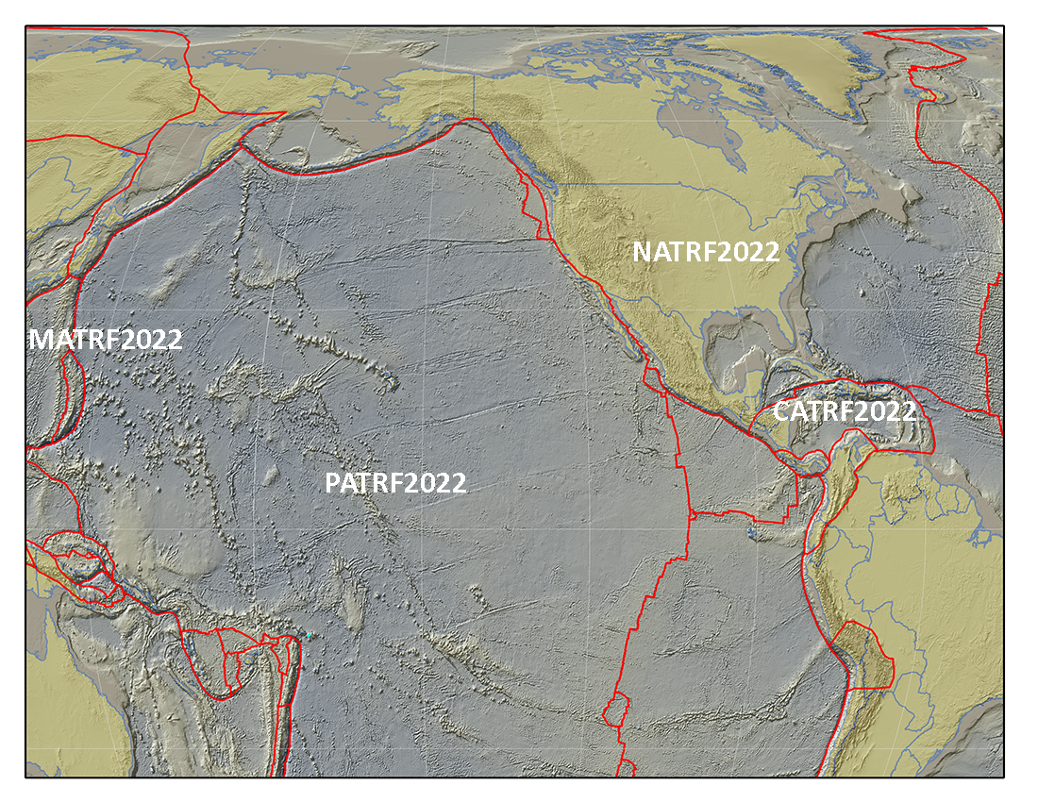
Slide from 2018: International Coordination
IAG (Comm. 1 & 2)
UN-GGIM
UN-SCOG (GGRF)
UN-GGIM-Americas
UN-GGIM-AP
SIRGAS
CGU (IAG), FIG et al.
ISO – TC 211/172
GLCC/IGLD 2025 (2020 campaign)
Notes:
A reminder from a previous FGCS presentation
GGRF is noted above

Slide 10
Global Geodetic Reference Frame Roadmap
Notes:
Note that the GGRF =/ ITRS
Rather it is an overarching agreement or framework for how to align global geospatial datasets
It is, in effect, the GDA on the international scale
Note also that ISO 19161-1 is IAG’s International Terrestrial Reference System (ITRS)
GGRF essentially stipulates that all national SRS must be tied to the ITRS
The NSRS is tied to the ITRS – currently through ITRF96 but eventually through ITRF2020
Note that the UN SCoG specifically excluded use of WGS-84 as it does not meet the standards required for all users

