Slide 1
Geoid improvement over Alaska/Yukon area by GRACE and GOCE models
X Li¹, JL Huang², YM Wang³, M Véronneau², D Roman³
¹ERT Inc USA
²Geodetic Survey Division, CCRS, NRCan, Canada
³National Geodetic Survey, NOAA, USA
European Geosciences Union, General Assembly 2012
Vienna | Austria | 22 – 27 April 2012

Slide 2
Outline
Objectives
Data sets used
GRACE/GOCE gravity models comparison with GPS/leveling data in Alaska/Yukon area
Improvement in local geoid computation by combing surface gravity data
Conclusions

Slide 3
Objectives
To assess the improvement of GRACE/GOCE satellite gravity models over EGM08 in the Alaska/Yukon area
To examine the improvement of GRACE/GOCE satellite gravity models in local geoid computation based on the method of remove-restore and kernel modification

Slide 4
Data used
Surface gravity data: 544,957
  457,477(NGS)+74,933(GSD)+12,547(NGA)
3,265,928 (DNSC08) altimetric gravity anomaly
95 and 90 GPS/leveling data in Alaska and Yukon, respectively
Sea surface topography model from Foreman et al 2008
Global gravity models used:
  TIM (Time-wise solution GO_CONS_GCF_2_TIM_R3)
  DIR (Direct solution GO_CONS_GCF_2_DIR_R3)
  GOCO02s
  EIGEN_6c
  EGM08
  CGG10 (Canada)

Slide 5
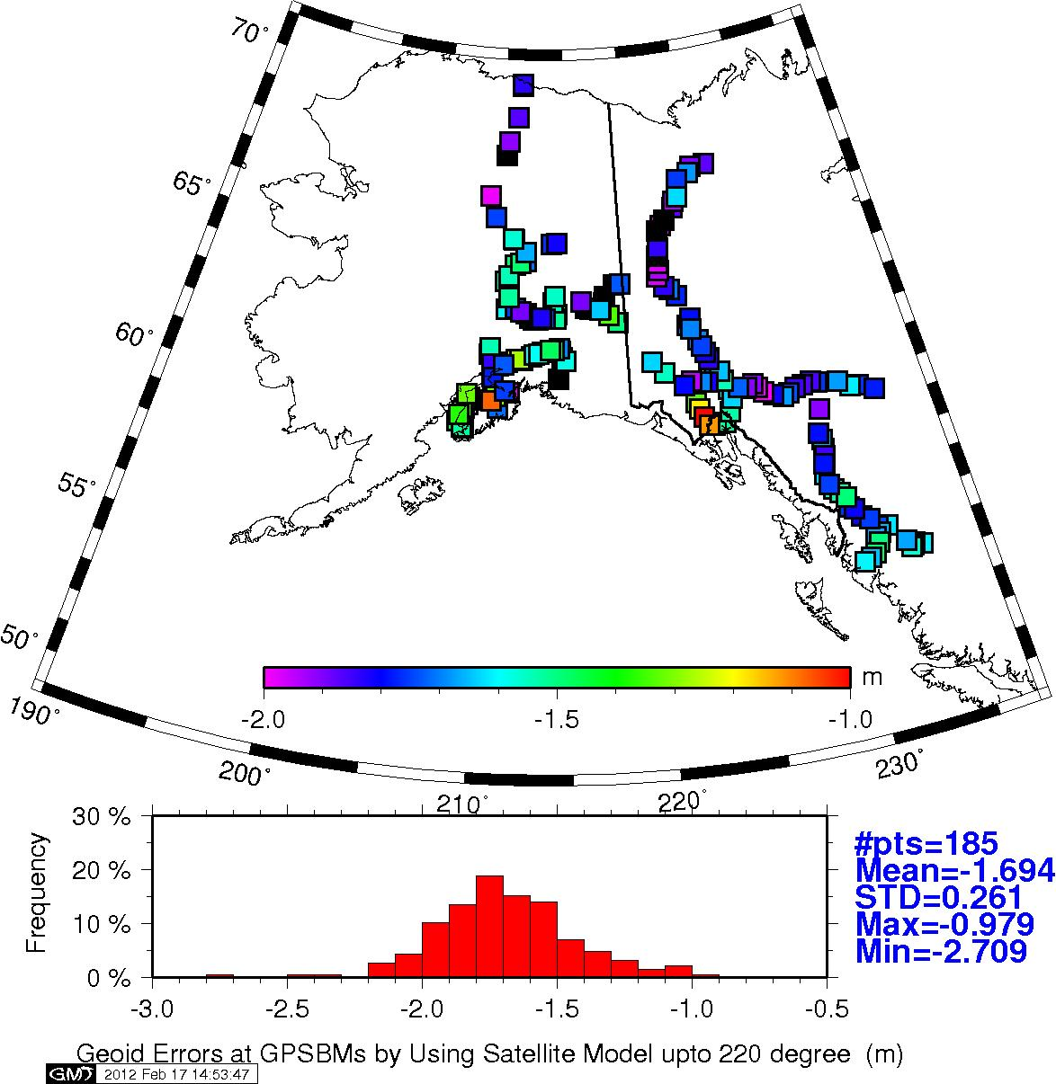

Slide 6
GRACE/GOCE gravity models comparison with GPS/leveling data
To avoid leakage of high frequency, only combined models (cut/paste) used
where

Slide 7
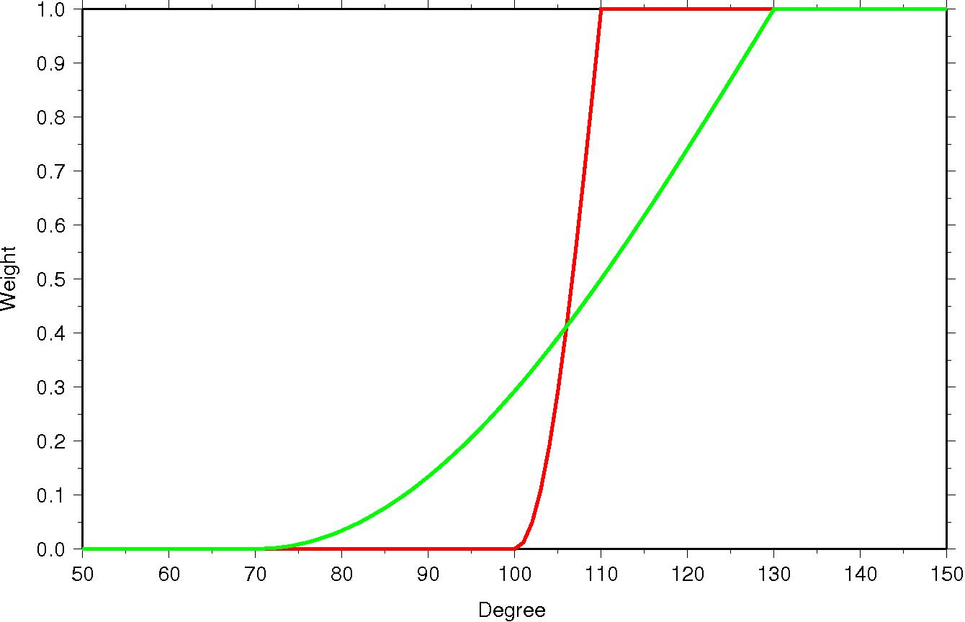
Weight function used (10&60 degree)

Slide 8
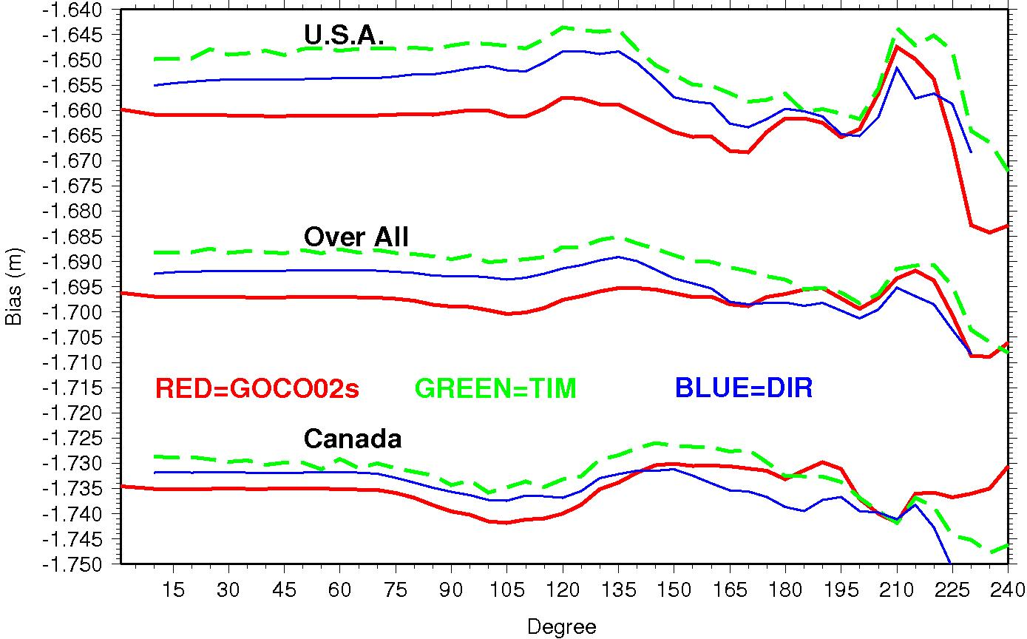
Mean geoid difference by degree
(h – H) – N

Slide 9
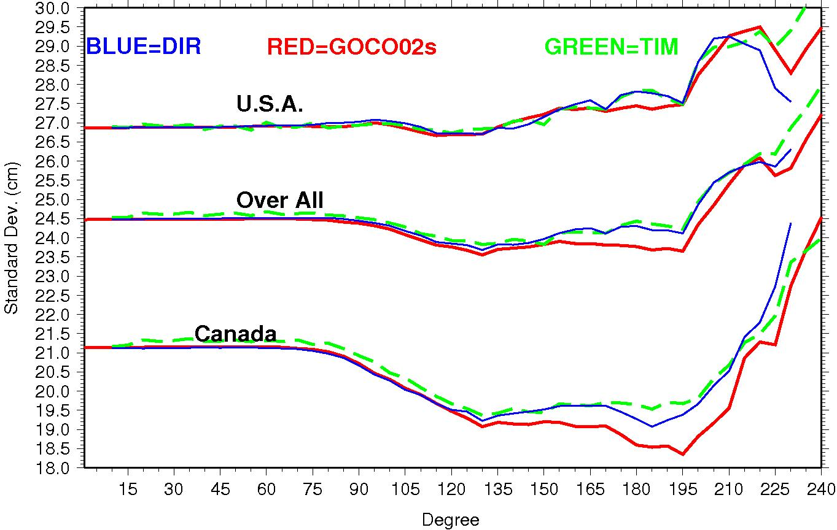
STD of Geoid difference by degree
(h – H) – N

Slide 10
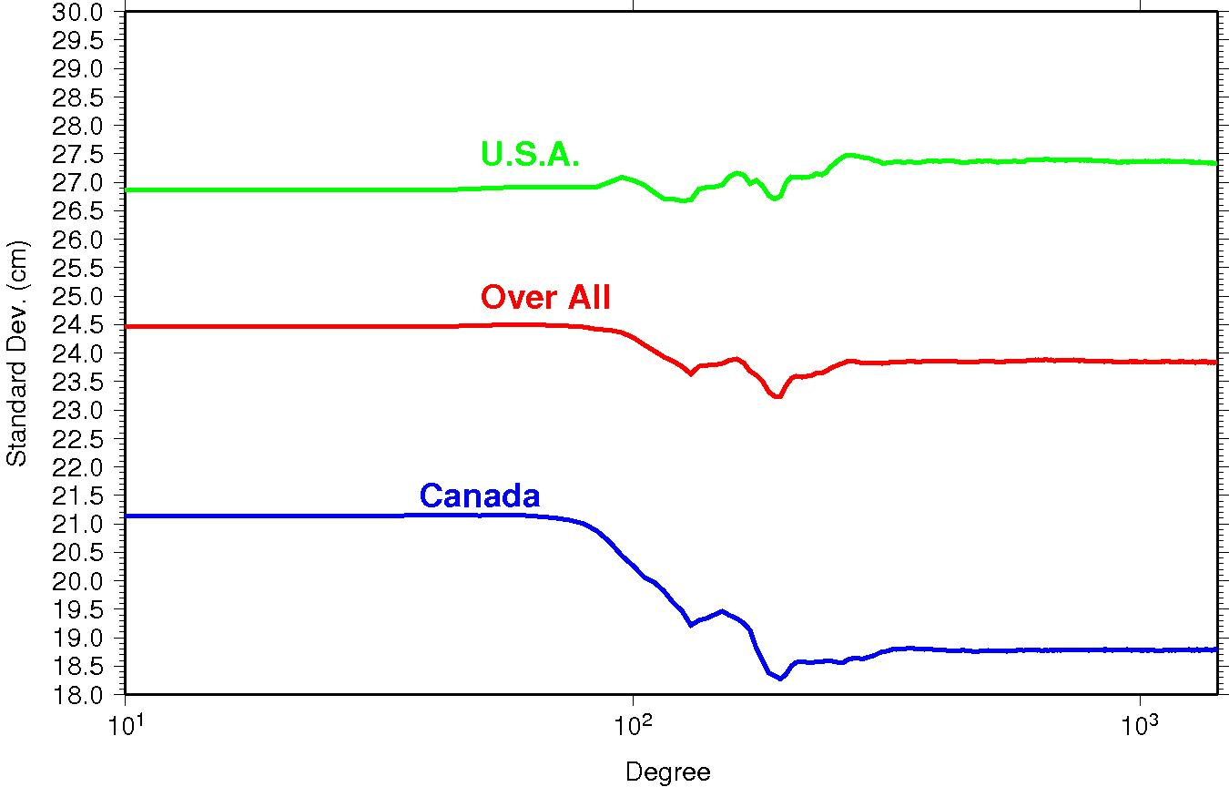
EIGEN_6c (10 degree c/p window)

Slide 11
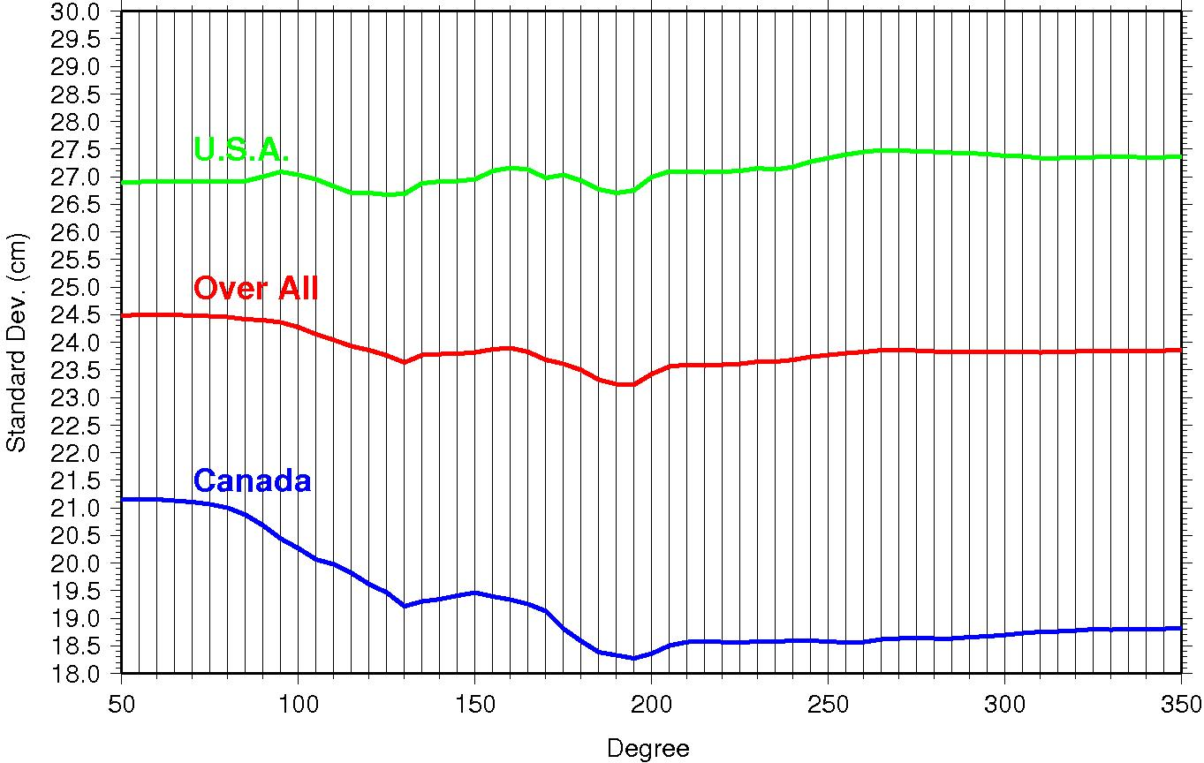
EIGEN_6c (zoom in)

Slide 12
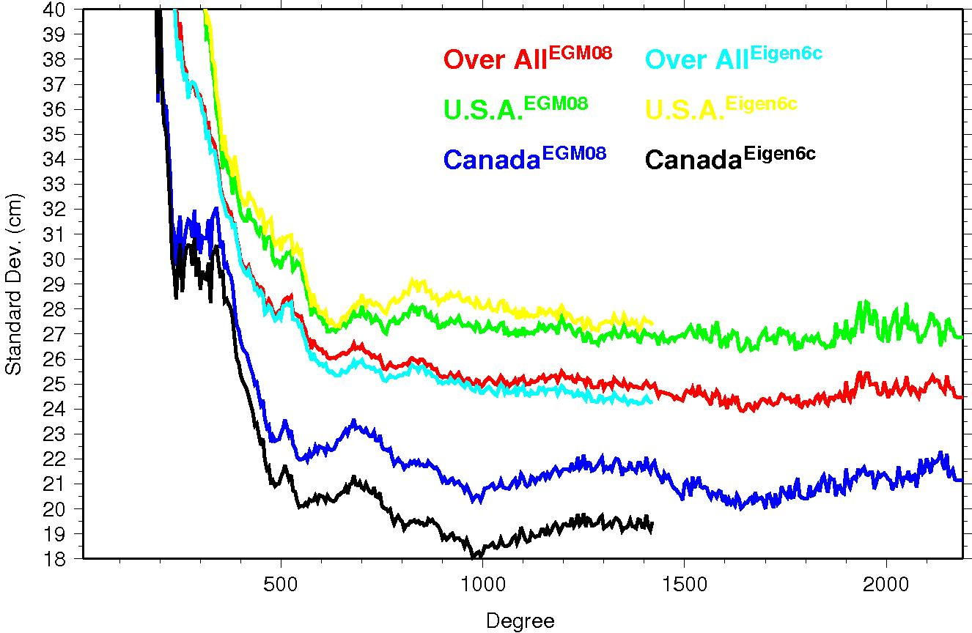
Eigen_6c and EGM08

Slide 13
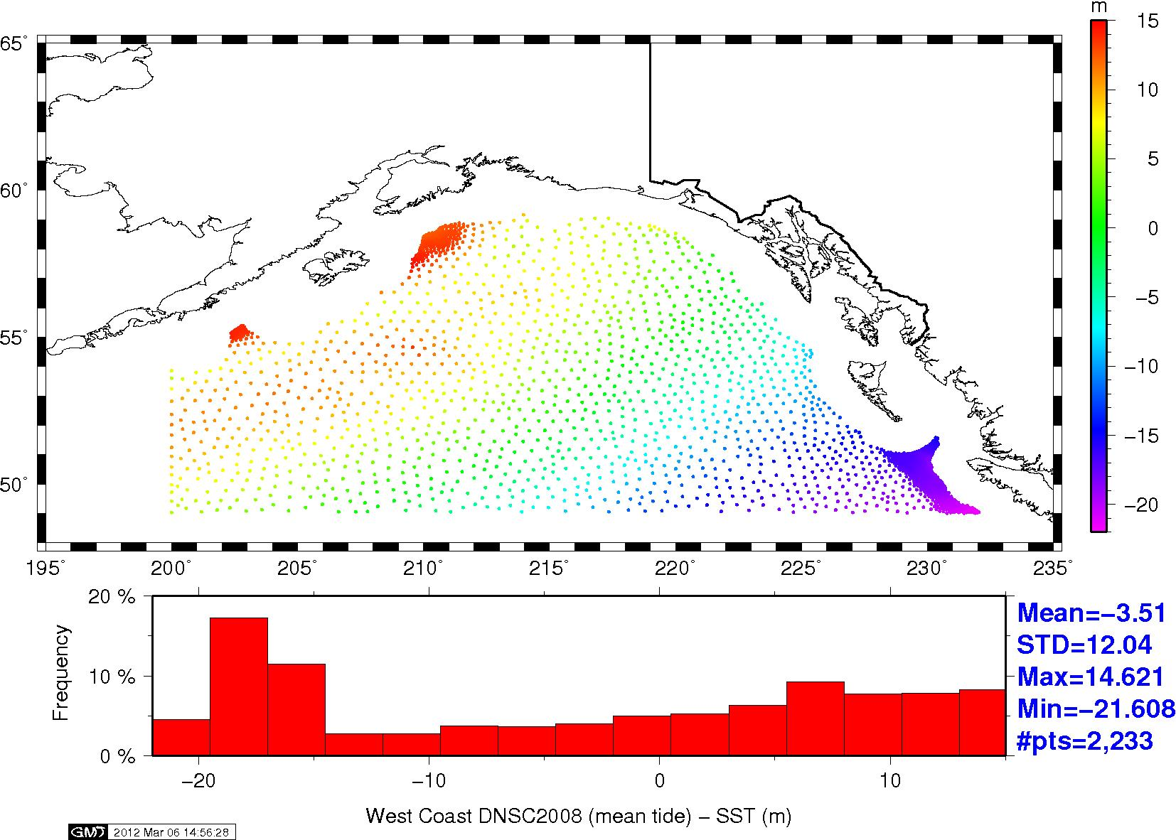
N = MSSH(DNSC08) – SST(Foreman)

Slide 14
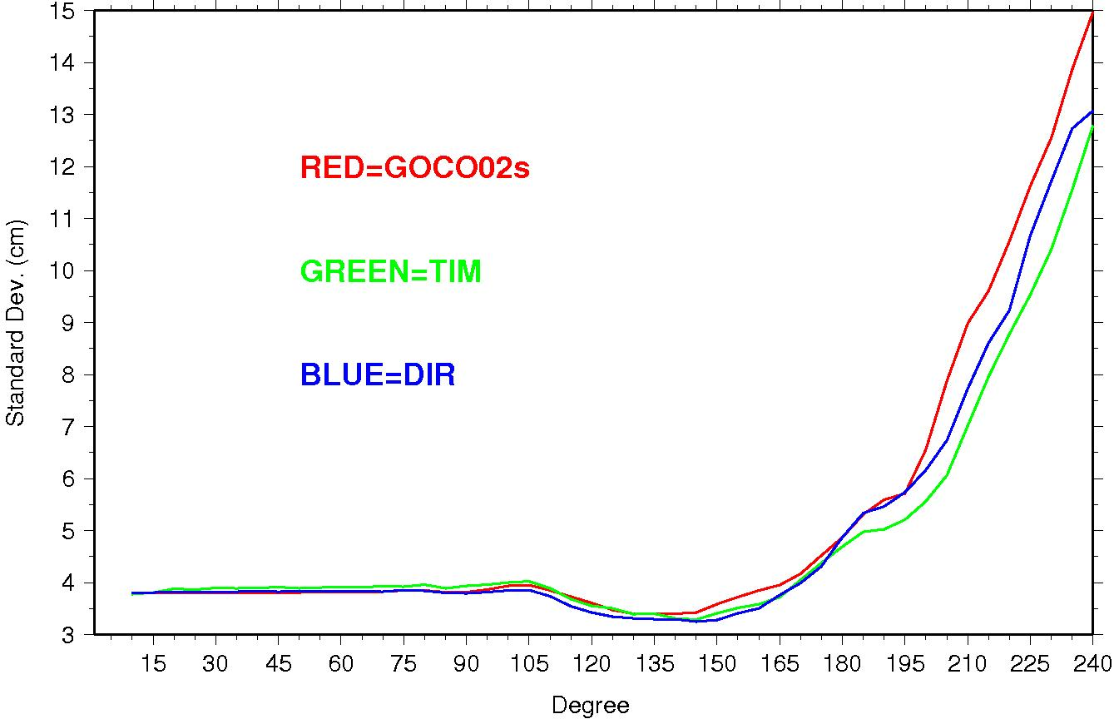
(MSSH – SST) – N(Combined models)

Slide 15
Local Geoid (Stokes-Helmert Method)
Geoid height:
Helmert co-geoid height:
Low-degree components:
Modification of the Degree-Banded Stokes kernel:

Slide 16
Weight function and its spectral
Modification coefficients
(Huang and Véronneau 2012) :
L=150
LE=L-u/2
Spectral transfer functions:
Truncation error coefficients:

Slide 17
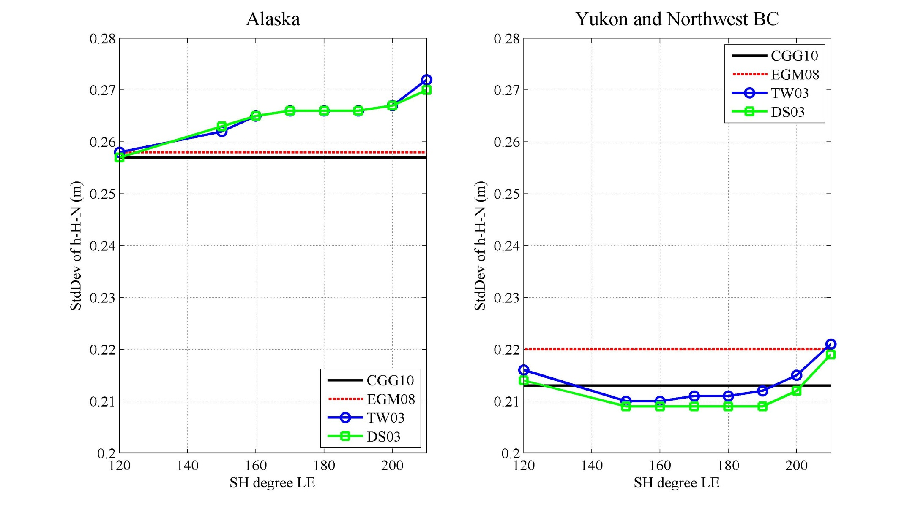
GPS/Levelling Test 1
93 GPS and leveling stations
90 GPS and leveling stations

Slide 18
Conclusions (1)
There is no noticeable improvement in GPS/leveling comparisons in Alaska (crustal motion, subsidence, PGR. etc.)
. GPS/leveling (Yukon) comparison shows the improvement of satellite models over EGM08 happens between degree 80 to 195.
3 cm (21 to 18 cm) improvement of EIGEN_6c over EGM08 is seen at degree 195. There is no improvement after degree 1000. EGM08 does not improve after degree 1000, too.

Slide 19
Conclusions (2)
GOCO02s seems more accurate than other solutions between degree 130 to 195.
Coefficients of all satellite models after degree 195 seem to degrade significantly and are not useable
Altimetric geoid comparisons show the improvement between degree 105 to 160.
Local geoid comparisons show a similar pattern

