Slide 1

Modernized
National Spatial Reference System (NSRS)
Use Cases
NOAA National Geodetic Survey Webinar
April 8, 2021

Slide 2

NSRS Modernization … not just new datums
Replacing NAD 83
Replacing NAVD 88
Re-inventing Bluebooking
Improving the Geodetic Toolkit
Better Surveying Methodologies
Blueprint for Modernized NSRS, Part 1
Blueprint for Modernized NSRS, Part 2
Blueprint for Modernized NSRS, Part 3
?
  How NGS will provide the frames/datum in the future
  How YOU can use the frames/datum

Slide 3


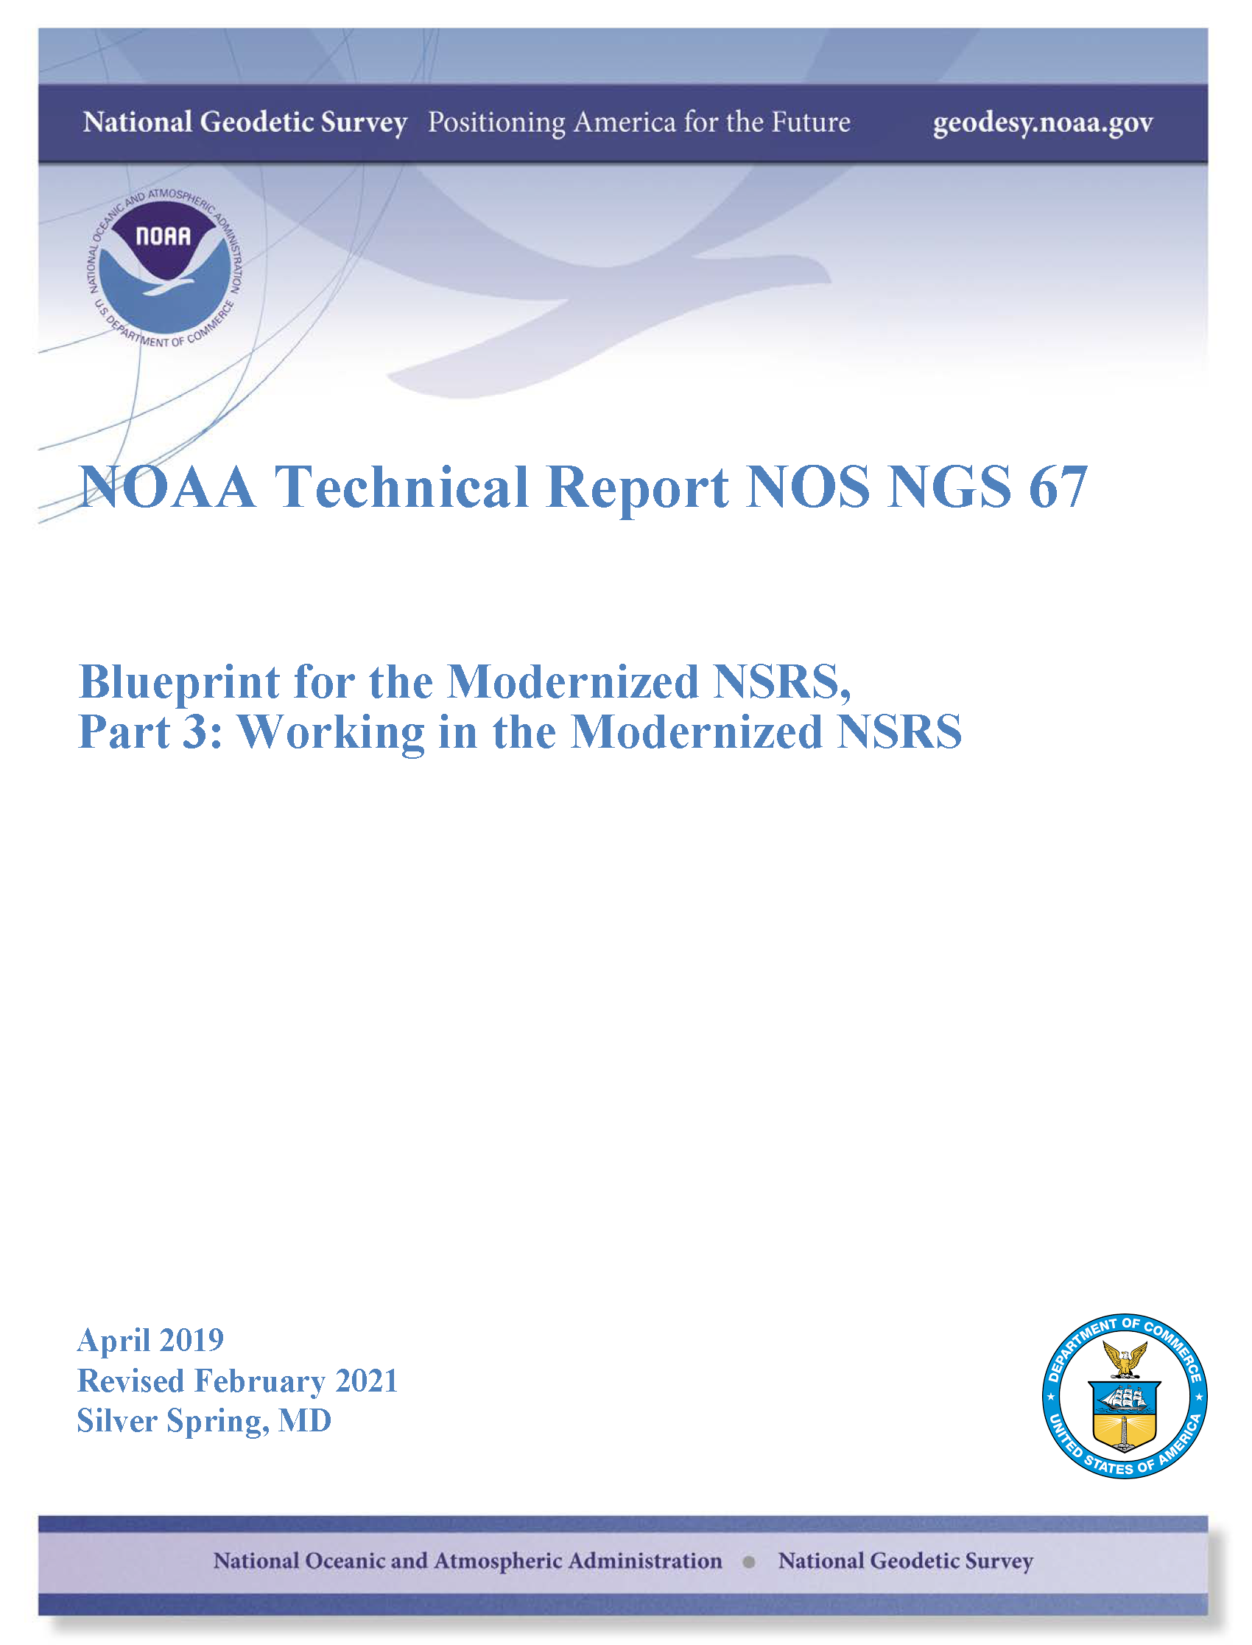
…your best source for information on modernization
Blueprints for the Modernized NSRS
All three have been revised for 2021
Geometric
Sep 2017; To Be Published Soon
NOAA TR NOS NGS 62
Geopotential
Nov 2017; Rev. Feb 2021
NOAA TR NOS NGS 64
Working in the modernized NSRS
Apr 2019; Rev. Feb 2021
NOAA TR NOS NGS 67

Slide 4

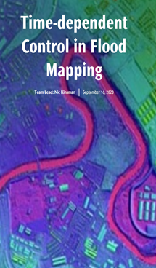
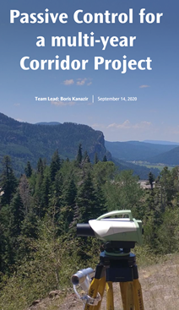

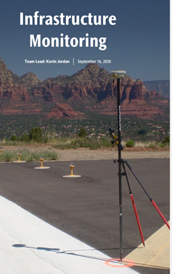
Use Cases – in Blueprint Part 3
Four examples of how today’s work becomes tomorrow’s work
These ‘thought experiments’ are the focus of today’s webinar

Slide 5
Terminology… Vocabulary… Lingo… Jargon…
Whatever you want to call it, there are some important phrases to know

Slide 6
Transitioning from NAD 83 to NATRF2022
Shift and Drift
  Shift
  One-time jump somewhere in the 0 to 4 meter range (in LLh)
    from fixing NAD 83’s non-geocentricity
  Drift
  The shift will take you to epoch 2020.00, from there on coordinates are time-dependent; working at any other epoch means you must account for the drift (velocity) of your coordinates
    as well as any other motions over time

Slide 7
Published Coordinates - Passive Control
Reference Epoch Coordinates
Survey Epoch Coordinates
Part of the NSRS
Based on “snapshot” of entire NSRS control network
Published every 5 or 10 years
RECs can be used to “hide” changes over time
Familiar to many users…
Part of the NSRS
Time-dependent coordinates, time being at “survey epoch”
Published every 4 weeks
SECs can be used to highlight changes over time

Slide 8
Published Coordinates - Active Control
Active Coordinates
Part of the NSRS
Coordinate function in time, of an active station such as a CORS
NOT associated with a specific epoch
CORSs will have these published ACs, or Coordinate Functions

Slide 9
Non-Published Coordinates
OPUS Coordinates
Tied to the NSRS → if OPUS recommendations are followed
Computed by OPUS from data you upload
NOT reviewed or evaluated by any person or machine at NGS
  hence “tied to” not “part of” NSRS
→ can be submitted to NGS for SECs & RECs

Slide 10

Published Coordinates
RECs ‘stable’ at project scales (5-10 years)

Slide 11
Published Coordinates
RECs ‘stable’ at project scales (5-10 years)
SECs reflective of narrow window in time
ACs or Coordinate Function at CORS
height
time

Slide 13
Flood Mapping
Nic Kinsman
Special thanks to:
Amy Whetter, Scott Lokken, and Dan Prouty
BP3 Team and Flood Use Case Reviewers

Slide 14
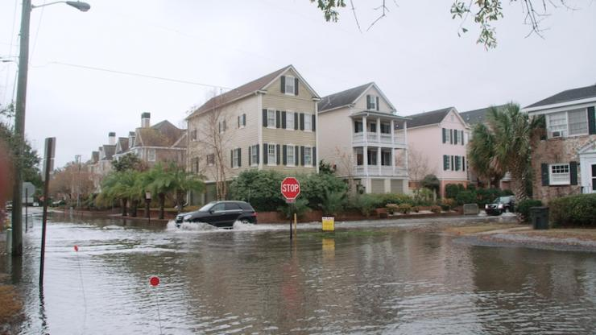
Water in the streets during a high-tide event on a sunny day in Charleston, South Carolina (toolkit.climate.gov)

Slide 15

NSRS Modernization benefits to Flood Mapping
A 2009 socio-economic study conducted on behalf of NOAA estimated that the GRAV-D project will save $2.2 billion over 15 years in avoidance costs from improved floodplain management alone.
2006 USACE U.S. Army Corps of Engineers Report on Hurricane Katrina:
“The floodwalls along the outfall canals were constructed to elevations nearly 2 feet below the original intent because of errors in relating the local geodetic datum to the water level datum.”
floodsmart.gov

Slide 16
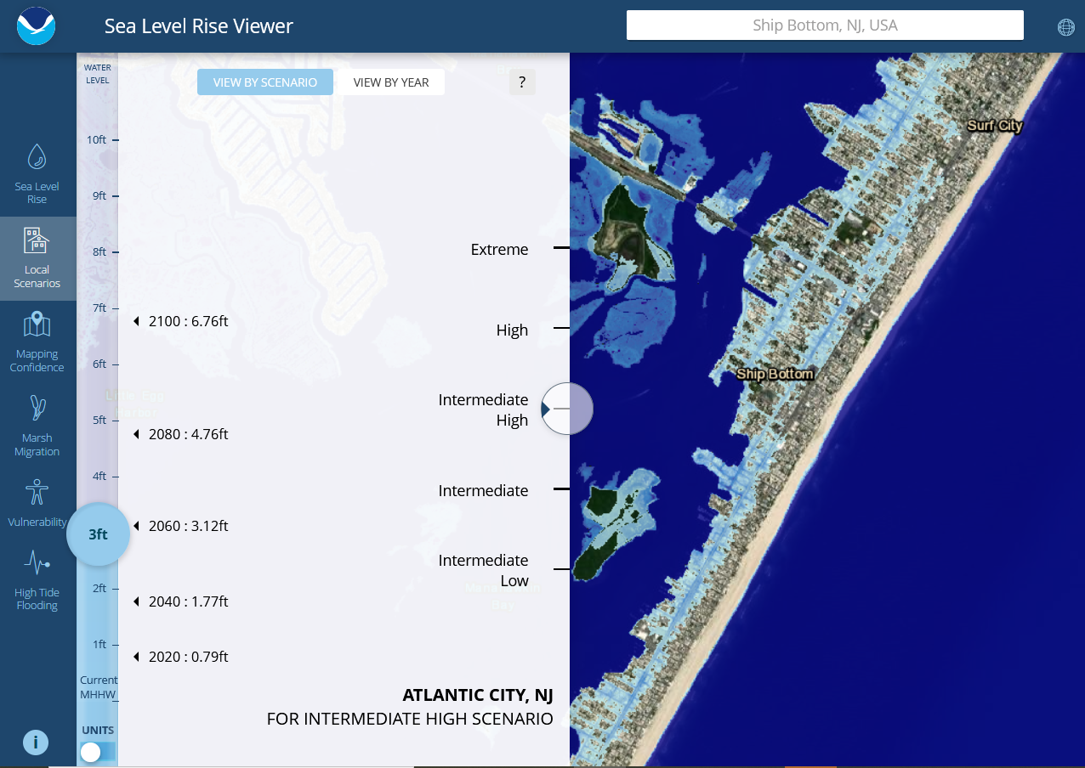
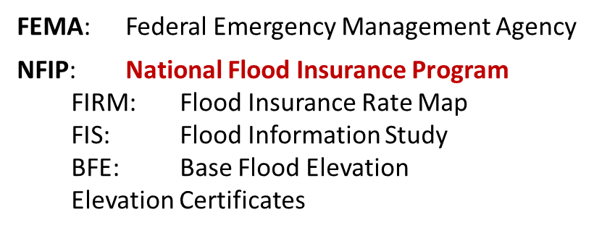
Flood ‘Thought Experiment’ Terminology
NOAA Digital Coast Sea Level Rise Viewer
coast.noaa.gov/slr
BP3 use case explores modernized NSRS implications on products and workflows in NFIP if today, but benefits are realized in any hydraulic flow models or inundation maps.

Slide 17
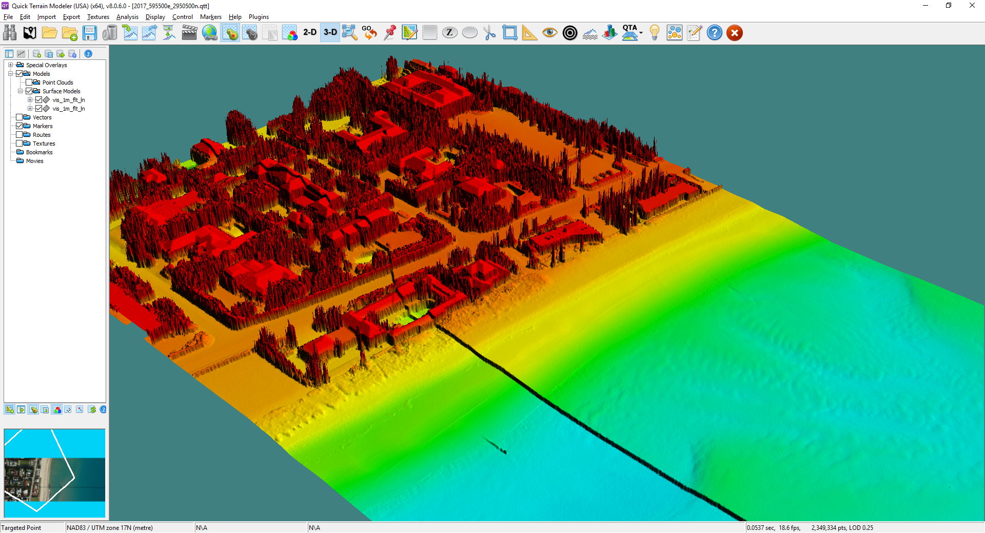
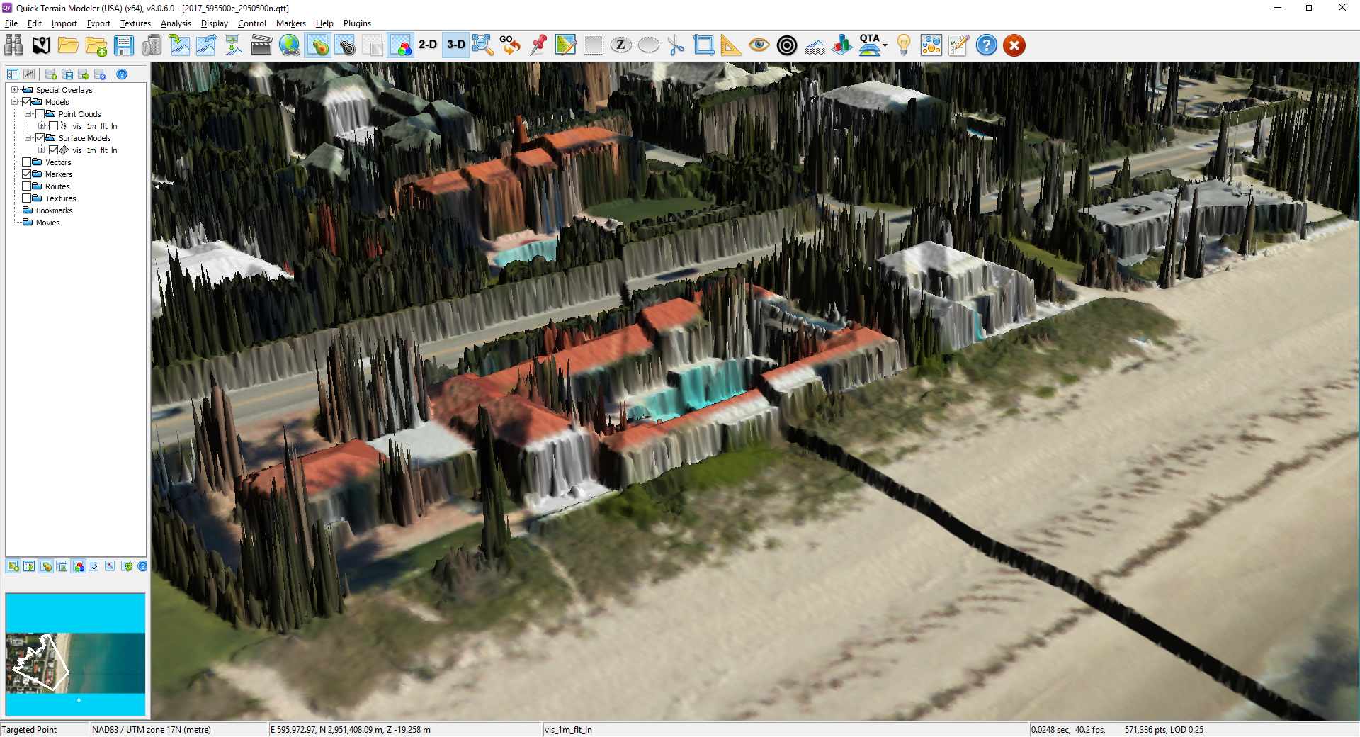
Minimizing negative impact of the SHIFT
FEMA requires use of the NSRS in the NFIP wherever practicable
Local Datum/NGVD 29 → NAVD 88
  inhibited by non-digital data and limited transformation tools;
  incomplete due to NAVD 88 extent/access exceptions
As NFIP operates today, rolling nature of FIS restudies allows for the gradual adoption of modernized NSRS
Projected vertical offset of >1 meter (Pacific NW)

Slide 18


Leveraging time-dependency to track the DRIFT
Susan
Fred
Base Flood Elevation
Not accounting for ground or mark motion can cause rate-setting to depart from true risk.

Slide 19
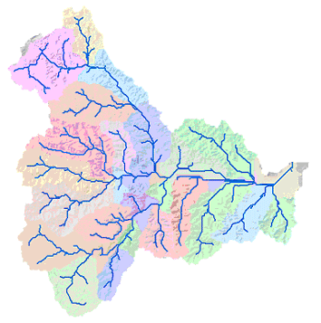
Layers of Benefits in Flood Insurance Study Updates
Digital elevation models
Hydraulic obstruction heights (toe, crest or deck on structures)
Stream cross section surveys for hydrograph calculations
FIRM production:
  Discovery phase leverages best available existing data
  Flood hydraulic modeling
  Hazard zone mapping
GIS Flow Accumulation Analysis

Slide 20
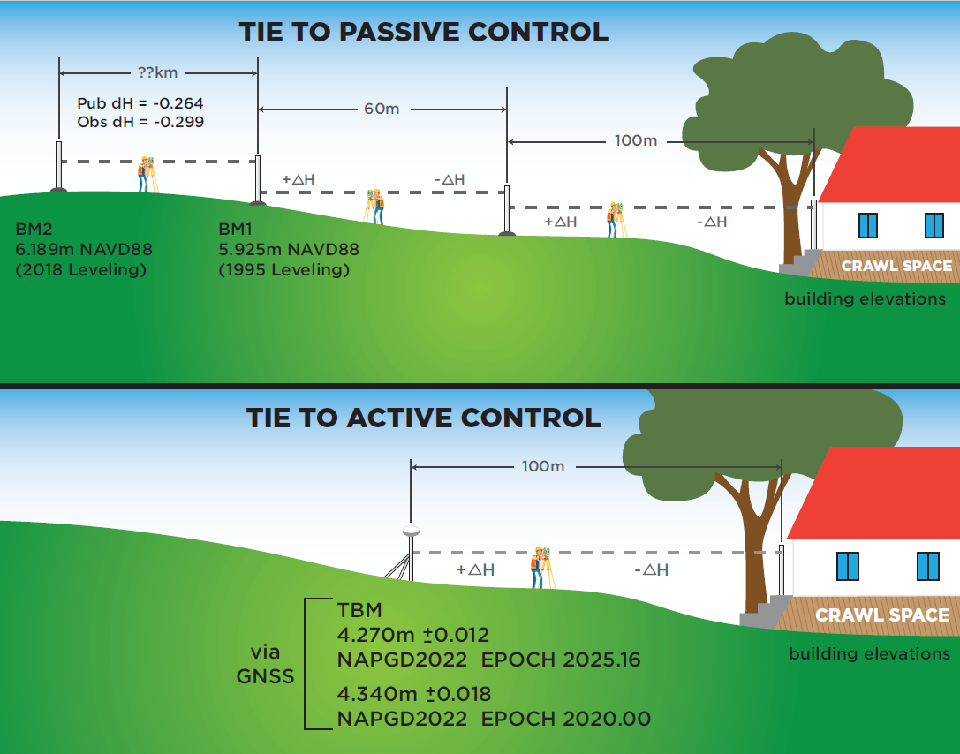
Added Convenience in NFIP Workflows

Slide 21
Added Convenience in NFIP Workflows

Slide 22
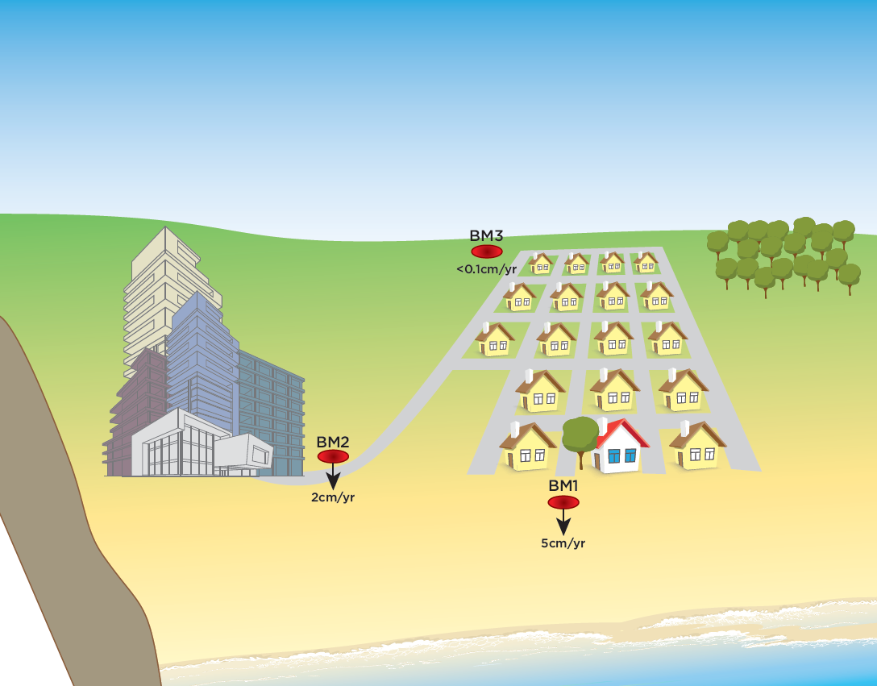

Slide 23
Summary and Next Steps
NSRS modernization benefits many types of inundation mapping in many ways
After initial shift, expect minimal changes to workflows in NFIP of today
Greatest risk reduction from fully leveraging modernized NSRS capabilities
___________________
Continue outreach and education about changes to come
Rolling coordination with FEMA on NSRS use in NFIP guidance
Provide technical assistance to flood mapping partners:
  Beta testing of tools
  Data-driven case studies
  Development of methodologies that embrace time-dependency

Slide 24
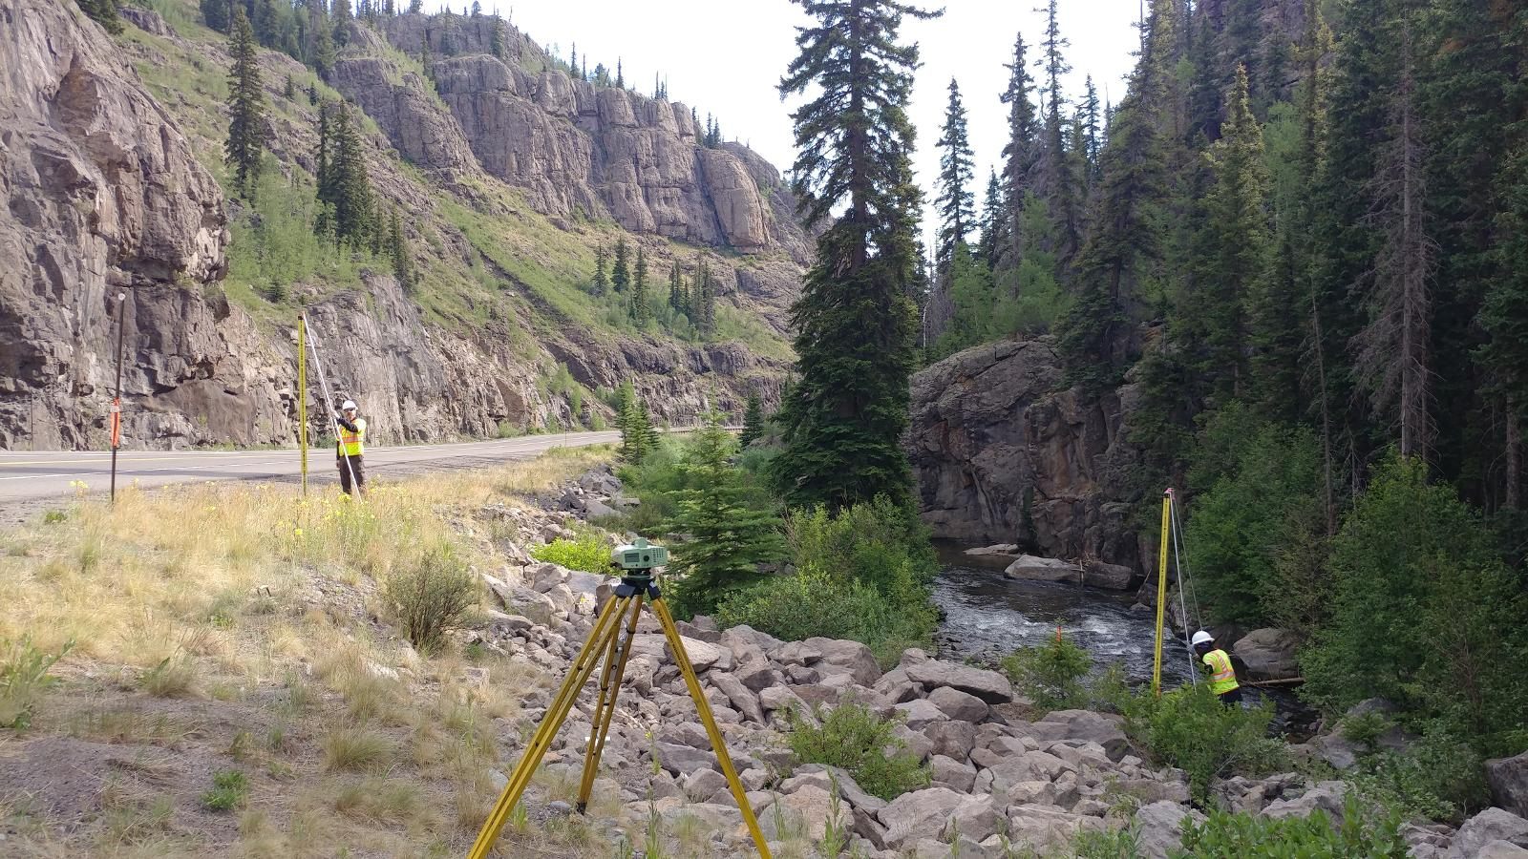
Why is Modernized NSRS
Important to Passive Control?
World is dynamic place
Everything (including geodetic control) around us is moving
Modernized NSRS will connect time-dependent positioning and passive control
This becomes critical when passive control is used to build new infrastructure

Slide 25
Passive Control Benefits in Modernized NSRS
Time series analysis
Epoch definitions
Trusted control marks
Project location selection
Infrastructure monitoring
More reliable and accurate data

Slide 26
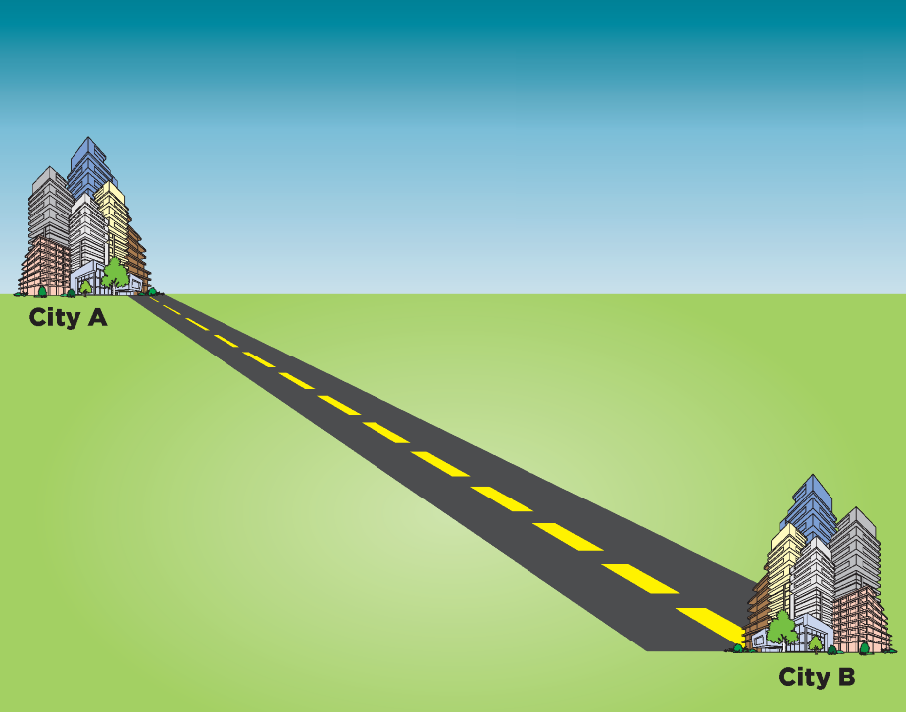
Multi-year Corridor Project
Imagine your job is to build something in a long corridor (a highway or pipeline, for example) over the course of ten years or more.
How will that change in the modernized NSRS?

Slide 27
Survey Data
CONTROL
GNSS
CONVENTIONAL
LEVELING
OTHER
Total Station
Static
RTK
Differential Leveling
Mobile LiDAR
Aerial LiDAR/Photogrammetry
Terrestrial Laser Scanning
RTN

Slide 28
Control Surveys and Coordinate Types
Control Surveys
Survey Epoch Coordinates
Survey Epoch Coordinates
RTN Alignment
Reference Epoch Coordinates
Leveling Control
Reference Epoch Coordinates
Reference Epoch Coordinates
GNSS Control

Slide 29
GNSS Control
A large change horizontally and/or vertically will require an update of the epoch (example 5-10 cm)
…but only if the change is so non-uniform that it cannot be adequately modeled by a best-fit coordinate transformation (e.g., “calibration” or “localization”)
A change of more than 10 cm horizontally and/or vertically will require an update of the epoch, regardless of how uniform the change is

Slide 30
RTN Alignments
Future service for RTN operators
Update RTN base station coordinates every 5 or 10 years
Ensure that RTN bases stations are aligned with RECs

Slide 31
Combining geodetic leveling & GNSS
REC = Reference Epoch Coordinates
SEC = Survey Epoch Coordinates
IFVM = Intra-Frame Velocity Model
PC = Primary Control
Leveling
Begin
Mid
End
SEC
IFVM
SEC
2.250
GNSS
on PC
2.200
GNSS
on PC
SEC
h
2.150
REC
2.100
GNSS
on PC
2.050
IFVM will be used to move primary control (PC) coordinates and
observations to REC 2020.00, and geometric and orthometric
values on all primary control points will be adjusted at REC 2020.00
2.000
REC
2020.00
Jan
2024
Jun
2024
Dec
2024
time

Slide 32
Preliminary Planning
Consider a scenario where someone is conducting a study to find the best location for future infrastructure project (road, pipeline or levee…)
Preliminary/Planning Surveys
Detect unsuitable zones
Plan route in desired location
Survey Epoch Coordinates
Survey Epoch Coordinates

Slide 33
Common Reference Epoch
Preliminary, construction, and as-built surveys can be tied to a common reference epoch!
This allows for a proper QA/QC (ensuring that projects are being built as designed) throughout all of the phases of the project
Construction Survey
Construction staking
Control checks
Reference Epoch Coordinates
Reference Epoch Coordinates
Survey Epoch Coordinates

Slide 34
Calibration or Localization
Terms used by various commercial software vendors for modifying surveying data obtained using GNSS
NGS traditionally has not supported this tool
It ensures that users can work in common epoch over a long-duration project
Transformations that generate final coordinates from GNSS devices
  Horizontal (2D)
  Vertical (1D)

Slide 35
Metadata
Metadata Statement Tomorrow
Horizontal Datum
Horizontal Datum Epoch
Vertical Datum
Vertical Datum Epoch
2020.00
Coordinates & Bearings
NATRF2022
NAPGD2022
2020.00
SPCS2022
2025.00
2030.00
2025.00
2030.00
Unit
Foot

Slide 36
Metadata Example
Latitude, longitude, and ellipsoid heights: North American Terrestrial Reference Frame of 2022 (NATRF2022)
Orthometric heights: North American-Pacific Geopotential Datum of 2022 (NAPGD2022)
Epoch: 2020.0000
Linear unit: International foot, ift (1 foot = 0.3048 meter)
Projected coordinate system: State Plane Coordinate System of 2022 (SPCS2022), Kentucky North Central zone (KY NC, 211007)

Slide 37
Transitioning Data to the Modernized NSRS

Slide 38
Best ways to determine coordinates in the Modernized NSRS
Listed in decreasing order of Accuracy, Cost, and Complexity
Resurvey: Return to the field and collect new observations, relying on geodetic control that has coordinates in the new datum. Useful for municipalities looking to migrate a local datum into the NSRS or for ongoing project control in areas experiencing lots of vertical motion
Readjust: Using existing observations, re-compute new coordinates based on geodetic control that has been defined in the new datum. Most appropriate for updating existing project control in stable regions
Transform: Take finished products that have coordinates in the old datum and use transformation software to estimate coordinates in the new datum. Best for for updates to legacy mapping data. Note - Not all data will need to be transformed as soon as the Modernized NSRS is released
OPUS
NCAT

Slide 39
How NGS will support transition of data
NGS will provide:
The source code, defining datasets, and robust documentation for NCAT and VDATUM so they can be incorporated into non-NGS software
Downloadable versions of NCAT & VDatum so they can be run locally
Sample input and output datasets so that users may test other transformation software against NGS’ definitive transformations
Uncertainty estimates for transformations
Note: Superseded historic transformation software will continue to be available on the NGS website, however they will not be updated.

Slide 40
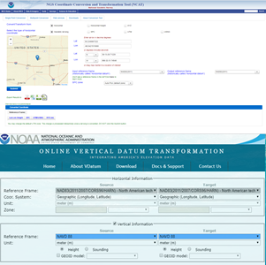
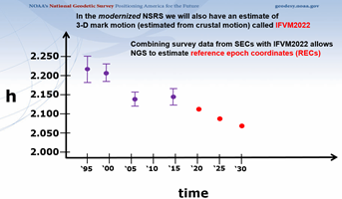
GPS on Bench Marks for the Modernized NSRS
GPS on Bench Marks is not only about building the Transformation Tool to connect the past and future Datums. It is about preparing the country and our communities to take full advantage of the benefits of the Modernized NSRS
GPSonBM Campaign Goals:
Data for NAVD 88 – NAPGD2022 Transformation Tools
2020.0 Reference Epoch Coordinates (REC’s)
Build time series of observations in areas of motion

Slide 41
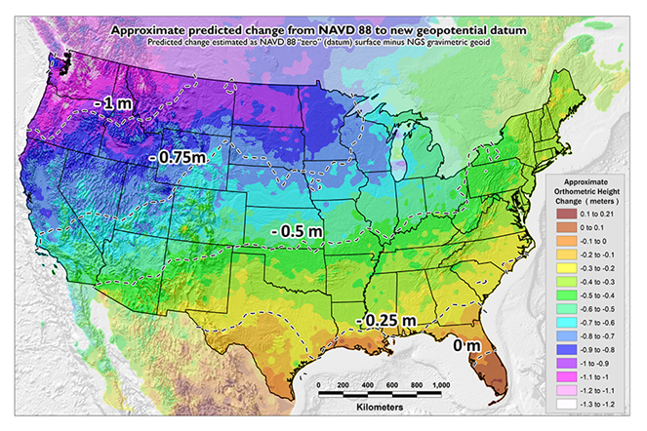
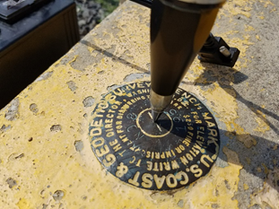
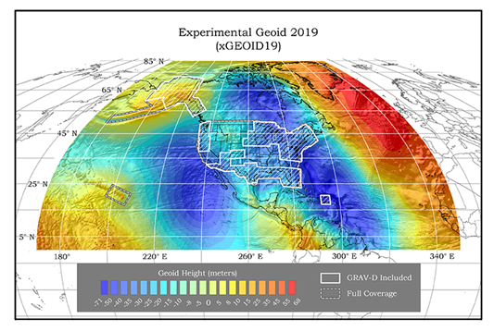
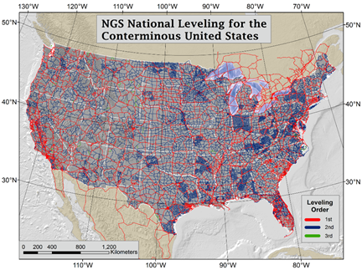
GPSonBM Measurements Connect
Old & New Datums
Because the relationships between the old and new datums vary by location, the accuracy of the transformations in any particular place is directly related to the density of GPSonBM data available in that area.

Slide 42
Modernized NSRS Use Case:
Airport and Other Infrastructure Monitoring
Kevin Jordan
Cartographer, NGS Field Operations Branch
NOAA’s National Geodetic Survey

Slide 43
Acknowledgments
Use case writing team
  Jeff Jalbrzikowski, Dan Martin, Dave Hatcher, Benjamin Gavin, Jeff Steele, Dan Determan, Kevin Jordan

Slide 44
Infrastructure Monitoring for Airports
Broadly speaking, infrastructure monitoring is tracking any motion of a bridge, dam, navigation locks, water level station, power plant (hydropower and nuclear), airport or any other infrastructure relative to itself and/or the NSRS. In this use case example, we will explore how the modernized NSRS can be used to monitor airport infrastructure.
Today, FAA contracted surveyors provide a proposal to the FAA for the establishment of one Primary Airport Control Station (PACS) and two or more Secondary Airport Control Stations (SACS). The PACS and SACS must meet all minimum siting, construction, and intervisibility requirements defined in the FAA Advisory Circular AC 150/5300-16B. Through an inter-agency agreement with the FAA, the National Geodetic Survey’s Airport Survey Program provides a comprehensive review of the proposed monumentation and observing scheme to provide an accurate tie to the NSRS.

Slide 45
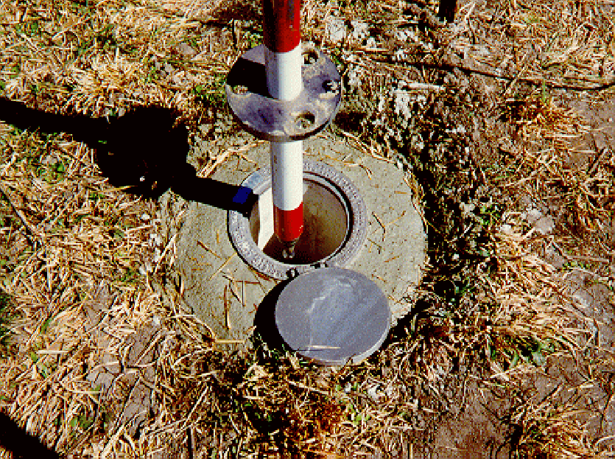
AC-16B Geodetic Control
Current Geodetic Control Network
CORS
FBN and BM ties must be observed simultaneously with PACS
PACS and SACS monuments are positioned and tied to the National Spatial Reference System through GPS observations.
BM#1
BM#2
PACS
SACS#1
HARN
Airport
SACS#2
AC 150/5300-16B
Simplified Schematic

Slide 46
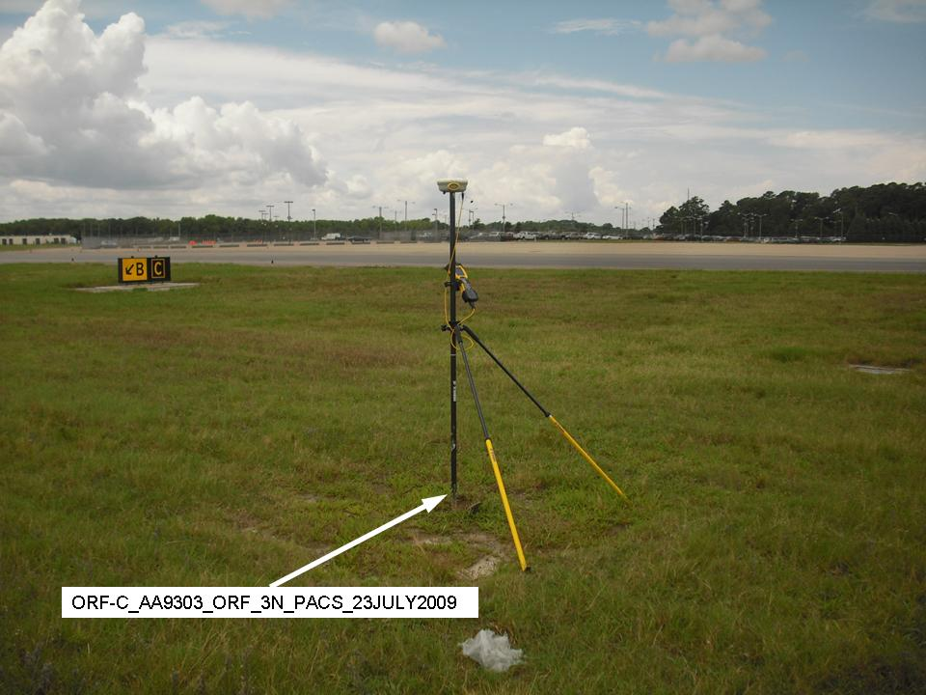
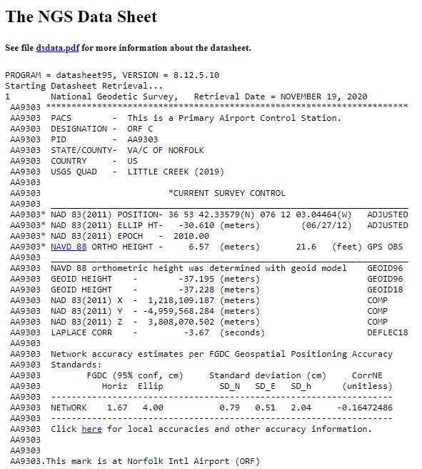

Slide 47
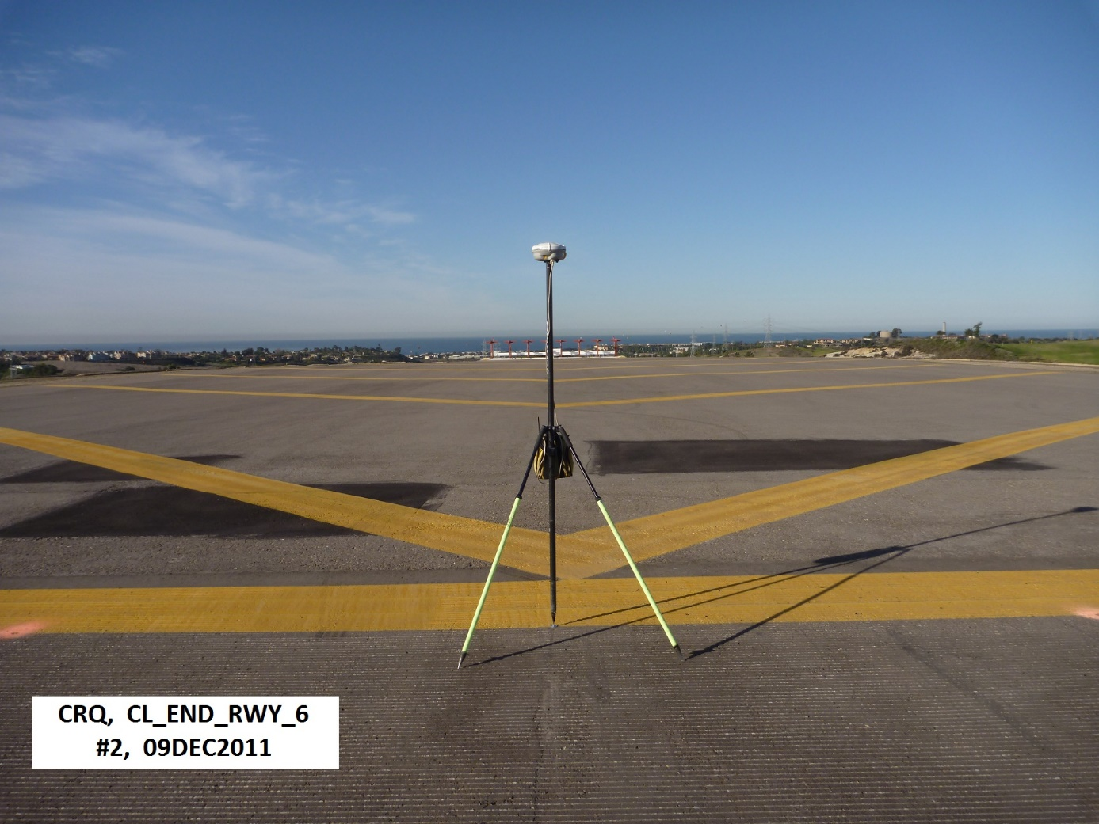
Why is the NSRS important to airport infrastructure?
What goes up, must come down
What are the position of the runway ends?

Slide 48
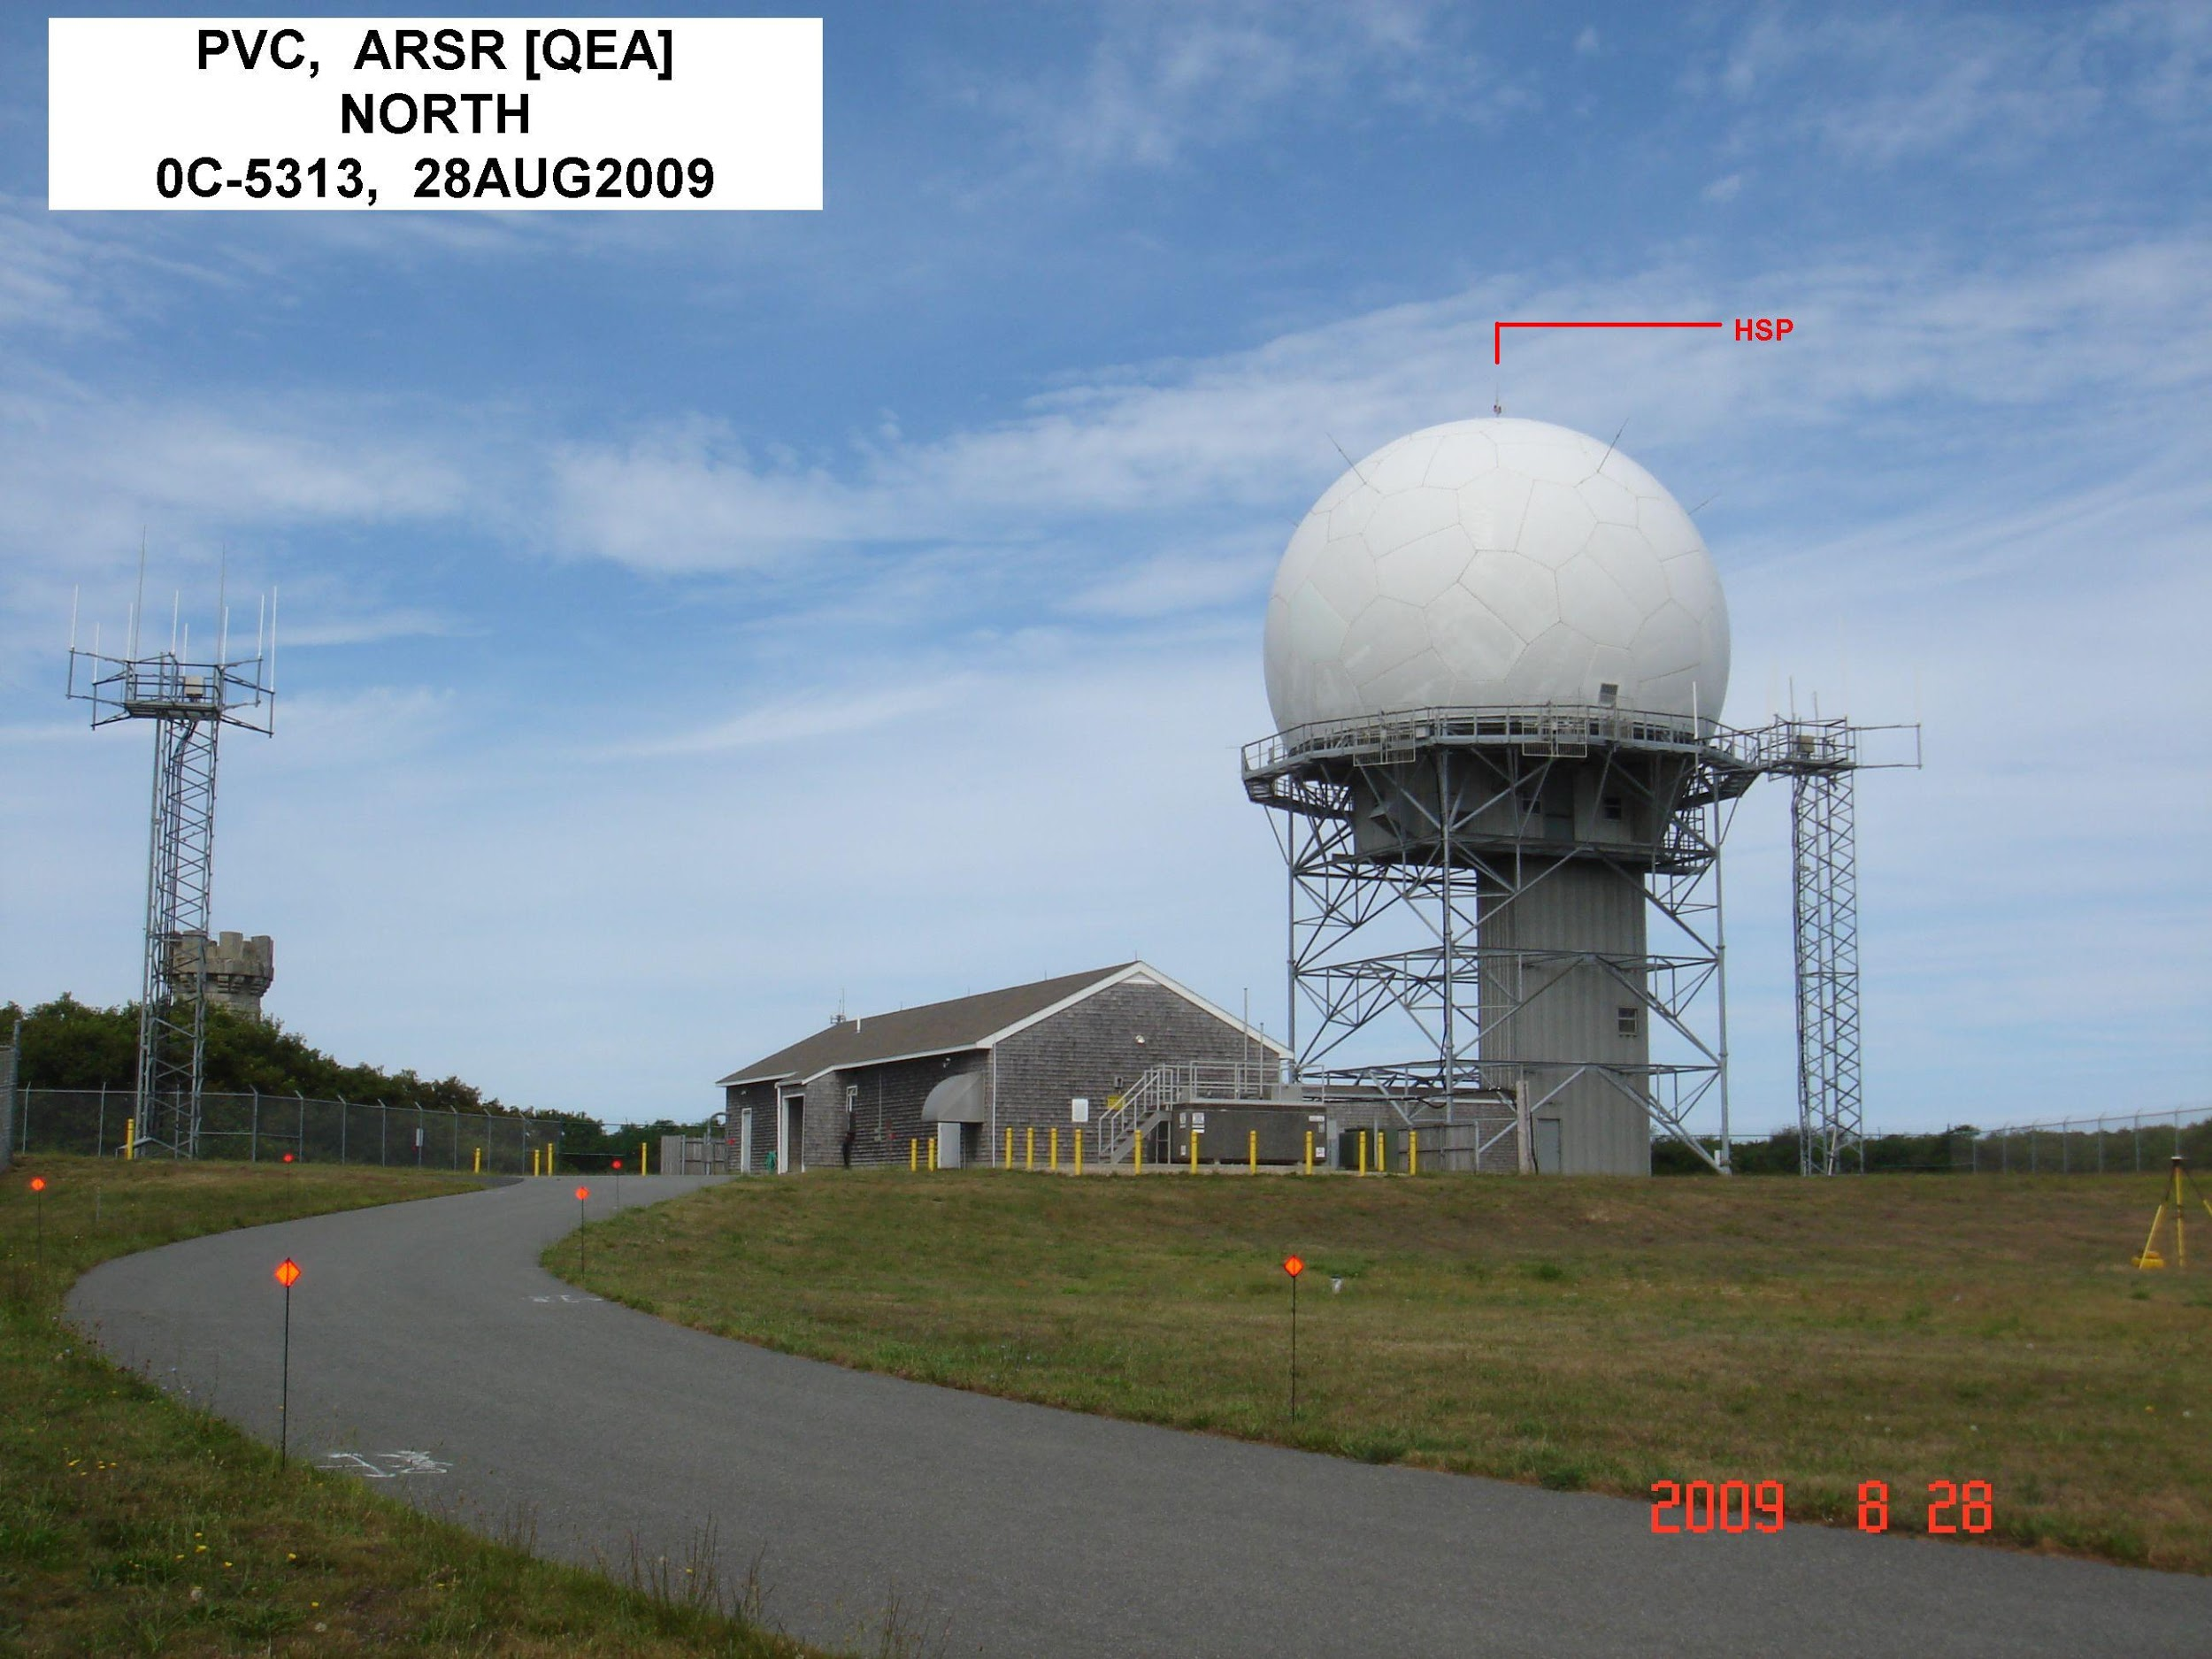
Why is the NSRS important to airport infrastructure?
How are the NAVAIDS positioned that guide aircraft to their destinations?

Slide 49
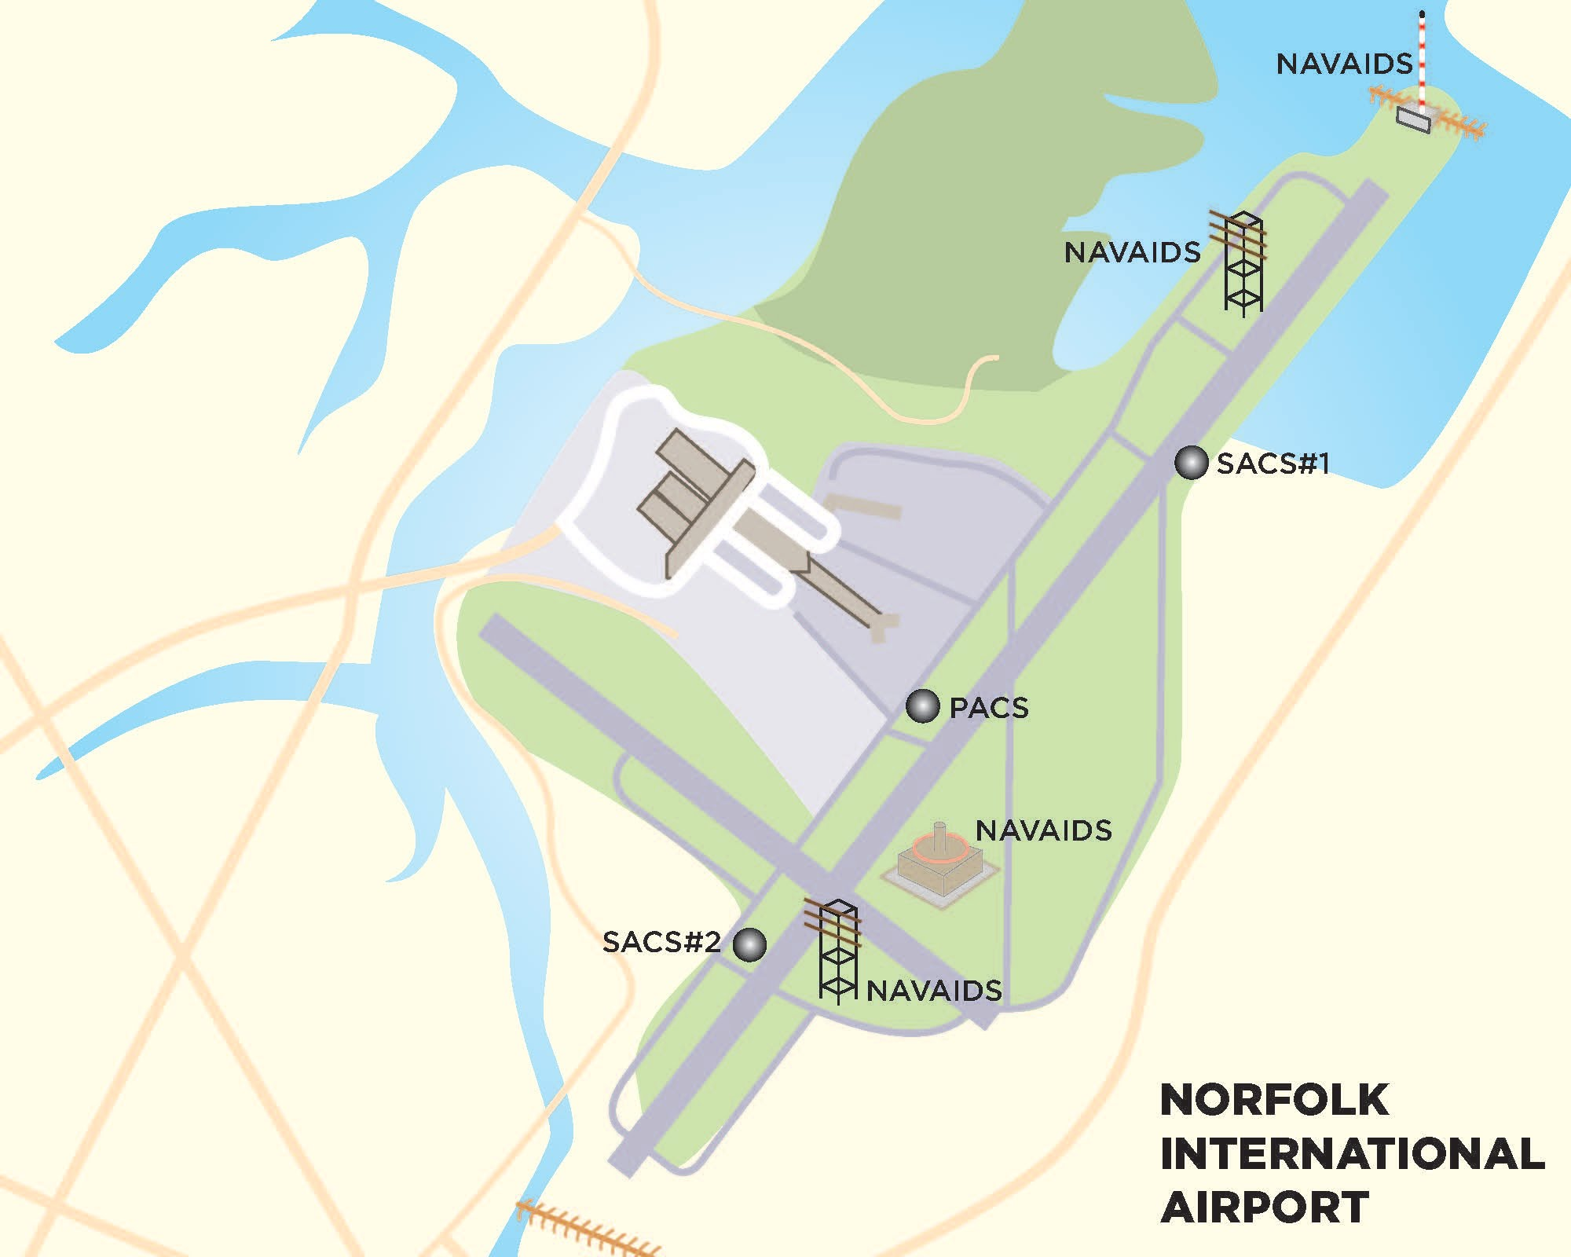
Why is the NSRS important to airport infrastructure?
What is the relationship of the airport infrastructure to the local environment and other types of infrastructure?

Slide 50
Why is the NSRS important to airport infrastructure?
Geodetic ties to runway ends, NAVAIDS, obstructions and other airport features are all necessary to maintain the spatial integrity that connects the National Air Space to those features and infrastructure on the ground.

Slide 51
Why is the NSRS important to airport infrastructure?
But what if those ties are broken or the marks themselves destroyed or damaged?
Can surveyors rely on old PACS/SACS GPS-derived orthometric heights that are not updated?

Slide 52
LEVERAGING THE MODERNIZED NSRS
AC-16B Geodetic Control
Modernized NSRS Geodetic Control Network
CORS
CORS
Local Passive Control requirements are optional in a modernized NSRS
PACS and SACS monuments are positioned and tied to the National Spatial Reference System through GPS observations.
BM#1
BM#2
PACS
SACS#1
HARN
Airport
SACS#2
CORS
AC 150/5300-16B
Simplified Schematic

Slide 53
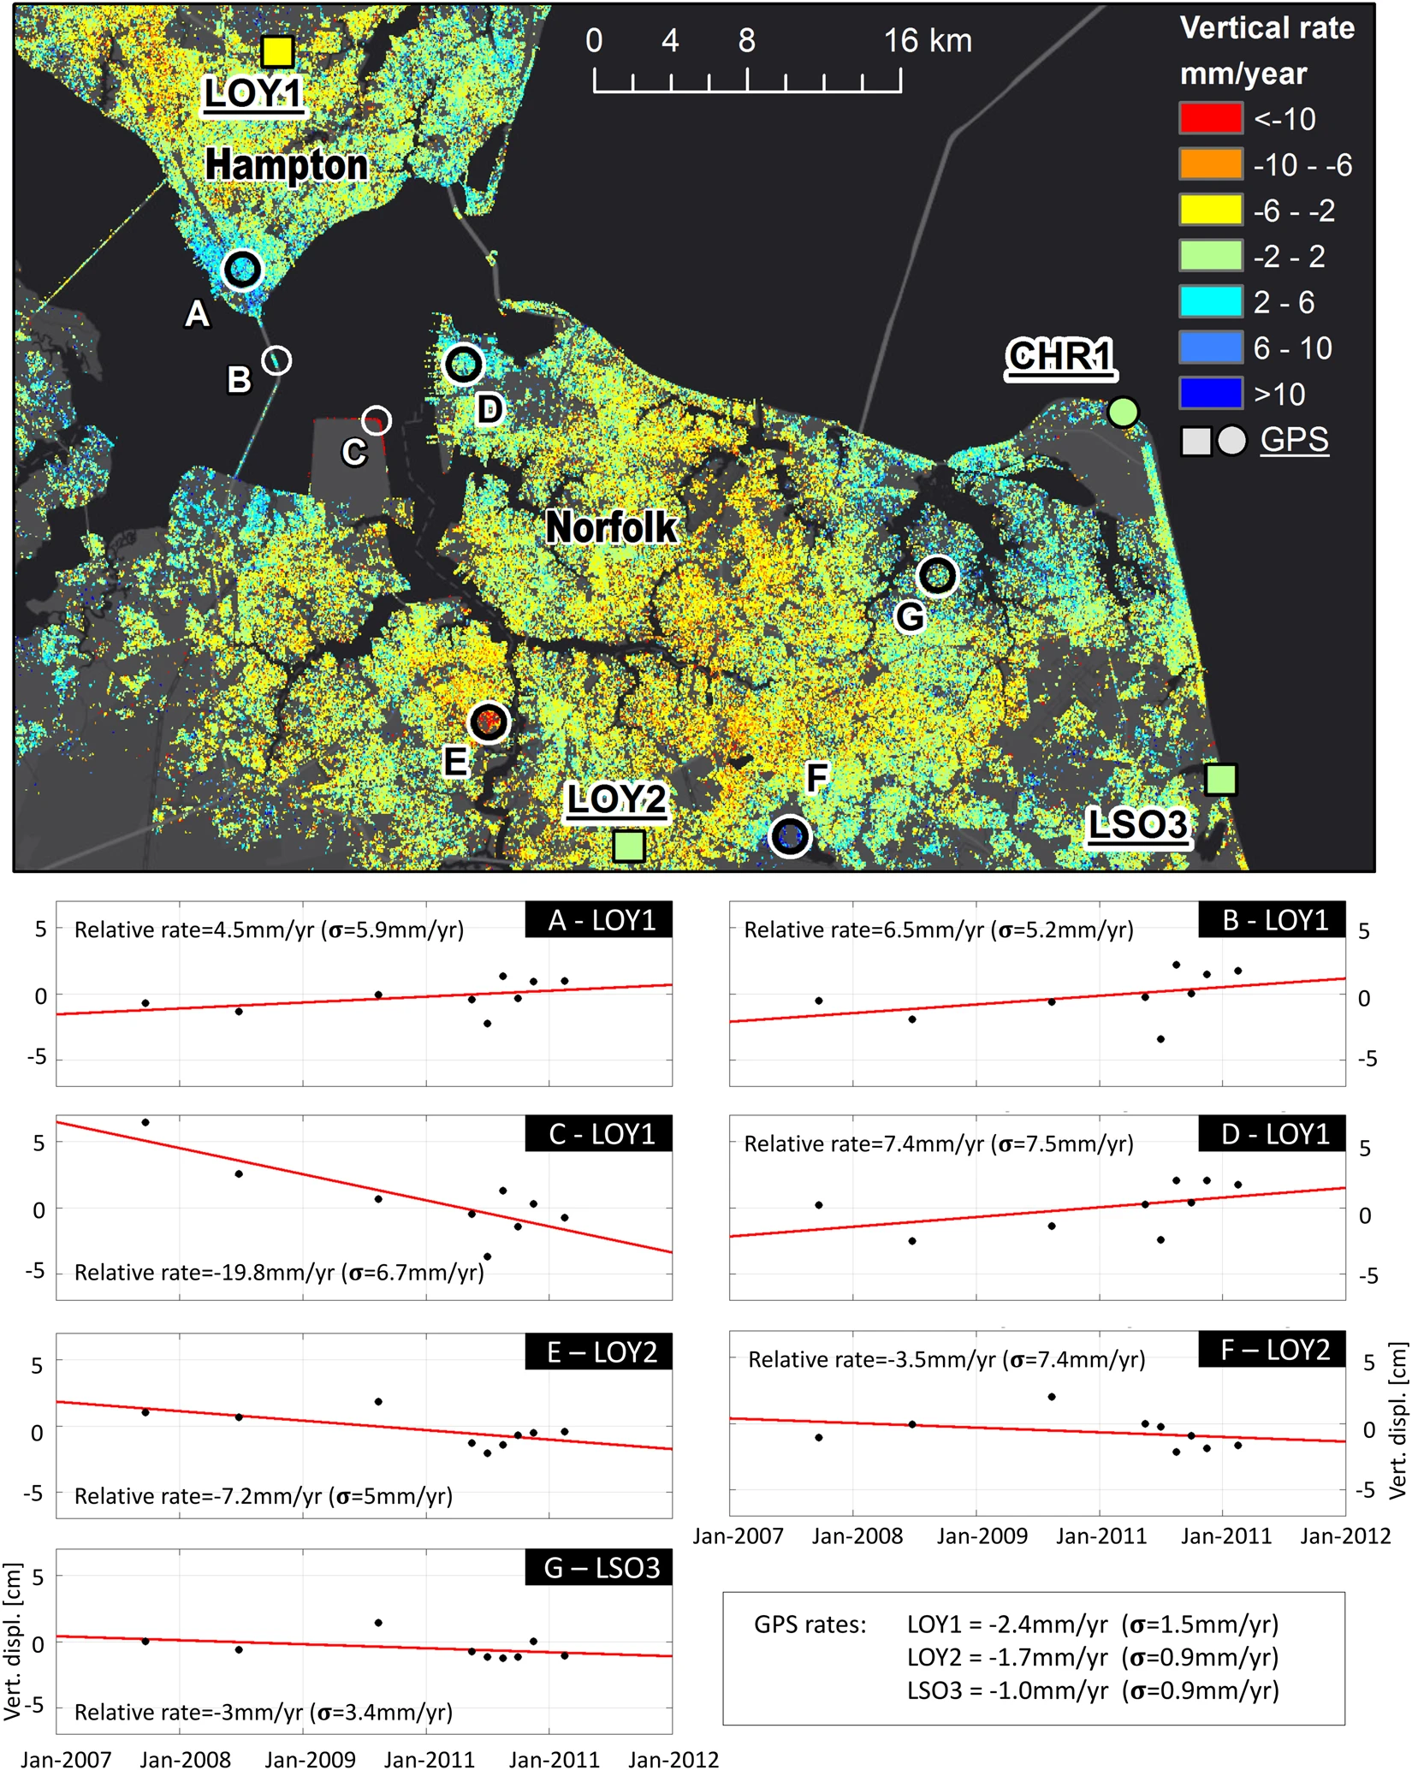
LEVERAGING THE MODERNIZED NSRS
Residual surface motion
SAR images between 2007-2011
GPS CORS data showing differing velocities
Source https://www.nasa.gov/feature/jpl/nasa-finds-va-metro-area-is-sinking-unevenly

Slide 54
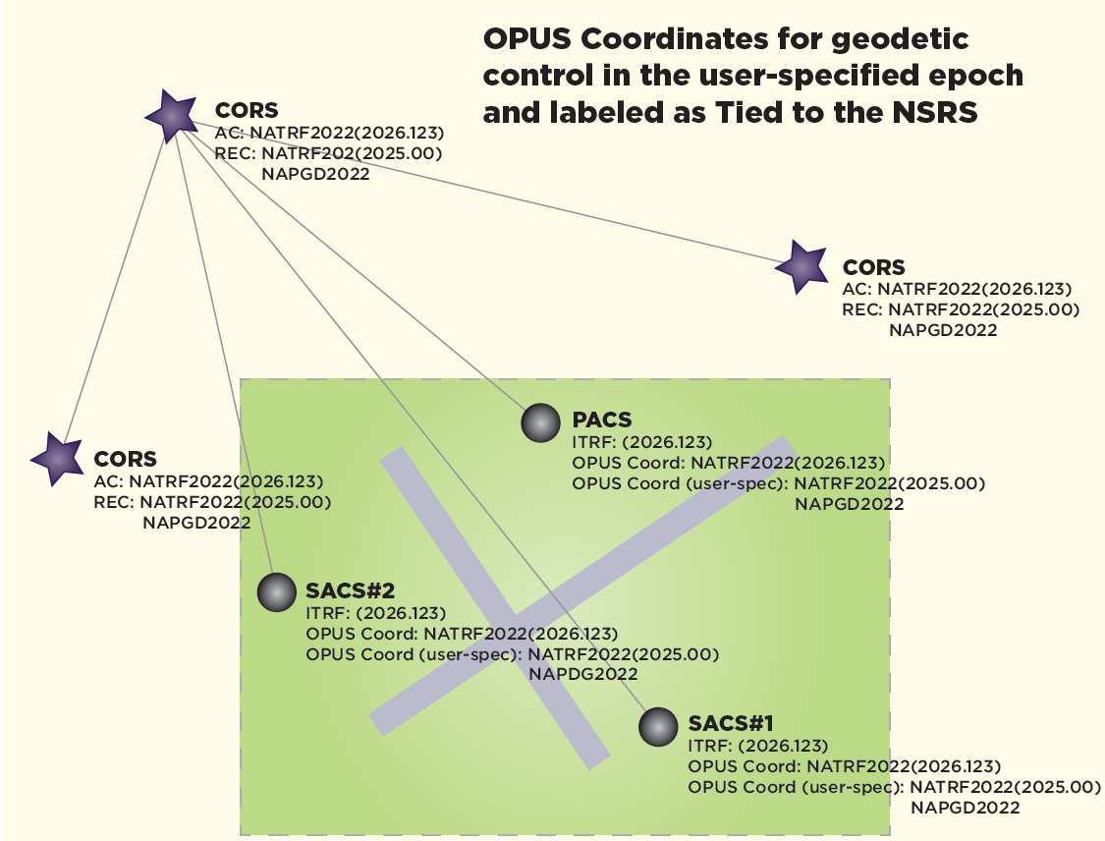

Slide 55
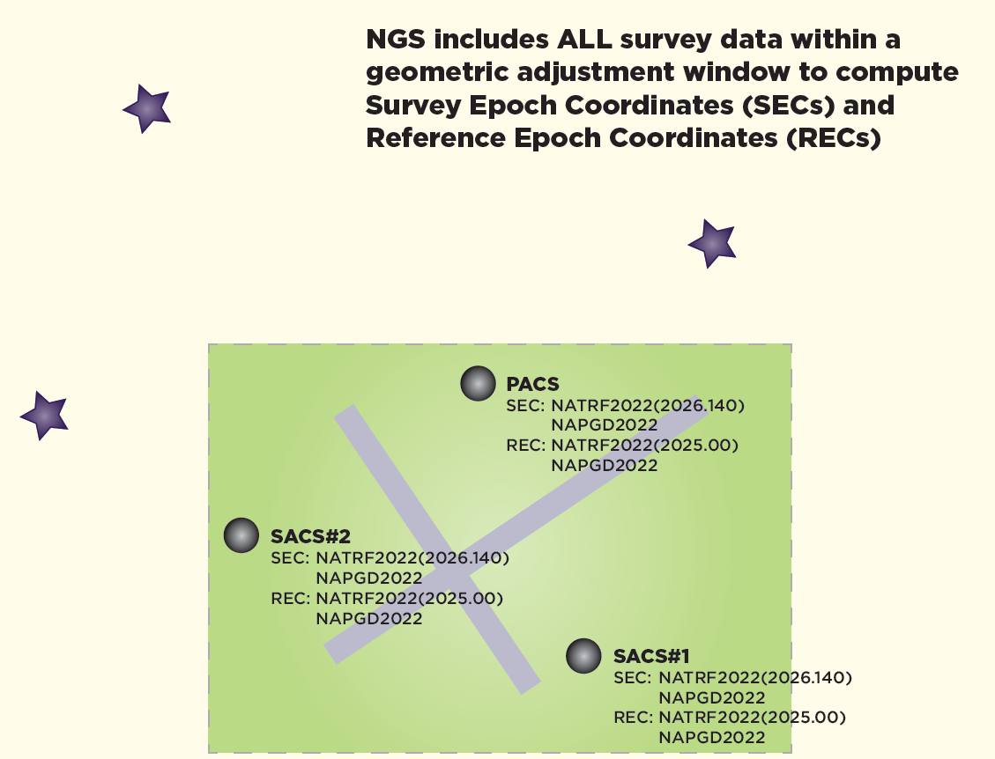

Slide 56
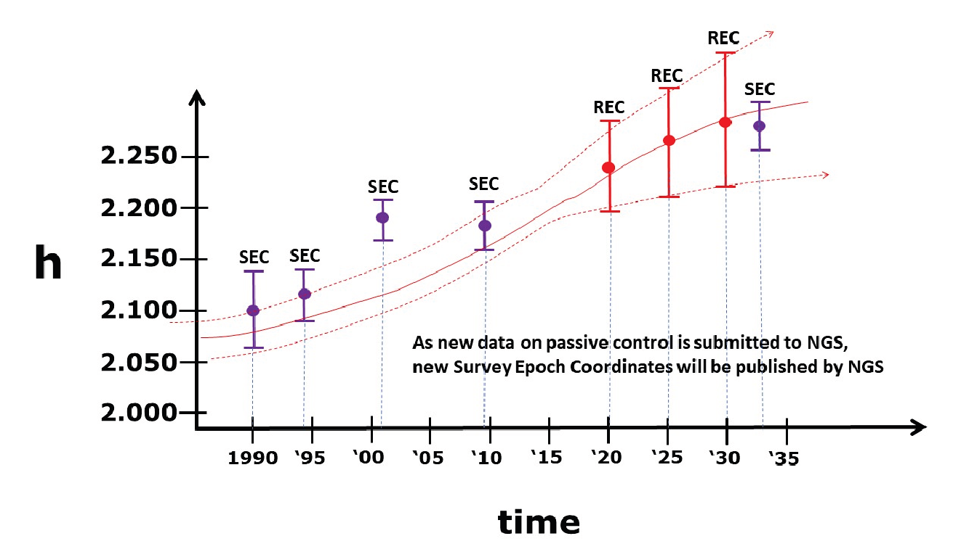

Slide 57
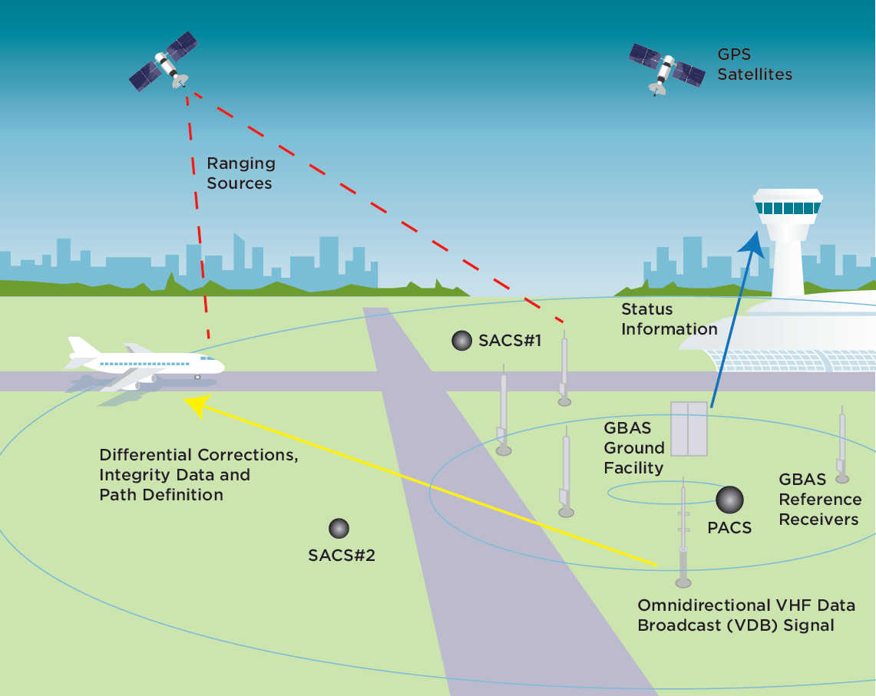

Slide 58
Use Cases – find them in Blueprint Part 3

Slide 59
Preparing for Modernization
Read the Blueprint Documents
  we also have recorded webinars from NSRS Modernization Manager
Subscribe to NGS news
  https://www.ngs.noaa.gov/INFO/subscribe.shtml
Check out the New Datums web page:
  https://www.ngs.noaa.gov/datums/newdatums/
Reach out to NGS for support as needed
  https://www.ngs.noaa.gov/ADVISORS/

Slide 60

Where to learn more?
FAQs on Modernization
Email Subscriptions:
NGS News
NGS Webinar Series
NGS Training
GPS on BM

Slide 61
Further Q&A

