Slide 1
Modernized NSRS Use Cases
Ed Carlson
Michael Dennis
Dan Determan
Benjamin Gavin
Daniel Gillins
Dave Hatcher
Ryan Hippenstiel
Jeff Jalbrzikowski
Boris Kanazir
Scott Lokken
Dan Martin
Dan Prouty
Galen Scott
Dru Smith
Jeff Steele
William Stone
Brian Ward
Amy Whetter
+ external reviewers!
2021 NGS Geospatial Summit
May 5, 4:10-4:25 EDT
Nicole Kinsman, Alaska Regional Geodetic Advisor
Kevin Jordan, NGS Field Operations Cartographer
Notes:
As we have discussed in this summit, NGS has released updated versions of the Blueprint document publication series which is intended to describe technical and policy decisions about the definition of the modernized NSRS → the third Blueprint document is focused on working in the modernized NSRS and that discussion is anchored by four applied use cases of direct interest to geospatial professionals (located at end of document)
In his final presentation of our summit today I am going to provide an extremely high-level overview of those applied use cases, a longer version of this content was provided as an NGS webinar in April and a recorded version of that can be viewed on our website.
Each use case was written by a team of NGS personnel, then received input and review from external partners that was above and beyond the rest of the Blueprint document content.
A big thanks to the all authors and reviewers and to Kevin Jordan who led the infrastructure monitoring use case and will be the primary person curating question responses in the text box behind the scenes.

Slide 2
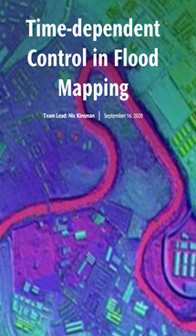
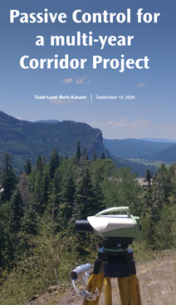
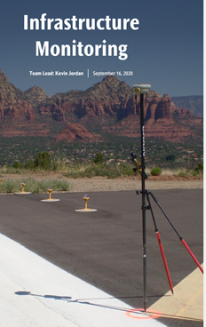
The Use Cases – in Blueprint Part 3
Four examples of how today’s work becomes tomorrow’s work
These ‘thought experiments’ are the focus of this last session
Notes:
You can think of each use case as a thought experiment, and each one was designed to showcase how features of the modernized NSRS can be best leveraged in familiar and new workflows.
(Read the 4)
Each “use case” describes how an NSRS user’s geodetic positioning workflow will change when the modernized NSRS is available. This begins with describing today’s workflow, and then describing how tomorrow’s workflow is likely to differ (or remain similar), and how the modernized NSRS features described in the Blueprint series will be utilized. No data was used for writing these, they are meant as a general description of change.
Motivation for NGS to include these:
You, our users, asked for them!
Having more concrete examples in the context of known workflows facilitates dialog on remaining NSRS modernization priorities
Tees up the opportunity for users to design and test data-driven case studies for further evaluation

Slide 3
Poll
Which of the following NGS case study topics do you anticipate will have the most relevance to your work?
Flood Mapping
Passive Control for a Multi-year Corridor Project
Transitioning Data to the Modernized NSRS
Leveraging the Modernized NSRS for Airport and Other Infrastructure Monitoring
Other
Notes:
Results from April 8 Webinar:
12% Flood Mapping
18% Passive Control
54% Transitioning Data
6% Airport/Infrastructure Monitoring
10% Other

Slide 4
Key Elements of each Use Case
Minimizing negative impacts of the shift
Leveraging full capabilities of:
time-dependency and new coordinate types
GNSS-based access convenience
NSRS product enhancements and new tools
to live and work better with the drift
Notes:
The earth is in motion and the NSRS is a positioning framework that allows us to do our work effectively and consistently in this changing world – the modernized NSRS provide tools to account for this shift with maximum accuracy, transparent metadata, and is optimized to meet the balanced needs of may geospatial professionals.
As you have heard about, when transitioning into the modernized NSRS, your coordinates will experience shift and drift
Shift: A one-time jump somewhere in the 0 to 4 meter range (latitude, longitude, ellipsoid height)
Drift: The shift will take you to epoch 2020.00, from there on coordinates are time-dependent. Working at any other epoch means you must account for the drift (velocity) of your coordinates
Therefore a big focus within each use case was a practical analysis of how to minimize the negative impacts of this one-time shift, and/or how to best leverage the enhanced capabilities of the modernized system to live and work better with the drift. (because the earth is actually moving, as much as we would like to pretend sometimes that it is not!)

Slide 5
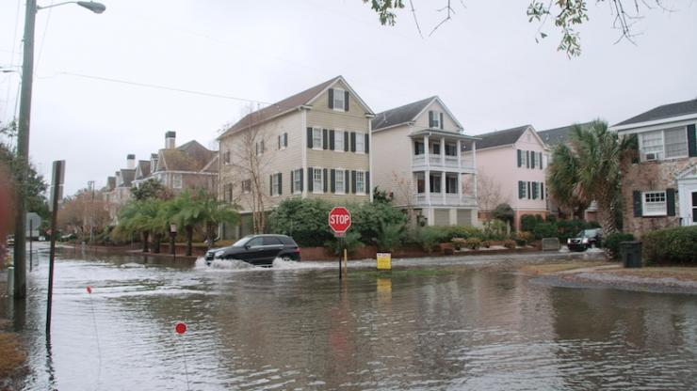
Flood Mapping
Water in the streets during a high-tide event on a sunny day in Charleston, South Carolina (toolkit.climate.gov)
Notes:
(scene familiar to many towns, ex: Norfolk, VA(tidal influenced), Houston/Katy, TX (overland flooding)
The first of the four use cases is a thought experiment focused on flood mapping. Precise positions, especially in the vertical, matter when it comes to knowing where water will flow under elevated conditions – both inland and at the coast.
This use case is framed around use of the NSRS and common workflows within the National Flood insurance program specifically – but the topics it explores are really relevant to any geospatial product that relies on accurate hydraulic modelling or on the successful compilation of multiple data sets from disparate sources, methods, and points in time. Examples: sea level inundation mapping, as well as other hydrologic modeling (e.g. contaminant spills).

Slide 6
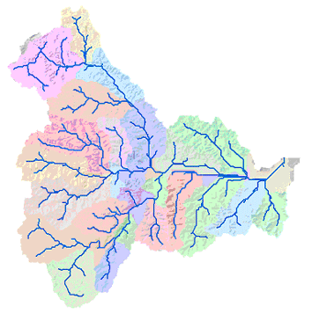
Layers of Benefits in Flood Insurance Study Updates
Digital elevation models
Hydraulic obstruction heights (toe, crest or deck on structures)
Stream cross section surveys for hydrograph calculations
FIRM production:
Discovery phase leverages best available existing data
Flood hydraulic modeling
Hazard zone mapping
GIS Flow Accumulation Analysis
Notes:
The use case itself looks at the many layers of benefits that the modernized NSRS brings to NFIP workflow. Just looking at the process of updating a Flood Insurance study and Flood Insurance rate Maps or FIRMS → DEMs, obstruction height surveys, and cross section surveys are just some of many types of geospatial data that must be brought together from different sources to accomplish such a task. Therefore, the NFIP will heavily leverage the ability to use Reference Epochs and RECs because these are regulatory products that require the combination of many surveys conducted at many times.
NSRS modernization benefits many types of inundation mapping in other ways as well → for example flood hydraulic modeling is improved with the use of a geopotential datum
One key finding is that after the initial shift, users can expect minimal changes to workflows associated with the NFIP of today
Greatest risk reduction from fully leveraging modernized NSRS capabilities in the NFIP of tomorrow, for example the time-dependency in especially important in areas undergoing subsidence therefore another outcome of this use case was a clearer understanding of how we need to continue working with our partners at FEMA to assist them with guidance updates.

Slide 7
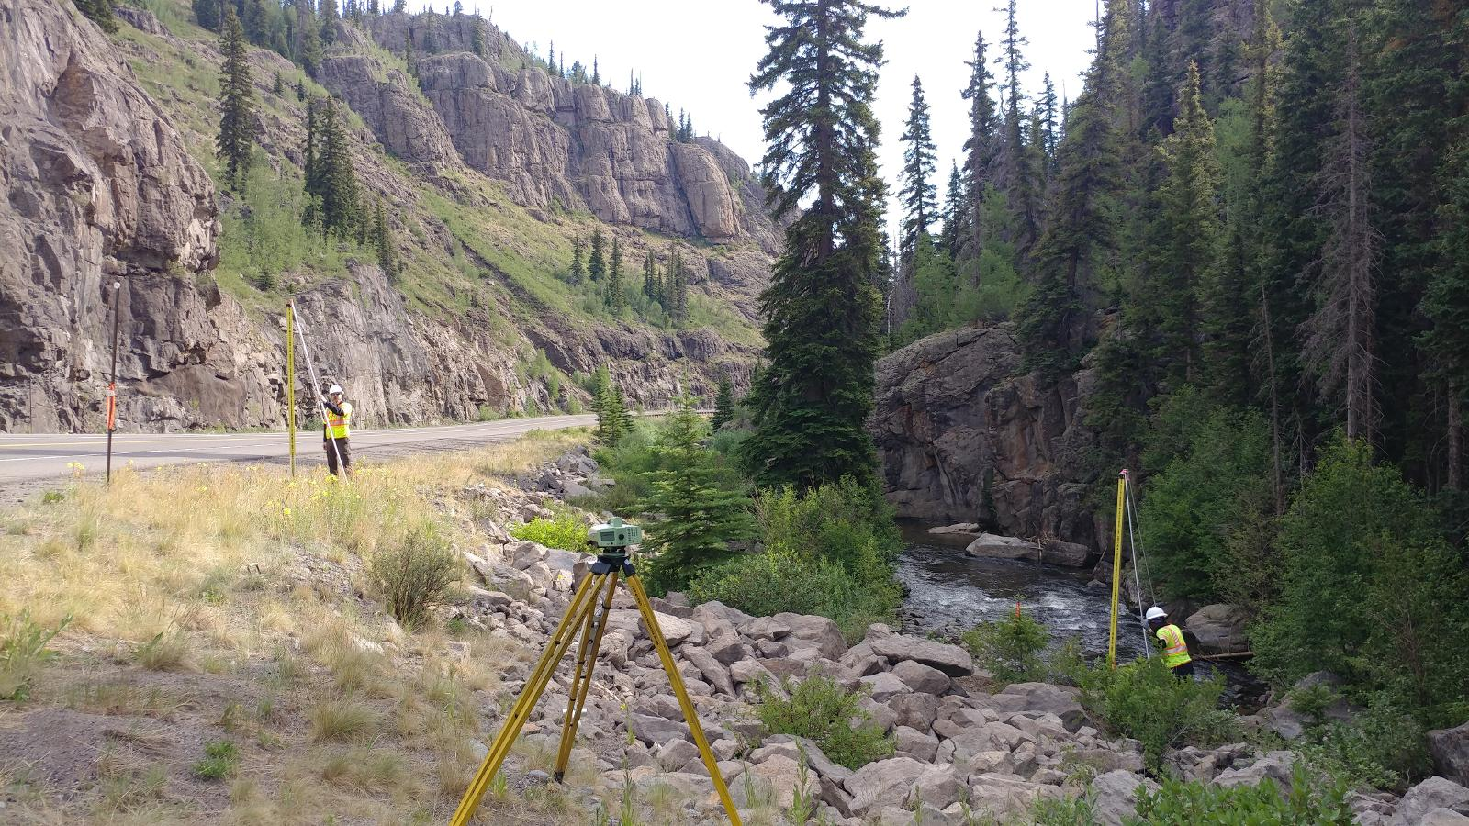
Passive Control in Multi-year Projects
Leveling to a passive control mark in a concrete headwall during GSVS17 (FW 161 RESET, PID - HL0137)
Notes:
The next use case is a thought experiment that examines how the Modernized NSRS will connect time-dependent positioning and passive control → this becomes critical when passive control is used to build new infrastructure.
The use case itself is framed around design of a multi-year corridor project: imagine your job is to build something in a long corridor (a highway or pipeline, for example) over the course of ten years or more – how will your workflows change to leverage use of the NSRS for establishing and maintaining control associate with that type of project?

Slide 8
Leveraging many types of Survey Data
CONVENTIONAL
Total Station
LEVELING
Differential Leveling
Construction Survey
Construction staking
Control checks
GNSS
Static
RTK
RTN
OTHER
Terrestrial Laser Scanning
Mobile LiDAR
Aerial LiDAR/ Photogrammetry
CONTROL
Reference Epoch Coordinates
Reference Epoch Coordinates
Survey Epoch Coordinates
Notes:
One of the reasons this use case was selected and why it will likely interest many of you is because such a project requires the use of many types of survey data (GNSS, Conventional, Leveling, and other such as lidar) → in the OPUS presentations you heard earlier you know we are already thinking about how to get the tools in place to support the reality of these real world projects that utilize more than just static GNSS campaigns, so this use case provides an opportunity to really explore how those tools can be used in a project that spans a decade.
The use case also describes how preliminary, construction, and as-built surveys can be tied to a common reference epoch and how the use of RECs and SECs factor into establishing and maintaining that control with an emphasis on proper QA/QC to ensure that projects are being built as designed throughout all of the phases of the project. A big piece of this is the invaluable role of coordinate metadata.
_________________________________
One key benefit of NSRS modernization will come in the form of time series applied to passive control -->
More reliable and accurate data will help during the decision making process (at both design and construction phases) and ultimately go a long way toward saving lives and property.

Slide 9
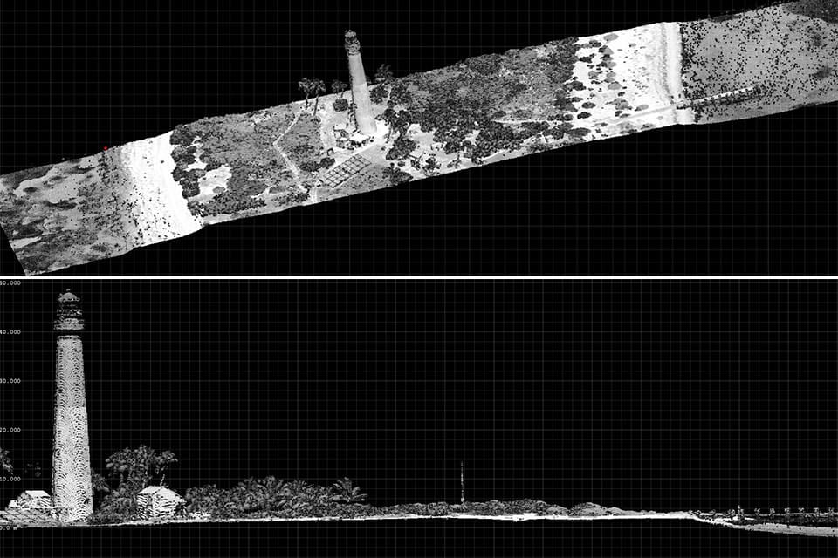
Resurvey
Readjust
Transitioning Data into the Modernized NSRS
Transform
NOAA Lidar data, Loggerhead Key Lighthouse, Dry Tortugas, Florida (Figure from NOS Facts/lidar online)
Notes:
The third use case is the one with the widest audience and voiced public interest to date: this looks at the process of transitioning data into the modernized NSRS and is particularly of interest to those with massive lidar point cloud holdings or map products.
Very much focused on minimizing the negative impacts of the shift → getting users the right tools at the right time (& the training/resources needed to navigate these decisions).
On right you can see, Listed in decreasing order of Accuracy, Cost, and Complexity, the ways for users of the NSRS to determine coordinates after modernization:
Resurvey: Return to the field and collect new observations, relying on geodetic control that has coordinates in the new datum. Useful for municipalities looking to migrate a local datum into the NSRS or for ongoing project control in areas experiencing lots of vertical motion
Readjust: Using existing observations, re-compute new coordinates based on geodetic control that has been defined in the new datum. Most appropriate for updating existing project control in stable regions
Transform: Take finished products that have coordinates in the old datum and use transformation software to estimate coordinates in the new datum. Best for updates to legacy mapping data.
Transition will be unlike past transition from NAD 27 and NGVD 29 to NAD 83 and NAVD 88:
Transformation tools will not trail release of Modernized NSRS
Resurveying/readjust still advised over transformations for most accuracy; tools to do this as well (e.g. better OPUS)
Digital data migration is far easier than the analog migrations of the past

Slide 10
How NGS will support Data Transformation
NGS will provide:
Source code, defining data sets, and full documentation for NCAT and VDatum so they can be incorporated into non-NGS software
Downloadable versions of NCAT & VDatum for local operation
Sample input and output datasets so that users may test other transformation software against NGS’ definitive transformations
Transformation uncertainty estimates
Notes:
Because transformation of existing data is likely to be the primary solution for most NSRS users = NGS will provide (read slide)
At this time, NGS plans to use Github to distribute and version control NGS tools for use in non-NGS software
Reminder: Not all data necessarily needs to be transformed at once as soon at the modernized NSRS is released & superseded transformation software will remain available in NADCON 5.0
One example of this to draw back from the flood plain example is that in the NFIP of today, each Flood Insurance Rate Map is only updated in the course of the routine update cycle.

Slide 11
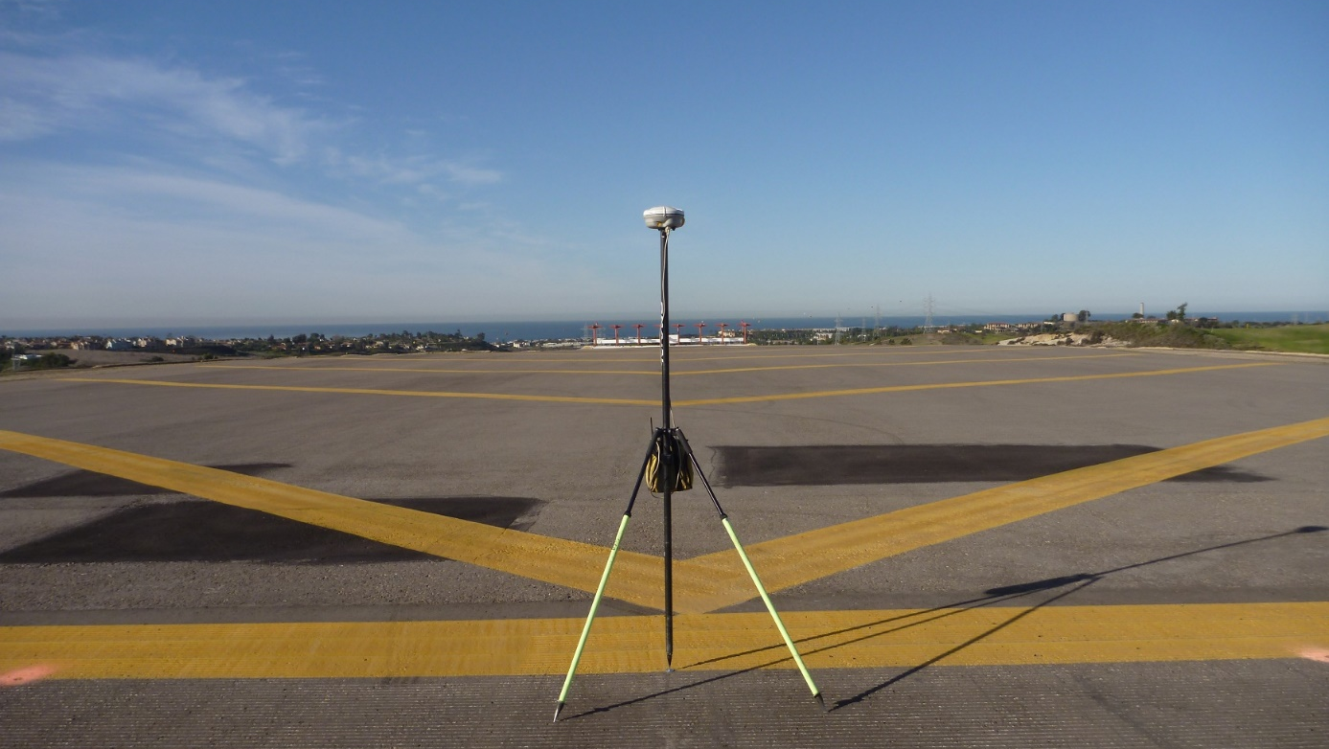
Infrastructure Monitoring at Airports
End of Runway 6 at McClellan Palomar Airport, Carlsbad, CA (December 9, 2011 FAA Airport Survey)
Notes:
Knowing the precise location and measurements of hard infrastructure can be essential for saving lives and reducing damage to private and public property. Broadly speaking, infrastructure monitoring is tracking any motion of a bridge, dam, navigation lock, water level station, power plant (hydropower and nuclear), airport or any other infrastructure relative to itself and/or the NSRS.
The last use case focuses on an airport example, since accurate positioning of airport infrastructure and maintaining a geospatial database is vital to the National Airspace System (NAS), but the methods and workflows discussed in this thought experiment can be extrapolated to other types of infrastructure.

Slide 12
Leveraging the Modernized NSRS
AC-16B Geodetic Control
Modernized NSRS Geodetic Control Network
CORS
CORS
PACS and SACS monuments are positioned and tied to the National Spatial Reference System through GNSS observations
BM#1
BM#2
PACS
SACS#1
HARN
Airport
SACS#2
CORS
AC 150/5300-16B
Simplified Schematic
Notes:
Routine surveys are conducted to monitor many types of infrastructure > tide stations, dam/levee crests, airports.
Local control is typically used as the basis for this, but the relationship of that control to a national time-dependent frame can provide insights to movement beyond the local scale.
At airports, geodetic ties to runway ends, NAVAIDS, obstructions and other airport features are all necessary to maintain the spatial integrity that connects the National Air Space to those features and infrastructure on the ground; this is conducted via routine surveys of PACS and SACS.
For airport infrastructure monitoring, NSRS time-dependent coordinates associated with NAVAIDS, runway ends and other airport features, the modernized NSRS will improve orthometric height accuracy and reliability relative to the local environment, especially in areas where NAVD 88 has become unreliable. Following the installation of PACS and SACS, future surveys can recover, observe and tie new surveys to the NSRS. Access and tying to the NSRS will remain as user-friendly as it has with OPUS, while the described enhancements to OPUS within a modernized NSRS will include GNSS, RTK, and RTN (and others) to produce OPUS Coordinates tied to the NSRS with improved convenience.

Slide 13
Summary and Next Steps
Continue outreach and education about changes to come
Rolling coordination with users on product/tool testing
Provide technical assistance to partners:
Data-driven case studies
Updated metadata guidance
New methodologies that embrace time-dependency
Workflows that leverage Modernized NSRS components
Notes:
Hopefully this whirlwind tour was enough to pique your interest to pick up the use cases, or check out the recorded webinar from April 6 that goes into a bit more detail.

