Slide 1
An optimist's 20 year
look-ahead at
geodesy and geophysics
Dru Smith, Chief Geodesist
NOAA’s National Geodetic Survey

Slide 2
Outline
The future of the past
not to be confused with “the present”
The future of today

Slide 3
1963
IAG President C.A. Whitten on the
Future of Geodesy:
✓
“…artificial satellites …used to determine
the geometric reference framework.”
✓
“…coordinate system…referred to the true
center of the Earth.”
✓
“…lasers to measure distances between
Points...”
“…geometric and physical geodesy have
been united.”
“…instruments measuring potentials
for height.”

Slide 4
1985
NRC: Committee on Geodesy
✓
“…the Transit Doppler system will..
be replaced by…GPS.”
“…the problem of time-varying positioning
will have to be faced on a systematic
basis.”
“…the difference between absolute and
relative positioning will eventually be
nearly obliterated.”
“…as better gyroscopes are developed
inertial positioning systems will be able
to operate for longer periods of time
without unacceptable error growth.”

Slide 5
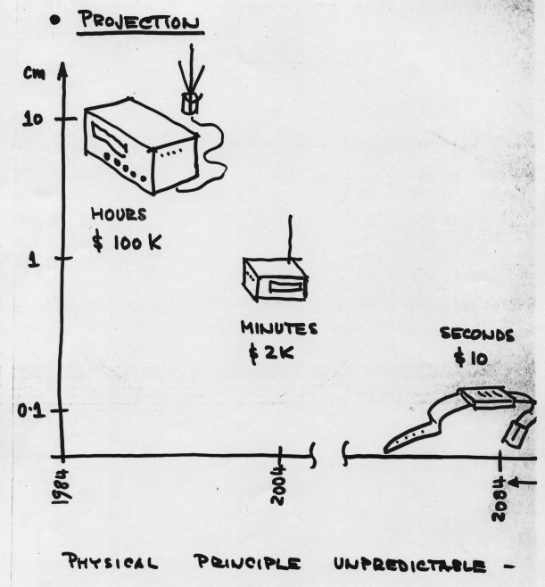
2001
Richard Langley on the
Future of GPS
✓
“2004: $2000 and a few minutes
gets you 1 cm…”
“2084: $10 and a few seconds gets
you 1 mm…”

Slide 6
2003
IAG President F. Sanso on the
Future of Geodesy:
“… a global geodetic reference frame may
be with an accuracy in the millimetric range
and a unified height datum, may be in the
centimetric range.
“…the exponential law for the development
of computing power has not yet exhausted
its trend
“…modelling the interactions of the
subsystems of the earth…”
“…new big challenge of optimal combination of different huge
data sets…contributions to…
mathematics in terms of interesting problems and advanced solutions…”

Slide 7
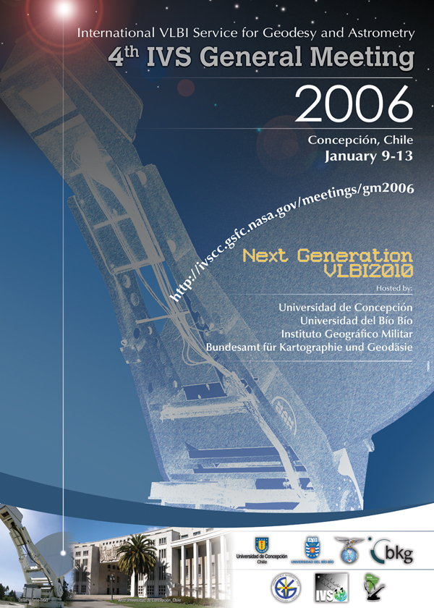
2006-7

Slide 8
2009
Plag and Pearlman:
“…meet future requirements of a global society facing increasing challenges on a changing planet…”
“Many satellite missions are research-oriented, while operational monitoring of many key indicators of the Earth system is insufficiently implemented.”
“…the integration of [geodetic imaging] into the traditional point-based approach of geodesy poses a major challenge…”

Slide 9
In the next 20 years…
GNSS will likely be pervasive (more so than today), with sub-meter instantaneous point positioning likely and the need for large networks for differential positioning going away.

Slide 10
In the next 20 years…
…nonetheless, from a practical standpoint, the surveying and mapping community continue to insist on using static datums and generally ignoring Earth’s dynamic nature.

Slide 11
In the next 20 years…
Budgets and politics will drive NASA and other space agencies to limit "exo-Earth"
work, instead focusing on low cost, operational Earth-looking satellite
monitoring.
Example:
GRACE:
$70M
Manned Mission to Mars:
$120,000M

Slide 12
In the next 20 years…
Military in-theater applications of a world height system are in place already with EGM08.
Finer details of the gravity field are needed for cm level heighting from GNSS and changes to the gravity field will be necessary for climate monitoring.

Slide 13
In the next 20 years…
Sea level rise will impact the majority of the world’s population. First from an ecological standpoint, but in the century-long view, as an inundation problem. Understanding this phenomenon is directly tied with mitigating the political destabilizing impacts it will have.

Slide 14
In the next 20 years…
Arctic sea ice will diminish significantly. The Arctic ocean becomes a major travel route for both trade and military.
Accurate positioning at the pole (both with GNSS and inertial) will be necessary.

Slide 15
In the next 20 years…
Earthquake and Tsunami prediction improves, probably to the point of minutes of warning. GGOS, GGP, and other global monitoring networks provide the key to “early” warning.
Predicting an earthquake more than an hour in advance seems unlikely within 20 years.

Slide 16
In the next 20 years…
Non-GNSS navigation and positioning (indoors, underground, underwater) will be a major focus of research.
Inertial navigation, accurate to sub-meter accuracies with weeks between zero-velocity points should be developed. Multi-sensor fusion advances to sub-meter indoor navigation.

Slide 17
In the next 20 years…
Atomic clocks improve in accuracy by 2 orders of magnitude, so that the observed relativistic effects on them allow atomic clocks to serve as gravity potentiometers.
If miniaturized, these clocks become field instruments, yielding gravity potential, and thus heights and thereby alleviating many needs for geoid models or geodetic leveling.

Slide 18
In the next 20 years…
High accuracy EM radiation based scanning that combines the accuracy of LIDAR with the cloud penetration of IFSAR, if developed, becomes the gold standard mapping tool.

Slide 19
In the next 20 years…
Progress in quantum entanglement leads conclusively to either instantaneous or non-instantaneous transmission of information between two entangled points.
If non-instantaneous, then distance correlation is feasible and QE becomes a distance measurement tool between any 2 points anywhere (underwater, outer space, inside, etc)

Slide 20
In conclusion…
The upcoming work in geodesy and geophysics will be:
Optimal fusion of super-massive quantities of data
How to fold cutting edge new technologies into operational use
How to get position to millimeters in real time

Slide 21
In conclusion…
The upcoming work in geodesy and geophysics will be:
How to set up a long term Earth monitoring service, with geodesy as the foundation
How to deal with a public that is increasingly “position capable” but ignorant of geodesy

