Slide 1
Introduction to Modernizing the National Spatial Reference System
Dru Smith
Joe Evjen
45 minutes

Slide 2
Outline
Why replace NAD 83 and NAVD 88?
Recap Previous Geospatial Summits and Customer Concerns
Recent Decisions: Naming conventions and white papers

Slide 3
Why replace NAVD 88 and NAD 83?
ACCESS!
easier to find the sky than a 60-year-old bench mark
GNSS equipment is cheap and fast
ACCURACY!
easier to trust the sky than a 60-year old bench mark
immune to passive mark instability
GLOBAL STANDARDS!
systematic errors of many meters across the US
aligns with GPS, international efforts
aligns with Canada, Mexico
Notes:
Things are looking up! GNSS technologies simplify and improve access to and accuracy of our spatial reference system.
While we can continue to leverage this technology to maintain the old datums, it makes sense to adopt GRAV-D results in an unpolluted form, and align it to modern global standards.

Slide 5
NAVD 88 is tilted and biased

Slide 6
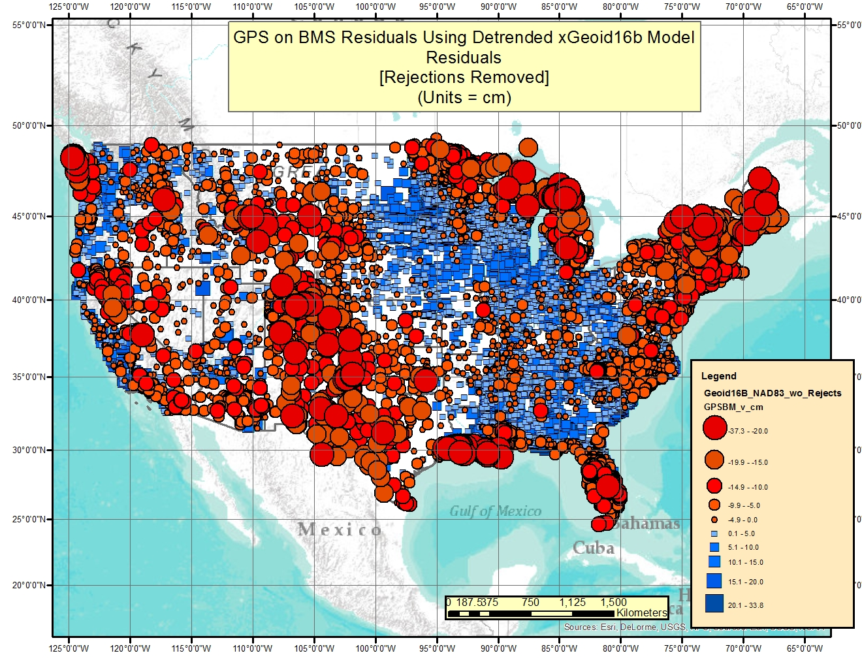
NAVD 88 is tilted and biased

Slide 7
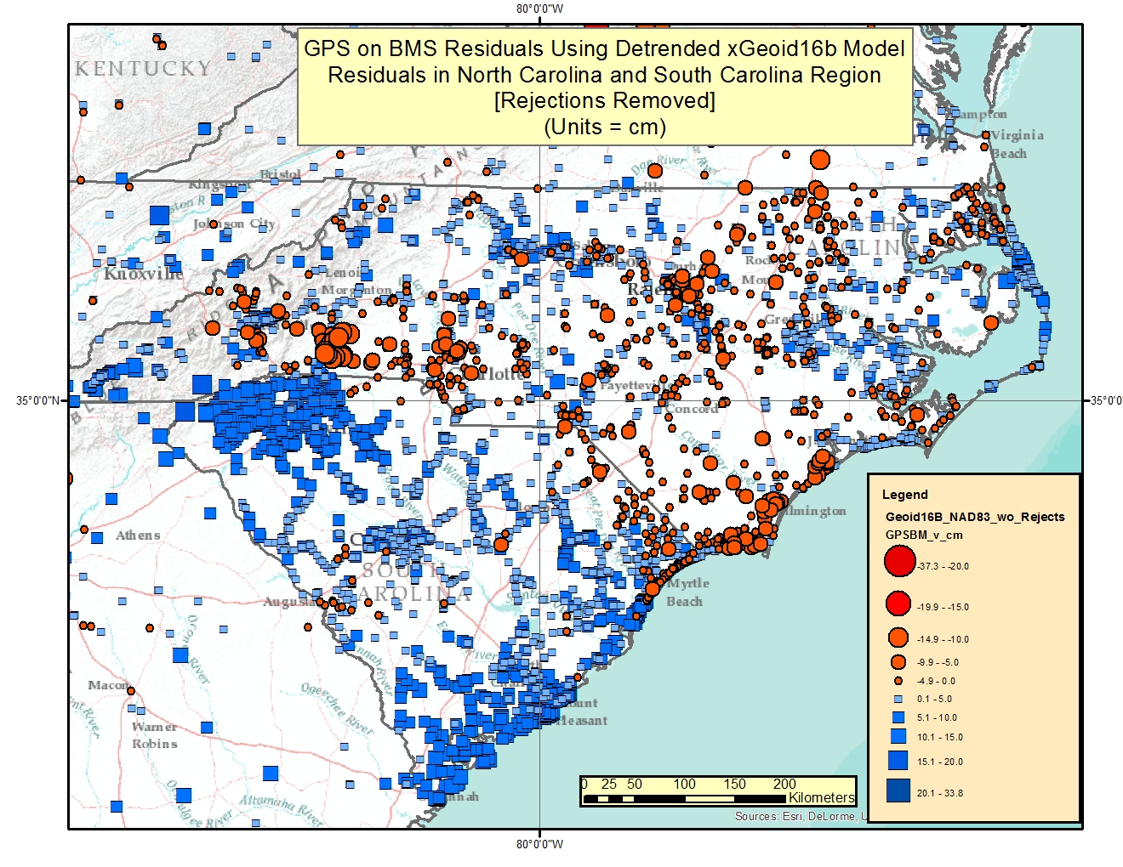
NAVD 88 is tilted and biased

Slide 8
passive marks are old

Slide 9
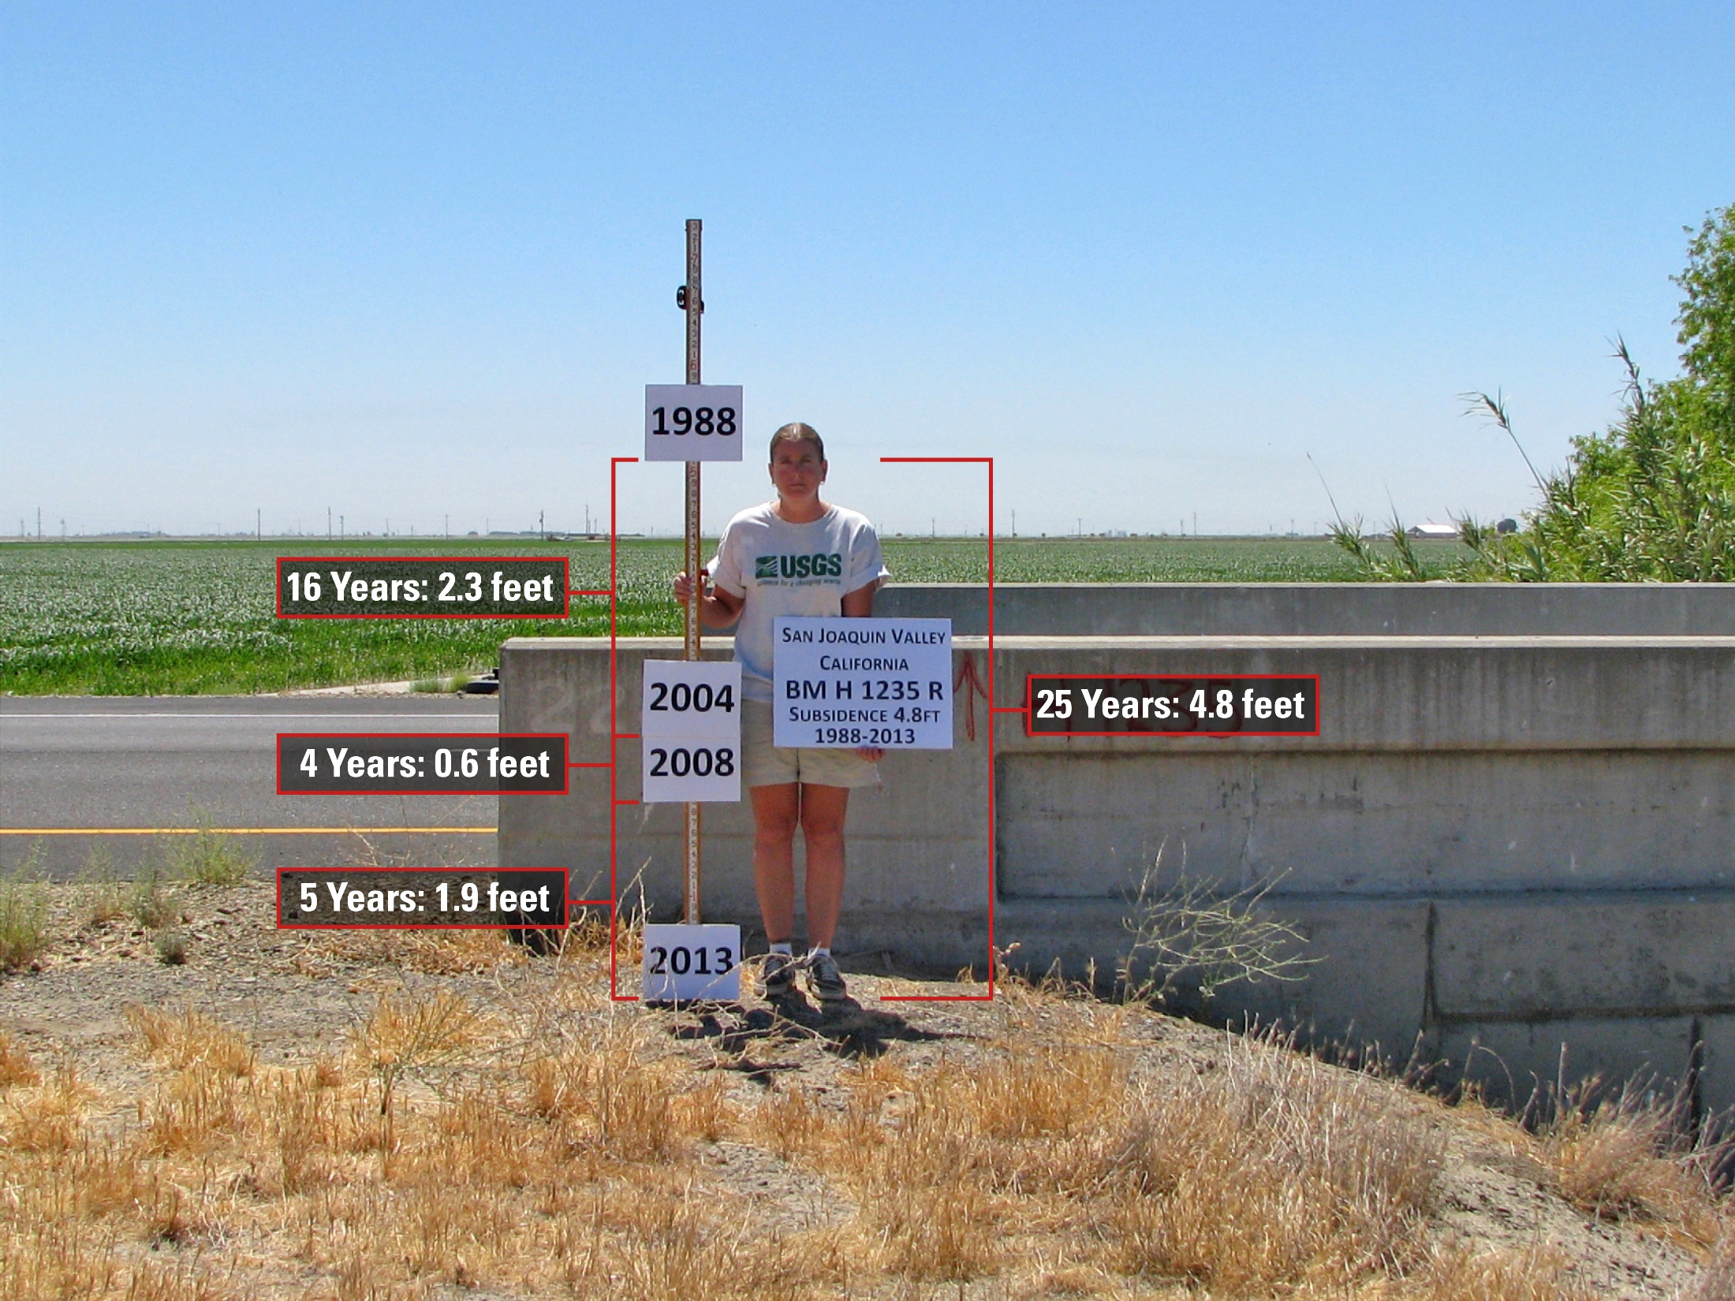
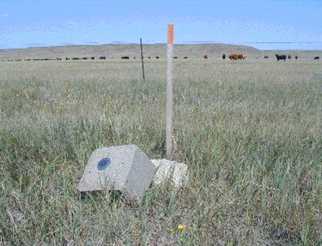
passive marks lie still, but still lie
small instability x long time = inaccuracy

Slide 10
NAVD 88 is not alone
NAVD 88 North American Vertical Datum of 1988
PRVD02 Puerto Rico Vertical Datum of 2002
ASVD02 American Samoa Vertical Datum of 2002
NMVD03 Northern Marianas Vertical Datum of 2003, 3 each
GUVD04 Guam Vertical Datum of 2004
VIVD09 Virgin Islands Vertical Datum of 2009, 3 each
Hawaii … Hawaiian Islands Vertical Datum (coming soon)
various local datums, as national datum is inaccessible
IGLD 85 International Great Lakes Datum of 1985
IGSN71 gravity dataset
GEOID12B geoid undulations
DEFLEC12B deflection of the vertical
one vertical datum
pole-to-equator

Slide 13
NAD 83 is non-geocentric
h₈₃
h_{yy}
Earth’s
Surface
same
GRS-80
ellipsoid
IGS yy
Origin
~2.2 meters
NAD 83
Origin
Notes:
ITRF (International Terrestrial Reference Frame) just has an origin; take NAD83 shaped ellipsoid centered at the ITRF origin to derive ITRF97 ellipsoid heights.
Ellipsoid heights NAD83 vs. ITRF97 - Defined origins are best estimate of the center of mass; NAD83 is not geocentric. Move origin; move ellipsoid surface as illustrated.
Ellipsoid height differences reflect the non-geocentricity of NAD83.

Slide 14
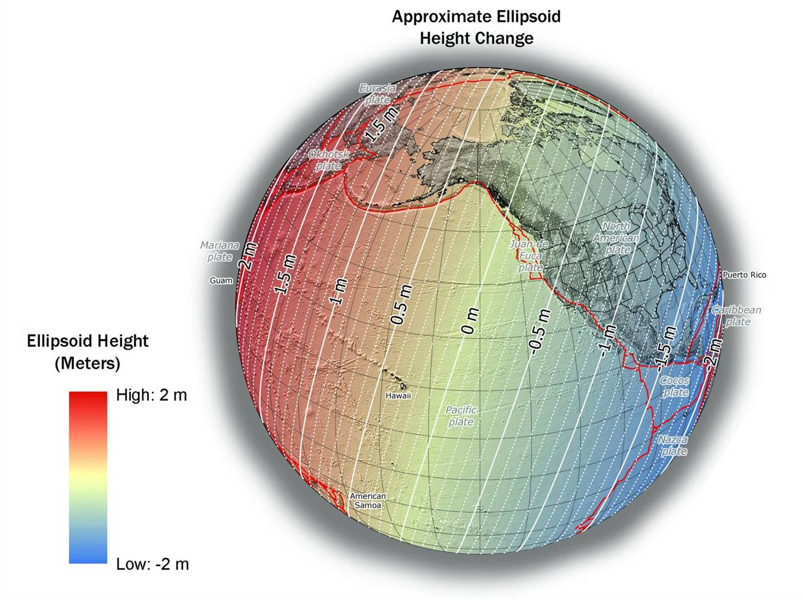
NAD 83(2011) to IGS08 at epoch 2022.0
Notes:
NGS has not yet determined the co-definitional epoch between IGSxx and the four TRFs. The epoch 2022.0 is for reference purposes only, and does not constitute a policy choice at this time

Slide 15
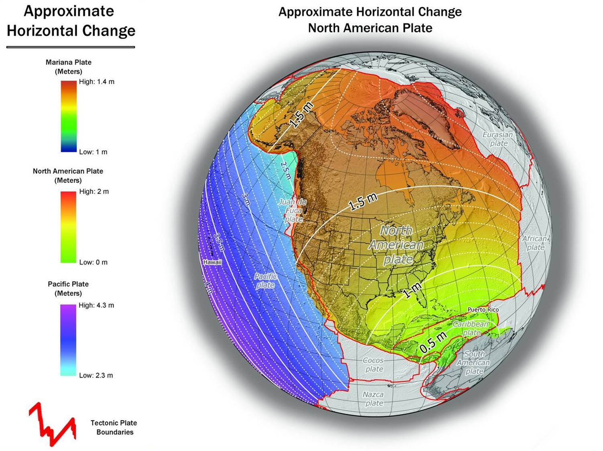
NAD 83(2011) to IGS08 at epoch 2022.0

Slide 16
Notes:
NAD83_epoch2010_to_IGS08_epoch2022
Horizontal change in meters from NAD 83 (2011) epoch 2010.00 to IGS08 epoch 2022.00. Represents the expecetd change from NAD 83 to the new North American, Pacific, Caribbean, and Mariana terrestrial reference frames in 2022. Computed using HTDP v3.2.5.

Slide 17
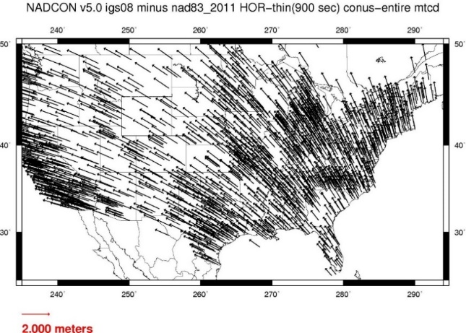

Slide 18
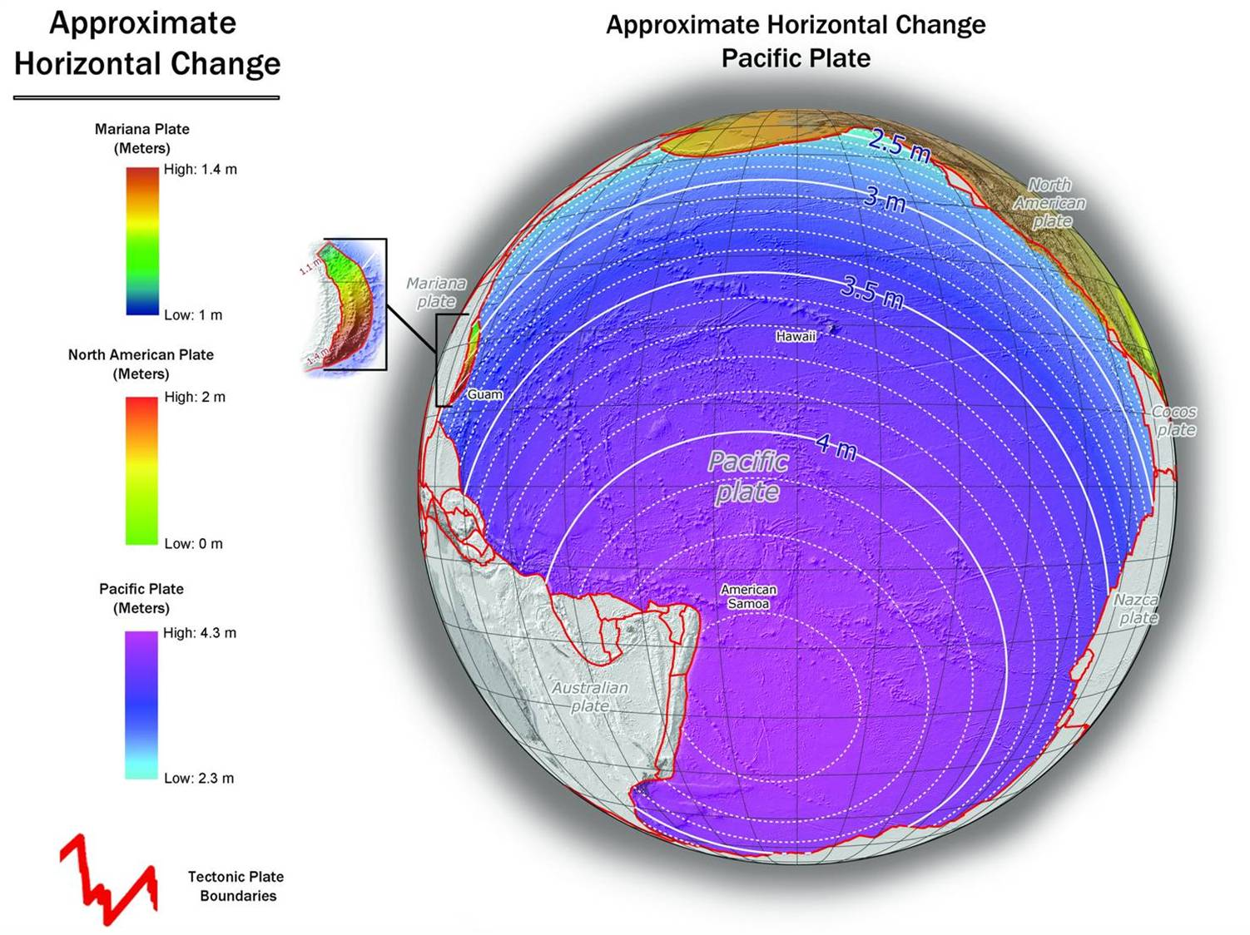
NAD 83(PA11) to IGS08 at epoch 2022.0

Slide 20
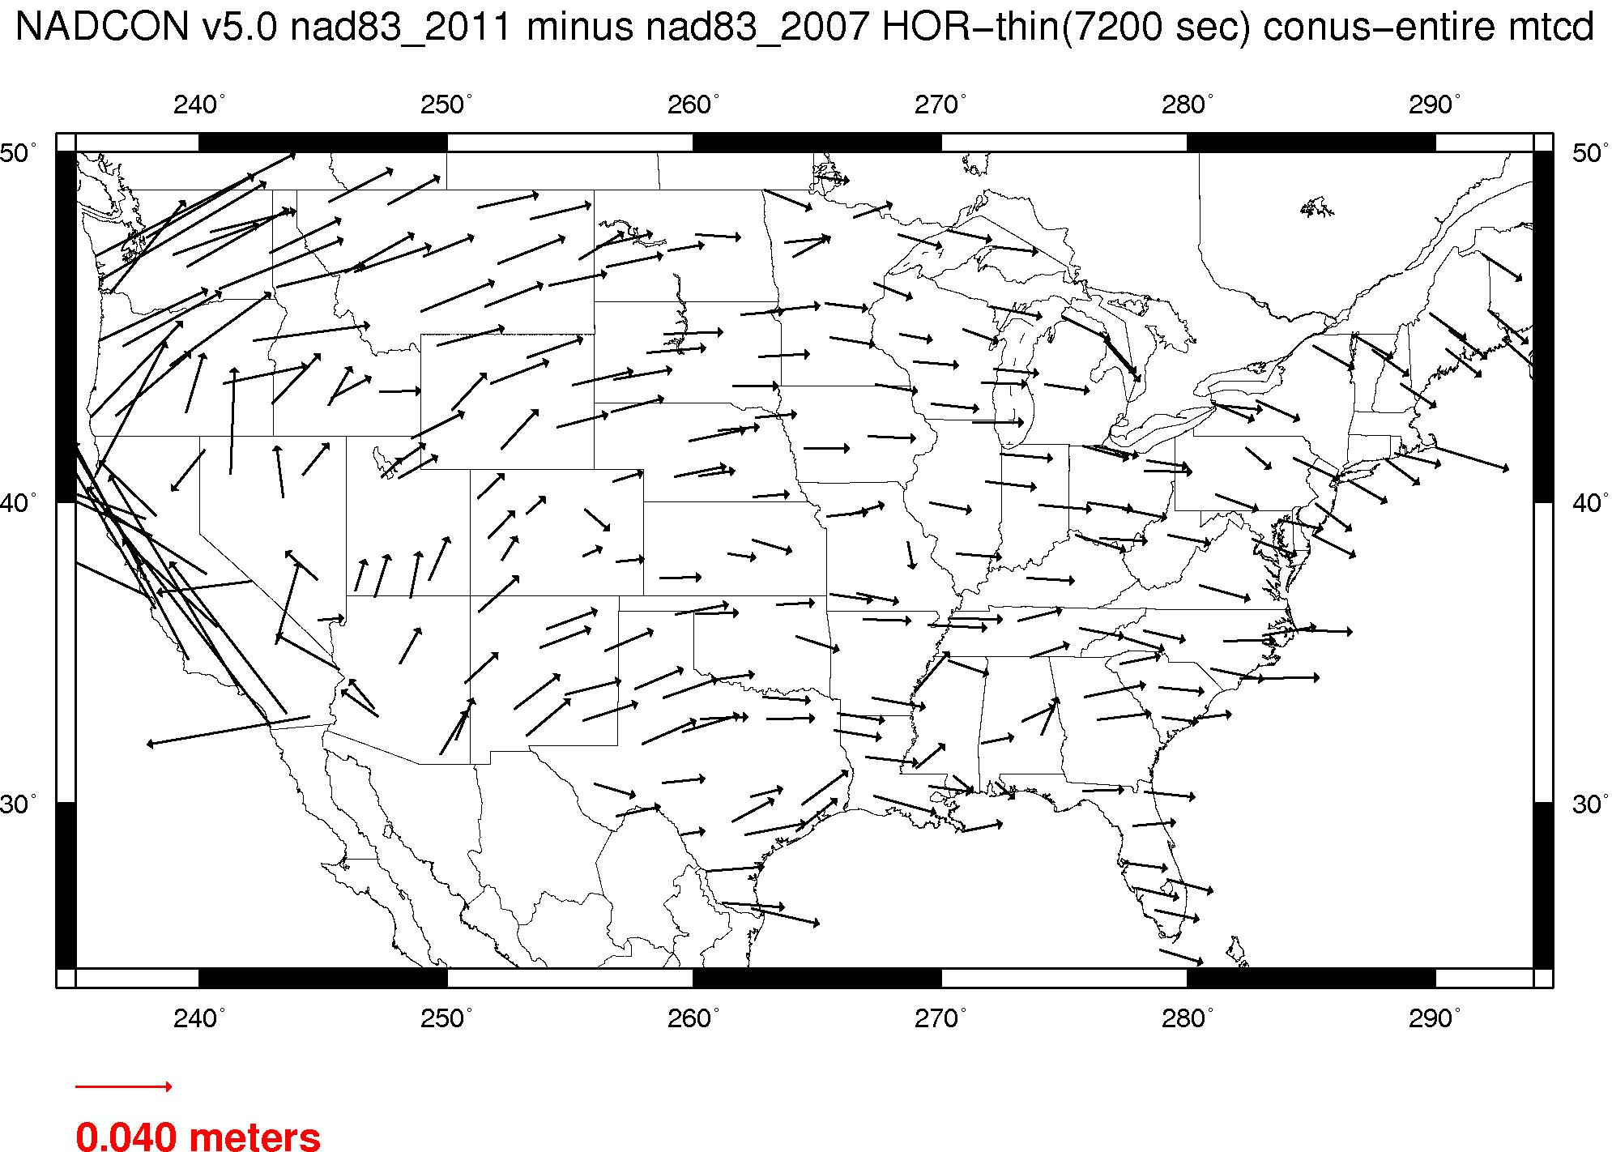
NAD 83 is not plate fixed very well
NAD 83(2011) epoch 2010.0 minus NAD 83(NSRS2007) epoch 2002.0
If NAD 83 were truly “plate fixed” then an 8 year epoch change would not yield the systematic plate rotation seen here.

Slide 21
ITRF is now mature

Slide 22
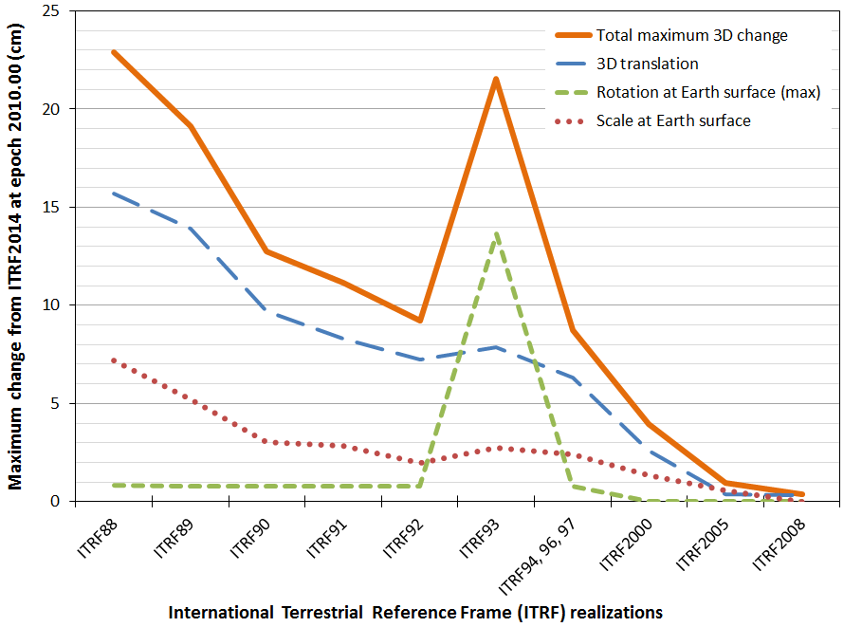
ITRF is now mature

Slide 23
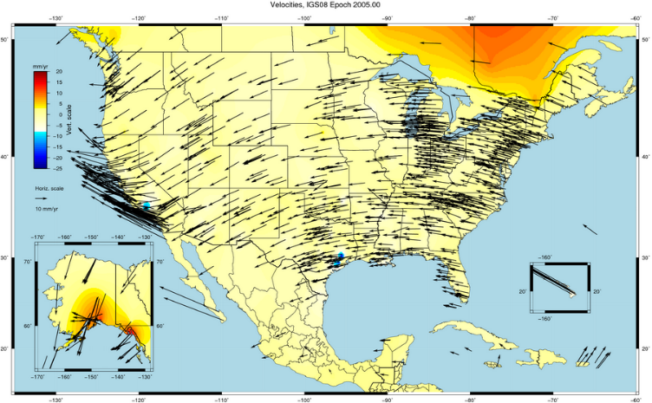
NAD 83 is not ITRF
GPS & WAAS navigation uses WGS84, aligned to ITRF
satellite orbits and other geospatial datasets use global frames
our TRFs will agree with ITRF (specifically, IGSyy) at the initial epoch
our TRFs will diverge from ITRF by a few cm each year to stay “plate-fixed”
difference is a simple Euler plate rotation
many areas will diverge further, as no plate is perfectly rigid
plate-fixed or ITRF-fixed; can’t have both

Slide 24
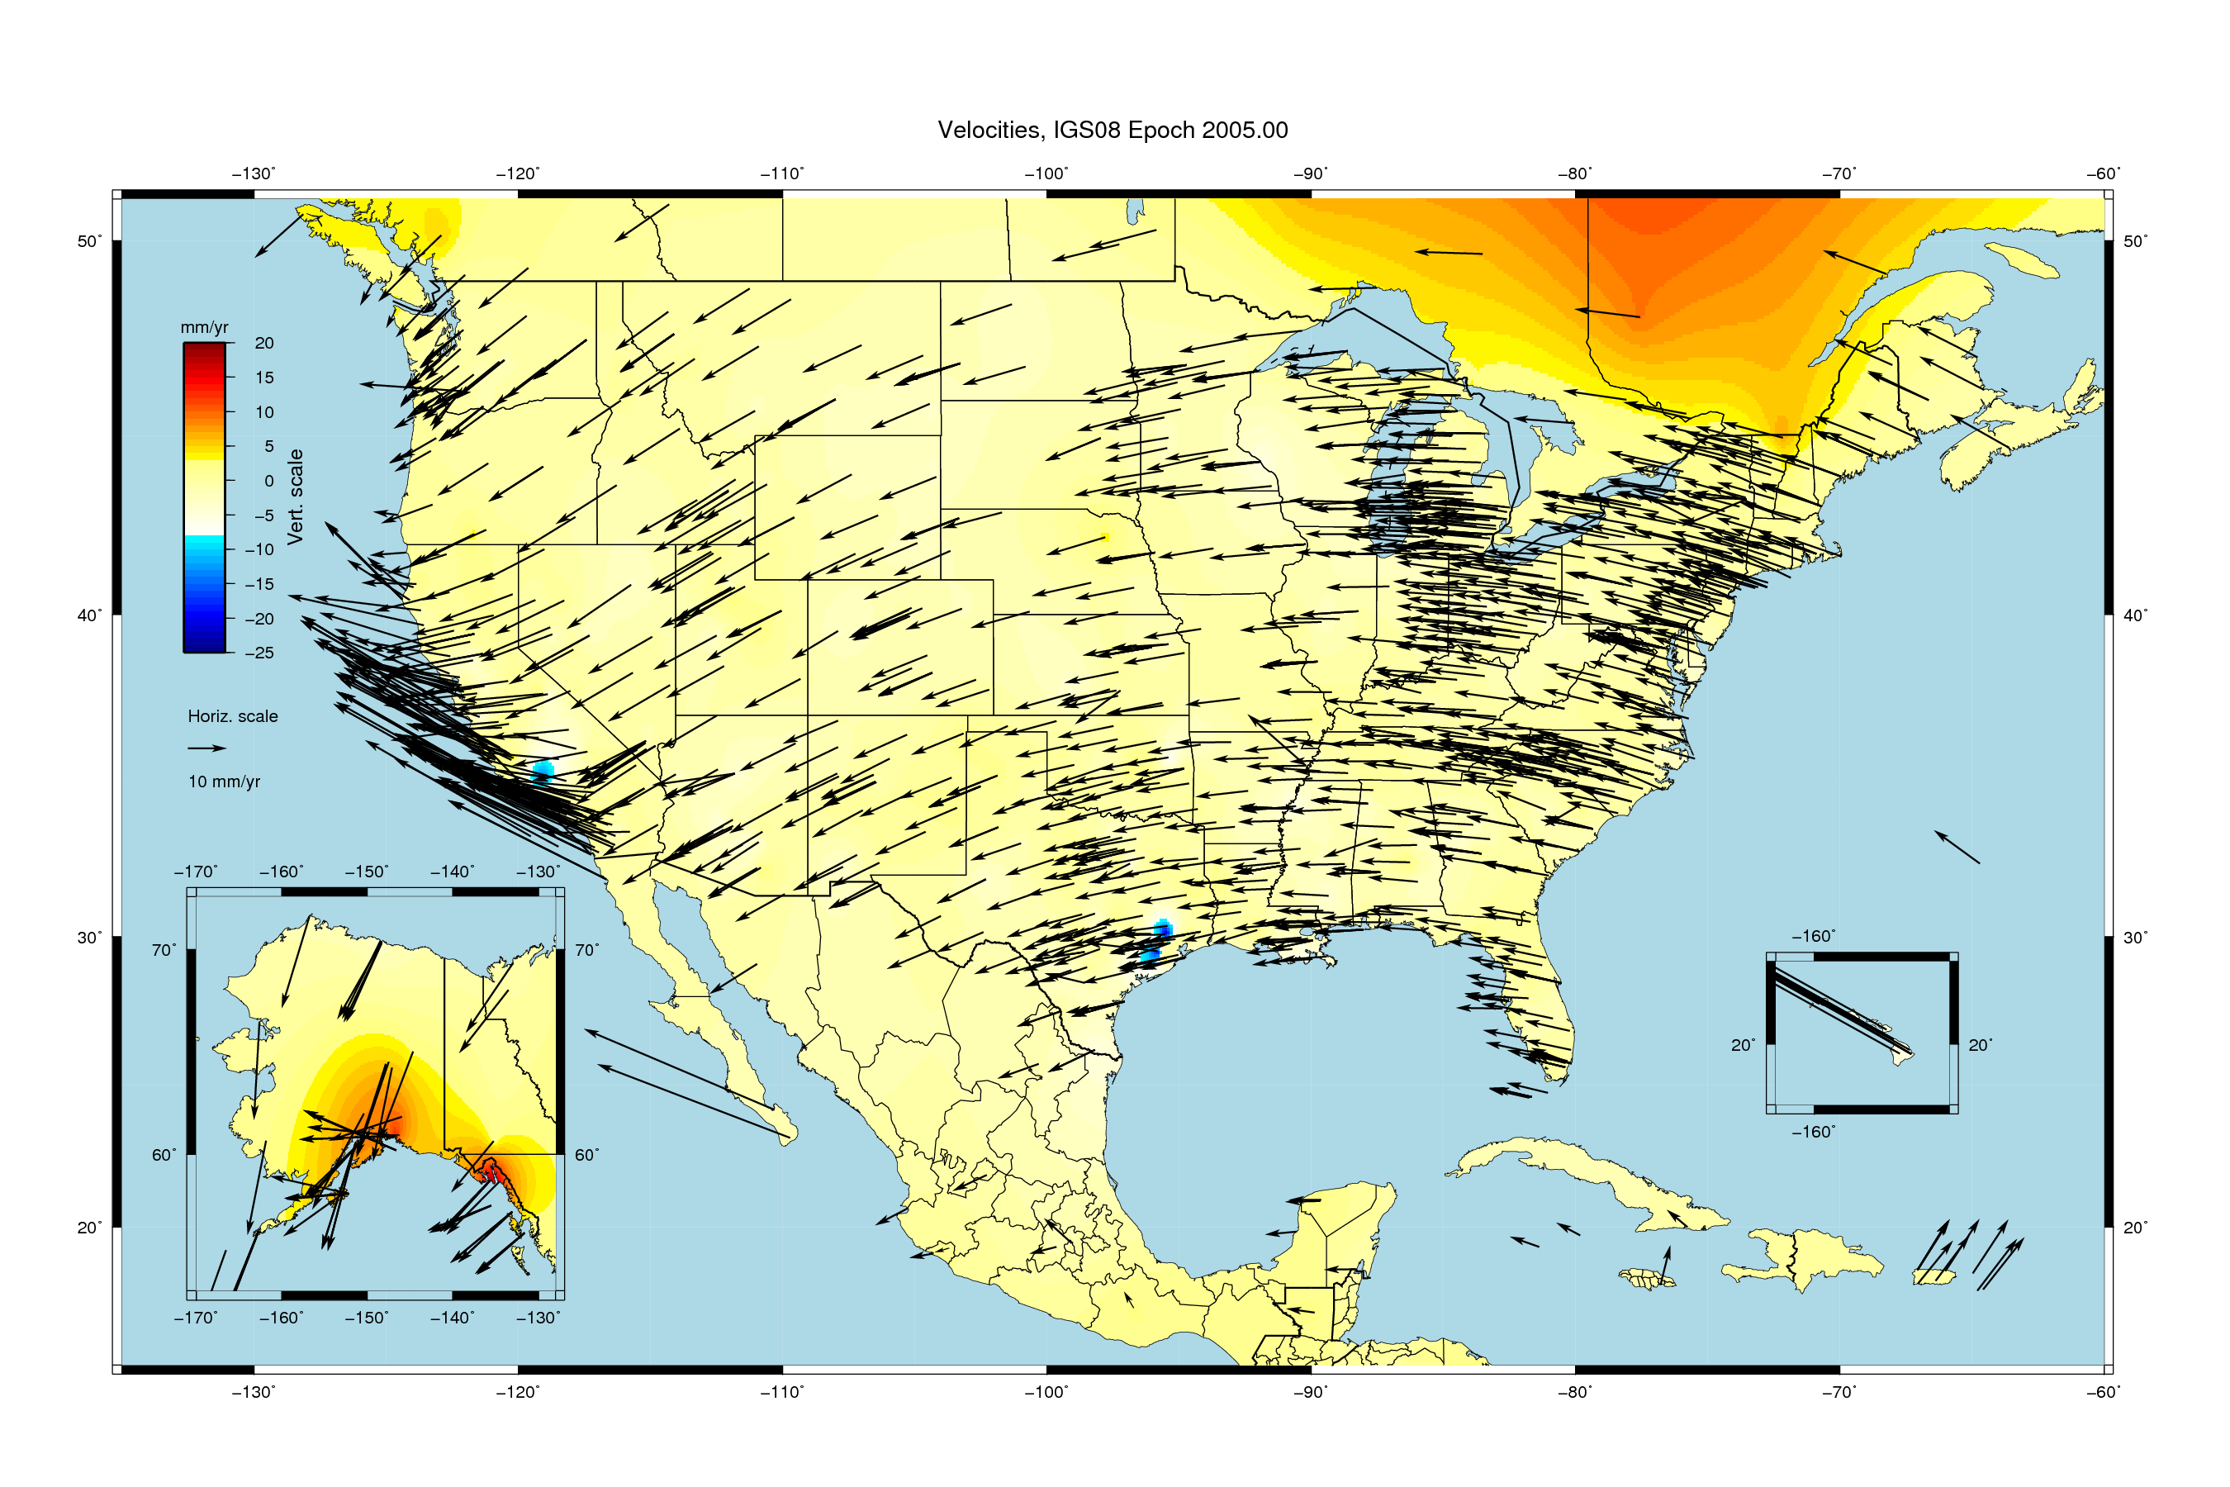

Slide 25
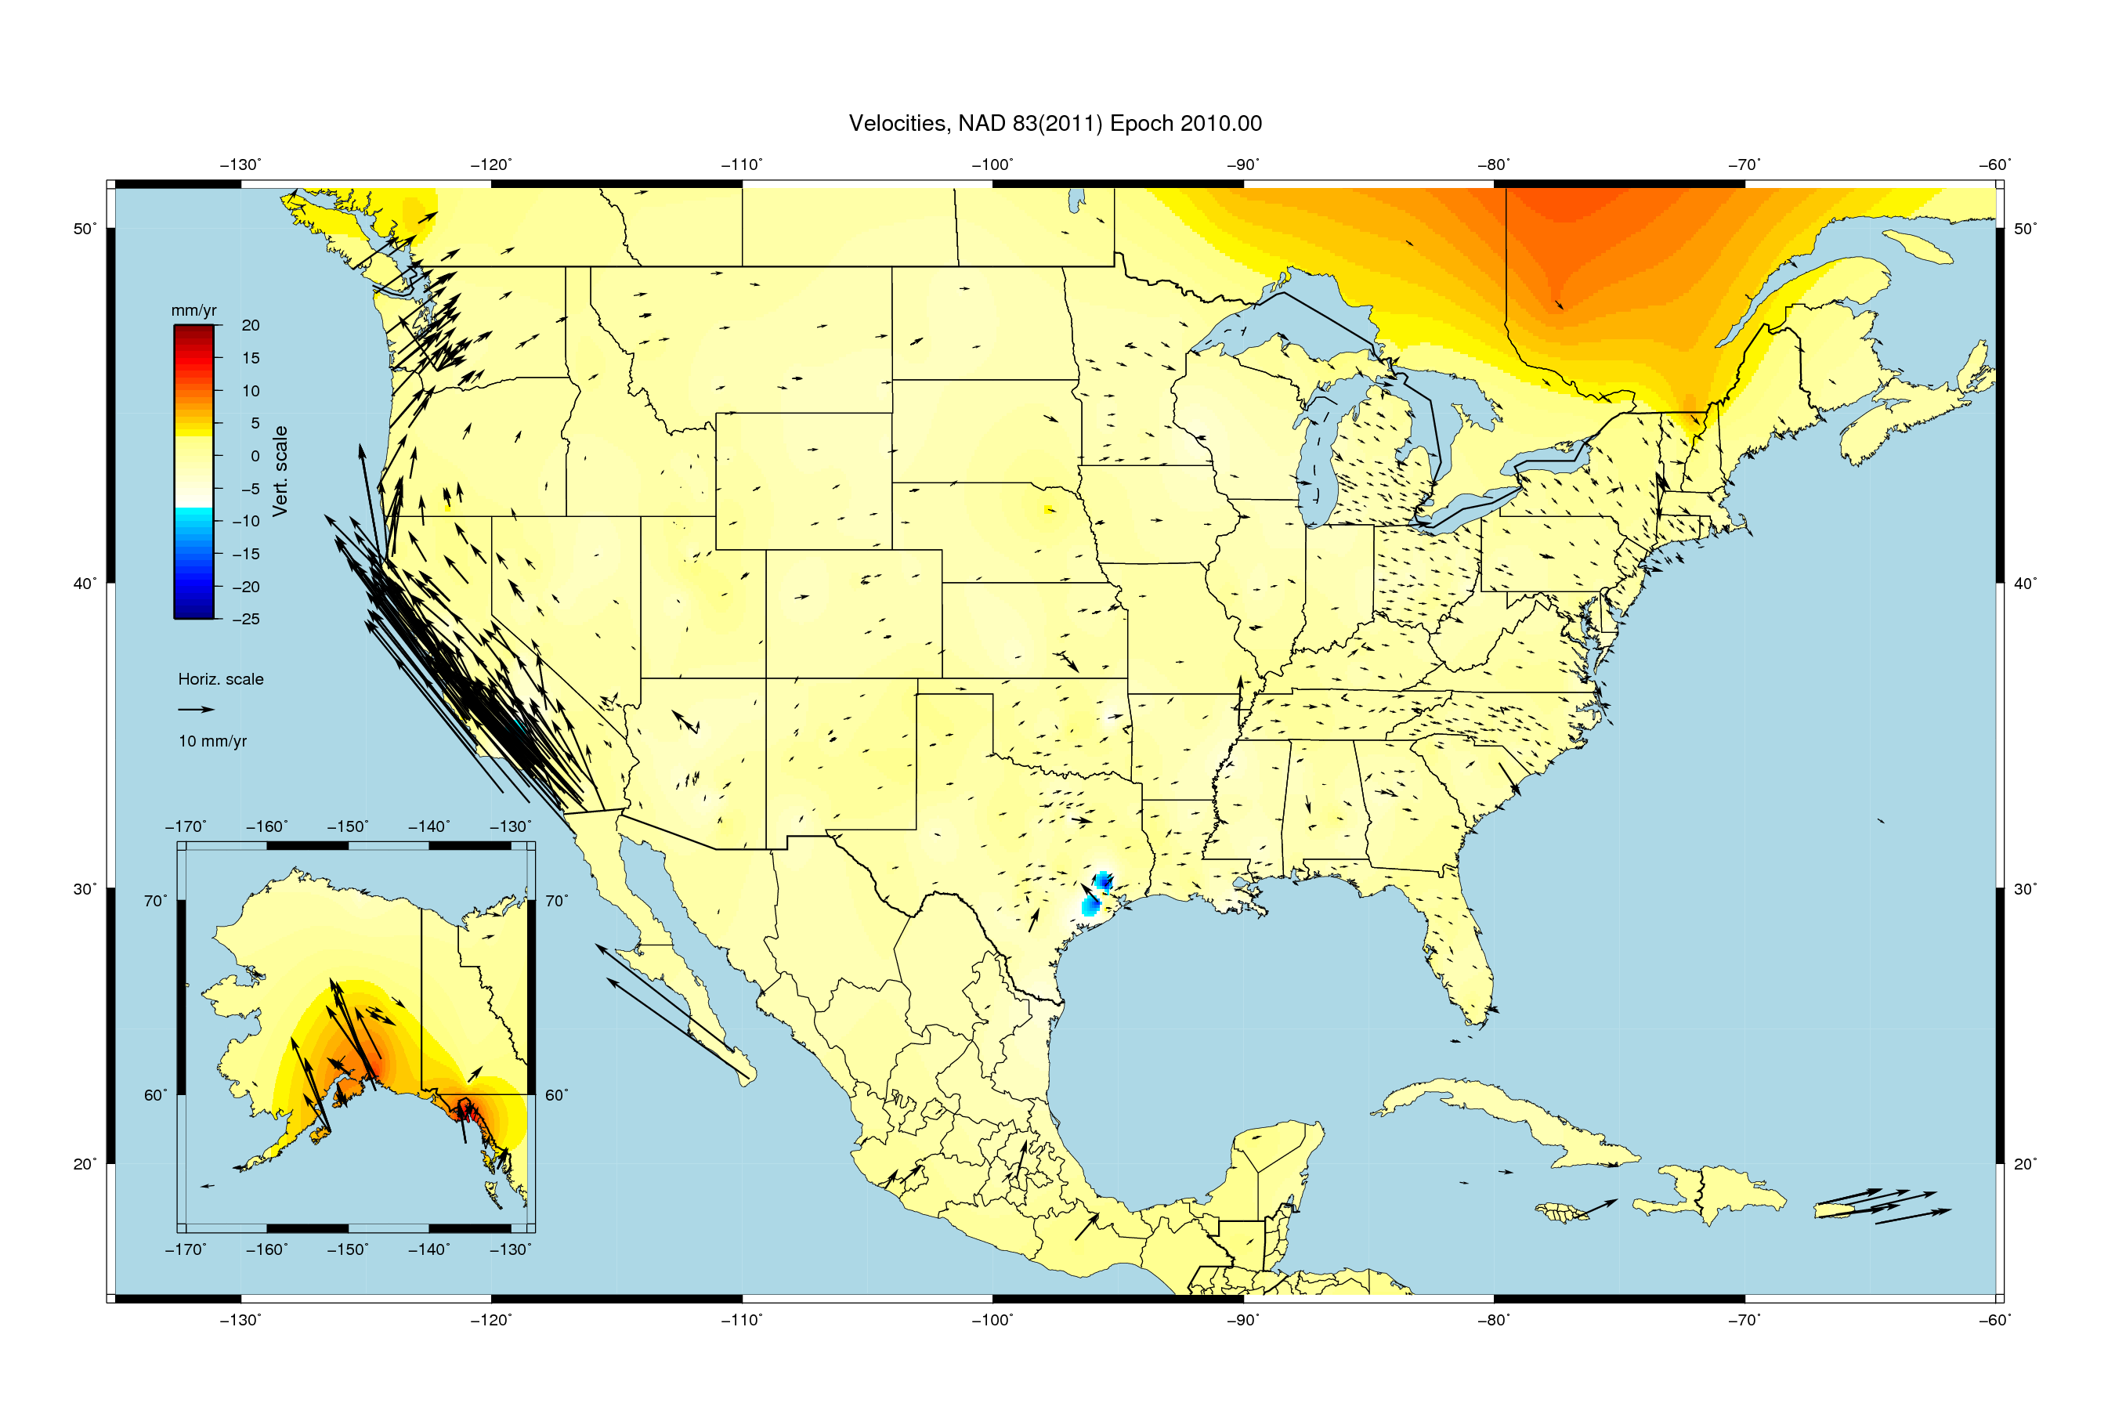

Slide 26
NAD 83 is not alone
NAD 83 (1986)
NAD 83 (HARNs)
NAD 83 (FBNs)
NAD 83 (NSRS)
NAD 83 (2011)
NAD 83 (PA11)
NAD 83 (MA11)
4 plate-fixed frames North America, Caribbean, Pacific, Marianas

Slide 27
Everything must shift
RED: NAD 83 coastline against NAD 83 imagery
GREEN: Coastline shifted into NATRF2022 but
the imagery remains on NAD 83

Slide 28
Summary: The NSRS in 2022…
Four semi-dynamic reference frames
Geoid/GPS based vertical datum
All data will be time tagged
All coordinates will come from GNSS surveys

Slide 29
Recap Previous Geospatial Summits
2010 summit changes proposed
2015 summit changes described
2017 summit changes detailed
reports, proceedings, presentations, and videos available on-line

Slide 30
Customer Concerns
control shouldn’t move!
a national terrestrial reference frame should minimize velocities, even if that means drifting away from ITRF/WGS84 over time.
don’t make us think!
provide vendor- and user-friendly transformation tools with modern programming
modernize datasheets and bluebooking
tell us more!
more updates, training, & tutorials
a formal publication describing the differences between NAD 83 / NAVD 88 and the new reference frames
help with legislation
NSPS distribute sample language to update state legislation that references NAD 83
Notes:
These high-level issues were all brought up in multiple presentations from our stakeholders at the Summit.
They are consistent with what is included in the Summit Report.
There were many other items that each stakeholder brought up that were more unique to his or her particular organization.

Slide 31
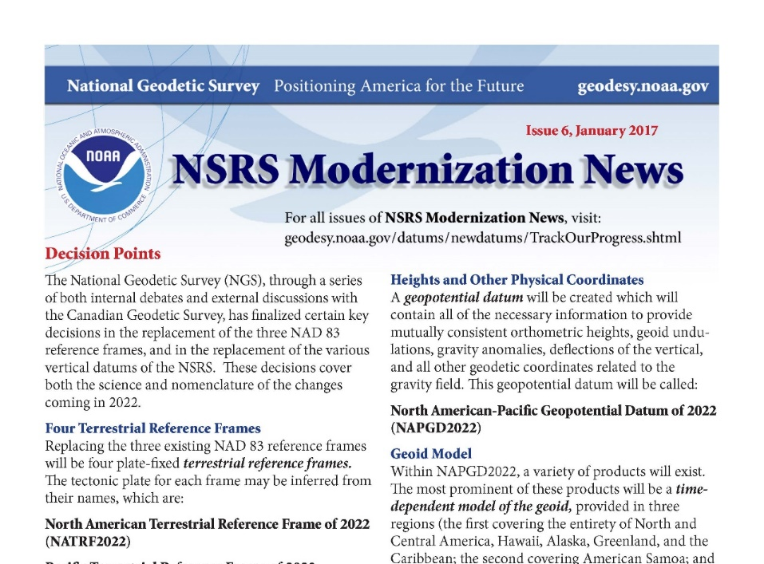
Customer Concerns
https://geodesy.noaa.gov/datums/newdatums/
✓
✓
control shouldn’t move!
a national terrestrial reference frame should minimize velocities, even if that means drifting away from ITRF/WGS84 over time.
don’t make us think!
provide vendor- and user-friendly transformation tools with modern programming
modernize datasheets and bluebooking
tell us more!
more updates, training, & tutorials
a formal publication describing the differences between NAD 83 / NAVD 88 and the new reference frames
help with legislation
NSPS distribute sample language to update state legislation that references NAD 83
✓
✓
Subscribe for email notifications
Notes:
These high-level issues were all brought up in multiple presentations from our stakeholders at the Summit.
They are consistent with what is included in the Summit Report.
There were many other items that each stakeholder brought up that were more unique to his or her particular organization.

