Slide 1
Replacing Bluebooking
Modern Data Submission to NGS
by
Dru Smith
NSRS Modernization Manager
David Zenk
Northern Plains Regional Advisor

Slide 2
Summary of Intent
The overall message is this: "Bluebooking" as we know it will go away, but a new process of people doing surveys and submitting them to NGS to include in the NSRS database will replace it.
That new process will be built around the general model of OPUS-Projects, which is to say it will be a browser-based analysis, processing and submitting tool.
OPUS-Projects will be expanded to take in the following surveys: Leveling will come first.
Then, in a priority order that is still to be determined, NGS will add to OPUS-Projects other survey types, including: Traverse, RTN, Absolute Gravity, Relative Gravity, each one being in a "tab" with the ability for data to flow between tabs.
In this way, mixed-method surveys will be processed in a method-by-method build up.
--- Dru Smith

Slide 3
First, a Bit of History
The “Bluebook” has been in effect since October 1980.
It has grown with the times, but cannot continue far into the future. Why not?
The Future Itself…
New Datum
New Database
More Efficient Methods Available

Slide 4
A Bit More History
The Integrated Data Base (IDB*) was built by combining previous databases
Horizontal
Vertical
Gravity
The IDB* is not:
Spatial
Capable of handling time dependencies
Built to handle GPS raw data files
* Note - NGS IDB will be known in the future as NSRS DB

Slide 5
NGS Ten Year Plan 2013-2023
Goal 2: Modernize and Improve the National Spatial Reference System.
Objective 1: Replace NAD 83
Objective 2: Replace NAVD 88
Objective 3: Re-invent Bluebooking
Objective 4: Fix the Toolkit
Objective 5: Better Surveying
both Short-term and Long-term
Notes:
Potential outline and speaker assignments; can be adjusted as needed.

Slide 6
Transformational Access
NGS will provide transformations between historic datums and the new reference frames, aimed at helping users manage data that is not in the NSRS DB.
But, the National Geodetic Survey considers readjustment of actual survey measurements, not coordinate transformations, as best practice.
So, if NGS can make it easier to store measurements in the NSRS DB, then NGS can provide better access to the new datums and better customer service.

Slide 7
The future of bluebooking
data submission:
OPUS PROJECTS

Slide 8
OPUS-Projects into the NSRS DB
The NSRS DB is the official repository of NSRS data
NSRS DB currently may only be populated through the FGCS Bluebook process
Horizontal Surveys (Volume 1)
GPS Surveys (Annex N)
Vertical Surveys (Volume 2)
Gravity Surveys (Volume 3)
So, the FGCS Bluebook will endure for a while yet

Slide 9
What Else is Being Planned?
NGS is taking a broad view that OP is a capable interface that can be adapted to essentially any type of survey data.

Slide 10
Leveling Data
A leveling project needs
mark descriptions,
mark locations,
mark photos, and
the leveling measurements.
OP already has the tools to ingest 3 of these 4
What’s needed is a Leveling Tab on OP…

Slide 11
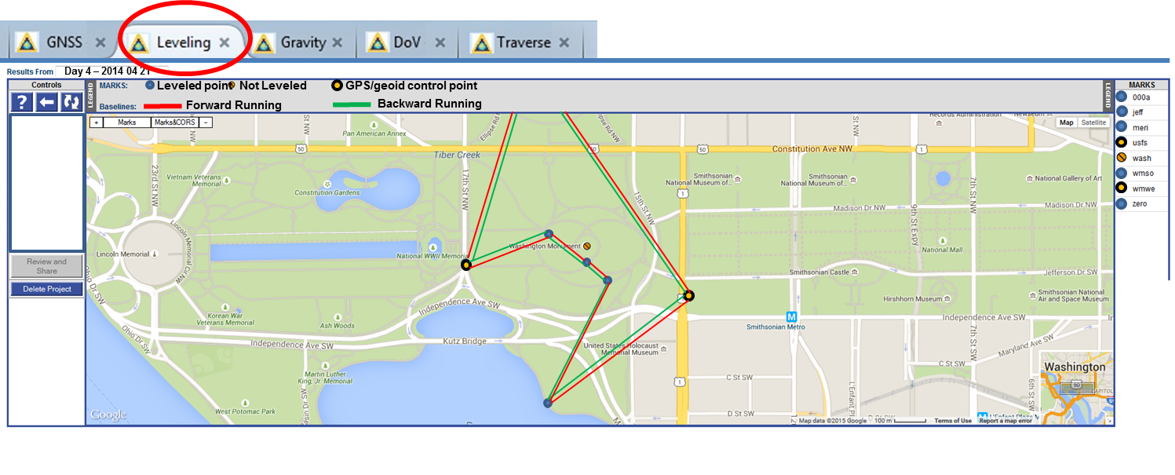
Leveling Tab
…Perhaps like this, with helpful graphics and symbols

Slide 12
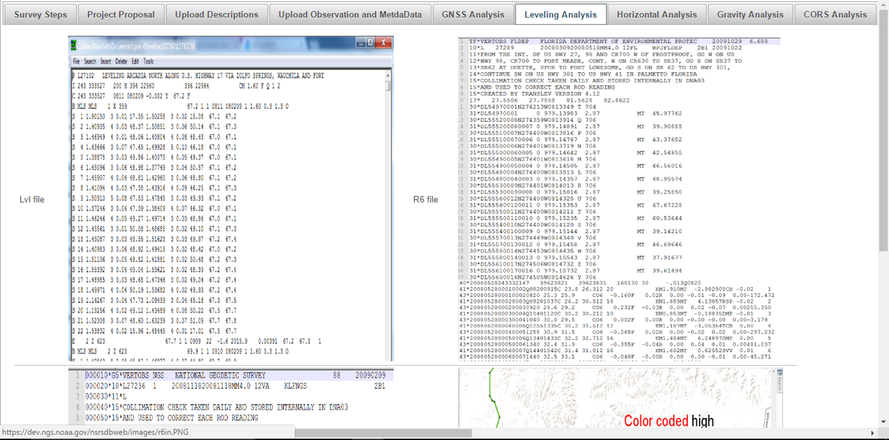
Leveling Tab
With support for familiar defined file formats
R6 file
VERTOBS
LVL file

Slide 13
Gravity
Like leveling, gravity surveys, whether aerial or terrestrial, absolute or relative, need metadata support, but also have special analytical needs.
All can be supported within Gravity Tabs in OP.

Slide 14
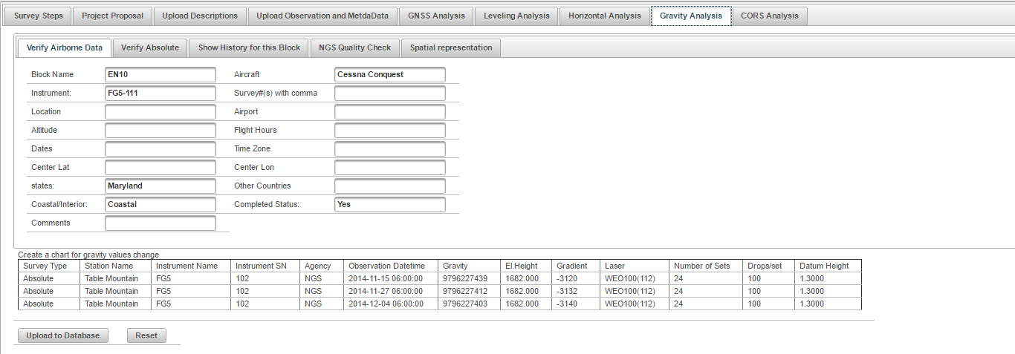
Gravity Tabs
Airborne Data sub-tab
With support for familiar defined input file formats

Slide 15
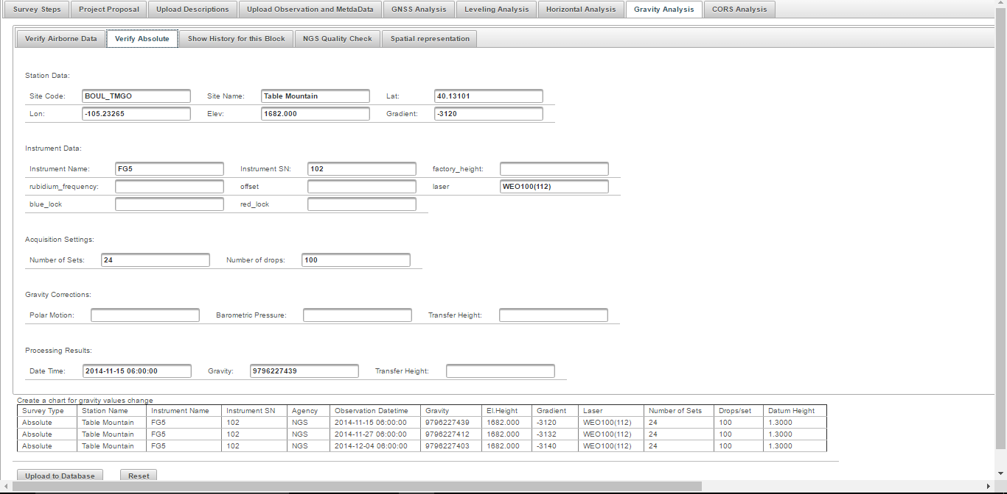
Gravity Tabs
Absolute Gravity sub-tab

Slide 16
Gravity Tabs
Historical Gravity sub-tab
Quality Check Gravity sub-tab

Slide 17
Traditional Optical Surveys
Traditional Optical Surveys can be supported
Traverse
Triangulation
Trilateration
River Crossings
Calibration Base Lines

Slide 18
Real Time Kinematic / Real Time Networks
RTK/RTN surveys efficiently produce accurate positions that may be of value in improving or validating other surveys.
Therefore, NGS could provide an RTK/RTN Tab to capture these valuable positions.

Slide 19
RTK/RTN - Validation Needed
RTK/RTN positions must be traceable to NSRS
RTK/RTN surveyors would prove that calibration to NSRS was performed using an approved combination of active and passive techniques, which might include:
Published passive marks
National CORS
OPUS Static

Slide 20
Synergy - Leveling and GPS
GPS Tab
GPS data → ellipsoid heights
Apply GEOID → orthometric heights
Leveling Tab
GPS data serve as:
stochastic control in the leveling processing and
improve systematic leveling corrections

Slide 21
Synergy – Leveling and Traverse
Traverse Tab
Load River Crossing Data
Compute differential height across river
Leveling Tab
connect the two parts of leveling on either side of the river

Slide 22
Synergy – Many More Possibilities
Leveling with Gravity and GPS
The leveling is now processed using the a-priori processed GPS and a-priori processed gravity to yield orthometric heights.
Establish a Calibration Base Line (CBL)
Leveling, slope angles, and EDM data are combined
Quality Control
Access and compare to data within NSRS DB

Slide 23
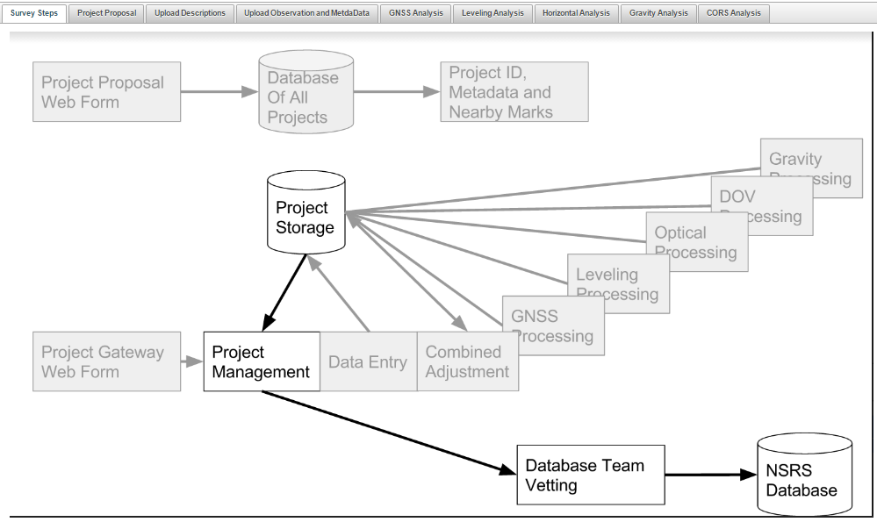
NSRS DB Flow Chart
Optional
“Submit” Button

Slide 24
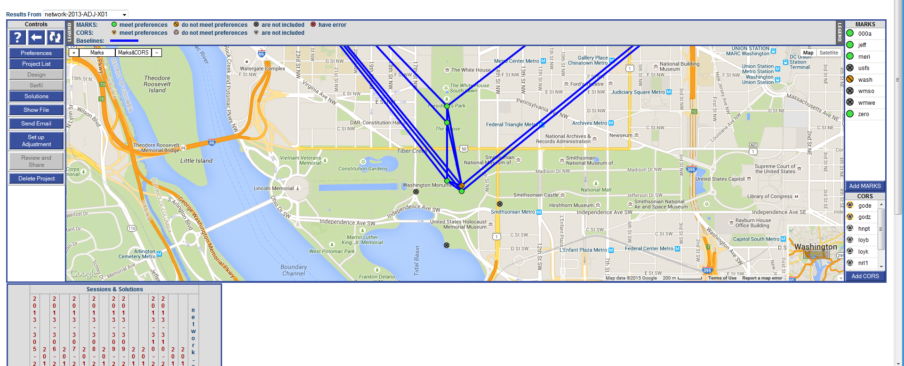
OPUS-Projects of the future?
The 2013 Survey of the
Washington Monument
had GPS, leveling and
traverse components.
An integrated OP might
allow for easier
processing and especially
cross-processing
Notes:
This slide shows a fictitious, yet possible, future mock-up of the OP interface. Note the TABS. A project consisting of multiple techniques, such as the survey of the Washington Monument, could have a tab for processing the GNSS data, and another for the Leveling, and etc.

Slide 25
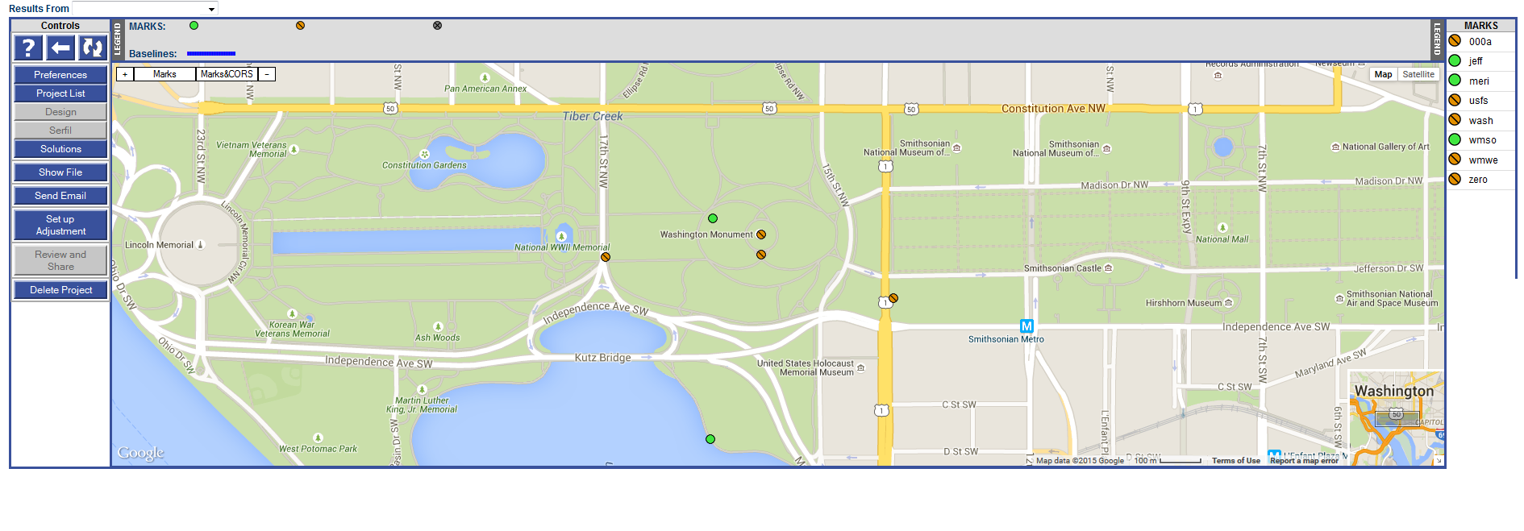
OPUS-Projects of the future?
Day 4 – 2014 04 21
Leveled point
Not Leveled
GPS/geoid control point
Forward Running
Backward Running
Notes:
This slide shows a fictitious, yet possible, future mock-up of the OP interface. Note the TABS. A project consisting of multiple techniques, such as the survey of the Washington Monument, could have a tab for processing the GNSS data, and another for the Leveling, and etc.

Slide 26
The New NSRS database
To support the future, the new database must be:
Spatially-enabled
Velocity-capable
Handle all current data types and allow for new future types
Nimble and Fast
Reliable (see challenge next slide)

Slide 27
Organize Historic Files
To prepare to populate the new NSRS with existing GPS data:
NGS has some 3000 GPS projects on file
400,000 receiver files out of 1.2 million files
Any name, any directory…
Metadata (receiver, antenna height, PID, times)
Once organized, these files will go through OP and build the NSRS database foundation

Slide 28
Old vs New Datums: Passive Control
Role of passive control in the future:
Control for projects
Depending on accuracy needs, new coordinates should be freshly determined, rather than relying on published coordinates based on old surveys
Monitoring sites for motion
Calibrating RTNs

Slide 29
Primary Access
Since 2008, NGS has clearly and publicly stated:
“The primary means of accessing this new datum is GNSS technology”

Slide 30
Primary Access: GNSS
This means (at a minimum):
CORS positions, velocities and discontinuities in the latest IGS reference frame
OPUS-S, OPUS-RS, and variants
An RTN validation service, quantifying levels of agreement with the NSRS
Relationship between the IGS reference frame and new geometric reference frame
Spatially and temporally

Slide 31
Secondary Access
And since 2008, NGS has clearly and publicly stated:
“While passive control continues to be used as
a secondary method to access the NSRS, such
control will be ‘tied to’, not a ‘part of’, the
NSRS.”

Slide 32
Secondary Access: Passive Control
This means (at a minimum):
GPS surveys on marks after 2022 can be “bluebooked” and submitted to NGS
This could mean:
A complete overhaul for bluebooking, database storage, and time dependencies

Slide 33
A GNSS/geoid vertical datum
 | Today | 2022
Step 1: | Find passive control in NAVD 88 near you, if it exists. Accept that there has been no validation of the published heights since the points were last occupied. | Find or set any new control near your project area.
Step 2: | Level or “Ht Mod” survey to the new control. This could be tens of kilometers at least. | Perform GNSS on your local control
Step 3: | Use NGS 58/59 (decades old) and NGS DOS based tools to bluebook and adjust your project (to the possibly outdated NAVD 88 control | Use OPUS, tied to monitored CORS, to get h and H at the epoch of your survey, to cm of accuracy
Step 4: | Perform leveling from your control to your local project | Perform leveling from your control to your local project

Slide 34
Questions

