Slide 1
Tips for Staying Afloat in
The Reference System Alphabet Soup NAD83? NAVD88? IGS08? ITRF14? NGVD29? NAD27? WGS84? NATRF22?
Which epoch... ellipsoid... geoid model?
Nic Kinsman
Alaska Regional Geodetic Advisor
National Organization for the Advancement of Acronyms
nicole.kinsman@noaa.gov
Anchorage, Alaska
202-306-5736

Slide 2
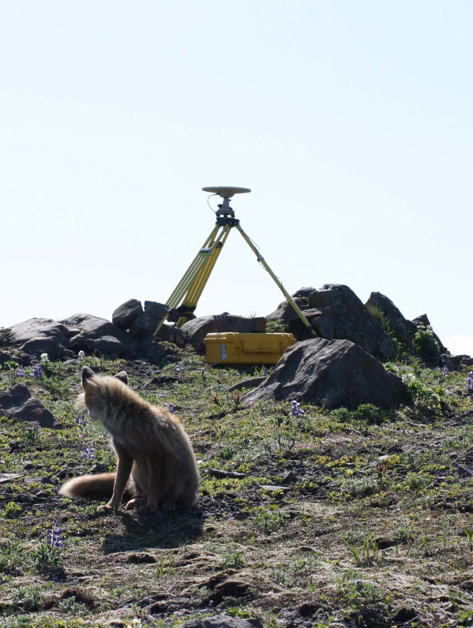
Overview of Topics
Introduction to the National Geodetic Survey (NGS)
Terms, definitions, & common reference frames
Useful tools
Best practices for documentation of reference frames (metadata)
Tips & resources for transformations
Practical guidance for working with geopositonal data in Alaska
AKPA 1996

Slide 3
NATIONAL GEODETIC SURVEY (NGS)
Introduction to the

Slide 4
NGS is part of NOAA NOS
Mission:
To provide science-based solutions through collaborative partnerships to address evolving economic, environmental, and social pressures on our ocean and coasts.

Slide 5
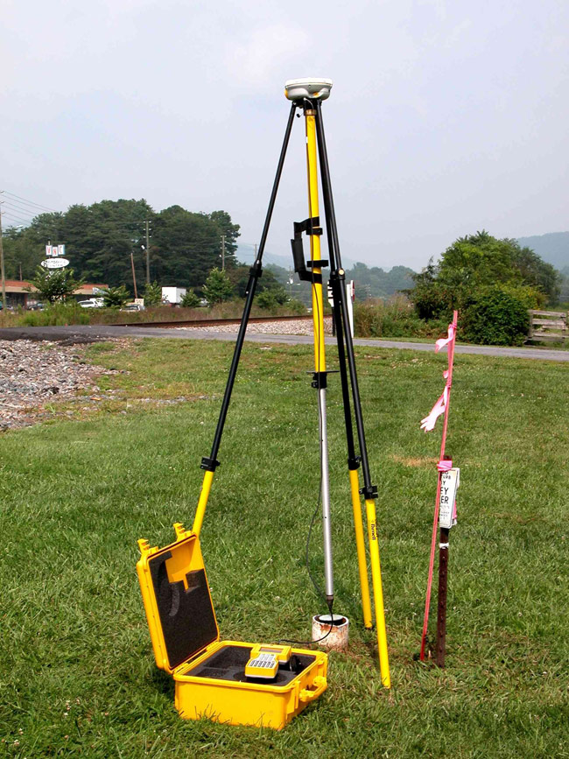
NGS MISSION:
To define, maintain and provide access to the National Spatial Reference System (NSRS) to meet our Nation’s economic, social, and environmental needs.
The foundational elements:
latitude, longitude, elevation,
shoreline position
+ changes over time
= informed decision making for:
mapping and charting, navigation,
flood risk determination,
transportation, land use and
ecosystem management
NGS provides the framework for all positioning activities in the Nation.

Slide 6
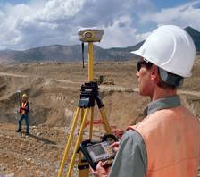
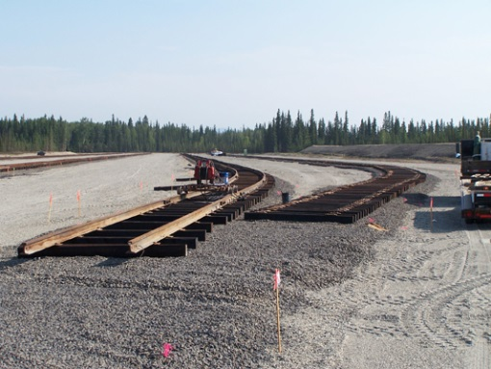
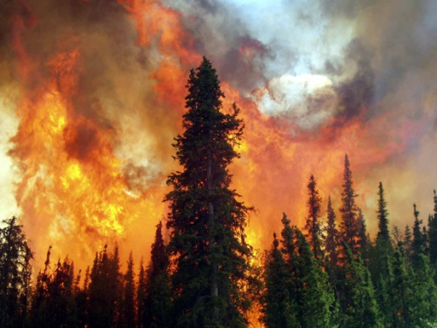
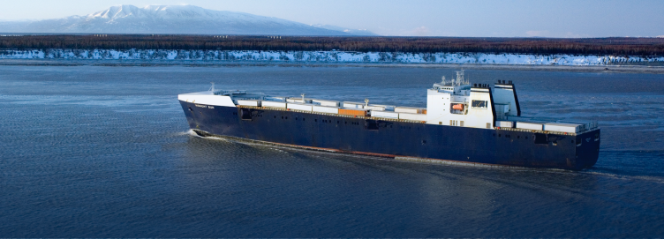
Meaningful coordinates
The NSRS is a common reference system for positioning geospatial data
Defining locations relative to geodetic control = absolute positional accuracy
Surveying
Flood Planning
Aviation
Engineering
Disaster Response
Navigation
Mapping

Slide 7
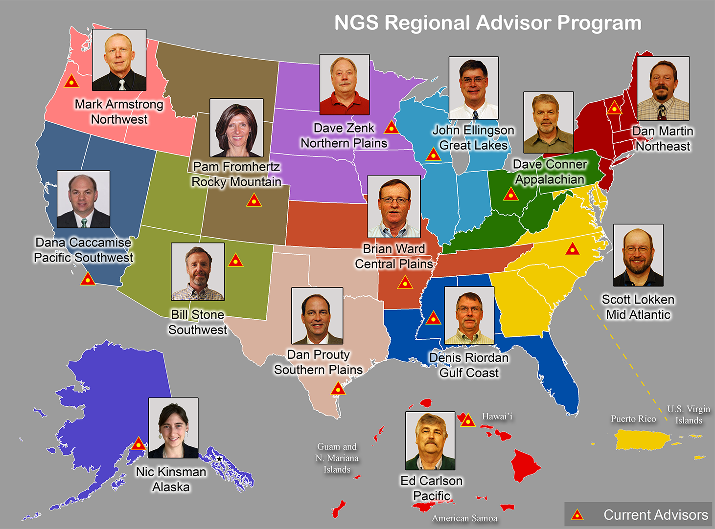
NGS Regional Advisor Program

Slide 8
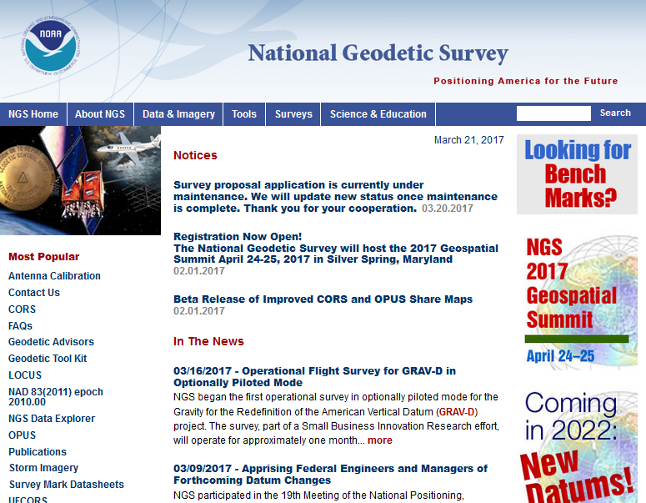

Slide 9
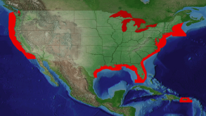
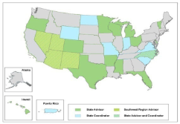
NGS Programs
Modernizing the NSRS
CORS
Height Modernization
GRAV-D
ECO
NGS Products and Services
Airport Surveys
OPUS
VDatum
GPS Satellite Orbits
Coastal Mapping
Geodetic Advisor Program
Emergency Response Imagery

Slide 10
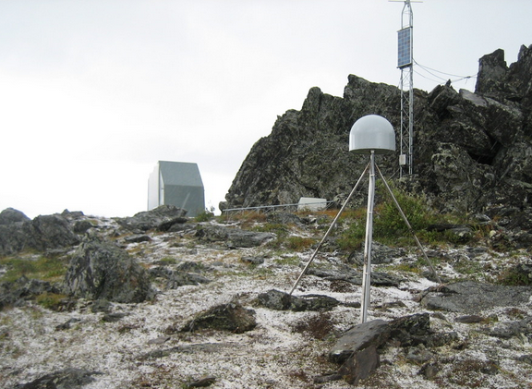
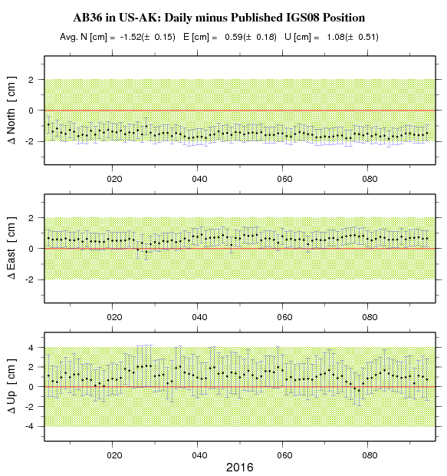
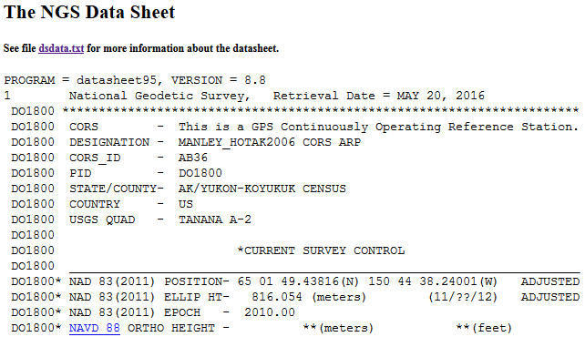
CORS Network
Network of designated GNSS receivers across the United States managed by NOAA’s National Geodetic Survey.
The CORS network facilitates position activities that are tied to the National Spatial Reference System (NSRS), there are presently 108 active CORS in Alaska.
Users can access authoritative NSRS positioning tools via NGS Online Positioning User Service (OPUS).
AB36
Manley Hot Spring
Notes:
The CORS network is a multi-purpose cooperative endeavor involving government, academic, and private organizations. The sites are independently owned and operated. Each agency shares their data with NGS, and NGS in turn analyzes and distributes the data free of charge. As of August 2015, the CORS network almost 2,000 stations, contributed by over 200 different organizations, and the network continues to expand.
Like with any dual use infrastructure, different stakeholders have different priorities. As active geodetic control has emerged as the new infrastructure for precise positioning activities, the scientific community has been primarily at the helm of the GNSS network development in Alaska. Surveyors and the GIS community are increasingly dependent on data being made freely available by scientific agencies with similar, but not identical priorities.
Examples of how priorities might be different:
- Scientific community seeks network densification over tectonically active/complex regions
- Surveying community largely desires densification around population centers, and other corridors such as roads and pipelines
- Surveying community desires real-time or near-real time data, and many scientific applications do not require consistent telemetry
Direct Uses:
Geodesy and Seismology (tectonic motion)
Surveying
Scientific field measurements
Space weather
Atmospheric water vapor
GPS reflectometry (snow depth, water levels, soil moisture)
In-direct Uses:
Remote sensing (imagery, elevation)
Mapping

Slide 11
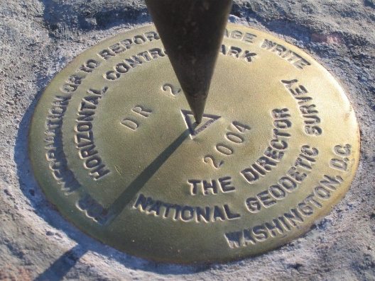
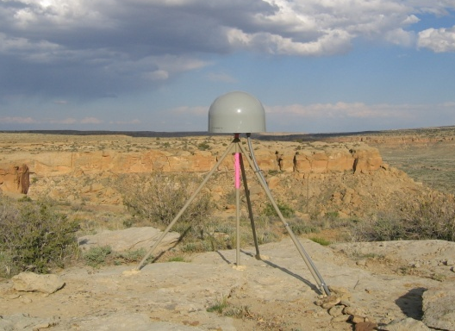
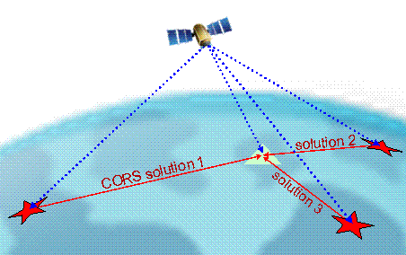
Online Positioning User Service (OPUS S/RS)
>15 min of L1/L2 GPS data >>> www.ngs.noaa.gov/OPUS
Processed automatically on NGS computers
Solution via email - in minutes
Fast, easy, consistent access to NSRS

Slide 12
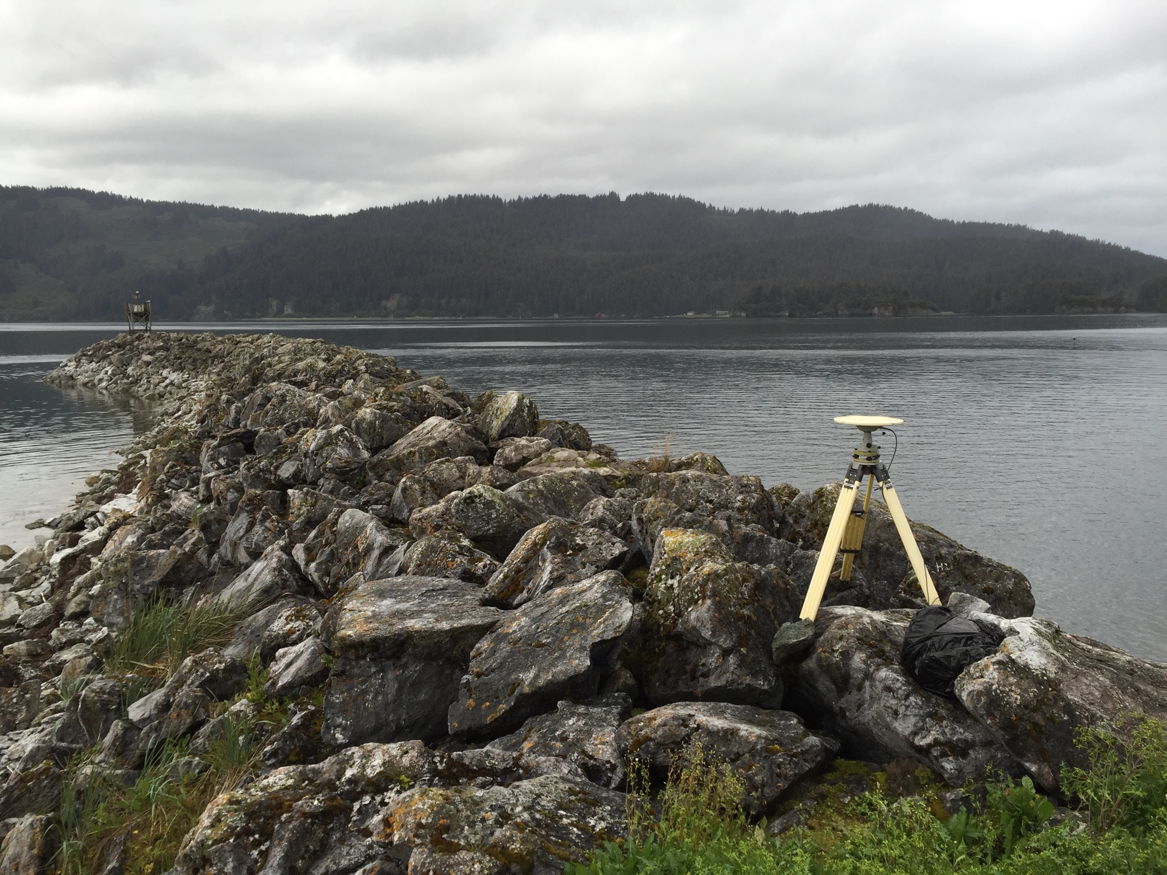
TERMS, DEFINITIONS and common reference frames
Overview of

Slide 13
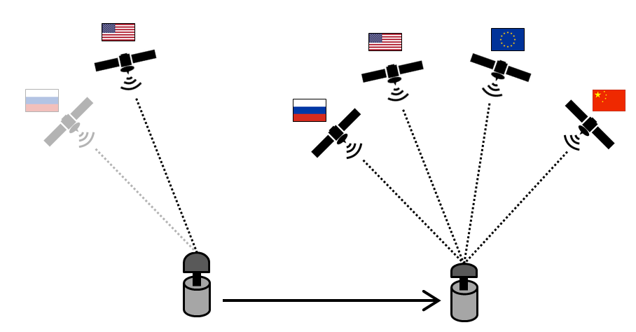
GPS vs. GNSS (space, control, and user segments)
Global Positioning System
Global Navigation Satellite System
GPS
GLONASS
Galileo
BeiDou

Slide 14
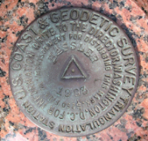
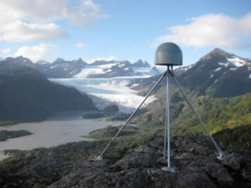
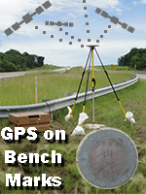
Geodetic Control =
The Gateway to the NSRS
Passive
Marks
Active
(CORS)

Slide 15
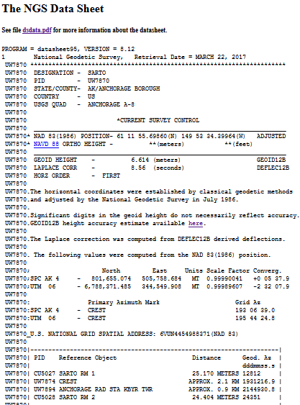
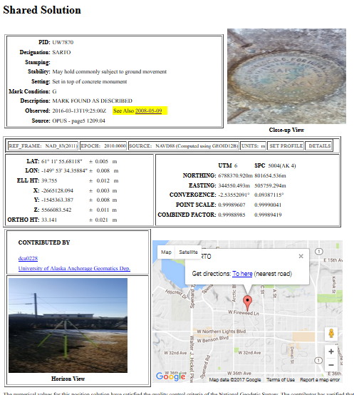
Data Sheets vs. Shared Solutions Integrated Database (IDB) OPUS Database

Slide 16
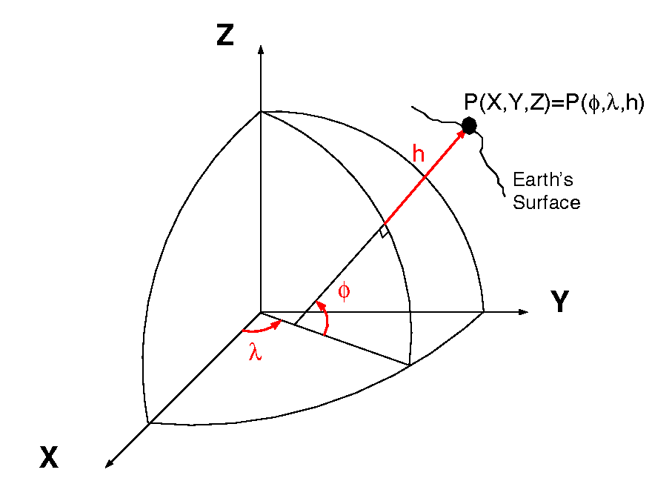
Datums & Reference Frames
Sally
Jane
aka P(L,L,H)
= ht.
?
= lat.
= long.
A reference standard for measuring elevations
XYZ vs. LLH

Slide 17
The Practicality of Datums
Meades Ranch,
Kansas
Rimouski, Quebec
And the MODERNIZATION →
We are aware
We can measure
We care

Slide 18
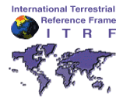
Common Reference Systems
International Terrestrial Reference Frame (ITRF##)
National Spatial Reference System (NAD27 & NGVD29, NAD83 & NAVD88, …)
World Geodetic System (…, WGS72, WGS84)

Slide 19
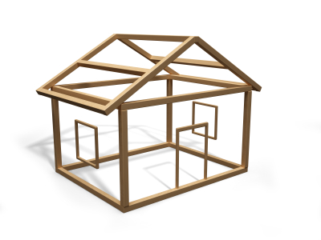
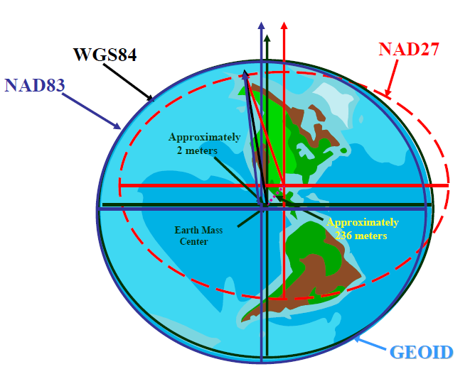
Reference Ellipsoids
Defined by:
Size/shape
Origin
Orientation
Scale
Clarke 1866 – in NAD 27
GRS80 – in NAD83
WGS84 – in WGS84
Note: GRS80 and WGS84 are VERY similar, but not exactly the same in shape.

Slide 20
Migrating Ellipsoids
WGS84
GRS80
Earth’s
Surface
h₀₀
h₈₃
1-2 cm/yr
in US
ITRF 00 ≈ WGS84
Origin
Geocentric!
2.2 meters
NAD 83
Origin
NAD83 (~static) is no longer geocentric

Slide 21
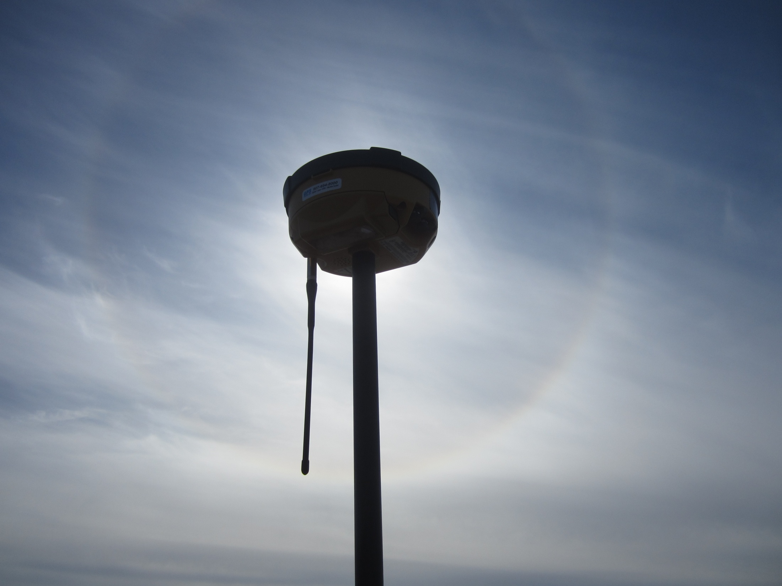
GNSS: What TYPE OF POSITIONAL DATA?
Autonomous GNSS:
All native GNSS data are collected with reference to IGS
Data may be transformed to a different reference frame
Augmented GNSS (NDGPS, RTK, RTNs):
Datum will correspond to that of your control [e.g. NAD83(2011)]
Heights are relative to the ellipsoid →
Reference Ellipsoid

Slide 23
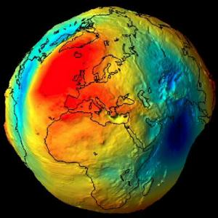
‘Societally-Relevant’ Elevations
Geoids are vertical ‘translation’ surfaces that approximate an idealized global sea surface
Geoid12A
Old source:
We got a ‘geoid’ by connecting observations at tide gauges to get a surface which most closely ‘fits’ the national mean sea level in a least squares sense.
New source:
We can measure gravity to map an equipotential surface that is a best fit to the global mean sea level.
But… for a geoid that can be combined with the ellipsoid to obtain heights that correspond to a regional/national vertical datum we make adjustments.

Slide 24
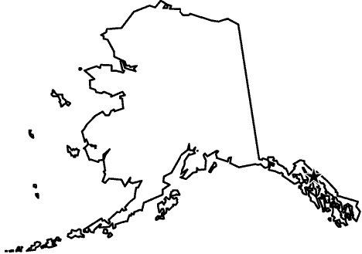
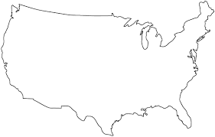
aka ‘Elevations’
Breaking down orthometric heights
Not exact
http://neverwildenough.blogspot.com/2013/12/cartography-and-visualisation-i.html

Slide 25
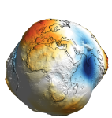
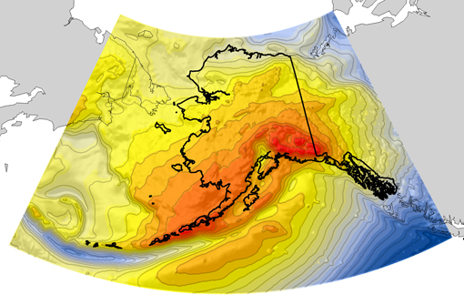
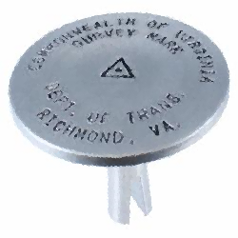
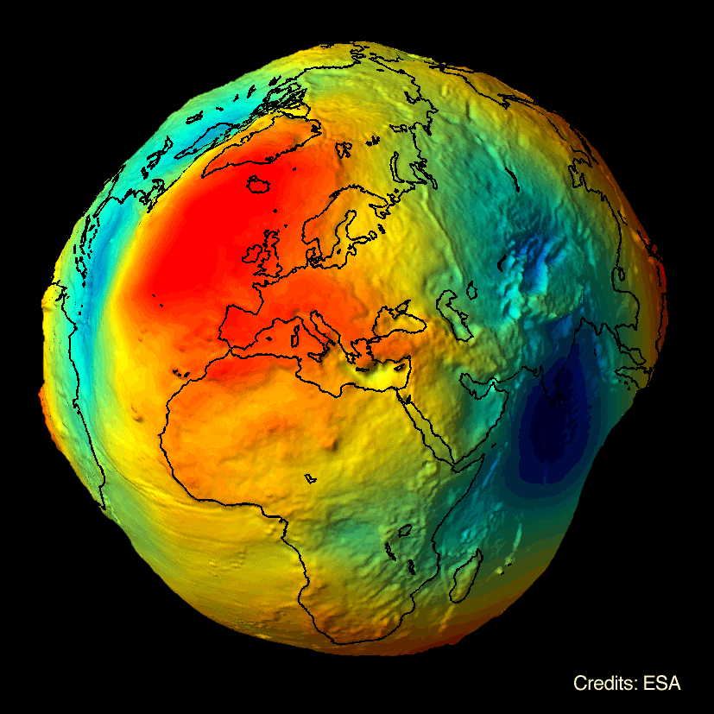
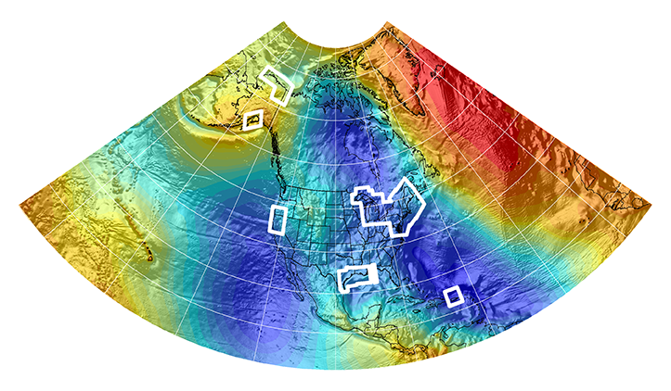
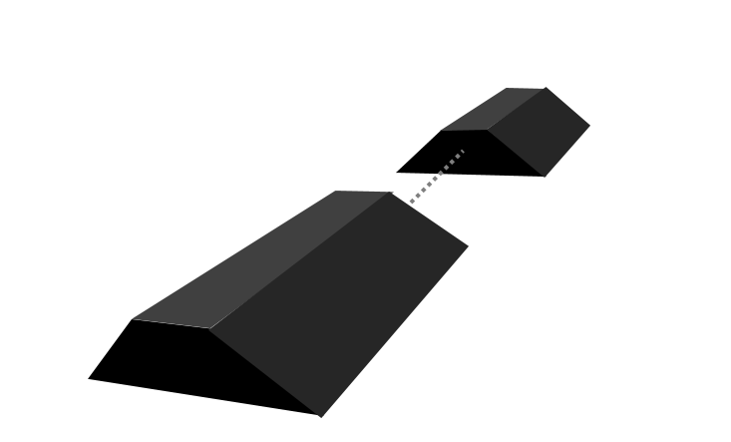
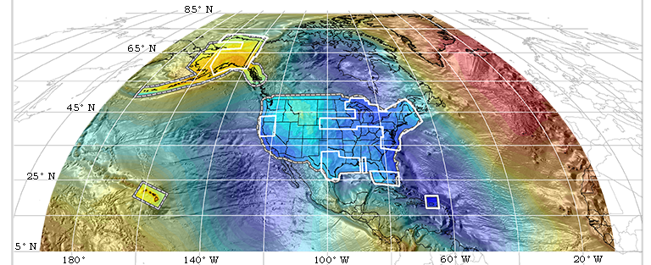
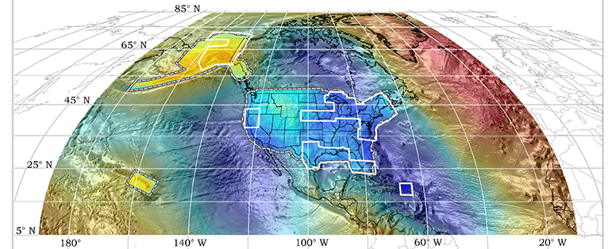
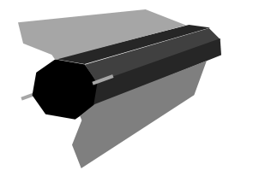
Evolution of the Gravimetric Geoid
EGM08
USGG2012
GEOID12A/B
NGA
ArcticGP
GRAV-D
2008
2012
2014
GOCO05S
2015
2016
xGeoid14B
GRACE
xGeoid15B
xGeoid16B
+
GOCE
Notes:
NGA Arctic Gravity Grid (2017)

Slide 26
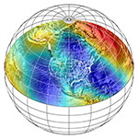
NSRS Modernization
NAD83/NAVD88 → NATRF2022*/NAPGD2022
Fixed → Semi-dynamic
GPS/GNSS = official gateway to precise positioning
*one of 4 RFs
Passive
Control
Active
Control
Geoid
+
(Geometric) (Geopotential)

Slide 27
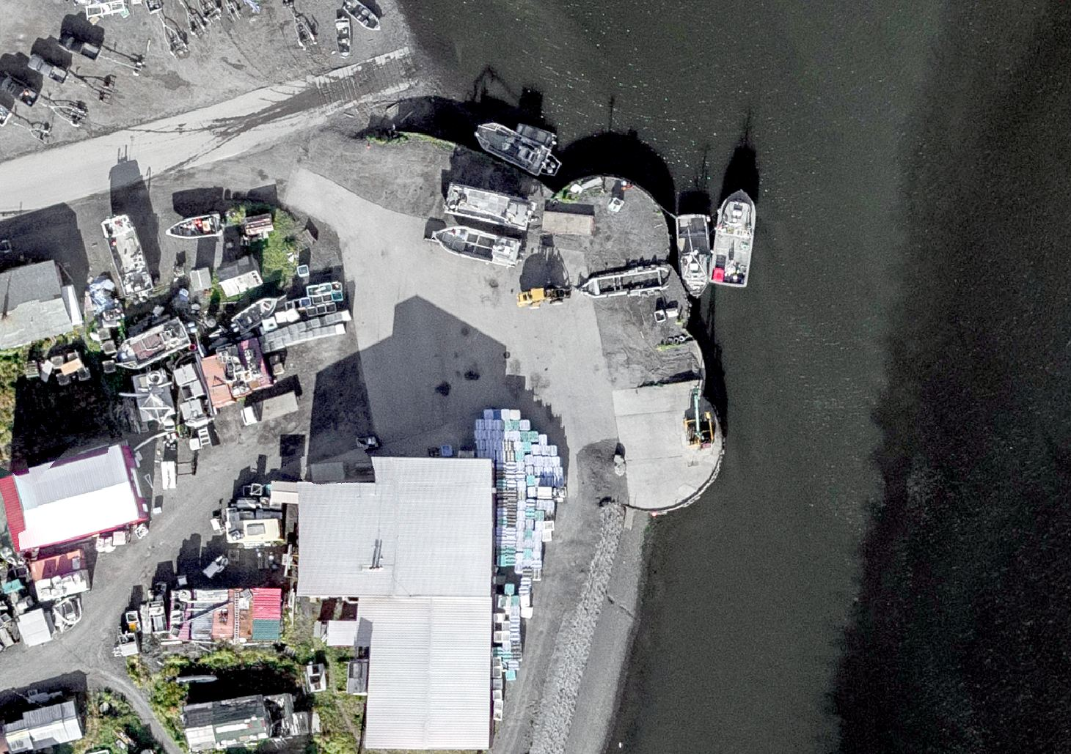
DOCUMENTATION OF DATUMS (metadata)
Best practices for

Slide 28
Use Complete Nomenclature
NAD83

Slide 29
Use Complete Nomenclature
NAD83(2011) epoch 2010.00
Reference System
&
Year Established
Realization
or
Adjustment
Reference date
Tells us:
mathematical framework
general application
Authority
Tells us:
data in refinement
location
geoid model
Tells us:
position of control
periodization length

Slide 30
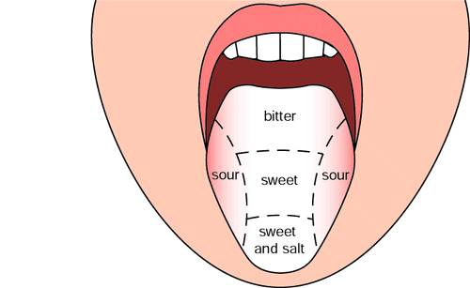
Relationship between the MANY ‘flavors’ of nad83 and GNSS-derived NAVD88 HEIGHTS
NAD83
(1986)
NAD83
(2011)
NAD83
(1997)
NAD83
(2011)
NAD83
(2007)
Adjustments to the National Spatial Reference System (NSRS)
All hybrid geoid models from NGS are intended for use with NAD83, but for the most consistent results, ensure that the geoid model used matches the correct ‘flavor’ of NAD83
Alaska: For NAD83(1986) use Geoid06
For NAD83(2007), NAD83(CORS96) use Geoid09
For NAD83(2011) use Geoid 12A/B
Birth: NAD83(1986) Differential leveling only
1st adjustment NAD83(1997) GNSS/HARN and more leveling also: NAD83(HARN)
NAD83(CORS96) GNSS/CORS (2007.00 epoch in AK)
2nd adjustment NAD83(2007) GNSS/CORS
3rd adjustment NAD83(2011) CORS
Note: for Alaska these are the only three hybrid geoid models that exist

Slide 31
Use Complete Nomenclature
MLLW

Slide 32
Use Complete Nomenclature
MLLW(9452210; NTDE 1960-78)
Datum
NOAA Tide Station
National Tidal Datum Epoch
(or Modified 5-year Procedure dates)

Slide 33
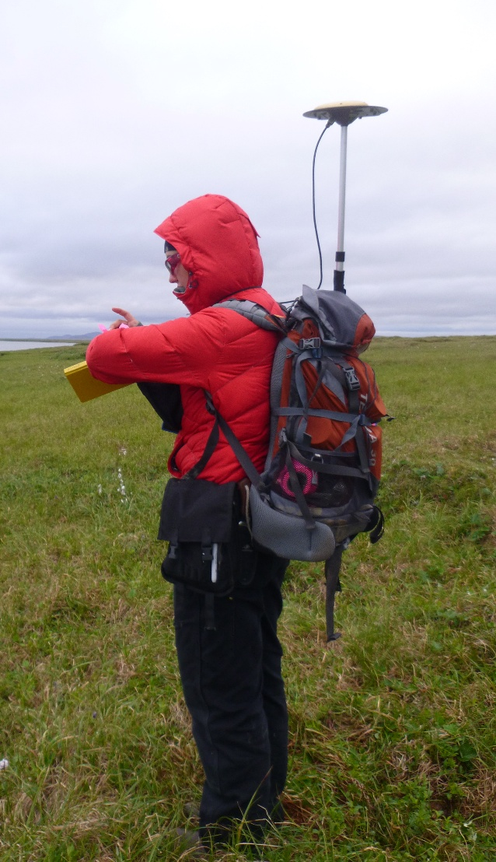
Guiding Principals:
Consider your data’s absolute & relative accuracies (CONTROL)
Consider the needs of future users
Epoch of datum and epoch of collection are different
Some notes:
EPSG codes are not always complete – use caution
Be careful with transformations

Slide 34
TRANSFORMATIONS
Tips and resources for

Slide 35
TRANFORMATION FLAVORS
Ellipsoid shifts are 3-D so planer shifting tools are only an approximation when going between NAD83 and ITRF08/WGS84
Options:
2 parameter 2 shifts
3 parameter 3 shifts
5 parameter 3 shifts, axis scale, flattening
7 parameter 3 shifts, 3 rotations, scale
10 parameter everything above + rotation origin
14 parameter 3 shifts, 3 rotations, scale + time
Surface fitting grid transformations (e.g. NADCON) n/a
A CAUTION for DATUM TRANSFORMATIONS IN GIS
Few handle 3-D geometric datum shifts at this time!!
Example:
NAD83 → WGS84
Data will be shifted horizontally, but the z values are the same (= ‘Franken-Datums’)

Slide 36
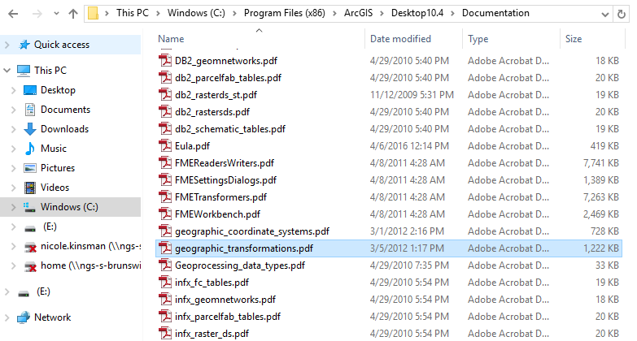
when in doubt… check.

Slide 37
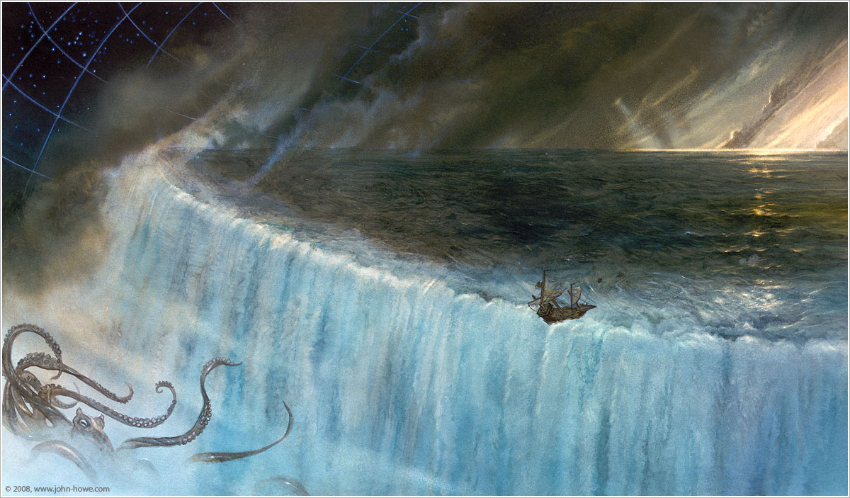
Vertical Datum Transformations
Sea of VERTCON
& VDATUM
NOME, 4th of JULY, 2012
Alaska
Here Be Dragons

Slide 38
TOOLS FOR VERTICAL DATUM CONVERSION
OUTSIDE:
VERTCON = NGVD29 → NAVD88
VDatum = NAVD88 (and others) to Local Tidal
NAD 83 (NSRS2007/CORS96) transformation grids
“VDatum was originally was designed to accommodate 28 transformations spanning the three major classes of vertical datums: orthometric, ellipsoidal, and tidal. A geoid model was used to convert between orthometric and ellipsoidal datums, a topography of the sea surface was computed to relate orthometric and tidal datums, and tidal modeling was used to compute the tidal datums.”
ALASKA:
?

Slide 39
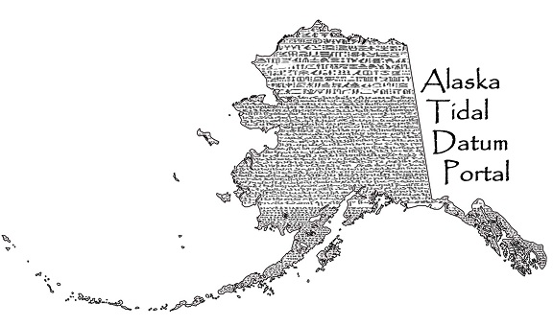
“Rosetta” Benchmarks
Two Published Elevations
Where do you find these for NGVD29?
Airport construction diagrams
Land survey plats (BLM often)
FEMA FIS documentation
Where do you find these for Local Tidal datums?
CO-OPS tidal BM sheets
OPUS Shared DB
DATUM A
DATUM B

Slide 40
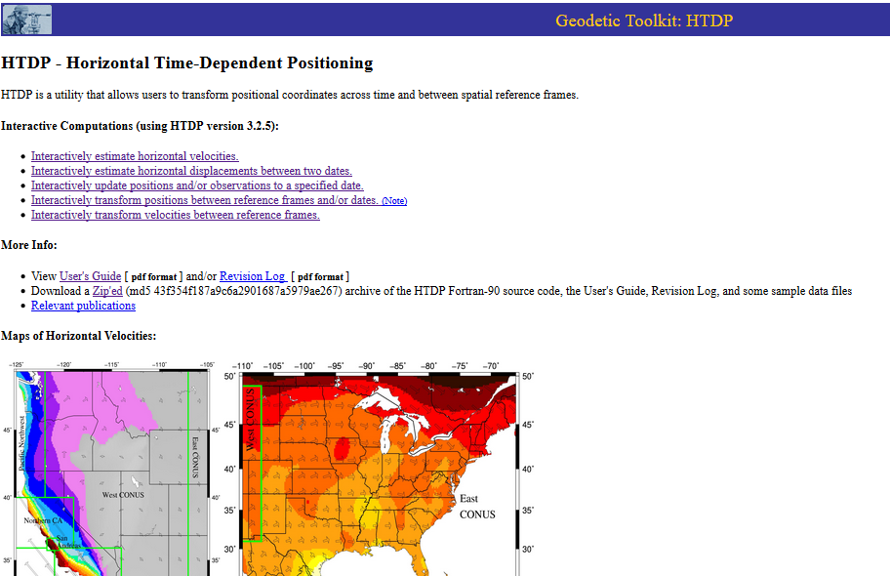
HTDP

Slide 41
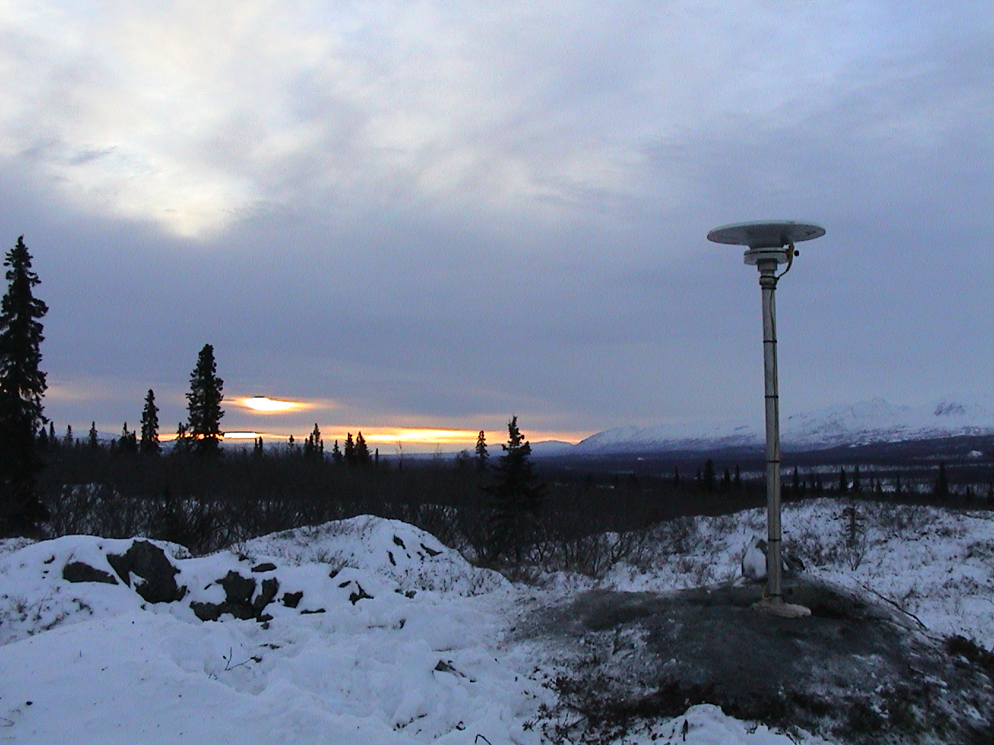
USEFUL TOOLS
Some other

Slide 42
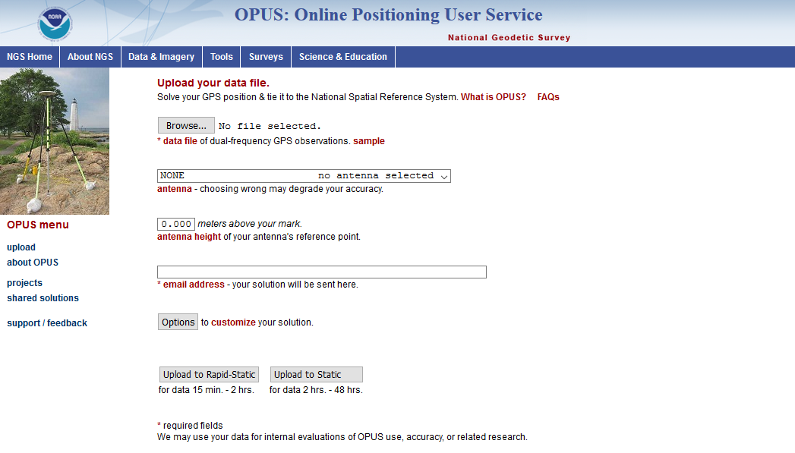
NGS Tools: OPUS
https://www.ngs.noaa.gov/OPUS/

Slide 43
SHARE YOUR OPUS SOLUTIONS
A call to arms.
- Support geoid model and 2022 transformation tool development
- provide a status update on the 'health' of all marks of public interest
- support the development of VDATUM and other tidal to geodetic transformation tools in Alaska
- Extended occupations (24-48 hours in duration) compliment long-term CORS records and improve models used within tools such as HTDP
New! Contact Nic for Sample Data
http://europa.ngs.noaa.gov/GPSonBM/

Slide 44
https://www.ngs.noaa.gov/marks/descriptions

Slide 45
OPUS Shared DB - Maps
https://www.ngs.noaa.gov/OPUS/showMarks.jsp
https://beta.ngs.noaa.gov/opusmap/

Slide 46
CORS Maps
https://www.ngs.noaa.gov/CORS_Map/
https://beta.ngs.noaa.gov/corsmap/

Slide 47
https://beta.ngs.noaa.gov/gtkweb/

Slide 48
Space Weather
http://www.swpc.noaa.gov/

Slide 49
RINEX Cheats
http://www.gage.es/sites/default/files/gLAB/HTML/SBAS_Navigation_Rinex_v3.01.html
https://igscb.jpl.nasa.gov/components/formats.html

Slide 50
Practical Guidance for Alaska
The reality up north:

Slide 51
rotate NRP to face true north
ARP
antenna type & hgt are important for accurate results
antenna height
each type has unique biases
mark
For antenna calibrations, photos, ARP and NRP diagrams, see geodesy.noaa.gov/ANTCAL/
JGE, 2015
Notes:
Antennas are the one area where OPUS users can force errors into their solutions.
Must be on approved list (e.g. calibrated).
Dual-frequency geodetic quality.
Phase center locations different, & that affects orthometric height.
Align North Reference Point to true north. Examples of NRP: face plate (as antenna above, antenna cable connector (for separate antenna/receiver), and north arrow on antenna.
ARP height measured vertically, NOT slant.
ANTENNA TYPE: GNSS antennas aren’t like survey telescopes, which have a point (reticule) where all measurements take place. The “phase center” measuring points of an antenna will wander as each satellite’s azimuth and elevation changes. These variations are unique for each model of antenna. OPUS mixes data from across long distances and from different antenna types (rover + CORS) so this is a source of error. However, the GNSS community has measured these phase center variations for many antenna types, a process known as “calibration” which measures the variations with respect to an antenna’s reference point, or ARP. You tell OPUS where the ARP is, and it will do the rest.
ANTENNA HEIGHT:
The height of the antenna is measure vertically (not slant height) up from the from the mark, to the Antenna Reference Point which is almost always the center of the bottom-most, permanently attached piece of the antenna. Some antennas have a short removable pipe or extension to them, these are NOT part of the antenna, and must be considered part of the tripod height.
If in doubt you can find photos and diagrams of each antenna (that we have calibrated) at the URL shown.
So if you leave the antenna height as “0” this will be the height OPUS returns, of the antenna’s ARP.
Image posted as http://geodesy.noaa.gov/sitemsgs/OPUS/about/images/ant_hgt_BBBK23.png

Slide 52
OPUS Static vs. Rapid Static
 | Static | Rapid Static
Input (dual-frequency GPS) | 2-48 hours | 15 minutes-2 hours
Output | normal, extended, XML sharing, projects | normal, extended, XML
Accuracy (95%confidence) | 1-2 cm horizontal 3-6 cm ellipsoidal height | 1-2 cm horizontal 4-8 cm ellipsoidal height
Network Geometry | 3 CORS, preferably within 1000 km of rover | 3-9 CORS, surrounding & within 250 km of rover
Availability | global | 90% of CONUS (subject to geometry, above)

Slide 53
OPUS AVAILIBILITY DELAYS

Slide 55
Check your CORS!

Slide 56
SOME GENERAL ‘MSL’ ADVICE FOR ALASKA
Any time you encounter an elevation or height (3 feet for example) be sure to ask “3 feet above WHAT?”
If the answer is height above ‘Mean Sea Level’, is it:
The National Standard Sea Level (NAVD88)
An older national vertical datum based on sea level (NGVD29)
Local Mean Sea Level (based on tide gauge)
Local Mean Sea Level (based on something else)
If it is Local Mean Sea Level, when was it calculated and by whom?

Slide 57
Educational Videos
http://www.ngs.noaa.gov/corbin/class_description/NGS_Video_Library.shtml
NGS has partnered with The COMET Program to develop educational videos.
View videos on COMET YouTube channel: https://www.youtube.com/playlist?list=PLsyDl_aqUTdGmAeHGgFucHkTfWDOwElOB
Notes:
There are currently seven videos, 2 to 5 minutes long.
Series on Geodetic Datums
What are Geodetic Datums? (4:30)
How Were Geodetic Datums Established? (3:11)
What is the Status of Today’s Geodetic Datums? (4:48)
What’s Next for Geodetic Datums? (4:41)
Other videos:
Precision and Accuracy in Geodetic Surveying (2:25)
Two 'Right' Feet? Understanding the Difference Between U.S. Survey Feet and International Feet (2:39)
Geospatial Infrastructure for Coastal Communities: Informing Adaptation to Sea Level Rise (4:06)
More videos coming:
Common GNSS Error Sources
Coastal Elevation Data
VDATUM
What is a bench mark (passive control)?
What is a CORS (active control)?

Slide 58
NGS Monthly Webinar Series
http://www.ngs.noaa.gov/web/science_edu/webinar_series/
Presentations related to NGS programs, projects, products and services.
Second Thursday of every month,
2:00-3:00 p.m. East Coast time.
Webinar series Web-pages:
view previously recorded webinars,
register for upcoming webinars, and
subscribe for monthly notifications.
Contact: NGS.Webinar@noaa.gov

Slide 59
Please contact me: nicole.kinsman@noaa.gov Cell: 202-306-5736
Thank You!

